Slide 1
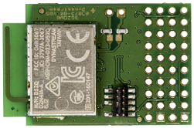
RF Technologies for Indoor Localization
Goal:
Comparison ANT and BLE protocals when used for indoor localization
Method:
Measure and analyze received signal strength indicator(RSSI)
Device:
Dynastream D52QM6 SoC modules
Based on nRF 52832 (ARM Cortex M4 Microcontroller)
Support for BLE and ANT
Result:
localization can clearly outperform BLE, when using fingerprinting as the underlying localization principle.

