Slide 1
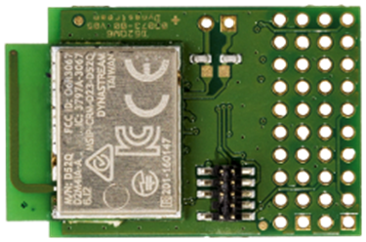
RF Technologies for Indoor Localization Xuanjiao Zhu, Marcus Handte, Rasit Eskicioglu
Goal:
Comparison ANT and BLE protocols when used for indoor localization
Method:
Measure and analyze RSSI
Device:
Dynastream D52QM6 SoC modules
Based on nRF52832 (ARM Cortex M4 Microcontroller) from Nordic
Support for BLE and ANT
Result:
Localization can clearly outperform BLE, when using fingerprinting as the underlying localization principle.

