Slide 1
on Image Classification
ViT
Presenter : Xuankun Yang
Junjie Yu

Slide 2
Background :
Image classification is a fundamental task in computer vision, where traditional convolutional neural networks (CNNs), such as ResNet, have achieved remarkable success.
In recent years, Transformer models have shown great success in natural language processing, inspiring research on their application to vision tasks.
However, ViT is sensitive to the amount of training data and specific training strategies. It also lacks an inherent inductive bias for local features, which leads to unstable performance on smaller datasets such as CIFAR-10.

Slide 3
Therefore, Our Goals ?
Reproduce the performance of the Vision Transformer (ViT) model on the CIFAR-10 dataset to evaluate its adaptability to small-scale datasets.
Integrate ViT and ResNet architectures to combine ViT’s global modeling capabilities with CNN’s local feature extraction, aiming to improve classification performance.
Design a series of ablation experiments to investigate the impact of key parameters (e.g., patch size, embedding dimension, encoder depth) on model performance.
Introduce various data augmentation strategies to compare their effects on model robustness and generalization.
Find our best model !

Slide 4
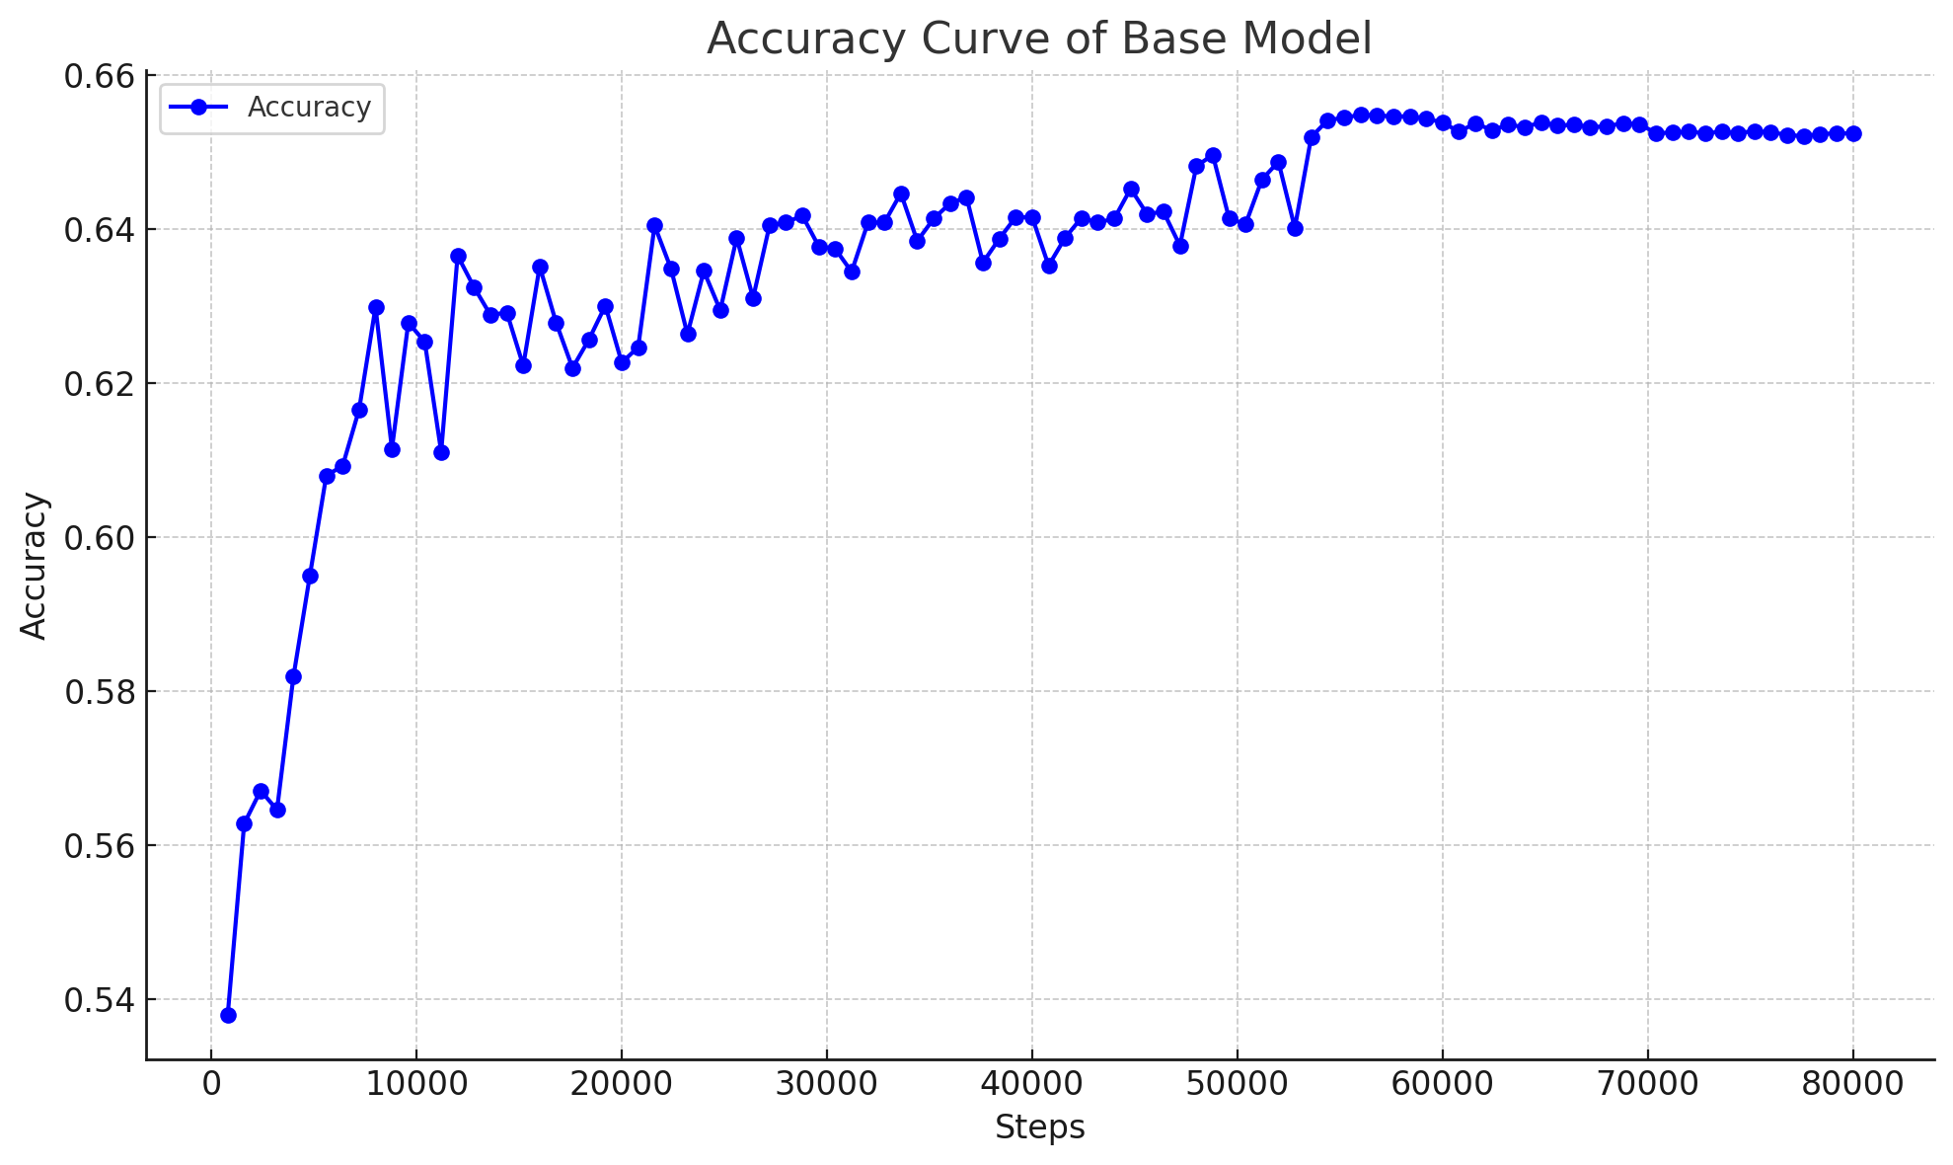
ViT Base Model's Performance :
Promotion!
Oops !
Too BAD!

Slide 5
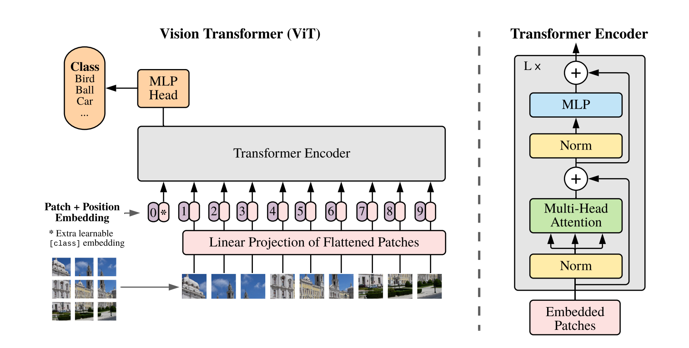
1. Model Architecture
1.1 Original Model
Reference:
[2010.11929] An Image is Worth 16x16 Words: Transformers for Image Recognition at Scale (arxiv.org)

Slide 6
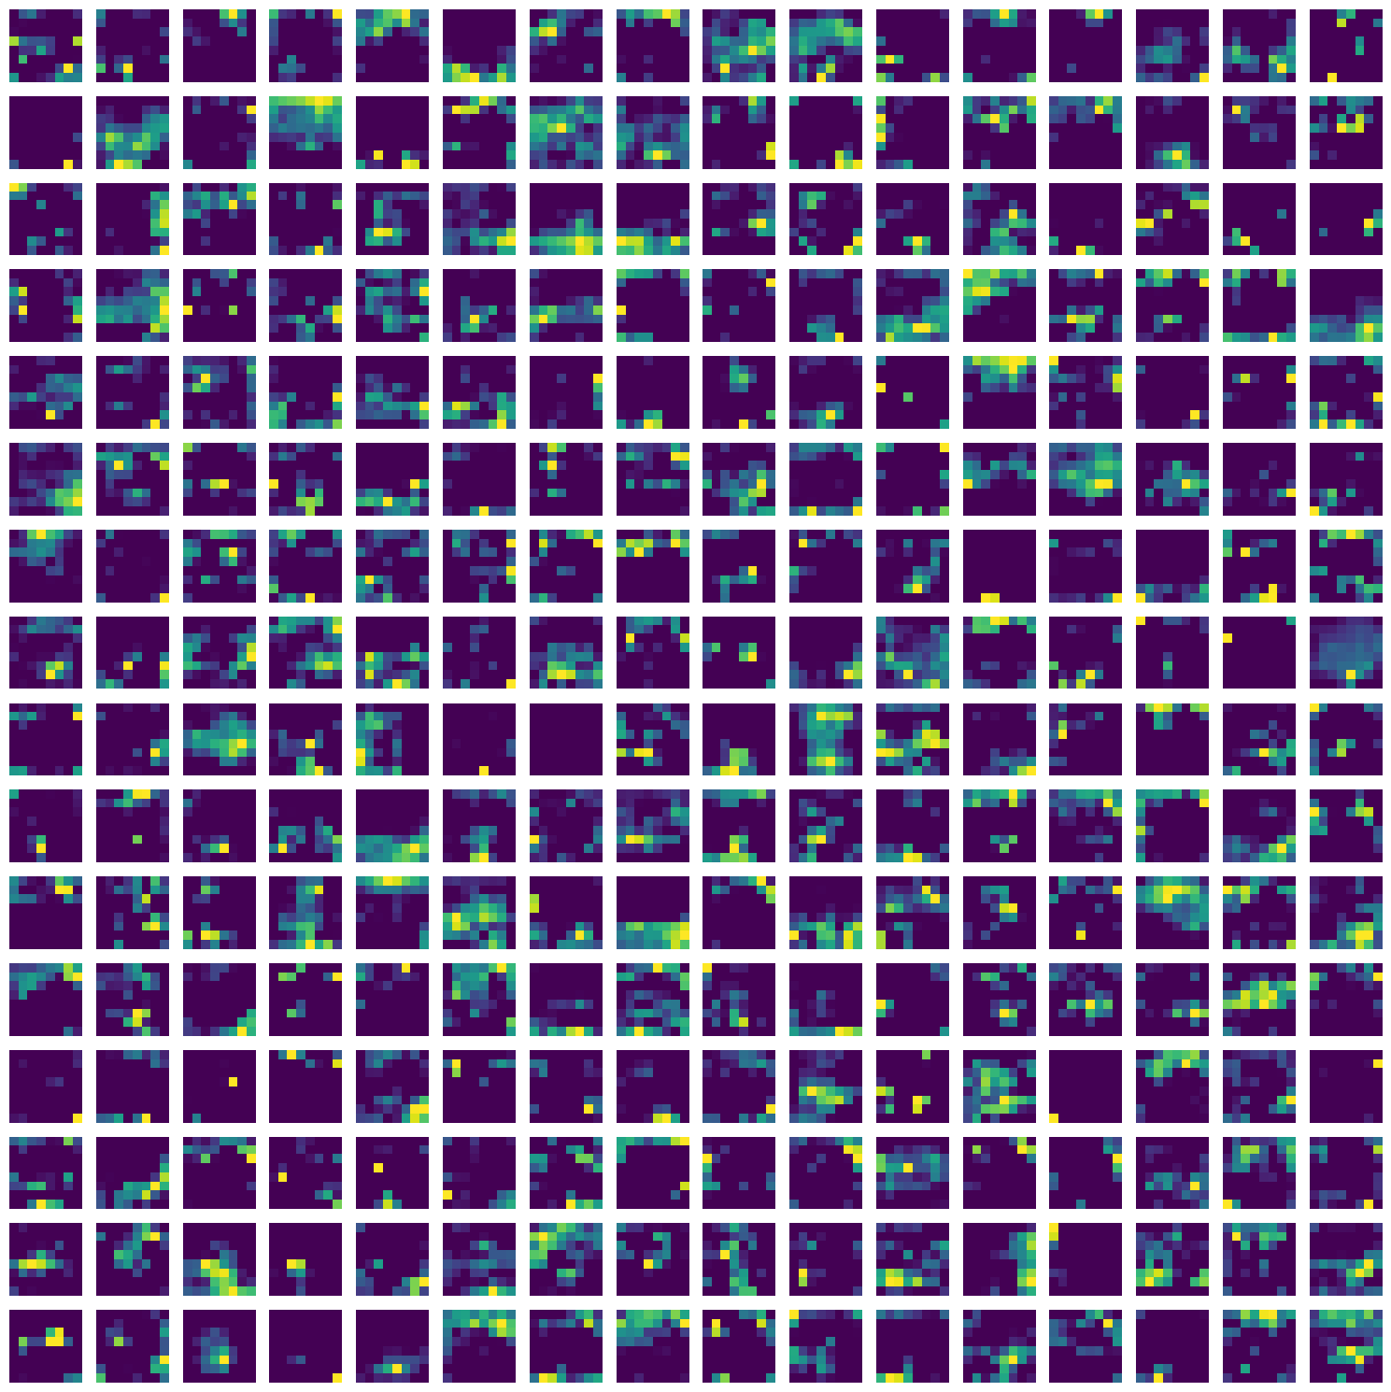
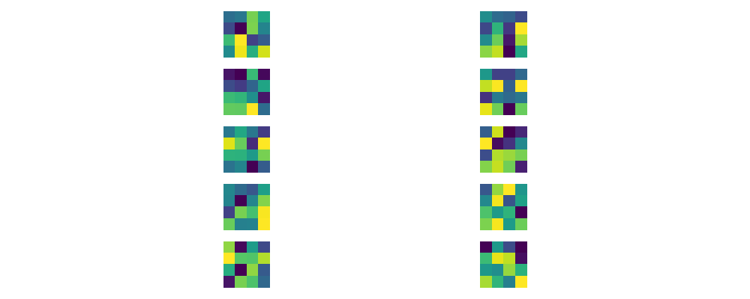
1. Model Architecture
1.2 Hybrid Model
Reference:
https://github.com/jeonsworld/ViT-pytorch

Slide 7
Ablation Study
模型架构层面（注意要强调参数量！！！）：
是否使用ResNet，ResNet架构：三组
Patch size：三组（2，2），（4，4），（8，8）
层数：三组（4，8，12）
头数：三组（8，12，16）
隐藏层大小：三组（288，384，768，1024）256是因为ResNet出来的channel维度为256
MLP层大小：三组（288，384，768，1024）这三个都要比原论文中的小得多，但是我们的解释是cifar10很小
（hidden_size，MLP_dim）：（288，288），（288，384），（384，384），（288，768），（384，768）
正则方法：
是否使用AUG以及AUG方法，五组（不做AUG，Batch_random，CutMix，MixUp，RandomCropPaste）
是否做随即深度以及Prob_pass大小，五组（0.0，1e-1，1e-2，1e-3，1e-4）
是否做Weight Decay以及lambda大小，六组（0.0，5e-1，5e-2，5e-3，5e-4，5e-5）
是否做Drop Out以及Dropout_Rate大小，四组（0.0，1e-1，1e-2，1e-3）
是否做Attention Drop Out以及Attn_Dropout_Rate大小，四组（0.0，1e-1，1e-2，1e-3）
是否做AutoAug，两组（Yes，No）

Slide 8
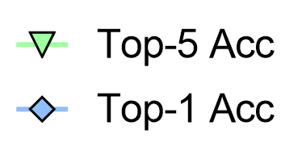
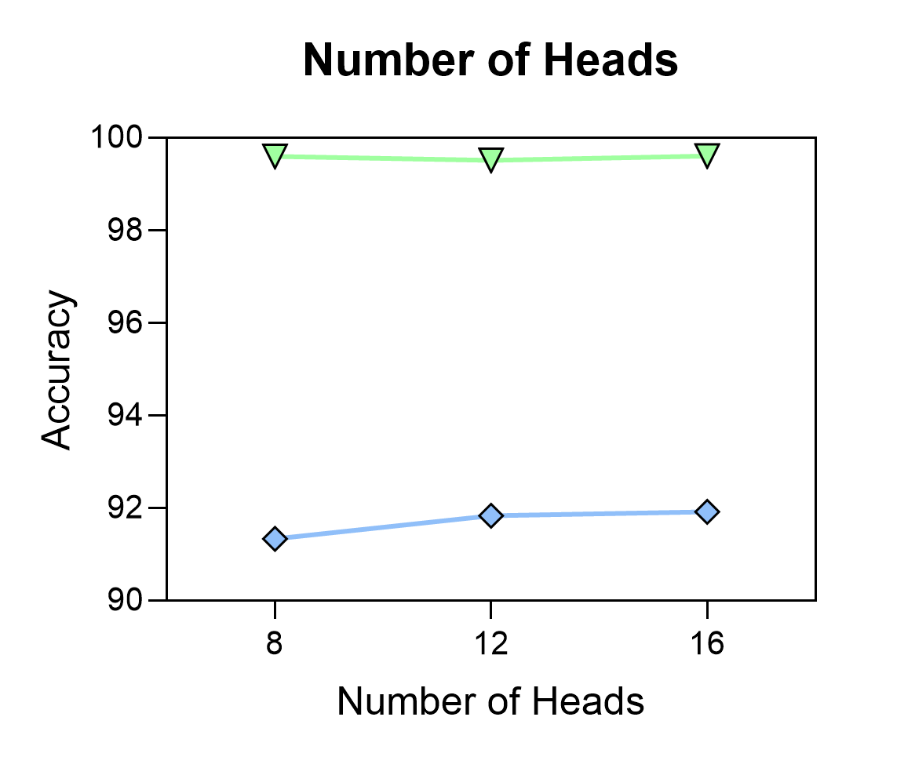
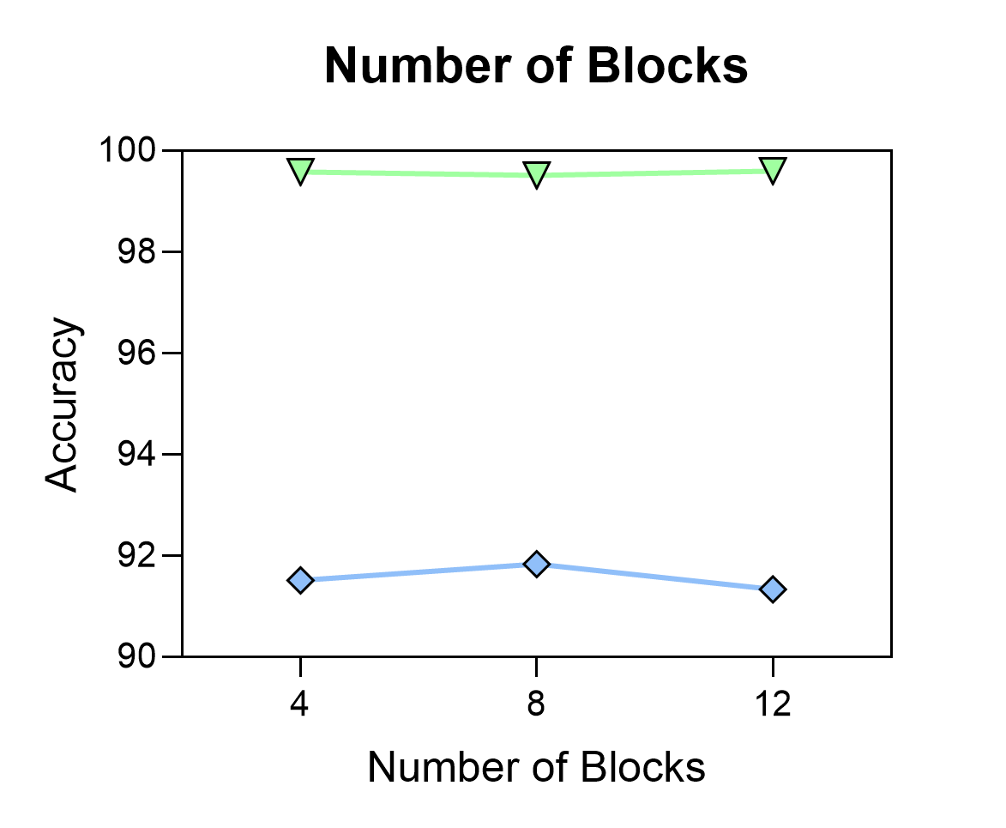
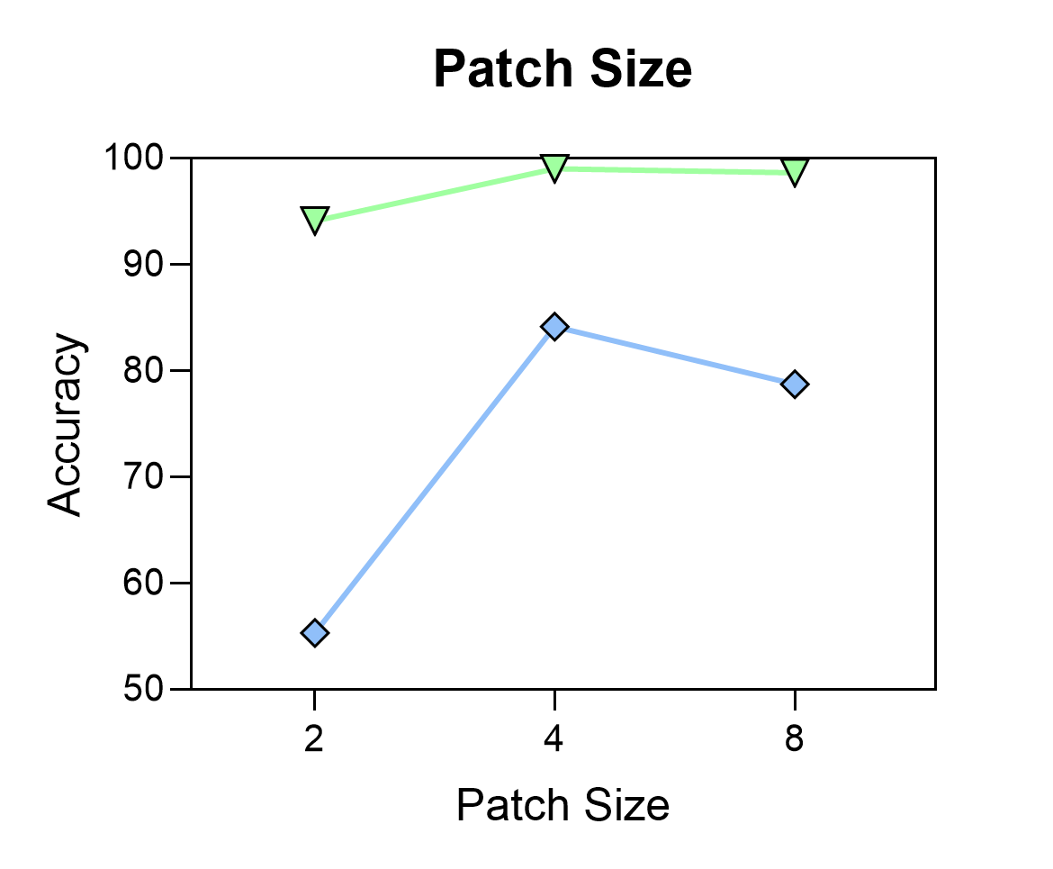
2. Architecture Study
2.1 Part Ⅰ
Parameters?

Slide 9
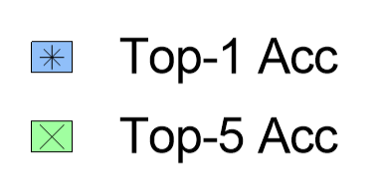
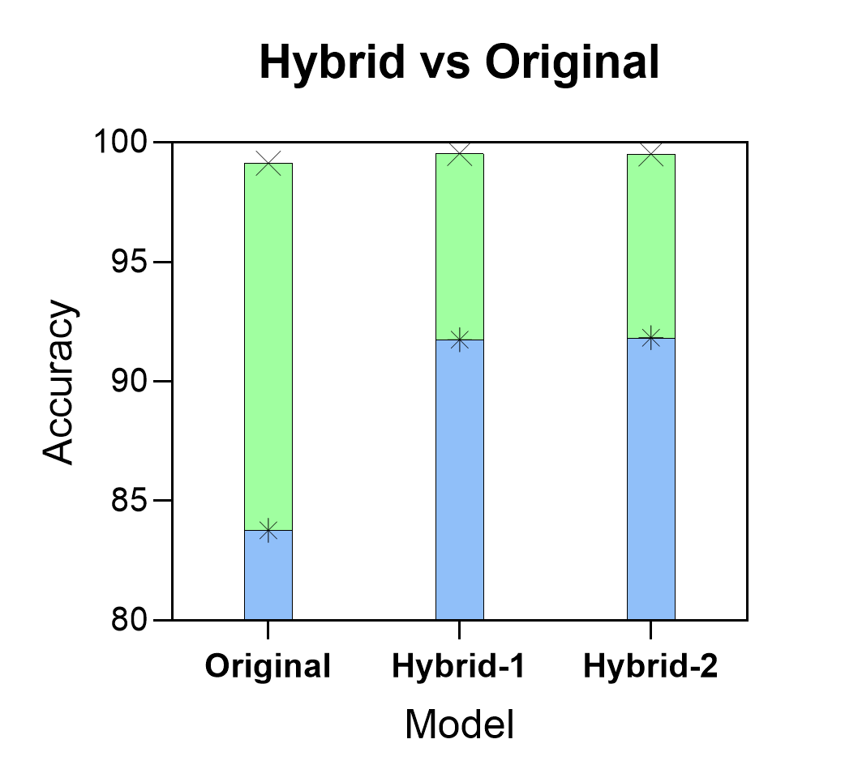
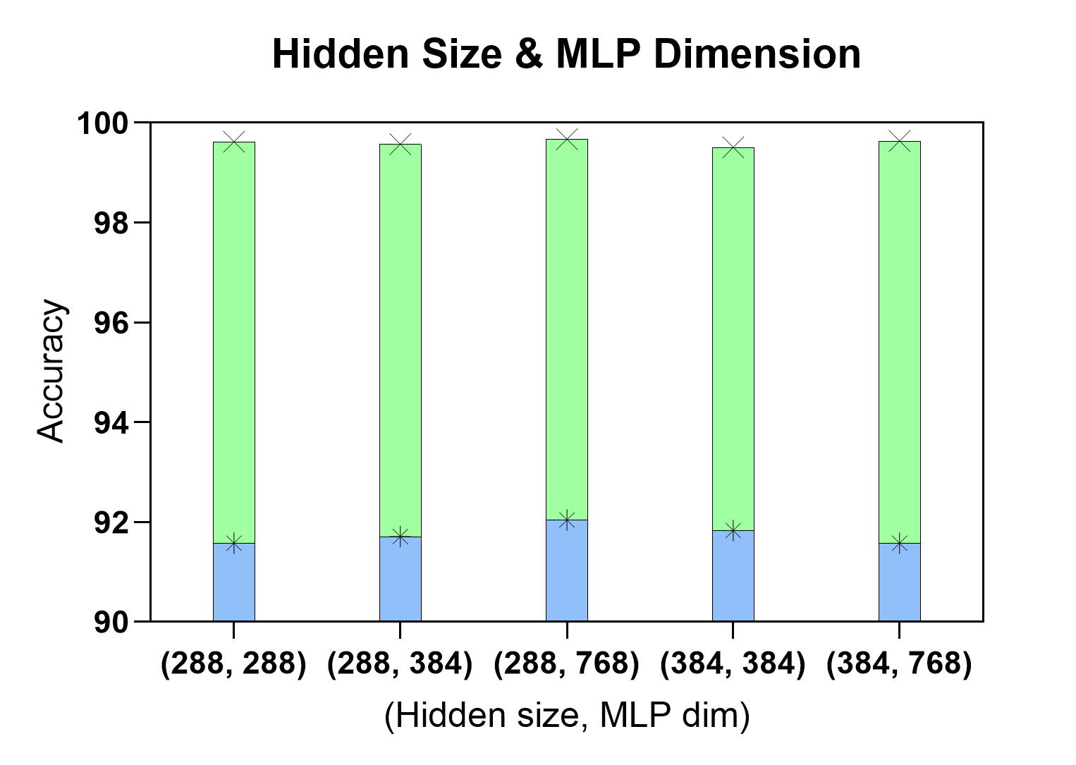
2. Architecture Study
2.2 Part Ⅱ
Parameters?

Slide 10
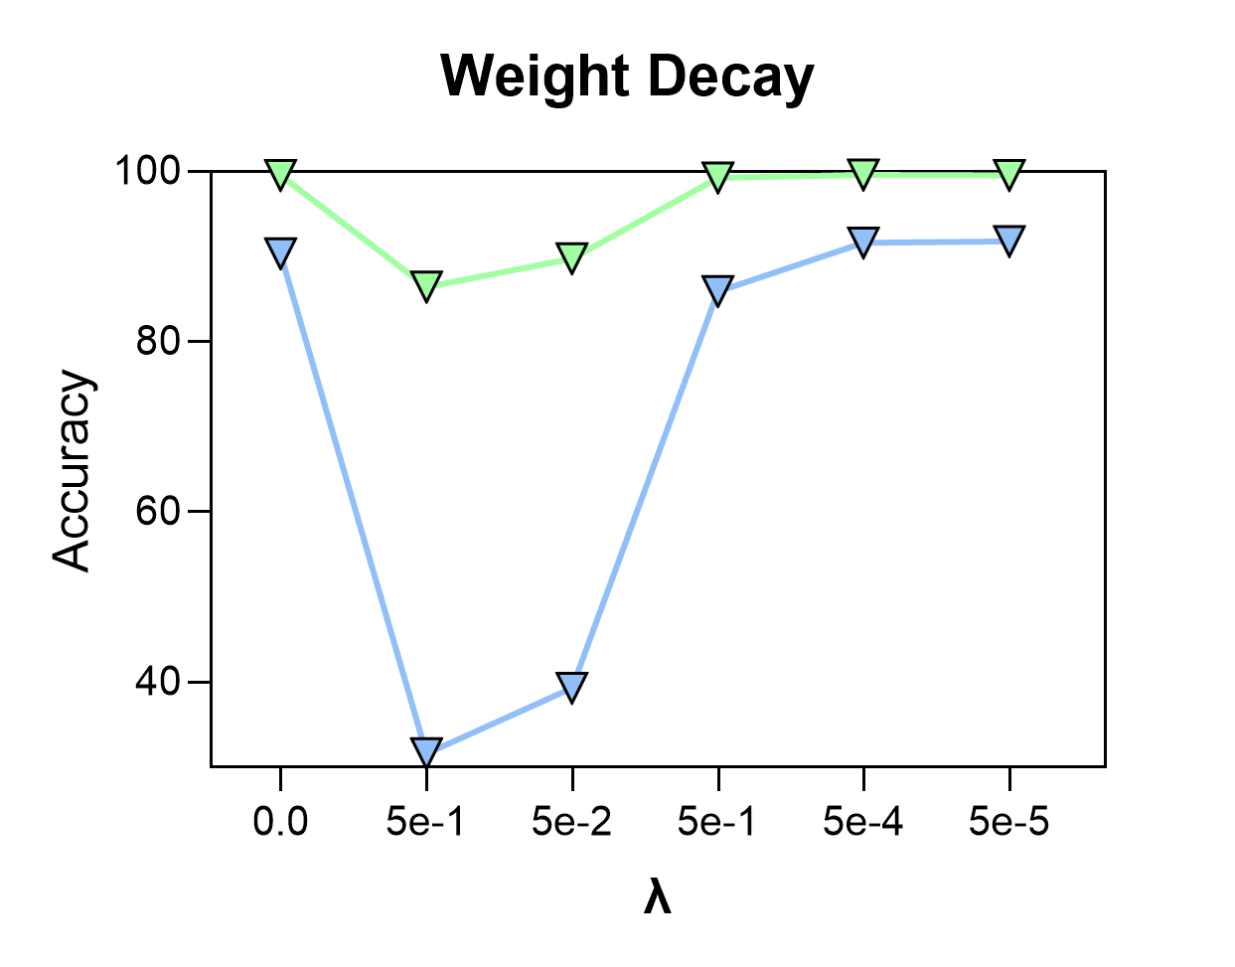
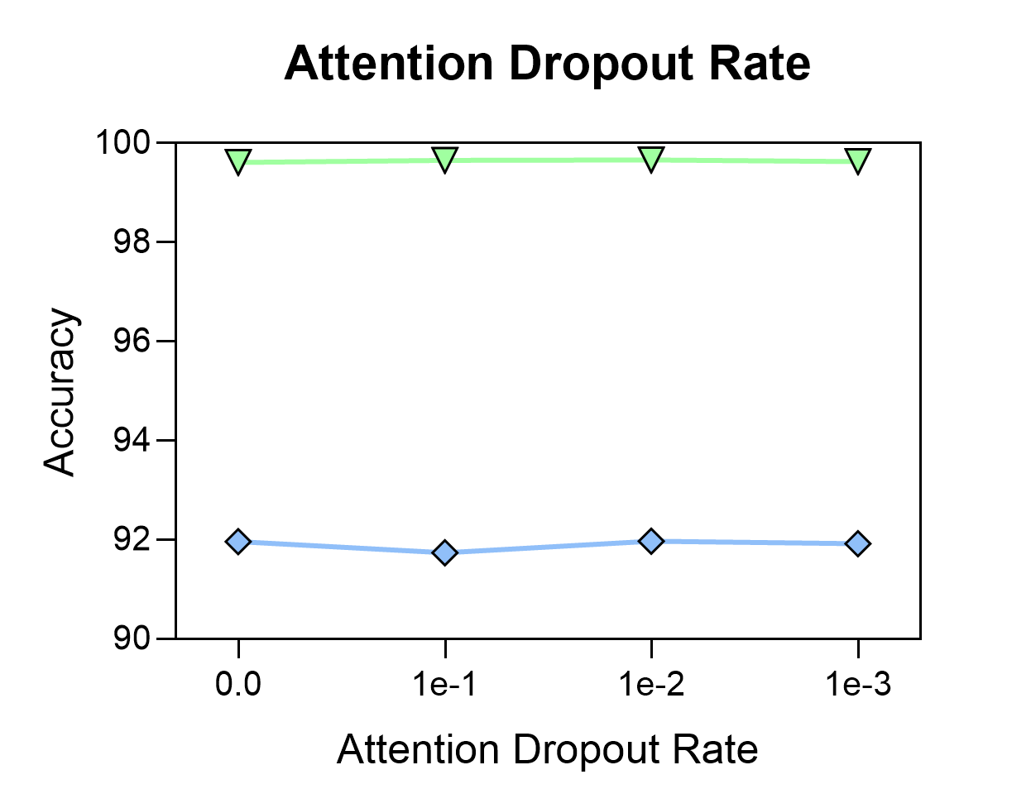
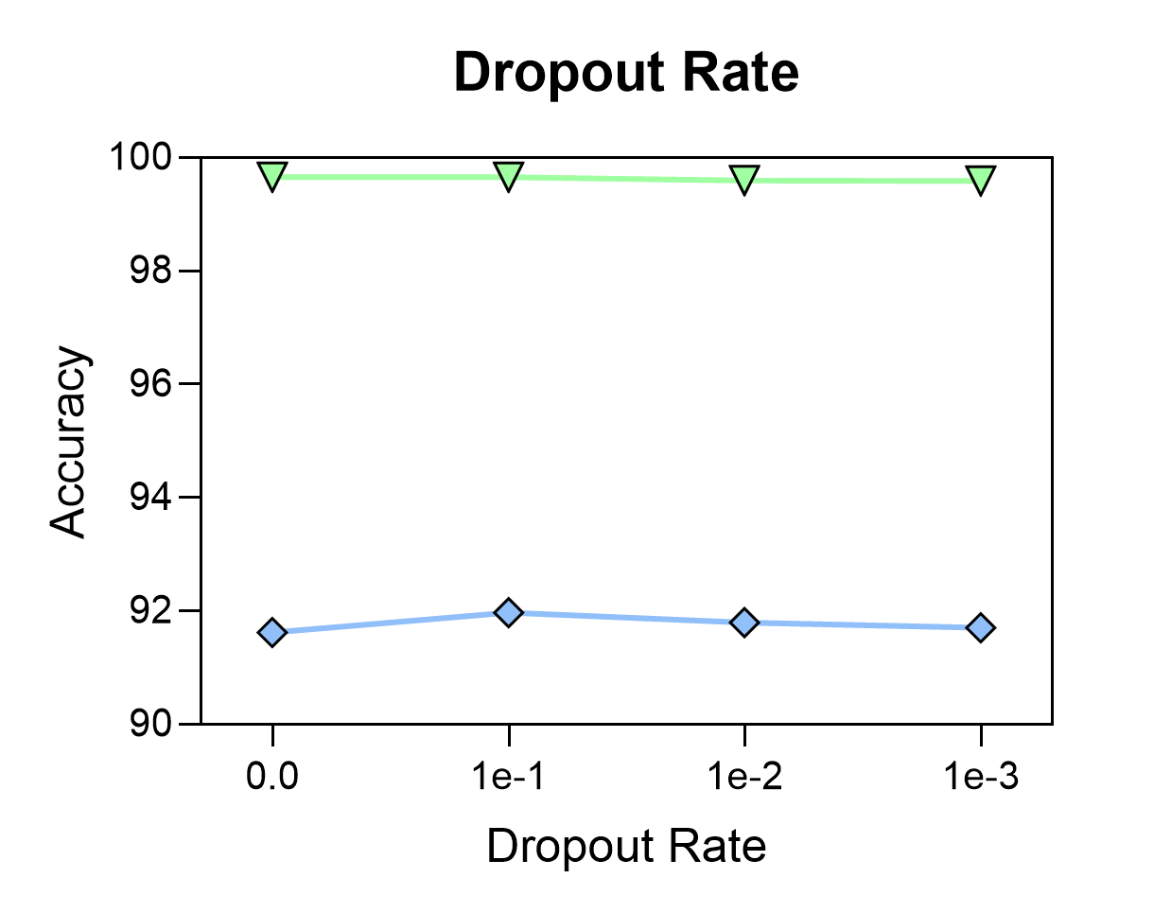
3. Regularization Study
3.1 Part Ⅰ

Slide 11
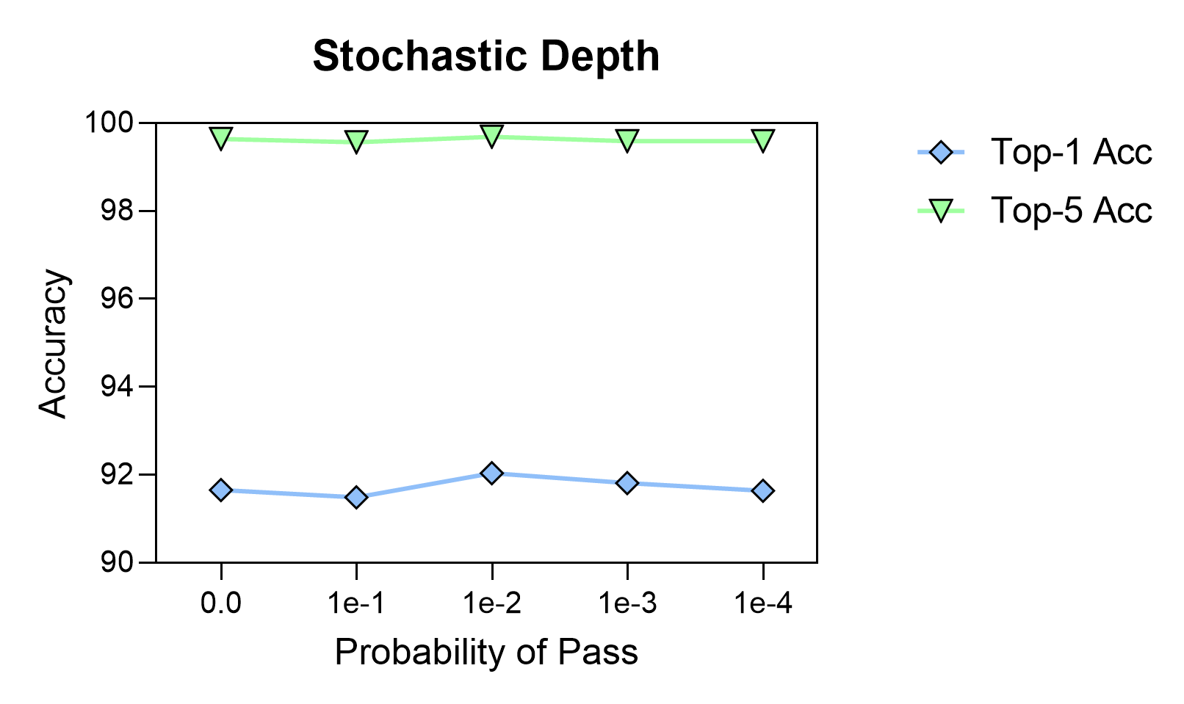










3. Regularization Study
3.2 Part Ⅱ
$$x$$
Block 1
$$p$$
$$H(x)$$
$$p(1−p)$$
Block 2
$$p^{2}$$
$$H(H(x))$$
$$p^{2}(1−p)$$
Block 3
$$p^{3}$$
$$H(H(H(x)))$$
$$p^{3}(1−p)$$
Reference:
https://arxiv.org/abs/1603.09382

Slide 12
4. Data Augment
Data Augmented method :
1、AutoAugment (Google Brain, 2019):
pros : official, better (most suitable for certain fig) (? not so good in our experiment)
cons : slow, costly, parameter not controlled
from torchvision.transforms import AutoAugment, AutoAugmentPolicy
autoaugment = AutoAugment(policy=AutoAugmentPolicy.CIFAR10)
2、RandAugment (Google Brain, 2020):
✔ to adjust parameter ourselves, efficiently, better in our experiment
from torchvision.transforms import RandAugment
randaugment = RandAugment(num_ops=4, magnitude=15)
3、Aug_utils we defined :
(1) cutmix
(2) mixup
(3) random_crop_paste
以batch为单位
以图片为单位
RandAugment (use or not) + ['None', 'CM', 'MU', 'RCP', 'Random']

Slide 13
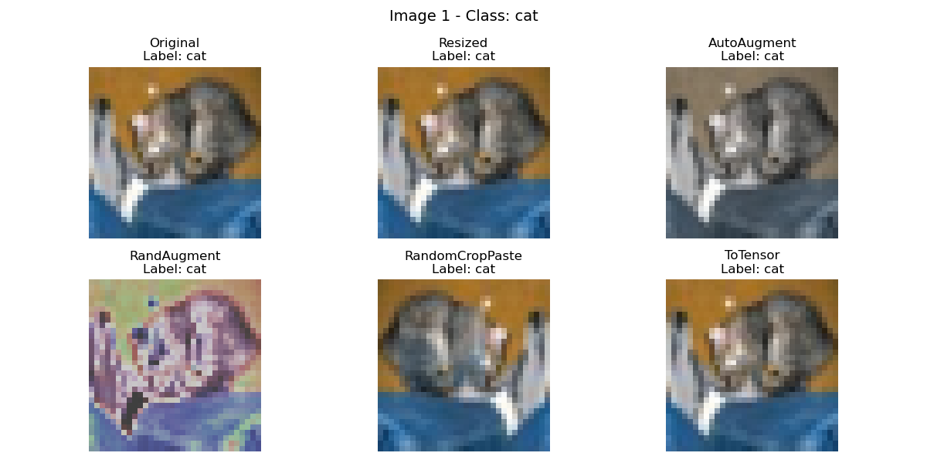
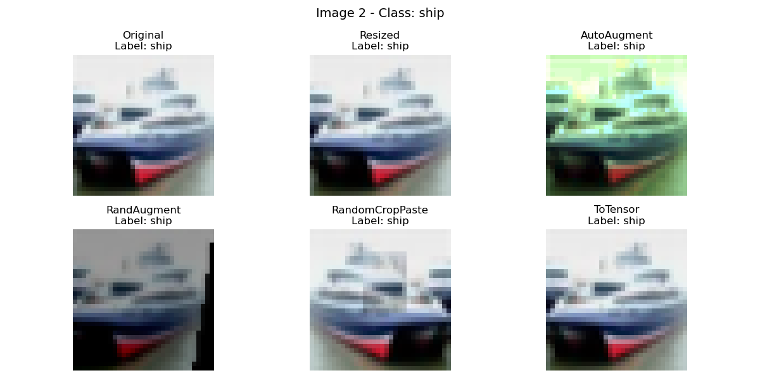
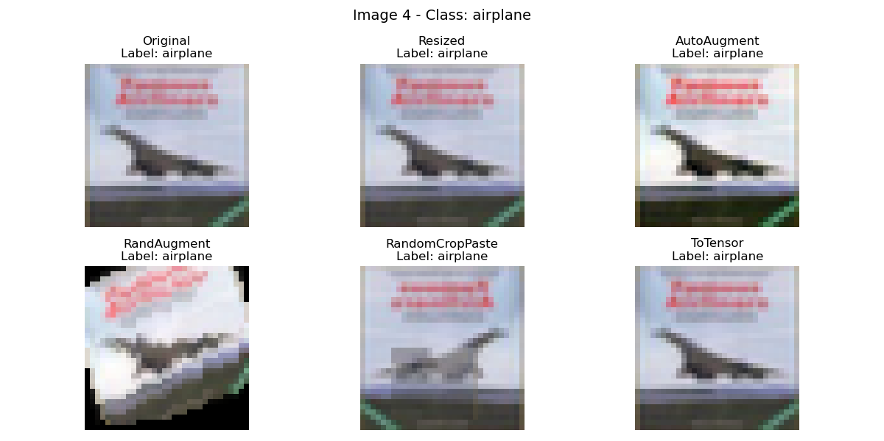
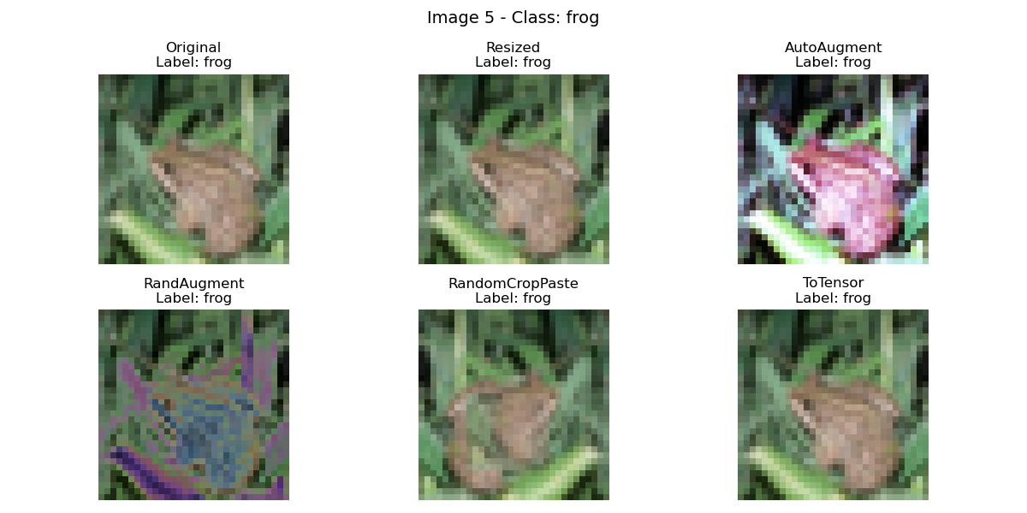

Slide 14
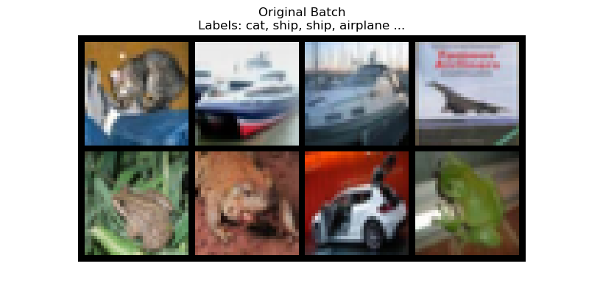
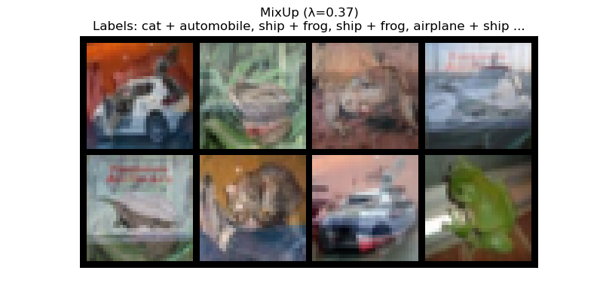
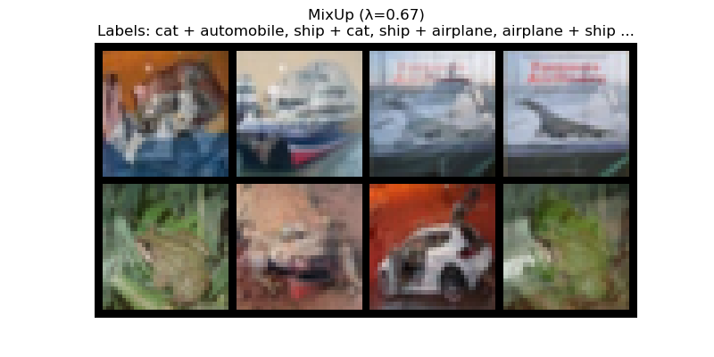
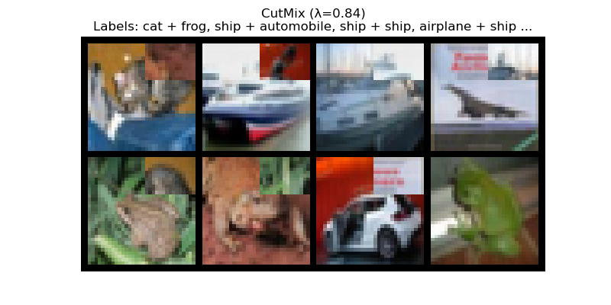
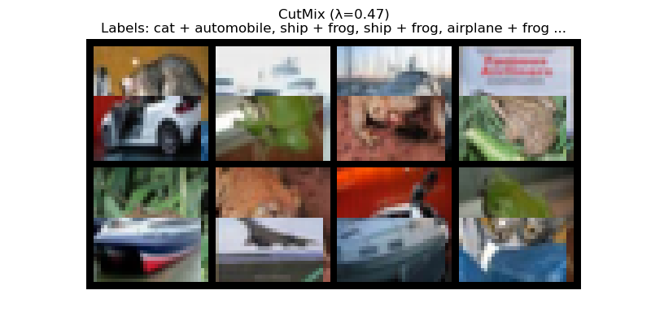

Slide 15
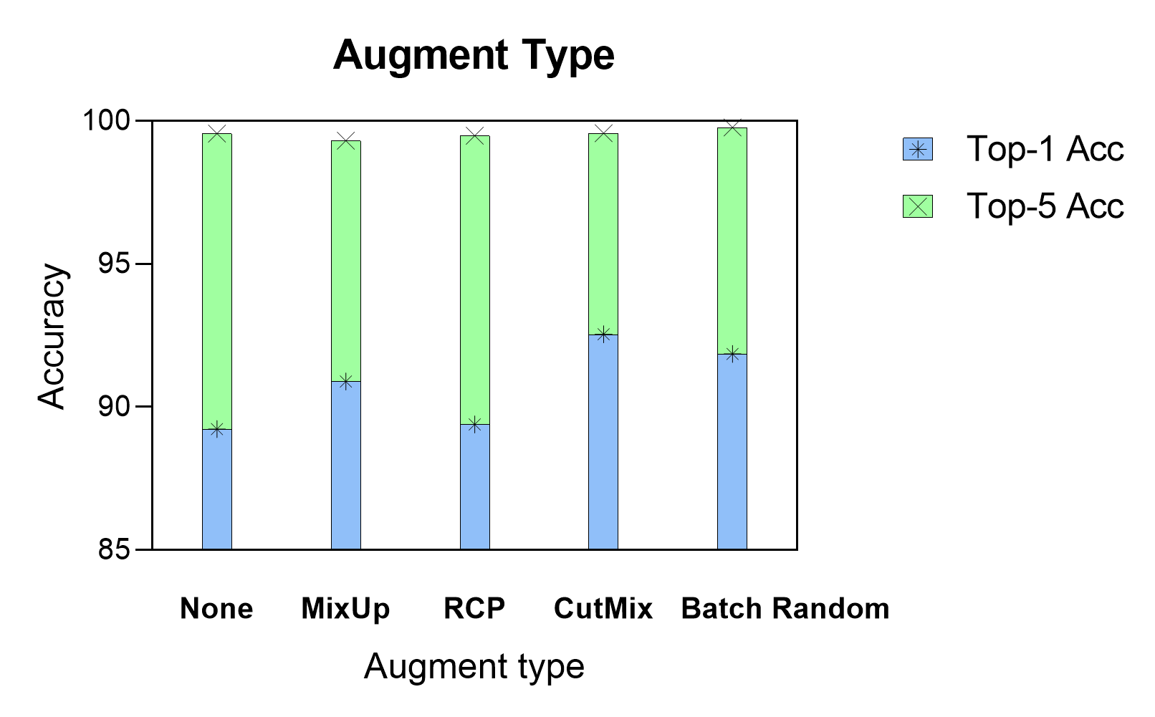
Result of ablation study on augment type without randaugment :
✔
✔

Slide 16
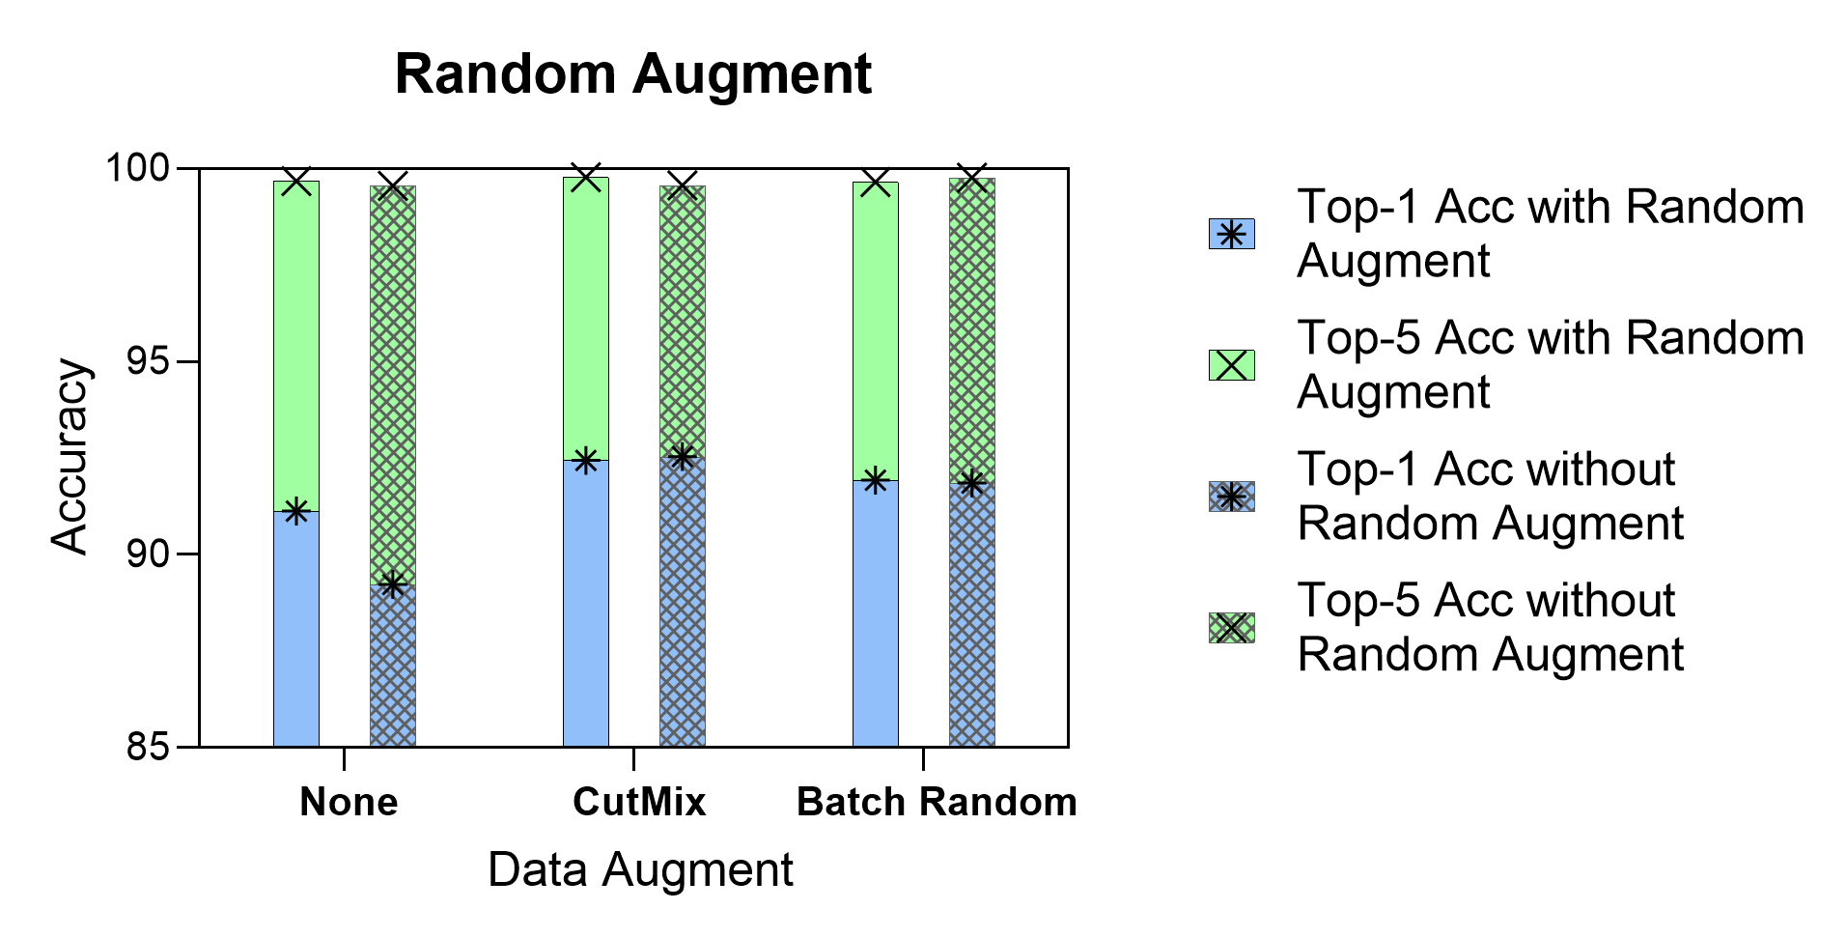
Result of ablation study on whether or not to use RandAugment
尽管RandAugment在已经有数据增强的情况下效果并不明显
但其依然有较好的性质 ：
（1）能够使在没有其他复杂数据增强的情况下使模型达到较好的效果
（2）使用RandAugment的增广方式在训练模型时消耗的显存（7000MiB左右）只需要
CutMix或Batch Random的一半（14000MiB左右），更为轻量

Slide 17
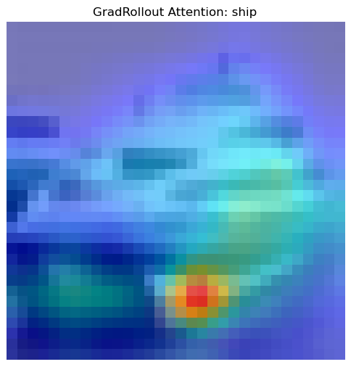
5. Visualization
5.1 Attention Map
Attending to image regions that are semantically relevant for classification
Reference:
https://github.com/nick8592/ViT-Classification-CIFAR10/blob/main/visualize_atteniton_map.ipynb
https://jacobgil.github.io/deeplearning/vision-transformer-explainability
[2010.11929] An Image is Worth 16x16 Words: Transformers for Image Recognition at Scale (arxiv.org)

Slide 18
5. Visualization
5.2 Feature Map
Too small
Redundancy
Contour
Depth

Slide 19
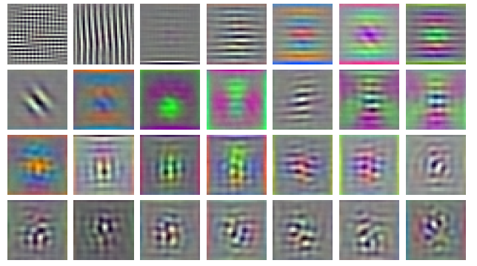
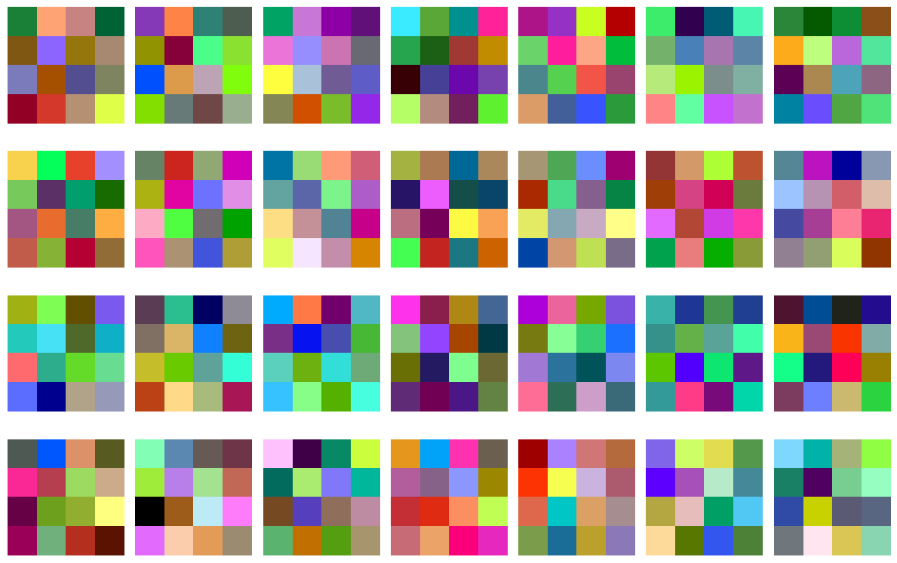
5. Visualization
5.3 RGB Embedding Filters
Too small
Poor interpretability

Slide 20
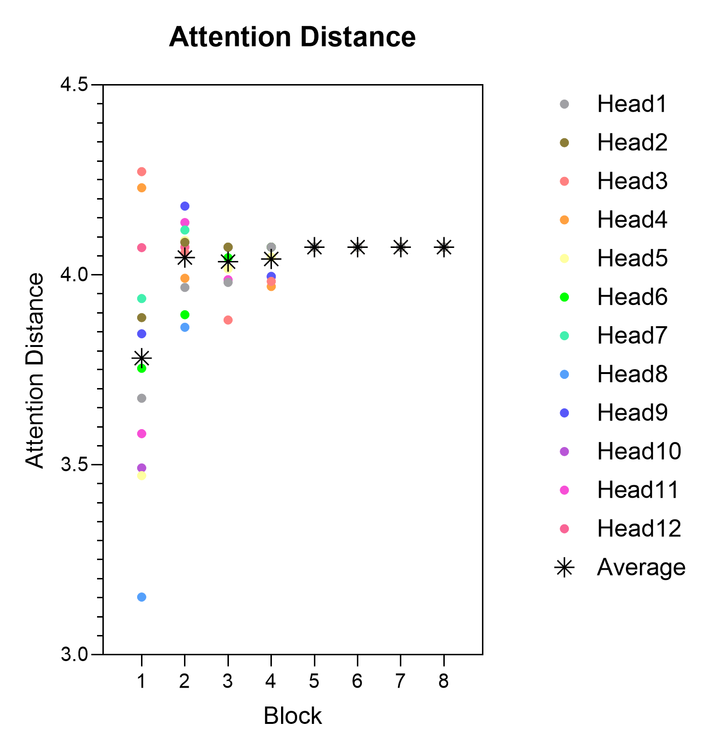
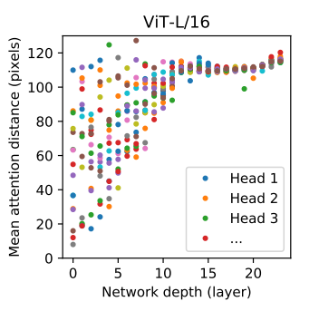
5. Visualization
5.4 Mean Attention Distance
Ascending with depth
Gradually becoming saturated
From the local to the whole

Slide 21
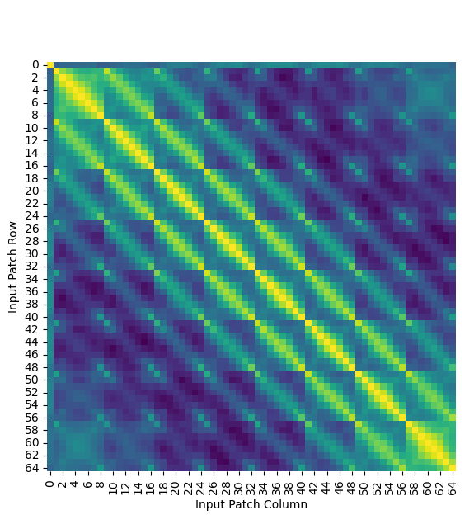
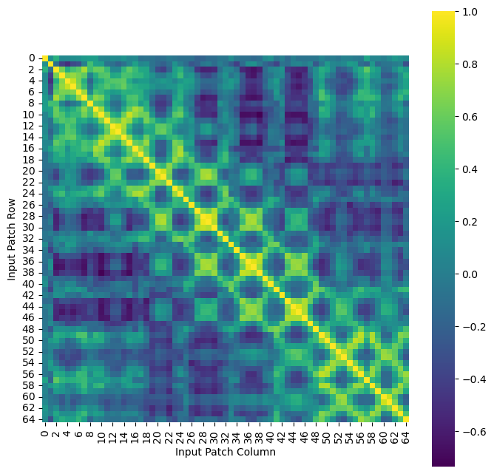
5. Visualization
5.2 Position Embedding Similarity
Original Model
Hybrid Model
In paper:
1-D, 2-D, Relative
Default, Learnable
The location information was indeed obtained
Patch size is too small

Slide 22
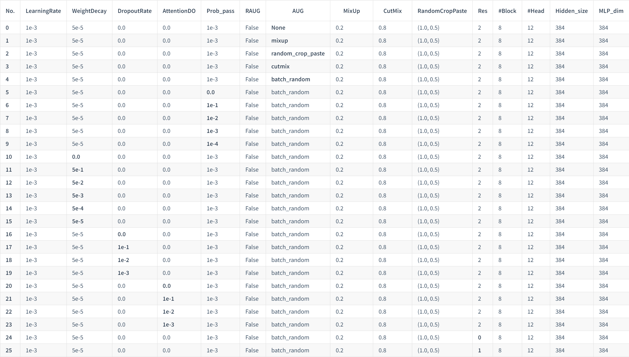
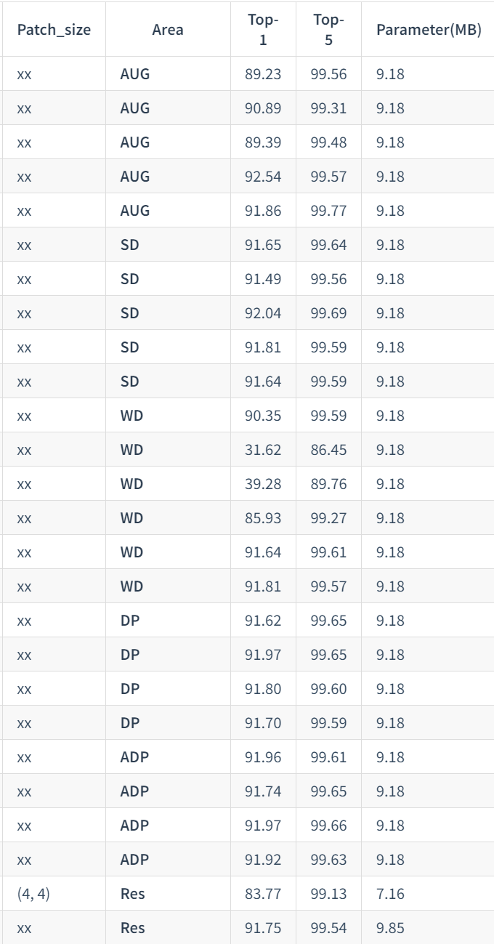
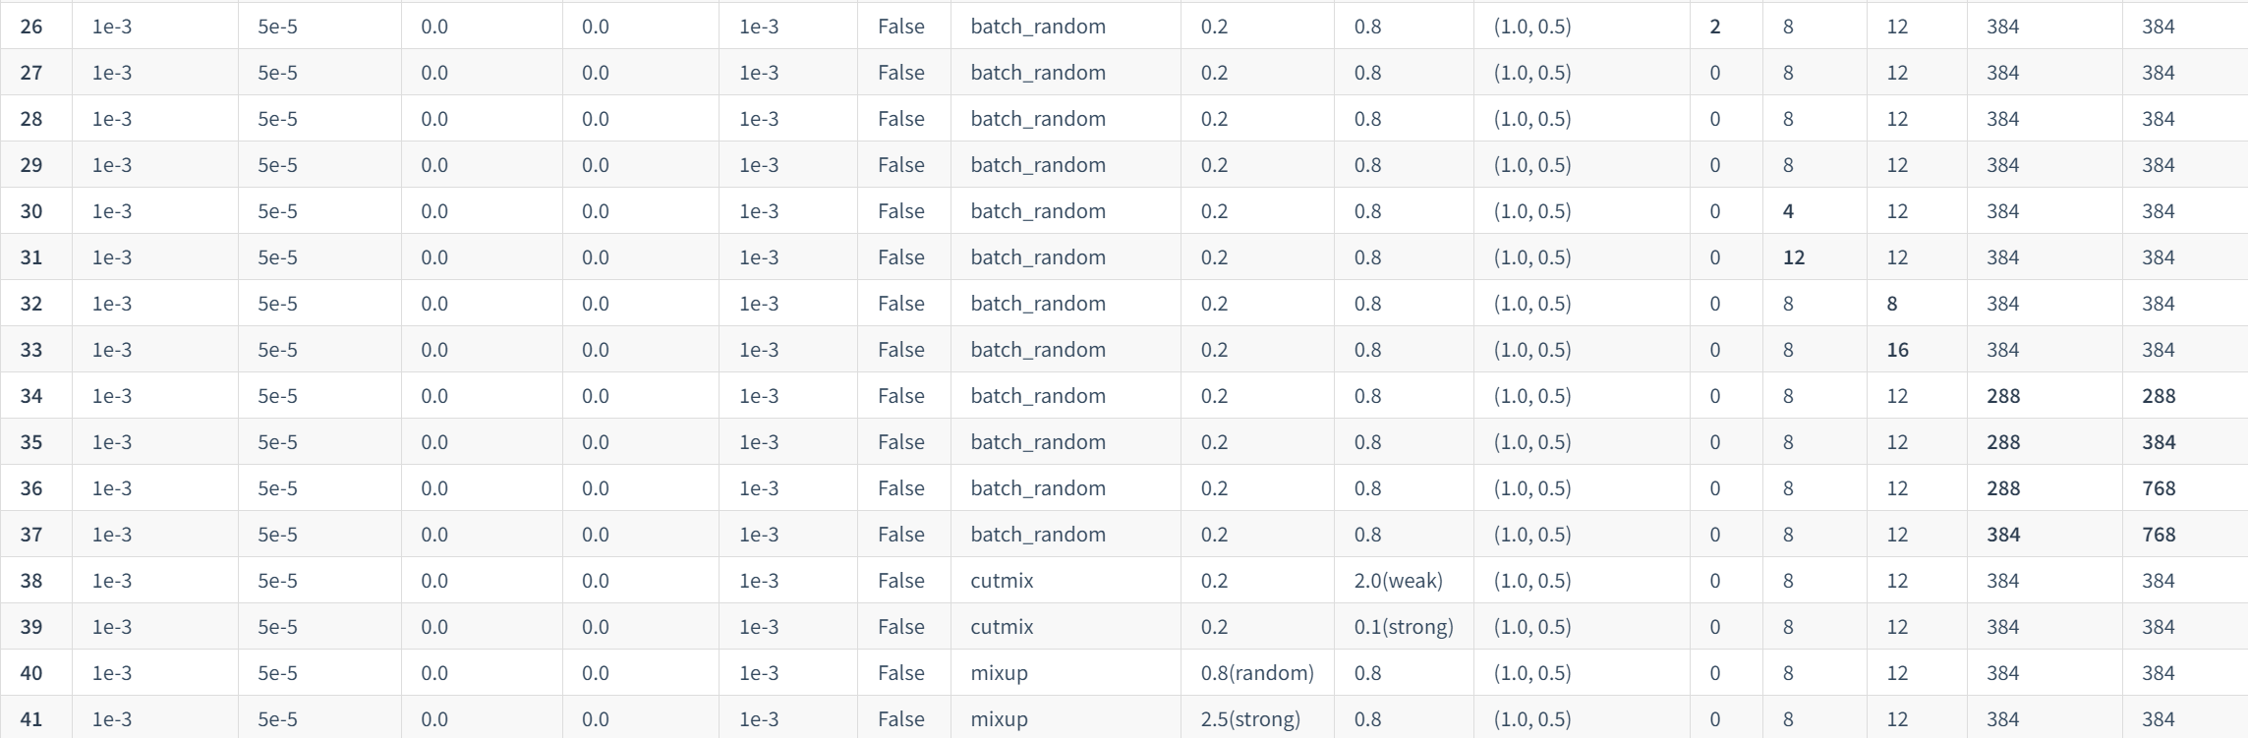
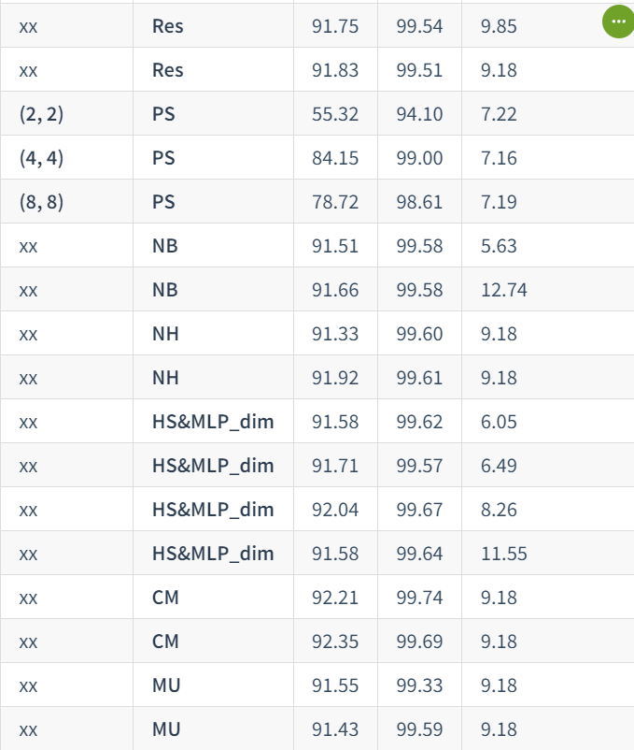
Our Experiment 💦 :
Part I
Part II

Slide 23
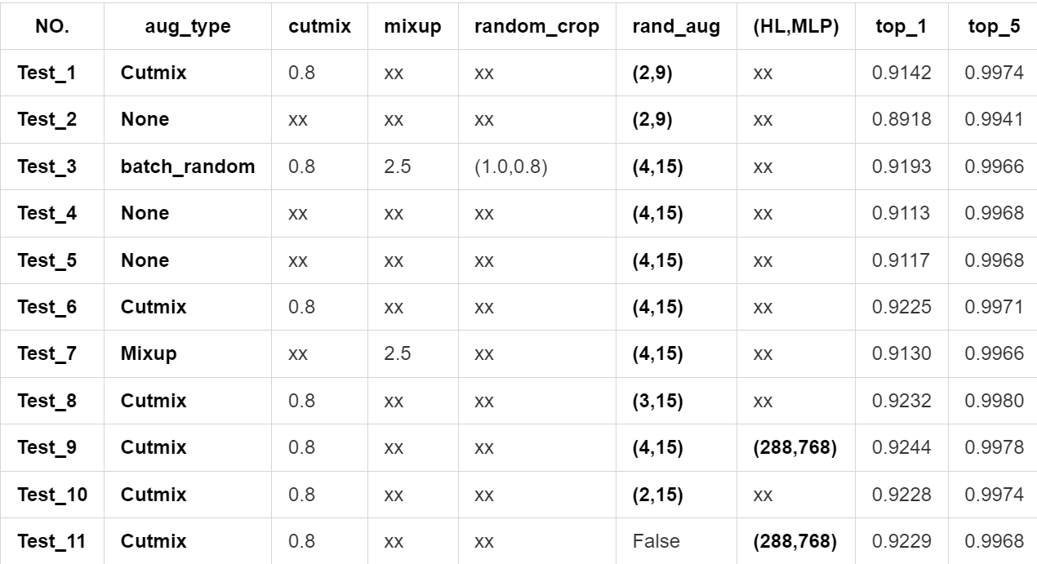
Our Experiment 💦 :

Slide 24
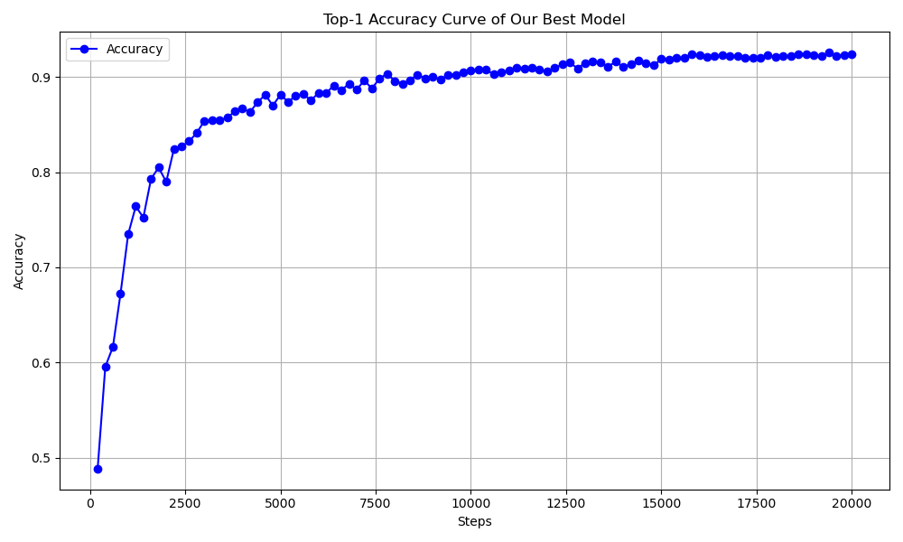
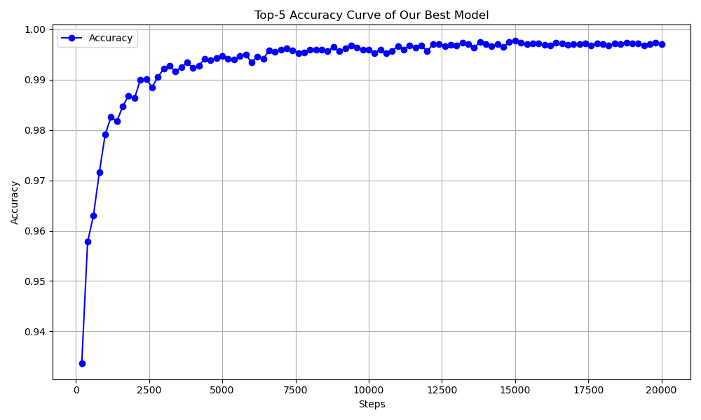
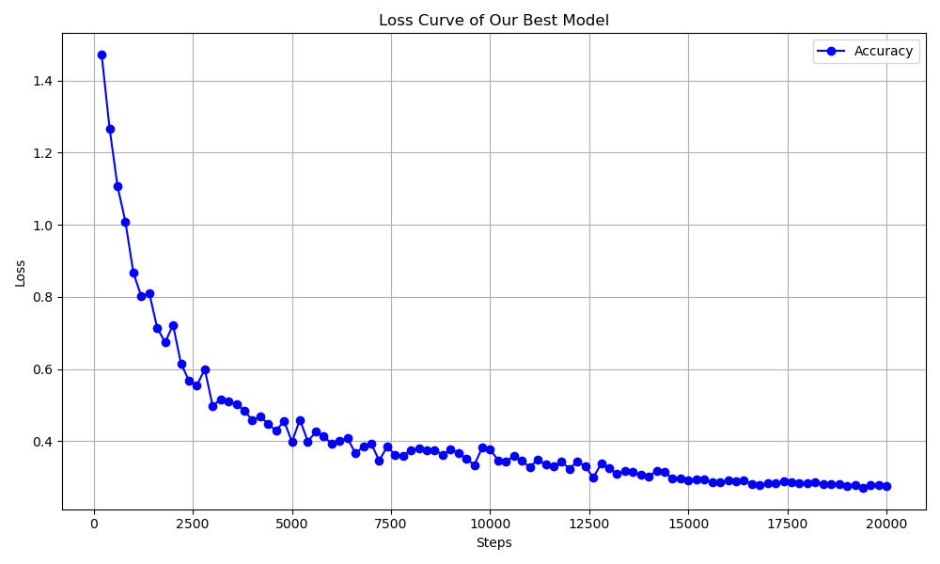
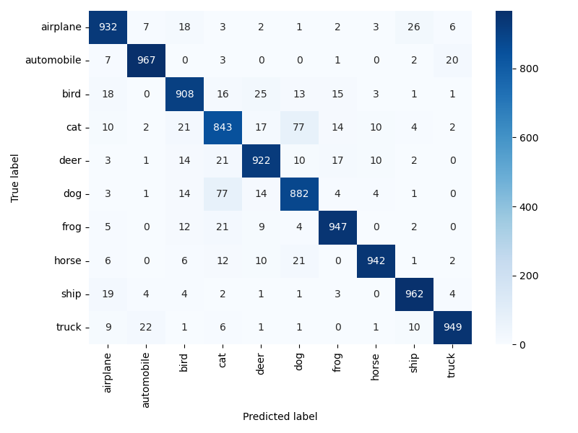
So, how about our best model ?
Cifar_No_3 : Best Top-1 Accuracy : 92.54% Best Top-5 Accuracy : 99.57%

Slide 25
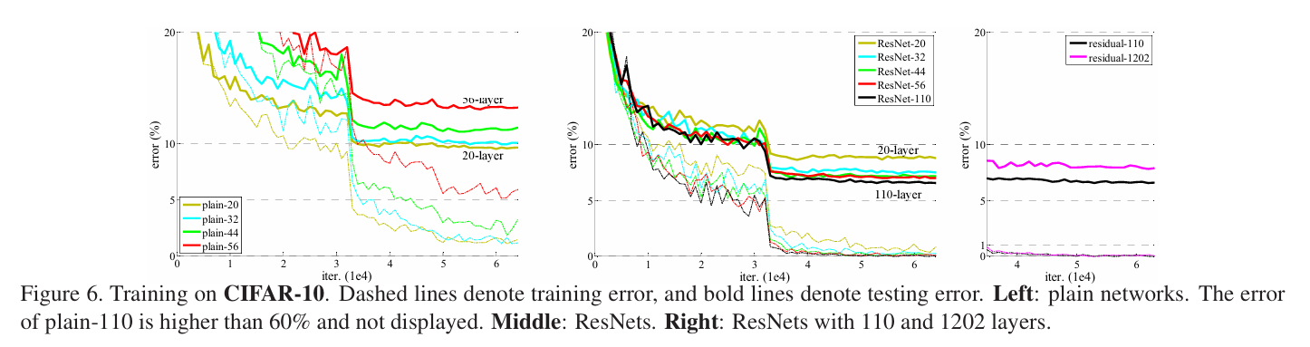
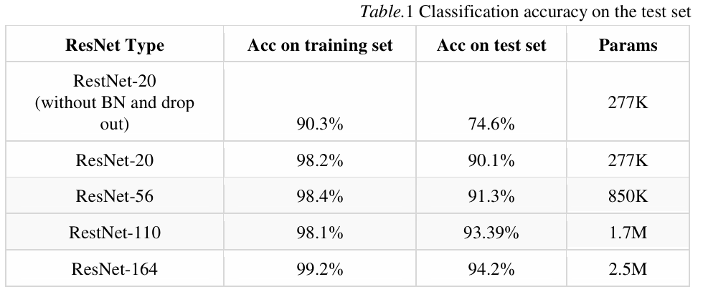
Compared with CNNs ?
Resnet :
一些不算很权威的数据(Top-1 acc)：
VGG : ~93%
GoogLeNet : ~94%
Reference:
He K, Zhang X, Ren S, et al. Deep residual learning for image recognition[C]//Proceedings of the IEEE conference on computer vision and pattern recognition. 2016: 770-778.
Jinliang N. Cifar10 image classification based on ResNet[J]. Системный анализ в проектировании и управлении, 2019, 23(1): 412-415.

Slide 26
纸上得来终觉浅，
绝知此事要躬行。
Thanks For Your Listening!

