Slide 1


Slide 2



PRESENTATION OF XLVT
-----Problem2(FactoryNet)
Xuan LIU
Department of Industrial and Systems Engineering
August 25, 2024

Slide 3
Design Requirement
The topic areas of this problem are data sanitization, dataset design, and creation/use of AI/ML models.
Challenges：
Inconsistent labeling standards(e.g. typos, synonymous and so on)
Labeled images aren't high enough quality
Relatively monotonous data, easily lead overfitting of AI models
Design Requirement:
Organized labels that the model understands (labels are standardized)
Image annotations and labels are well aligned (e.g. feature vectors are close)
Easy to extend with new AI tools (With pre-trained parameters)
Goal:
A well-pretrained model that effectively aligns images and text;
It's user-friendly and easy to fine-tune.

Slide 4
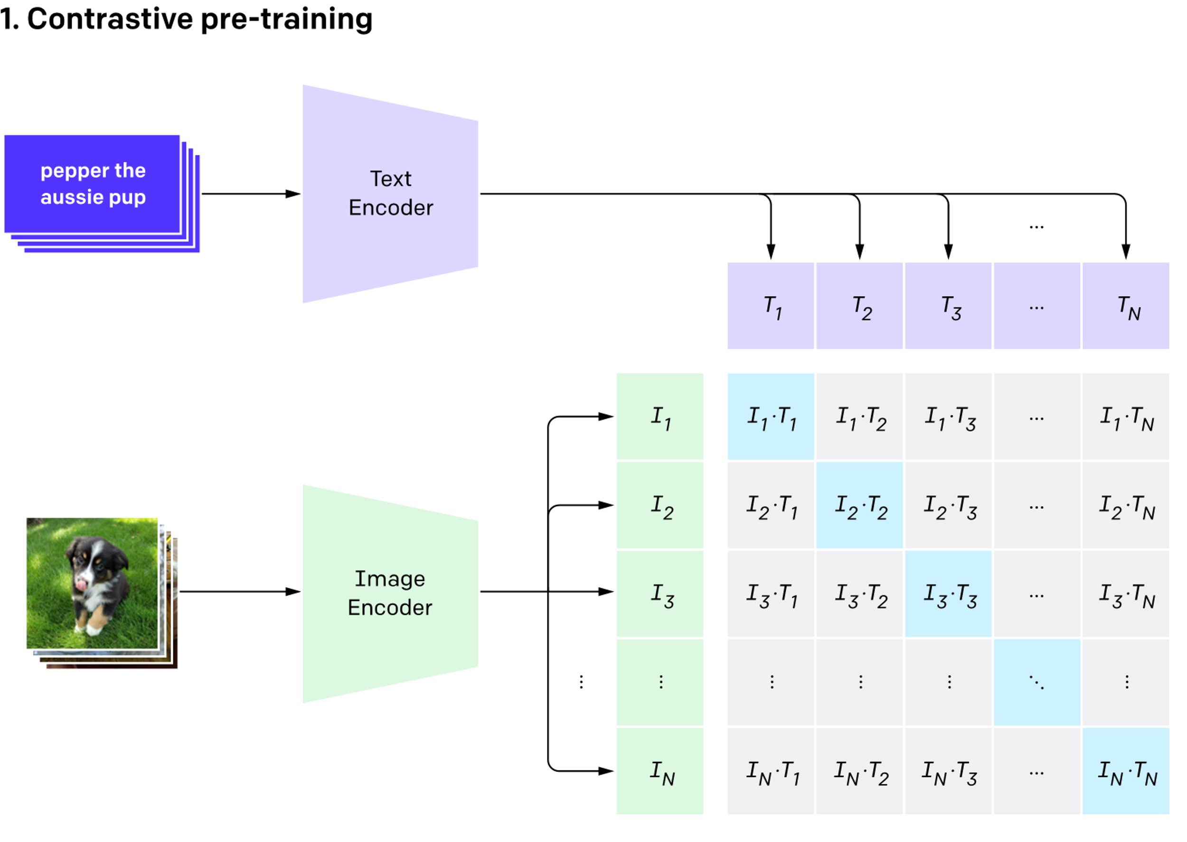
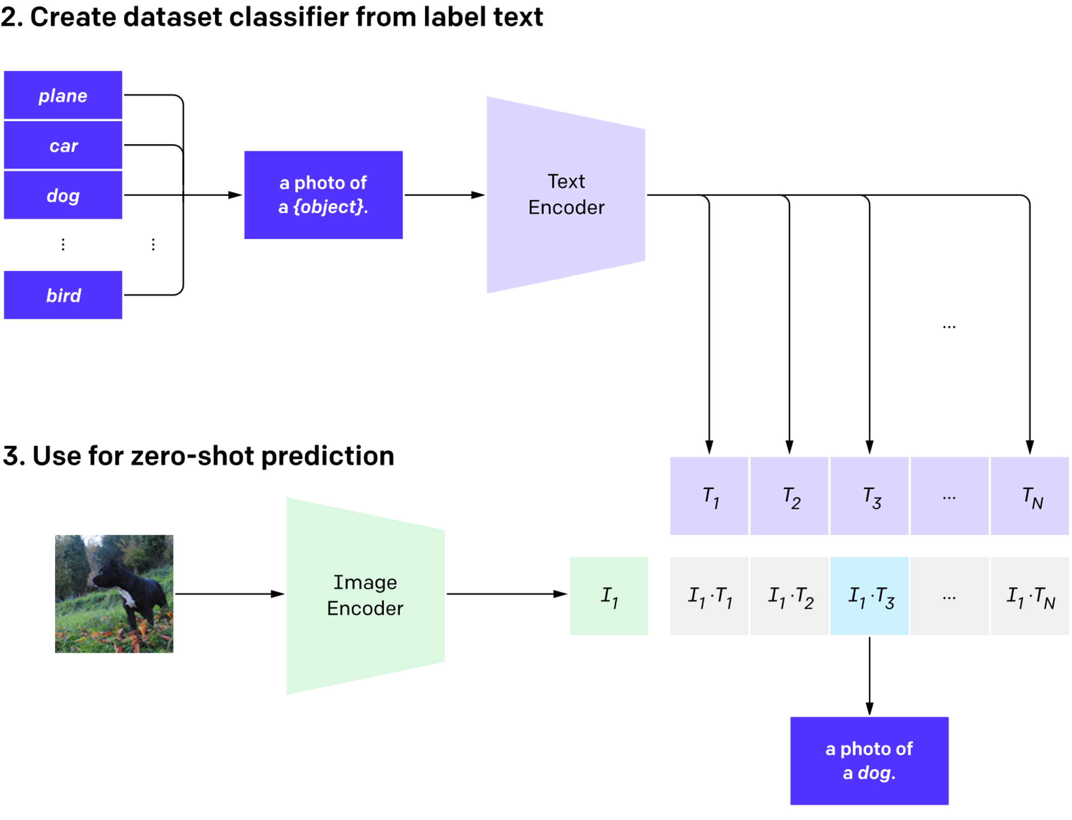
Base model - CLIP
Powerful Multi-Modal tools from OpenAI^{[1]} that connect Text and Image. (Encode image and text together for data sanitization)
Comparative Learning and Standard Vision Transformer Architecture. (Adaptable and easily extendable for new multimodal applications)
Including a large number of images and text data (e.g. ImageNet) for Pre-training (Well pre-trained model can be used directly)
[1]Radford A, Kim J W, Hallacy C, et al. Learning transferable visual models from natural language supervision[C]//International conference on machine learning. PMLR, 2021: 8748-8763.

Slide 5
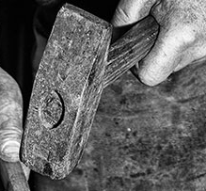
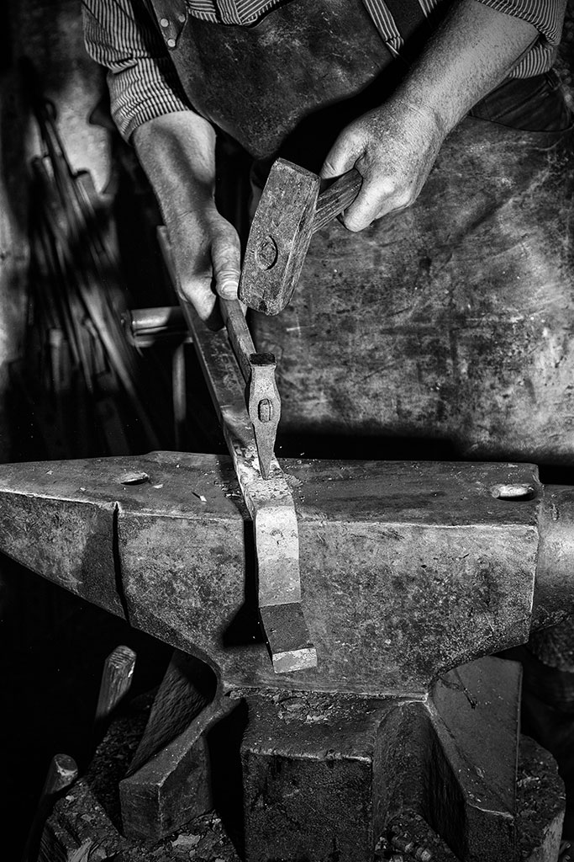
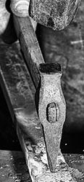
Data Sanitization
Common Problems for User's Labeling
Same image box but with different labeling
Mallet or Hammer?
Result from CLIP*:
Hammer: 0.7042,
Mallet: 0.2958
Chisel or Hammer?
Result from CLIP*:
Hammer: 0.1648,
Chisel: 0.8352
'1711553074711.jpg'
Mallet | 262 | 184 | 203 | 219 | user
hammer | 262 | 184 | 203 | 219 | user
Chisel | 243 | 333 | 250 | 116 | user
hammer | 243 | 333 | 250 | 116 | user
*Both image and text model use pretrained model "openai/clip-vit-large-patch14"

Slide 6
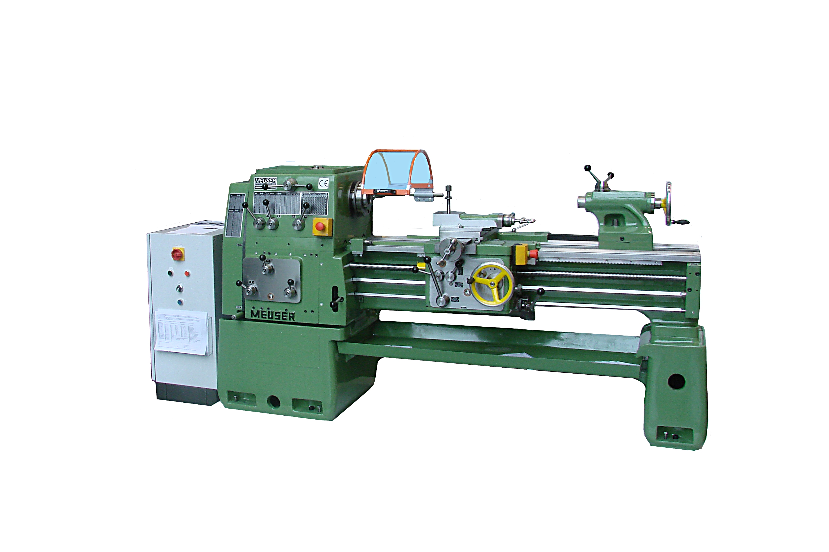
Data Sanitization
Common Problems for User's Labeling
Image and labeling is unmatch
Text Vector
Image Vector
"A photo of a Lathes"
CLIP Encoder
Cosine score
Image Vector
Text Vector
CLIP-encoded feature vector
Cosine score
(e.g. over threshold -> Closely labeling)
By calculating the cosine similarity of the vectors ——
Calculate whether the labeling is a synonym, similar images , and the matching level of images and labeling

Slide 7
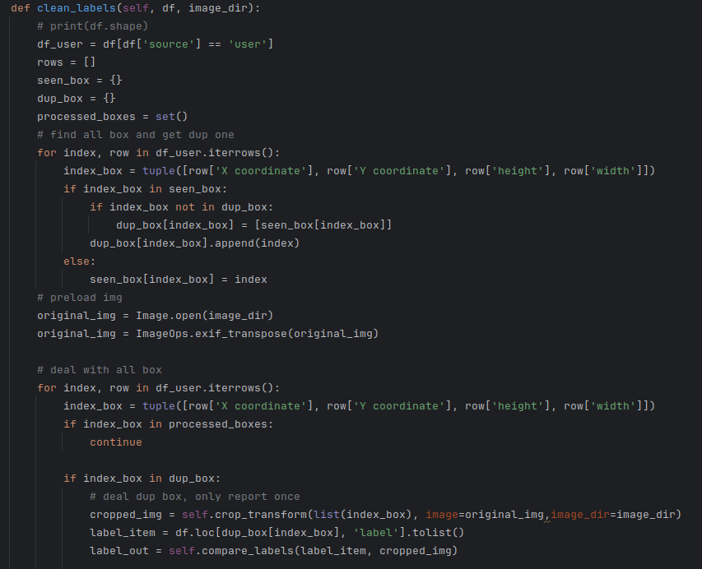
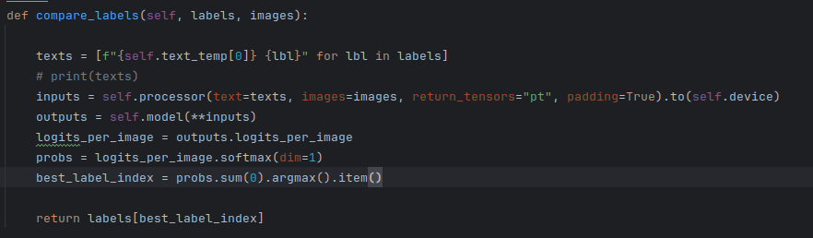
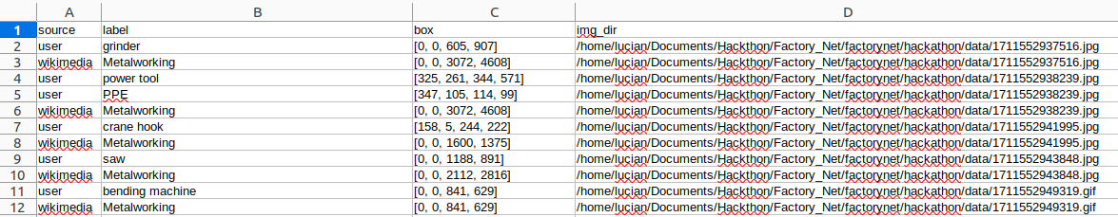
Data Sanitization
Step1- Use CLIP for data sanitization
Inital Data Sanitization
Find overlap image box for a single image
Get all label for overlap image box
Calculate cosine score – allocate best match label for this box
Output: ['source', 'label', 'box', 'img_dir']：
First two tabs for getting label relationship
The last two tabs for fetching actual image

Slide 8
Data Sanitization
Step2 - Record as json file| Step3 – Merge Labeling
Save data in two mode for text similarity calculation
wiki2user
user2wiki:
Loading the CLIP model and tokenizer:
Loaded pretrained model as Step1;
Merging similar label:
Takes a list of text labels (values) and a similarity threshold(e.g. 0.9).
Encode labels to embeddings and Compute the cosine similarity between the embeddings.
Labels with a similarity score above the threshold are grouped together.
Selecting the best match for each group:
Selecting the best matching value from a group of merged values for a given key.
The highest similarity is selected as the best match.
"Metalworking": [
"grinder",
"power tool",
"PPE",
"crane hook",
"saw",
"bending machine",
"hydraulic press",
"cut off tool",
"drill press",
"hand drill",
…...
"resistance welder"
],
"grinder": [
"Metalworking",
"Welding",
"Jewellery tools",
"Grinding and lapping",
"Grinding tools",
"Grinding wheels",
"Glass grinding",
"Angle grinders",
"Bench grinders",
"Hand grinders",
…...
"Sharpener in Serbia",
"Portable hand coffee mills"
],
Use group and similarity threshold for Filtering Data
"grinder": [
"Hand grinders",
"Glass grinding",
"Angle grinders",
"Bench grinders",
"Bosch angle grinders",
"Press cake breakers",
"Edge runner millstones",
"Sharpener in Serbia",
"Portable hand coffee mills"
],
"grinder": [
"Hand grinders",
"Bosch angle grinders",
"Edge runner millstones",
"Sharpener in Serbia"
],
threshold ：0.6
threshold ：0.7

Slide 9
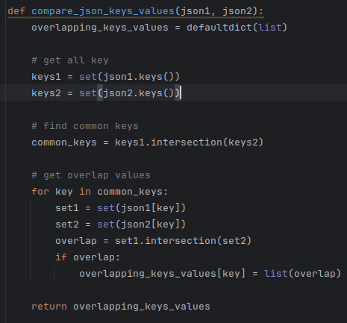
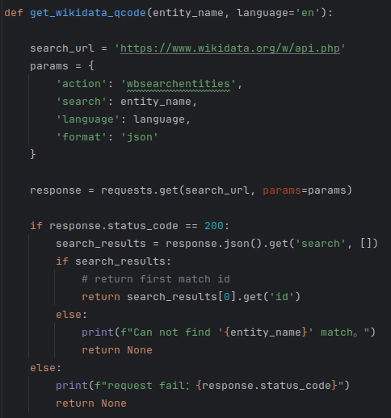
Output classes
Step4 Output data
Merge both with same key-values in format wiki2user.
Get Q code for each item
Use key(from wiki) as mother classes and values(from user) as subclasses

Slide 10
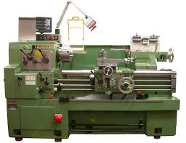
Optional
We have image box and img_dir:
Encode image and label into embedding to find the match level.
2. Use Q code find pure data as meta dataset:
From FactoryNet
From Wiki
Compare two image in feature vectors to find out the match level of box

Slide 11
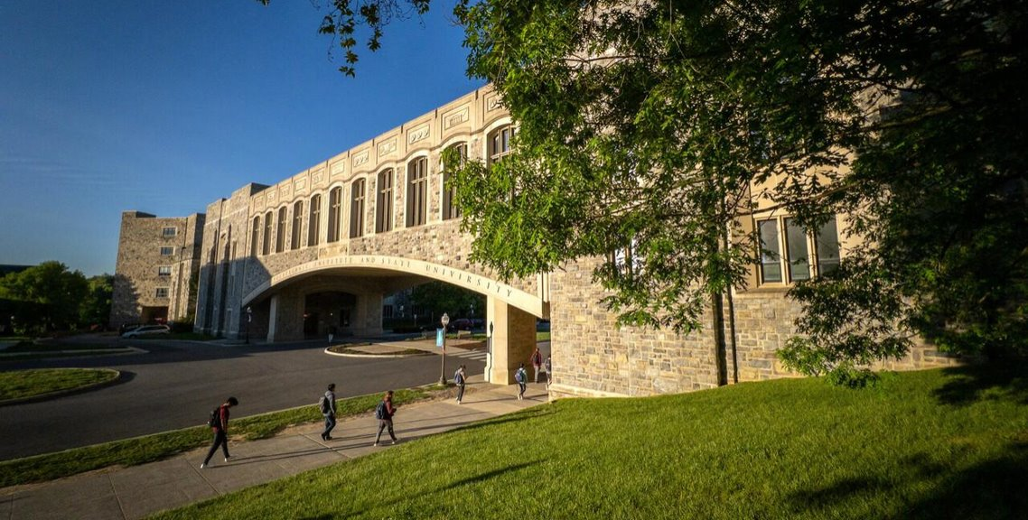
That's All, Thank You For Listening!

