Slide 1

Library Management System

Slide 2
Group 5
Xuan Loc, Le
Ngoc Cuong, Nguyen
Duy Tien, Duong

Slide 3
Use cases

Slide 4
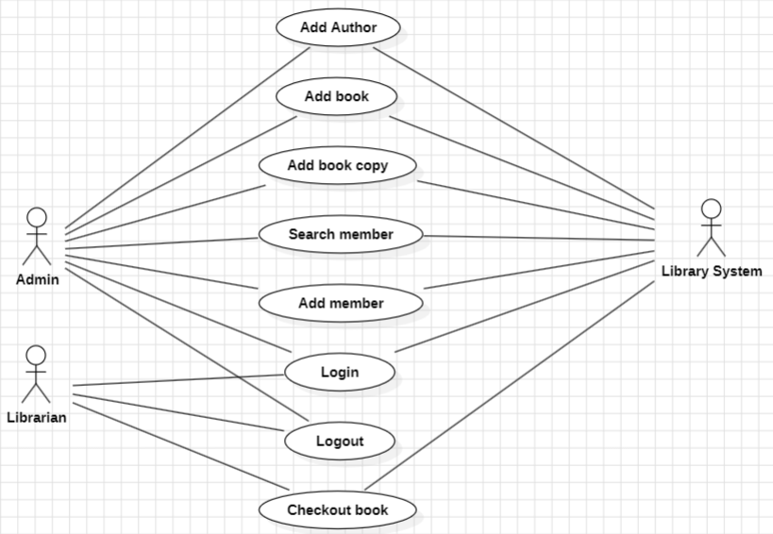

Slide 5
Structure

Slide 6
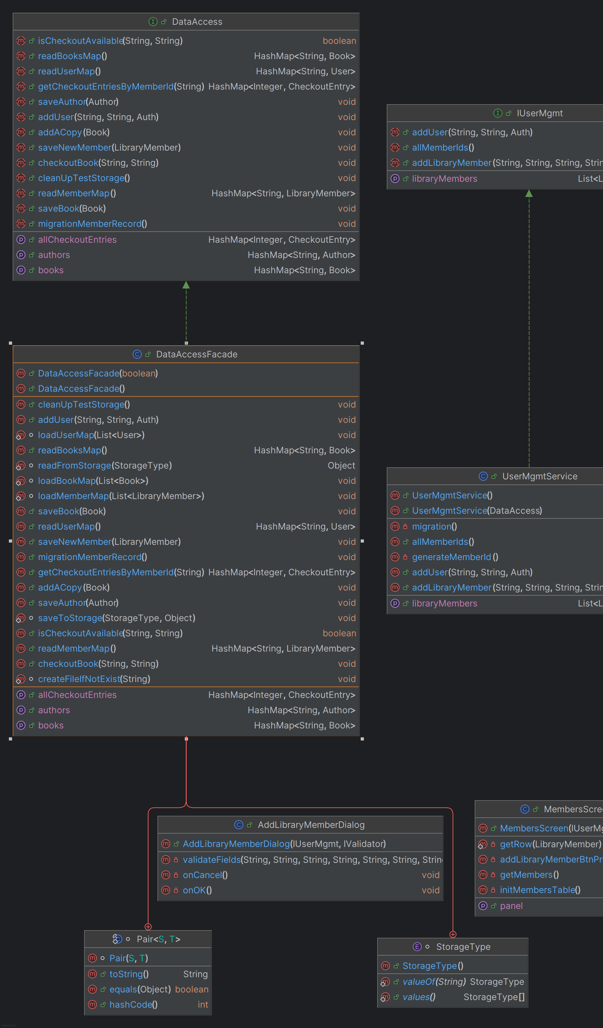
Add new library member

Slide 7
Feature flow

Slide 8
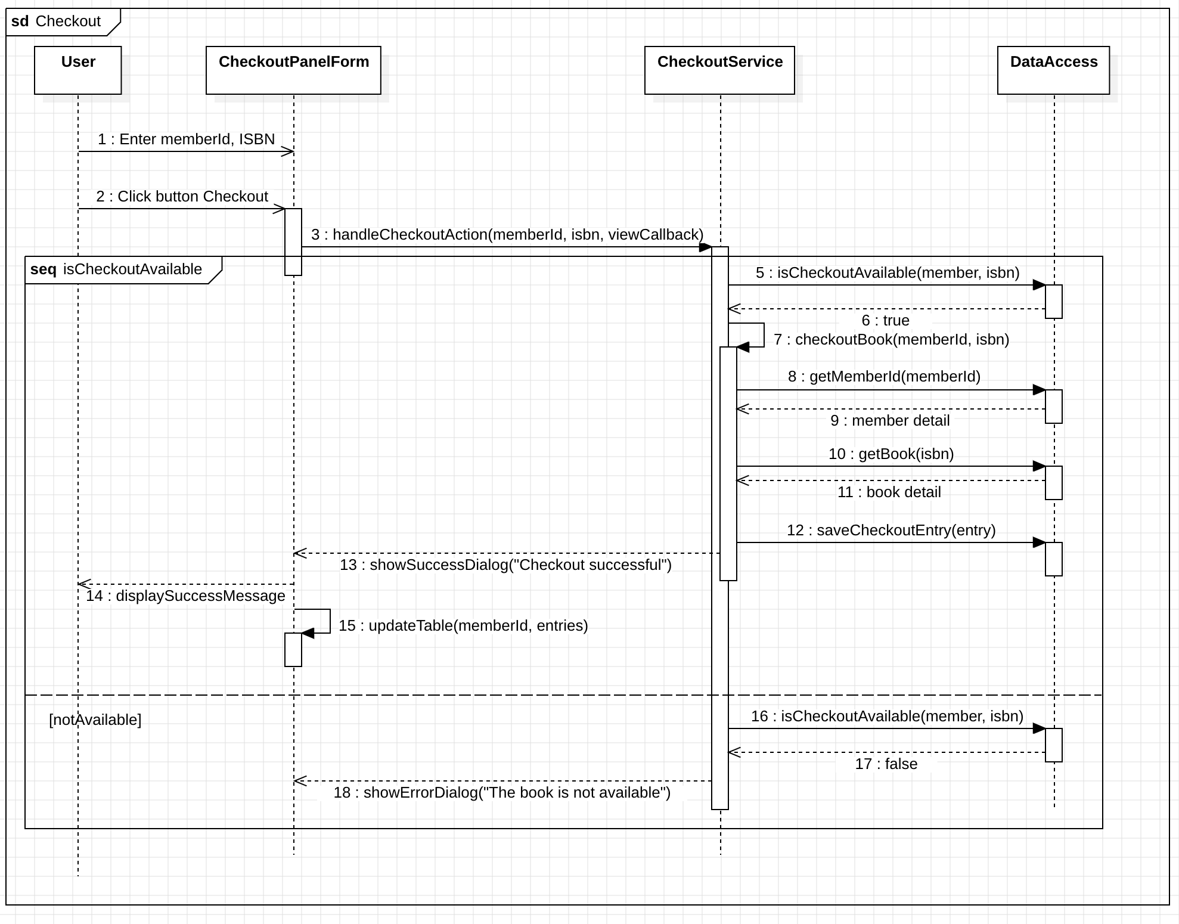
Checkout Book

Slide 9
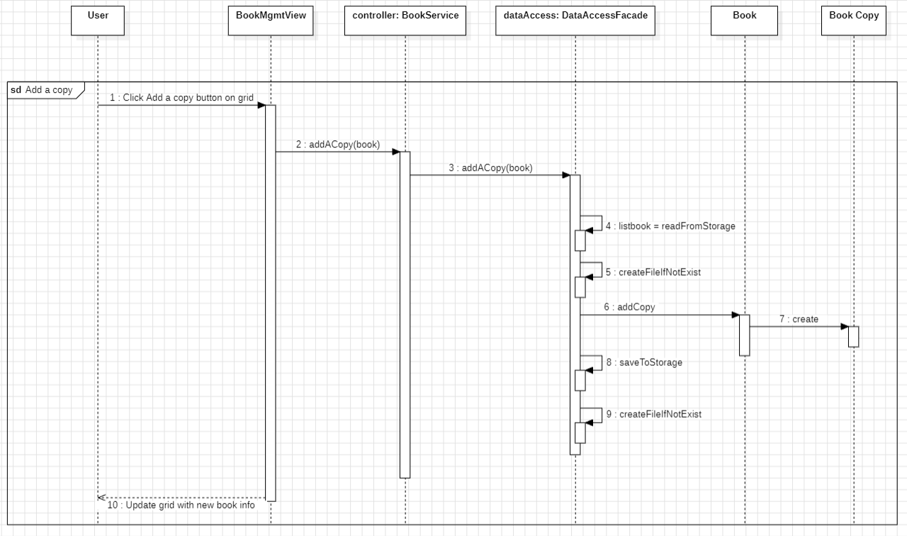
Add a copy

Slide 10
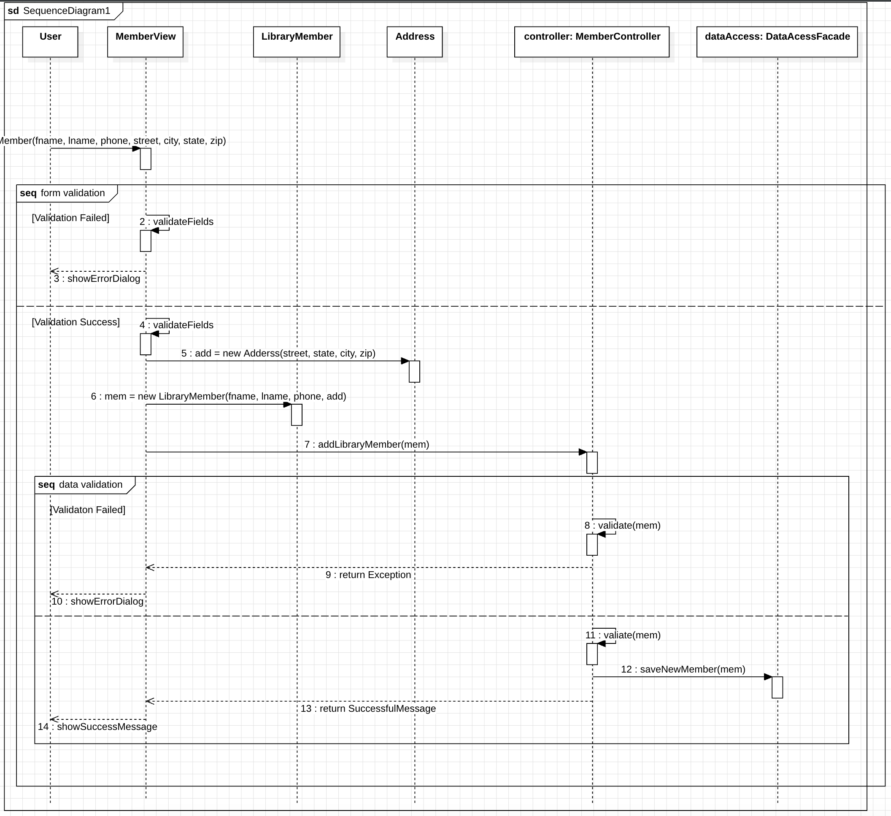
Add a new member

Slide 11
Validation Rules of Windows UI

Slide 12
Regex-Based Validation Format Validation
This type of validation is usually used when the input value should have specific pattern or format.
Example: An email field should contain @ and a domain (example@domain.com), or a credit card field should follow a specific numerical pattern.
Apply this for ISBN.

Slide 13
Required Fields Validation
Certain fields are mandatory, and users cannot proceed without entering data in these fields.
We should apply this validation for both front-end and back-end.

Slide 14
Data Type Validation
Input must match the expected data type (e.g., string, number, date).
Apply for Phone number, Zip code, etc.

Slide 15
Length Validation
Ensures that the input falls within a specified minimum and/or maximum length.
Apply for Phone number, Zip code, etc.

Slide 16
Conclusion

Slide 17
Input Validation and Clean Data: The Mind and Clarity
Concept: Input validation ensures that the data entered into a system is accurate, precise, and free from error. This process mirrors the mind’s ability to filter and refine information, ensuring clarity and correctness before any decision-making or deeper processing.
Relation to Consciousness: In the Science of Consciousness, a clear and focused mind allows for higher-quality thoughts, decisions, and actions. Just as validation ensures clean data for better outputs in a system, mental clarity ensures more productive and meaningful experiences in life.
Technology Parallel: Meditation or mindfulness techniques could be seen as a form of "validation" for the mind—filtering distractions, thoughts, and emotional noise to focus on the essential, true inputs that align with personal goals or awareness.

Slide 18
Clean Source Code: Organized Thought and Structure
Concept: A well-organized codebase with clean structure is crucial for development, especially in collaborative environments. It enables easy understanding, maintenance, and extension of the system by various developers. Clean code represents simplicity, order, and efficiency.
Relation to Consciousness: In the Science of Consciousness, mental organization, logical reasoning, and structured thought processes are key for higher cognitive functions. Just as clean code allows for smooth operation and collaboration in programming, a structured and organized mind allows for smooth interaction, creativity, and problem-solving in life.
Technology Parallel: Practices like mental discipline, self-awareness, and structured thinking could be seen as "mental architecture"—ensuring thoughts and ideas are aligned with broader goals, similar to how developers align code with project objectives. A mind cluttered with disorganized thoughts can be likened to a codebase filled with inefficiencies and bugs.

Slide 19
Consciousness as the Ultimate Validation and Structure
In both cases, the underlying theme is about order, clarity, and efficiency. Input validation cleanses data before it’s processed, while clean code organizes structure before collaboration. Similarly, the Science and Technology of Consciousness seeks to cleanse and organize the mind for higher awareness, decision-making, and harmonious living. Whether in code or consciousness, clarity and structure are fundamental to achieving optimized outcomes.

