Slide 1

Triangle Counting by Adaptively Resampling over Evolving Graph Streams
Wei Xuan, Huawei Cao, Mingyu Yan, Zhimin Tang,
Xiaochun Ye and Dongrui Fan
Institute of Computing Technology, Chinese Academy of Sciences, China
SEKE 2021
July 1 - July 10, 2021
Notes:
Hello, my name is Wei Xuan, a student from Institute of computing technology, Chinese academy of sciences. It’s my honor to share our recent work here. Entitled “Triangle counting by adaptively resampling over evolving graph streams”.

Slide 2
Outline
Introduction
Related Work
Proposed Method
Experiments
Conclusions
Notes:
We will share this work in five sections. First is Introduction.

Slide 3


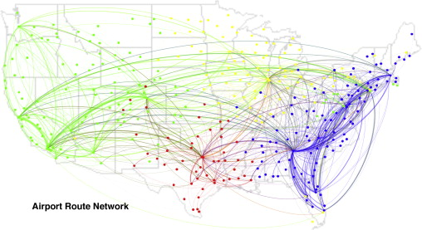
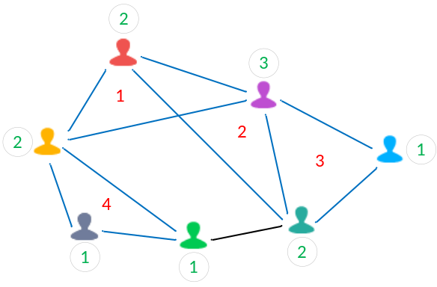
Triangle Counting in a Graph
Graphs are ubiquitous
  vertex: entity, edge: relation between entities
  social networks、E-commerce networks、traffic networks
Triangle counting
  Global triangles: 3-node connected to each other
  Local triangles: triangles for each vertex
Notes:
Graphs are ubiquitous: Vertices represent entities, edges represent relationships between entities, among social networks, traffic networks, and son on.
Triangle is a fundamental primitive, which 3 nodes connected to each other.

Slide 4

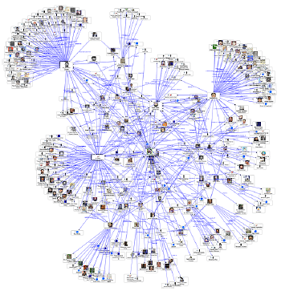
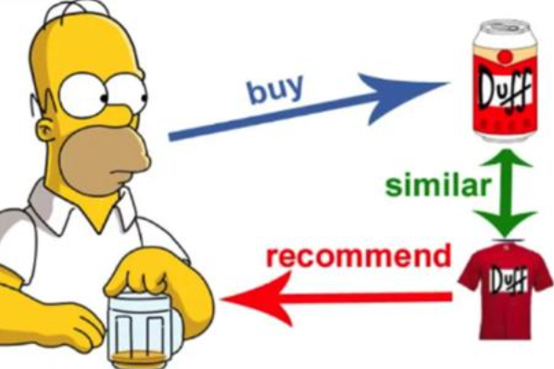
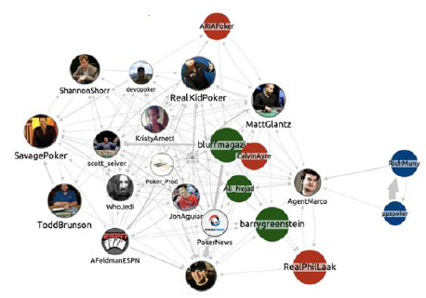
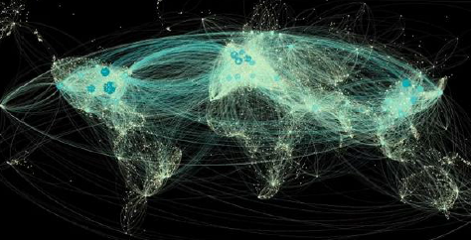

Applications of Triangle Counting
Financial Fraud Detection
Community Discovery
Recommended System
Social Network Analysis
Traffic Network
Spam Detection
Notes:
Triangle counting has many applications in our lives. Such as financial fraud detection, community discovery, spam detection, and so on.

Slide 5
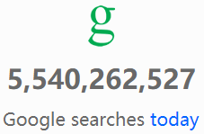
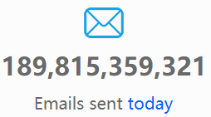
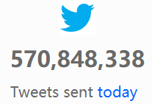
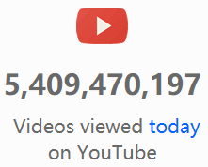


Evolving Graph Streams
Real-world graphs are dynamic
  Stream of edges
  Adversarial order
Notes:
In real-world, graphs are dynamic, called streaming graphs. a sequence of insert/delete edges.
For example, the number of Google searches, emails sent, videos viewed are always dynamic over a day

Slide 6
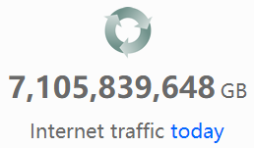
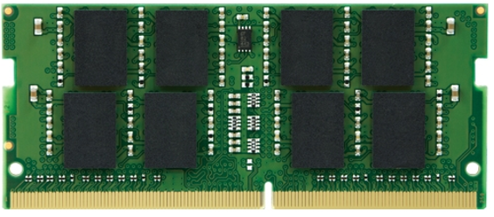
Challenges in Streaming Graphs
Massive real-world graphs
Growing upwards as a whole
Limited memory space
Notes:
However, streaming graph process faces huge challenges. Real-world graphs are massive and continually grow upwards. And limited by memory capacity, they are difficult to fit in main memory.

Slide 7
Outline
Introduction
Related Work
Proposed Method
Experiments
Conclusions
Notes:
The second section is related work about previous triangle counting in streaming graphs.

Slide 8
Related Work
Two categories based on memory allocation strategy
  Reservoir-based method
  Bernoulli-based method
Sampling Method | Sampling Ratio | Memory Budget
BSR-Sample (Proposed) | ≥Threshold | Adaptive
Reservoir-based sample | Decreased | Fixed
Bernoulli-based sample | Fixed | Increased
Notes:
Based on different memory allocation strategy, previous triangle counting algorithms can be divided into two categories.
One is reservoir-based method, which sampling ratio decrease, memory budget is fixed.
Another is Bernoulli-based method, which sampling ratio is fixed, memory budget increases.
Our proposed method, called BSR-Sample,

Slide 9
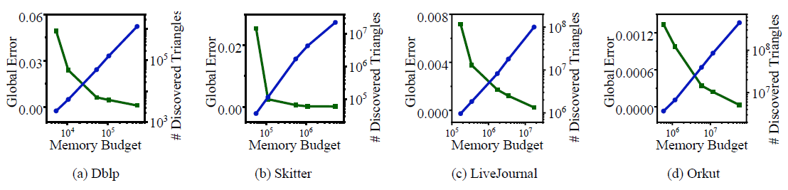
Reservoir-based method
State-of-the-art approaches
  TRIEST: first handle fully-dynamic graph streams
  WRS: employ temporal locality
  ThinkD: improve TRIEST by “Counting first then Sampling”
Accuracy
  affected by memory budget size
As the memory memory increases, global error decreases and the number of discovered triangles increases.
Notes:
State-of-the-art Reservoir-based approaches in recent years.
TRIEST is the first to handle fully-dynamic graph streams, which includes edge insertion and deletion.
WRS employs temporal locality to discover as many triangles as possible, which future edges are more likely to form triangles with recent edges than with older edges.
ThinkD further improves TRIEST by “counting first then sampling”, which leverages unsampled edges to update the estimations of triangles.
As shown in the experiment, the accuracy of reservoir-based method is mainly affected by memory budget size, along the scale of graph streams increase.

Slide 10
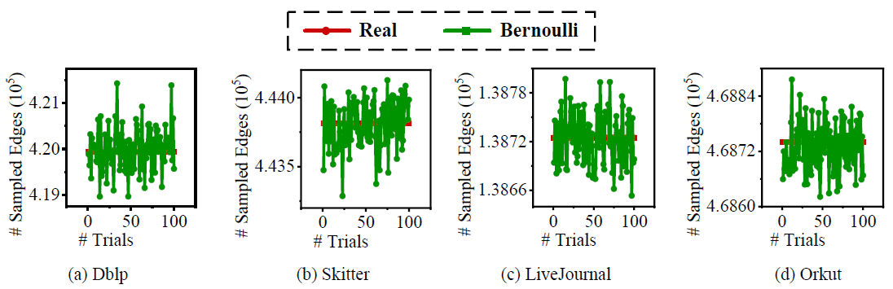
Bernoulli-based method
State-of-the-art approaches
  gSH: a sampling framework using different probabilities
  GPS: a sampling framework by setting different priority
  MASCOT: local triangle estimation
Consumed memory
  fluctuated around the real value
  affected by initial sampling probability
Notes:
State-of-the-art Bernoulli-based approaches in recent years.
gSH is sampling framework using different probabilities based on the graph properties of interest; for example, sample current arriving edge with probability p when it depends on previously sampled edges, otherwise holds the edge with probability q.
GPS utilizes different priority for sequentially sampling over graph streams.
MASCOT is the first one to count local triangles by the means of “unconditional counting before sampling”.
However, the sample size of Bernoulli-based sample fluctuates around the real value.
Therefore, it is difficult to allocate appropriate memory space for triangle counting over evolving graph streams.

Slide 11
Outline
Introduction
Related Work
Proposed Method
Experiments
Conclusions
Notes:
We will introduce proposed method in the third section, which counts triangles by adaptively resampling over evolving graph streams.

Slide 12
Observations
Scale of graph streams is unknown in advance
Evolving graph streams usually grow upwards
Limited main memory space
How to maintain an appropriate sampling ratio and how much memory space to allocate for accurate global and local triangle counting?
Notes:
We observed that: first the scale of graph streams is unknown in advance, and usually grow upwards, so the whole size of graph streams is large. On the contrary, the main memory space is limited.
Therefore, lead to new challenges for global and local triangle counting, that is to say, how to maintain an appropriate sampling ratio? and how much memory space to allocate for triangle counting?

Slide 13
Goals
Maintain a bounded-sampling-ratio
  achieve accurate and stable estimation of global and local triangle counting
Control Consumed memory budget
  improve the efficiency of memory usage
Develop single-pass streaming algorithm
  avoid multi-repeated and redundant operations
Process only in memory space
  no need to access slower secondary storage
Notes:
To solve the new challenges, the goals of our work are as follows.
First is to maintain a bounded-sampling-ratio, which can discover more triangles and achieve accurate and stable estimation of global and local triangle counting.
Second is to control Consumed memory budget. which can improve the efficiency of memory usage.
Then is single-pass streaming algorithms to avoid multi-repeated and redundant operations.
It’s also necessary that the process only in memory space, which is no need to access slower disk, thus can get rapid response for real-world applications.

Slide 14
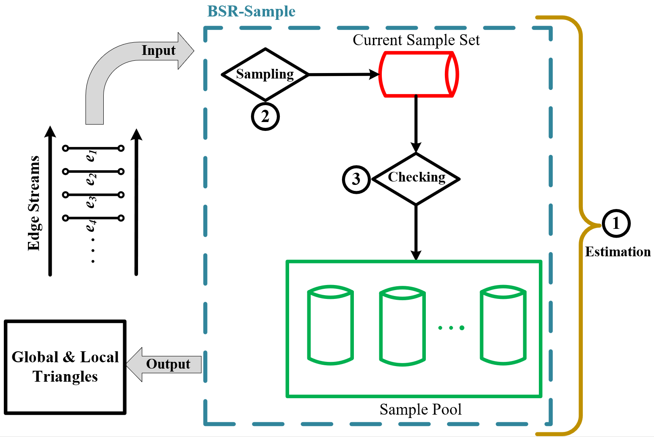
Overview
The framework of BSR-Sample & BSR-TC
Notes:
We propose the BSR-Sample (Bounded-Sampling-Ratio Sample) algorithm, which always maintain the sampling ratio greater than or equal to a specified sampling-ratio threshold, by leveraging multi-sets of Reservoir-based sample.
BSR-TC (BSR-Triangle Counting) uses the BSR-Sample method for triangle counting.
BSR-TC takes edge streams as the input, and outputs the count of global and local triangles; Consist of Estimation, Sampling and Checking.

Slide 15
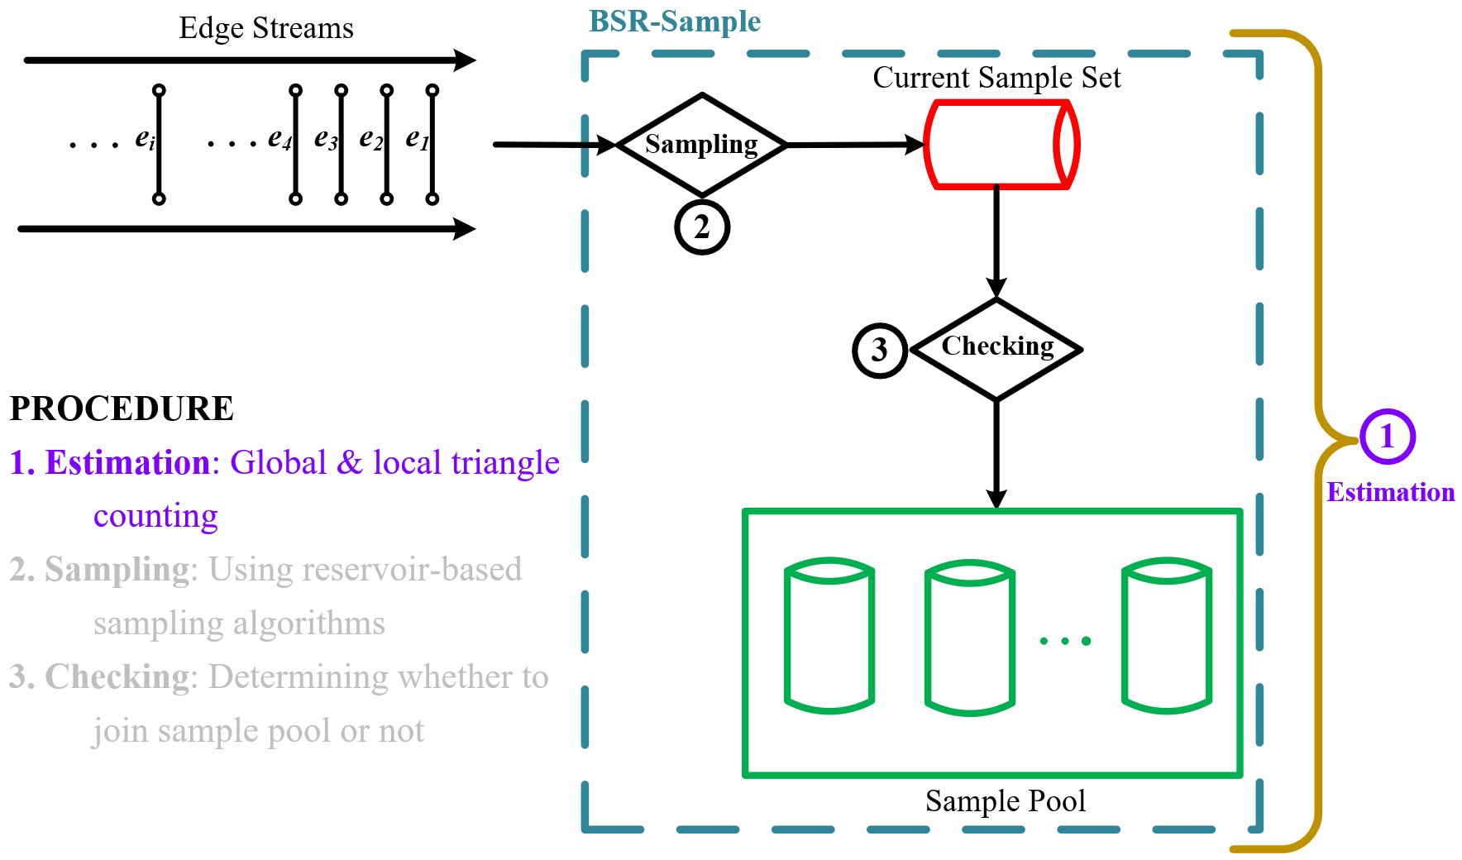
Estimation
The framework of BSR-Sample & BSR-TC
Notes:
The first step is to estimate global and local counting. Here, we use a mechanism called “first counting, then sampling”, which improves the estimation accuracy by leveraging more edges to participate in statistics analysis.

Slide 16
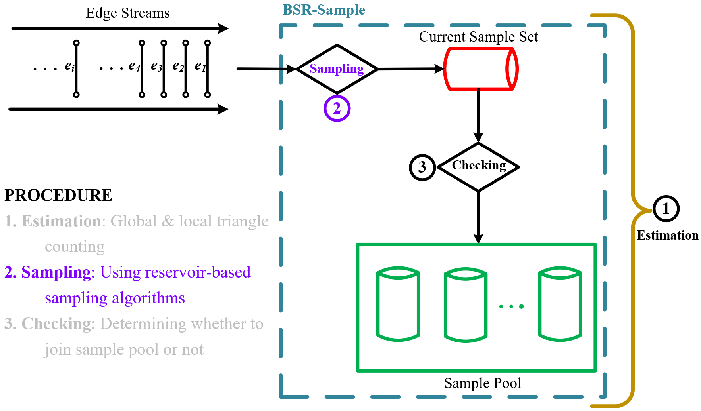
Sampling
The framework of BSR-Sample & BSR-TC
Notes:
The second step is sampling.
The whole sampling set of BSR-Sample is divided into two parts: the current sampling set and the sampling pool.
The former is used to maintain dynamically updated edges.
The sampling ratio of the current sampling set is always greater than the specified threshold. BSR-Sample will remove the sampled edges into sampling pool once it equals the threshold, and allocates new memory budget as the current sampling set.

Slide 17
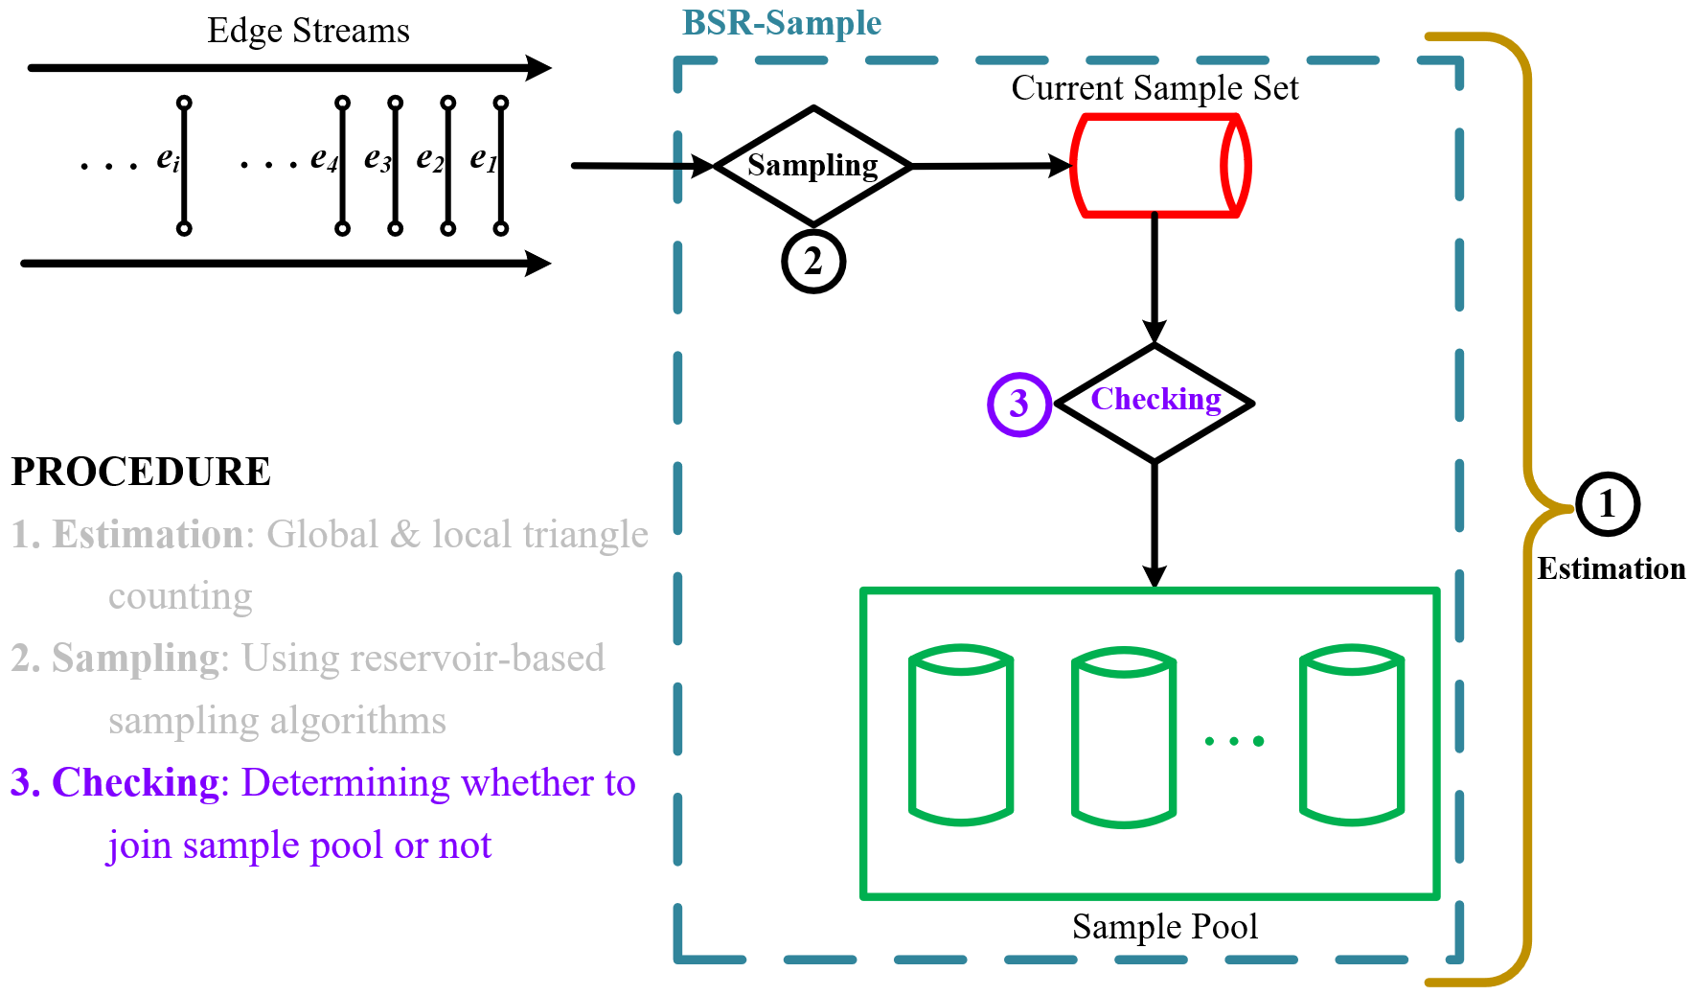
Checking
The framework of BSR-Sample & BSR-TC
Notes:
The third step is checking.
BSR-Sample determines whether to enable the current sampling set join into the sampling
pool.
When the sampling ratio of the current sampling set equals the specified sampling-ratio threshold, BSR-Sample will remove the entire current sampling set into sampling pool,
and then create a new sampling set to substitute for current sampling set.
Through adaptively incrementing the current sampling set, BSR-Sample is capable of keeping a bounded sample-ratio when the available memory is large enough.

Slide 18
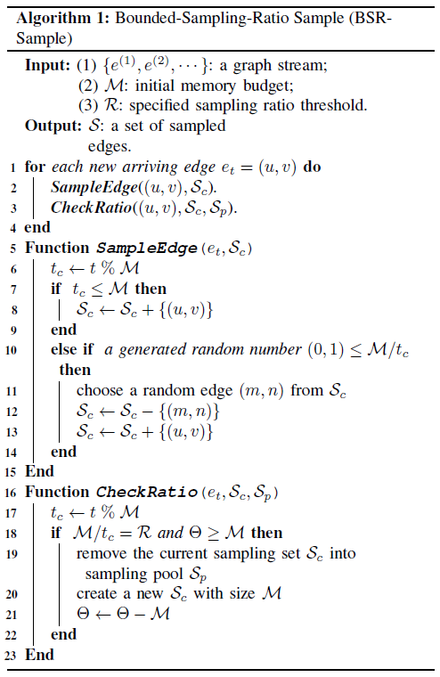
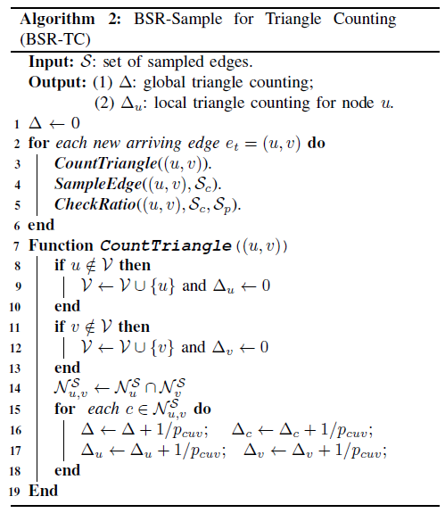
Algorithms
Notes:
Here are algorithms about BSR-Sample and BSR-TC in our work.

Slide 19
Outline
Introduction
Related Work
Proposed Method
Experiments
Conclusions
Notes:
The forth section is experiments for triangle counting in streaming graphs.

Slide 20
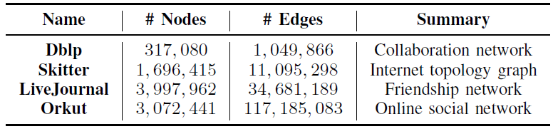


Evaluation
Platforms
  A server with Intel Xeon Gold 6148 processors
  64-bit Red Hat Linux OS
Datasets
  4 real-world graph datasets
Baseline
  Three state-of-the-art triangle counting algorithms: WRS, MASCOT and ThinkDAcc
Metrics
  Global error
  Local Error
Notes:
In our experiments,
The platforms: we use a server with Intel Xeon Gold, Red hat Linux OS.
We adopt four real-world graph datasets to simulate graph streams.
Baseline is three state-of-the-art triangle counting algorithms: WRS, MASCOT and ThinkDAcc
And we use the two formulas to calculate global and local error.

Slide 21
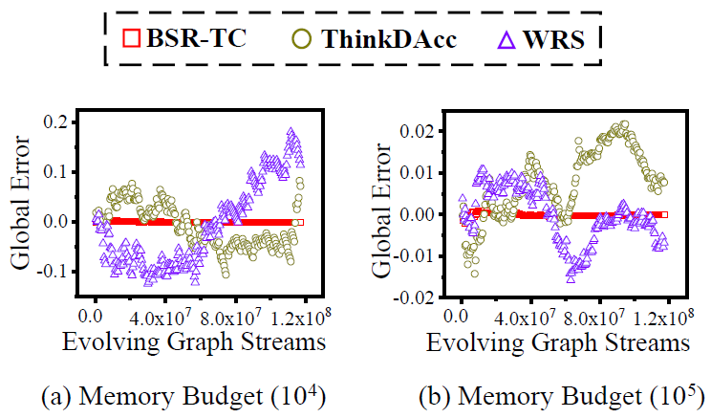
Scalability
Maintain accuracy over evolving graph streams
  BSR-TC has unbiased estimates
  BSR-TC keeps stable
Notes:
Scalability (BSR-TC maintains accuracy over evolving streams)
As shown in Figure (a and b), when initial memory budget is fixed, the global errors of both ThinkDAcc and WRS fluctuate as graph streams evolves, while BSR-TC is almost always equal to zero.
This is because the memory budget of ThinkDAcc and WRS is fixed and is difficult to set appropriately without any knowledge about the scale of graph streams.
Our proposed BSR-TC can keep stable and high accuracy by the adaptively resampling method over evolving graph streams.

Slide 22
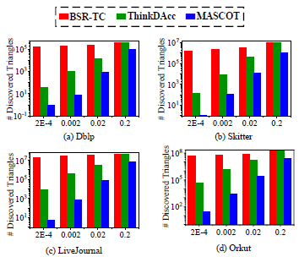
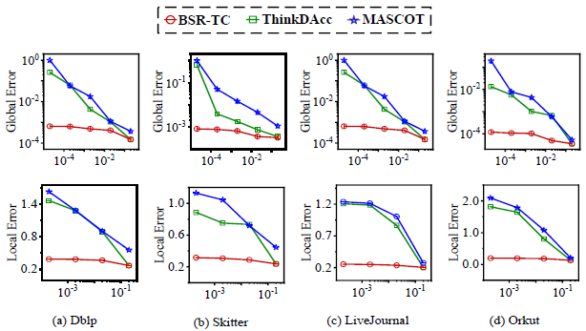
Accuracy
Estimation Errors
  BSR-TC discovers orders of magnitude more triangles
  BSR-TC reduces both global and local errors
Notes:
Accuracy (regardless of small initial memory budget).
Left Figure shows proposed BSR-TC discovers more triangles than ThinkDAcc and MASCOT by adaptively resampling method, over different initial memory budget.
{ By sampling the first arriving edges in memory budget with probability 1, ThinkDAcc always discovers more triangles than MASCOT. }
Right Figure depicts that BSR-TC achieves accuracy of at least 99.8%(percent) for global triangles and 60.0%(percent) for local triangles,
respectively, when sampling ratio threshold is 20%(percent) . Under this condition, BSR-TC gains accuracy of global triangles more than 100 time better than ThinkDAcc.
Therefore, our proposed BSR-TC can maintain high accuracy by adaptively incrementing memory budget to maintain a bounded sampling ratio over the growth of graph streams.

Slide 23
Outline
Introduction
Related Work
Proposed Method
Experiments
Conclusions
Notes:
In the last section, we conclude our work

Slide 24
Conclusions
Method: novel and general sampling
  Adaptively resampling
  Sampling ratio is always ≥ user-specified one
  without any prior knowledge about graph streams
Algorithms: global and local triangle counting
  BSR-Sample(Bounded-Sampling-Ratio Sample)
  BSR-TC(Bounded-Sampling-Ratio for triangle counting)
Analyses: scalability and accuracy
  BSR-TC has accurate and unbiased results
Notes:
First, we introduce a novel and general sampling method. It can adaptively re-sample, ensure sampling ratio is always greater than or equal to a user-specified threshold, without knowing any prior knowledge about graph streams.
Then, we propose global and local triangle counting algorithms, BSR-Sample and BSR-TC for triangle counting.
Finally, we analyze the scalability and accuracy, and experiments show BSR-TC has accurate and unbiased results.

Slide 25
Thanks!
Notes:
Thanks for your attention. My presentation is finished/over new. Has anyone any questions?

