Slide 1

DTC: Real-Time and Accurate Distributed Triangle Counting in Fully Dynamic Graph Streams
Wei Xuan, Yan Liang, Huawei Cao, Ning Lin,
Xiaochun Ye and Dongrui Fan
Institute of Computing Technology,
Chinese Academy of Sciences, China
Notes:
Good afternoon, my name is Wei XUAN, come from Institute of computing technology, Chinese academy of sciences.
It’s my honor to share our recent work here, which entitled “DTC: Real-Time and Accurate Distributed Triangle Counting in Fully Dynamic Graph Streams”.

Slide 2



Outline
Background and Related Work
Proposed Solution
Experiments and Conclusions
Notes:
I will present this work in three sections. The first section covers the background and related work. Then is our proposed solution. Lastly, I will discuss the experiments and conclusions.

Slide 3
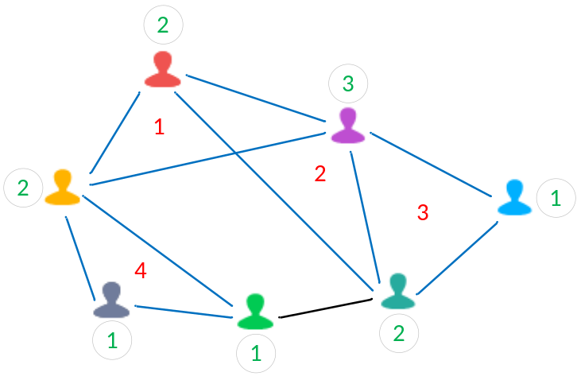
Triangles in Graphs
Graphs are ubiquitous
  A mathematical model depicting relationships between entities.
  A vertex symbolizes an entity, and an edge denotes a relation between entities.
  Applied across diverse domains including social networks, e-commerce networks, traffic networks.
Triangles comprise three pairwise interconnected edges
  A fundamental primitive in graph mining.
  Global triangles involve three nodes connected to each other.
  Local triangles form around individual vertices.
  Important metrics include clustering coefficient and transitivity ratio.
Notes:
Graphs are widespread, serving as a mathematical model that depicts relationships between entities. In this model, a vertex represents an entity, while an edge signifies a relation between entities. Graphs find application across diverse domains such as social networks, e-commerce networks, and traffic networks.
Triangles, consisting of three pairwise interconnected edges, are a fundamental primitive in graph mining. Global triangles involve three nodes interconnected to each other, while local triangles are formed around individual vertices. Key metrics include the clustering coefficient and transitivity ratio.

Slide 4








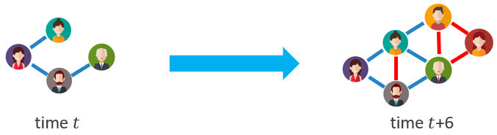
Evolving Graph Streams
They consist of a sequence of edges continuously generated from the real world
Exhibit full dynamism with edge insertions & deletions, topological structural changes.
Vast in scale, continuously expanding, and evolving dynamically without any prior predefined order.
Time sensitivity is paramount, necessitating real-time feedback for processing outcomes.
Edge sequence of a streaming graph
Evolution of graph's topological structure
4
Notes:
Evolving graph streams are characterized by a sequence of edges continually generated from real-world sources. These streams exhibit full dynamism, involving edge insertions and deletions along with topological structural changes. They are vast in scale, continuously expanding, and dynamically evolving without any predefined order. Time sensitivity is crucial in handling these streams, requiring real-time feedback for processing outcomes.
The first figure illustrates the edge sequence of a streaming graph, while the second figure depicts the evolution of the graph's topological structure.

Slide 5
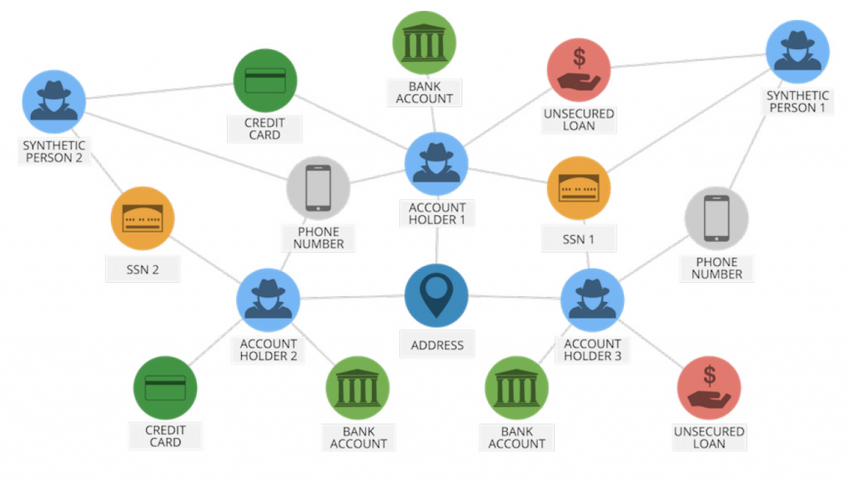
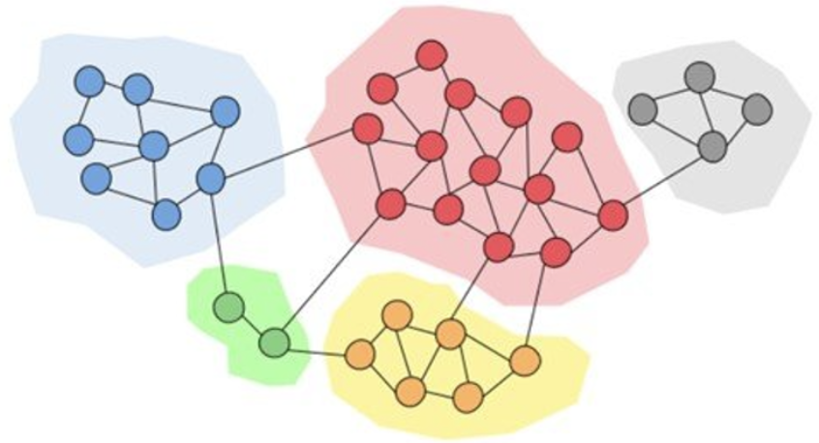
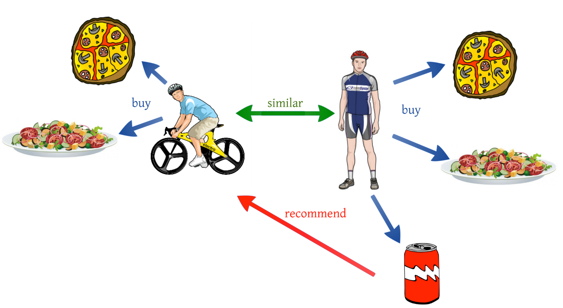
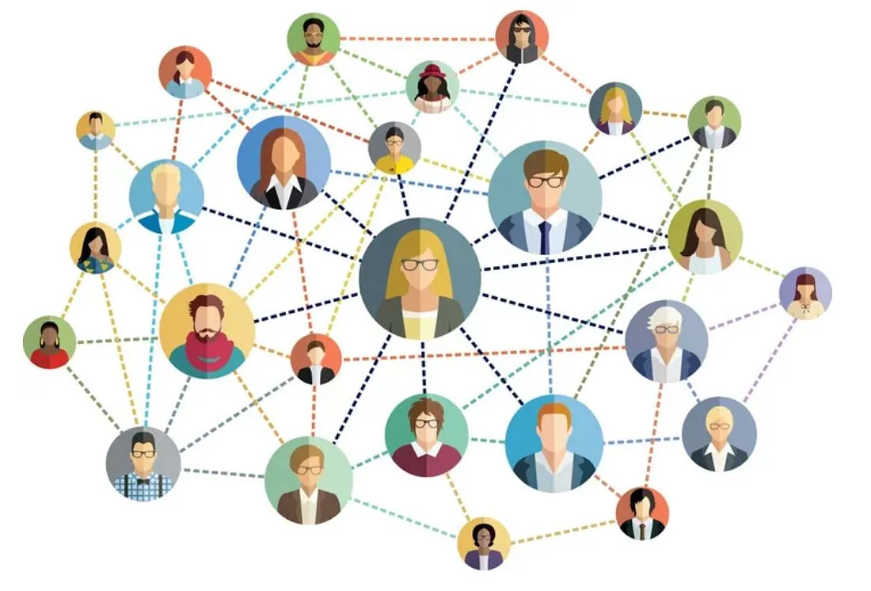
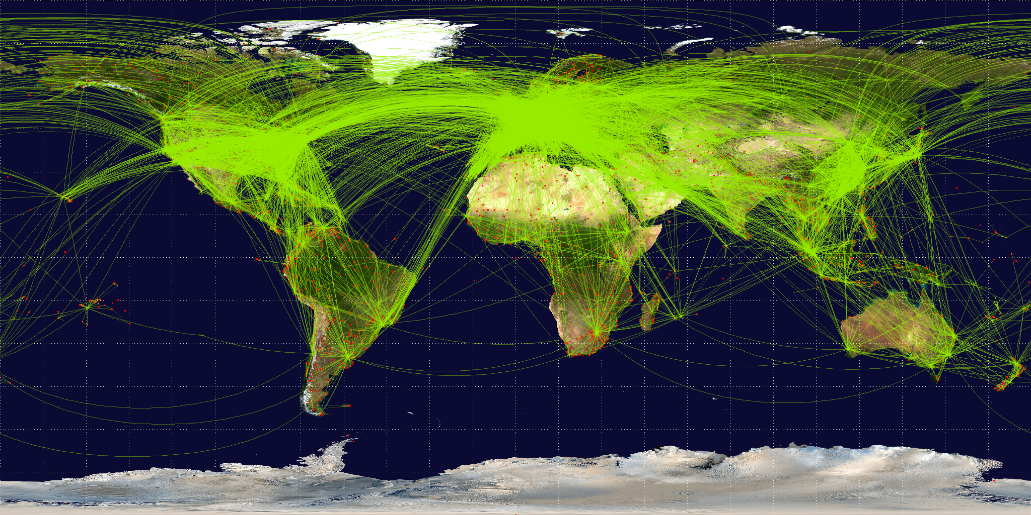

Ubiquitous Applications of Triangle Counting
Financial Fraud Detection
Community Discovery
Recommended System
Social Network Analysis
World Airline Routemap
Spam Detection
Notes:
Triangle counting holds significant importance across diverse domains such as financial fraud detection and community discovery to recommendation systems, social network analysis, world airline route maps, and spam detection.

Slide 6

Challenges in Streaming Graphs
Real-world graphs are vast in scale, and continually expanding
Lack of prior knowledge over evolving graph streams
Constrained primary memory capacity for real-time analysis
Given these challenges, exact counts of global and local triangles by storing the entire graph streams in memory becomes practically impossible.
Current research has focused on streaming algorithms that employ sampling approaches for obtaining approximate triangle counts.
Notes:
Real-world graphs are vast in scale, constantly expanding, and present a lack of prior knowledge regarding evolving graph streams. Furthermore, there is a constraint on primary memory capacity for real-time analysis.
In light of these challenges, achieving exact counts of global and local triangles by storing the entire graph streams in memory becomes practically infeasible. Consequently, current research has shifted into streaming algorithms that use sampling approaches to obtain approximate triangle counts.

Slide 7
Streaming Algorithms
Sampling Methods
Reservoir-based sampling employs a fixed-size storage budget to store sampled edges for triangle counting
Bernoulli-based sampling: sample every edge with a same probability
Resource Utilization
Single-machine streaming algorithms
Multi-machine distributed streaming algorithms
Processing Capability
Handle insertion-Only edge streams
Handle fully dynamic streams
Notes:
Streaming Algorithms can be classified by three main types, including Sampling Methods, Resource Utilization, and Processing Capability.
Sampling Methods encompass Reservoir-based sampling, which utilizes a fixed-size storage budget for storing sampled edges used in triangle counting, and Bernoulli-based sampling, which samples every edge with the same probability.
Resource Utilization includes Single-machine streaming algorithms and Multi-machine distributed streaming algorithms. Processing Capability involves managing insertion-only edge streams and handling fully dynamic streams.

Slide 8
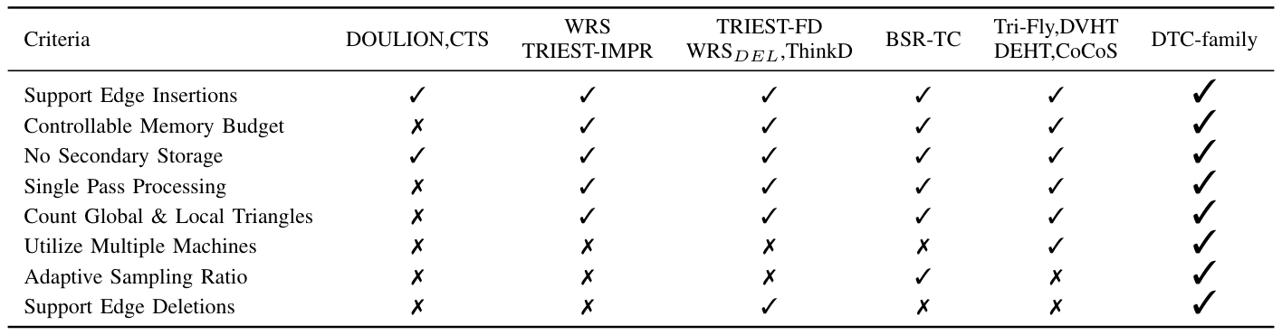
Comparative Analysis of Current Research
Single-machine streaming algorithms, such as Reservoir-based sampling methods and Bernoulli-based sampling ones, operate solely on a single machine by employing various sampling techniques to approximate triangle counts.
However, existing distributed streaming algorithms are limited to handling edge insertions and require prior knowledge of the entire graph stream size to set appropriate parameters for accurate estimation.
Our proposed DTC-family, a suite of streaming algorithms designed for counting global and local triangles in fully dynamic graph streams, encompassing both edge insertions and deletions.

Slide 9
Outline
Background and Related Work
Proposed Solution
Experiments and Conclusions
Notes:
The second section is about our proposed solution

Slide 10
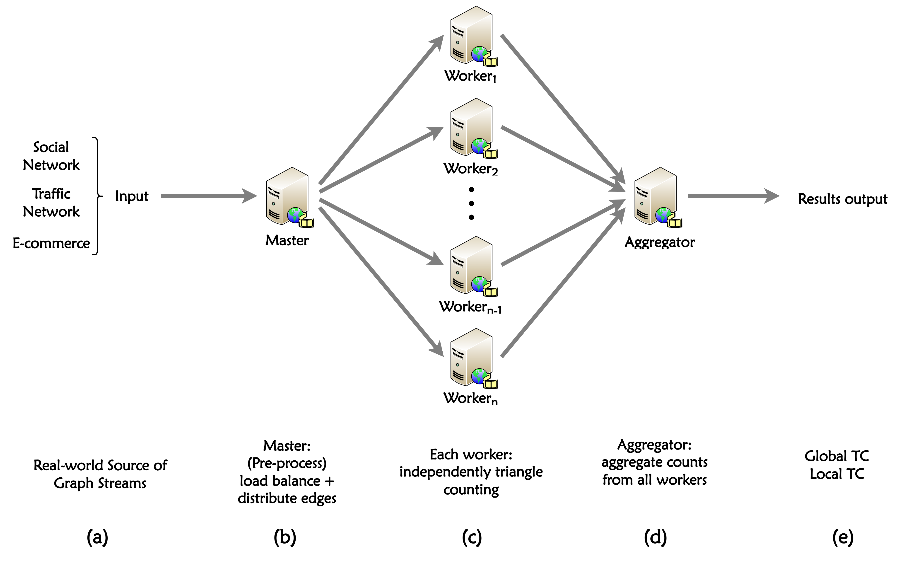
Architecture of Distributed Streaming Algorithms
Input
Real-world source of graph streams, such as social network, traffic network, e-commerce
Master-Workers-Aggregator (MWA)
Master: load balancing and edge distribution
Worker: streaming algorithm for triangle counting
Aggregator: aggregate the results from all workers
Output
results of global and local counts
Notes:
This figure depicts the architecture of distributed streaming algorithms.
The inputs are real-world graph streams, such as social network, and traffic network. It includes Master-Workers-Aggregator, where the Master is responsible for load balancing and efficient edge distribution among the workers, the Workers Execute streaming algorithms for triangle counting within the distributed system, the Aggregator accumulates the results from all workers. The output includes global and local triangle counts derived from the graph streams.

Slide 11
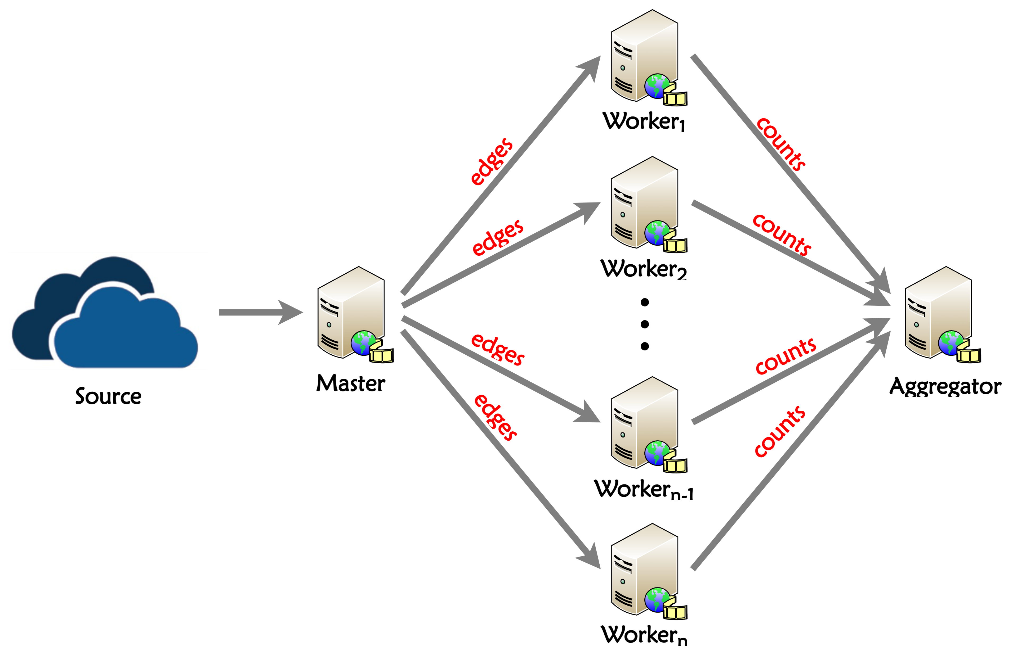
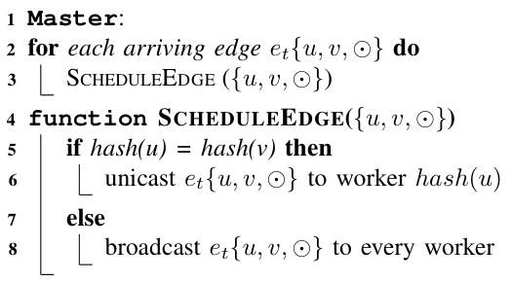
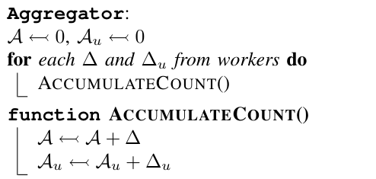
Proposed DTC-family
Distributed Triangle Counting with Adaptive Resampling (DTC-AR)
achieves high accuracy by an adaptive sampling ratio method
eliminates the need for prior knowledge about the graph streams
Distributed Triangle Counting in Fully Dynamic Graph Streams (DTC-FD)
considering edge insertions and deletions across multiple machines
Notes:
The algorithm pseudo-code on the left represents the Master, which determines the scheduling method based on the hash values of the two vertices of each edge. On the other side, the pseudo-code represents the Aggregator, responsible for real-time updates on global and local triangle counting.
Our Proposed DTC-family comprises two key algorithms: DTC-AR and DTC-FD. Distributed Triangle Counting with Adaptive Resampling (DTC-AR) achieves remarkable precision through an adaptive sampling ratio method, eliminating the necessity for prior knowledge about the graph streams. Distributed Triangle Counting in Fully Dynamic Graph Streams (DTC-FD) accounts for edge insertions and deletions across multiple machines.

Slide 12
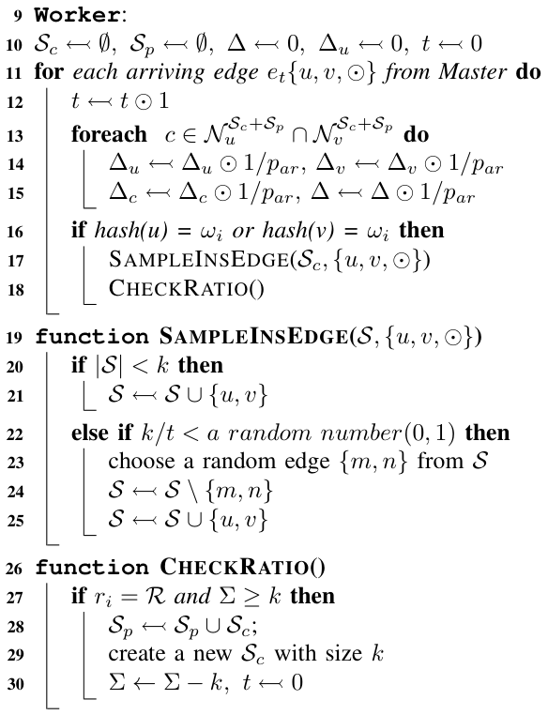
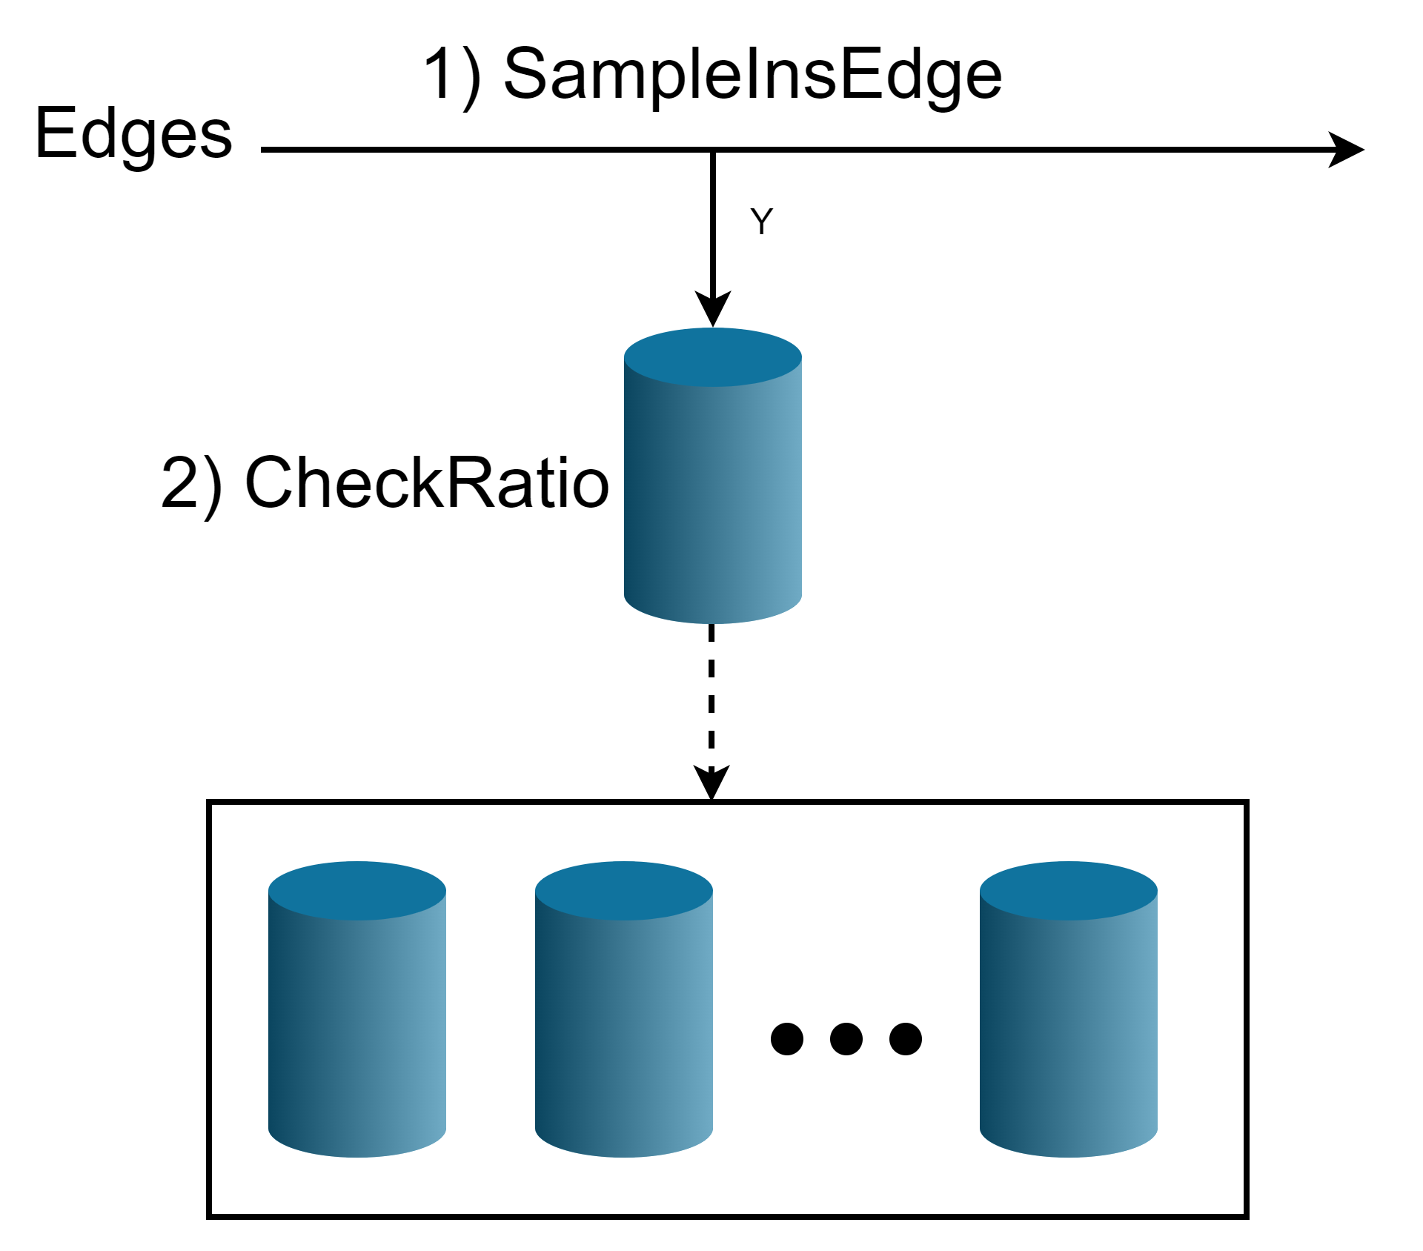
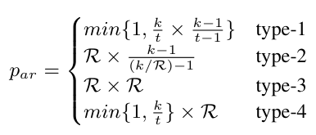
Proposed DTC-AR
Distributed Triangle Counting with Adaptive Resampling (DTC-AR)
Incremental sample maintenance
Preserve Sampling Fairness
Efficient Resource Utilization
Avoid external storage access
Single-pass streaming algorithm
Notes:
Distributed Triangle Counting with Adaptive Resampling (DTC-AR) incorporates the following characteristics: Incremental sample maintenance, Preservation of Sampling Fairness, Efficient Resource Utilization, Avoidance of external storage access, and Single-pass streaming algorithm.
The algorithm on the right shows the process of each worker, mainly including two functions: sampleInsEdge and CheckRatio. The below diagram vividly illustrates the worker's workflow, enabling adaptive adjustment of sampling accuracy through Incremental sample maintenance. Upon sampling an edge, the triangle count initiation begins updating.

Slide 13
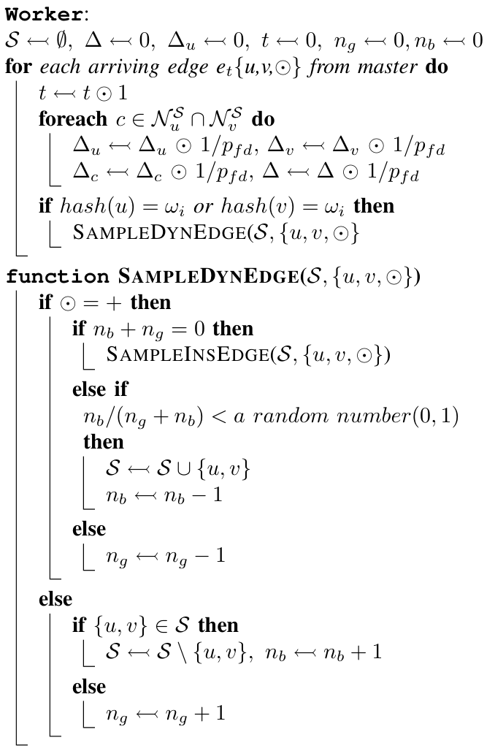
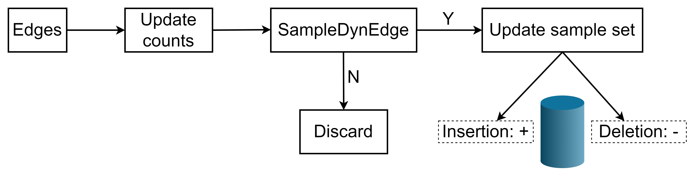
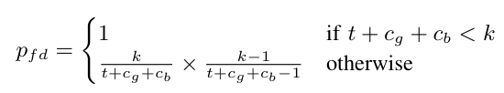
Proposed DTC-FD
Distributed Triangle Counting in Fully Dynamic Graph Streams (DTC-FD)
Support fully dynamic graph streams using future edge insertions to compensate for previous deletions
Single-pass streaming algorithm
Notes:
Distributed Triangle Counting in Fully Dynamic Graph Streams (DTC-FD) include the following features: Supporting fully dynamic graph streams by utilizing future edge insertions to offset prior deletions; Employing a single-pass streaming algorithm.
The pseudo-code on the right represents the worker for DTC-FD. Within it, the function SampleDynEdge is responsible for sampling in fully dynamic graph streams, handling edge insertions and deletions. The diagram below illustrates the processing flow of DTC-FD. Upon the arrival of edges in the graph streams, triangle counts are updated, followed by a decision based on SampleDynEdge on whether to update the sample set.

Slide 14
Outline
Background and Related Work
Proposed Solution
Experiments and Conclusions
Notes:
The final section comprises experiments and conclusions

Slide 15
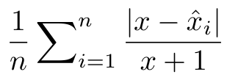
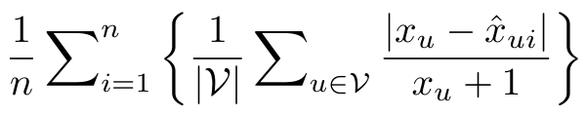
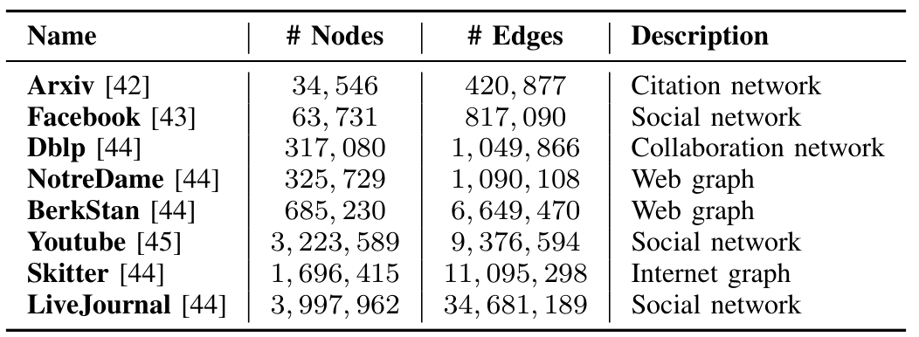
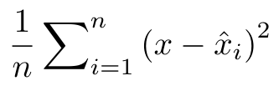
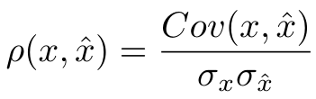
Evaluation Setup
Platforms
  A server with Intel Xeon Gold 6148 CPU @2.40GHz
  Using C++ and MPICH implement distributing algorithms
Datasets
  8 real-world graph datasets
  Preprocess to remove all parallel, self-loop and directed edges
  Produce fully dynamic graph streams by randomly deleting and relocating
Implemented algorithms
  Single-machine algorithms: TRIEST-IMPR, MASCOT, ThinkDAcc, TRIEST-FD, MASCOT-FD
  Distributed algorithms: CoCoS, DTC-AR, DTC-FD
  Metrics
  Evaluate the accuracy and performance over real-world datasets by the following measurable metrics:
①
Mean Global Error
②
Mean Local Error
③
Global variance
④
Pearson Correlation Coefficient
Notes:
We conducted the evaluation using the Intel server and implemented distributing algorithms using C++ and MPICH. Preprocessing 8 real-world graph datasets by removing parallel, self-loop, and directed edges, ultimately generating fully dynamic graph streams through random edge deletion and relocation. The evaluation includes a range of algorithms designed for single-machine and distributed environments. We employ metrics like mean global error, mean local error, global variance, and Pearson correlation coefficient to evaluate accuracy and performance.

Slide 16




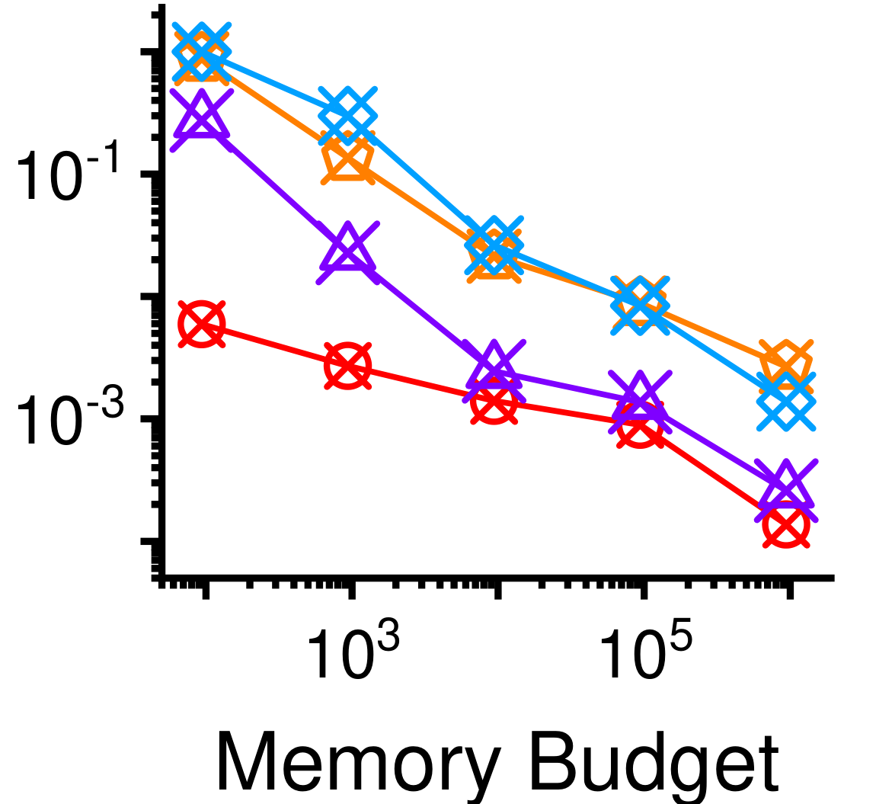
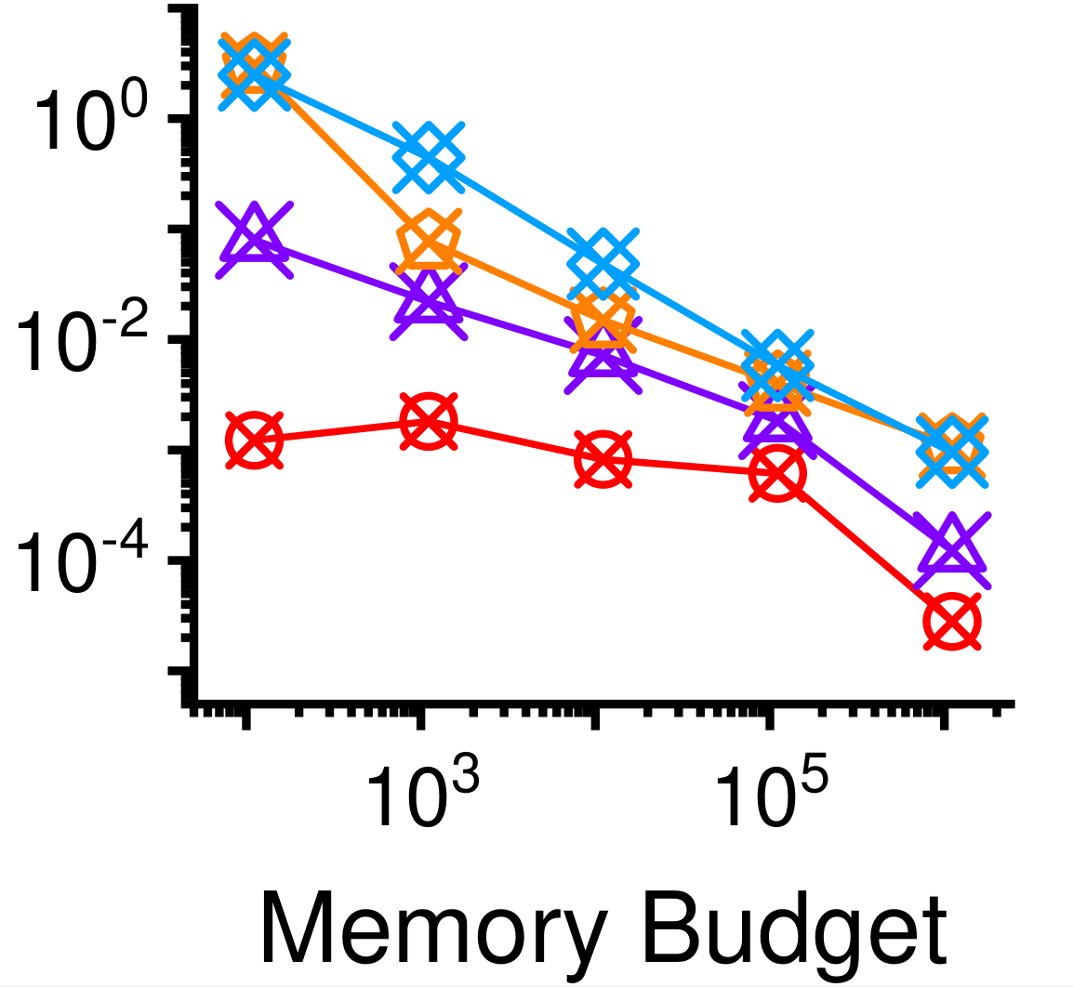
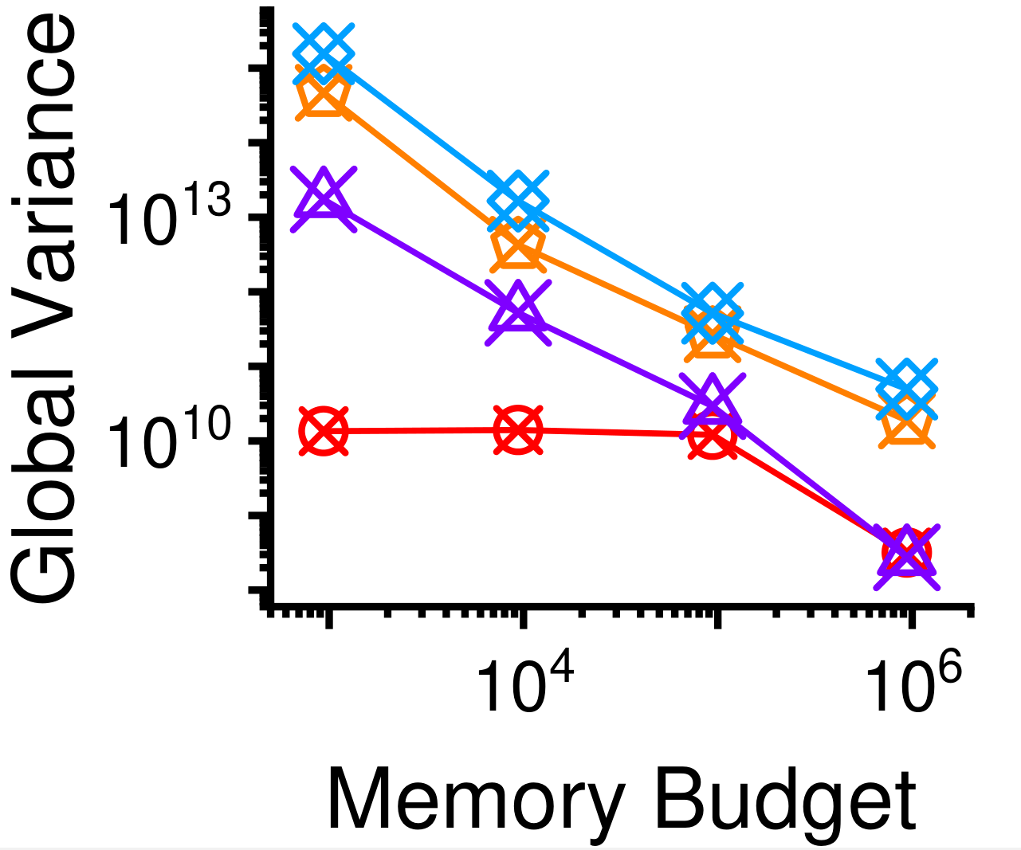
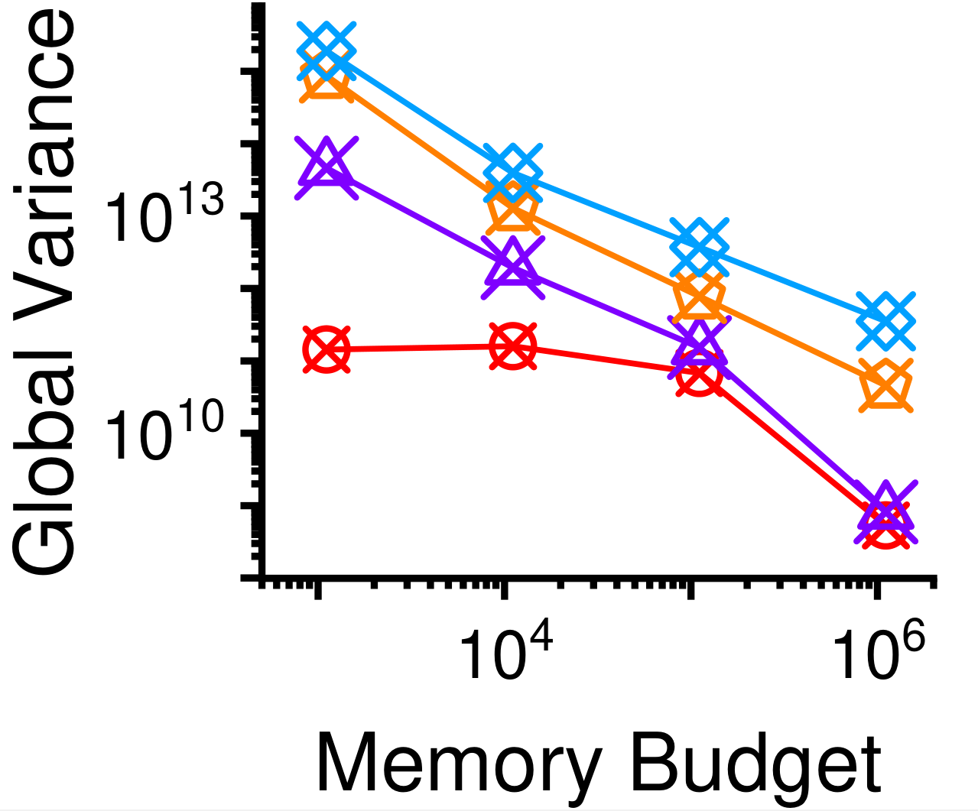
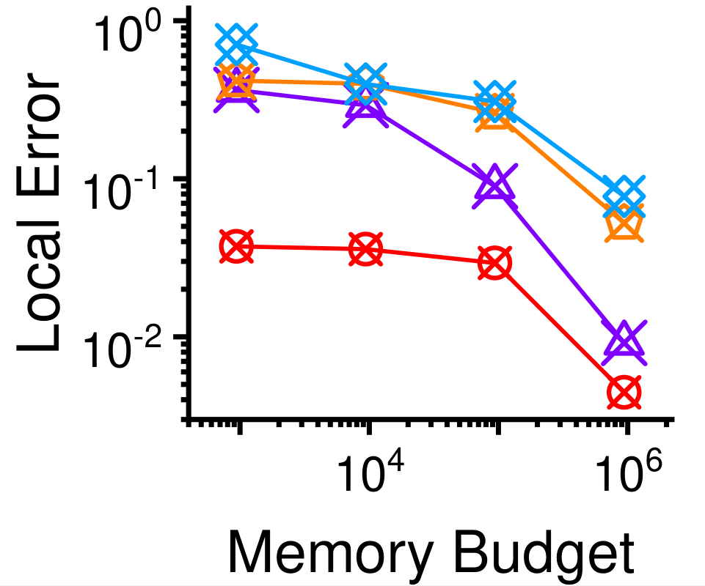
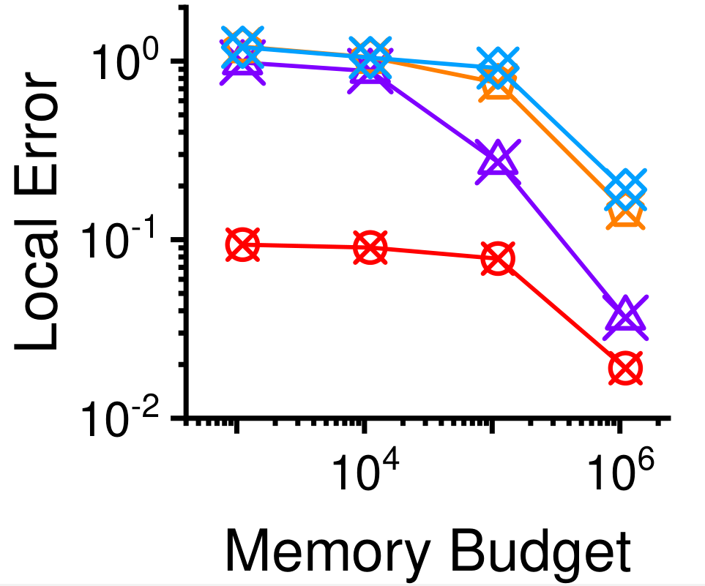
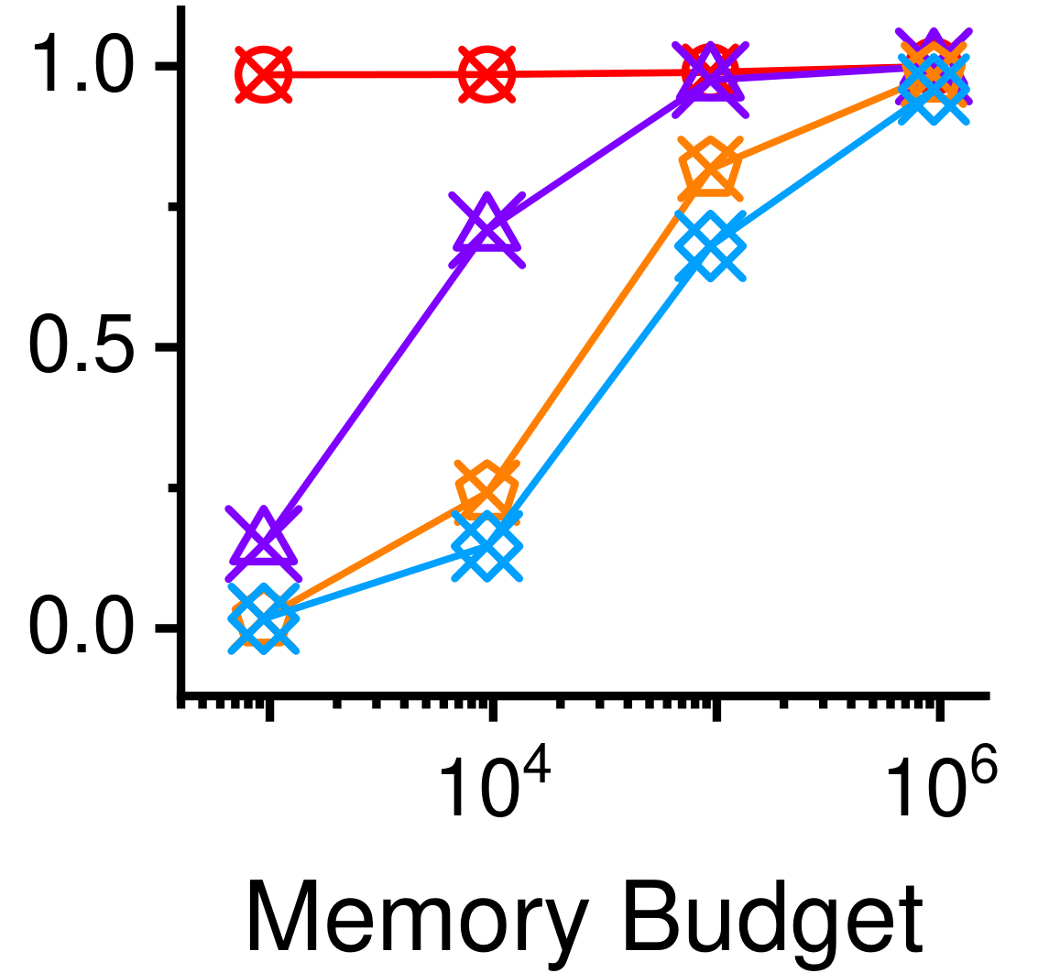
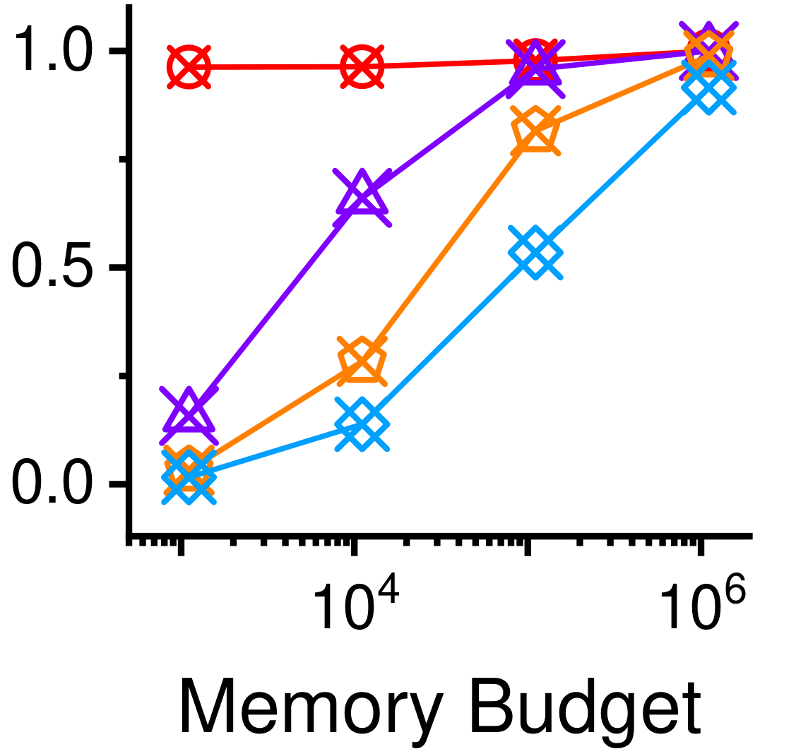
DTC-AR: Accuracy
Global Error (lower is better)
Global Variance (lower is better)
Set a large range of variation for the storage budget to simulate the variability in the size of graph streams.
Youtube
Skitter
Youtube
Skitter
Local Error (lower is better)
Pearson Coefficient (higher is better)
DTC-AR demonstrates significantly enhanced accuracy and speed compared to others.
Youtube
Skitter
Youtube
Skitter
Notes:
By setting a large range of storage budget variations to simulate the fluctuating sizes of graph streams, DTC-AR demonstrates notably improved accuracy and speed compared to its counterparts, such as CoCoS, TRIEST-IMPR and MASCOT.

Slide 17
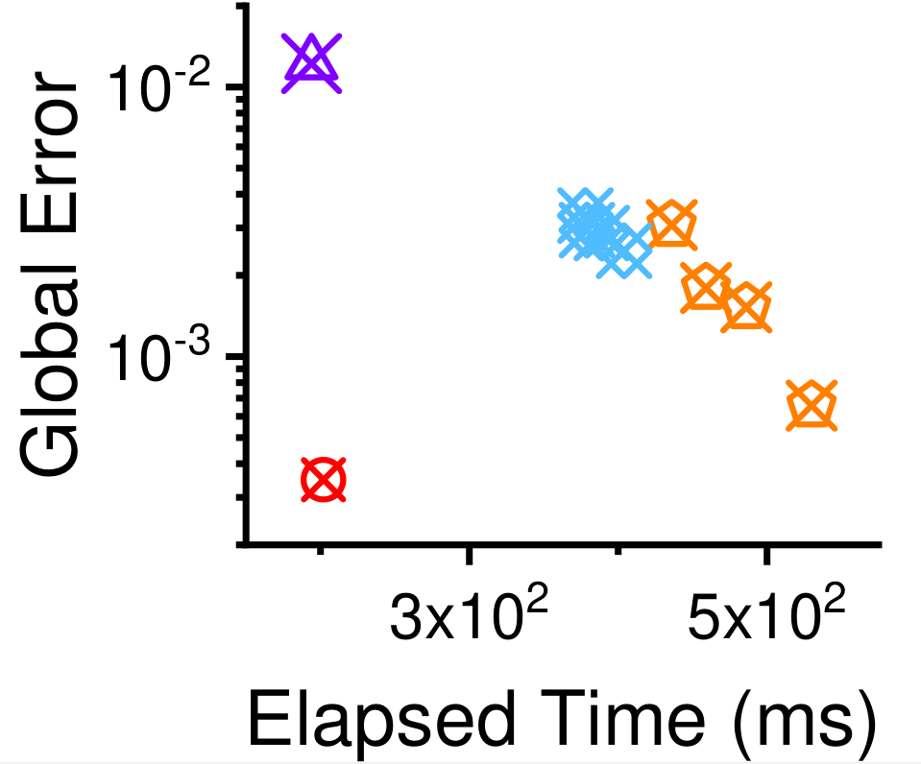
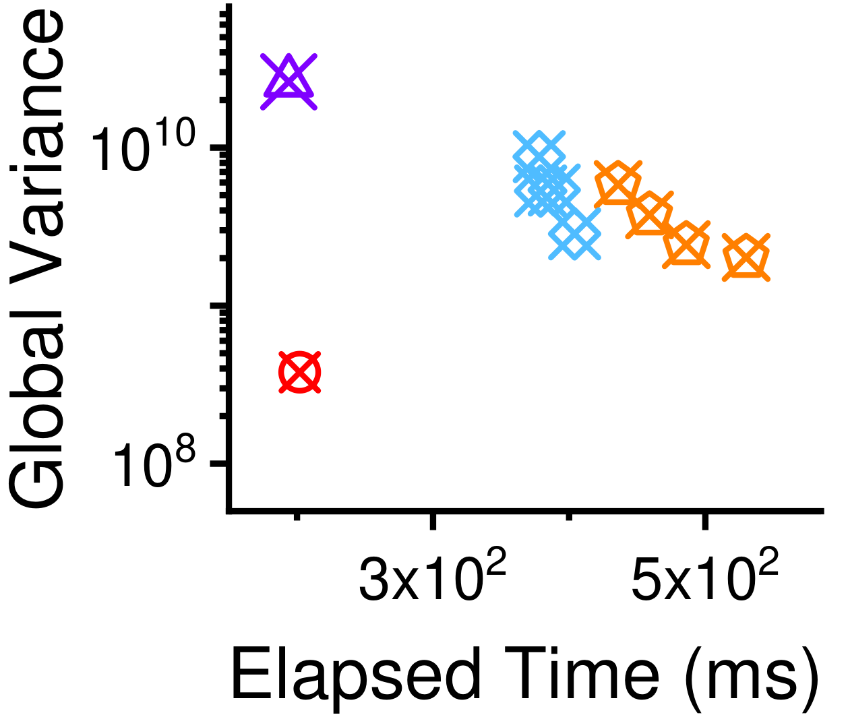
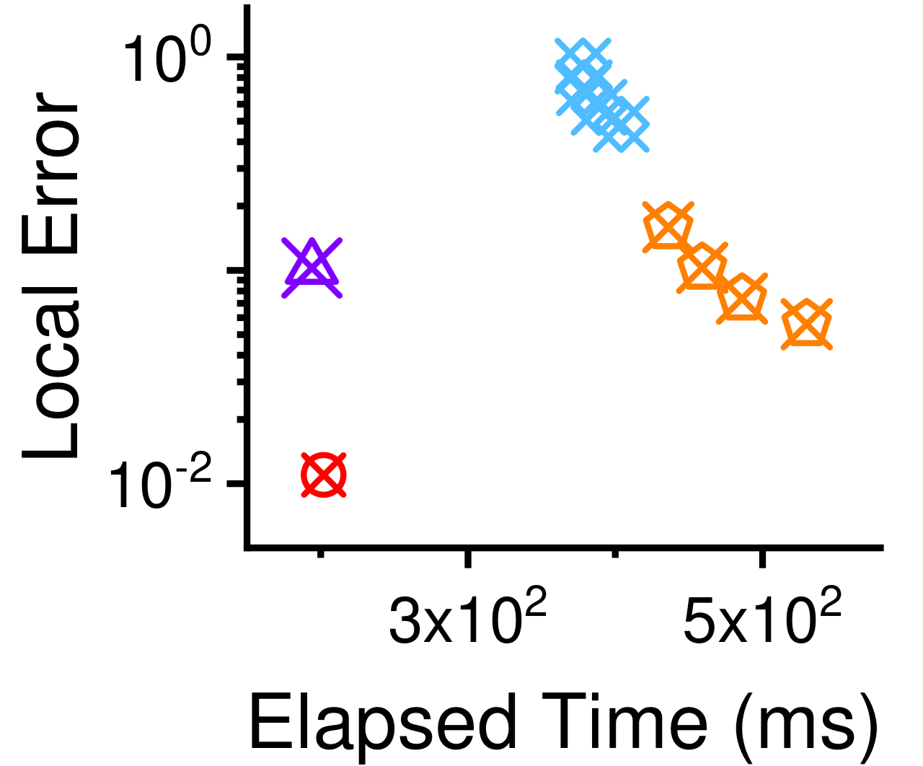
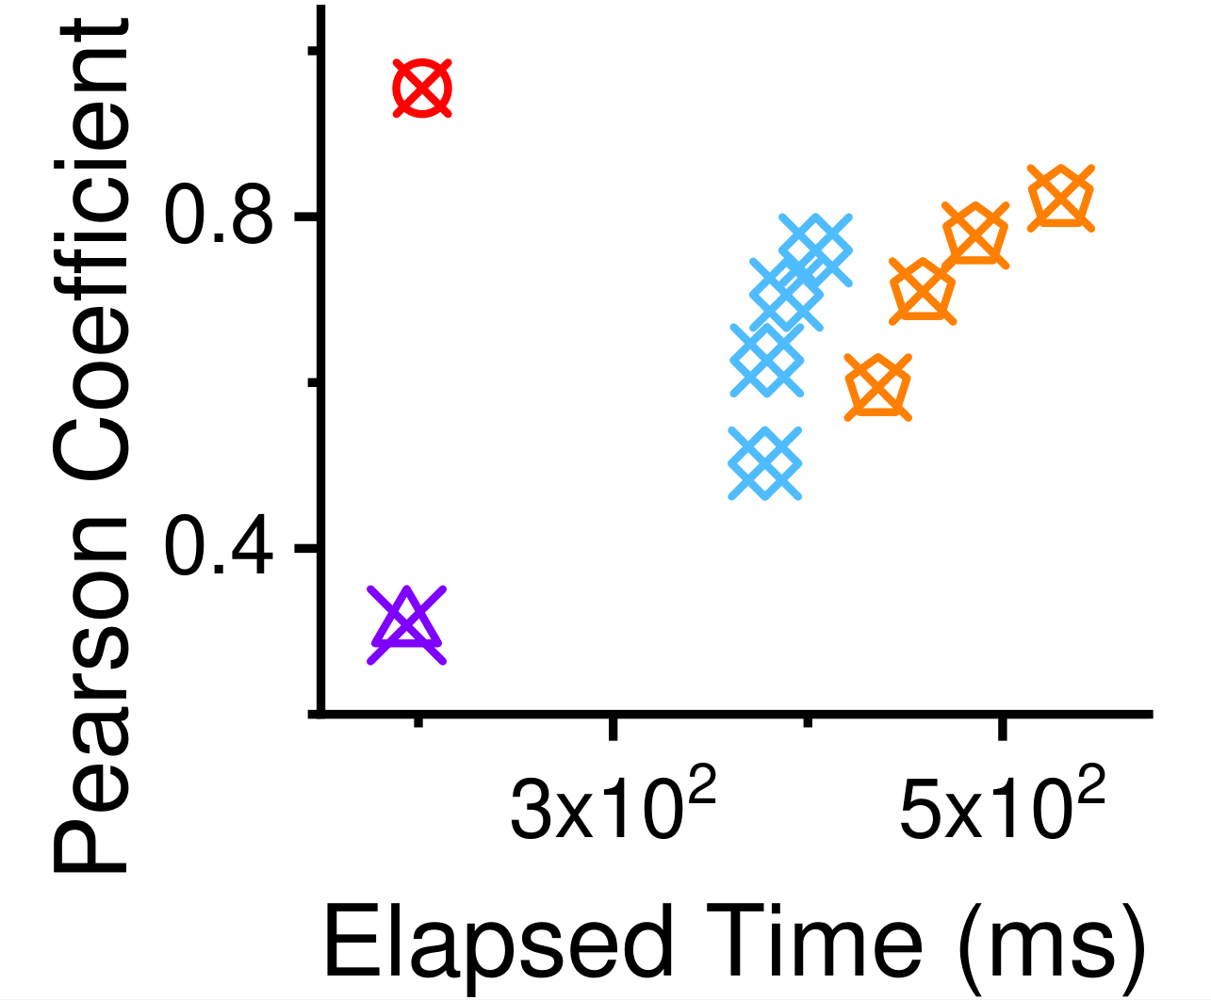
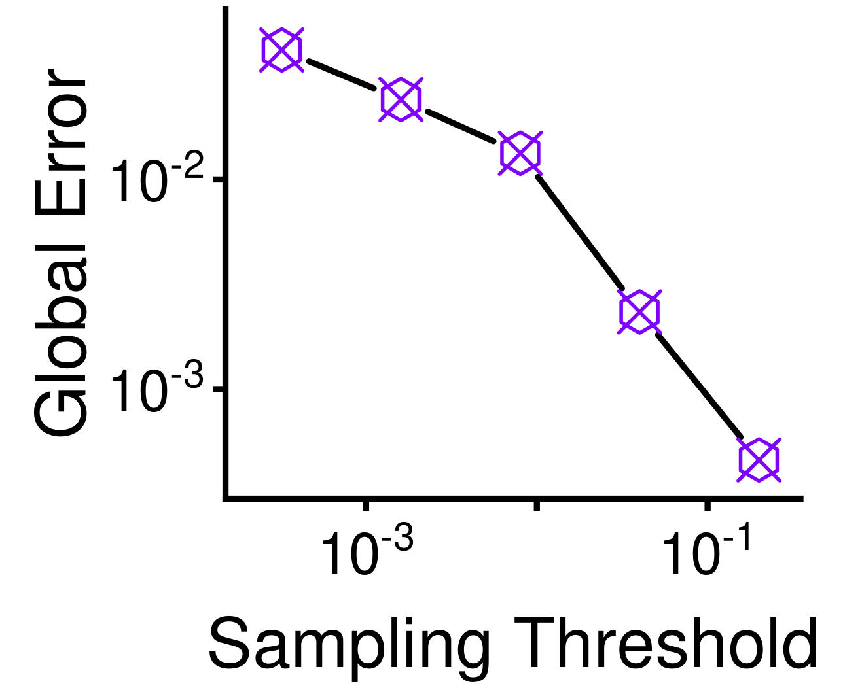
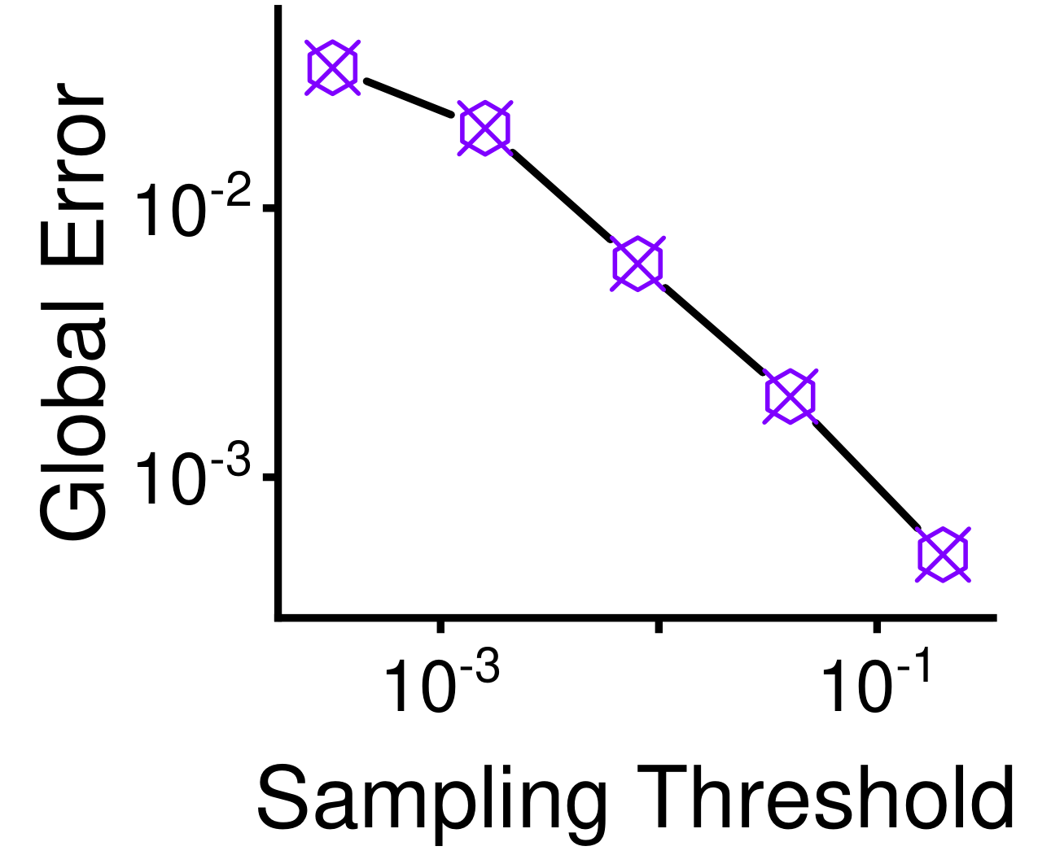
DTC-AR: Speed and Scalability
The number of workers was 10, only stored 0.1% of graph dataset Dblp in distributed settings.
The storage budget of TRIEST-IMPR: 2% to 5% of the number of edges.
The sampling probability of MASCOT is from 2% to 5%.
DTC-AR yielded best trade-off between speed and accuracy comparing with TRIEST-IMPR and MASCOT.
DTC-AR achieved up to 35.0× more accuracy than CoCoS in terms of global error, when they consumed similar time.
The scalability of DTC-AR is directly proportional to the sampling threshold in graph streams, ensuring efficient performance as the threshold increases.
berkStan
youtube
Notes:
With 10 workers and storing only small storage budget of the graph dataset Dblp in distributed settings, DTC-AR outperformed CoCoS, TRIEST-IMPR and MASCOT by achieving the optimal trade-off between speed and accuracy. Notably, DTC-AR demonstrated a remarkable 35.0× increase in accuracy over CoCoS in terms of global error while maintaining similar processing times. Furthermore, the scalability of DTC-AR is directly proportional to the sampling threshold in graph streams, ensuring efficient performance as the threshold value increases.

Slide 18
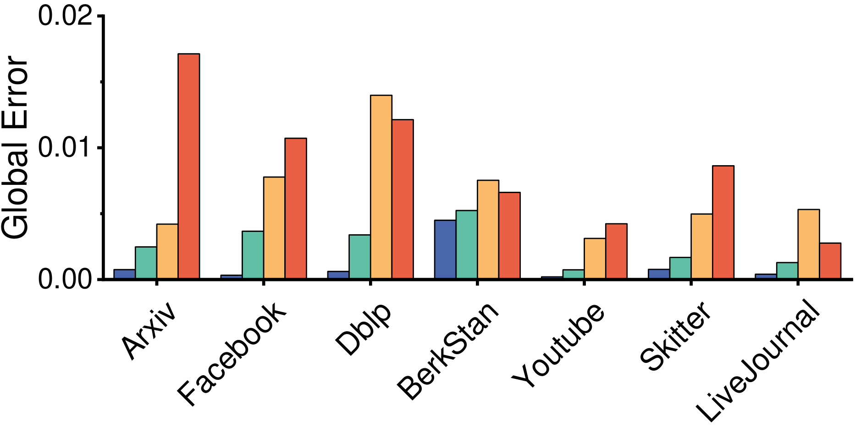
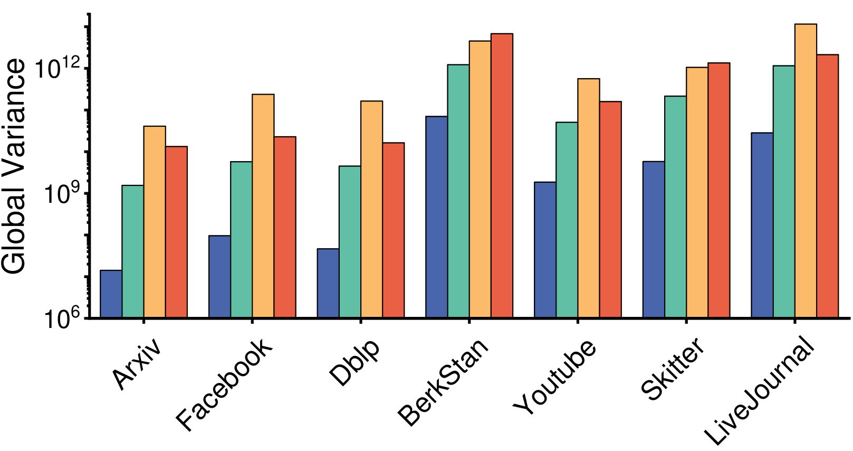
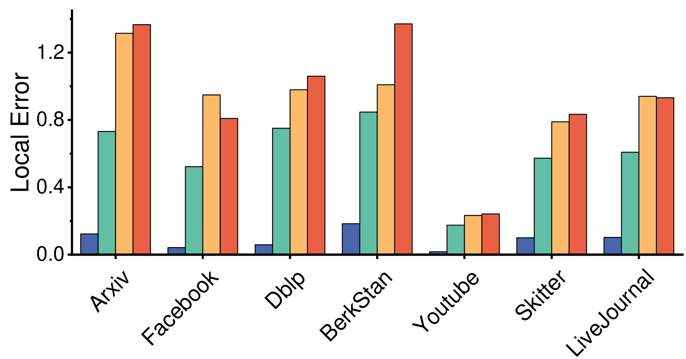
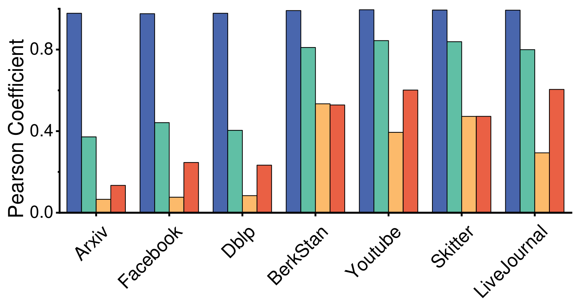
DTC-FD: Accuracy
DTC-FD demonstrates significantly higher accuracy compared to MASCOT-FD, achieving up to 32.5× and 19.3× improvement in global error and local error, respectively.
Additionally, DTC-FD outperforms ThinkDAcc with up to 109.7× improvement in global variance and 2.6× improvement in the Pearson coefficient.
Global Error
Global Variance
Local Error
Pearson Coefficient
Notes:
DTC-FD demonstrates significantly higher accuracy compared to MASCOT-FD, achieving up to 32.5× and 19.3× improvement in global error and local error, respectively.
Additionally, DTC-FD outperforms ThinkDAcc with up to 109.7× improvement in global variance and 2.6× improvement in the Pearson coefficient.

Slide 19




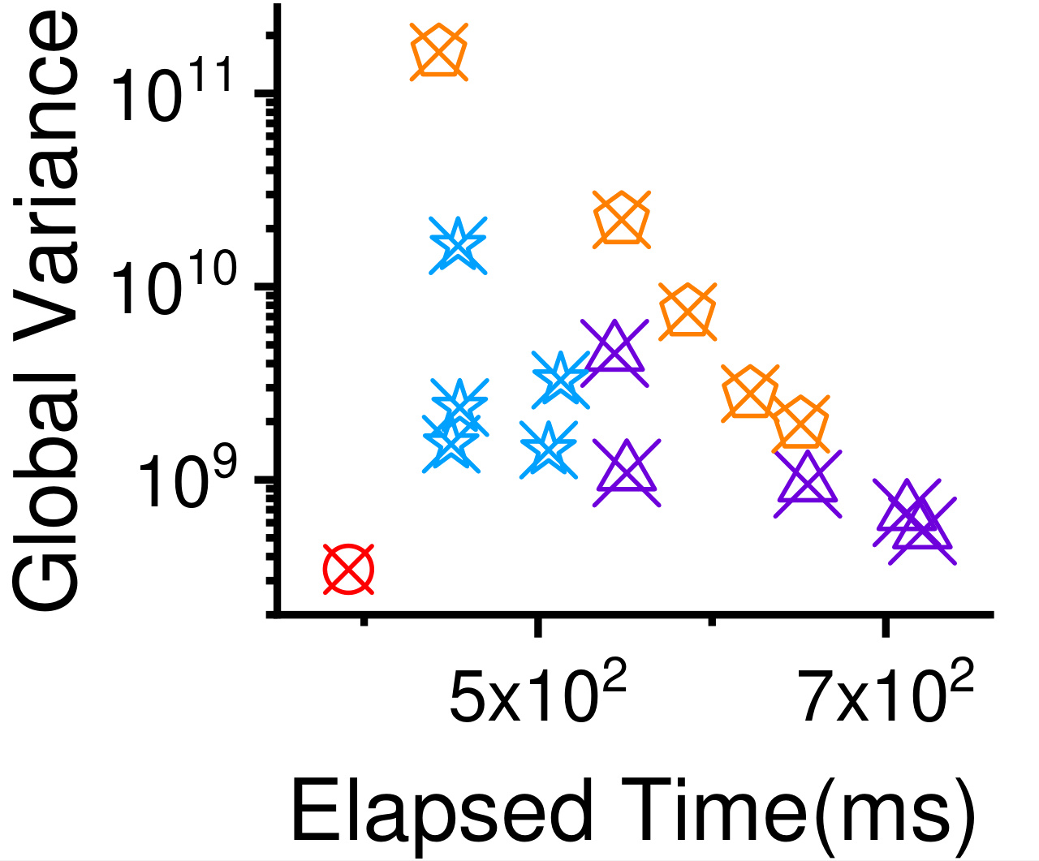
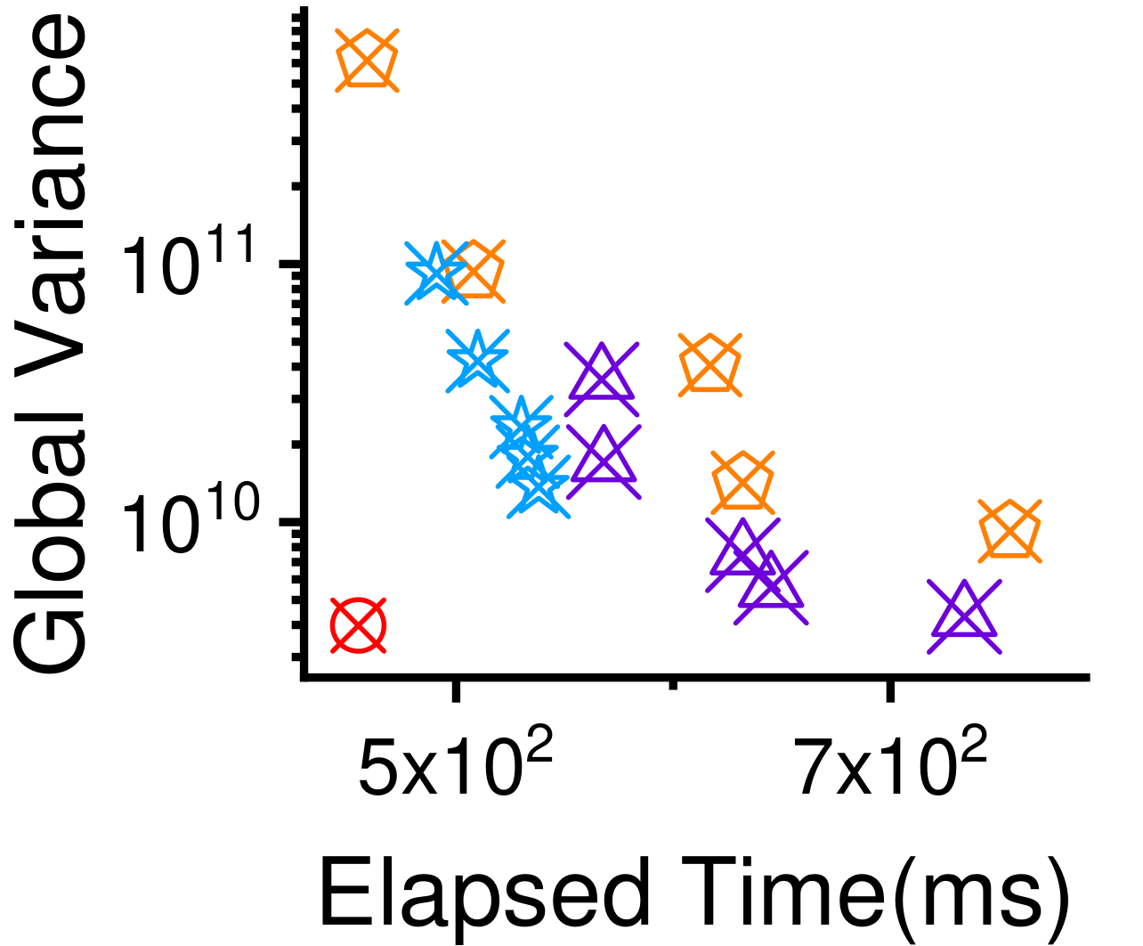
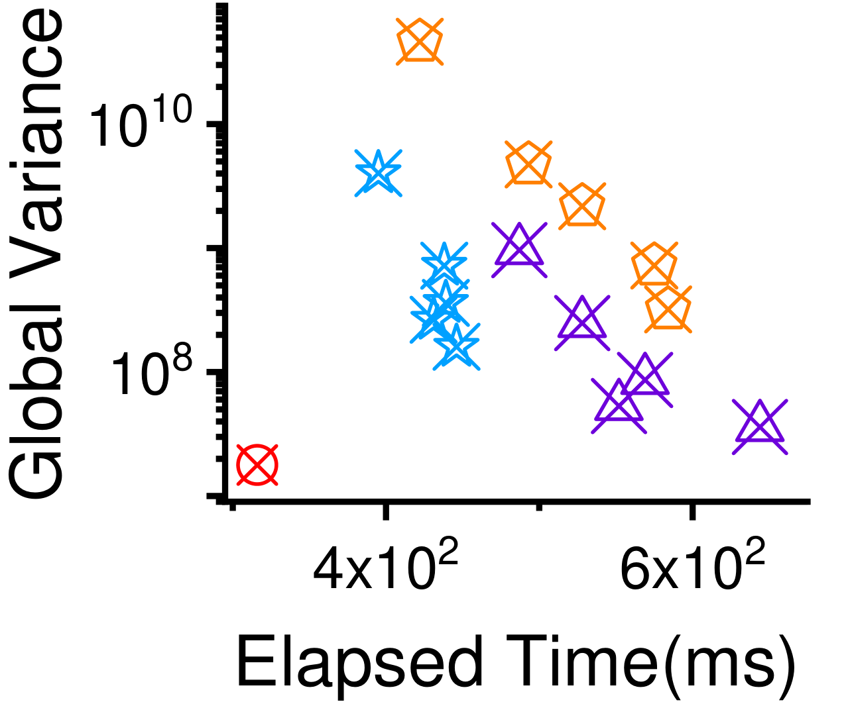
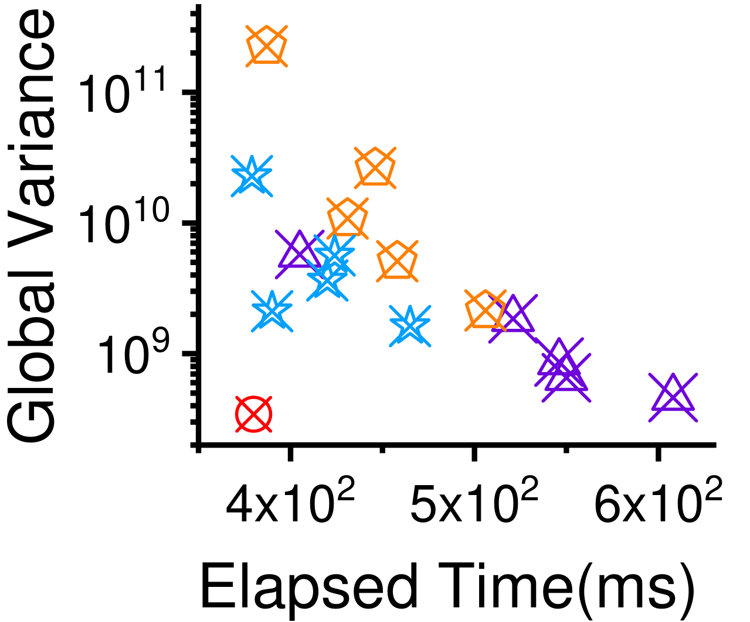
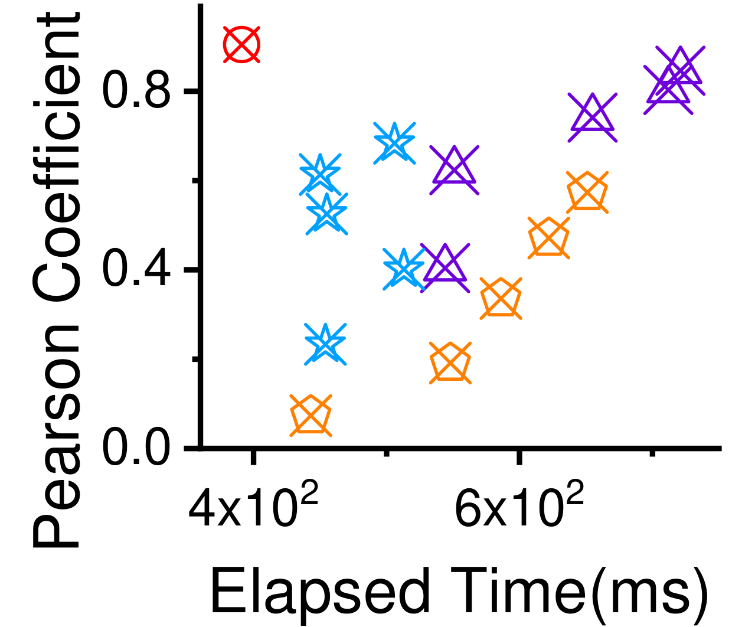
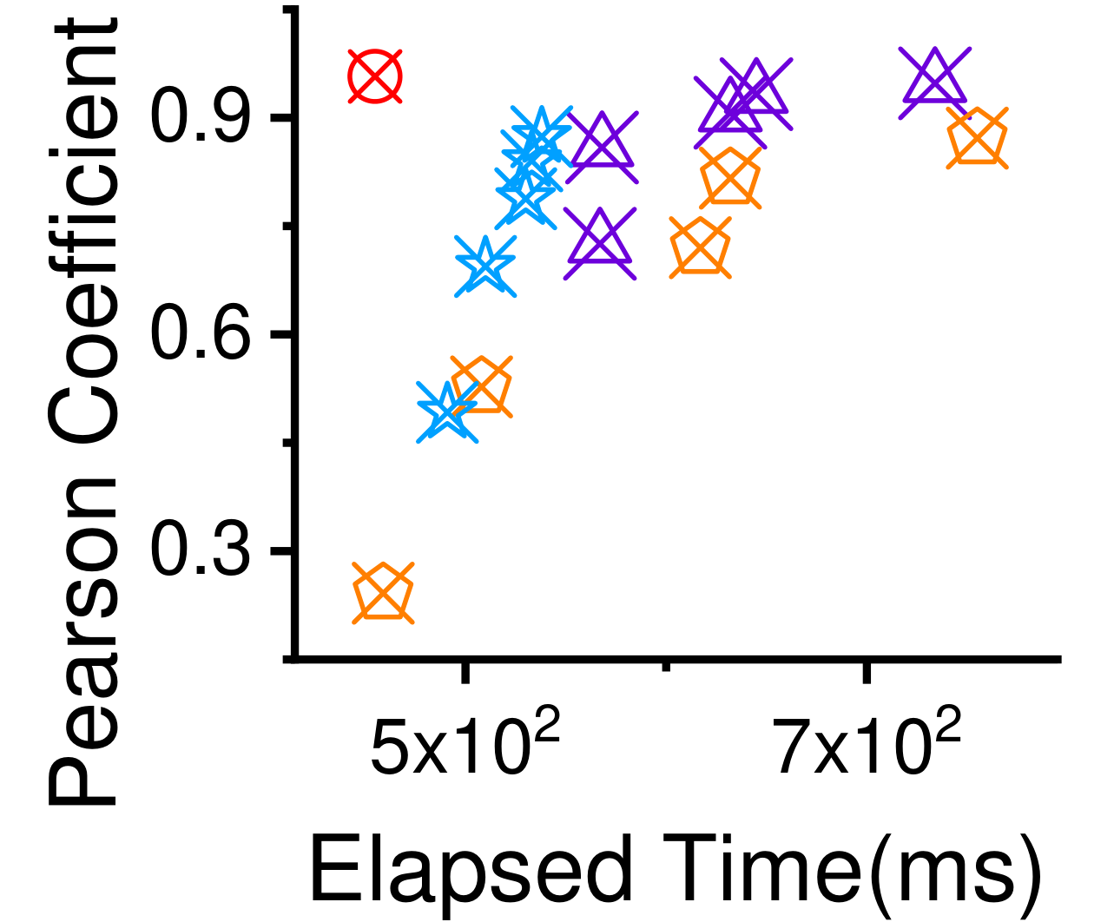
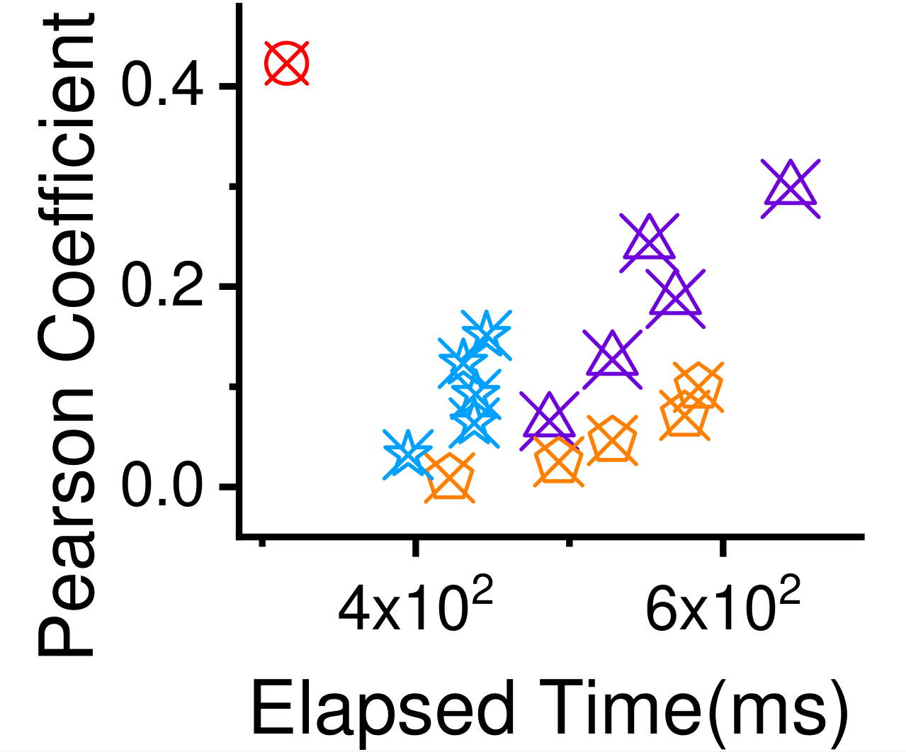
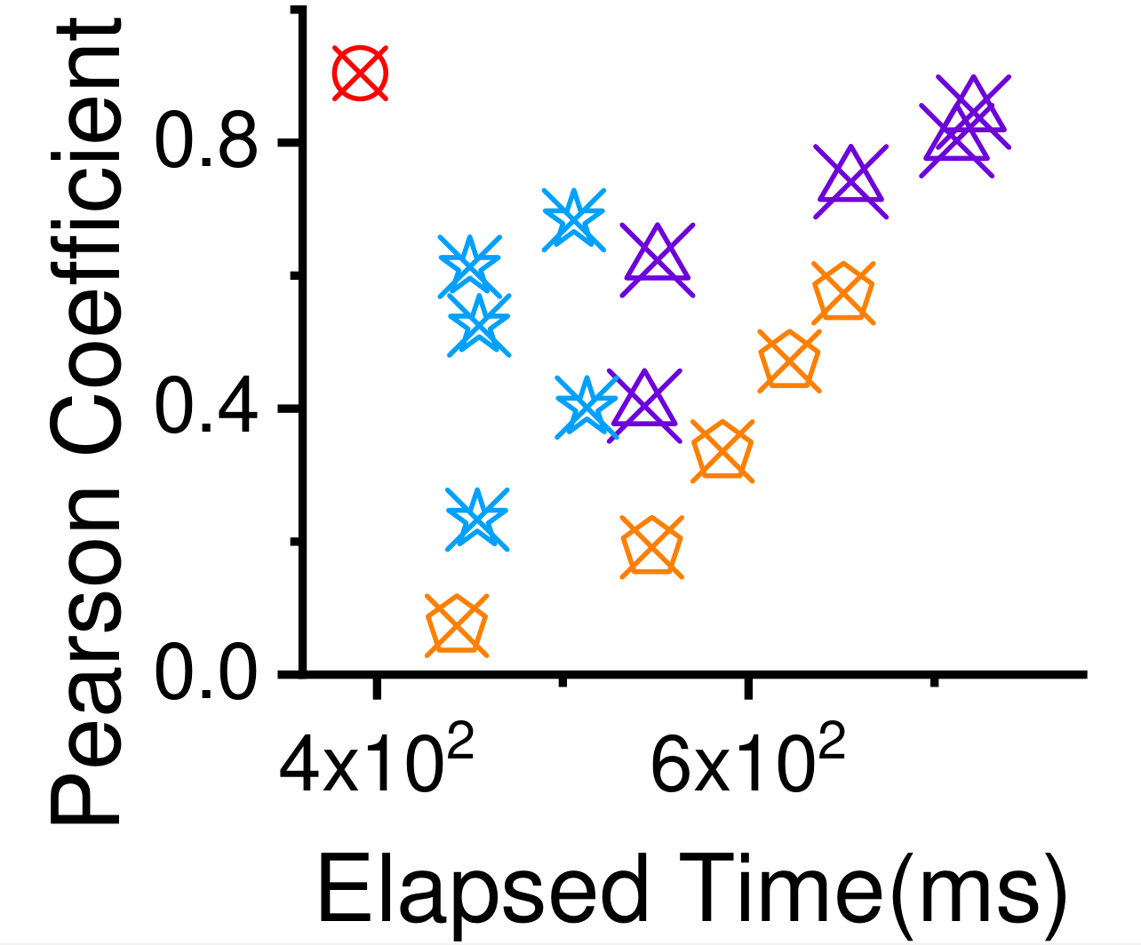
DTC-FD: Speed and Scalability
Global Variance (lower is better)
DTC-FD achieves the best trade-off between speed and accuracy compared to other algorithms for triangle counting in fully-dynamic graph streams.
Specifically, DTC-FD was up to 2.1× faster than ThinkDAcc with almost the same global error.
dblp
notreDame
amazon
facebook
Pearson Coefficient (higher is better)
dblp
notreDame
amazon
facebook
Notes:
DTC-FD achieves the best trade-off between speed and accuracy compared to other algorithms for triangle counting in fully-dynamic graph streams.
Specifically, DTC-FD was up to 2.1× faster than ThinkDAcc while maintaining nearly same levels of global error.

Slide 20



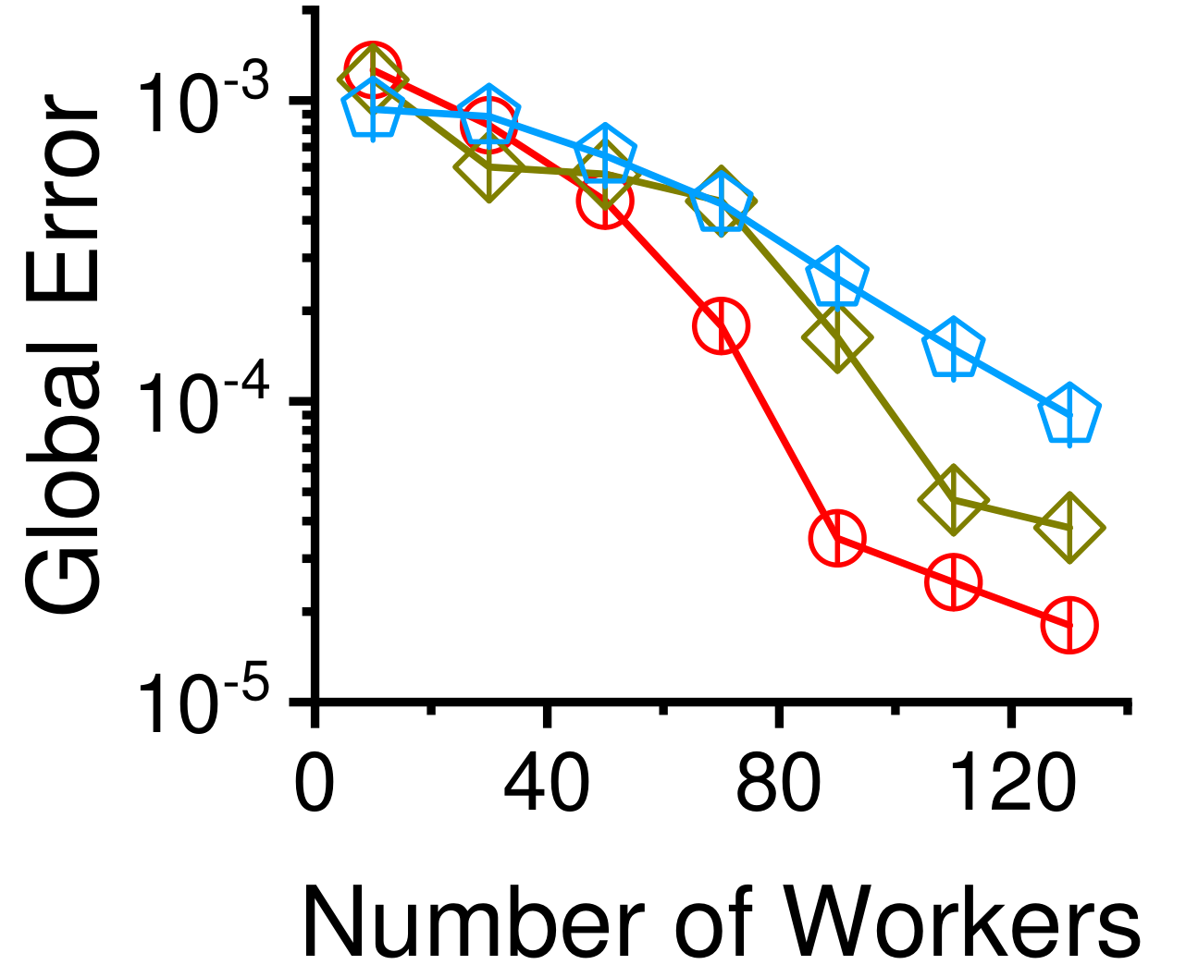






DTC-FD: Scalability
DTC-FD yielded more accuracy, as more workers were added.
Specifically, global error, global variance and local error dropped quickly with the increase of workers, and the pearson coefficient almost became 1 with about 130 workers.
The time consumed by DTC-FD exhibits a linear relationship with the number of edges in fully dynamic streams, ensuring efficient processing as the edge count increases.
skitter
youtube
liveJournal
Notes:
As the number of workers increased, DTC-FD demonstrates enhanced accuracy. Global error, global variance, and local error dropped quickly with the increase of workers.
Moreover, the processing time of DTC-FD displayed a linear correlation with the number of edges in fully dynamic streams, ensuring efficient computational throughput even as the edge count scaled up.

Slide 21
Conclusions
Insights: limitations of existing methods
  Multifaceted perspectives: sampling methods, resource utilization, processing capability
  Single-machine streaming algorithms: constrained primary memory resources
  Multi-machine distributed streaming algorithms: limited to handling edge insertions and require prior knowledge
Proposed DTC-family: distributed triangle counting algorithms
  DTC-AR (Incremental sample maintenance with adaptive resampling)
  DTC-FD (Support fully dynamic graph streams using future edge insertions to compensate for previous deletions)
Analysis of results: real-world graph datasets
  Accuracy, Speed, Scalability
Notes:
We observed the limitations of existing methods from many perspectives, such as sampling methods, resource utilization and processing capability. And highlight the challenges, Single-Machine Streaming Algorithms within constrained primary memory constraints, while Multi-Machine Distributed Streaming Algorithms are limited to handling edge insertions and require prior knowledge.
In response to these challenges, we introduce a suite of distributed triangle algorithms, called DTC-family. DTC-AR introduces adaptive resampling techniques, while DTC-FD compensates for prior deletions by leveraging future edge insertions for sustained stream dynamism.
Through an in-depth analysis of experimental results, the DTC-family emerges as a superior solution, demonstrating remarkable accuracy, speed, and scalability across diverse real-world graph datasets.

Slide 22

Thank you!
Notes:
Thank you all for your attention.

