Slide 1



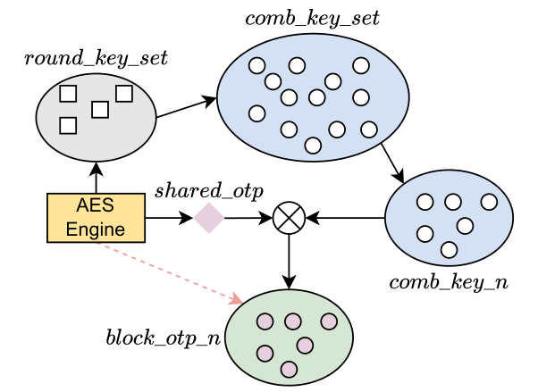


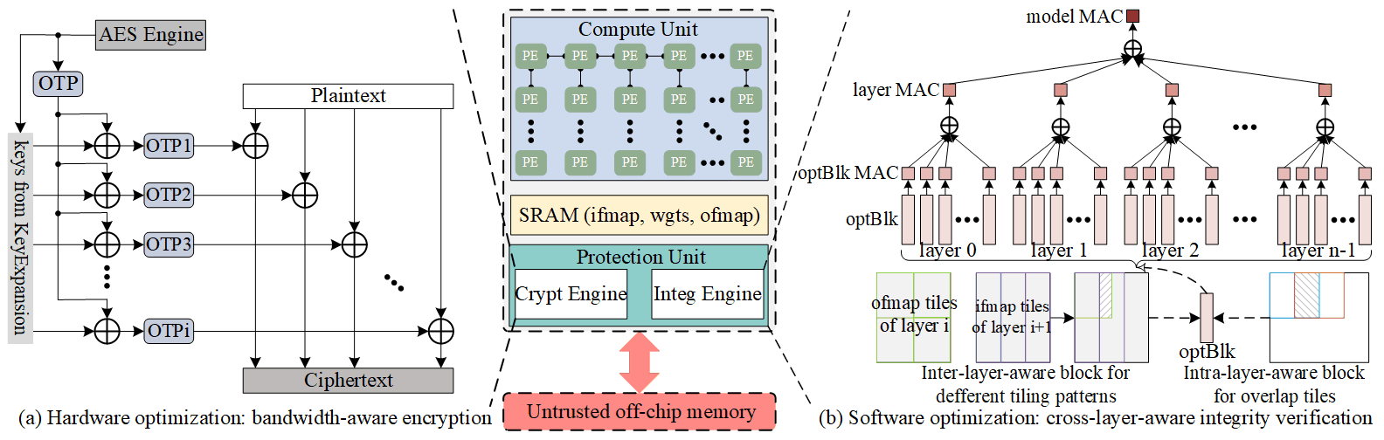
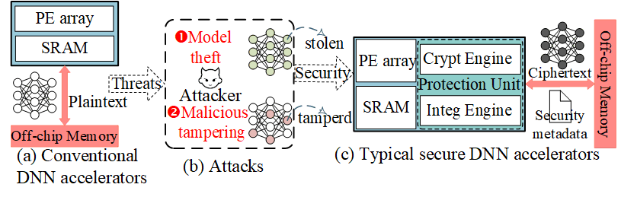
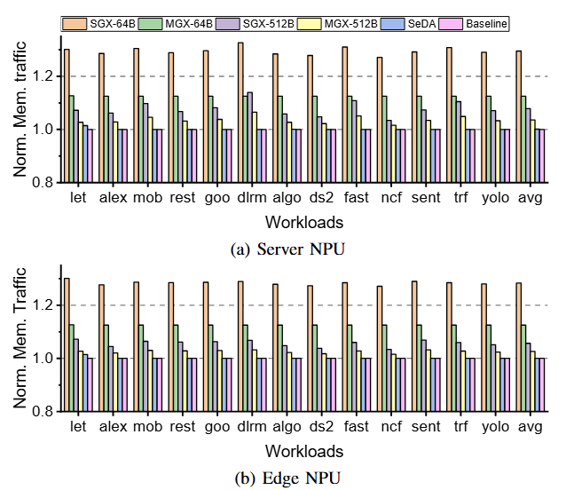
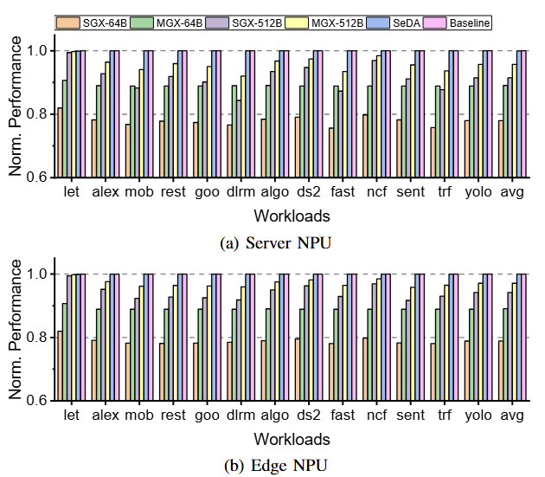
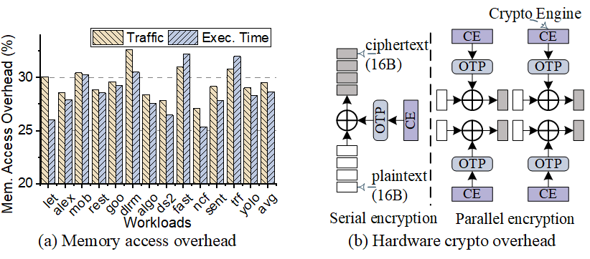
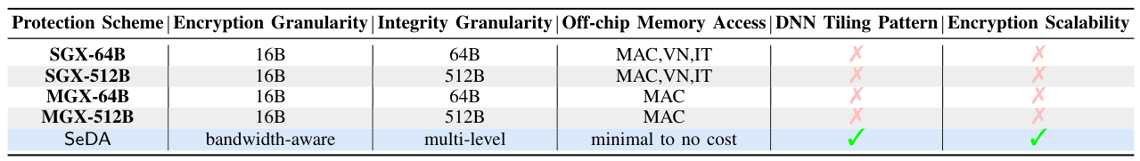

SeDA: Secure and Efficient DNN Accelerators
with Hardware/Software Synergy
Wei Xuan, Zhongrui Wang, Lang Feng, Ning Lin, Zihao Xuan,
Rongliang Fu, Tsung-Yi Ho, Yuzhong Jiao, Luhong Liang
1. Background
3. Proposed SeDA
Secure is important for DNN-based Applications:
Bandwidth-Aware Encryption Scheme:
Utilize KeyExpansion of AES to generate multiple unique OTPs
It can en/decrypt all 128-bit sub-blocks by running one time of AES engine
Improve the memory protection bandwidth to meet requirements
Attacked auto-vehicles can disrupt critical functions and pose safety risks
Healthcare cybersecurity endanger patient data, medical devices, and operations
Maliciously hacked AI robots may harm human interests
Malicious data alterations undermine financial market fairness and investor trust
Multi-level Integrity Verification:
Explore optimal block (optBlk) considering diverse cross-layer tiling patterns;
Calculate message authentication code of each optBlk (optBlk MAC);
Aggregate layer MAC (model MAC) by XORing all optBlk MACs (layer MACs);
Typical Secure DNN Accelerators:
Threat Model: unsecure off-chip memory and communication buses.
Memory Protection Mechanism: authentication encryption.
2. Motivations
4. Evaluation
Costly Off-Chip Memory Access Overhead for Integrity Verification
Merkle Tree (MT) with its variants incurs extra off-chip data access, to defend replay attacks.
Different cross-layer tiling patterns introduce redundant authentication data read and computation.
XOR-based MAC scheme may lead to re-permutation attack.
High Hardware Overhead for Confidentiality Protection
Serial encryption engine provides limited bandwidth.
Parallel approach incurs amount of hardware overhead.
Shared one-time pad (OTP) can be vulnerable to the single-element collision attacks.
Through systematic experiments, SeDA is shown to mitigate performance overhead by over 12% for both server and edge NPUs, through the implementation of bandwidth-aware encryption and multi-level integrity verification framework.
Normalized to the unsecured baseline
Acknowledgment：This research was partially supported by the National Key R&D Program of China (Grant No. 2022YFB3608300). It was supported in part by ACCESS – AI Chip Center for Emerging Smart Systems, sponsored by the InnoHK initiative of the Innovation and Technology Commission of the Hong Kong Special Administrative Region Government. It was also supported in part by Shenzhen Science and Technology Innovation Commission (Grant No. SGDX20220530111405040), Beijing Natural Science Foundation (Grant No. Z210006), Hong Kong Research Grant Council (Grant Nos. 27209621, 17205922, 17212923), the National Natural Science Foundation of China under Grant 62204111.
DAC 2025, Moscone West, San Francisco, CA
June 25, 2025

