Slide 1


SeDA: Secure and Efficient DNN Accelerators with Hardware/Software Synergy
Wei Xuan, Zhongrui Wang, Lang Feng, Ning Lin, Zihao Xuan, Rongliang Fu, Tsung-Yi Ho, Yuzhong Jiao and Luhong Liang
25 June 2025

Slide 2
Introduction
Motivation
Solution
Evaluation

Slide 3




Secure DNN Accelerators is important
(1) Autonomous vehicles are susceptible to cyberattacks that can disrupt critical functions and pose serious safety risks
(3) Healthcare cybersecurity threats are escalating, endangering patient data, medical devices, and operations
(2) Maliciously hacked AI robots may harm human interests
(4) Malicious data alterations by attackers undermine financial market fairness and investor trust

Slide 4
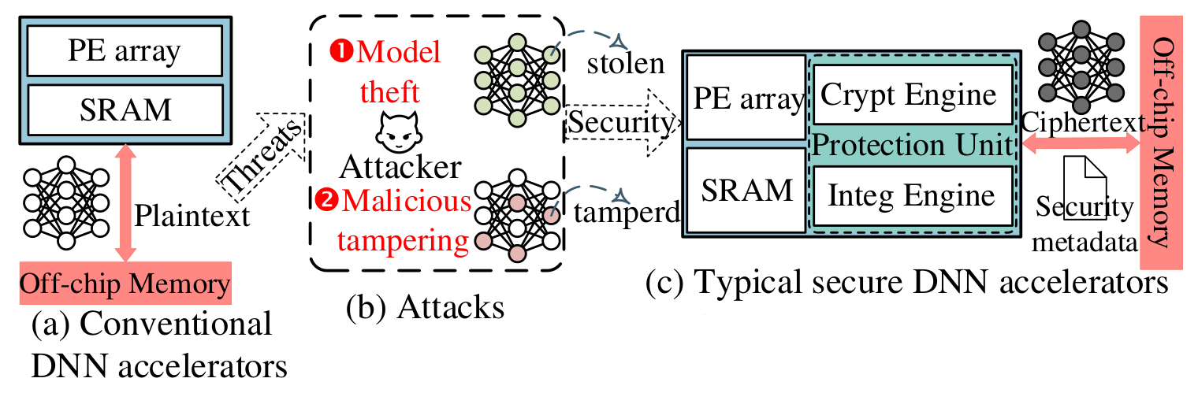
Memory Protection Mechanism
Goal: augment traditional unsecure DNN accelerators with the capability to cryptographic authentication

Slide 5
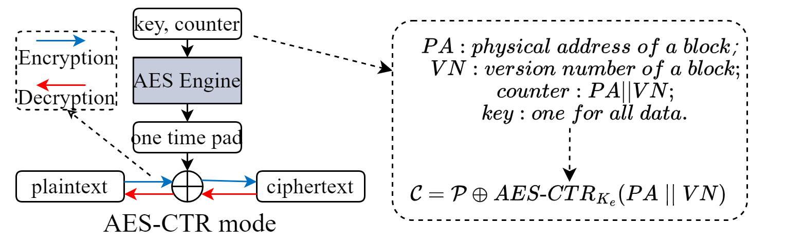
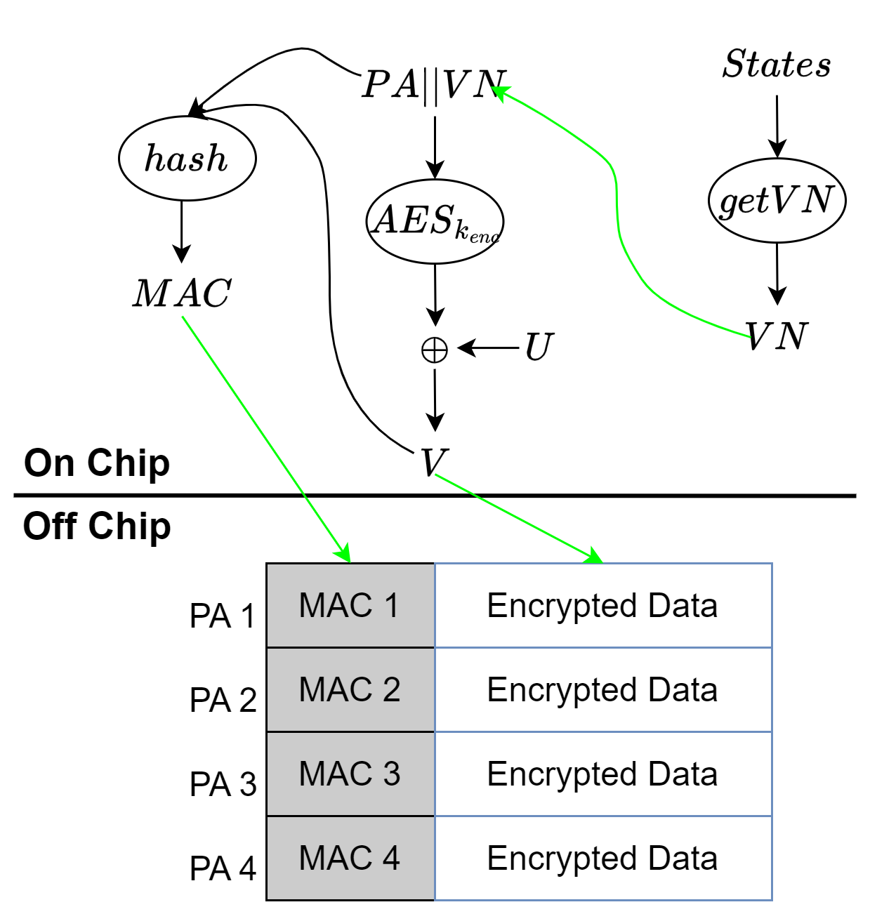
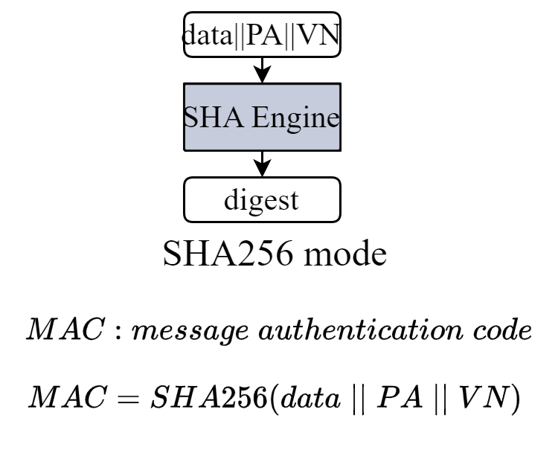
Authentication En/Decryption
Confidentiality Protection
Confidentiality protection (CP) and Integrity Verification (IV) both involve the current data block's PA and VN.
Introduce memory overhead for MACs.
Integrity Verification

Slide 6
Introduction
Motivation
Solution
Evaluation

Slide 7
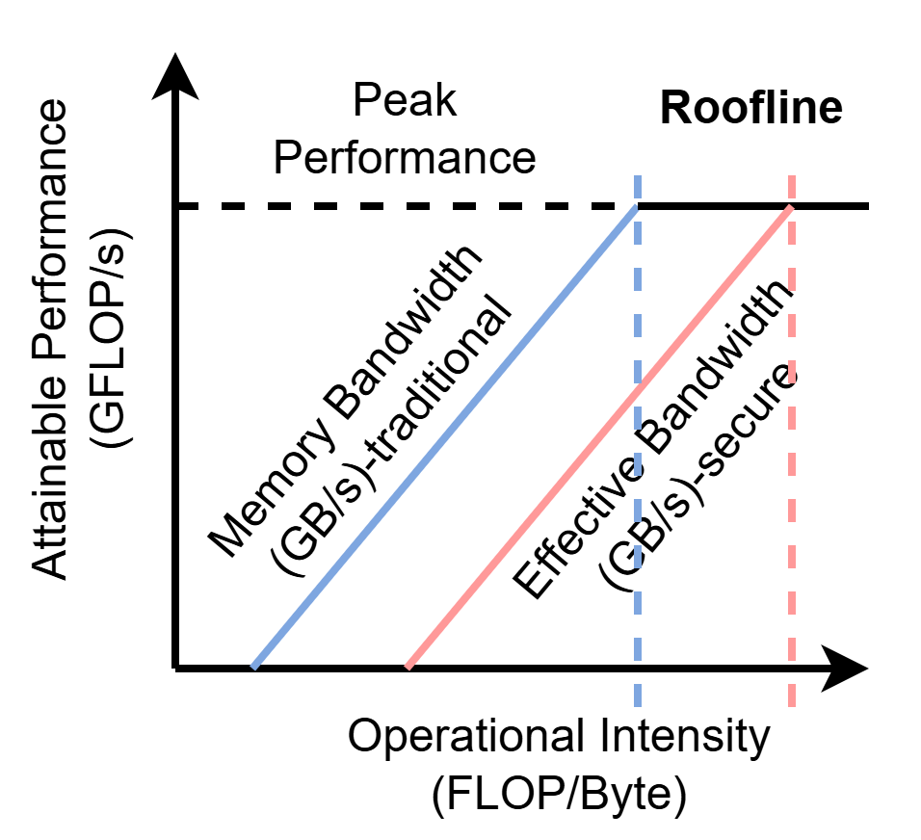
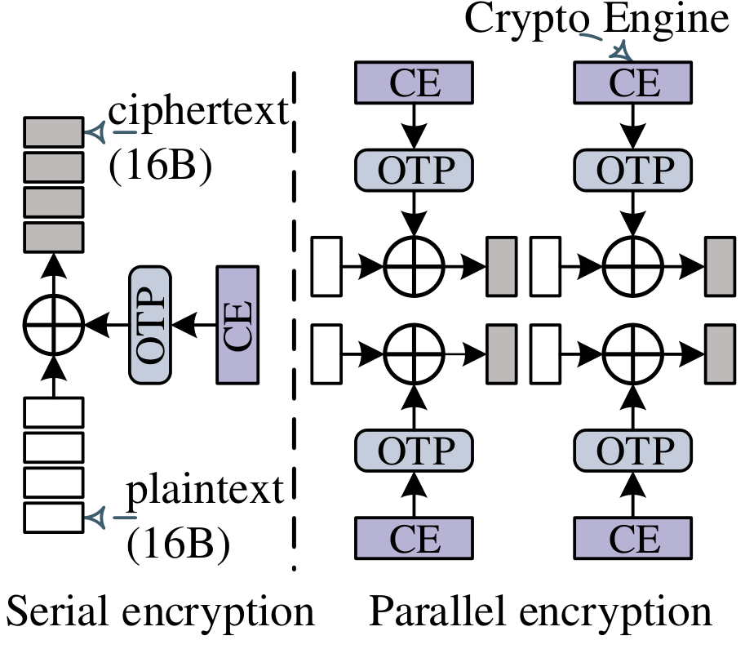
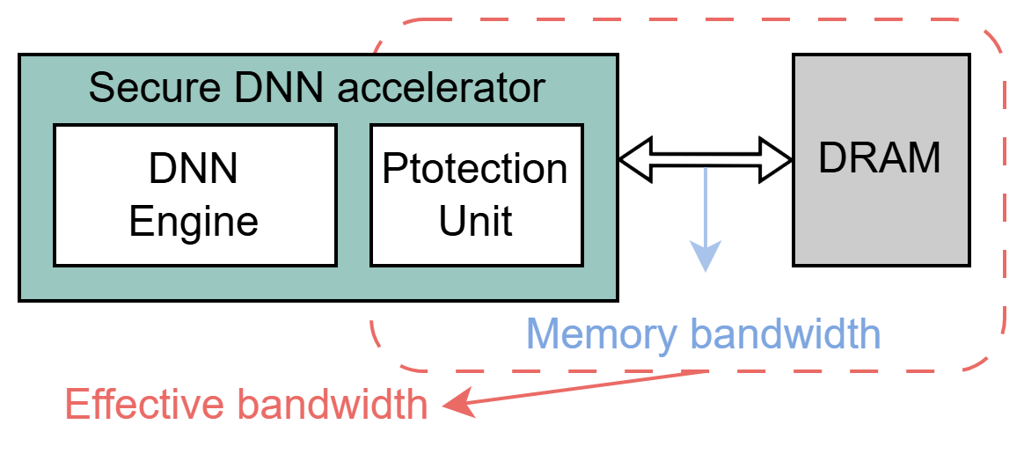
Hardware Overhead of Security
Secure DNN accelerators can model cryptographic and authentication operations as an additional constraint on off-chip DRAM bandwidth [1]
Effective memory bandwidth = Min (original memory bandwidth, memory protection bandwidth)
Analysis via the roofline model reveals that the bandwidth of security protection unit could constrain the performance of secure DNN accelerators
Parallel hardware encryption incurs overhead to meet bandwidth needs of accelerators
​Diagram of effective memory bandwidth
Serial & parallel hardware implement
Roofline model analysis
[1] SecureLoop: Design Space Exploration of Secure DNN Accelerators

Slide 8
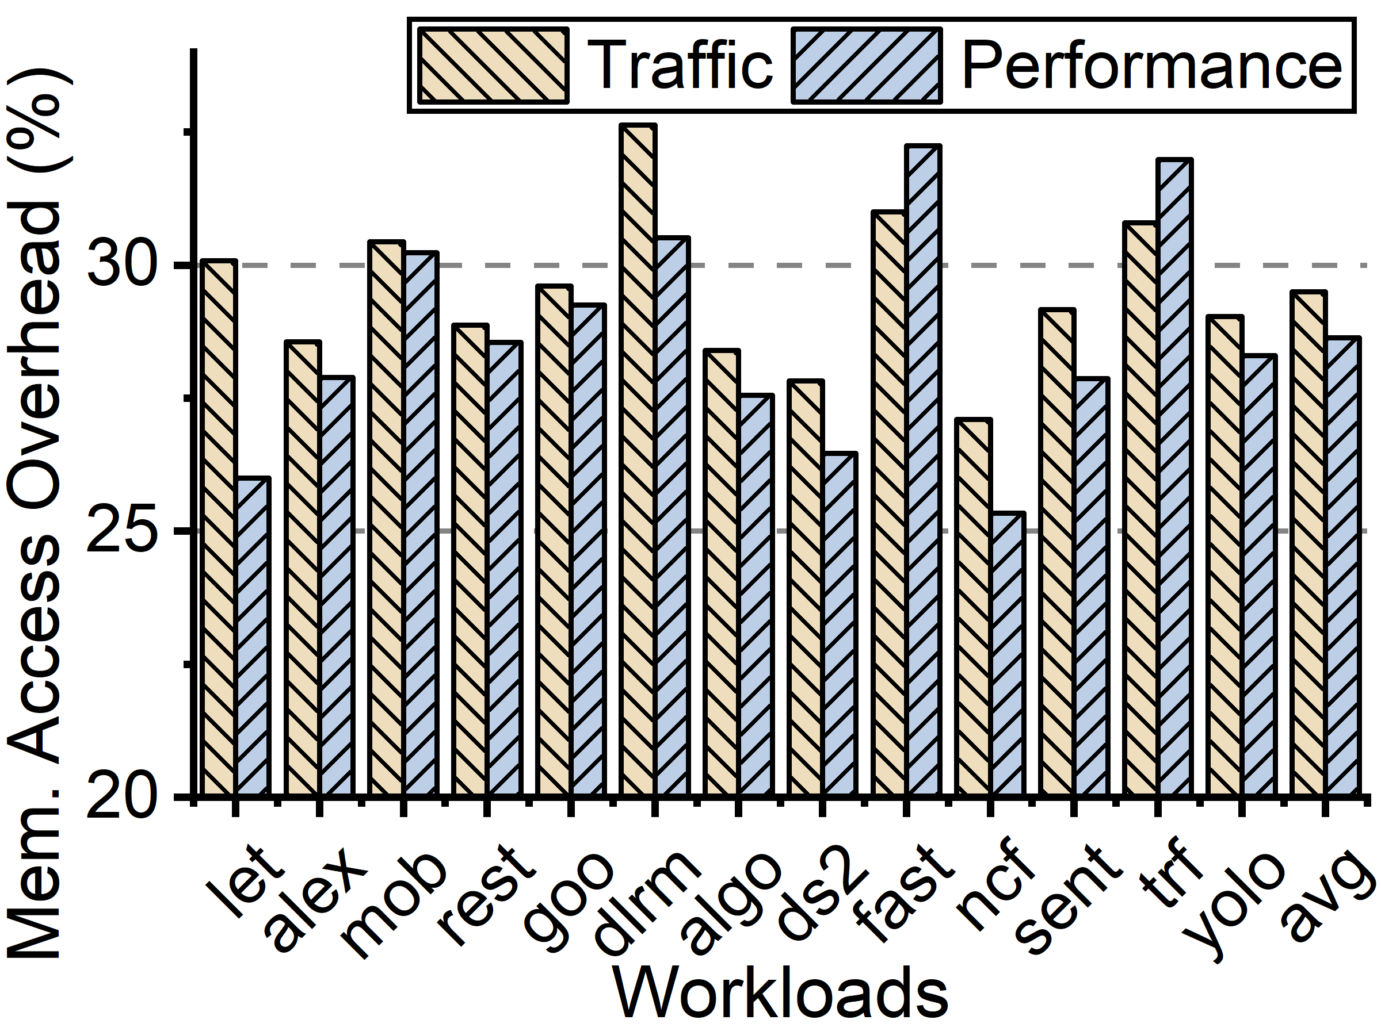
Extra Off-chip Memory Access
Costly off-chip memory access overhead due to security metadata:
      Memory traffic increases 29.5% on average
      Performance decreases 28.6% on average
29.5%
28.6%
Memory access overhead of security metadata

Slide 9
Introduction
Motivation
Solution
Evaluation

Slide 10
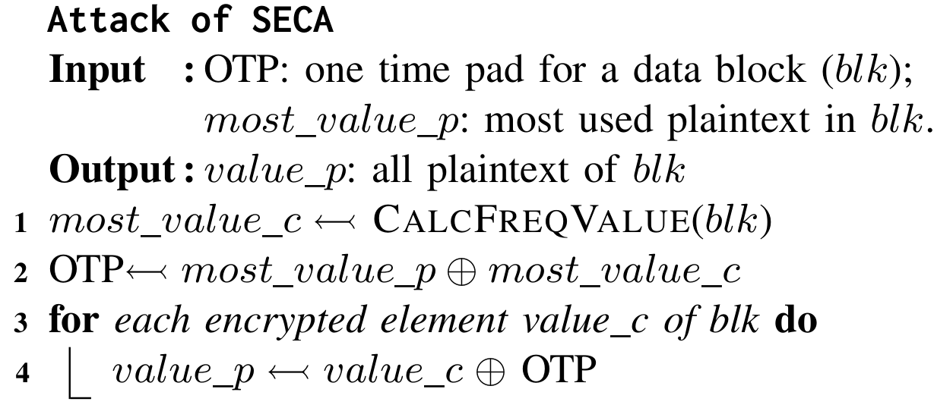
Key Insight 1: Multi-OTP Generation
High hardware resources for confidentiality protection to provide high en/decryption bandwidth
Shared OTP incurs Single-Element Collision Attack (SECA)
Minimal hardware overhead, supporting multiple distinct OTPs generation

Slide 11
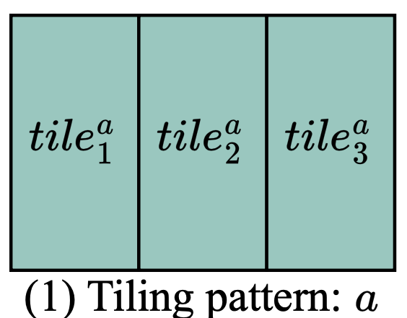
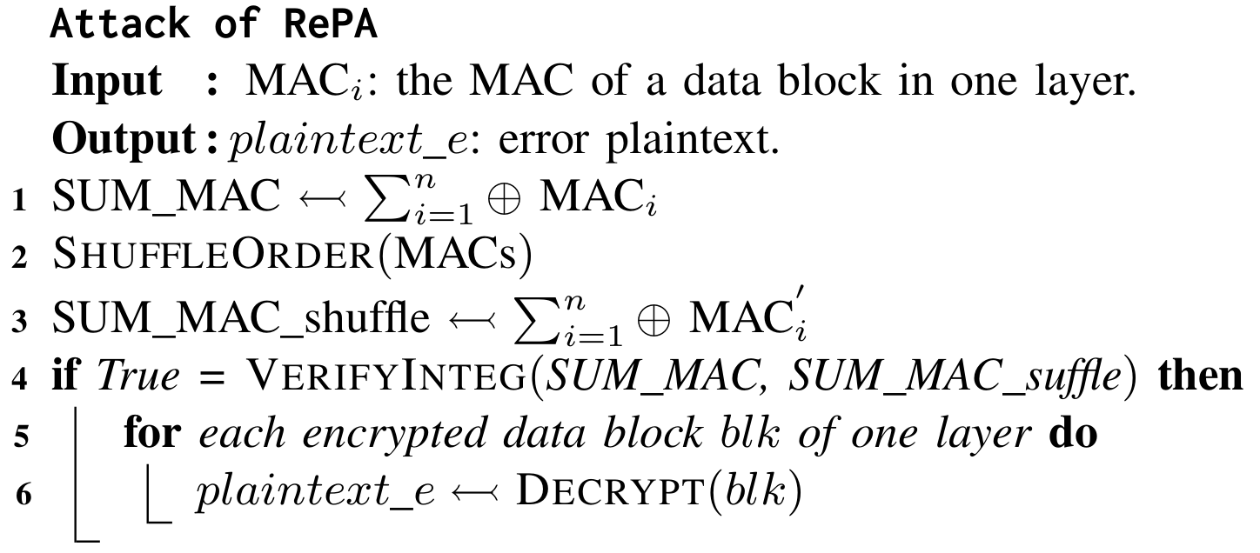
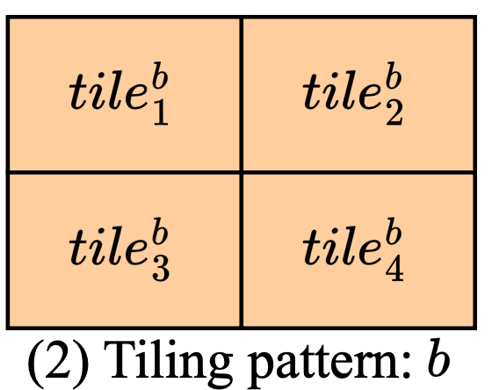
Key Insight 2: Cross-layer Authentication
High hardware resources for confidentiality protection to provide high en/decryption bandwidth
Shared OTP incurs Single-Element Collision Attack (SECA)
Cross-layer different tiling patterns incurs error of integrity check
Different tiling patterns for the same matrix
Cross-layer authentication considering different tiling patterns

Slide 12
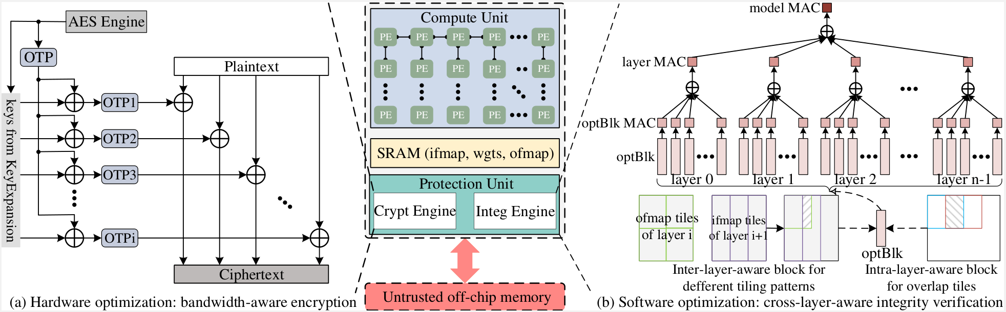
Overview of This Work
(a) The Crypt Engine optimizes hardware by XORing keys from the AES Engine’s KeyExpansion module with OPT, creating bandwidth-sensitive encryption granularity and reducing hardware overhead compared to using multiple AES Engines.
(b) The Integ Engine optimizes software by analyzing overlapping tiles within a layer and patterns across layers to determine the optimal block size, optBlk, for integrity verification.

Slide 13
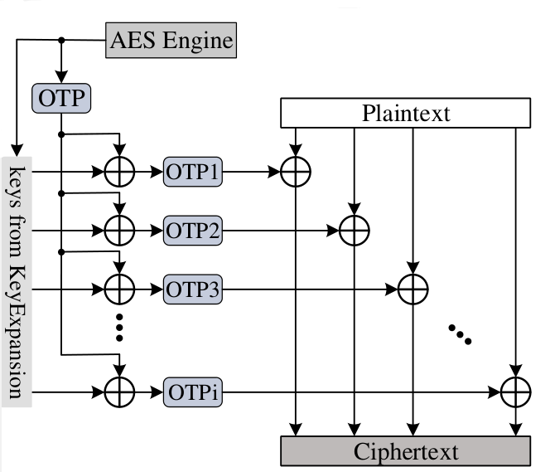
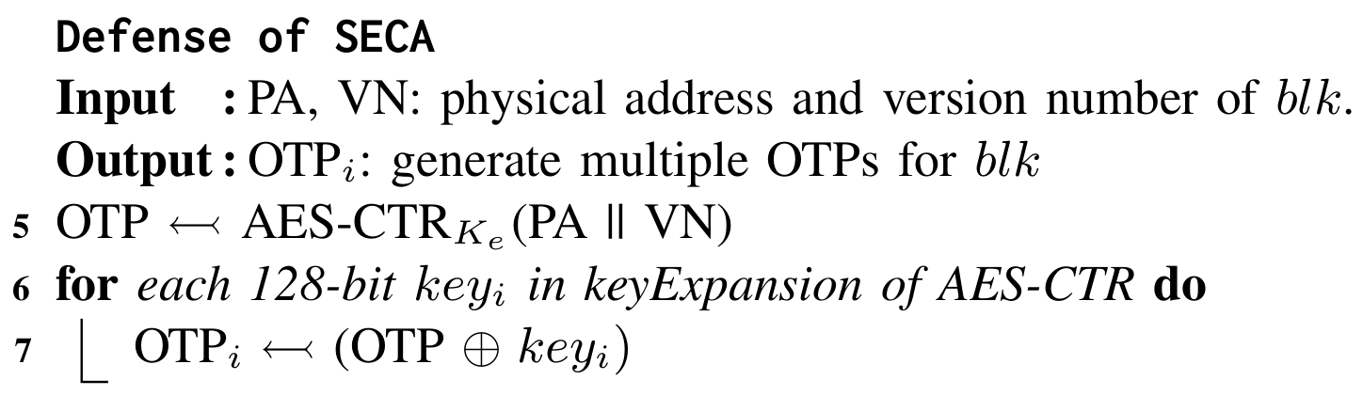
Bandwidth-aware Encryption
Leverage the inherent features of AES-CTR encryption mode
Use just a single AES engine and a minimal number of XOR logic gates to generate multiple distinct OTPs at KeyExpansion
Provide high effective bandwidth while avoid SECA

Slide 14
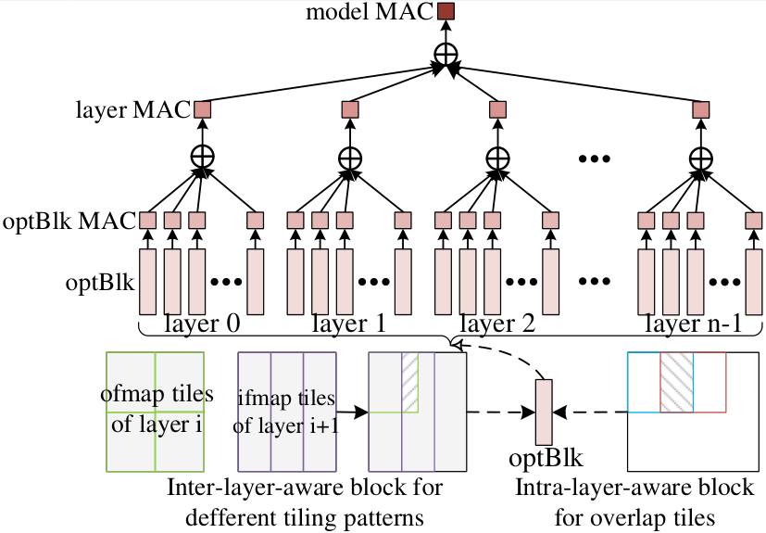
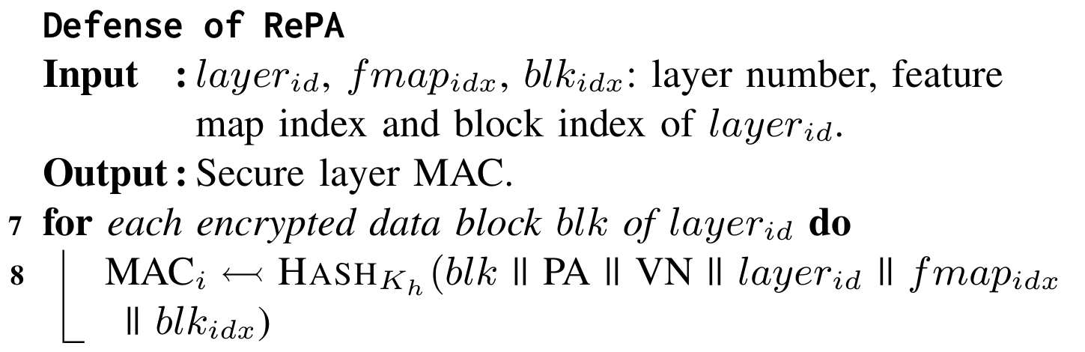
Multi-level Integrity Verification
Explore optimal block (optBlk) of authentication using Secureloop [1], considering diverse inter-layer tiling patterns
Calculate message authentication code of each optBlk (optBlk MAC)
Aggregate layer MAC (model MAC) by XORing all optBlk MACs (layer MACs)
Minimize the off-chip memory access to only layer MACs
[1] SecureLoop: Design Space Exploration of Secure DNN Accelerators

Slide 15
Introduction
Motivation
Solution
Evaluation

Slide 16
Evaluation Methodology
Simulators:
  SCALE-Sim2 [1], Ramulator2 [2]
Workloads:
  Lenet, Alexnet, Mobilenet, ResNet18, GoogleNet, DLRM, AlphaGoZero, DeepSpeech2, FasterRCNN, NCF_recommendation, Sentimental_seqCNN, Transformer_fwd, Yolo_tiny
Accelerator configuration:
  Server NPU (Google TPU v1), Edge NPU (Samsung Exynos 990)
Metrics | Server (Google TPU v1) | Edge (Samsung Exynos 990)
PE | 256 x 256 in systolic array | 32 x 32 in systolic array
Bandwidth | 20 GB/s with 4 channels | 10 GB/s with 4 channels
Frequency | 1 GHz | 2.75 GHz
SRAM | 24 MB | 480 KB
Precision | 1 B for per element | 1 B for per element
Authentication en/decryption | Mode | Cycle
AES-GCM | parallel | 19 cycles [3]
[1] A systematic methodology for characterizing scalability of DNN accelerators using SCALE-sim
[2] Ramulator 2.0: A modern, modular, and extensible DRAM simulator.
[3] Energy-efficient protocols and hardware architectures for transport layer security

Slide 17
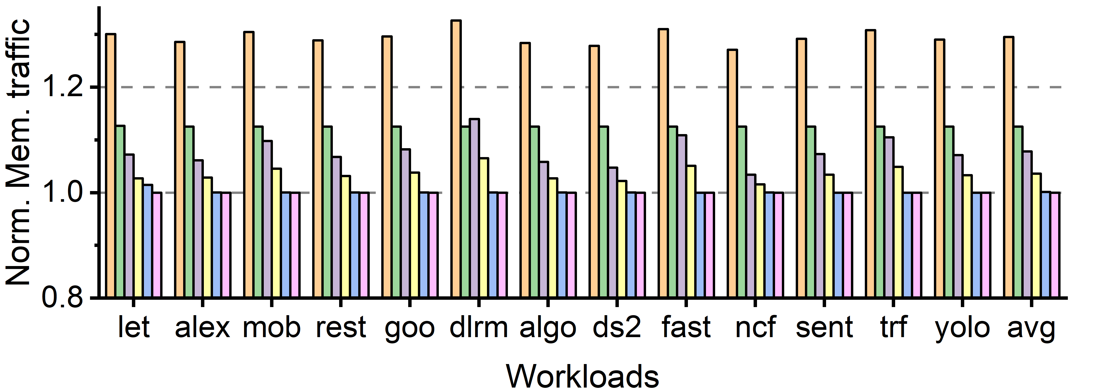
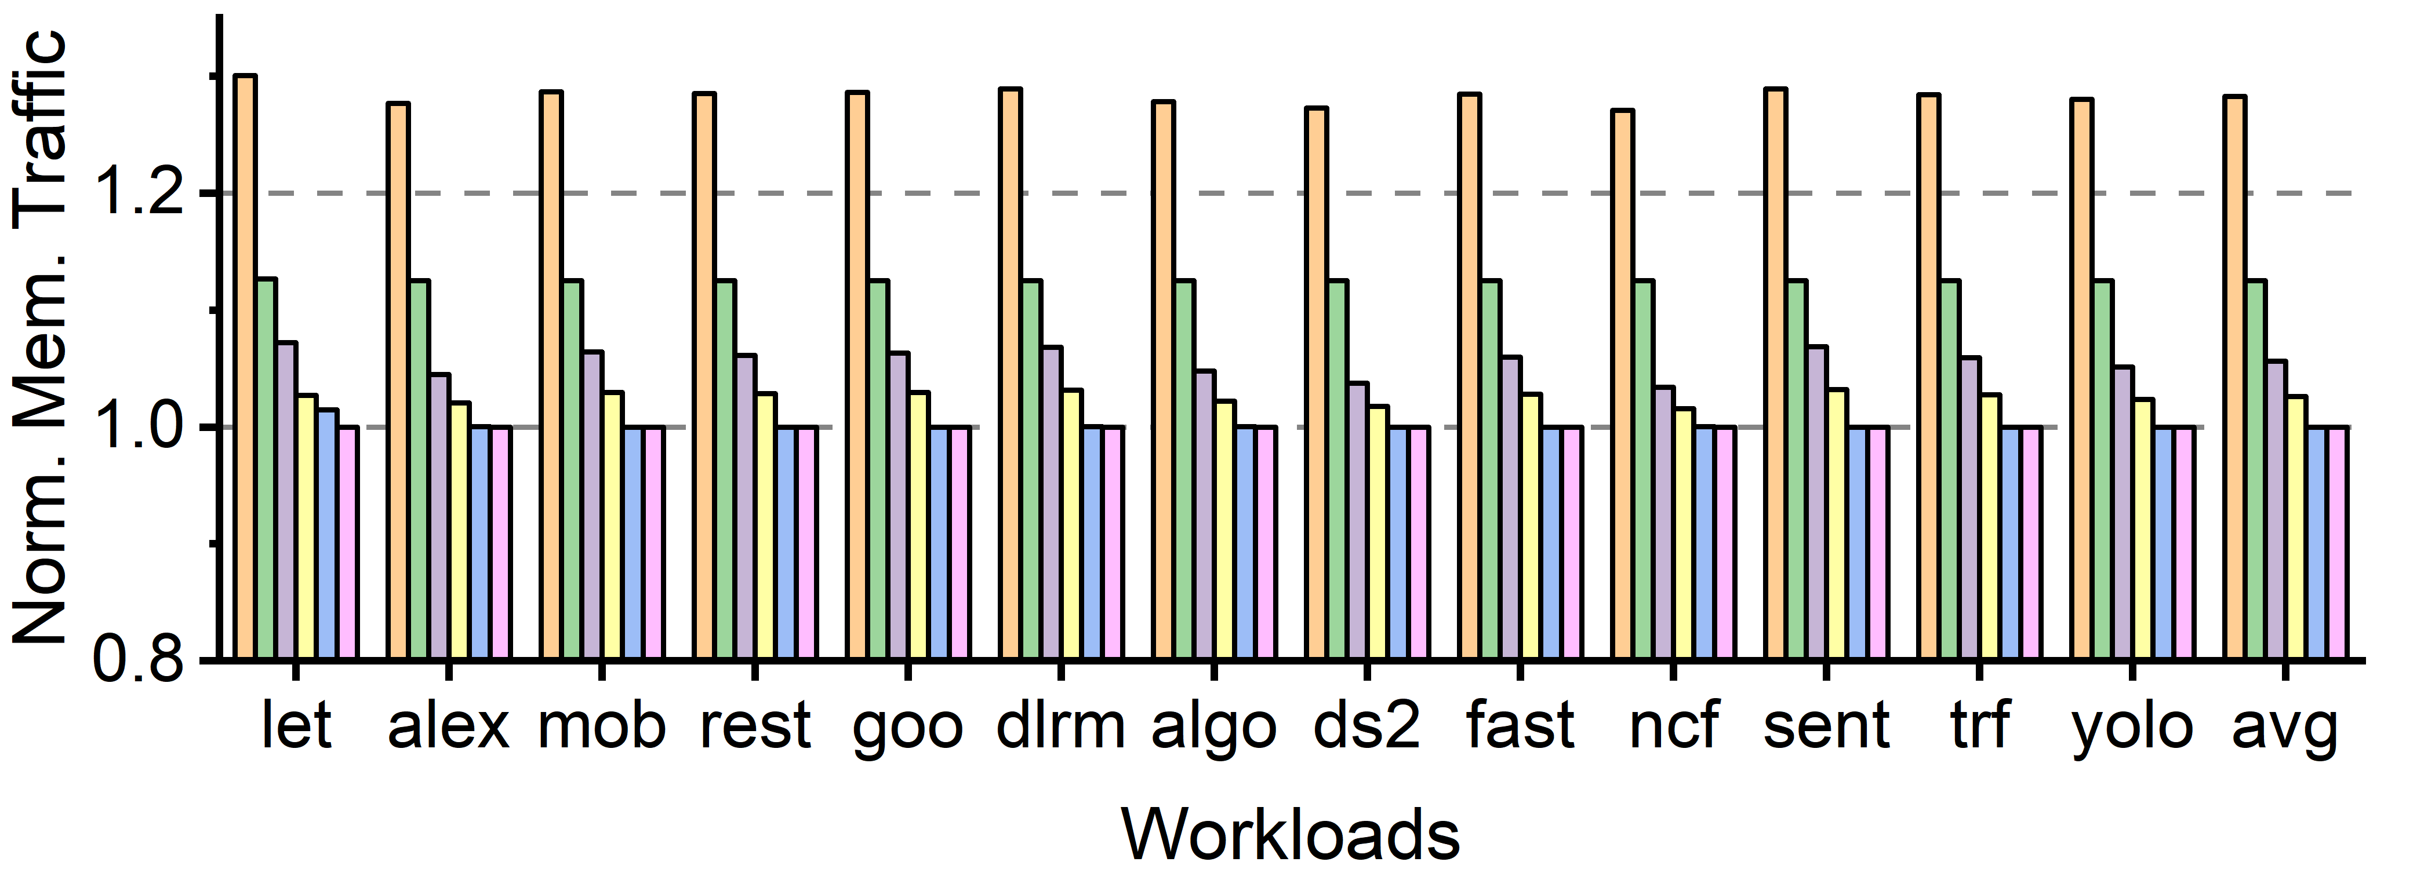
Traffic Comparison
Traffic comparison with five protection schemes:
  SGX-64B, SGX-512B, MGX-64B, MGX-512B and unsecure baseline
  64B and 512B indicate different security granularities
Server NPUs
Up to 22.7%
Lower is better
SeDA reduces authentication metadata by multi-level integrity verification
Off-chip memory traffic reduces over 22% for both server and edge NPUs
Up to
22.0%
Edge NPUs

Slide 18
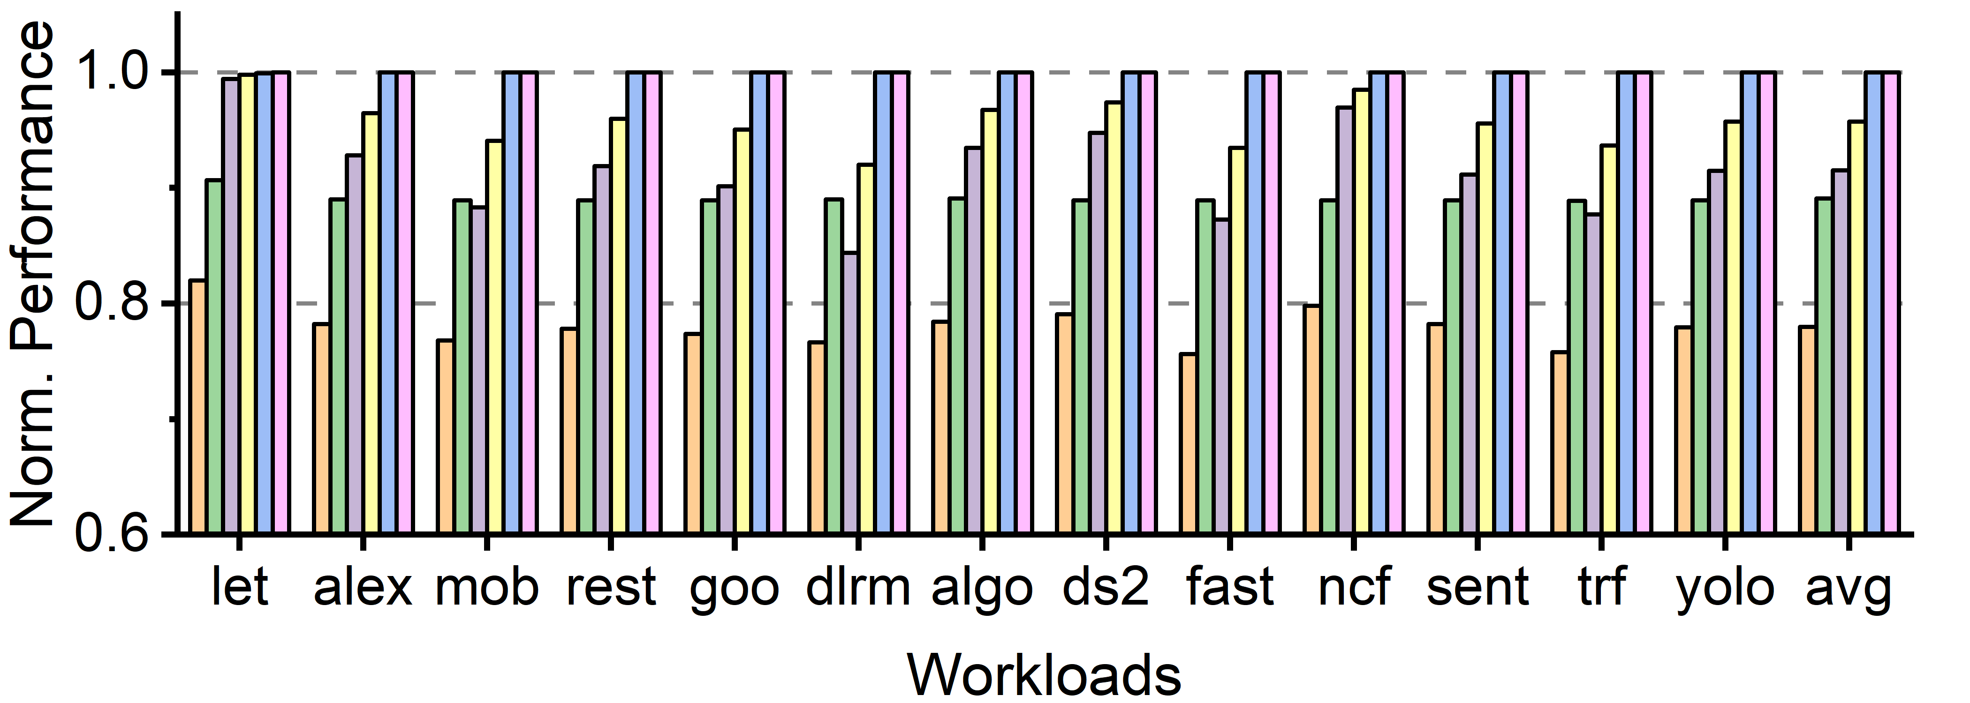
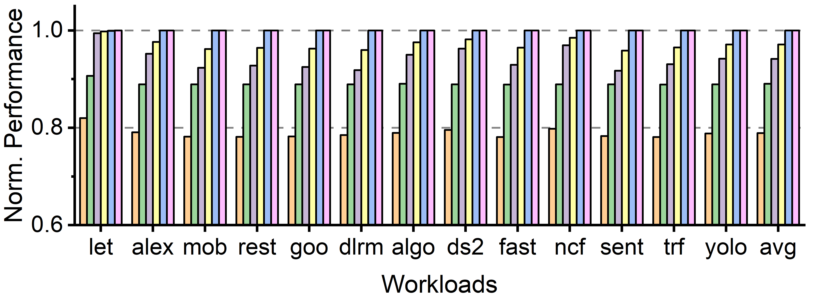
Performance Comparison
Traffic comparison with five protection schemes:
  SGX-64B, SGX-512B, MGX-64B, MGX-512B and unsecure baseline
  64B and 512B indicate different security granularities
Server NPUs
Up to 12.1%
Higher is better
SeDA utilizes bandwidth-aware encryption to efficiently generate OTPs and multi-level integrity verification to reduce memory access
Performance improve over 12% for both server and edge NPUs
Up to
12.4%
Edge NPUs

Slide 19
Summary
Problem
  Secure DNN accelerator increases off-chip memory access and degrades the performance
Solution
  Bandwidth-aware encryption reduces hardware resources for confidentiality protection
  Multi-level integrity verification reduces off-chip memory access of security metadata
Evaluation
  Reduce the performance overhead by over 12% compared to of state-of-the-art approaches

Slide 20
Thank You!
Thank You!
Q & A

Slide 21


