Slide 1



Tool for Logistic Regression
Team member: Xuanyi Fu, Qianqi Huang, Shaohua Shen, Shangshang Wang, Rong Yang

Slide 2
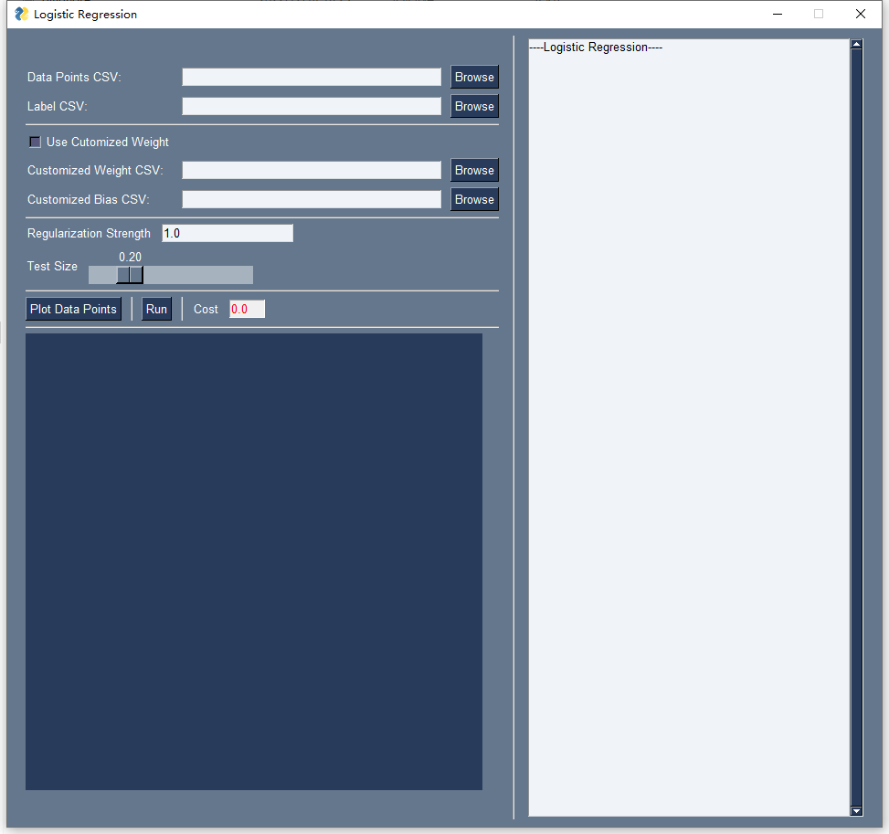
Overview
This is a tool built for performing regression analysis on the dataset given with utilization of logistic regression .
It supports automatic logistic regression model generated by scikit_learn library and manual model by user.
User can plot data points with our frontend. Besides, the result of analysis will be stored in file and be presented in frontend graph.

Slide 3



Table of Contents
Prerequisite
Manual
Technology
01
02
03
How to set up environment for running the tool
How to start an analyzation with the tool
Technical skills supporting the tool

Slide 4
01
Prerequisite

Slide 5


Prerequisite
First you need to have python 3 installed on your device, and then use `pip install` command to install the following libraries and packages.
matplotlib
numpy
PySimpleGUI
scikit-learn
For creating static, animated, and interactive visualizations
For comprehensive mathematical functions and more
For fast and simple-to-learn GUI programming
For built-in ready-to-use logistic regression model

Slide 6
02
Manual

Slide 7
After Libraries Installed …
Use python command run main.py in the root directory of the project. A frontend will show up as below

Slide 8

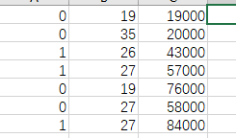
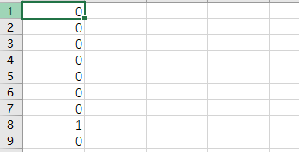
Import Data Set
Here, user can browse local files to import data points and labels for training and testing. In a standard data points csv file, a row is a piece of data and each column stands for a feature value. A standard label csv should contains rows of 0s and 1s, which represents the logistic label for the associated data.
Data points csv example
Label csv example

Slide 9

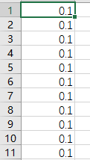

Set customized weight
Here, user can click to choose whether he/she would like to use manual logistic regression model. If yes, the user can browse local files to import customized weights and bias values. The dimension of weights and bias should be correct according to the dimension of data points. For example, if data points is a N × M (row × column) matrix, then weights should be M × 1 and bias should be N × 1.
Bias csv example
Weight csv example

Slide 10

Set other variables
Here, user can enter the regularization strength of the model and choose the test size, which sets how much data will be used for testing.

Slide 11
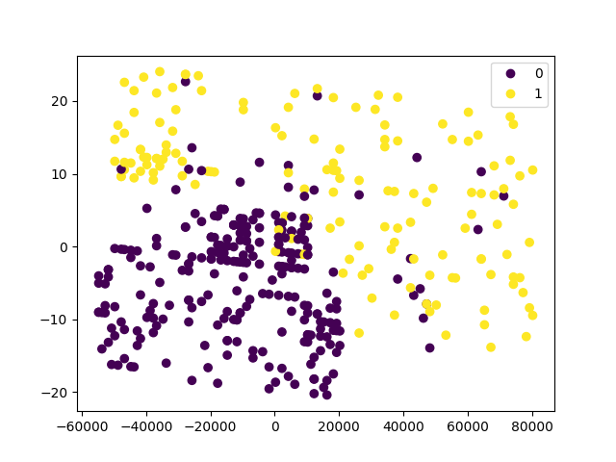
Plot data points
By clicking Plot Data Points, user can plot the data set in the frontend with labels represented by different colors.
Data points plot example

Slide 12
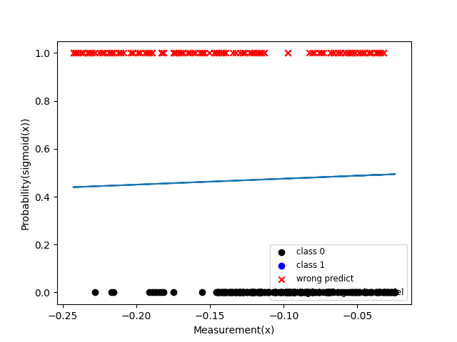


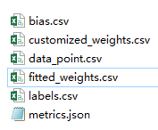
Get the model
By clicking Run, user can get the model generated with logistic regression and results will be stored in metrics.json. Cost value will be shown in the frontend just on the right of Run button. If the user chose to use automatic logistic regression, a file contains fitted weights will be generated and stored. The directory of saved files will be shown on right.
Result plot example

Slide 13
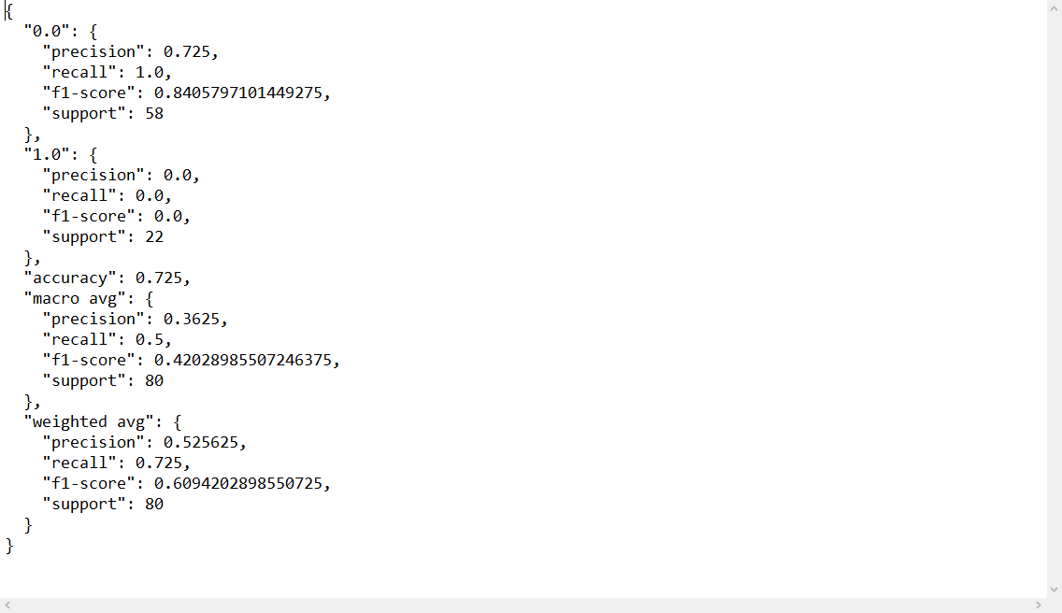
Contents of metrics.json

Slide 14
03
Technology

Slide 15
Technical Skills
Cost value calculation can be customized by using manual logistic regression model with user-specified weights and bias values through our frontend UI.
We use log loss as our cost function. Each time when the user changes input parameters, our tool would recalculate the cost value and output to the frontend.

Slide 16
END

