Slide 1
Chapter 14: Transactions

Slide 2
Chapter 14: Transactions
Transaction Concept
Transaction State
Concurrent Executions
Serializability
Recoverability
Implementation of Isolation
Transaction Definition in SQL
Testing for Serializability.

Slide 3
14.1 Transaction Concept
A transaction is a unit of program execution that accesses and possibly updates various data items.
E.g. transaction to transfer $50 from account A to account B:
  1. read(A)
  2. A := A – 50
  3. write(A)
  4. read(B)
  5. B := B + 50
  6. write(B)
Two main issues to deal with:
  Failures of various kinds, such as hardware failures and system crashes
  Concurrent execution of multiple transactions

Slide 4
14.2 Example of Fund Transfer
Transaction to transfer $50 from account A to account B:
  1. read(A)
  2. A := A – 50
  3. write(A)
  4. read(B)
  5. B := B + 50
  6. write(B)
Atomicity requirement
  if the transaction fails after step 3 and before step 6, money will be “lost” leading to an inconsistent database state
    Failure could be due to software or hardware
  the system should ensure that updates of a partially executed transaction are not reflected in the database
Durability requirement — once the user has been notified that the transaction has completed (i.e., the transfer of the $50 has taken place), the updates to the database by the transaction must persist even if there are software or hardware failures.

Slide 5
14.2 Example of Fund Transfer (Cont.)
Transaction to transfer $50 from account A to account B:
  1. read(A)
  2. A := A – 50
  3. write(A)
  4. read(B)
  5. B := B + 50
  6. write(B)
Consistency requirement in above example:
  the sum of A and B is unchanged by the execution of the transaction
In general, consistency requirements include
    Explicitly specified integrity constraints such as primary keys and foreign keys
    Implicit integrity constraints
      e.g. sum of balances of all accounts, minus sum of loan amounts must equal value of cash-in-hand
  A transaction must see a consistent database.
  During transaction execution the database may be temporarily inconsistent.
  When the transaction completes successfully the database must be consistent
    Erroneous transaction logic can lead to inconsistency

Slide 6
14.2 Example of Fund Transfer (Cont.)
Isolation requirement — if between steps 3 and 6, another transaction T2 is allowed to access the partially updated database, it will see an inconsistent database (the sum A + B will be less than it should be).
T1 T2
  1. read(A)
  2. A := A – 50
  3. write(A)
  read(A), read(B), print(A+B)
  4. read(B)
  5. B := B + 50
  6. write(B
Isolation can be ensured trivially by running transactions serially
  that is, one after the other.
However, executing multiple transactions concurrently has significant benefits, as we will see later.

Slide 7
ACID Properties
A transaction is a unit of program execution that accesses and possibly updates various data items.To preserve the integrity of data the database system must ensure:
Atomicity. Either all operations of the transaction are properly reflected in the database or none are.
Consistency. Execution of a transaction in isolation preserves the consistency of the database.
Isolation. Although multiple transactions may execute concurrently, each transaction must be unaware of other concurrently executing transactions. Intermediate transaction results must be hidden from other concurrently executed transactions.
  That is, for every pair of transactions T_{i} and T_{j}, it appears to T_{i} that either T_{j}, finished execution before T_{i} started, or T_{j} started execution after T_{i} finished.
Durability. After a transaction completes successfully, the changes it has made to the database persist, even if there are system failures.

Slide 8
14.4 Transaction Atomicity and Durability
Transaction State
  Active – the initial state; the transaction stays in this state while it is executing
  Partially committed – after the final statement has been executed.
  Failed -- after the discovery that normal execution can no longer proceed.
  Aborted – after the transaction has been rolled back and the database restored to its state prior to the start of the transaction. Two options after it has been aborted:
    restart the transaction
      can be done only if no internal logical error
    kill the transaction
      It usually does so because of some internal logical error
  Committed – after successful completion.

Slide 9
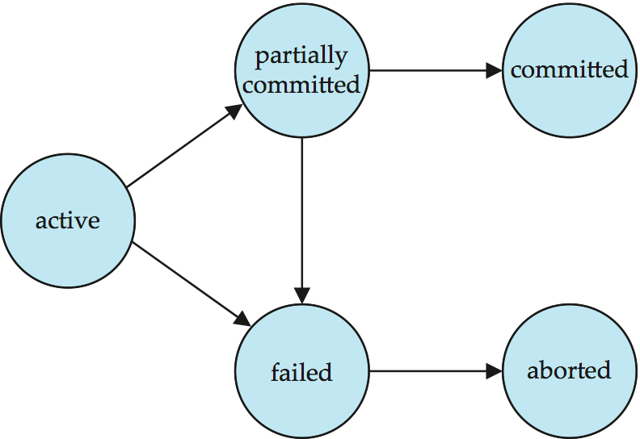
Transaction State (Cont.)

Slide 10
14.5 Transaction Isolation
Multiple transactions are allowed to run concurrently in the system. Advantages are:
  increased processor and disk utilization, leading to better transaction throughput
    E.g. one transaction can be using the CPU while another is reading from or writing to the disk
  reduced average response time for transactions: short transactions need not wait behind long ones.
Concurrency control schemes – mechanisms to achieve isolation
  that is, to control the interaction among the concurrent transactions in order to prevent them from destroying the consistency of the database
    Will study in Chapter 16, after studying notion of correctness of concurrent executions.

Slide 11
Concurrent Executions
Multiple transactions are allowed to run concurrently in the system. Advantages are:
  increased processor and disk utilization, leading to better transaction throughput
    E.g. one transaction can be using the CPU while another is reading from or writing to the disk
  reduced average response time for transactions: short transactions need not wait behind long ones.
Concurrency control schemes – mechanisms to achieve isolation
  that is, to control the interaction among the concurrent transactions in order to prevent them from destroying the consistency of the database

Slide 12
Schedules
Schedule – a sequences of instructions that specify the chronological order in which instructions of concurrent transactions are executed
  a schedule for a set of transactions must consist of all instructions of those transactions
  must preserve the order in which the instructions appear in each individual transaction.
A transaction that successfully completes its execution will have a commit instructions as the last statement
  by default transaction assumed to execute commit instruction as its last step
A transaction that fails to successfully complete its execution will have an abort instruction as the last statement

Slide 13
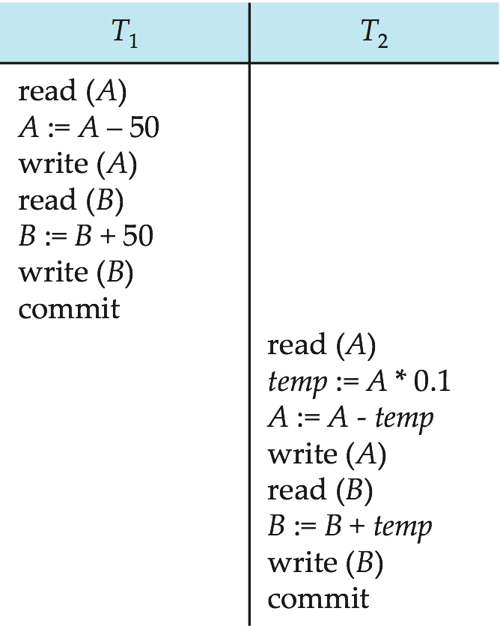
Schedule 1
Let T₁ transfer $50 from A to B, and T₂ transfer 10% of the balance from A to B. Suppose the current values of accounts A and B are $1000 and $2000, respectively.
A serial schedule in which T₁ is followed by T₂ :
A = 855
B = 2145
A+B = 3000

Slide 14
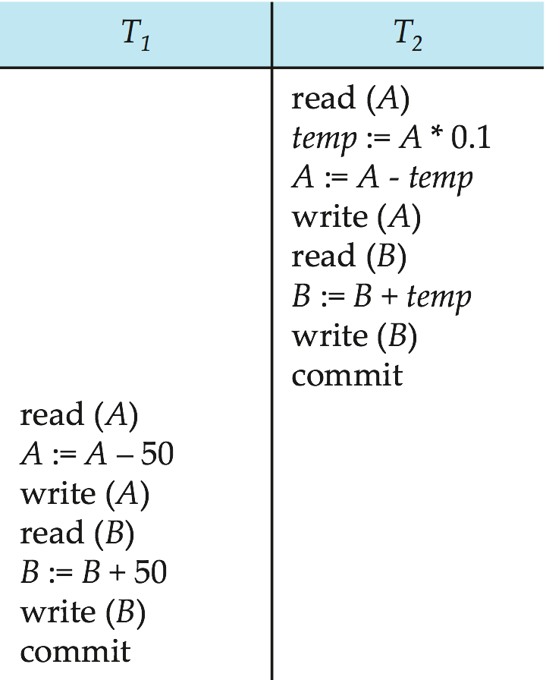
Schedule 2
A serial schedule where T₂ is followed by T₁
A = 850
B = 2150
A+B = 3000

Slide 15
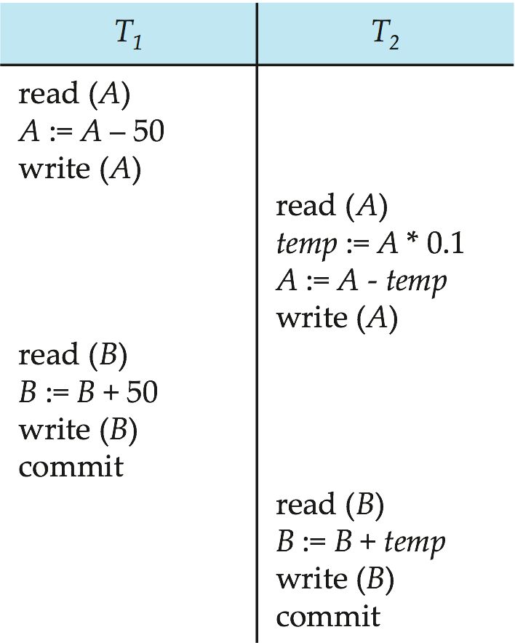
Schedule 3
Let T1 and T2 be the transactions defined previously. The following schedule is not a serial schedule, but it is equivalent to Schedule 1.
A = 855
B = 2145
A+B = 3000
The sum A + B is preserved.

Slide 16
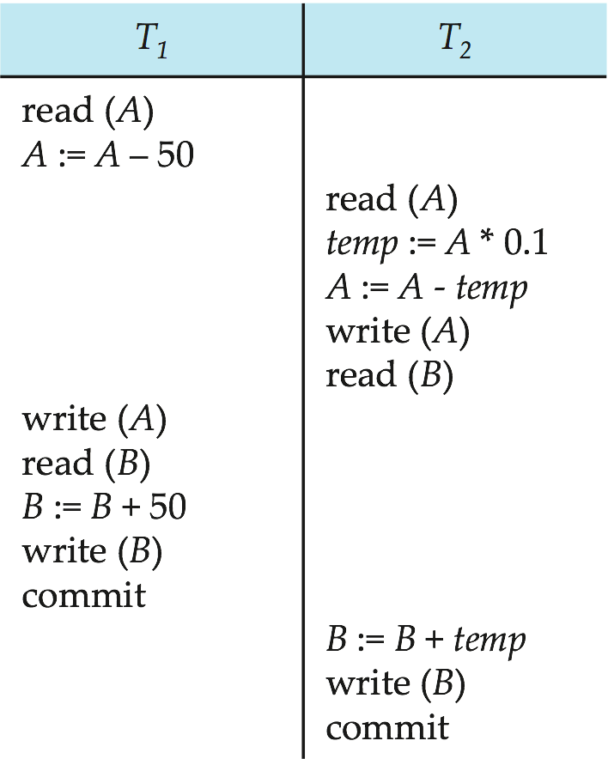
Schedule 4
The following concurrent schedule does not preserve the value of (A + B ).
A = 950
B = 2100
A+B = 3050
X

Slide 17
Serializable Schedules
We can ensure consistency of the database under concurrent execution by making sure that any schedule that is executed has the same effect as a schedule that could have occurred without any concurrent execution.
That is, the schedule should, in some sense, be equivalent to a serial schedule. Such schedules are called serializable schedules.

Slide 18
14.6 Serializability
Basic Assumption – Each transaction preserves database consistency.
Thus serial execution of a set of transactions preserves database consistency.
A (possibly concurrent) schedule is serializable if it is equivalent to a serial schedule. Different forms of schedule equivalence give rise to the notions of:
  1. conflict serializability
  2. view serializability

Slide 19
Simplified view of transactions
We ignore operations other than read and write instructions
We assume that transactions may perform arbitrary computations on data in local buffers in between reads and writes.
Our simplified schedules consist of only read and write instructions.

Slide 20
Conflicting Instructions
Instructions l_{i} and l_{j} of transactions T_{i} and T_{j} respectively, conflict if and only if there exists some item Q accessed by both l_{i} and l_{j}, and at least one of these instructions wrote Q.
1. l_{i} = read(Q), l_{j} = read(Q). l_{i} and l_{j} don’t conflict.
2. l_{i} = read(Q), l_{j} = write(Q). They conflict.
3. l_{i} = write(Q), l_{j} = read(Q). They conflict
4. l_{i} = write(Q), l_{j} = write(Q). They conflict
Intuitively, a conflict between l_{i} and l_{j} forces a (logical) temporal order between them.
  If l_{i} and l_{j} are consecutive in a schedule and they do not conflict, their results would remain the same even if they had been interchanged in the schedule.

Slide 21
Conflict Serializability
If a schedule S can be transformed into a schedule S´ by a series of swaps of non-conflicting instructions, we say that S and S´ are conflict equivalent.
We say that a schedule S is conflict serializable if it is conflict equivalent to a serial schedule

Slide 22
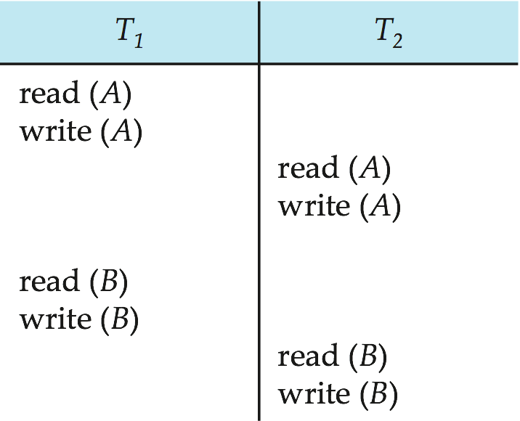
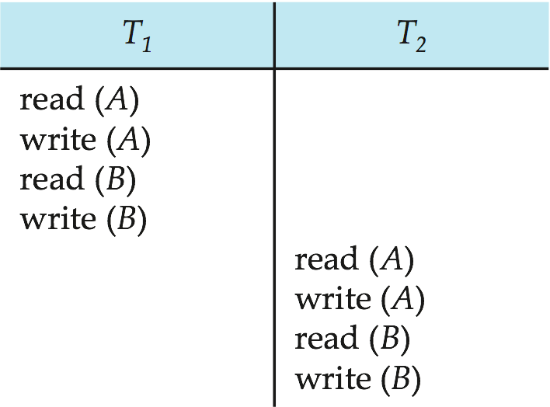
Conflict Serializability (Cont.)
Schedule 3 can be transformed into Schedule 6, a serial schedule where T₂ follows T₁, by series of swaps of non-conflicting instructions. Therefore Schedule 3 is conflict serializable.
Schedule 3
Schedule 6

Slide 23
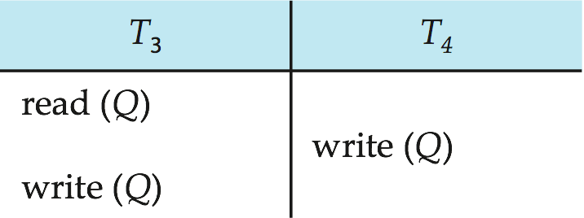
Conflict Serializability (Cont.)
Example of a schedule that is not conflict serializable:
We are unable to swap instructions in the above schedule to obtain either the serial schedule < T₃, T₄ >, or the serial schedule < T₄, T₃ >.

Slide 24
View Serializability
Let S and S´ be two schedules with the same set of transactions. S and S´ are view equivalent if the following three conditions are met, for each data item Q,
  If in schedule S, transaction T_{i} reads the initial value of Q, then in schedule S’ also transaction T_{i} must read the initial value of Q.
  If in schedule S transaction T_{i} executes read(Q), and that value was produced by transaction T_{j} (if any), then in schedule S’ also transaction T_{i} must read the value of Q that was produced by the same write(Q) operation of transaction T_{j} .
  The transaction (if any) that performs the final write(Q) operation in schedule S must also perform the final write(Q) operation in schedule S’.
As can be seen, view equivalence is also based purely on reads and writes alone.

Slide 25
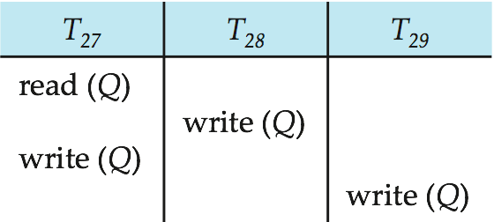
View Serializability (Cont.)
A schedule S is view serializable if it is view equivalent to a serial schedule.
Every conflict serializable schedule is also view serializable.
Below is a schedule which is view-serializable but not conflict serializable.
What serial schedule is above equivalent to?
Every view serializable schedule that is not conflict serializable has blind writes.

Slide 26
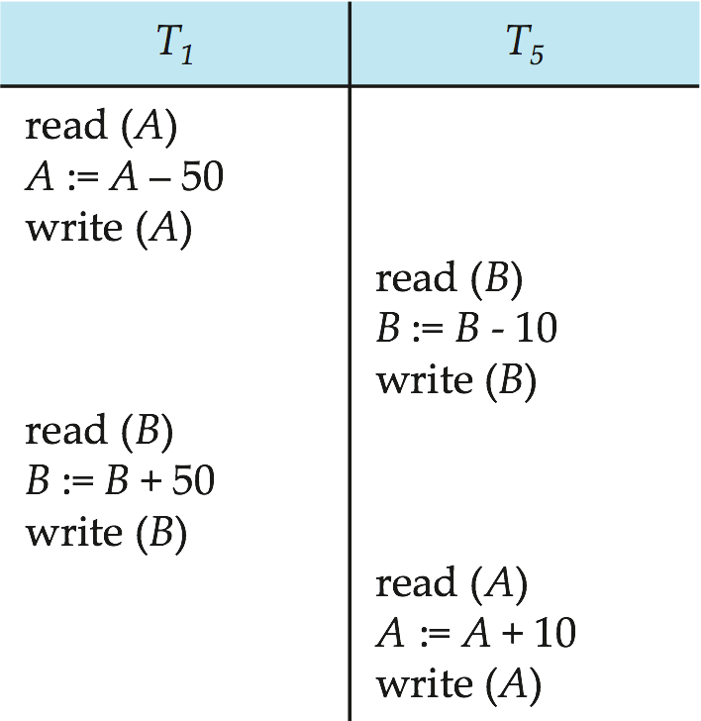
Other Notions of Serializability
The schedule below produces same outcome as the serial schedule < T₁, T₅ >, yet is not conflict equivalent or view equivalent to it.
Determining such equivalence requires analysis of operations other than read and write.

Slide 27
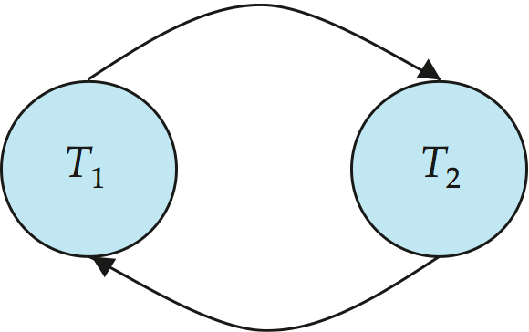
Testing for Serializability
Consider some schedule of a set of transactions T₁, T₂, ..., T_{n}
Precedence graph — a direct graph where the vertices are the transactions (names).
We draw an arc from T_{i} to T_{j} if the two transaction conflict, and T_{i} accessed the data item on which the conflict arose earlier.
We may label the arc by the item that was accessed.
Example 1

Slide 28
Example Schedule (Schedule A) + Precedence Graph
T₁ T₂ T₃ T₄ T₅
read(X)
read(Y)
read(Z)
read(V)
read(W)
read(W)
read(Y)
write(Y)
write(Z)
read(U)
read(Y)
write(Y)
read(Z)
write(Z)
read(U)
write(U)
T₁
T₂
T₄
T₃
T₅

Slide 29
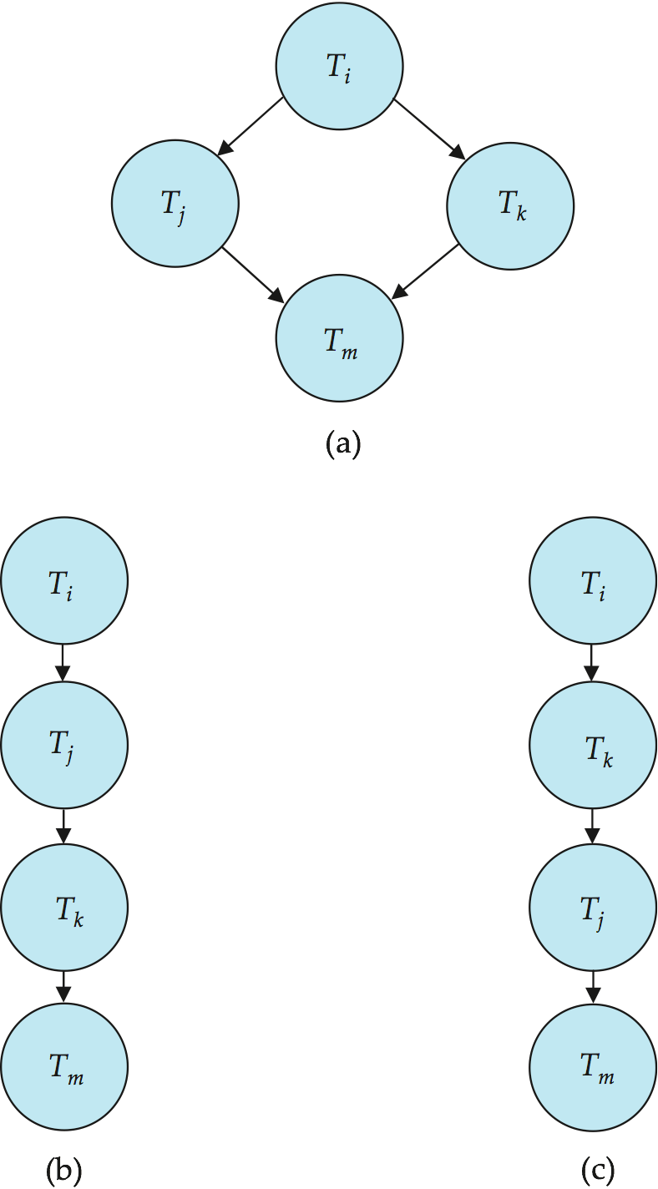
Test for Conflict Serializability
A schedule is conflict serializable if and only if its precedence graph is acyclic.
Cycle-detection algorithms exist which take order n² time, where n is the number of vertices in the graph.
  (Better algorithms take order n + e where e is the number of edges.)

Slide 30
Test for Conflict Serializability
If precedence graph is acyclic, the serializability order can be obtained by a topological sorting of the graph.
  This is a linear order consistent with the partial order of the graph.
  For example, a serializability order for Schedule A would be
  T₅ → T₁ → T₃ → T₂ → T₄
    Are there others?
T₁
T₂
T₄
T₃
T₅

Slide 31
Test for View Serializability
The precedence graph test for conflict serializability cannot be used directly to test for view serializability.
  Extension to test for view serializability has cost exponential in the size of the precedence graph.
The problem of checking if a schedule is view serializable falls in the class of NP-complete problems.
  Thus existence of an efficient algorithm is extremely unlikely.
However practical algorithms that just check some sufficient conditions for view serializability can still be used.

Slide 32
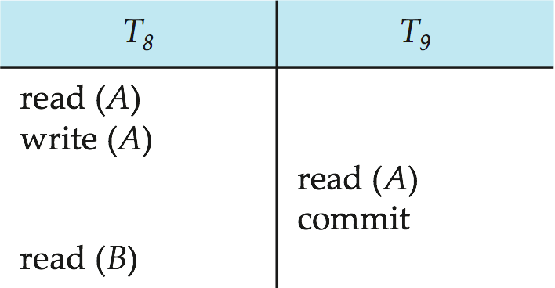
14.7 Transaction Isolation and Atomicity
Need to address the effect of transaction failures on concurrently
running transactions.
The following schedule (Schedule 11) is not recoverable if T₉ commits immediately after the read
If T₈ should abort, T₉ would have read (and possibly shown to the user) an inconsistent database state. Hence, database must ensure that schedules are recoverable.
Recoverable schedule — if a transaction T_{j} reads a data item previously written by a transaction T_{i} , then the commit operation of T_{i} appears before the commit operation of T_{j}.

Slide 33
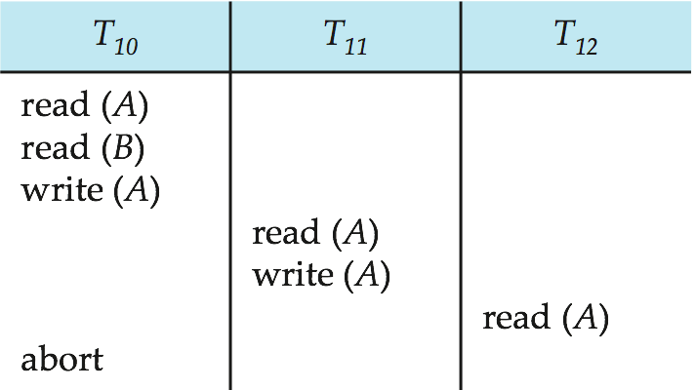
Cascading Rollbacks
Even if a schedule is recoverable, to recover correctly from the failure of a transaction T_{i} , we may have to roll back several transactions
Cascading rollback – a single transaction failure leads to a series of transaction rollbacks. Consider the following schedule where none of the transactions has yet committed (so the schedule is recoverable)
If T₁₀ fails, T₁₁ and T₁₂ must also be rolled back.

Slide 34
Cascadeless Schedules
Cascading rollback is undesirable, since it leads to the undoing of a significant amount of work.
Cascadeless schedules — cascading rollbacks cannot occur; for each pair of transactions T_{i} and T_{j} such that T_{j} reads a data item previously written by T_{i}, the commit operation of T_{i} appears before the read operation of T_{j}.
Every cascadeless schedule is also recoverable

Slide 35
Concurrency Control
A database must provide a mechanism that will ensure that all possible schedules are
  either conflict or view serializable, and
  are recoverable and preferably cascadeless
A policy in which only one transaction can execute at a time generates serial schedules, but provides a poor degree of concurrency
  Are serial schedules recoverable/cascadeless?
Testing a schedule for serializability after it has executed is a little too late!
Goal – to develop concurrency control protocols that will assure serializability.

Slide 36
Concurrency Control vs. Serializability Tests
Concurrency-control protocols allow concurrent schedules, but ensure that the schedules are conflict/view serializable, and are recoverable and cascadeless .
Concurrency control protocols generally do not examine the precedence graph as it is being created
  Instead a protocol imposes a discipline that avoids nonseralizable schedules.
  We study such protocols in Chapter 16.
Different concurrency control protocols provide different tradeoffs between the amount of concurrency they allow and the amount of overhead that they incur.
Tests for serializability help us understand why a concurrency control protocol is correct.

Slide 37
14.8 Transaction Isolation Levels
可串行化调度是保证熟即可一致性的理想方案，但保证绝对的可串行化有可能只能满足极小的并发度。现实中为了提高系统响应时间，SQL标准允许事务可以以一种与其他事务不可串行化的方式来执行。
Serializable — 保证可串行化调度
Repeatable read — 只允许读取已提交数据，一个事务两读取同一数据项的时候，其他事务不得更新该数据，但不要求该事务与其他事务可串行化
Read committed — 只允许读取已提交数据，但不要求可重复读
Read uncommitted — 允许读取未提交数据。这是SQL允许的最低一致性级别。

Slide 38
Transaction Definition in SQL
Data manipulation language must include a construct for specifying the set of actions that comprise a transaction.
In SQL, a transaction begins implicitly.
A transaction in SQL ends by:
  Commit work commits current transaction and begins a new one.
  Rollback work causes current transaction to abort.
In almost all database systems, by default, every SQL statement also commits implicitly if it executes successfully
  Implicit commit can be turned off by a database directive
    E.g. in JDBC, connection.setAutoCommit(false);

Slide 39
Assignment
14.12
14.15

Slide 40
End of Chapter

