Slide 1
Chapter 15 : Concurrency Control

Slide 2
15.1 Lock-Based Protocols
A lock is a mechanism to control concurrent access to a data item
Data items can be locked in two modes :
1. exclusive (X) mode. Data item can be both read as well as written. X-lock is requested using lock-X instruction.
2. shared (S) mode. Data item can only be read. S-lock is requested using lock-S instruction.
Lock requests are made to concurrency-control manager. Transaction can proceed only after request is granted.

Slide 3
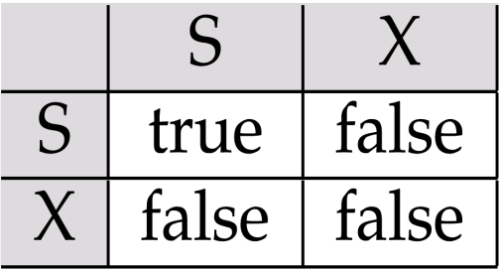
Lock-Based Protocols (Cont.)
Lock-compatibility matrix
A transaction may be granted a lock on an item if the requested lock is compatible with locks already held on the item by other transactions
Any number of transactions can hold shared locks on an item,
  but if any transaction holds an exclusive on the item no other transaction may hold any lock on the item.
If a lock cannot be granted, the requesting transaction is made to wait till all incompatible locks held by other transactions have been released. The lock is then granted.

Slide 4
Lock-Based Protocols (Cont.)
Example of a transaction performing locking:
T₂: lock-S(A);
read (A);
unlock(A);
lock-S(B);
read (B);
unlock(B);
display(A+B)
Locking as above is not sufficient to guarantee serializability — if A and B get updated in-between the read of A and B, the displayed sum would be wrong.
A locking protocol is a set of rules followed by all transactions while requesting and releasing locks. Locking protocols restrict the set of possible schedules.

Slide 5
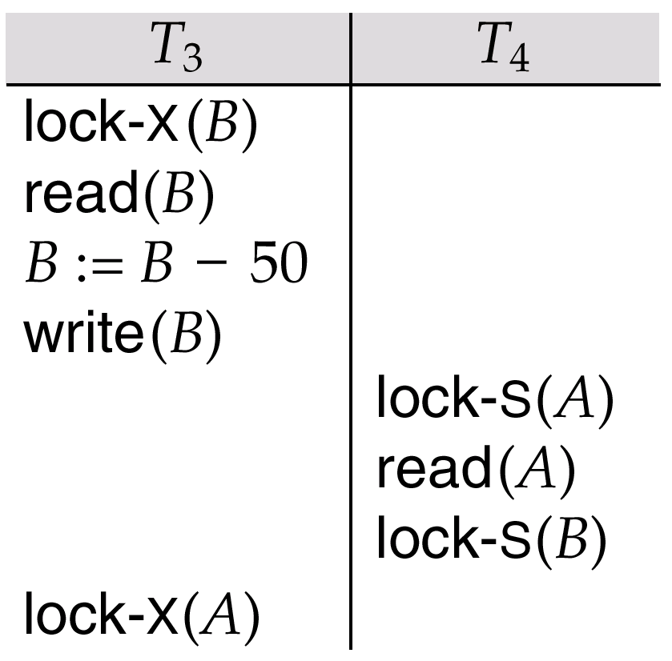
Pitfalls of Lock-Based Protocols
Consider the partial schedule
Neither T₃ nor T₄ can make progress — executing lock-S(B) causes T₄ to wait for T₃ to release its lock on B, while executing lock-X(A) causes T₃ to wait for T₄ to release its lock on A.
Such a situation is called a deadlock.
  To handle a deadlock one of T₃ or T₄ must be rolled back
  and its locks released.

Slide 6
Pitfalls of Lock-Based Protocols (Cont.)
The potential for deadlock exists in most locking protocols. Deadlocks are a necessary evil.
Starvation is also possible if concurrency control manager is badly designed. For example:
  A transaction may be waiting for an X-lock on an item, while a sequence of other transactions request and are granted an S-lock on the same item.
  The same transaction is repeatedly rolled back due to deadlocks.
T1 | T2 | T3 | T4
 | lock-S(A)
lock-X(A) | … | lock-S(A)
Wait… | … | … | lock-S(A)
Wait… | … | … | …

Slide 7
The Two-Phase Locking Protocol
This is a protocol which ensures conflict-serializable schedules.
Phase 1: Growing Phase
  transaction may obtain locks
  transaction may not release locks
Phase 2: Shrinking Phase
  transaction may release locks
  transaction may not obtain locks
The protocol assures serializability. It can be proved that the transactions can be serialized in the order of their lock points (i.e. the point where a transaction acquired its final lock).

Slide 8
The Two-Phase Locking Protocol (Cont.)
Two-phase locking does not ensure freedom from deadlocks

Slide 9
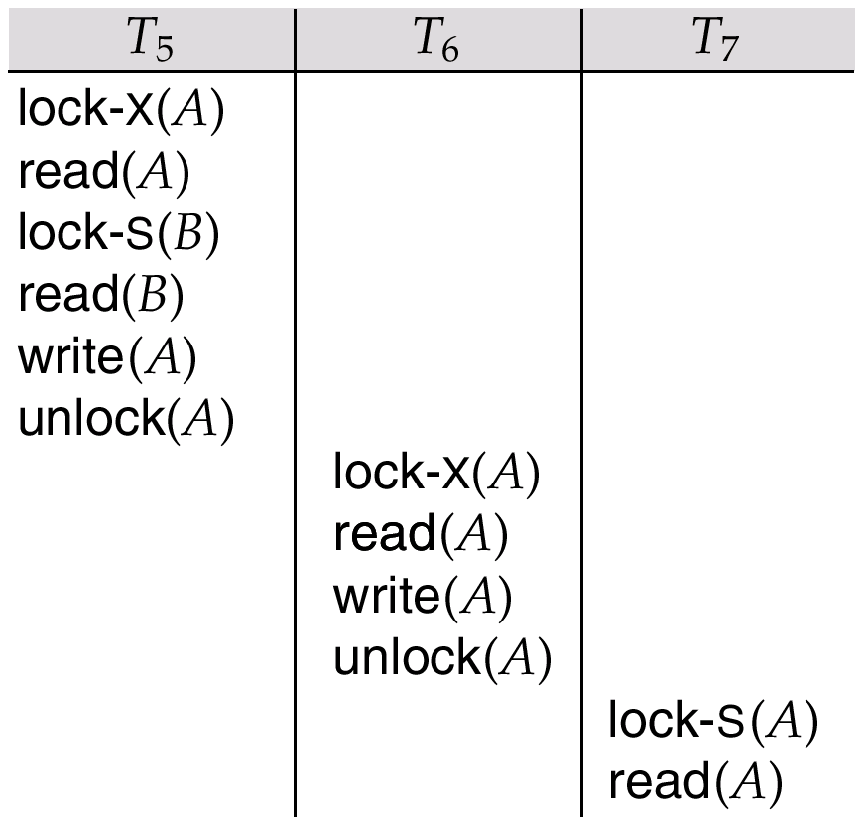
Partial Schedule Under Two-Phase Locking
Cascading roll-back is possible under two-phase locking.
To avoid this, follow a modified protocol called strict two-phase locking. Here a transaction must hold all its exclusive locks till it commits/aborts.
Rigorous two-phase locking is even stricter: here all locks are held till commit/abort. In this protocol transactions can be serialized in the order in which they commit.
事务T₇的 read(A)步骤之后事务T₅发生故障，从而导致T₆与T₇级联回滚。

Slide 10
Lock Conversions
Two-phase locking with lock conversions:
– First Phase:
  can acquire a lock-S on item
  can acquire a lock-X on item
  can convert a lock-S to a lock-X (upgrade)
– Second Phase:
  can release a lock-S
  can release a lock-X
  can convert a lock-X to a lock-S (downgrade)
This protocol assures serializability. But still relies on the programmer to insert the various locking instructions.

Slide 11
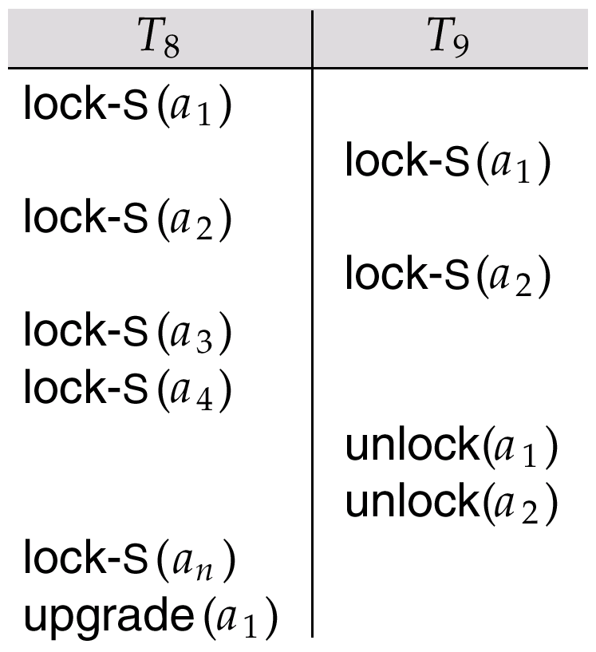
Incomplete Schedule With a Lock Conversion
T8:
  Read(a1)
  Read(a2)
  ……
  Read(an)
  Write(a1)
T9:
  Read(a1)
  Read(a2)
  Display(a1 + a2)
T8 and T9 can access a1 and a2 simultaneously.
If we employ the two-phase locking protocol, then T8 musk lock a1 in X-mode. Then any concurrent execution of both transactions amounts to a serial execution.

Slide 12
Implementation of Locking
A lock manager can be implemented as a separate process to which transactions send lock and unlock requests.
The lock manager replies to a lock request by sending a lock grant messages (or a message asking the transaction to roll back, in case of a deadlock).
The requesting transaction waits until its request is answered.
The lock manager maintains a data-structure called a lock table to record granted locks and pending requests.
The lock table is usually implemented as an in-memory hash table indexed on the name of the data item being locked.

Slide 13
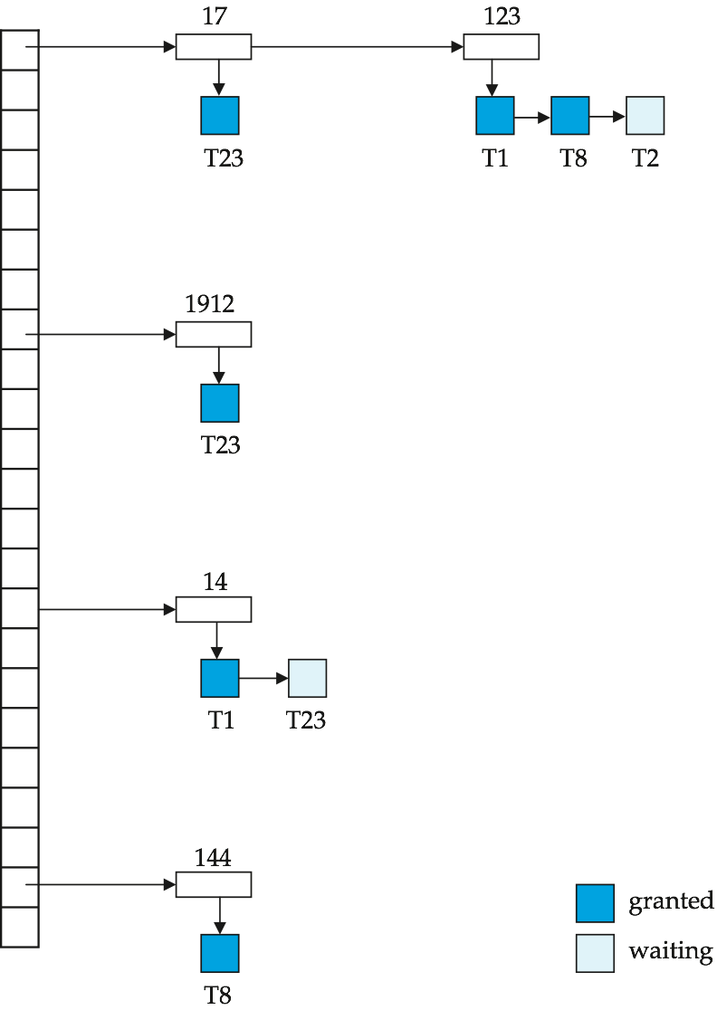
Lock Table
Deep blue rectangles indicate granted locks, light ones indicate waiting requests
Lock table also records the type of lock granted or requested
New request is added to the end of the queue of requests for the data item, and granted if it is compatible with all earlier locks
Unlock requests result in the request being deleted, and later requests are checked to see if they can now be granted
If transaction aborts, all waiting or granted requests of the transaction are deleted
  lock manager may keep a list of locks held by each transaction, to implement this efficiently

Slide 14
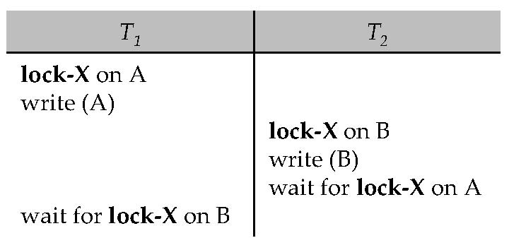
15.2 Deadlock Handling
A system is in a deadlock state if there exists a set of transactions such that every transaction in the set is waiting for another transaction in the set.
Schedule with deadlock
There are two principal methods:
  deadlock prevention protocol to ensure that the system will never enter a deadlock state
  allow the system to enter a deadlock state, and then try to recover by using a deadlock detection and deadlock recovery scheme

Slide 15
15.2.1 Deadlock Handling
Deadlock prevention protocols ensure that the system will never enter into a deadlock state. Some prevention strategies :
  要求每个事务在开始之前封锁它的所有数据项(先声明)
    事务开始之前很难预知所需要的所有数据项
    导致数据项的使用率很低
  对所有数据项强加一个次序，事务只能按要求的次序顺序封锁数据项
    例如：两阶段锁协议

Slide 16
More Deadlock Prevention Strategies
The second approach for preventing deadlocks is to use preemption (抢占) and transaction rollbacks (事务回滚).
  wait-die scheme — non-preemptive
    older transaction may wait for younger one to release data item. Younger transactions never wait for older ones; they are rolled back instead.
    a transaction may die several times before acquiring needed data item
  wound-wait scheme — preemptive
    older transaction wounds (forces rollback) of younger transaction instead of waiting for it. Younger transactions may wait for older ones.
    may be fewer rollbacks than wait-die scheme.
Both in wait-die and in wound-wait schemes, a rolled back transactions is restarted with its original timestamp. Older transactions thus have precedence over newer ones, and starvation is hence avoided.

Slide 17
Deadlock prevention (Cont.)
Another simple approach to deadlock prevention is based on lock timeouts.:
  a transaction waits for a lock only for a specified amount of time. After that, the wait times out and the transaction is rolled back.
  thus deadlocks are not possible
  simple to implement; but starvation is possible. Also difficult to determine good value of the timeout interval.

Slide 18
15.2.2 Deadlock Detection
Deadlocks can be described as a wait-for graph, which consists of a pair G = (V,E),
  V is a set of vertices (all the transactions in the system)
  E is a set of edges; each element is an ordered pair T_{i} →T_{j}.
If T_{i} → T_{j} is in E, then there is a directed edge from T_{i} to T_{j}, implying that T_{i} is waiting for T_{j} to release a data item.
When T_{i} requests a data item currently being held by T_{j}, then the edge T_{i} T_{j} is inserted in the wait-for graph. This edge is removed only when T_{j} is no longer holding a data item needed by T_{i}.
The system is in a deadlock state if and only if the wait-for graph has a cycle. Must invoke a deadlock-detection algorithm periodically to look for cycles.

Slide 19
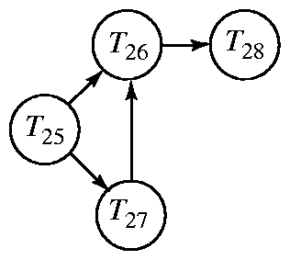
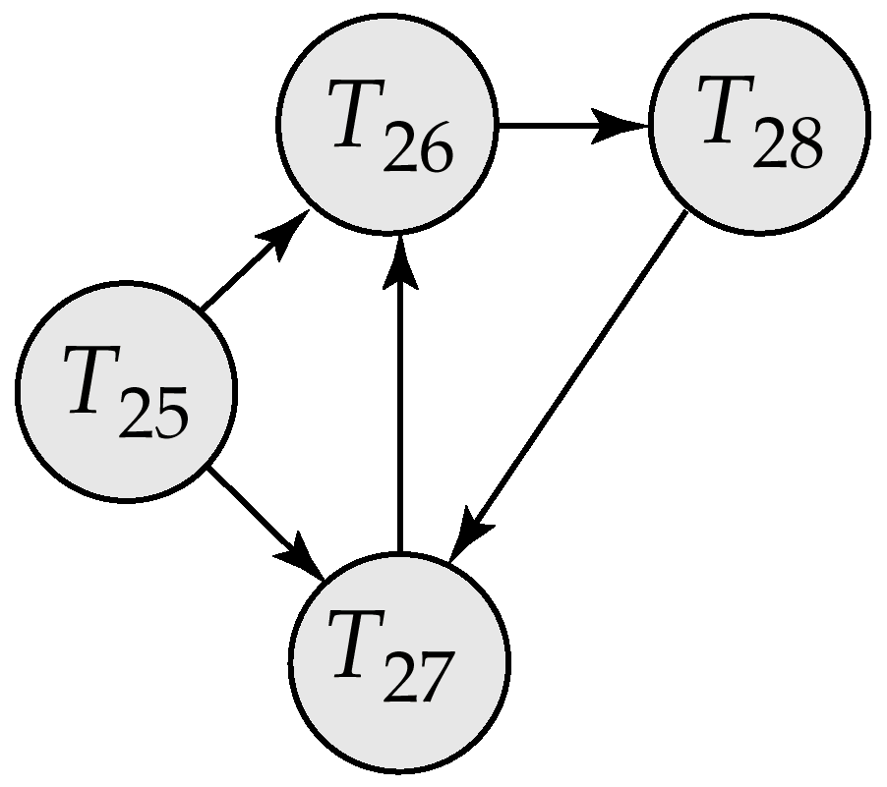
Deadlock Detection (Cont.)
Wait-for graph without a cycle
Wait-for graph with a cycle

Slide 20
Deadlock Recovery
When deadlock is detected :
  Selection of a victim. Some transaction will have to rolled back (made a victim) to break deadlock. Select that transaction as victim that will incur minimum cost.
    a. How long the transaction has computed, and how much longer the transaction will compute before it completes its designated task.
    b. How many data items the transaction has used.
    c. How many more data items the transaction needs for it to complete.
    d. How many transactions will be involved in the rollback.
  Rollback -- determine how far to roll back transaction
    Total rollback: Abort the transaction and then restart it.
    More effective to roll back transaction only as far as necessary to break deadlock.
  Starvation happens if same transaction is always chosen as victim. Include the number of rollbacks in the cost factor to avoid starvation

Slide 21
15.4 Timestamp-Based Protocols
Each transaction is issued a timestamp when it enters the system. If an old transaction T_{i} has time-stamp TS(T_{i}), a new transaction T_{j} is assigned time-stamp TS(T_{j}) such that TS(T_{i}) <TS(T_{j}).
The protocol manages concurrent execution such that the time-stamps determine the serializability order.
In order to assure such behavior, the protocol maintains for each data Q two timestamp values:
  W-timestamp(Q) 表示成功执行write(Q)的所有事务的最大时间戳.
  R-timestamp(Q)表示成功执行read(Q的所有事务的最大时间戳.

Slide 22
Timestamp-Based Protocols (Cont.)
基于时间戳的排序协议可以保证任何有冲突的read 和 write 操作按时间戳顺序执行。
Suppose a transaction T_{i} issues a read(Q):
  If TS(T_{i}) ≤ W-timestamp(Q), then T_{i} needs to read a value of Q that was already overwritten.
    Hence, the read operation is rejected, and T_{i} is rolled back.
  If TS(T_{i})≥ W-timestamp(Q), then the read operation is executed, and R-timestamp(Q) is set to max(R-timestamp(Q), TS(T_{i})).

Slide 23
Timestamp-Based Protocols (Cont.)
Suppose that transaction T_{i} issues write(Q).
  If TS(T_{i}) < R-timestamp(Q), then the value of Q that T_{i} is producing was needed previously, and the system assumed that that value would never be produced.
    Hence, the write operation is rejected, and T_{i} is rolled back.
  If TS(T_{i}) < W-timestamp(Q), then T_{i} is attempting to write an obsolete value of Q.
    Hence, this write operation is rejected, and T_{i} is rolled back.
  Otherwise, the write operation is executed, and W-timestamp(Q) is set to TS(T_{i}).

Slide 24
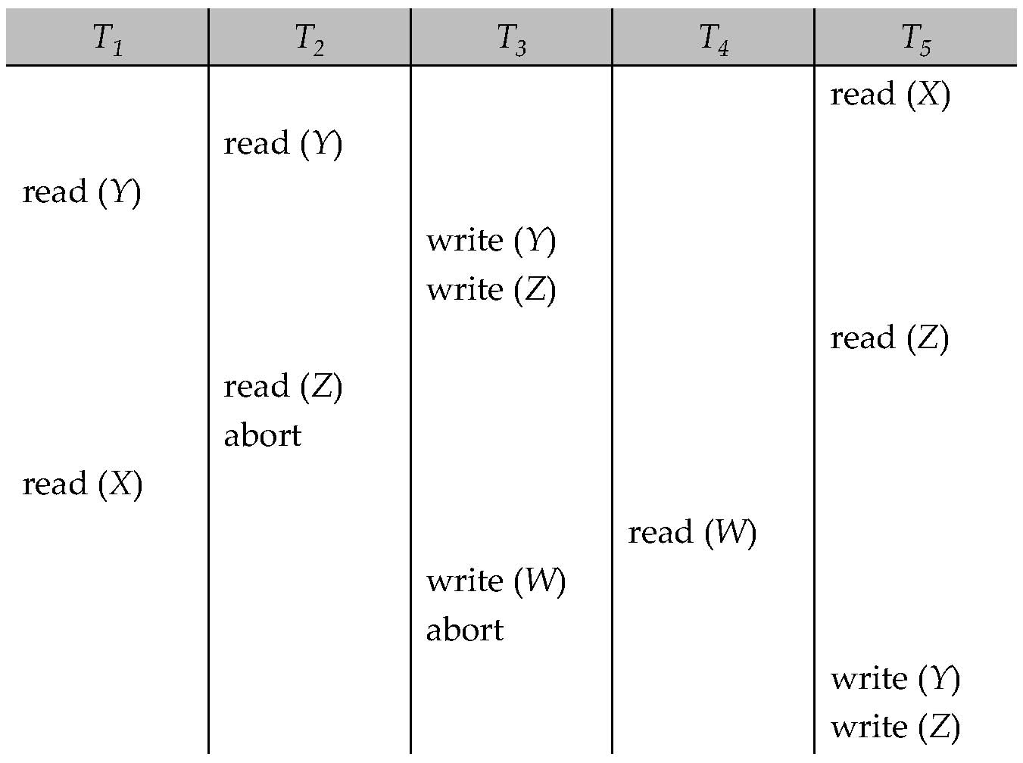
Example Use of the Protocol
A partial schedule for several data items for transactions with
timestamps 1, 2, 3, 4, 5. (Analysis it by youself)

Slide 25
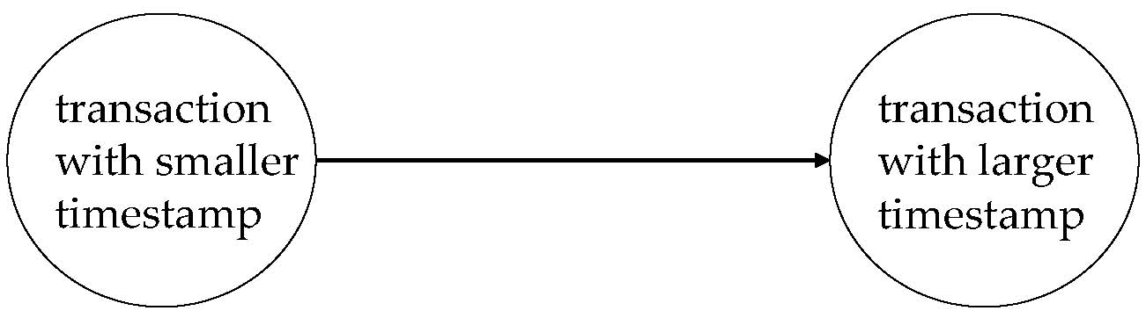
Correctness of Timestamp-Ordering Protocol
The timestamp-ordering protocol guarantees serializability since all the arcs in the precedence graph are of the form:
Thus, there will be no cycles in the precedence graph.
Timestamp protocol ensures freedom from deadlock as no transaction ever waits.
But the schedule may not be cascade-free, and may not even be recoverable.

Slide 26
End of Chapter

Slide 27
Assignment
15.21,29
A scheduled flight has 50 tickets. Agency one wants to book 10 tickets and agency two want to book 20 tickets. Please design a lock strategy to implement the concurrency control.
Agency one | Agency two
Read(A)
 | Read(A)
A=A-10
Write(A)
 | A=A-20
 | Write(A)

