Slide 1
Chapter 4: Intermediate SQL

Slide 2
Chapter 4: Intermediate SQL
Join Expressions
Views
Transactions
Integrity Constraints
SQL Data Types and Schemas
Authorization
Notes:
1

Slide 3
Joined Relations
Join operations take two relations and return as a result another relation.
A join operation is a Cartesian product which requires that tuples in the two relations match (under some condition). It also specifies the attributes that are present in the result of the join
The join operations are typically used as subquery expressions in the from clause

Slide 4
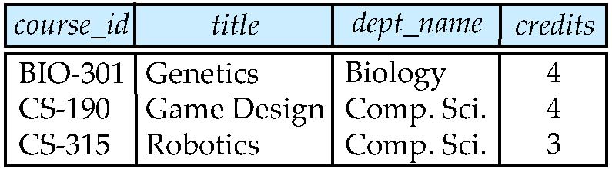
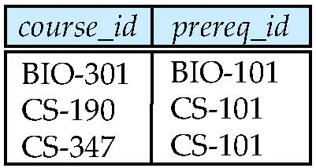
Join operations – Example
Relation course
Relation prereq
Observe that
prereq information is missing for CS-315 and
course information is missing for CS-347

Slide 5
Outer Join
An extension of the join operation that avoids loss of information.
Computes the join and then adds tuples form one relation that does not match tuples in the other relation to the result of the join.
Uses null values.

Slide 6
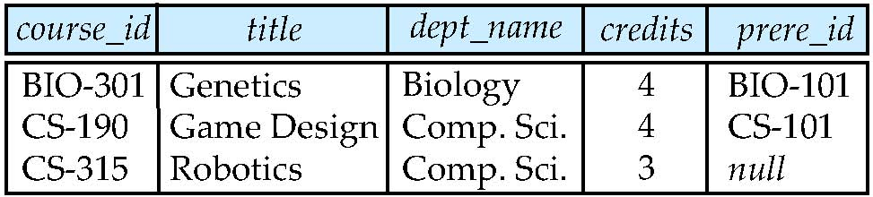
Left Outer Join
  select *
  from course natural left outer join prereq
course
prereq

Slide 7
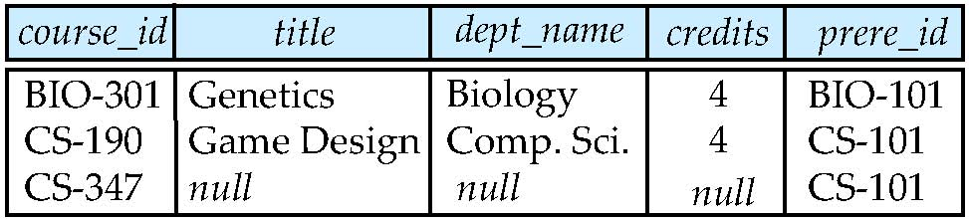
Right Outer Join
  select *
  from course natural right outer join prereq
course
prereq

Slide 8
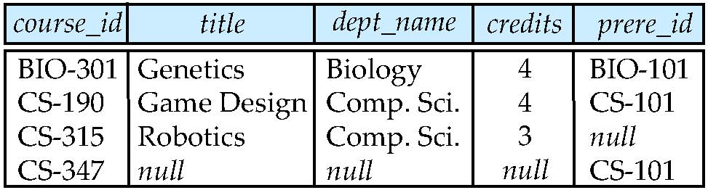
Full Outer Join
  select *
  from course natural full outer join prereq
course
prereq

Slide 9
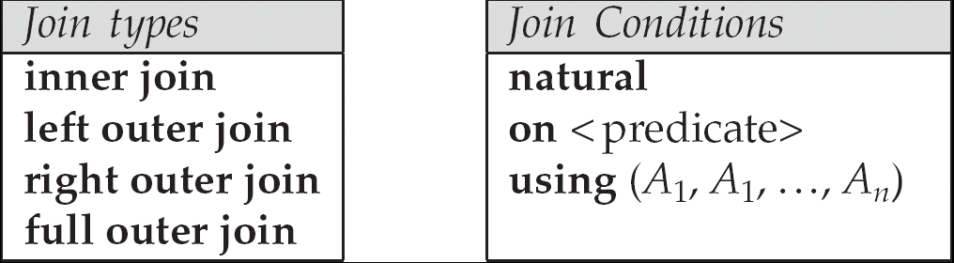
Joined Relations
Join operations take two relations and return as a result another relation.
These additional operations are typically used as subquery expressions in the from clause
Join condition – defines which tuples in the two relations match, and what attributes are present in the result of the join.
Join type – defines how tuples in each relation that do not match any tuple in the other relation (based on the join condition) are treated.

Slide 10
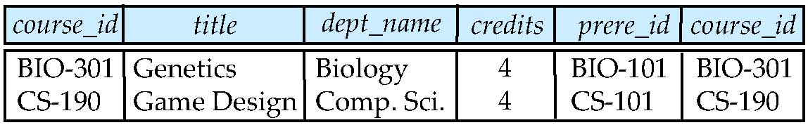
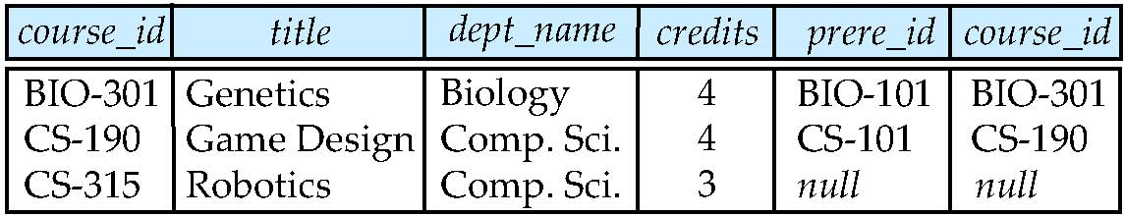
Joined Relations – Examples
course inner join prereq on
course.course_id = prereq.course_id
What is the difference between the above, and a natural join?
course left outer join prereq on
course.course_id = prereq.course_id

Slide 11
Joined Relations – Examples
course natural right outer join prereq
course full outer join prereq using (course_id)

Slide 12
Views
In some cases, it is not desirable for all users to see the entire logical model (that is, all the actual relations stored in the database.)
Consider a person who needs to know an instructors name and department, but not the salary. This person should see a relation described, in SQL, by
select ID, name, dept_name
from instructor
A view provides a mechanism to hide certain data from the view of certain users.
Any relation that is not of the conceptual model but is made visible to a user as a “virtual relation” is called a view.

Slide 13
View Definition
A view is defined using the create view statement which has the form
create view v as < query expression >
where <query expression> is any legal SQL expression. The view name is represented by v.
Once a view is defined, the view name can be used to refer to the virtual relation that the view generates.
View definition is not the same as creating a new relation by evaluating the query expression
  Rather, a view definition causes the saving of an expression; the expression is substituted into queries using the view.

Slide 14
View
Base table 1
Base table 2

Slide 15
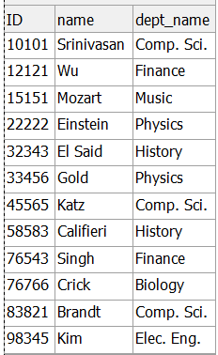


Example Views
A view of instructors without their salary
  create view faculty as
  select ID, name, dept_name
  from instructor
Find all instructors in the Biology department
select name
from faculty
where dept_name = 'Biology'

Slide 16
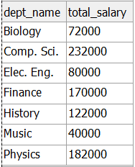
Example Views
Create a view of department salary totals
create view departments_total_salary as
select dept_name, sum (salary) as total_salary
from instructor
group by dept_name;

Slide 17
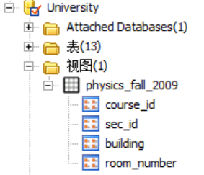
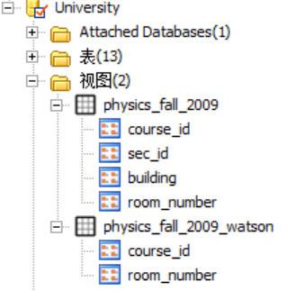
Views Defined Using Other Views
create view physics_fall_2009 as
select course.course_id, sec_id, building, room_number
from course, section
where course.course_id = section.course_id
and course.dept_name = ’Physics’
and section.semester = ’Fall’
and section.year = ’2009’;
create view physics_fall_2009_watson as
select course_id, room_number
from physics_fall_2009
where building= ’Watson’;

Slide 18
View Expansion
Expand use of a view in a query/another view
create view physics_fall_2009_watson as
(select course_id, room_number
from ( select course.course_id, building, room_number
from course, section
where course.course_id = section.course_id
and course.dept_name = ’Physics’
and section.semester = ’Fall’
and section.year = ’2009’)
where building= ’Watson’;)

Slide 19
Views Defined Using Other Views
One view may be used in the expression defining another view
A view relation v₁ is said to depend directly on a view relation v₂ if v₂ is used in the expression defining v₁
A view relation v₁ is said to depend on view relation v₂ if either v₁ depends directly to v₂ or there is a path of dependencies from v₁ to v₂
A view relation v is said to be recursive if it depends on itself.

Slide 20
View Expansion
A way to define the meaning of views defined in terms of other views.
Let view v₁ be defined by an expression e₁ that may itself contain uses of view relations.
View expansion of an expression repeats the following replacement step:
repeat
Find any view relation v_{i} in e₁
Replace the view relation v_{i} by the expression defining v_{i}
until no more view relations are present in e₁
As long as the view definitions are not recursive, this loop will terminate

Slide 21
Update of a View
Add a new tuple to faculty view which we defined earlier
insert into faculty values ('30765', 'Green', 'Music');
This insertion must be represented by the insertion of the tuple
('30765', 'Green', 'Music', null)
into the instructor relation

Slide 22
Some Updates cannot be Translated Uniquely
create view departments_total_salary as
select dept_name, sum (salary) as total_salary
from instructor
group by dept_name;
insert into departments_total_salary values (‘Biology', 111000);
    How it works?
Most SQL implementations allow updates only on simple views
  The from clause has only one database relation.
  The select clause contains only attribute names of the relation, and does not have any expressions, aggregates, or distinct specification.
  Any attribute not listed in the select clause can be set to null
  The query does not have a group by or having clause.

Slide 23
为什么需要视图（视图的优点）
核心作用 1：控制数据访问权限，保障数据安全
  数据库中常存在敏感数据（如用户身份证号、员工薪资、客户联系方式），但不同角色（如普通员工、管理员、外部合作方）对数据的访问需求不同。视图是实现 “精细化权限控制” 的核心工具，避免直接暴露基础表的全部数据。
  场景示例：某公司的 “员工表” 包含员工ID、姓名、部门、薪资、身份证号5 个字段。
    给部门主管的权限：需查看本部门员工的ID、姓名、部门，但不能看薪资、身份证号；
    给 HR 的权限：需查看所有员工的完整信息（含薪资、身份证号）。
  解决方案：创建两个视图
    给部门主管的 “部门员工视图”：仅包含ID、姓名、部门字段，且通过WHERE 部门=当前主管所在部门过滤数据；
    给 HR 的 “完整员工视图”：包含全部字段。
  效果：主管只能通过视图看到授权范围内的数据，无法接触敏感信息，从逻辑层阻断了数据泄露风险，无需修改基础表结构或单独维护多份数据。

Slide 24
为什么需要视图（视图的优点）
核心作用 2：简化复杂查询，降低操作门槛
  实际业务中，频繁用到的查询可能涉及多表关联、复杂过滤、聚合计算（如 “查询近 3 个月各门店的销售额排名” 需关联 “门店表、订单表、商品表”，并计算总和、排序）。若每次操作都重复写长 SQL，不仅效率低，还易出错。视图可将复杂查询 “固化” 为虚拟表，后续使用时直接调用视图名，无需重复编写底层逻辑。
  场景示例：电商平台需频繁统计 “每个用户的近 1 年订单数、总消费金额”，原始 SQL 需关联用户表和订单表，并使用COUNT()、SUM()聚合函数，且过滤订单时间>=DATE_SUB(NOW(),INTERVAL 1 YEAR)。
  解决方案：创建 “用户消费统计视图”，将上述复杂 SQL 定义为视图。
  效果：各部门（如运营、财务）只需执行SELECT * FROM 用户消费统计视图 WHERE 用户ID=xxx，即可快速获取数据，无需理解多表关联逻辑，降低了非技术人员的操作门槛，也避免了重复编写 SQL 的错误。
用户消费统计视图（含聚合函数，统计数据）
门店表
订单表
商品表

Slide 25
为什么需要视图（视图的优点）
核心作用 3：实现 “逻辑数据独立”，隔离基础表变更
  数据库的基础表结构可能因业务需求调整（如新增字段、修改字段名、拆分表），若应用程序直接依赖基础表，每次结构变更都需修改所有关联的 SQL 语句（如报表、接口、前端查询），成本极高。视图可作为 “中间层”，隔离基础表与应用程序的直接关联 —— 即使基础表结构变更，只需修改视图的定义语句，应用程序调用视图的方式无需改变，实现 “逻辑数据独立”。
  场景示例：某系统的 “客户表” 原本包含客户ID、姓名、电话，后因业务需求，将 “电话” 拆分为手机号、固话两个字段。若之前有 100 个报表直接查询客户表.电话，现在需全部修改为客户表.手机号，成本极高。
  解决方案：提前创建 “客户信息视图”，包含客户ID、姓名、电话（由手机号+固话拼接而成）。
  效果：基础表拆分字段后，只需修改视图的电话字段定义（如CONCAT(手机号, ' / ', 固话) AS 电话），所有报表仍可通过视图查询电话字段，无需修改报表逻辑，大幅降低变更成本。

Slide 26
为什么需要视图（视图的优点）
核心作用 4：聚合分散数据，适配多业务场景
  实际业务中，同一业务对象的关键信息常因 “数据分类管理” 需求，分散在多张基础表中（客户订单信息可能与 “客户表”“订单主表”“订单明细表”“商品表”相关），但业务人员（如客服、财务）需要的是 “关联整合后的完整信息”（如 “某客户某笔订单的商品明细、下单时间、应付金额”）。此时视图可将多表分散数据 “一键聚合为虚拟表”，直接匹配业务查询需求，无需每次手动写复杂的多表关联 SQL。
  场景示例：某电商平台的数据库中，与 “订单” 相关的核心数据分散在 4 张基础表中，当客户致电客服询问 “我上周下的订单里买了什么商品？什么时候下的单？总共花了多少钱？” 时，客服需要的是 “整合后的完整信息”—— 包括客户姓名、订单 ID、下单时间、应付总金额、商品名称、购买数量、商品单价。
  解决方案：提前将上述 4 表关联的逻辑封装为视图
  效果：客服后续查询时，只需执行简单的单表查询 SQL，即可快速获取整合后的完整订单详情，无需理解底层多表关联逻辑。同时，财务部门核算 “某客户的年度消费明细”、运营部门分析 “某商品的购买客户画像” 时，也可直接复用该视图，无需重复开发关联逻辑，实现 “一份视图，多业务复用”，大幅提升跨部门协作效率。
  CREATE VIEW 订单详情聚合视图 AS
  SELECT ……
  FROM 客户表 u
  JOIN 订单主表 om ON u.客户ID = om.客户ID
  JOIN 订单明细表 od ON om.订单ID = od.订单ID
  JOIN 商品表 p ON od.商品ID = p.商品ID;

Slide 27
为什么需要视图（视图的优点）
核心作用 5：支持 “数据脱敏”，满足合规要求
  在数据共享场景（如对外提供数据、跨部门协作）中，需对敏感数据进行 “脱敏处理”（如隐藏身份证号的中间 6 位、将手机号显示为 “138****5678”），避免原始敏感数据泄露，同时满足《数据安全法》《个人信息保护法》等合规要求。视图可在定义时直接对敏感字段进行脱敏处理，输出的虚拟表中仅包含脱敏后的数据，不影响基础表的原始数据。
  场景示例：某银行需向合作的征信公司提供 “客户基本信息”，但需隐藏客户的身份证号（原始格式：110101199001011234）和手机号（原始格式：13812345678）。
  解决方案：创建 “客户脱敏视图”，通过函数处理敏感字段：
    身份证号：CONCAT(LEFT(身份证号,6), '******', RIGHT(身份证号,4)) AS 身份证号（结果：110101******1234）；
    手机号：CONCAT(LEFT(手机号,3), '****', RIGHT(手机号,4)) AS 手机号（结果：138****5678）。
  效果：征信公司仅能通过视图获取脱敏数据，无法接触原始敏感信息，既满足业务需求，又符合合规要求。

Slide 28
为什么需要视图（视图的优点）
核心作用 6：辅助数据校验，确保数据一致性
  视图可结合CHECK约束或WHERE条件，对数据进行 “逻辑校验”，确保通过视图操作（如插入、更新数据）时，数据符合业务规则，避免非法数据进入基础表（注：部分数据库支持 “可更新视图”，即通过视图修改基础表数据）。
  场景示例：某电商的 “订单表” 中，订单状态字段只能是 “待付款、已付款、已发货、已完成、已取消”5 种状态，若允许直接修改基础表，可能误输入 “待发货”（非法值）。
  解决方案：创建 “可更新的订单视图”，并添加WHERE 订单状态 IN ('待付款','已付款','已发货','已完成','已取消')约束。
  效果：用户通过视图更新订单状态时，若输入非法值（如 “待发货”），数据库会直接拒绝操作，确保订单状态字段的数据一致性，减少数据错误。

Slide 29
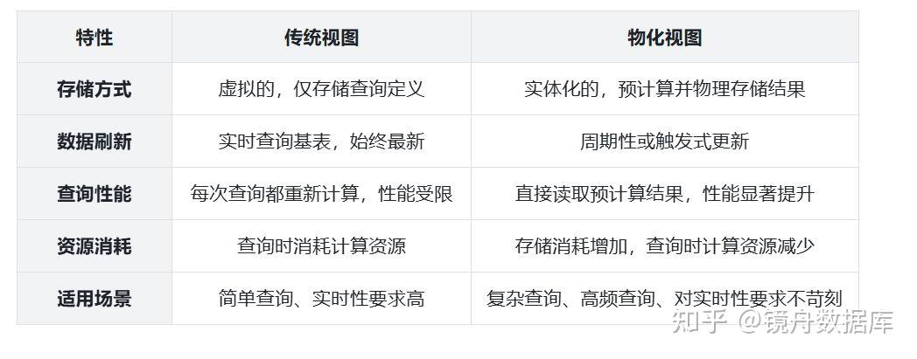
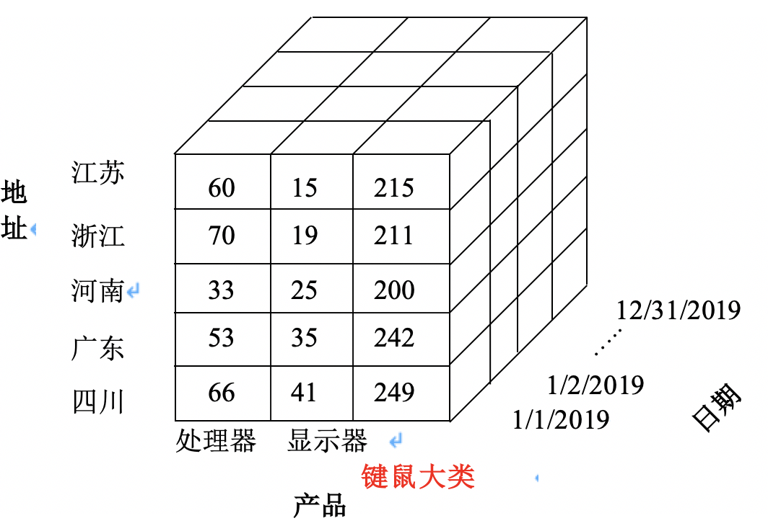
Materialized Views
Materializing a view: create a physical table containing all the tuples in the result of the query defining the view
If relations used in the query are updated, the materialized view result becomes out of date
  Need to maintain the view, by updating the view whenever the underlying relations are updated.

Slide 30
Transactions
Unit of work
Atomic transaction
  either fully executed or rolled back as if it never occurred
Isolation from concurrent transactions
Transactions begin implicitly
  Ended by commit work or rollback work
But default on most databases: each SQL statement commits automatically
  Can turn off auto commit for a session (e.g. using API)
  In SQL:1999, can use: begin atomic …. end
    Not supported on most databases

Slide 31
Integrity Constraints
Integrity constraints guard against accidental damage to the database, by ensuring that authorized changes to the database do not result in a loss of data consistency.
  A checking account must have a balance greater than $10,000.00
  A salary of a bank employee must be at least $4.00 an hour
  A customer must have a (non-null) phone number

Slide 32
Integrity Constraints on a Single Relation
not null
primary key
unique
check (P), where P is a predicate

Slide 33
Not Null and Unique Constraints
not null
  Declare name and budget to be not null
  name varchar(20) not null
  budget numeric(12,2) not null
unique ( A₁, A₂, …, A_{m})
  The unique specification states that the attributes A1, A2, … Am
  form a candidate key.
  Candidate keys are permitted to be null (in contrast to primary keys).

Slide 34
The check clause
check (P) where P is a predicate
Example: ensure that semester is one of fall, winter, spring or summer:
    create table section (
    course_id varchar (8),
    sec_id varchar (8),
    semester varchar (6),
    year numeric (4,0),
    building varchar (15),
    room_number varchar (7),
    time slot id varchar (4),
    primary key (course_id, sec_id, semester, year),
    check (semester in ('Fall', 'Winter', 'Spring', 'Summer'))
    );

Slide 35
Referential Integrity
Ensures that a value that appears in one relation for a given set of attributes also appears for a certain set of attributes in another relation.
  Example: If “Biology” is a department name appearing in one of the tuples in the instructor relation, then there exists a tuple in the department relation for “Biology”.
Let A be a set of attributes. Let R and S be two relations that contain attributes A and where A is the primary key of S. A is said to be a foreign key of R if for any values of A appearing in R these values also appear in S.

Slide 36
Cascading Actions in Referential Integrity
create table course (
course_id char(5) primary key,
title varchar(20),
dept_name varchar(20) references department
)
create table course (
…
dept_name varchar(20),
foreign key (dept_name) references department
on delete cascade
on update cascade,
. . .
)
alternative actions to cascade: set null, set default

Slide 37
Integrity Constraint Violation During Transactions
E.g.
  create table person (
  ID char(10),
  name char(40),
  mother char(10),
  father char(10),
  primary key ID,
  foreign key father references person,
  foreign key mother references person)
How to insert a tuple without causing constraint violation ?
  insert father and mother of a person before inserting person
  OR, set father and mother to null initially, update after inserting all persons (not possible if father and mother attributes declared to be not null)
  OR defer constraint checking (next slide)

Slide 38
Complex Check Clauses
check (time_slot_id in (select time_slot_id from time_slot))
  why not use a foreign key here?
  Because time_slot_id is not a primary key of timeslot
Every section has at least one instructor teaching the section.
  how to write this?-subquery is needed
  Unfortunately: subquery in check clause not supported by pretty much any database
Alternative: triggers (later)
create assertion <assertion-name> check <predicate>
create assertion credits_earned_constraint check
(not exists (select ID from student
where tot_cred <> (select sum(credits)
from takes natural join course
where student.ID = takes.ID
and grade is not null and grade<> ‘F’)

Slide 39
Built-in Data Types in SQL
date: Dates, containing a (4 digit) year, month and date
  Example: date '2005-7-27'
time: Time of day, in hours, minutes and seconds.
  Example: time '09:00:30' time '09:00:30.75'
timestamp: date plus time of day
  Example: timestamp '2005-7-27 09:00:30.75'
interval: period of time
  Example: interval '1' day
  Subtracting a date/time/timestamp value from another gives an interval value
  Interval values can be added to date/time/timestamp values

Slide 40
Index Creation
create table student
(ID varchar (5),
name varchar (20) not null,
dept_name varchar (20),
tot_cred numeric (3,0) default 0,
primary key (ID))
create index studentID_index on student(ID)
Indices are data structures used to speed up access to records with specified values for index attributes
  e.g. select *
  from student
  where ID = '12345'
  can be executed by using the index to find the required record, without looking at all records of student
  More on indices in Chapter 11

Slide 41
User-Defined Types
create type construct in SQL creates user-defined type
  create type Dollars as numeric (12,2) final
  create table department
  (dept_name varchar (20),
  building varchar (15),
  budget Dollars);

Slide 42
Domains
create domain construct in SQL-92 creates user-defined domain types
  create domain person_name char(20) not null
Types and domains are similar. Domains can have constraints, such as not null, specified on them.
create domain degree_level varchar(10)
constraint degree_level_test
check (value in ('Bachelors', 'Masters', 'Doctorate'));

Slide 43
Large-Object Types
Large objects (photos, videos, CAD files, etc.) are stored as a large object:
  blob: binary large object -- object is a large collection of uninterpreted binary data (whose interpretation is left to an application outside of the database system)
  clob: character large object -- object is a large collection of character data
  When a query returns a large object, a pointer is returned rather than the large object itself.

Slide 44
Authorization
Forms of authorization on parts of the database:
Read - allows reading, but not modification of data.
Insert - allows insertion of new data, but not modification of existing data.
Update - allows modification, but not deletion of data.
Delete - allows deletion of data.
Forms of authorization to modify the database schema
Index - allows creation and deletion of indices.
Resources - allows creation of new relations.
Alteration - allows addition or deletion of attributes in a relation.
Drop - allows deletion of relations.

Slide 45
Authorization Specification in SQL
The grant statement is used to confer authorization
grant <privilege list>
on <relation name or view name> to <user list>
<user list> is:
  a user-id
  public, which allows all valid users the privilege granted
  A role (more on this later)
Granting a privilege on a view does not imply granting any privileges on the underlying relations.
The grantor of the privilege must already hold the privilege on the specified item (or be the database administrator).

Slide 46
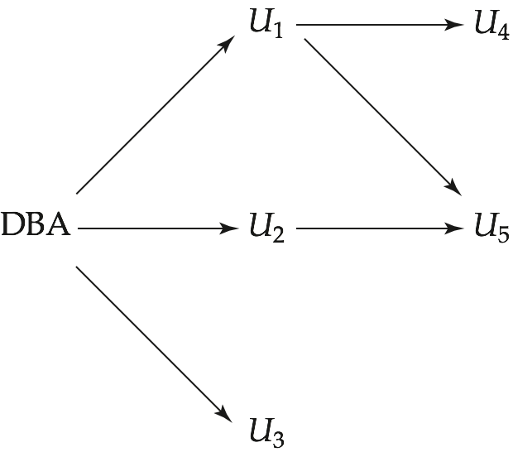
Figure 4.03

Slide 47
Privileges in SQL
select: allows read access to relation,or the ability to query using the view
  Example: grant users U₁, U₂, and U₃ select authorization on the instructor relation:
grant select on instructor to U₁, U₂, U₃
insert: the ability to insert tuples
update: the ability to update using the SQL update statement
delete: the ability to delete tuples.
all privileges: used as a short form for all the allowable privileges

Slide 48
Revoking Authorization in SQL
The revoke statement is used to revoke authorization.
  revoke <privilege list>
  on <relation name or view name> from <user list>
Example:
  revoke select on branch from U₁, U₂, U₃
<privilege-list> may be all to revoke all privileges the revokee may hold.
If <revokee-list> includes public, all users lose the privilege except those granted it explicitly.
If the same privilege was granted twice to the same user by different grantees, the user may retain the privilege after the revocation.
All privileges that depend on the privilege being revoked are also revoked.

Slide 49
Roles
Specify the authorizations that every instructor is to be given, and to identify separately which database users are instructors
When a new instructor is hired, he must be identified as an instructor
create role instructor;
grant select on takes to instructor;
grant instructor to Amit;
Privileges can be granted to roles:
Roles can be granted to users, as well as to other roles
  create role teaching_assistant
  grant teaching_assistant to instructor;
Instructor inherits all privileges of teaching_assistant

Slide 50
Authorization on Views
create view geo_instructor as
(select *
from instructor
where dept_name = 'Geology');
grant select on geo_instructor to geo_staff
Suppose that a geo_staff member issues
  select *
  from geo_instructor;
What if
  geo_staff does not have permissions on instructor?
  creator of view did not have some permissions on instructor?

Slide 51
Other Authorization Features
references privilege to create foreign key
  grant reference (dept_name) on department to Mariano;
  why is this required?
transfer of privileges
  grant select on department to Amit with grant option;
  revoke select on department from Amit, Satoshi cascade;
  revoke select on department from Amit, Satoshi restrict;
Etc. read Section 4.6 for more details we have omitted here.

Slide 52
End of Chapter 4

