Slide 1

The Human Genome Project
Discoveries, applications and what comes next
What is the Human Genome Project,
and what have we learned from it?
I. Overview
II. What We Learned
III. Applications
IV. Limitations and Future
Notes:
SPEAKER A: 25 seconds | 0:00–0:25
English
Good afternoon, everyone. Today, our group will discuss the Human Genome Project, or HGP. Our topic is: "What is the Human Genome Project, and what have we learned from it?" We'll focus on how it changed our understanding of human DNA.
中文译文
大家下午好。今天，我们小组将介绍人类基因组计划，简称 HGP。我们的汇报题目是：“什么是人类基因组计划？我们从中学到了什么？”我们将重点讨论，这项计划如何改变了我们对人类 DNA 的认识。

Slide 2
Presentation roadmap
I
Overview
What was the HGP, and how did it work?
II
What We Learned
What have we learned from the HGP?
III
Applications
How does the reference support research and medicine?
IV
Limitations, Ethics and Future Directions
What remains unresolved, and what comes next?
I. Overview
II. What We Learned
III. Applications
IV. Limitations and Future
Notes:
SPEAKER A: 25 seconds | 0:25–0:50
English
Our presentation has four parts. First, we'll explain what the HGP was and how it worked. Then we'll focus on what we learned from it. My partner will discuss its applications, followed by its limitations, ethical questions, and future directions.
中文译文
我们的报告分为四个部分。首先，介绍人类基因组计划是什么，以及科学家如何开展这项工作。接着，重点讨论我们从中获得了哪些认识。之后，由我的搭档介绍它的应用，再讨论它的局限、相关伦理问题和未来的发展方向。
Timing Plan
Total 15:00
I. Overview 2:30
II. What We Learned 5:00
III. Applications 3:45
IV. Limitations, Ethics and Future Directions 3:35
References and closing 0:10

Slide 3
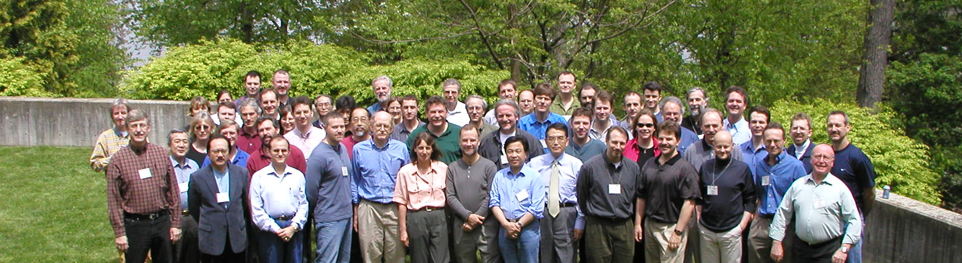
I.1 What was the Human Genome Project?
International teams, including China, built a shared reference for three billion human DNA bases.
International Human Genome Sequencing Consortium, 2002. Photo: Eric Green / NHGRI. Cropped. [1]
1990
2001
2003
The international
project begins.
The draft sequence
is published.
The project announces
completion.
I. Overview
II. What We Learned
III. Applications
IV. Limitations and Future
Notes:
SPEAKER A: 50 seconds | 0:50–1:40
English
A genome is an organism's complete set of DNA. The HGP aimed to read about three billion DNA letters and identify human genes, creating a reference that researchers could share. Teams from several countries, including China, took part. This photograph shows members of the sequencing consortium in 2002.
The timeline below shows how long the work took. The project began in 1990, published a draft in 2001, and announced its completion in 2003. That was thirteen years of international effort. Why did reading the genome take so long? To answer that, we need to look at how scientists sequenced DNA at the time.
中文译文
基因组是一个生物体所拥有的全部 DNA。人类基因组计划的目标，是读取约三十亿个 DNA“字母”，识别人类基因，并建立一份供研究者共同使用的参考序列。包括中国在内，多个国家的团队参与了这项工作。照片中是人类基因组测序协作组织的成员，拍摄于2002年。
下方的时间轴展示了项目的历程：1990年启动，2001年发表基因组草图，2003年宣布完成。这项工作凝聚了十三年的国际合作。读取人类基因组，为什么需要这么长时间？要回答这个问题，我们先来看看当时科学家是怎样测序的。

Slide 4
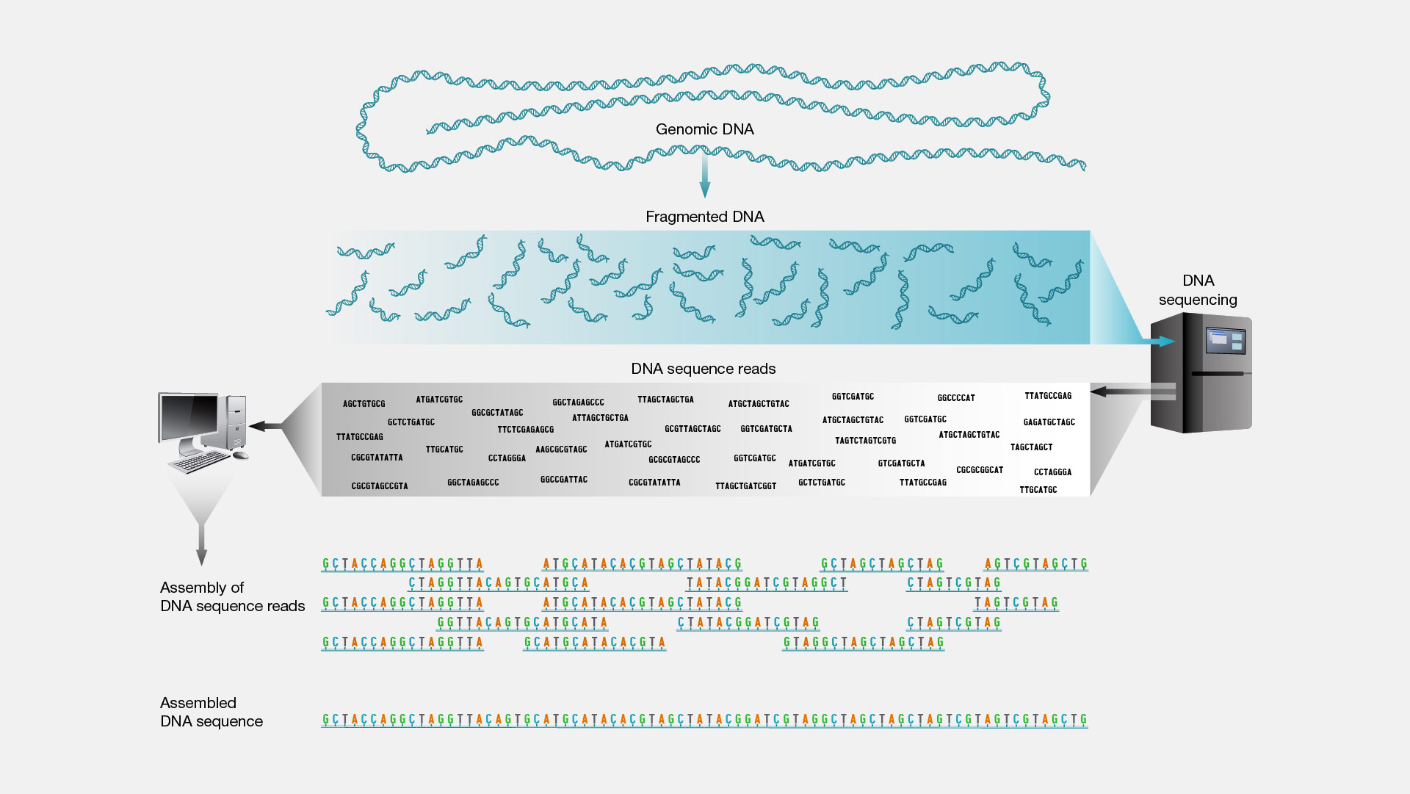
I.2 How did scientists read the genome?
1
Map the genome
Scientists first locate large DNA fragments on a physical map.
2
Read small pieces
They use Sanger sequencing on smaller pieces within each mapped fragment.
3
Assemble the reads
Computers use overlaps to reconstruct the sequence and combine mapped fragments.
III. Applications
Figure: NHGRI, “Shotgun Sequencing.” [2] The HGP used this approach within mapped fragments.
I. Overview
II. What We Learned
IV. Limitations and Future
Notes:
SPEAKER A: 50 seconds | 1:40–2:30
English
At the time, scientists could only read short stretches of DNA at once. They first placed large fragments on a physical map. Within each fragment, they used Sanger sequencing to read smaller pieces.
The diagram shows how those pieces were assembled. Look at the matching letters near the bottom: overlapping sequences helped computers put the short reads in order. Scientists then combined the mapped sections. Repeated sequences made this difficult because similar reads could fit in several places. Building the reference required careful sequencing, assembly and checking. Through sustained international effort, the teams achieved this ambitious goal in 2003.
中文译文
当时，科学家每次只能读取一小段 DNA。他们先利用物理图谱确定较大 DNA 片段的位置，再在每个大片段内部，用桑格测序读取更小的片段。
图中展示了这些小片段如何被组装起来。请看下方相互匹配的字母：读段之间重叠的序列，能帮助计算机判断它们的排列顺序。随后，科学家再把已经定位的各部分连接起来。重复序列增加了组装的难度，因为相似的读段可能对应多个位置。因此，建立参考序列需要细致的测序、组装和核查。经过持续的国际合作，研究团队终于在2003年完成了这一宏伟目标。

Slide 5
II.1 Surprise 1: Fewer genes than expected
The estimated number of human protein-coding genes fell from roughly 100,000 to about 20,000.
Does greater complexity require more genes?
What did we learn?
Gene number alone cannot explain human biological complexity.
Gene regulation and alternative splicing help a limited gene set perform different tasks.
Early estimate: IHGSC (2001). Later gene counts: NHGRI.
Approximate values. [3] [4] [5]
I. Overview
II. What We Learned
III. Applications
IV. Limitations and Future
Notes:
SPEAKER A: 100 seconds | 2:30–4:10
English
Now let’s turn to what we learned from the HGP. The first surprise was the number of protein-coding genes.
Early estimates put the number of human protein-coding genes at roughly 100,000，shown by the left bar. Sequencing and subsequent analyses brought that estimate down to about 20,000，shown by the right bar.
Why was this surprising? The tiny roundworm C. elegans also has roughly twenty thousand protein-coding genes. Humans therefore do not have the enormous increase in gene number that many had expected. This challenged a simple assumption: a more complex organism should have many more genes.
Part of the explanation lies in how genes are used. Gene regulation controls when and where genes are active. Alternative splicing allows one gene to produce different RNA transcripts and, in some cases, different proteins.
The key lesson is that gene number alone cannot explain human biological complexity. We also need to understand how genes are regulated and how one gene can produce different products.
中文译文
接下来，我们进入报告的核心问题：我们从人类基因组计划中学到了什么？第一个令人意外的结果，是人类蛋白质编码基因的数量。
许多研究者原先认为，与结构相对简单的动物相比，人类应该需要多得多的基因。一些早期估计达到了十万个左右，也就是左侧柱子所表示的数量。随着测序和后续分析的开展，这个估计逐渐下调到两万个左右，如右侧柱子所示。
为什么这个结果令人意外？体型微小的秀丽隐杆线虫，也有大约两万个蛋白质编码基因。也就是说，人类的基因数量并没有像许多人预期的那样，比线虫多出一大截。这个结果挑战了一种直观的假设：生物越复杂，就应该拥有多得多的基因。
部分答案在于基因如何被使用。基因调控决定了基因在何时、何处处于活跃状态；可变剪接则让一个基因能够产生不同的 RNA 转录本，有时也会产生不同的蛋白质。
我们得到的核心认识是：单靠基因数量，无法解释人类的生物学复杂性。我们还需要理解基因如何受到调控，以及同一个基因如何产生不同的产物。

Slide 6
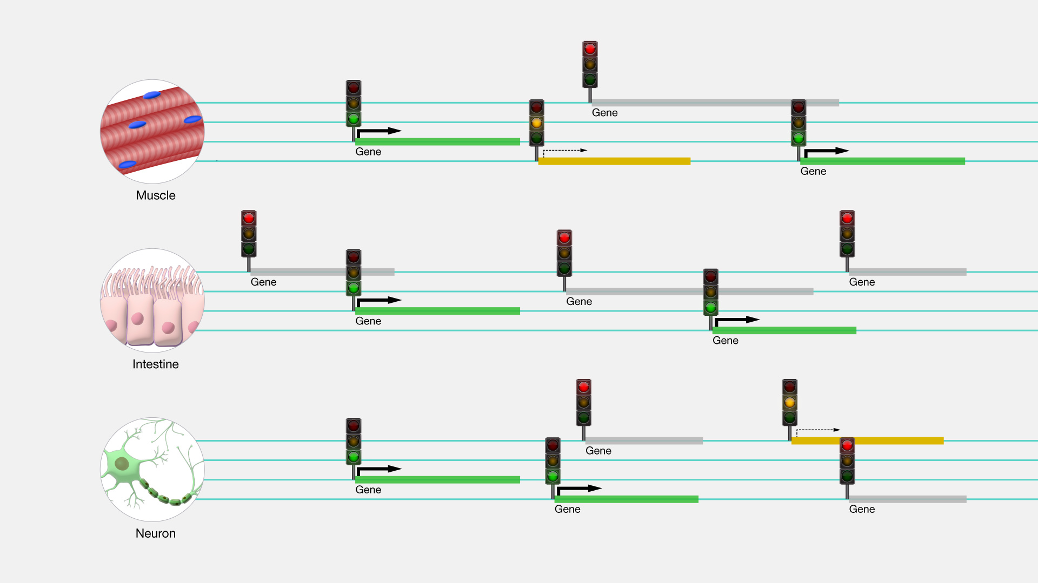
II.2 Surprise 2: Most DNA does not encode proteins
Most DNA does not encode proteins. Some noncoding regions help control gene activity.
Most of the genome is noncoding
Regulation gives cells different roles
~1.5%
directly encodes
proteins
~98.5% is other DNA
Chart redrawn from NHGRI, “Gene.” Approximate proportions. [5]
NHGRI, “Gene Regulation.” [6]
Different patterns of gene activity help cells use the same genome in different ways.
I. Overview
II. What We Learned
III. Applications
IV. Limitations and Future
Notes:
SPEAKER A: 100 seconds | 4:10–5:50
English
How much of our DNA directly codes for proteins? As the chart on the left shows, only about 1.5 percent, represented by that small blue slice. The rest is noncoding DNA. So what does this much larger part of the genome do?
One important role of some noncoding sequences is to regulate gene activity. They help control when a gene is switched on, in which cells, and how active it is.
To see why this matters, look at the diagram on the right. Muscle, intestinal and nerve cells generally share the same genome, but they carry out very different functions. The traffic lights represent the activity of different genes. A gene may be active in one cell type but less active, or switched off, in another. These patterns affect which proteins the cells produce and in what amounts, helping each cell type perform its own role.
This example shows why DNA does not have to encode a protein to be important. Some noncoding sequences help cells use their genes in different ways. The HGP provided a shared reference for studying these sequences and investigating their functions across the genome.
中文译文
我们的DNA中，有多少直接编码蛋白质？左侧图表显示，这一比例只有约1.5%，也就是那一小块蓝色区域。其余部分都是非编码DNA。那么，占据基因组绝大部分的这些DNA，究竟在做什么？
其中一些非编码序列的重要作用，是调控基因活动。它们帮助控制一个基因在什么时间、哪些细胞中开启，以及它的活跃程度。
看看右侧的示意图，就能理解这种调控为什么重要。肌肉细胞、肠道细胞和神经细胞通常拥有相同的基因组，却承担着截然不同的功能。
图中的交通灯表示不同基因的活动状态。同一个基因，在一种细胞中可能很活跃，在另一种细胞中则可能活动较弱，甚至处于关闭状态。这些不同的基因活动模式，会影响细胞产生哪些蛋白质，以及产生多少，从而帮助各类细胞执行各自的功能。
这个例子说明，DNA即使不编码蛋白质，也可以发挥重要作用。一些非编码序列，能够帮助不同细胞以不同的方式使用基因。人类基因组计划提供了一份共同的参考序列，使研究者能够在整个基因组范围内研究这些非编码序列，探索它们的功能。

Slide 7
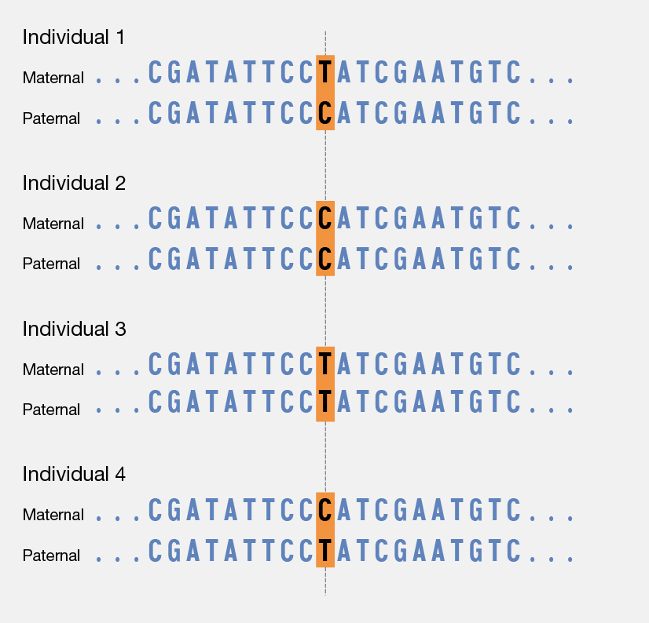
II.3 Surprise 3: A shared genome with meaningful variation
A reference gives researchers common coordinates for describing differences between human genomes.
How human genomes differ
At the highlighted position, people can carry T or C. This is a single nucleotide polymorphism(SNP).
Other variants include insertions, deletions and larger structural changes.
Some variants affect traits or disease risk
Figure: NHGRI, “Single Nucleotide Polymorphisms (SNPs).” Outer whitespace cropped. [7]
I. Overview
II. What We Learned
III. Applications
IV. Limitations and Future
Notes:
SPEAKER A: 100 seconds | 5:50–7:30
English
Our third insight is that human genomes share a great deal of sequence, while also containing differences between individuals. These differences give us a way to study human variation.
The diagram shows four people. Each person has two rows, representing the chromosome copies inherited from their mother and father. Most of the letters match. At one position, however, the letter can be T or C. The first person carries both versions, while the second carries C on both copies. This is an example of a single nucleotide polymorphism, or SNP. Other variants involve inserted or missing DNA, or changes to larger sections.
The reference gives each position a common address. A laboratory studying a variant can report that address, so another laboratory can find the same place and compare its results. Researchers can then examine how variants relate to traits, disease risk or drug response.
Together, these findings gave us a richer view of the human genome: its importance lies in how genes are used, in noncoding sequences, and in variation between people. I'll now hand over to my partner to explain how this knowledge can be used.
中文译文
第三点认识是：人类基因组有大量相同的序列，同时也存在个体之间的差异。研究这些差异，可以帮助我们理解人类的遗传变异。
图中展示了四个人的情况。每个人对应两行序列，分别代表从母亲和父亲那里继承的染色体副本。大多数字母都相同，但在某一个位置，既可能是 T，也可能是 C。第一个人的两份副本分别携带 T 和 C，第二个人的两份副本则都是 C。这就是单核苷酸多态性，也叫 SNP 的一个例子。其他类型的变异还包括 DNA 的插入、缺失，以及更大片段的改变。
参考基因组为每个位置提供了统一的“地址”。一个实验室在研究某个变异时，可以报告它的位置，其他实验室就能找到同一处，比较各自的结果。在此基础上，研究者可以进一步考察这些变异与性状、疾病风险或药物反应之间的关系。
这些认识共同丰富了我们对人类基因组的理解：除了基因如何被使用，非编码序列和个体之间的变异也值得关注。接下来，由我的搭档介绍这些知识如何用于实际研究和应用。

Slide 8
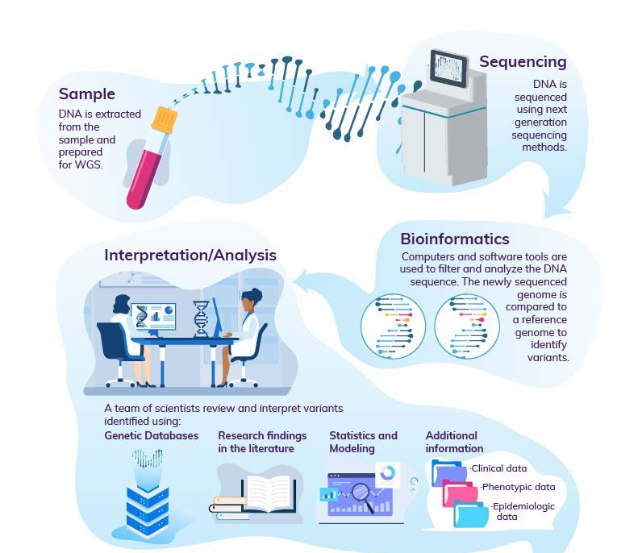
III.1 Finding the genetic causes of disease
1
Find candidate variants
Comparing a patient’s DNA with a reference helps locate differences in relevant genes.
2
Evaluate the evidence
Symptoms, family history and earlier research help assess what each candidate means.
3
Interpret and validate
Clinical interpretation and, when needed, laboratory tests support a diagnosis.
Workflow excerpt: NHS Genomics Education Programme, via
Washington State HCA (2024), Fig. 1. CC BY 2.0. [8]
I. Overview
II. What We Learned
III. Applications
IV. Limitations and Future
Notes:
SPEAKER B: 75 seconds | 7:30–8:45
English
Thank you. Now let’s turn to the medical applications of the HGP. One important use of the reference genome is to help identify the genetic causes of disease.
The diagram on the right shows how this works. First, DNA is extracted from a patient’s sample and sequenced. Computers then compare the sequence with the reference genome to identify genetic variants.
The next step is to determine which of these variants could explain the patient’s condition. Clinicians use genetic databases and published research, together with the patient’s symptoms and family history, to narrow down the candidates. When necessary, additional tests can help determine how a particular variant affects gene function.
The reference genome provides a common starting point for this search, while clinical information helps connect the findings to the patient. For someone with unexplained symptoms, this process can help identify an underlying genetic cause and provide evidence for a diagnosis.
中文译文
谢谢。接下来，我们来看人类基因组计划在医学中的应用。参考基因组的一个重要用途，就是帮助我们寻找疾病的遗传原因。
右侧流程图展示了具体过程。首先，从患者样本中提取DNA并进行测序。随后，计算机将测得的序列与参考基因组进行比较，找出其中的遗传变异。
下一步，是判断哪些变异可能解释患者的病情。医生结合遗传数据库和已发表的研究，再参考患者的症状与家族史，逐步缩小候选范围。必要时，还可以通过进一步的检测，判断某个变异如何影响基因功能。
在这个过程中，参考基因组为寻找变异提供了共同的起点，而临床信息则帮助我们把分析结果与患者的病情联系起来。对于病因尚不明确的患者，这套流程可以帮助找到潜在的遗传原因，为诊断提供依据。

Slide 9
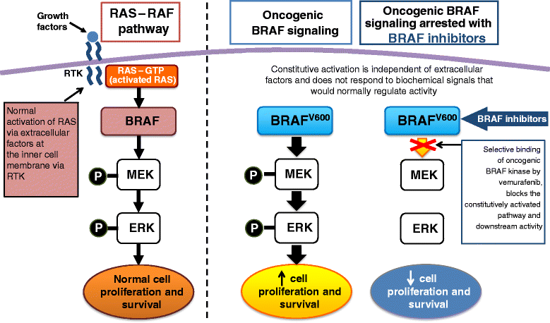
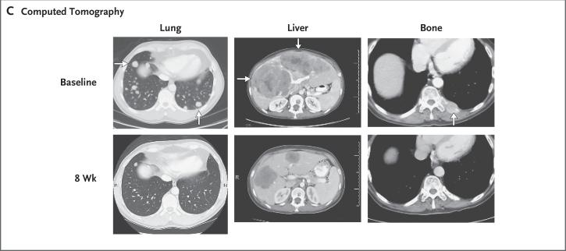
III.2 Guiding treatment with genomic information
HGP: a shared sequence [9]
2002: BRAF mutations [10]
2011: treatment selection [11]
The reference enabled systematic searches for mutations in cancer.
Mutations can keep growth signals switched on in melanoma cells.
A BRAF V600E tumor test identifies candidates for vemurafenib. [12]
An altered protein becomes a drug target
Tumor shrinkage after treatment
Ascierto et al. (2012), Fig. 1 excerpt. CC BY 2.0. [13]
Flaherty et al. (2010), Fig. 2C. Different patients. © MMS. [14]
I. Overview
II. What We Learned
III. Applications
IV. Limitations and Future
Notes:
SPEAKER B: 75 seconds | 8:45–10:00
English
The HGP also helped researchers connect genetic differences with treatment choices. BRAF in melanoma, a type of skin cancer, is one example.
Using the public human genome sequence, the Cancer Genome Project systematically searched for mutations in cancer. In 2002, researchers identified BRAF mutations in melanoma.
The diagram on the left shows why this mattered. Some mutations keep BRAF growth signaling switched on. Vemurafenib inhibits the altered protein and interrupts this signal. The CT images on the right show examples of tumors becoming smaller after eight weeks of treatment.
In 2011, vemurafenib was approved for advanced melanoma with the BRAF V600E mutation. Testing the tumor’s DNA for the BRAF V600E mutation helps identify patients who may benefit from vemurafenib.
The HGP supplied a shared sequence for discovery. Studies of gene function and clinical trials then connected that discovery to a treatment selected using genetic information.
中文译文
人类基因组计划还帮助研究者把遗传差异与治疗选择联系起来。黑色素瘤中的BRAF就是一个例子。黑色素瘤是一种皮肤癌。
利用公开的人类基因组序列，癌症基因组计划系统地寻找癌症中的基因突变。2002年，研究者在黑色素瘤中发现了BRAF突变。
左侧示意图展示了这项发现为什么重要。一些突变会使BRAF相关的生长信号持续开启。维莫非尼能够抑制异常蛋白，阻断这一信号。右侧CT影像展示了治疗8周后肿瘤缩小的实例。
2011年，维莫非尼获批用于具有BRAF V600E突变的晚期黑色素瘤。检测患者肿瘤中是否存在这一突变，可以帮助判断哪些患者可能从治疗中获益。
在这个过程中，人类基因组计划为发现突变提供了共享序列；基因功能研究和临床试验则进一步把这项发现转化为依据遗传信息选择的治疗。

Slide 10
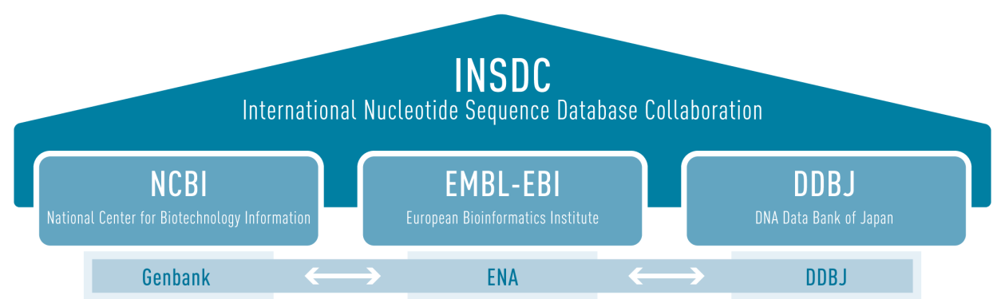
III.3 Open data expands the reach of discovery
Rapid public release let researchers use new sequences while the HGP was still under way. [15]
Rohden et al. (2020), Fig. 2. Archive-exchange excerpt. CC BY 4.0. Diagram depicts later infrastructure. [16]
The Bermuda principles promoted daily release of sequence assemblies for public reuse.
I. Overview
II. What We Learned
III. Applications
IV. Limitations and Future
Notes:
SPEAKER B: 75 seconds | 10:00–11:15
English
The BRAF example also highlights the value of sharing genome data. Researchers could use the HGP’s publicly available sequences to investigate genes involved in cancer.
This access was built into the project. In 1996, the Bermuda principles called for rapid public release of newly assembled sequences, ideally each day. Researchers could therefore use new results as they appeared, without waiting for the entire genome to be completed.
The diagram shows how public databases support this sharing. GenBank in the United States, ENA in Europe, and DDBJ in Japan exchange sequence data. The arrows represent these exchanges: sequences submitted to one archive become available through the others.
Sharing allowed sequencing and further research to move forward at the same time. While HGP teams continued reading the genome, other scientists could use the available sequences to locate genes, compare DNA, and investigate disease. The project’s results were already supporting new discoveries before the project itself was finished.
中文译文
刚才的 BRAF 案例也体现了共享基因组数据的价值。研究者能够利用人类基因组计划公开的序列，寻找与癌症有关的基因。
这种开放获取的做法，是项目组织方式的一部分。1996年提出的百慕大原则要求尽快公开新组装的序列，最好做到每天发布。这样，研究者就能随时使用新获得的序列，而不必等到整个基因组测序完成。
图中展示了公共数据库如何支持这种共享。美国的 GenBank、欧洲的 ENA 和日本的 DDBJ 相互交换序列数据。图中的箭头表示的就是这种交换：提交到其中一个数据库的序列，也会通过另外两个数据库向研究者开放。
数据共享让测序工作和后续研究能够同时推进。在人类基因组计划的团队继续解读基因组时，其他科学家已经可以利用公开的序列定位基因、比较 DNA，并研究疾病。因此，项目尚未完成，它的成果就已经在支持新的发现。

Slide 11
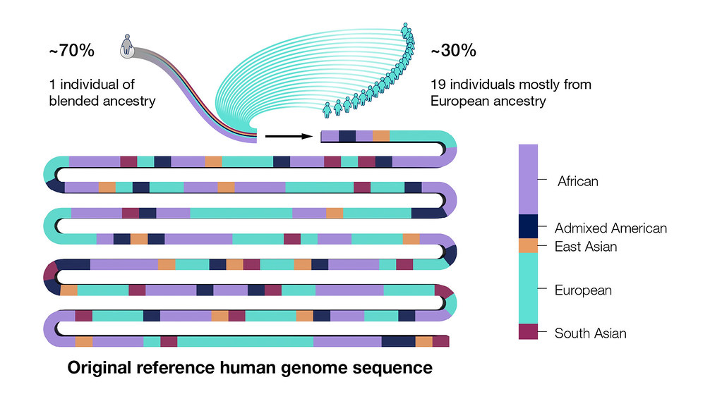
IV.1 What the reference genome cannot tell us
Limitation | Why it matters
Sequence challenges | Repetitive DNA can be difficult to read and assemble accurately.
Limited donors | One reference cannot represent all human variation.
Uncertain function | DNA sequence alone cannot explain cell behavior or health.
The original reference reflected few donors.
NHGRI. Original reference donor composition. [1]
I. Overview
II. What We Learned
III. Applications
IV. Limitations and Future
Notes:
SPEAKER B: 65 seconds | 11:15–12:20
English
The HGP provided a valuable reference, but there are limits to what it can tell us.
First, highly repetitive DNA can still be difficult to read and assemble accurately. This makes some genetic differences between individuals harder to detect.
Second, the original reference could not fully represent human diversity. It was assembled from DNA sequences from several donors. As the figure shows, about seventy percent came from one person, and the rest from nineteen others. Although people share many genes, they can carry different versions of those genes. A reference built from such a small group cannot capture all these differences.
Third, reading a sequence does not tell us exactly how it works. We still need experiments to understand how particular sequences affect cells, and clinical evidence to establish how genetic differences relate to disease.
中文译文
人类基因组计划提供了一份重要的参考序列，但它能够告诉我们的信息仍然有限。
首先，高度重复的 DNA 仍然可能难以准确读取和拼接。因此，有些人与人之间的遗传差异，也更难被检测出来。
其次，原始参考序列无法充分呈现人类的遗传多样性。它由多位供者的 DNA 序列拼接而成。如图所示，约百分之七十来自同一位供者，其余部分来自另外十九位。虽然人们具有许多共同的基因，但同一个基因在不同人身上可能存在不同版本。依据这样一个小群体建立的参考序列，无法涵盖所有这些差异。
第三，读出序列，并不等于理解了它如何发挥作用。我们仍然需要通过实验，研究特定序列如何影响细胞；也需要临床证据，确定遗传差异与疾病之间的关系。

Slide 12
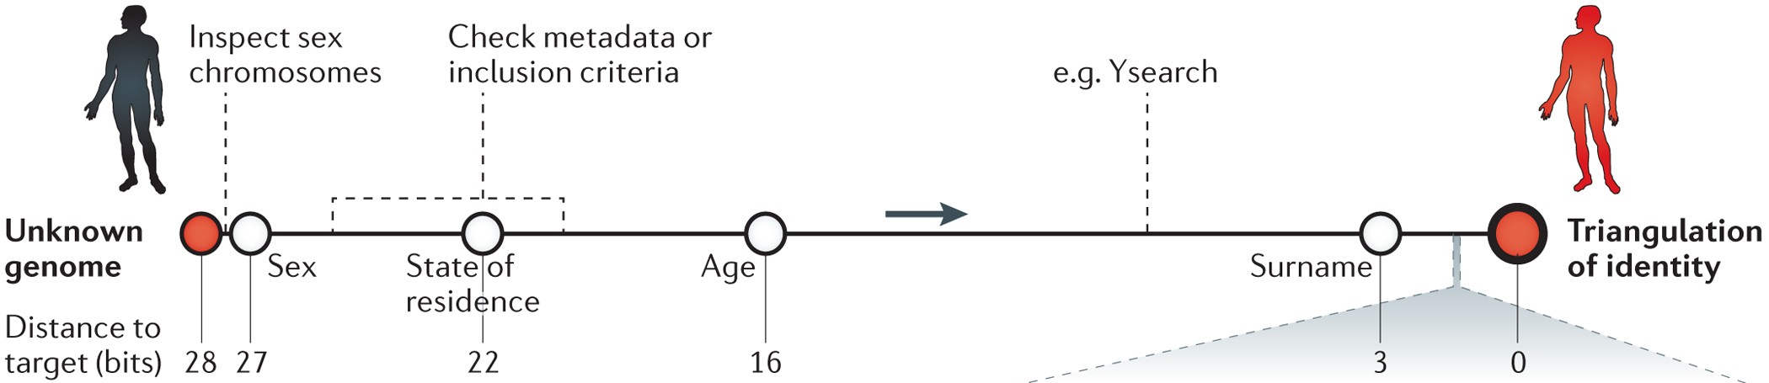
IV.2 Ethical challenges of genomic research
Removing names does not guarantee genomic privacy.
Erlich, Y. & Narayanan, A. Routes for breaching and protecting genetic privacy. Nature Reviews Genetics 15, 409–421 (2014). [17]
Fig. 2, main pathway excerpt. Numbers show identity uncertainty (bits). doi:10.1038/nrg3723
Informed consent
Protection from misuse
Participants should understand and agree to how their data may be used.
Genetic information should not lead to unfair treatment in employment or insurance.
I. Overview
II. What We Learned
III. Applications
IV. Limitations and Future
Notes:
SPEAKER B: 50 seconds | 12:20–13:10
English
The HGP also raised questions about genetic privacy. Removing a participant's name does not always prevent identification.
In this example, the black figure represents a person whose genome has no name attached. Genetic clues are combined with age and location from study records. Public records then help narrow the possible matches to the person shown in red.
The privacy risk comes from linking information across sources. Participants therefore need to understand how their data may be used and who may access them. Research also needs safeguards against misuse, so that genetic information does not become a reason for unfair treatment in employment or insurance.
中文译文
人类基因组计划也提出了与遗传隐私有关的问题。删除参与者的姓名，并不总能防止其身份被识别。
在图示的例子中，黑色人物代表一位基因组数据未标注姓名的人。遗传线索与研究记录中的年龄、居住地信息相结合，再借助公开记录，就可能逐步缩小身份范围，最终确定右侧红色人物的身份。
这种隐私风险来自不同来源信息的相互关联。因此，参与者需要了解自己的数据可能被如何使用，以及谁可以获取这些数据。研究也需要防止信息被滥用，避免遗传信息成为求职、投保等情况下受到不公平对待的理由。

Slide 13
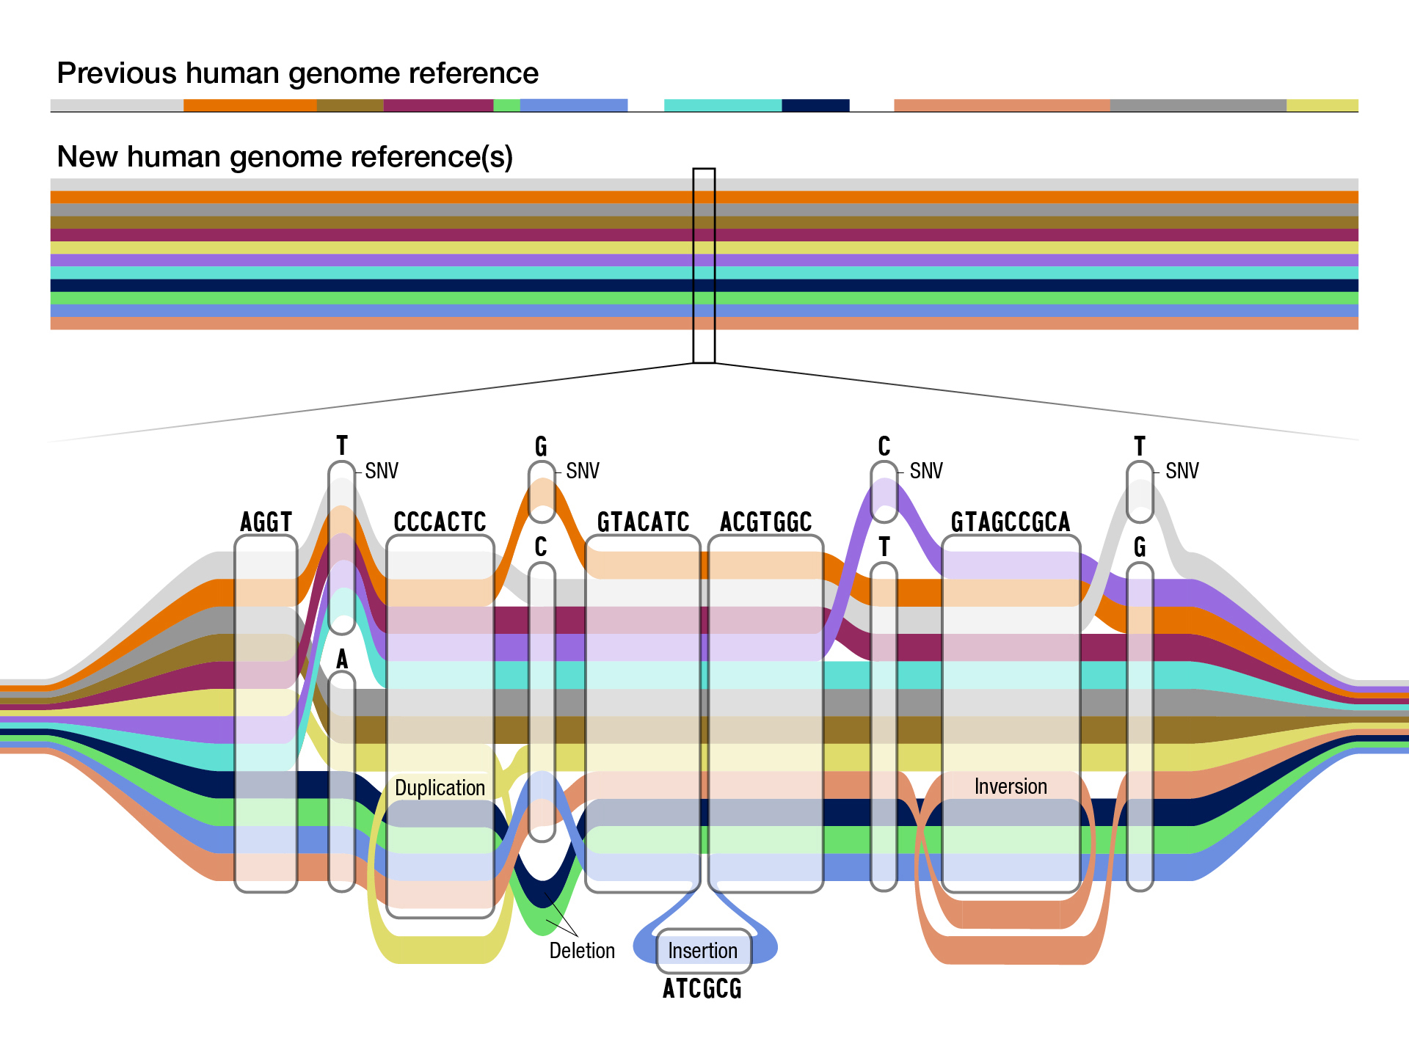
IV.3 Better representation and deeper understanding
Pangenomes broaden representation
Multi-omics connects sequence to function
Multiple genome paths capture more human diversity.
Multi-omics helps explain how cells work.
Information | A question it helps address
DNA | Which variants are present?
RNA | Which genes are active?
Proteins | Which molecules carry out cell functions?
Metabolites | Which chemical processes are occurring?
Research: Liao et al. [18] Figure: Darryl Leja / NHGRI (2023). [19]
Multi-omics context: Marwaha et al. (2022). [20]
I. Overview
II. What We Learned
III. Applications
IV. Limitations and Future
Notes:
SPEAKER B: 80 seconds | 13:10–14:30
English
The future of genomics follows directly from these challenges. One priority is to represent more human diversity.
In the diagram on the left, a single reference expands into multiple genome sequences. Their differences appear as branching paths, including alternative stretches of DNA. This is the idea of a pangenome: combining genomes from diverse people so that variation missed by one reference can be included.
A second priority is to connect sequence with function. The table on the right shows how different measurements help. DNA identifies variants. RNA reveals patterns of gene activity. Proteins and metabolites tell us more about what cells are doing. Studying these measurements together is called multi-omics.
Combining them helps researchers investigate how a genetic difference affects a biological process. Experimental studies can then test those explanations. Both directions build on the HGP: broader references help us describe human variation, while functional studies help us understand what that variation means.
中文译文
这些挑战也指明了基因组学未来的发展方向。一个重点，是更充分地体现人类的遗传多样性。
左图从单一参考扩展到多份基因组序列，再用分支路径表示它们的差异，包括不同版本的 DNA 片段。这就是泛基因组的基本思路：整合来自不同人群的基因组，纳入单一参考可能遗漏的变异。
另一个重点，是把序列与功能联系起来。右侧表格展示了不同类型的测量各自能提供什么信息。DNA 帮助我们识别变异，RNA 揭示基因活动的模式，蛋白质和代谢物则进一步反映细胞正在进行哪些活动。把这些测量结果结合起来研究，就称为多组学。
整合这些信息，可以帮助研究者分析某个遗传差异如何影响生物学过程，再通过实验检验相应的解释。这两个方向都建立在人类基因组计划的基础上：更广泛的参考序列帮助我们描述人类的遗传变异，功能研究则帮助我们理解这些变异意味着什么。

Slide 14
References
[1] National Human Genome Research Institute. Human
Genome Project Fact Sheet. genome.gov (updated 13 June 2024;
accessed 14 October 2026).
[6] National Human Genome Research Institute. Gene
Regulation. Talking Glossary of Genomic and Genetic Terms.
genome.gov (accessed 14 October 2026).
[2] National Human Genome Research Institute. Shotgun
Sequencing. Talking Glossary of Genomic and Genetic Terms.
genome.gov (accessed 14 October 2026).
[7] National Human Genome Research Institute. Single
Nucleotide Polymorphisms (SNPs). Talking Glossary of
Genomic and Genetic Terms. genome.gov (accessed 14 October
2026).
[3] International Human Genome Sequencing Consortium.
Initial sequencing and analysis of the human genome. Nature
409, 860–921 (2001).
[8] Washington State Health Care Authority. Whole Genome
Sequencing: Final Evidence Report. Fig. 1 (2024). Adapted from
Genomics Education Programme (CC BY 2.0).
[4] International Human Genome Sequencing Consortium.
Finishing the euchromatic sequence of the human genome.
Nature 431, 931–945 (2004).
[9] Wellcome Trust Sanger Institute. Scientists identify gene
involved in 70 percent of melanomas. sanger.ac.uk (2002;
accessed 14 October 2026).
[5] National Human Genome Research Institute. Gene. Talking
Glossary of Genomic and Genetic Terms. genome.gov (accessed
14 October 2026).
[10] Davies, H. et al. Mutations of the BRAF gene in human
cancer. Nature 417, 949–954 (2002).
I. Overview
II. What We Learned
III. Applications
IV. Limitations and Future
Notes:
SPEAKER B: 4 seconds | 14:50–14:54
English
Here are the main sources used in our presentation.
中文译文
这里列出了我们本次汇报使用的主要参考资料。

Slide 15
The HGP’s lasting impact
A shared reference
The HGP established a common reference
for studying human DNA.
Scientific and
medical progress
It reshaped our understanding of the genome
and enabled further research into disease and treatment.
Understanding diverse genomes and using genetic information responsibly remain ongoing tasks.
Continuing challenges
I. Overview
II. What We Learned
III. Applications
IV. Limitations and Future
Notes:
SPEAKER B: 20 seconds | 14:30–14:50
English
The HGP established a shared reference, changed our understanding of human DNA, and provided a foundation for later advances in medicine. The work continues: we still need to understand how genomes function, represent human diversity, and use genetic information responsibly.
中文译文
人类基因组计划建立了共享参考，改变了我们对人类DNA的认识，也为后续医学进展奠定了基础。这项探索仍在继续：我们还需要理解基因组如何发挥作用，充分体现人类多样性，并负责任地使用遗传信息。

Slide 16
References (continued)
[11] Chapman, P. B. et al. Improved survival with vemurafenib
in melanoma with BRAF V600E mutation. New England
Journal of Medicine 364, 2507–2516 (2011).
[16] Rohden, F. et al. Combined study on digital sequence
information in public and private databases and traceability.
Convention on Biological Diversity,
CBD/DSI/AHTEG/2020/1/4 (2020).
[12] National Cancer Institute. Melanoma Treatment
(PDQ®)–Health Professional Version. cancer.gov (accessed 14
October 2026).
[17] Erlich, Y. & Narayanan, A. Routes for breaching and
protecting genetic privacy. Nature Reviews Genetics 15,
409–421 (2014).
[13] Ascierto, P. A. et al. The role of BRAF V600 mutation in
melanoma. Journal of Translational Medicine 10, 85 (2012).
[18] Liao, W.-W. et al. A draft human pangenome reference.
Nature 617, 312–324 (2023).
[14] Flaherty, K. T. et al. Inhibition of mutated, activated BRAF
in metastatic melanoma. New England Journal of Medicine 363,
809–819 (2010).
[19] National Human Genome Research Institute. Scientists
release a new human “pangenome” reference. genome.gov
(2023; accessed 14 October 2026).
[15] National Human Genome Research Institute. Reaffirmation
and Extension of NHGRI Rapid Data Release Policies:
Large-scale Sequencing and Other Community Resource
Projects. genome.gov (2003; accessed 14 October 2026).
[20] Marwaha, S. et al. A guide for the diagnosis of rare and
undiagnosed disease: beyond the exome. Genome Medicine 14,
23 (2022).
I. Overview
II. What We Learned
III. Applications
IV. Limitations and Future
Notes:
SPEAKER B: 1 second | 14:54–14:55
English
Continued here.
中文译文
此页为续表。

Slide 17
Thank you for listening!
Questions and discussion are welcome.
I. Overview
II. What We Learned
III. Applications
IV. Limitations and Future
Notes:
SPEAKER B: 5 seconds | 14:55–15:00
English
Thank you for listening. We're happy to take your questions.
中文译文
感谢大家的倾听，欢迎提问。

