Slide 1



Fundamentals of Optoelectronics
（光电子学基础）
Prof. Zongyin Yang （杨宗银）
College of Information Science and Electronic Engineering,
Zhejiang University （浙江大学信息与电子工程学院）
Email：yangzongyin@zju.edu.cn
Website: optoelectronicszju.com
2025 春夏学期

Slide 2
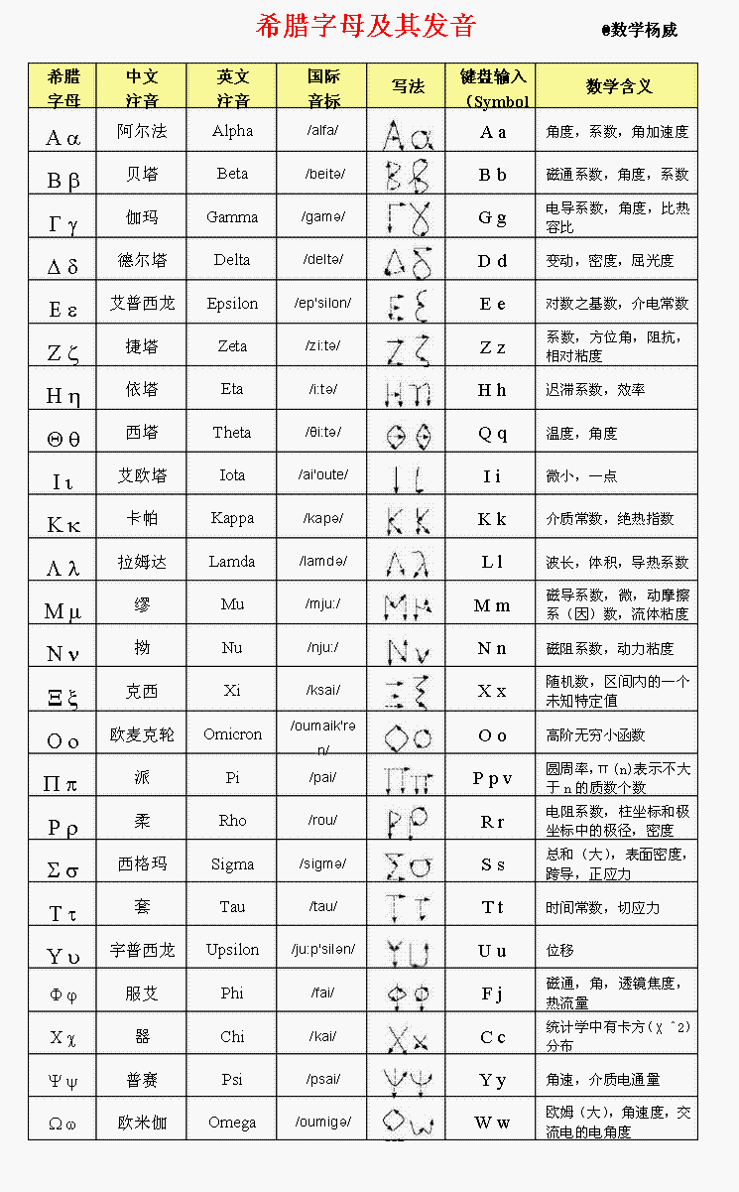
Greek Letters
Greek Alphabet Symbols List

Slide 3
Quiz: Greek letters
Γ
Ε
Ι
Λ
H
Gamma
Epsilon
Iota
Lamda
Eta
Μ
Ν
Ξ
Ο
Mu
Nu
ξ 克西
Omicron
Σ
Υ
Χ
Ψ
Sigma
Upsilon
Kai
Psi
ξ
σ
υ
χ
ψ
克西
Sigma
Upsilon
Kai
Psi
γ
Δ
ε
ζ
Gamma
Delta
Epsilon
Zeta
η
ι
κ
ν
Eta
Iota
Kappa
Nu

Slide 4
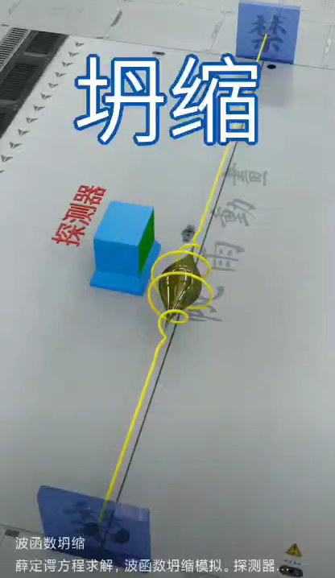
What is light?
光偏振无法机械波解释，传播介质解释，麦克斯韦推导电磁波速等于光速
光电效应不满足波动理论的光强对应能量，黑体辐射紫外灾难，杰弗里泰勒单光子双缝干涉
17世纪，牛顿力学，光是粒子，解释反射、折射、色散
杨氏双缝干涉，为什么光变暗。惠更斯原理光是波
几何光学
粒子学说
波动光学
电磁光学
波粒二象性
量子场论：
光被视为电磁场的量子化激发态，表现为离散的能量包，即光子。
Electromagnetic optics: vector theory comprising an electric field and magnetic field that vary in time and space.
1. Our course starts here
Wave optics: approximation to electromagnetic optics that relies on the wavefunction, a scalar function of time and space.
2. Next stage
Ray optics: the limit of wave optics when the wavelength is very short
Notes:
1638年法国数学家皮埃尔·伽森荻提出物体是由大量坚硬粒子组成的。牛顿随后对于伽森荻的这种观点进行研究，于1675年提出假设，认为光是从光源发出的一种物质微粒。惠更斯认为，光是一种机械波；光波是一种靠物质载体来传播的纵向波，传播它的物质载体是“以太”；波面上的各点本身就是引起媒质振动的波源。根据这一理论，惠更斯证明了光的反射定律和折射定律，也比较好的解释了光的衍射、双折射现象和著名的“牛顿环”实验。1817年，托马斯·杨放弃了惠更斯的光是一种纵波的说法，提出了光是一种横波的假说，比较成功的解释了光的偏振现象。1905年3月，爱因斯坦在德国《物理年报》上发表了题为《关于光的产生和转化的一个推测性观点》的论文他认为对于时间的平均值，光表现为波动；对于时间的瞬间值，光表现为粒子性。

Slide 5
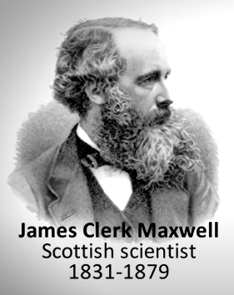
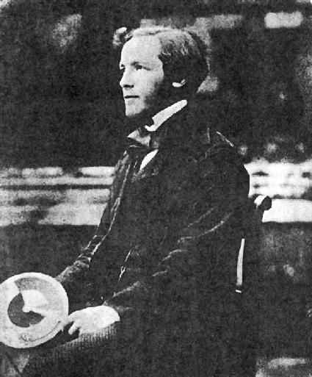
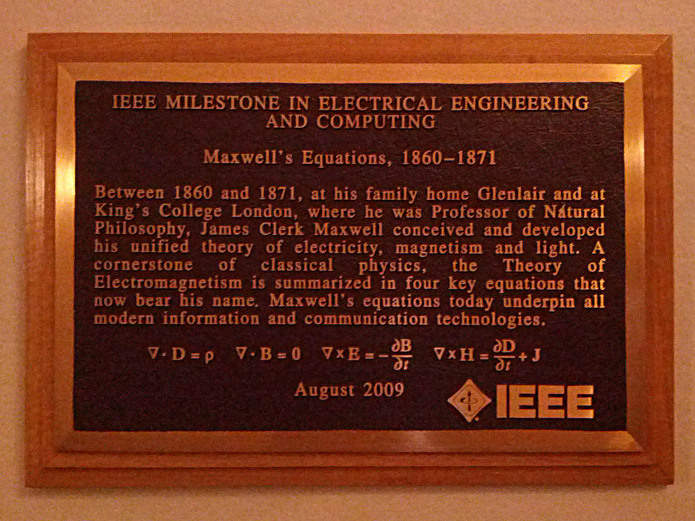
Maxwell’s Equation
Maxwell’s Equation: In honor of Scottish physicist James Clerk Maxwell, who published them in 1865.
Before Maxwell unified electromagnetism into a single framework, the study of electricity, magnetism, and light was fragmented. Key developments leading to Maxwell's work include:
(1) Ancient Observations : The Greeks discovered static electricity by rubbing amber and observed natural magnets (lodestones).
18th Century : Scientists like Benjamin Franklin and Charles-Augustin de Coulomb studied electric charges and forces, leading to Coulomb's law for electrostatics.
(2) Hans Christian Ørsted discovered that an electric current could deflect a compass needle, showing a connection between electricity and magnetism. This marked the beginning of the study of electromagnetism.
(3) André-Marie Ampère's formulated the relationship between electric currents and magnetic fields, now known as Ampère's law. He showed that moving charges produce magnetic fields.
(4) Michael Faraday's discovered electromagnetic induction: a changing magnetic field induces an electric field. His work introduced the concept of "fields" and laid the groundwork for understanding how electric and magnetic phenomena are interconnected.

Slide 6

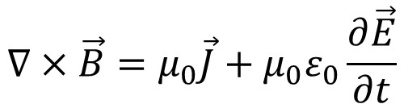
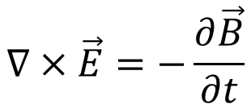
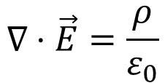
Maxwell’s Equation in free space
James Clerk Maxwell synthesized the existing knowledge of electricity and magnetism into a coherent theoretical framework. His key contributions include:
(1) Unification of Electric and Magnetic Fields
Maxwell combined the works of Gauss, Faraday, and Ampère into a single set of equations.
(2) Prediction of Electromagnetic Waves
Maxwell's equations predicted that electric and magnetic fields could propagate through space as waves. He calculated the speed of these waves and found it to be equal to the speed of light, leading him to conclude that light is an electromagnetic wave .
$$∇⋅\vec{B}=0$$
Gauss’s law of magnetism
（高斯磁定律: 磁单极不存在）
$$∇⋅\vec{E}=\frac{ρ}{ε_{0}}$$
Gauss’s law of electrostatic
（高斯静电定律：电荷如何产生电场）
$$∇×\vec{E}=−\frac{∂\vec{B}}{∂t}$$
Faraday’s law of of Induction
（法拉第感应定律：时变磁场产生电场）
$$∇×\vec{B}=μ_{0}\vec{J}+μ_{0}ε_{0}\frac{∂\vec{E}}{∂t}$$
Ampere’s Circuital law
（安培定律：时变电场产生磁场）

Slide 7
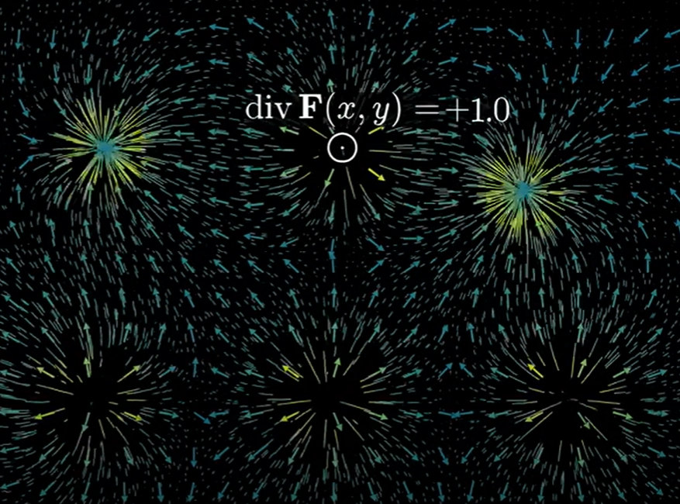
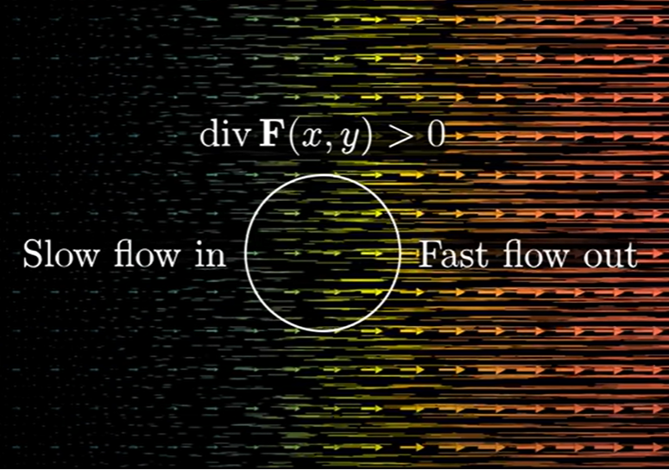
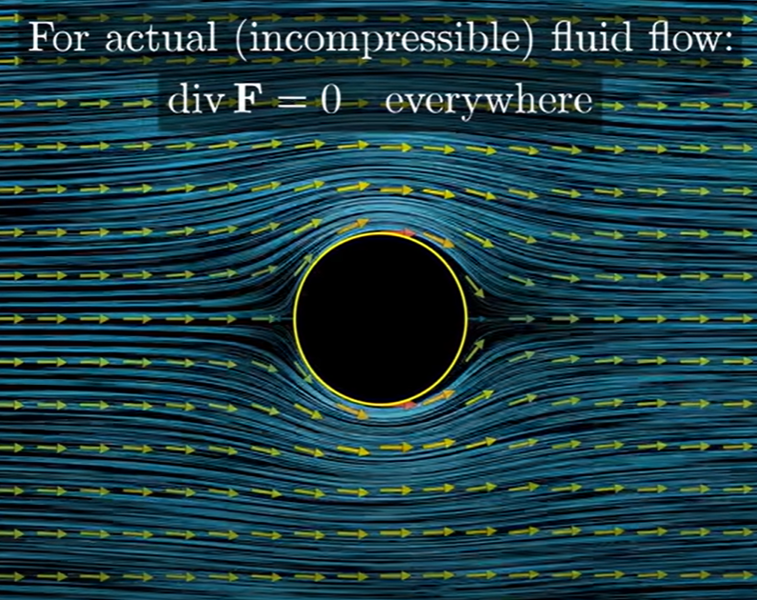
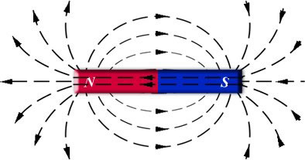


Maxwell’s Equation 1: Gauss’s law of magnetism
$$∇⋅\vec{B}=0$$
$$∇⋅\vec{B}=\operatorname{div}{\vec{B}}=\frac{∂B_{x}}{∂x}+\frac{∂B_{y}}{∂y}+\frac{∂B_{z}}{∂z}$$
一阶偏导
Divergence
(散度）读del或nabla /ˈnæblə/算子，黑体代表矢量算符
Magnetic flux density
Divergence of a vector field at a particular point of the plane tells you how much the fluid tends to flow out of or into small regions near it.
散度（divergence）可用于表征空间各点矢量场发散的强弱程度，能够反映该点通量体积变化率的重要度量。
物理上，散度的意义是场的有源性。当div F>0 ，表示该点有散发通量的正源（发散源）；当div F<0 表示该点有吸收通量的负源（洞或汇）；当div F=0，表示该点的矢量场场线没有发出也没有汇聚。

Slide 8

Maxwell’s Equation 1: Gauss’s law of magnetism
Integral Form
Differential Form
$$∮_{s}\vec{B}⋅dA=∇⋅\vec{B}=0$$
Total magnetic flux through any closed surface is zero.
Flux of the magnetic field through an infinitesimal area element dA
Consider a bar magnet enclosed by a Gaussian surface. The magnetic field lines form closed loops, and the total flux through the surface is zero.
No matter how you position the surface, the number of field lines entering equals the number leaving.

Slide 9
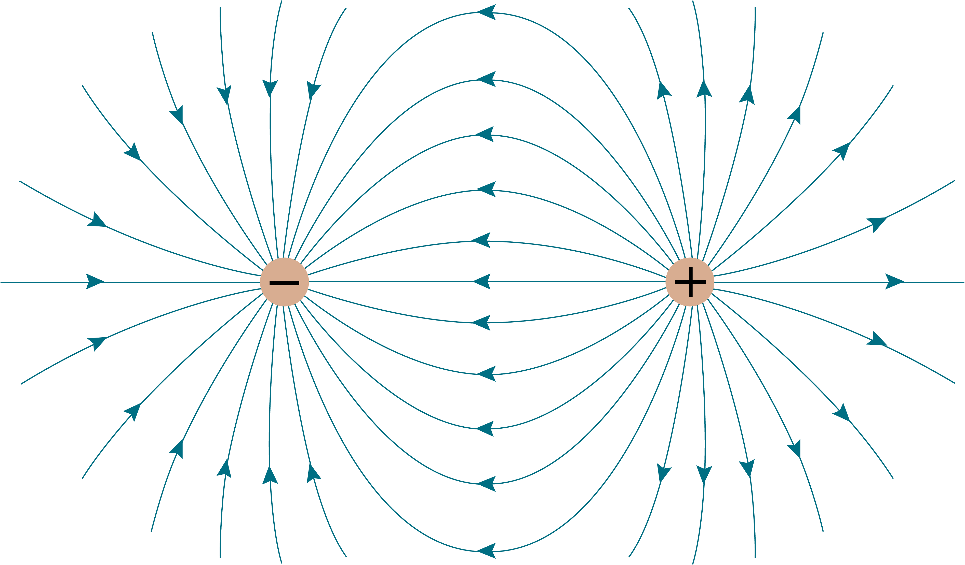
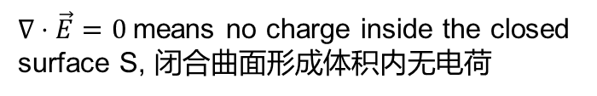



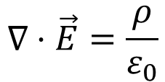
Maxwell’s Equation 2：Gauss’s law of electrostatic
Differential Form
Charge density $\text{(}\text{电荷密度）}ρ=\frac{ⅆq}{ⅆv}$
$$∇⋅\vec{E}=\frac{ρ}{ε_{0}}$$
Permittivity (介电常数，电容率，诱电率）电介质是在电场作用下能建立极化的物质。介电常数是描述某种材料放入电容器中增加电容器存储电荷能力的物理量，是相对介电常数与真空中绝对介电常数乘积。
Electric field
In general form:
$$∇⋅\vec{D}=ρ$$
电感应强度 $\vec{D}=ε_{0}\vec{E}$
Positive charges act as sources of electric field lines (field lines radiate outward).
Negative charges act as sinks of electric field lines (field lines converge inward).
If there is no net charge inside the closed surface, the total electric flux through the surface is zero. This does not mean the electric field is zero everywhere.
$∇⋅\vec{E}=0$means no charge inside the closed surface S, 闭合曲面形成体积内无电荷
The integral of electric flux density is always equal to charge enclosed over a closed surface. It implies that electric field lines originate from positive charges and terminate on negative charges.（电场的源与汇大小正比于电荷密度）

Slide 10
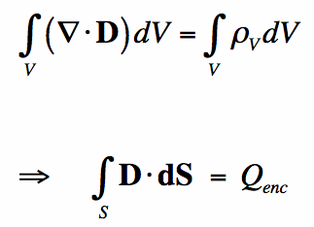
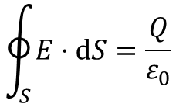

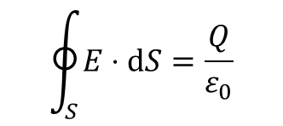
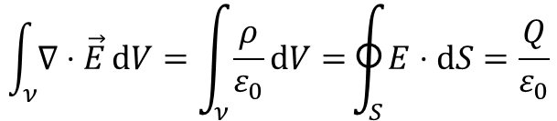
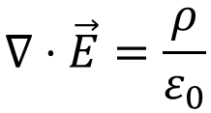
Maxwell’s Equation 2：Gauss’s law of electrostatic
Integral Form
$$\oint_{S}{E⋅ⅆS=\frac{Q}{ε_{0}}}$$
Total electric charge enclosed by the surface S
面积分，表示电场穿过闭合曲面S的通量
The integral form states that the electric flux through any closed surface is proportional to the net charge enclosed by the surface.
Differential Form
Integral Form
$$∇⋅\vec{E}=\frac{ρ}{ε_{0}}$$
$$\oint_{S}{E⋅ⅆS=\frac{Q}{ε_{0}}}$$
$$\int_{ν}{∇⋅\vec{E}ⅆV}=\int_{ν}{\frac{ρ}{ε_{0}}ⅆV=}\oint_{S}{E⋅ⅆS=\frac{Q}{ε_{0}}}$$
散度的体积分，即体积V中所有源点和汇点的总流量
Other form derivation
Divergence Theorem（散度定理）：散度体积分等效于面积分。
Total net flow generated inside the volume (volume integral of divergence) equals the total flow exiting or entering the surface enclosing the volume (surface integral of the field).
电感应强度 $\vec{D}=ε_{0}\vec{E}$

Slide 11
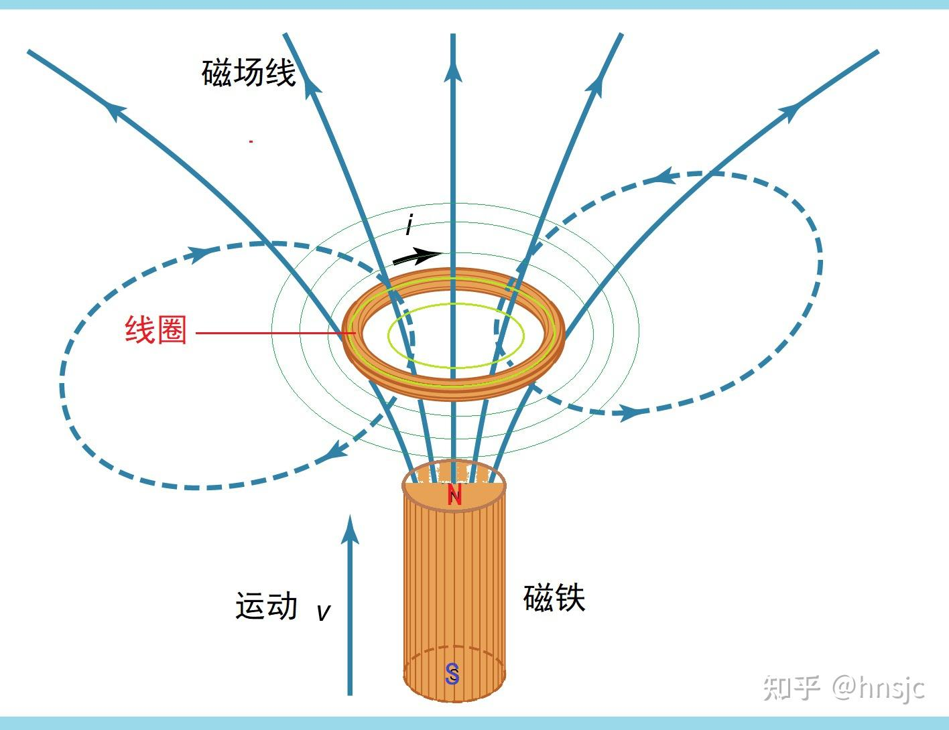
Maxwell’s Equation 3
Faraday’s law of electromotive force （法拉第感应定律：时变磁场产生电场）
Michael Faraday, a self-taught scientist, conducted a series of experiments
(1831) that led to the discovery of electromagnetic induction.
(1)The Induction Ring: Faraday wound two coils of wire around an iron ring. When he connected one coil to a battery, creating a current, he observed a transient current in the second coil, even though it was not directly connected to the battery.
(2) Magnetic Flux and Motion: Faraday also experimented with moving magnets near coils of wire. He found that moving a magnet through a coil or moving a coil relative to a magnet induced an EMF in the coil.
Based on his experiments, Faraday formulated the principle of electromagnetic induction: "An electromotive force is induced in a conductor whenever there is a change in the magnetic flux linked with the conductor."
Lenz's Law
Heinrich Lenz later clarified the direction of the induced current, stating that the induced EMF always opposes the change in magnetic flux that caused it. This is now known as Lenz's Law , which explains the negative sign in Faraday's equation.
楞次总结了安培的电动力学与法拉第的电磁感应现象后，于1833年在圣彼得堡科学院宣读了题为“关于用电动力学方法决定感生电流方向”的论文，提出了感应电动势阻止产生电磁感应的磁铁或线圈的运动，后来这条定律被称为楞次定律，在1834年的《物理学和化学年鉴》上发表。随后德国物理学家亥姆霍兹证明楞次定律实际上是电磁现象的能量守恒定律。

Slide 12
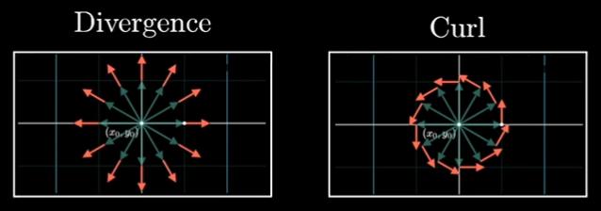
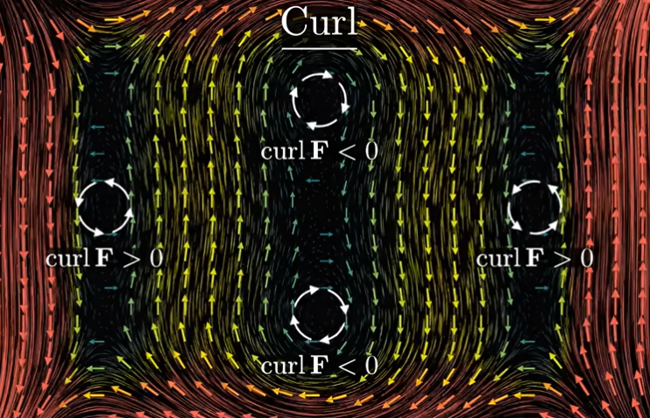
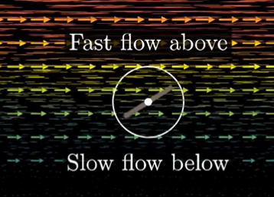
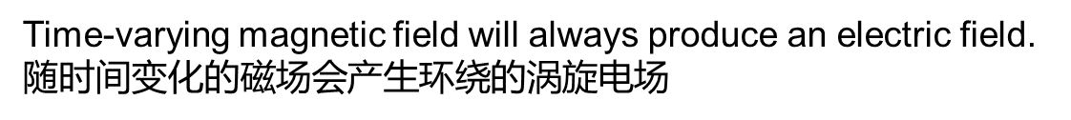
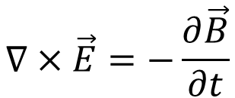
Maxwell’s Equation 3
Faraday’s law of electromotive force （法拉第感应定律：时变磁场产生电场）
Faraday's experimental findings were later formalized mathematically by James Clerk Maxwell in the 1860s.
$$∇×\vec{E}=−\frac{∂\vec{B}}{∂t}$$
旋度是描述向量场中是否存在“旋转”或“涡旋”的趋势。
叉乘将微分算子del转换为Curl 旋度
一侧快，另一侧慢（颜色代表速度），则该点也是有旋的。

Slide 13
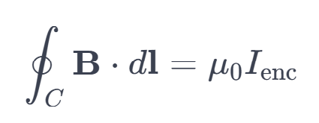
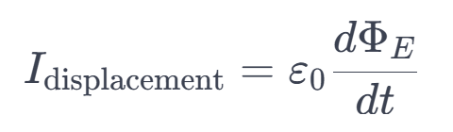
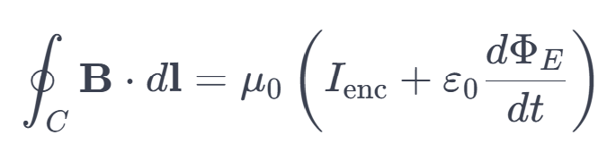
Maxwell’s Equation 4
Ampere’s Circuital law （安培定律：时变电场产生磁场）
1820s，Ampère conducted experiments with two parallel current-carrying wires and observed that they exerted forces on each other. Ampère generalized his findings into a mathematical law, now known as Ampère's Circuital Law : ​
where: B is the magnetic field, C is a closed loop, dl is an infinitesimal segment of the loop, I_{enc}​ is the total current enclosed by the loop, μ₀​ is the permeability of free space.
The law states that the line integral of the magnetic field around a closed loop is proportional to the total current passing through the surface bounded by the loop.
The original form of Ampère's law did not account for the displacement current, which arises when electric fields change with time.
Maxwell introduced the concept of displacement current , which accounts for the changing electric flux through a surface:
Leading to the modern (integral) form of the equation：

Slide 14
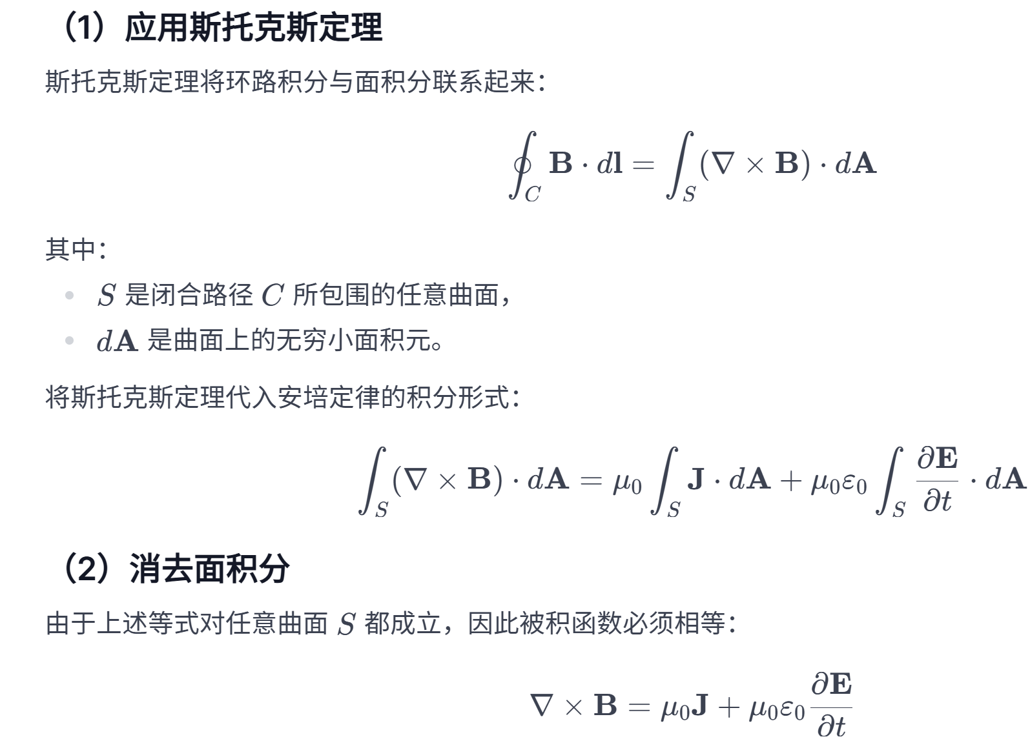
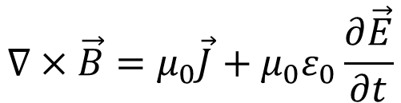
Maxwell’s Equation 4
$$∇×\vec{B}=μ_{0}\vec{J}+μ_{0}ε_{0}\frac{∂\vec{E}}{∂t}$$
Differential Form of the equation：
从积分形式到微分形式的转换

Slide 15
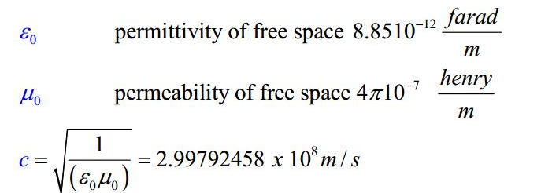
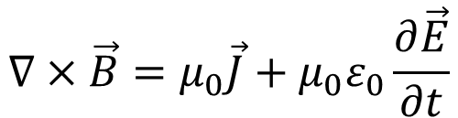
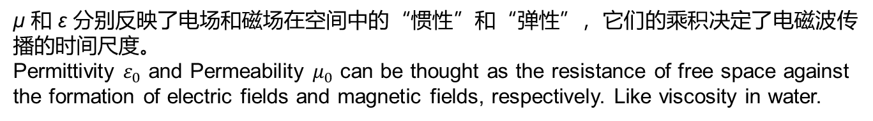
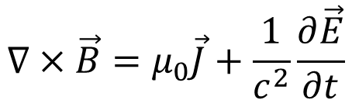
Maxwell’s Equation 4
Ampere’s Circuital law （安培定律：时变电场产生磁场）
$$∇×\vec{B}=μ_{0}\vec{J}+μ_{0}ε_{0}\frac{∂\vec{E}}{∂t}$$
电场随时间变化率
Permeability /ˌpɜːmiəˈbɪləti/ (磁导率):
the measure of magnetization produced in a material in response to magnetic field.
Current density
Permittivity (介电常数）
电流和随时间变化的电场(移动电场)会激发出环绕的涡旋磁场
Speed of light
$$∇×\vec{B}=μ_{0}\vec{J}+\frac{1}{c^{2}}\frac{∂\vec{E}}{∂t}$$
μ 和 ε 分别反映了电场和磁场在空间中的“惯性”和“弹性”，它们的乘积决定了电磁波传播的时间尺度。
Permittivity $ε_{0}$ and Permeability $μ_{0}$ can be thought as the resistance of free space against the formation of electric fields and magnetic fields, respectively. Like viscosity in water.

Slide 16

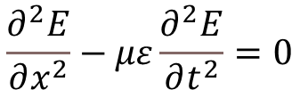

Wave optics：What is a wave?
In the mathematical sense, a wave is any function that moves.
Define the concept of a wave: function of space (x) and time (t).
One space dimensional（only in x direction）wave equation in simple form:
Forward f(x-vt) and backward f(x+vt)，where v is phase velocity of the wave.
$$\frac{∂^{2}E}{∂x^{2}}−με\frac{∂^{2}E}{∂t^{2}}=0$$
But…why do I always see wave equations like these
What are they???
$$E\left(x,t\right)=A\cos\left[\left(kx−ωt\right)−δ\right]$$
$$E\left(x,t\right)=E_{0}ⅇ^{j\left(kx−ωt\right)}$$

Slide 17
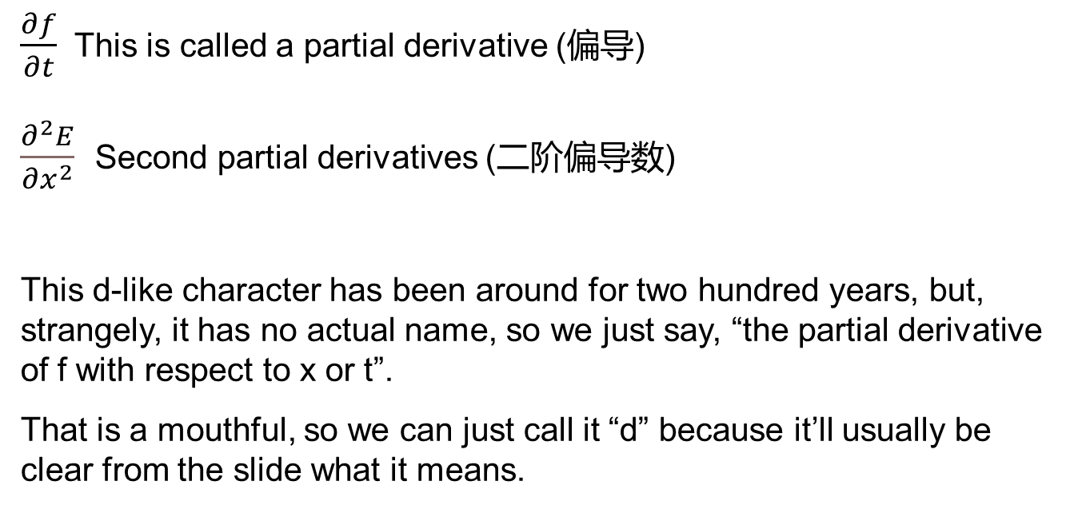
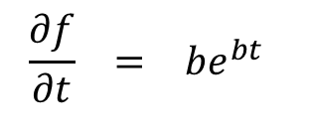
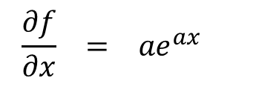
Partial derivatives
For example, if f(x,t) = e^{ax} + e^{bt}, then:
$$\frac{∂f}{∂x} = a​e^{ax}$$
$$\frac{∂f}{∂t} = b​e^{bt}$$
and
$\frac{∂f}{∂t}$ This is called a partial derivative (偏导)
$\frac{∂^{2}E}{∂x^{2}}$ Second partial derivatives (二阶偏导数)
This d-like character has been around for two hundred years, but, strangely, it has no actual name, so we just say, “the partial derivative of f with respect to x or t”.
That is a mouthful, so we can just call it “d” because it’ll usually be clear from the slide what it means.

Slide 18
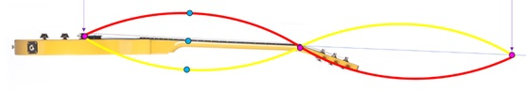
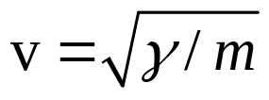
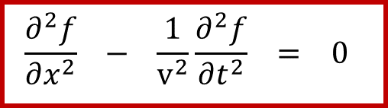
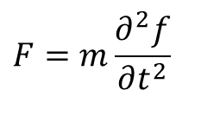
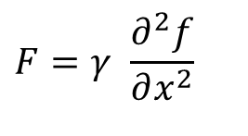
General wave equation
f
x
A guitar string wants to be straight; the restoring force is proportional to how much it’s stretched or curvature:
$$F=γ \frac{∂^{2}f}{∂x^{2}}$$
where γ is constant 张力, f(x,t) is the displacement （弦中横向位移）from straight at the point x at time t. f
$$F=m\frac{∂^{2}f}{∂t^{2}}$$
But Newton’s 2nd Law (F = ma) says that this equals:
$$\frac{∂^{2}f}{∂x^{2}} − \frac{1}{v^{2}}\frac{∂^{2}f}{∂t^{2}} = 0$$
Setting them equal:
where:
Waves are a solution to this equation. And v is the wave’s velocity, also called its phase velocity.
Notes:
Let’s construct the wave equation using a guitar string.
A guitar string wants to be straight, but, if we pluck it, there’ll be a force pulling it back to its desired straight shape, which is called the restoring force and is proportional to how much it’s stretched, that is, its curvature, which is given by some constant γ times ∂2f/∂x2, where f(x,t) is the displacement from straight at the point x at time t.

Slide 19
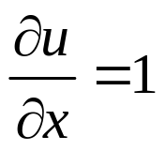
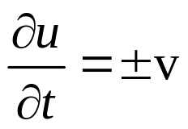
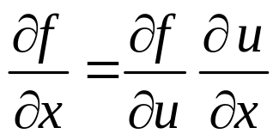
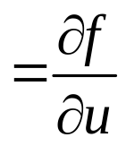
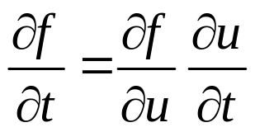
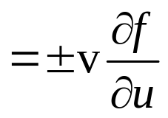





Proof that f (x ± vt) solves the wave equation
Write f (x ± vt) as f (u), where u = x ± vt.
So and
Use the chain rule:
Computing the second derivatives adds another factor of ∂u/∂x or ∂u/∂t:
Substituting into the wave equation:
Notes:
Let’s construct the wave equation using a guitar string.
A guitar string wants to be straight, but, if we pluck it, there’ll be a force pulling it back to its desired straight shape, which is called the restoring force and is proportional to how much it’s stretched, that is, its curvature, which is given by some constant γ times ∂2f/∂x2, where f(x,t) is the displacement from straight at the point x at time t.

Slide 20





Electromagnetic wave equation
$$\frac{∂^{2}f}{∂x^{2}} − \frac{1}{v^{2}}\frac{∂^{2}f}{∂t^{2}} = 0$$
$$\frac{∂^{2}E}{∂x^{2}}−με\frac{∂^{2}E}{∂t^{2}}=0$$
E(x,t) is electric field，
μ is permeability 磁导率，
ε is permittivity 介电常数
f(x,t) is the displacement
v is the wave’s velocity
$$c=\frac{1}{\sqrt{με}}$$
Light velocity
时变电场和磁场相互激发，有一个π/2的相位差。电场激发的磁场往前移了λ/4个波长的位置，磁场激发电场也是一样，相互激发往前传播。
We derive the electromagnetic wave equation from Maxwell’s equations.
$$∇×\vec{E}=−\frac{∂\vec{B}}{∂t}$$

Slide 21













Electromagnetic wave equation
$$∇×\vec{E}=−\frac{∂\vec{B}}{∂t}$$
$$∇×\left(∇×\vec{E}\right)=∇×\left(−\frac{∂\vec{B}}{∂t}\right)$$
Taking the curl of both sides:
1
The right-hand side is simplified by noting that：
$$∇×\left(−\frac{∂\vec{B}}{∂t}\right)=−\frac{∂}{∂t}\left(∇×\vec{B}\right)$$
$∇× is$ for spatial operation, do not related to $\frac{∂}{∂t}$
2
Recalling Maxwell’s Equation 4 (Ampère’s Law)
$$∇×\vec{B}=μ_{0}\vec{J}+μ_{0}ε_{0}\frac{∂\vec{E}}{∂t}$$
$$∇×\left(∇×\vec{E}\right)=−\frac{∂}{∂t}\left(∇×\vec{B}\right)=−μ_{0}ε_{0}\frac{∂^{2}\vec{E}}{∂t^{2}}$$
Substituting $∇×\vec{B}$ in eq.2 :
The left hand side is simplified by the following vector identity（向量恒等式）:
$$∇×\left(∇×\vec{E}\right)=∇\left(∇⋅\vec{E}\right)−∇^{2}\vec{E}$$
For a constant field or no charges
$$∇⋅\vec{E}=\frac{ρ}{ε_{0}}=0$$
Hence
$$∇×\left(∇×\vec{E}\right)=−∇^{2}\vec{E}$$
$$∇^{2}\vec{E}=\frac{∂^{2}\vec{E}}{∂x^{2}}$$
$$\frac{∂^{2}\vec{E}}{∂x^{2}}=μ_{0}ε_{0}\frac{∂^{2}\vec{E}}{∂t^{2}}$$
Laplace operator, Laplacian
拉普拉斯算子：函数的梯度的散度给出的微分算子，通常写成 Δ或 $∇^{2}$，二阶偏导数
Therefore

Slide 22

Harmonic wave solutions to the wave equation
Harmonic solutions 是波动方程的特定解，描述了在空间和时间上呈正弦或余弦形式的周期性波。这些解通常被称为简谐波解 ，因为它们具有简单的正弦或余弦形式，并且是波动方程中最基本、最重要的解之一。
Harmonic waves are sinusoidal solutions to the wave equation. They are periodic in both space and time and can be written in the general form:
$$E\left(x,t\right)=A\cos\left[\left(kx−ωt\right)−δ\right]$$
or equivalently:
$$E\left(x,t\right)=E_{0}ⅇ^{j\left(kx−ωt\right)}$$
A is the amplitude of the wave,
k is the wave number , related to the wavelength λ by k=λ2π​,
ω is the angular frequency , related to the frequency f by ω=2πf,
δ is the phase constant,
v=kω​ is the wave speed.

Slide 23


Harmonic wave solutions to the wave equation
$$\frac{∂^{2}E}{∂x^{2}}−με\frac{∂^{2}E}{∂t^{2}}=0$$
The most general solution has two unknown constants, which
cannot be determined without some additional information about
the problem.
We might expect that oscillatory solutions (sines and cosines) will be very relevant for light waves. (二阶线性齐次微分方程通解：)
$$E\left(x,t\right)=B\cos\left[k\left(x±ct\right)\right]+C\sin\left[k\left(x±ct\right)\right]$$
Making the substitution
$$kc=ω$$
$$E\left(x,t\right)=B\cos\left(kx±ωt\right)+C\sin\left(kx±ωt\right)$$

Slide 24



A simpler equation for a harmonic wave
$$E\left(x,t\right)=B\cos\left(kx±ωt\right)+C\sin\left(kx±ωt\right)$$
$$B=A\cos\left(θ\right)$$
$$C=A\sin\left(θ\right)$$
$$E\left(x,t\right)=A\cos\left(kx±ωt\right)\cos\left(θ\right)+A\sin\left(kx±ωt\right)\sin\left(θ\right)$$
根据三角恒等式化解上述公式Trigonometric identity:
cos(α – β) = cos(α) cos(β) + sin(α) sin(β)
where α = k x ± ω t and β = θ.
Common way of writing the solution to the wave equation:
$$E\left(x,t\right)=A\cos\left[\left(kx±ωt\right)−θ\right]$$
α
β
A = Amplitude， $θ$ = Absolute phase (or “initial” phase t = 0)

