Slide 1

Auxiliary Potential Functions and Reciprocity Theorem
Xing-Chang WEI
Zhejiang Univ., China
2011.12.05

Slide 2
Agenda
Introduction
The Vector Potential A for an Electric Current Source J
The Vector Potential F for an Magnetic Current Source M
Solution of the Inhomogeneous Vector Potential Wave Equation
Far-Field Radiation from Electric and Magnetic Currents
Duality Theorem
Reciprocity Theorem

Slide 3
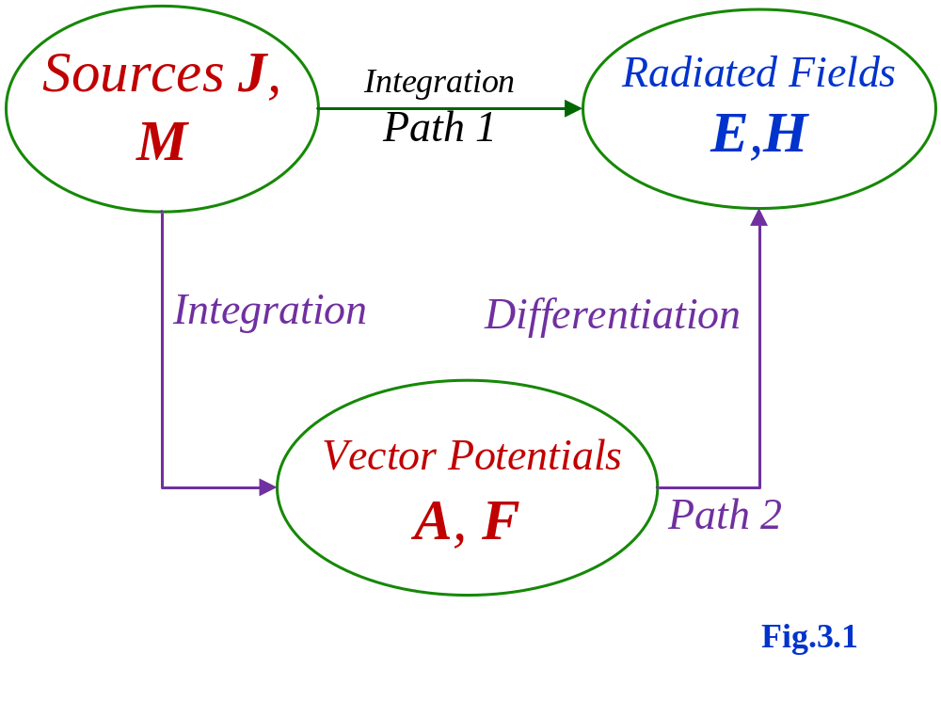
Two methods to solve the electric and magnetic fields

Slide 4
The most common vector potential functions are the A (magnetic vector potential) and F (electric vector potential). Another pair is the Hertz potentials П_{e} and П_{h}. In this lesson, we only talk about A and F.
Related to A and F are φ (electric scalar potential) and φ_{m} (magnetic scalar potential) respectively.
All potentials are strictly mathematical tools, they do not present any physically measurable variables.
The most difficult operation in the two-step procedure is the integration to determine A and F. Once A and F are known, then E and H can be easily determined by differentiation.

Slide 5


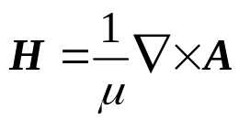




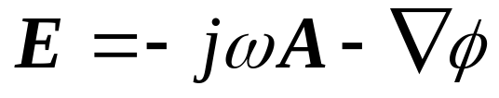
Derive Magnetic Vector Potential A and Electrical Scalar Potential φ
The magnetic flux is always solenoidal (无散场)
so that B can be represented as the curl of another vector A
(3-2)
or
(3-2a)
because for any vector A we have
Substituting (3-2) into Maxwell’s curl equation
(3-3)
reduces it to
(3-5)
so that it can be represented as the gradient of another scalar φ
(3-7)
or
(3-7a)

Slide 6
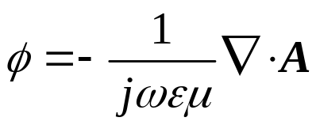


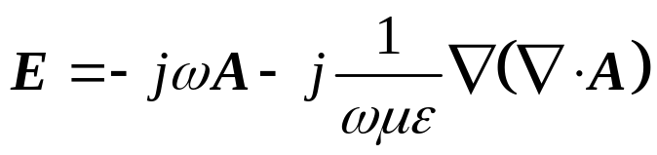
*
A: magnetic vector potential; φ: electric scalar potential
The curl of A was defined, now we are at liberty to define the divergence of A, which is independent of its curl. We can define the following Lorentz condition
or
(3-13)
Substituting (3-13) into Maxwell’s equation leads to
*
(3-14)
In addition
(3-15)

Slide 7






Derive Electric Vector Potential F and Magnetic Scalar Potential φ_{m}
Magnetic current and charge do not exist in the nature. However, during the analysis of EM problem, we can
  Define some special electric current distribution as magnetic current;
  Define E field distribution as magnetic current when we use the volume or surface equivalence theorems.
Electric current J
Magnetic current M

Slide 8
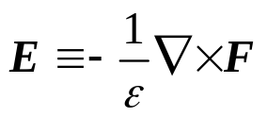

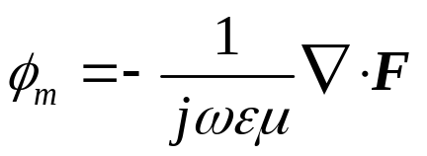

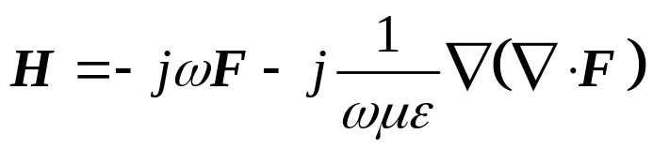
Define Electric Vector F
Define Magnetic Potential φ_{m}
Lorentz condition
Finally, the potential equation
H field is rewritten as

Slide 9


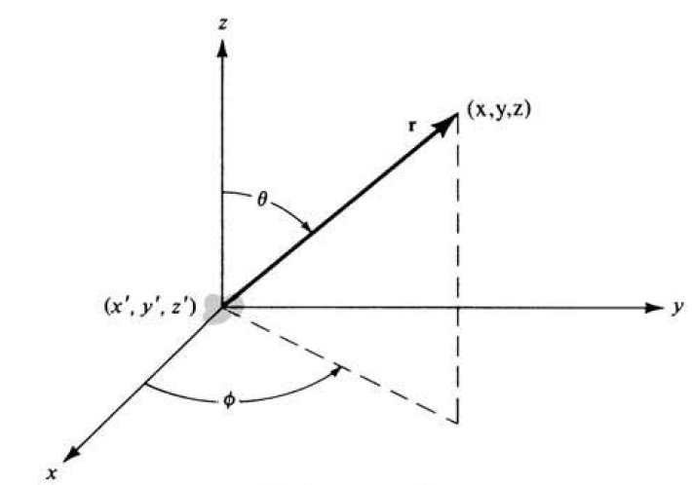
Solution of the Inhomogeneous Vector Potential Wave Equation
Assume an infinitesimal source with current density J_{z}, only an A_{z} component will exist.
(3-31)
At source-free(无源) region, where J_{z}=0, (3-31) reduces to
(3-32)
J_{z}

Slide 10
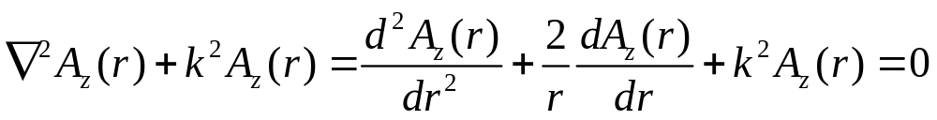

Since in the limit the source is a point, it requires that A_{z} is not a function of direction (θ and φ); in a spherical coordinate system, A_{z} = A_{z}(r) where r is the radial distance
(3-34)
* in the spherical coordinates system can be found in Appendix VII, page1085

Slide 11
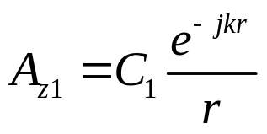
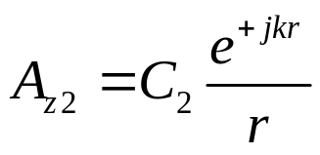
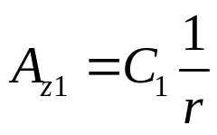
The differential equation of (3-34) has two independent solutions
wave traveling along r direction
(3-35)
We choose (3-35)
wave traveling along -r direction
(3-36)
In the static case (ω = 0, k = 0), (3-35) simplifies to
(3-38)
Thus in source-free region, the time-varying solution and the static solution of (3-35) and (3-38) differ only by the e^{−jkr} factor
the time-varying solution of (3-35) can be obtained by multiplying the static solution of (3-38) by e^{−jkr}

Slide 12


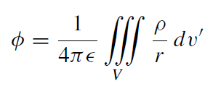
In the presence of the source (J_{z} ≠0) and k = 0, the wave equation of (3-31) reduces to
Poisson’s Equation
(3-39)
The solution of Poisson’s equation is widely documented.
The most familiar equation with Poisson’s form is that relating the scalar electric potential φ to the electric charge density ρ.
which solution is

Slide 13
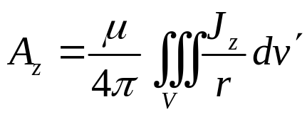
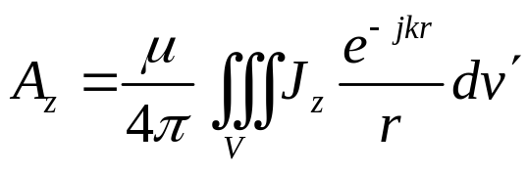
(3-39)
of which the solution is
(3-42)
the time-varying solution can be obtained by multiplying the static solution of (3-42) by e^{−jkr}
(3-43)

Slide 14
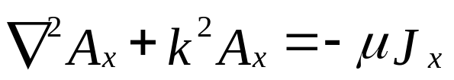
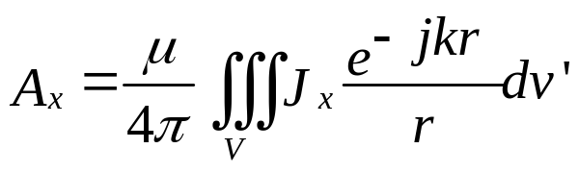
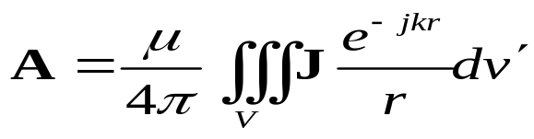
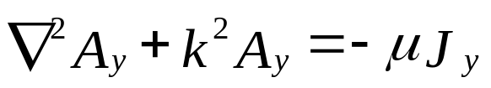
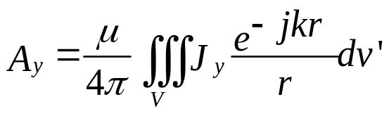
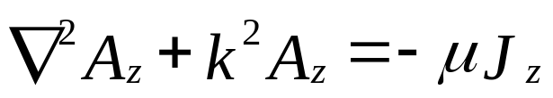
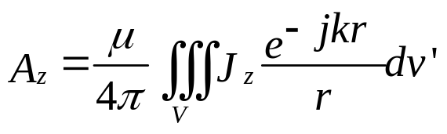
(source) (3-44)
(3-46)
(source) (3-45)
(3-47)
(source) (3-31)
(3-43)

Slide 15
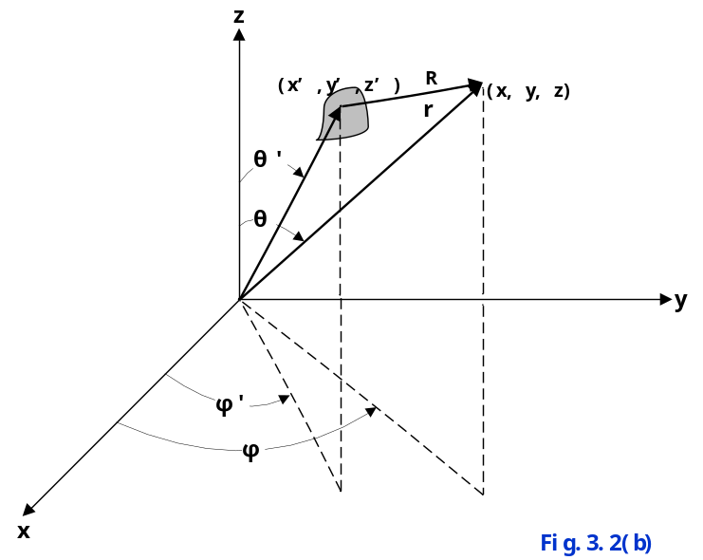
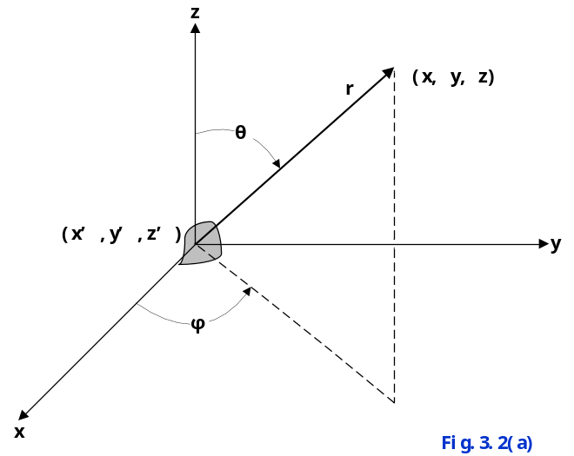

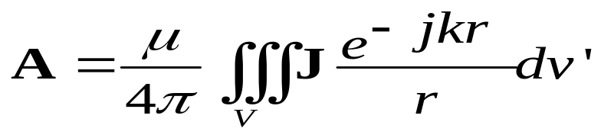
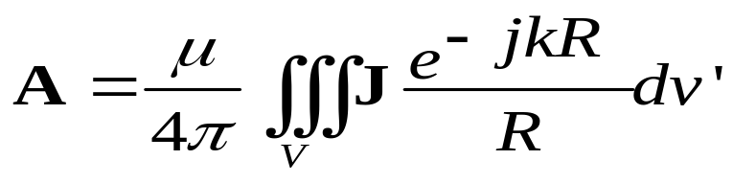
Source At Origin
Source Not At Origin
(3-48)
(3-49)

Slide 16
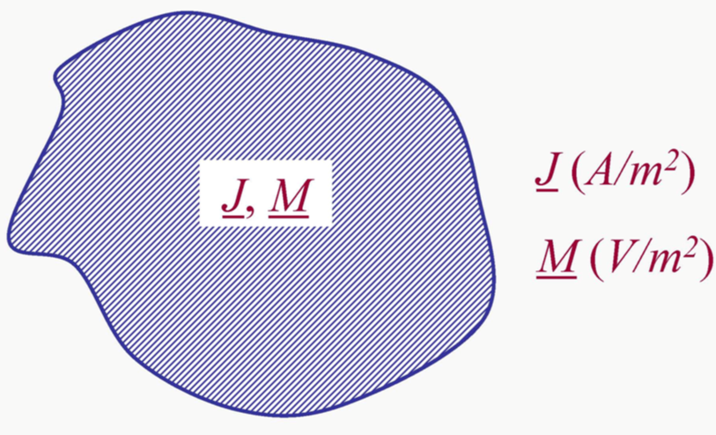
Volumetric Distributed
Current Densities
*

Slide 17
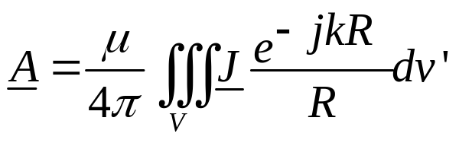
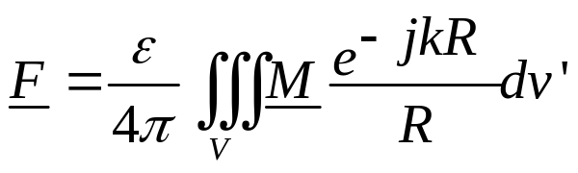
When J has units of A/m²
M has units of V/m²
Then
(3-27)
(3-28)

Slide 18
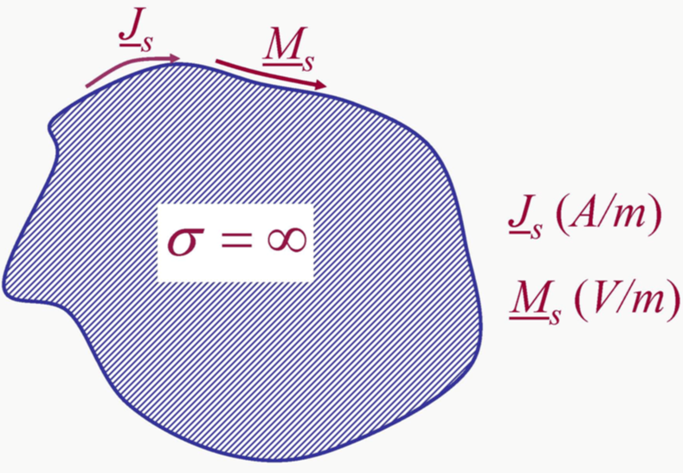
Surface Distributed
Current Densities
*

Slide 19
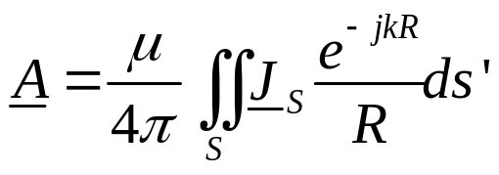
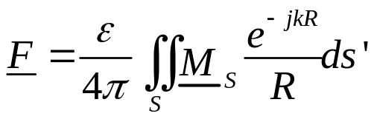
When J has units of A/m
M has units of V/m
Then
(3-51)
(3-52)

Slide 20
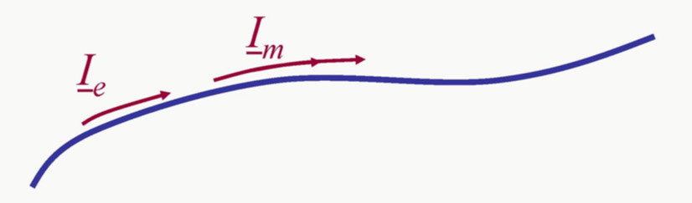
Line Distributed Current

Slide 21


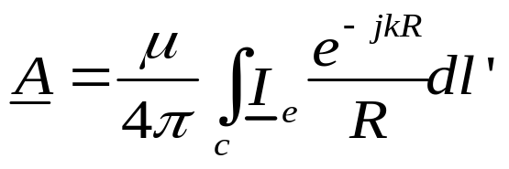
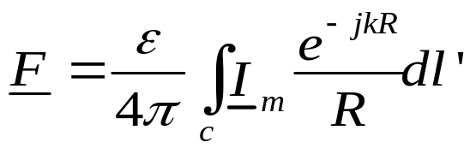
When J has units of Amps
M has units of Volts
Then
(3-53)
(3-54)

Slide 22
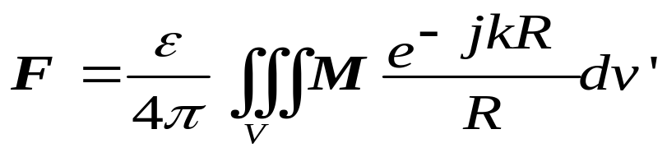
Summary
Specify sources: electric current density J and magnetic current density M.
a. Find A (due to J) using
b. Find F (due to M) using

Slide 23
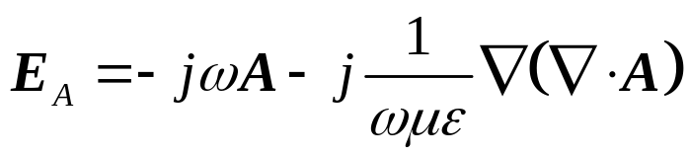
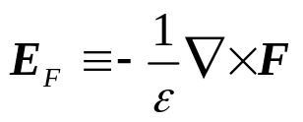
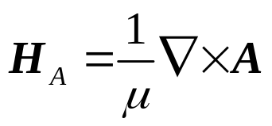
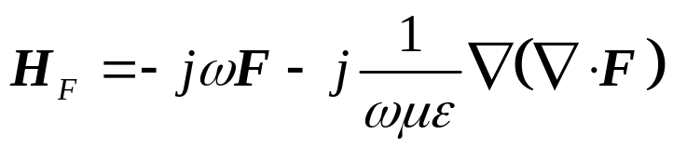
The total electric and magnetic fields are then determined by
E=E_{A}+E_{F}
H=H_{A}+H_{F}

Slide 24
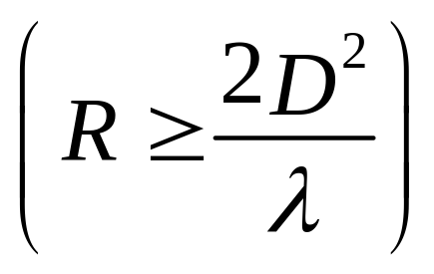
Far-Field
D=Largest Dimension of the Antenna

Slide 25
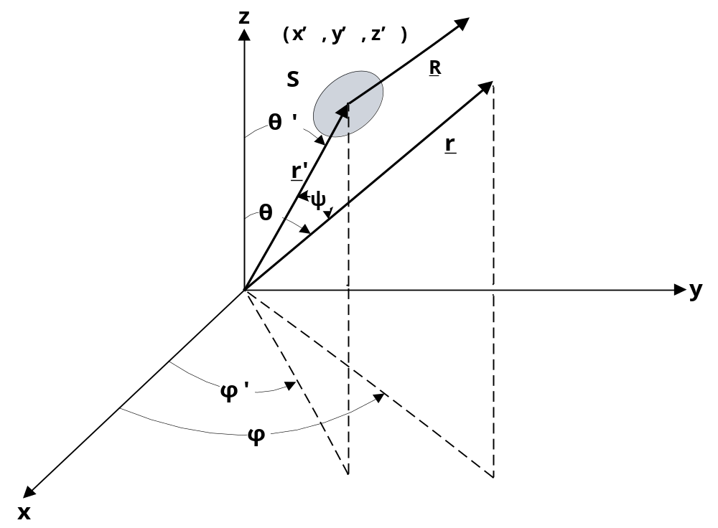
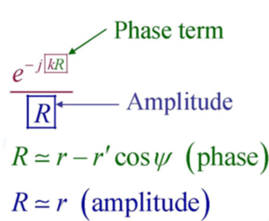
Far-Field

Slide 26

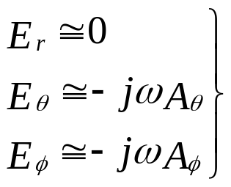
In the far field region, only contributes the E_{r} component (it contributes to the near field);
jωA contributes to all E components, including E_{r}, E_{θ}, and E_{φ}.
Since in far field region E and H are TEM wave, E_{r} will be zero.- This requires that the E_{r} contributions from and jωA must cancel each other in the far field region.
Conclusion: when calculating far E field, we only consider the contributions from jωA. – this shows the benefit of using auxiliary functions
*

Slide 27
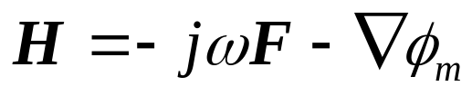
Same conclusion can be draw for the far H field due to magnetic current
when calculating far H field, we only consider the contributions from jωF
Above conclusion is widely used in the CEM software (such as those based on MoM), where the EM field is calculated in the far field region – this reduces the computing time.

Slide 28

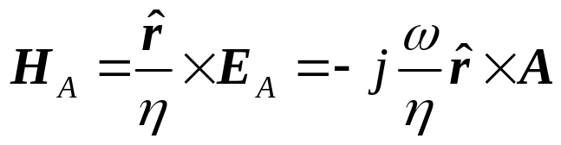
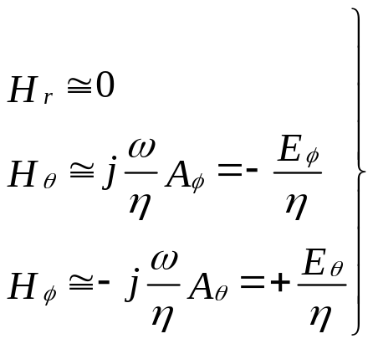
E and H fields due to J
(for θ and φ components only)
(3-58a)
(for θ and φ components only)
(3-58b)

Slide 29

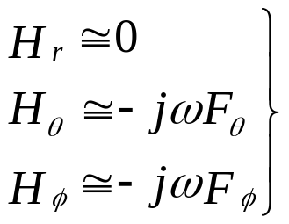

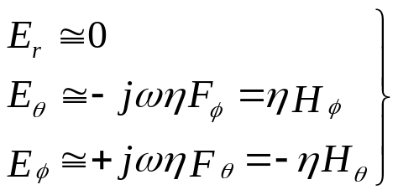
E and H fields due to M
(for θ and φ components only)
(for θ and φ components only)

Slide 30


Electromagnetics: Core Theorems
Duality
Principal
Green’s Theorem
Uniqueness Theorem
Reciprocity
Theorem
Equivalence
Theorem
Huygens’
Principal

Slide 31





Duality Theorem
When two equations that describe the behavior of two different variables are of the same mathematical form, their solutions will also be identical. The variables in the two equations that occupy identical positions are known as dual quantities and a solution of one can be formed by a systematic interchange of symbols to the other.
Electric current J and electric charge ρ
Magnetic current M and magnetic charge ρ_{m}
It must, however, be emphasized that this is purely mathematical, since it is known, as of today, that there are no magnetic charges or currents in nature

Slide 32

Examples of Duality Theorem
Radiated E & H fields are known

Slide 33
Reciprocity

Slide 34




Reciprocity Theorems in Circuits
Port 1
Port 2
Port 1
Port 2
Reciprocity means
I₂ V₁= I₁ V₂
Z₁₂= Z₂₁

Slide 35
Reciprocity Theorems for Antennas
Transmitting & receiving patterns are reciprocal provided the medium of wave propagation is linear.
A. We usually analyze patterns in the transmitting mode
B. We usually measure patterns in the receiving mode

Slide 36


Reciprocity Theorems for EM Fields
In a linear and isotropic medium, there exist two sets of sources J₁ and J₂, which are allowed to radiate simultaneously or individually inside the same medium at the same frequency. J₁ and J₂ produces fields (E₁, H₁) and (E₂, H₂), respectively.
From Maxwell’s curl equations we can get
(3-60)
r
Lorentz Reciprocity Theorem in differential form
Taking a volume integral of both sides of (3-60) and apply divergence theorem
(3-61)
Lorentz Reciprocity Theorem in integral form

Slide 37





Let S be a spherical surface and →∞ (S is in the far-field region of J₁ & J₂)
TEM waves
and
therefore
r
(3-61) is reduced to

Slide 38

If both sources are constant line current I₁ and I₂
The unit of both sides is Watt, but they does not present the power, they are defined as Reaction

Slide 39






The equivalent circuit network of transmitting & receiving antennas system and its reciprocity
Reciprocity of EM fields
Reciprocity of circuit
Z₁₂= Z₂₁
Beside the T & R antennas system, for any circuit system(including RLCG) with two ports, we can prove:
Maxwell’s curl equations->reciprocity of EM fields->reciprocity of circuit

Slide 40

Antenna Arrangement for Pattern
Measurements & Reciprocity Theorem
V_{2oc} = V_{1oc}
The receiving mode of operation for the test antenna is most widely used to measure antenna patterns because the transmitting equipment is, in most cases, bulky and heavy while the receiver is small and lightweight

Slide 41


Homework
Page 150

