Slide 1

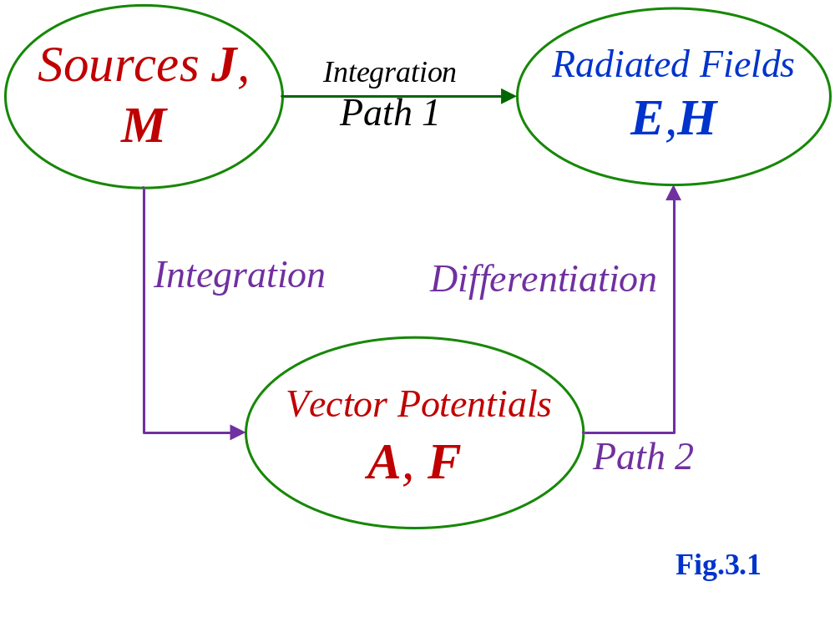
Review of Last Lesson

Slide 2
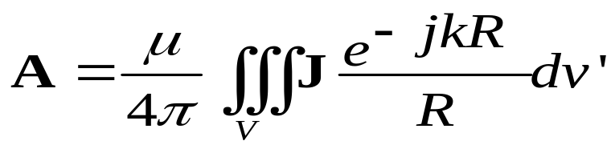
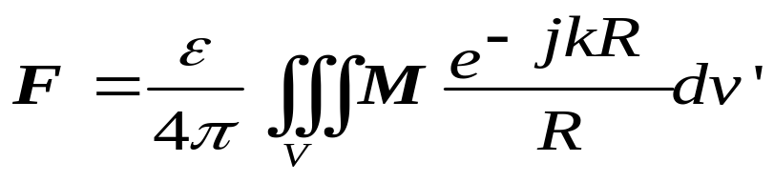
Review of Last Lesson
Summary
Specify sources: electric current density J and magnetic current density M.
a. Find A (due to J) using
b. Find F (due to M) using

Slide 3
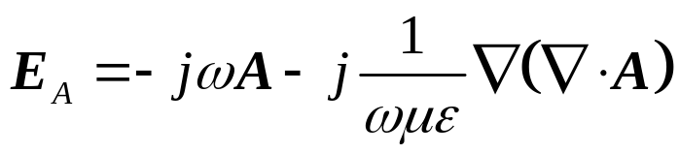
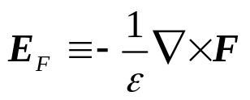
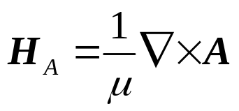
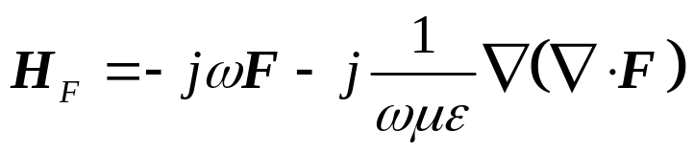
Review of Last Lesson
The total electric and magnetic fields are then determined by
E=E_{A}+E_{F}
H=H_{A}+H_{F}

Slide 4
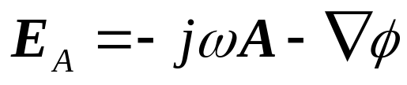
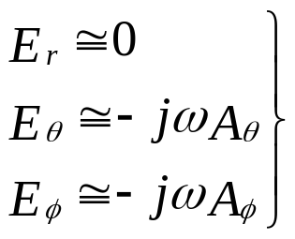
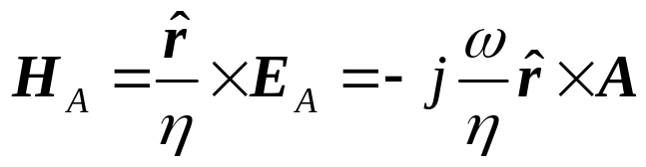
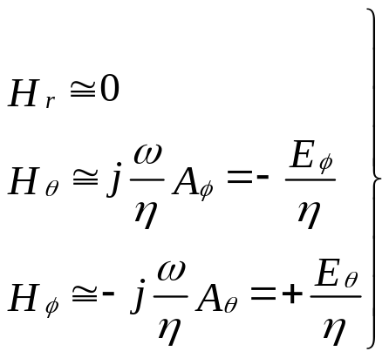
Review of Last Lesson
E and H far fields due to J
only contributes the E_{r} component in far field
(3-58a)
(for θ and φ components only)
(3-58b)

Slide 5
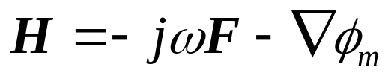
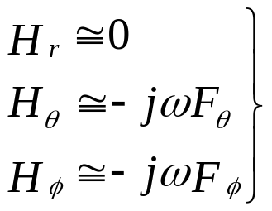

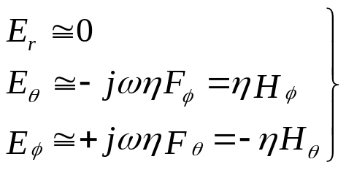
Review of Last Lesson
E and H far fields due to M
only contributes the H_{r} component in far field
(for θ and φ components only)

Slide 6


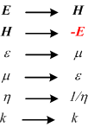


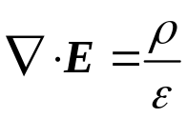
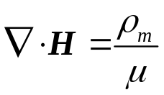


Review of Last Lesson
Duality Theorem
Electric current J and electric charge ρ
Magnetic current M and magnetic charge ρ_{m}

Slide 7
Review of Last Lesson
Reciprocity Theorems for Antennas
Provided the medium of wave propagation is linear
Transmitting patterns & receiving patterns of one antenna are the same.
A pair of transmitting and receiving antennas can be equivalent to a two-ports network with their impedance parameter z₁₂= z₂₁.

Slide 8
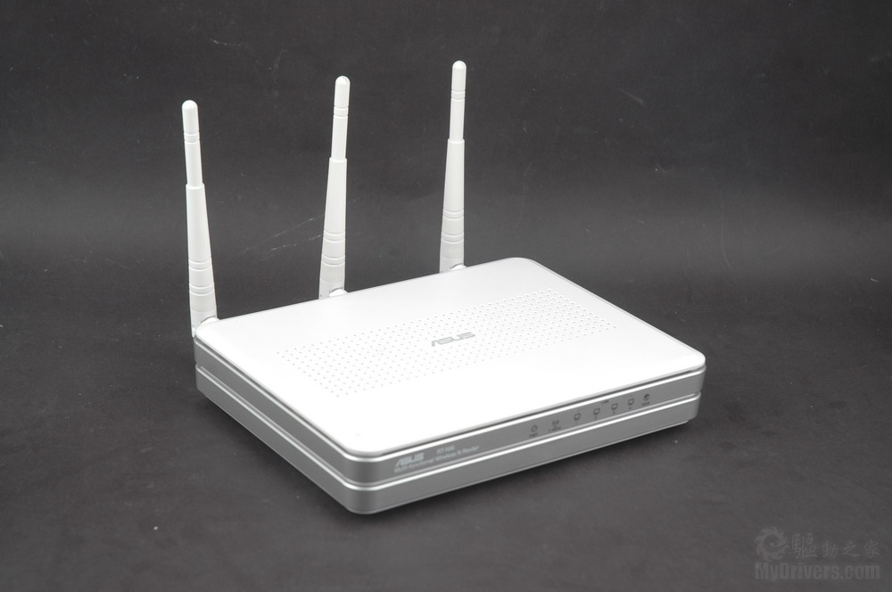
Chapter 4
Linear Wire Antennas
Xing-Chang WEI
Zhejiang Univ., China
2011.12.07

Slide 9
Agenda
Infinitesimal dipole
  Radiated Field,
  Power Density and Radiation Resistance
  Near-Field Region, Intermediate-Field Region and Far-Field Region
  Directivity
Small Dipole
Finite Length Dipole
  Current Distribution
  Radiated Field
  Power Density and Radiation Resistance
  Directivity
  Input Resistance
Half-Wavelength Dipole
Linear Elements Near or on Infinite Perfect Conductors
  Image theory
  Vertical Electric Dipole
  Horizontal Electric Dipole
Linear Antennas for Mobile Communication Systems

Slide 10
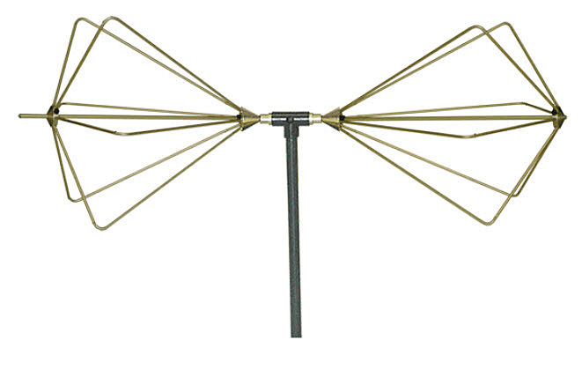
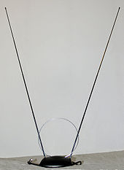
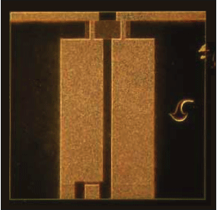
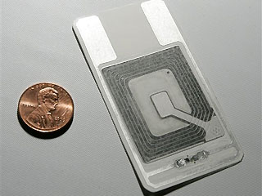
Introduction
Wire antennas are the oldest, simplest, and cheapest antennas;
Wire Antennas have many applications
Embedded Chip Antenna
A "rabbit-ears" antenna with a UHF loop antenna.
RFID Antenna

Slide 11
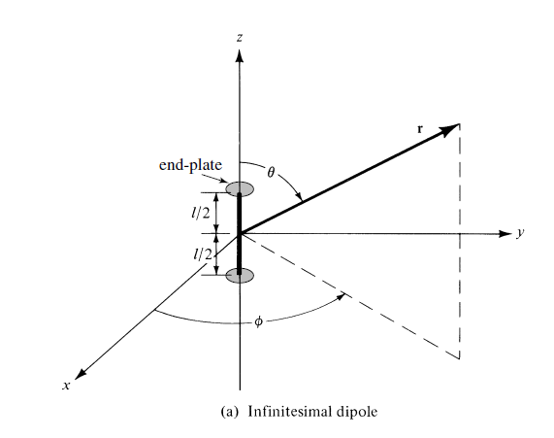
Infinitesimal dipole
An infinitesimal dipole means l<<λ
The end plates are used to provide capacitive loading in order to maintain the uniform current.
Observation point
Fig.4.1(a)

Slide 12
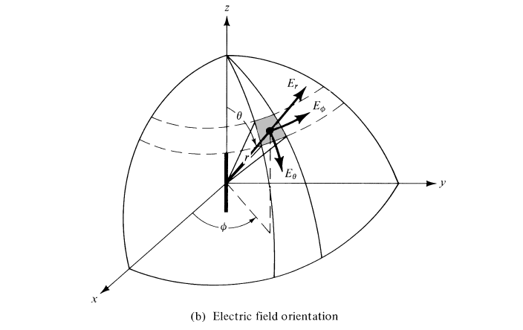
Electric Field Orientation
Infinitesimal dipole
Fig.4.1(b)

Slide 13
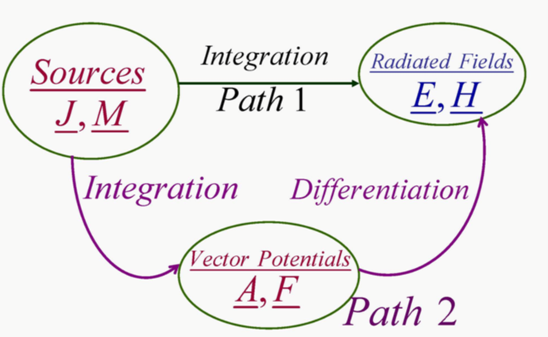
Calculation of Radiated Fields
Infinitesimal dipole

Slide 14
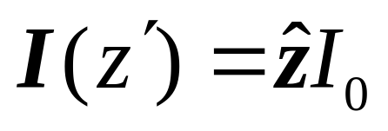
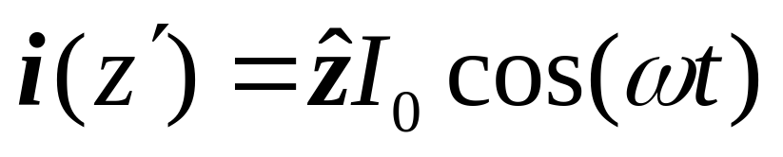
Step one: determine the current source
Frequency and Time Domain Current
Infinitesimal dipole
(4-1)

Slide 15
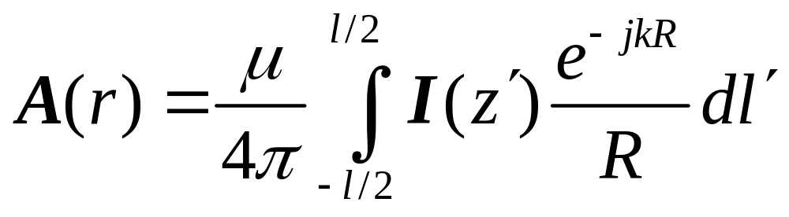
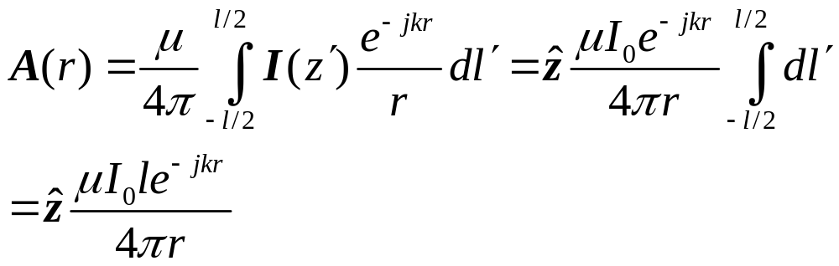
Step two: Vector Potential
Infinitesimal dipole
(4-2)
R=|r-r'| .Assume the observation distance r is large enough than the dipole length l, which means R≈r. * not for the far field

Slide 16
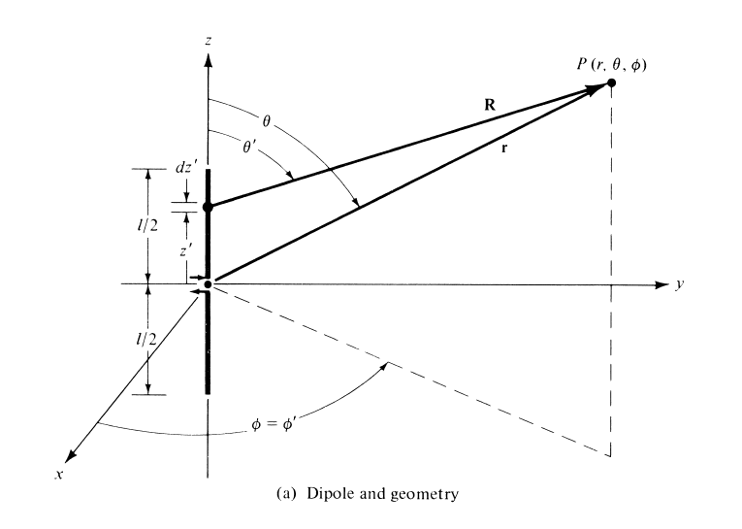
Dipole and Geometry
Infinitesimal dipole
Observation point
Fig.4.4(a)

Slide 17
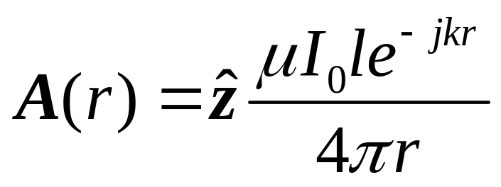
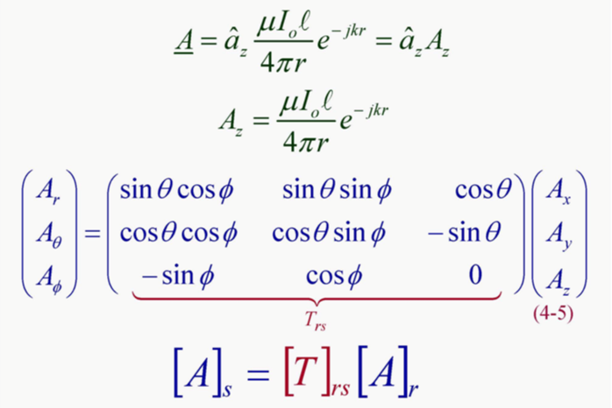
Cartesian Coordinates->Spherical Coordinates
Infinitesimal dipole

Slide 18
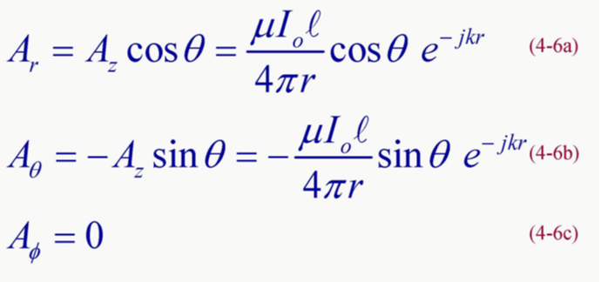
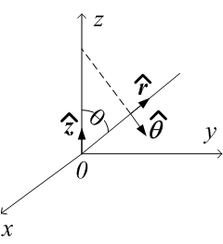
A under Spherical Coordinates
Infinitesimal dipole

Slide 19
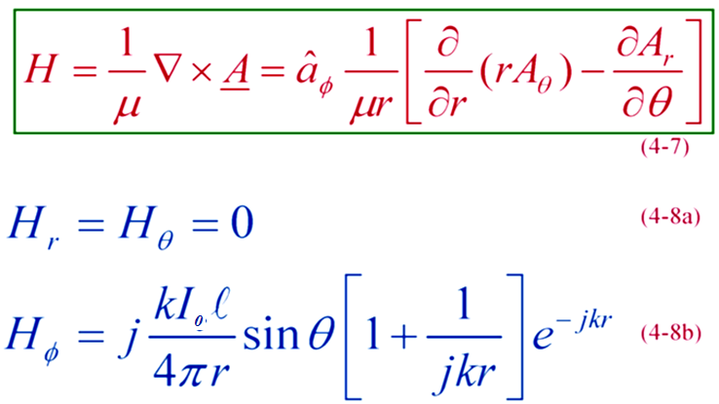
Step Three: Calculate E & H
Magnetic Field
Infinitesimal dipole

Slide 20
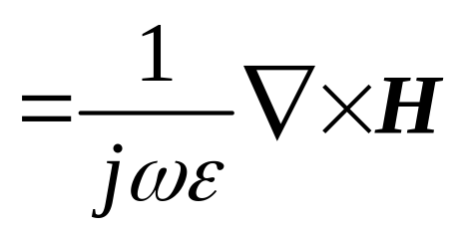
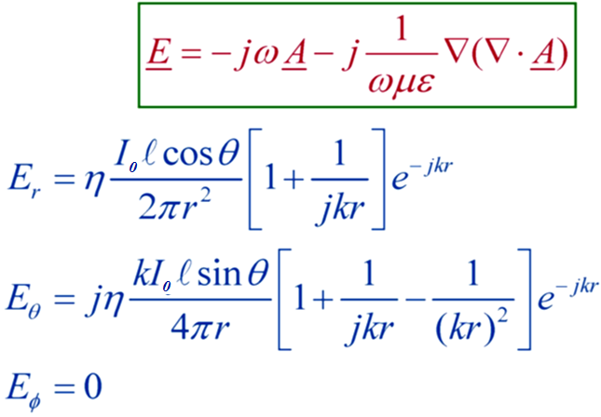
Electric Field
Infinitesimal dipole

Slide 21
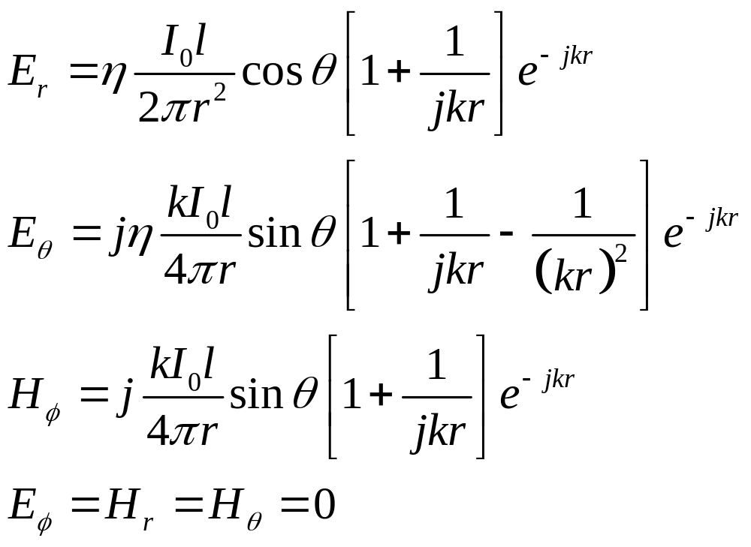
Radiated Fields – Summary for all regions
Infinitesimal dipole
(4-10a)
(4-10b)
(4-8b)
(4-10c)

Slide 22
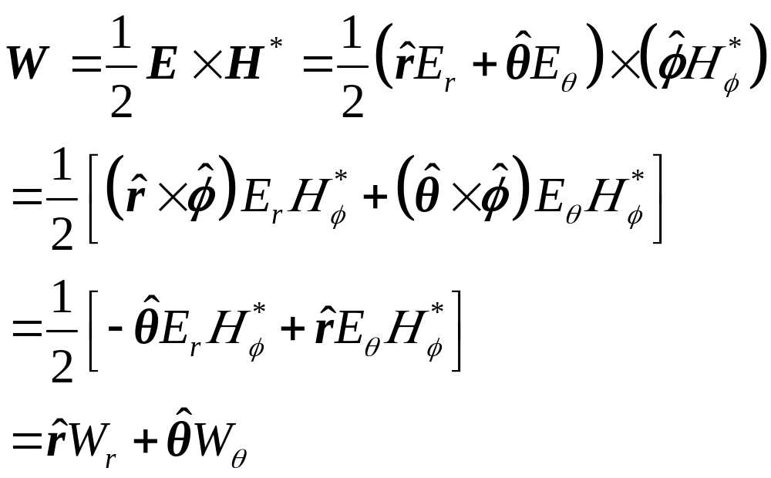
Infinitesimal dipole
Power Density
(4-11)

Slide 23
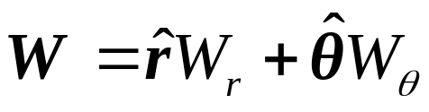
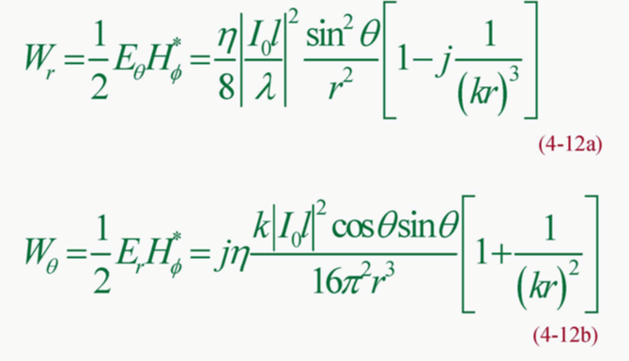
Infinitesimal dipole
Power Density

Slide 24
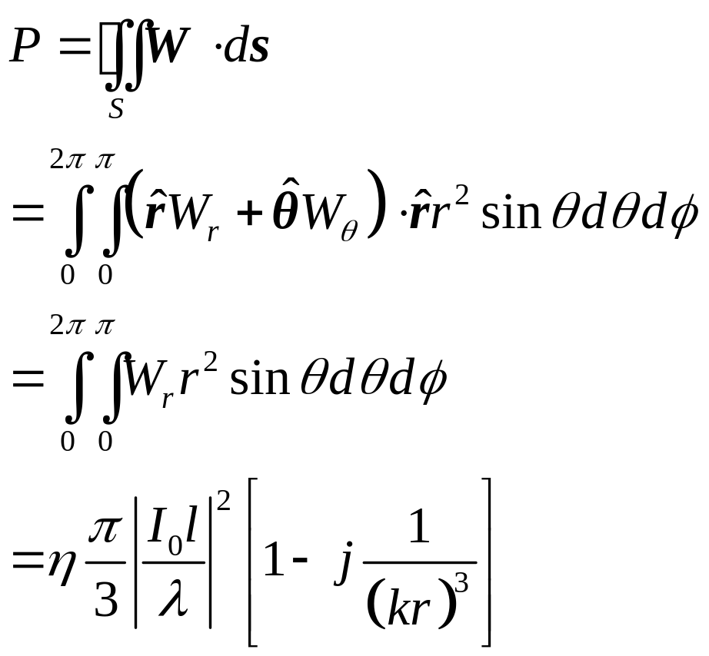
Infinitesimal dipole
Radiated Power
(4-14)

Slide 25
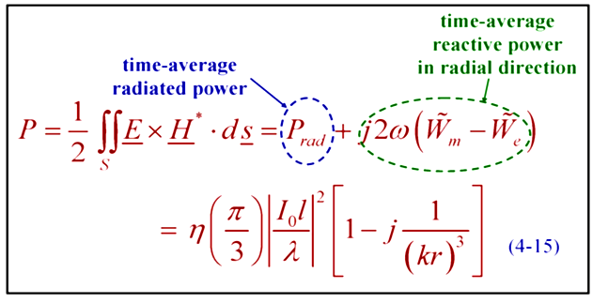
Outwardly Flowing Complex Power from Infinitesimal Dipole
Infinitesimal dipole

Slide 26
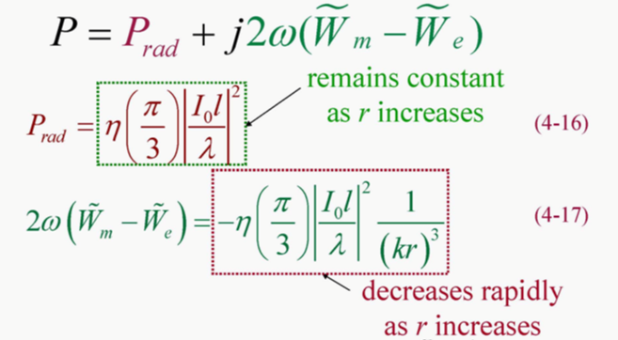
Outwardly Flowing Complex Power from Infinitesimal Dipole
Infinitesimal dipole

Slide 27
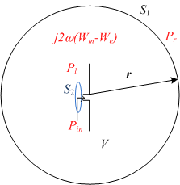

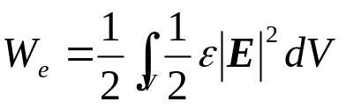
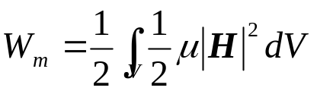

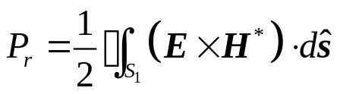

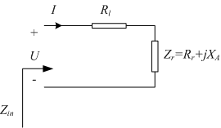
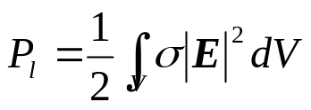


According to the Poynting Theorem, we get
Where
Averaged stored electric energy inside volume V
Averaged stored magnetic energy inside volume V
Power flowing out forward volume V
Ohm loss of the antenna
Power flowing into the volume V
Thevenin Equivalent of a transmitting antenna

Slide 28




Infinitesimal dipole
Near-Field Region(reactive near field), Intermediate-Field Region(radiating near field) and Far-Field Region
Magnitude
kr

Slide 29
Infinitesimal dipole
kr=1
Near-Field
(kr<<1)
Intermediate-Field
(kr>1)
Far-Field
(kr>>1)

Slide 30

Infinitesimal dipole
kr<<1 (Near-Field)

Slide 31

Infinitesimal dipole
kr<<1 (Near-Field)
Dominant power is Reactive power

Slide 32

Infinitesimal dipole
kr>>1 (Far-Field)
(4-26)
TEM Wave

Slide 33

Infinitesimal dipole
kr>>1 (Far-Field)
Dominant power is real power

Slide 34
Far Field Parameters:
Radiation Resistance
Directivity
Effective Area
Effective Length

Slide 35

Infinitesimal dipole
Radiation Resistance

Slide 36

Directivity
Infinitesimal dipole
In far-field region

Slide 37


Directivity
Infinitesimal dipole

Slide 38


Maximum Effective Area A_{em}
Infinitesimal dipole

Slide 39



Infinitesimal dipole
Vector Effective Length
:the length of a thin straight conductor oriented perpendicular to the given direction (θ,φ) and parallel to the antenna polarization, having a uniform current equal to that at the antenna terminals and producing the same far-field strength as the antenna in that direction.

Slide 40

Infinitesimal dipole
Vector Effective Length

Slide 41


Infinitesimal dipole
Vector effective length is calculated at transmitting mode

Slide 42

Infinitesimal dipole

Slide 43

Infinitesimal dipole

Slide 44

Infinitesimal dipole

Slide 45

Infinitesimal dipole

Slide 46
Far-field Radiation Characteristics of an Infinitesimal Dipole – Summary
Infinitesimal dipole
U_{n}=sin²θ
R_{r}=80π²(l/λ)²
D₀=1.5=1.76dB
A_{em}=0.119 λ²
l_{e}=lsinθ

Slide 47

Dipole and Geometry
Small dipole
l<<lambda;
No end plates

Slide 48

Current Distribution of Small Dipole
Small dipole
Fig.4.4(b)

Slide 49

Small dipole
Since the current distribution of a small dipole is not uniform, the analysis of its radiation field is more complex than that of the infinitsimal dipole. Here, only the far field is considered.

Slide 50

Small dipole
Radiation Resistance

Slide 51

Small dipole
Directivity and maximum effective area

Slide 52

Dipole and Geometry
Finite Length Dipole
Fig.4.5(a)

Slide 53


Ideal Current Distribution
Finite Length Dipole
(4-56)

Slide 54



Finite Length Dipole
Vector Potential
The calculation is a little complex, in the following, let us only consider the far-field region

Slide 55

Finite Length Dipole

Slide 56


Finite Dipole Geometry &Far-field Approximations
Finite Length Dipole
Far-Field Approximation
Fig.4.5(b)

Slide 57


Finite Length Dipole
The whole finite dipole is divided into many segments, each segment is taken as an infinitesimal dipole

Slide 58

Finite Length Dipole
The finite dipole is taken as an array of infinitesimal dipoles

Slide 59
Ideal Sinusoidal Current Distribution
Finite Length Dipole

Slide 60

Finite Length Dipole

Slide 61

Finite Length Dipole
Radiated Far-Field

Slide 62

Finite Length Dipole
Far Field Parameters
Far-Field Power Density

Slide 63

Finite Length Dipole
Far-Field Radiation Intensity

Slide 64

Finite Length Dipole

Slide 65



Finite Length Dipole
Radiation Pattern

Slide 66


Finite Length Dipole
Radiation Pattern
As the length of the dipole increases beyond one wavelength (l > λ), the number of lobes begin to increase.
Fig.4.7(a)

Slide 67

Finite Length Dipole
Fig.4.7(b)

Slide 68

Finite Length Dipole
Radiated Power

Slide 69

Finite Length Dipole
Radiated Power

Slide 70


Finite Length Dipole
Radiation Resistance
Z_{in}=R_{r}+jX_{m}
Can not be derived form P_{rad}

Slide 71

Finite Length Dipole
C_{i} and S_{i} are cosine and sine integrals

Slide 72

Finite Length Dipole
Directivity

Slide 73

Finite Length Dipole
Directivity

Slide 74

Directivity and Radiation /Input Resistance
Finite Length Dipole
resonance

Slide 75

Finite Length Dipole

Slide 76

Finite Length Dipole

Slide 77

Ideal Sinusoidal Current Distribution
Finite Length Dipole

Slide 78

Current Distributions Along the Length of a Linear Wire Antenna
Finite Length Dipole
Fig.4.8

Slide 79

Current Distribution of a Linear Wire Antenna When Current Maximum
Does not Occur at the Input Terminals
Finite Length Dipole
Fig.4.10

Slide 80

Finite Length Dipole
Input Impedance

Slide 81

Finite Length Dipole
Input Impedance

Slide 82

Finite Length Dipole

Slide 83
Finite Length Dipole
Nonideal current distribution of Finite Dipole
Not sine distribution due to radiation*
Finite Feed Gap
Accurate calculation of current need numerical methods, such Moment Method (MoM), Finite Element Method (FEM), and Finite Difference Time Domain Method (FDTD).

Slide 84

Finite Length Dipole

Slide 85

Finite Length Dipole

Slide 86

Half-Wavelength Dipole

Slide 87

Half-Wavelength Dipole
Radiated Far-Field
kl=π
TEM Wave

Slide 88

Half-Wavelength Dipole
Power Density and Radiation Intensity

Slide 89

Half-Wavelength Dipole
Radiated Power

Slide 90

Half-Wavelength Dipole
Directivity and Radiation Resistance

Slide 91

Half-Wavelength Dipole

Slide 92

Half-Wavelength Dipole

Slide 93


Half-Wavelength Dipole
Fig.2.13(a)

Slide 94

Three-Dimensional Directivity Pattern of a λ/2 Dipole
Half-Wavelength Dipole
Fig.2.13(b)

Slide 95


Slide 96


Slide 97


Slide 98

Linear Elements Near or on Infinite Perfect Conductors

Slide 99

Linear Elements Near or on Infinite Perfect Conductors

Slide 100

Linear Elements Near or on Infinite Perfect Conductors

Slide 101

Linear Elements Near or on Infinite Perfect Conductors

Slide 102

Actual and Equivalent Problems
Linear Elements Near or on Infinite Perfect Conductors

Slide 103

Vertical Infinitesimal Dipole above Infinite Electric Conductor (PEC)
Linear Elements Near or on Infinite Perfect Conductors
Fig.4.14(a)

Slide 104

Linear Elements Near or on Infinite Perfect Conductors
Radiated Far-Field

Slide 105



Vertical Electric Dipole above Infinite Electric Conductor(PEC)
Linear Elements Near or on Infinite Perfect Conductors
Fig.4.14(b)

Slide 106

Linear Elements Near or on Infinite Perfect Conductors

Slide 107

Linear Elements Near or on Infinite Perfect Conductors
Radiated Far-Field

Slide 108

Linear Elements Near or on Infinite Perfect Conductors
Radiation Pattern
Fig.4.15

Slide 109

Scalloping of Amplitude Pattern of Vertical Dipole
Linear Elements Near or on Infinite Perfect Conductors
Fig.4.16

Slide 110

Linear Elements Near or on Infinite Perfect Conductors

Slide 111



Linear Elements Near or on Infinite Perfect Conductors
Radiated Power

Slide 112

Linear Elements Near or on Infinite Perfect Conductors
Radiation Intensity and Directivity

Slide 113

Linear Elements Near or on Infinite Perfect Conductors
Radiation Resistance

Slide 114


Linear Elements Near or on Infinite Perfect Conductors
Directivity of isolated infinitesimal dipole
Radiation resistance of isolated infinitesimal dipole
Fig.4.18
l=λ/50

Slide 115

Linear Elements Near or on Infinite Perfect Conductors

Slide 116

Linear Elements Near or on Infinite Perfect Conductors

Slide 117


Linear Elements Near or on Infinite Perfect Conductors
Fig.4.19(a)

Slide 118

Linear Elements Near or on Infinite Perfect Conductors

Slide 119



Linear Elements Near or on Infinite Perfect Conductors
Monopole vs. Dipole
where the length of monopole and dipole are λ/4 and λ/2 respectively.
P_{rad}(monopole)=1/2P_{rad}(dipole)

Slide 120

Linear Elements Near or on Infinite Perfect Conductors

Slide 121


Linear Antennas for Mobile Communication Systems
Fig.4.22

Slide 122

Linear Elements Near or on Infinite Perfect Conductors

Slide 123

Linear Elements Near or on Infinite Perfect Conductors
Fig.4.24

Slide 124

Linear Elements Near or on Infinite Perfect Conductors
Fig.4.25(a)

Slide 125

Linear Elements Near or on Infinite Perfect Conductors
Fig.4.25(b)

Slide 126

Linear Elements Near or on Infinite Perfect Conductors

Slide 127

Linear Elements Near or on Infinite Perfect Conductors

Slide 128

Linear Elements Near or on Infinite Perfect Conductors
Fig.4.26

Slide 129

Linear Elements Near or on Infinite Perfect Conductors
Fig.4.28

Slide 130

Linear Elements Near or on Infinite Perfect Conductors

Slide 131

Linear Elements Near or on Infinite Perfect Conductors

Slide 132

Linear Elements Near or on Infinite Perfect Conductors

Slide 133

Linear Elements Near or on Infinite Perfect Conductors

Slide 134

Linear Elements Near or on Infinite Perfect Conductors

Slide 135

Linear Elements Near or on Infinite Perfect Conductors

Slide 136

Radiation Resistance and Directivity
Linear Elements Near or on Infinite Perfect Conductors
Fig.4.29

Slide 137


Linear Elements Near or on Infinite Perfect Conductors
Fig.4.30

Slide 138

Modeling of the Effect of Earth on Antenna Systems
Linear Elements Near or on Infinite Perfect Conductors

Slide 139

Effect of Imperfectly Conducting ，Flat Earth
Linear Elements Near or on Infinite Perfect Conductors

Slide 140

Effect of Imperfectly Conducting ，Flat Earth
Linear Elements Near or on Infinite Perfect Conductors

Slide 141

Linear Elements Near or on Infinite Perfect Conductors

Slide 142

Reflection From A Flat Surface
Linear Elements Near or on Infinite Perfect Conductors
Fig.4.33(a)

Slide 143

Reflection From A Spherical Surface
Linear Elements Near or on Infinite Perfect Conductors
Fig.4.33(a)

Slide 144

Homeworks
Page 219, 4.1, 4.5(only calculate (a)), 4.29,
HFSS Simulation
Frequency: 200MHz-400MHz
To find:
Zin and VSWR (when this monopole is connected to a 50Ohm transmission line) for the whole frequency band
Radiation Pattern @300MHz

