Slide 1

集成电路原理与设计
期中辅学
申佳欣
2025/11/1

Slide 2

期中考试属于课堂测验的一部分
占比较低且难度不高
大家可以放轻松一些

Slide 3
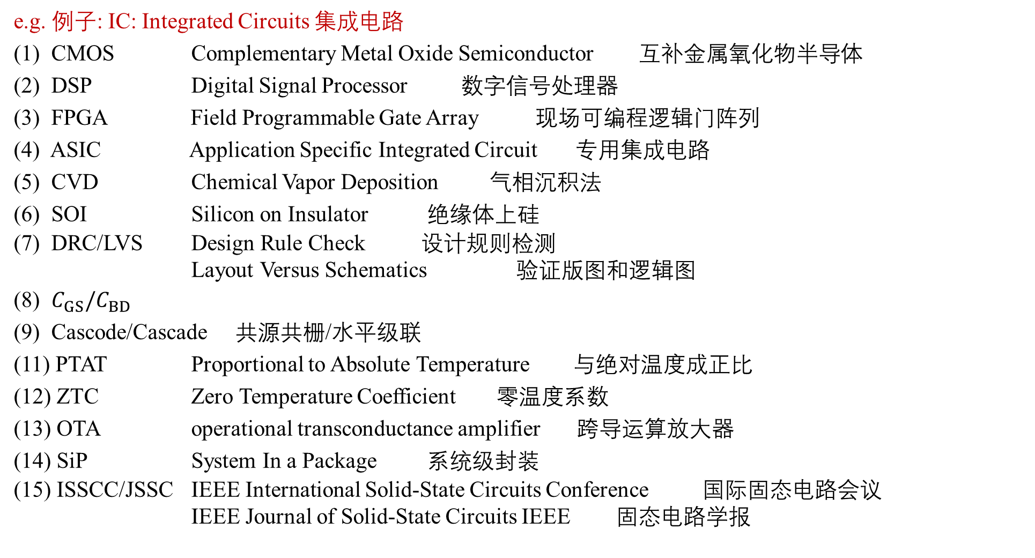
1、Explain the Abbreviations(English and Chinese) 3×15 = 45 pts
e.g. 例子: IC: Integrated Circuits 集成电路
(1) CMOS Complementary Metal Oxide Semiconductor 互补金属氧化物半导体
(2) DSP Digital Signal Processor 数字信号处理器
(3) FPGA Field Programmable Gate Array 现场可编程逻辑门阵列
(4) ASIC Application Specific Integrated Circuit 专用集成电路
(5) CVD Chemical Vapor Deposition 气相沉积法
(6) SOI Silicon on Insulator 绝缘体上硅
(7) DRC/LVS Design Rule Check 设计规则检测
Layout Versus Schematics 验证版图和逻辑图
(8) $C_{GS}/C_{BD}$
(9) Cascode/Cascade 共源共栅/水平级联
(11) PTAT Proportional to Absolute Temperature 与绝对温度成正比
(12) ZTC Zero Temperature Coefficient 零温度系数
(13) OTA operational transconductance amplifier 跨导运算放大器
(14) SiP System In a Package 系统级封装
(15) ISSCC/JSSC IEEE International Solid-State Circuits Conference 国际固态电路会议
IEEE Journal of Solid-State Circuits IEEE 固态电路学报

Slide 4
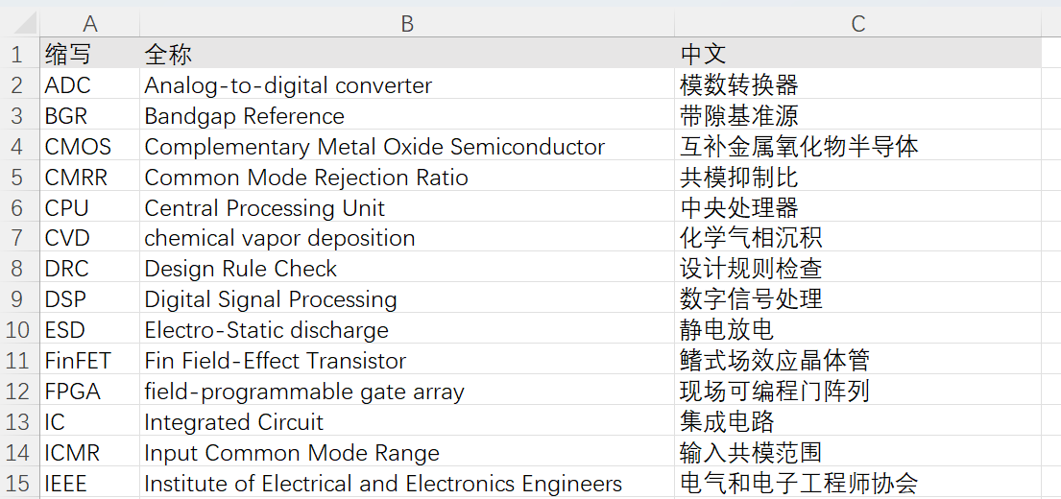
1、Explain the Abbreviations(English and Chinese) 3×15 = 45 pts
集成电路名词解释

Slide 5
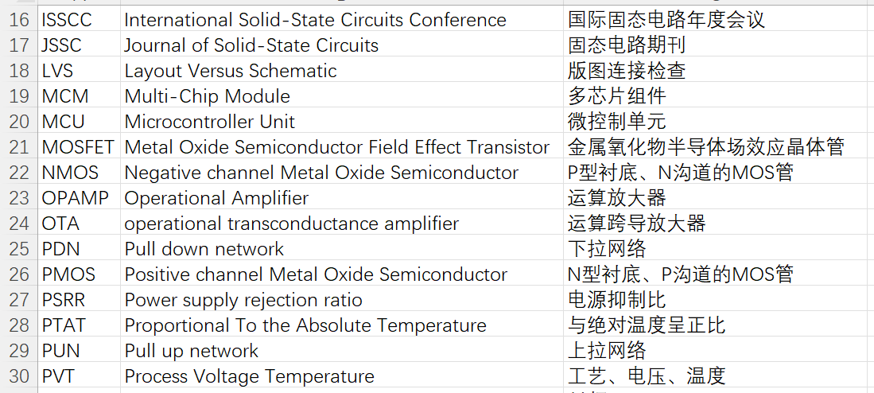
1、Explain the Abbreviations(English and Chinese) 3×15 = 45 pts
集成电路名词解释

Slide 6
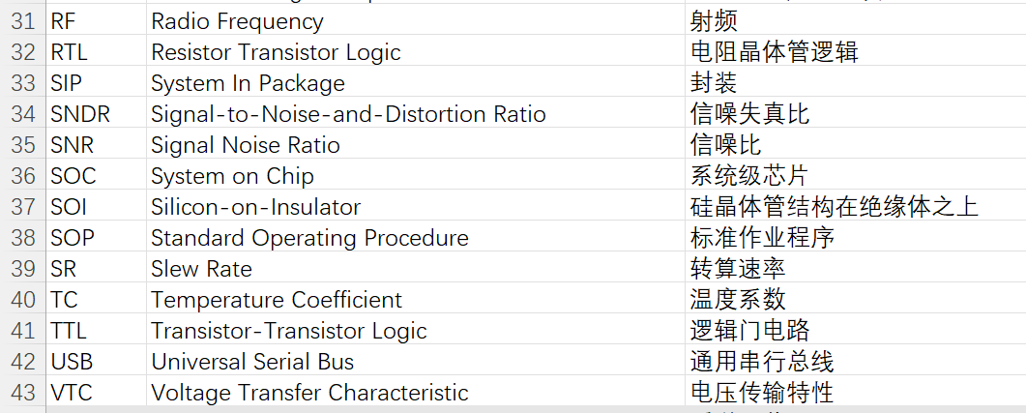
1、Explain the Abbreviations(English and Chinese) 3×15 = 45 pts
集成电路名词解释

Slide 7
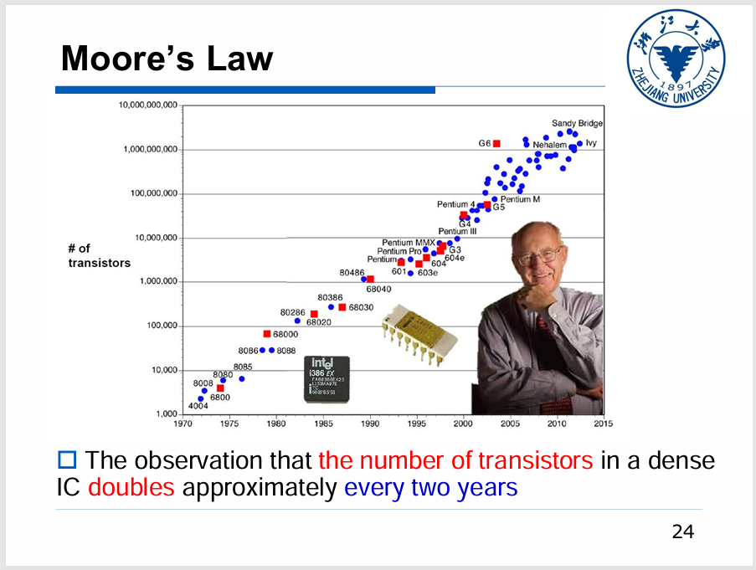
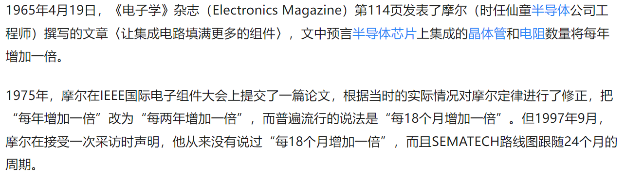
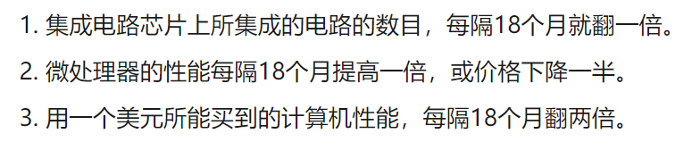
2、Short Questions 4×8 = 32 pts
(1) Moore's Law refers to Gordon Moore's perception that the number of transistors (what) on a microchip doubles (change how many times) every 18-24 month, though the cost of computers is halved.
(2) Analog (Analog/Digital) IC design differs greatly from digital IC design. Where digital (analog/digital) IC design is mostly done at an abstracted level with HDL (Hardware Description Language), analog (analog/digital) IC design generally involves more personalized focus into each transistor, determining the sizing of each.
摩尔定律的三种版本（我们IC有自己的“茴”的四种写法）

Slide 8
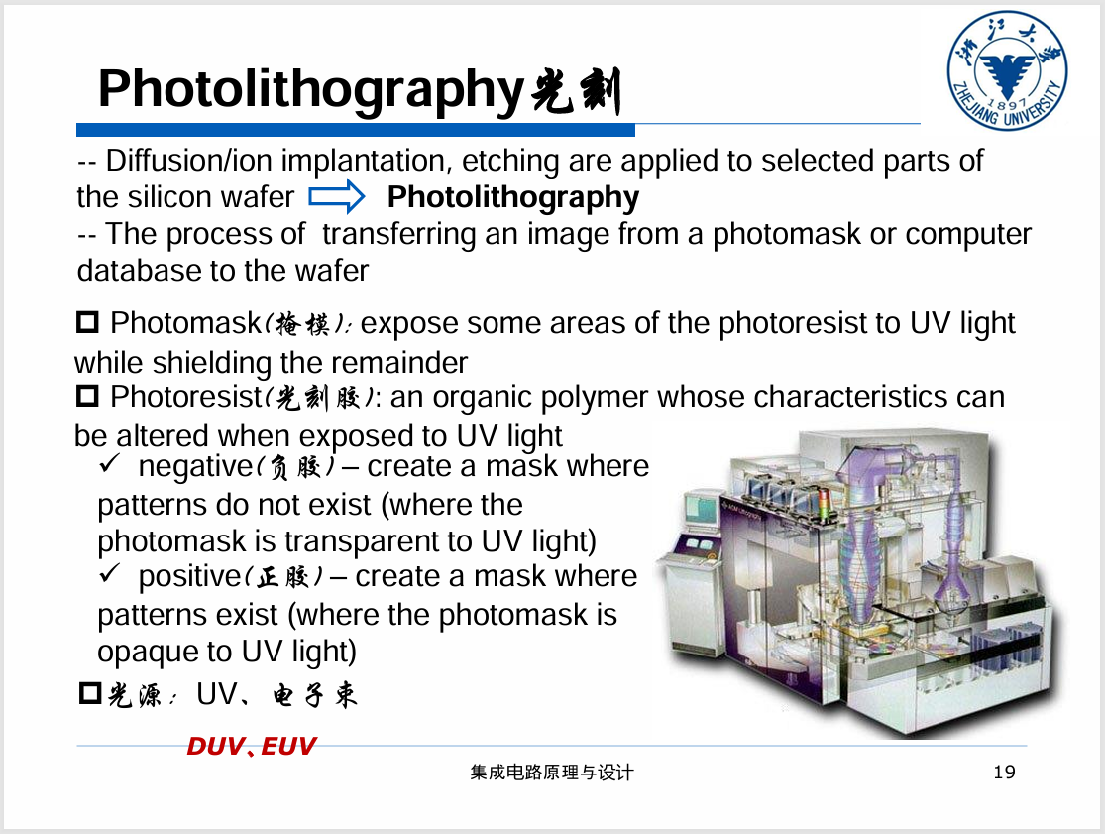
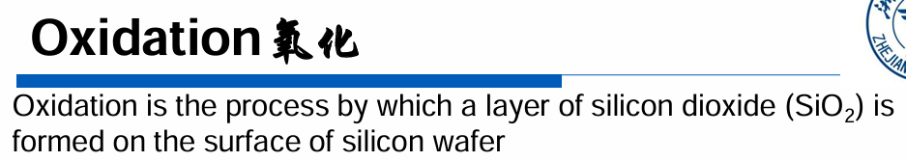
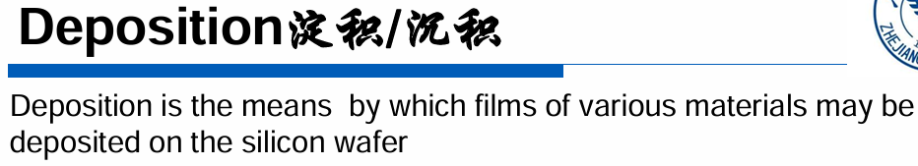
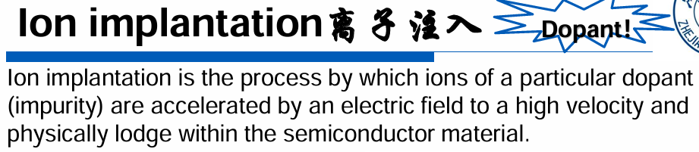
2、Short Questions 4×8 = 32 pts
(3) Modern CMOS technologies involve roughly the following operations: Wafer Preparation: produce the proper type of substrate;  lithography : (step name) precisely define each region by light;  Oxidation, deposition and ion (what) implantation: add materials to the wafer;  Etching: remove materials from the wafer.

Slide 9
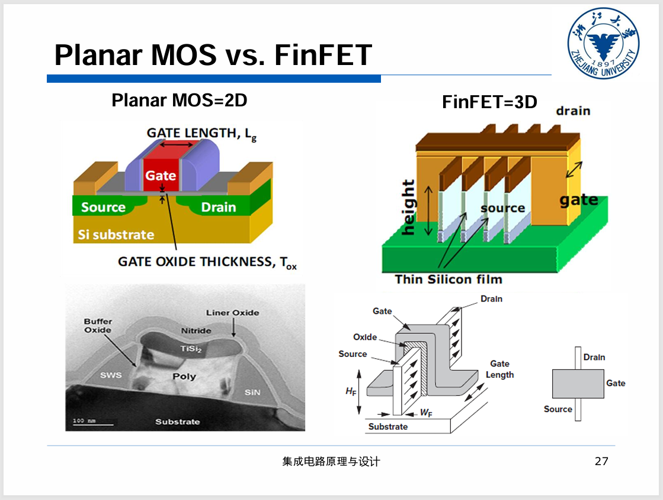
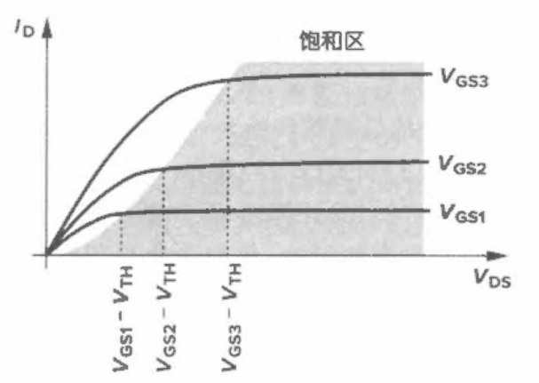
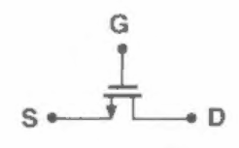

2、Short Questions 4×8 = 32 pts
(4) The type of transistors in the following figure.1 is FinFET (Planar MOS/FinFET), which is invented for advanced (conventional/advanced) technology node like 14nm CMOS.
(5) An NMOS transistor with a higher (lower/higher) Vds tends to work in saturation region. In saturation region, it usually has a higher (higher/lower) small signal resistance (r_{o}) compared to linear region.

Slide 10
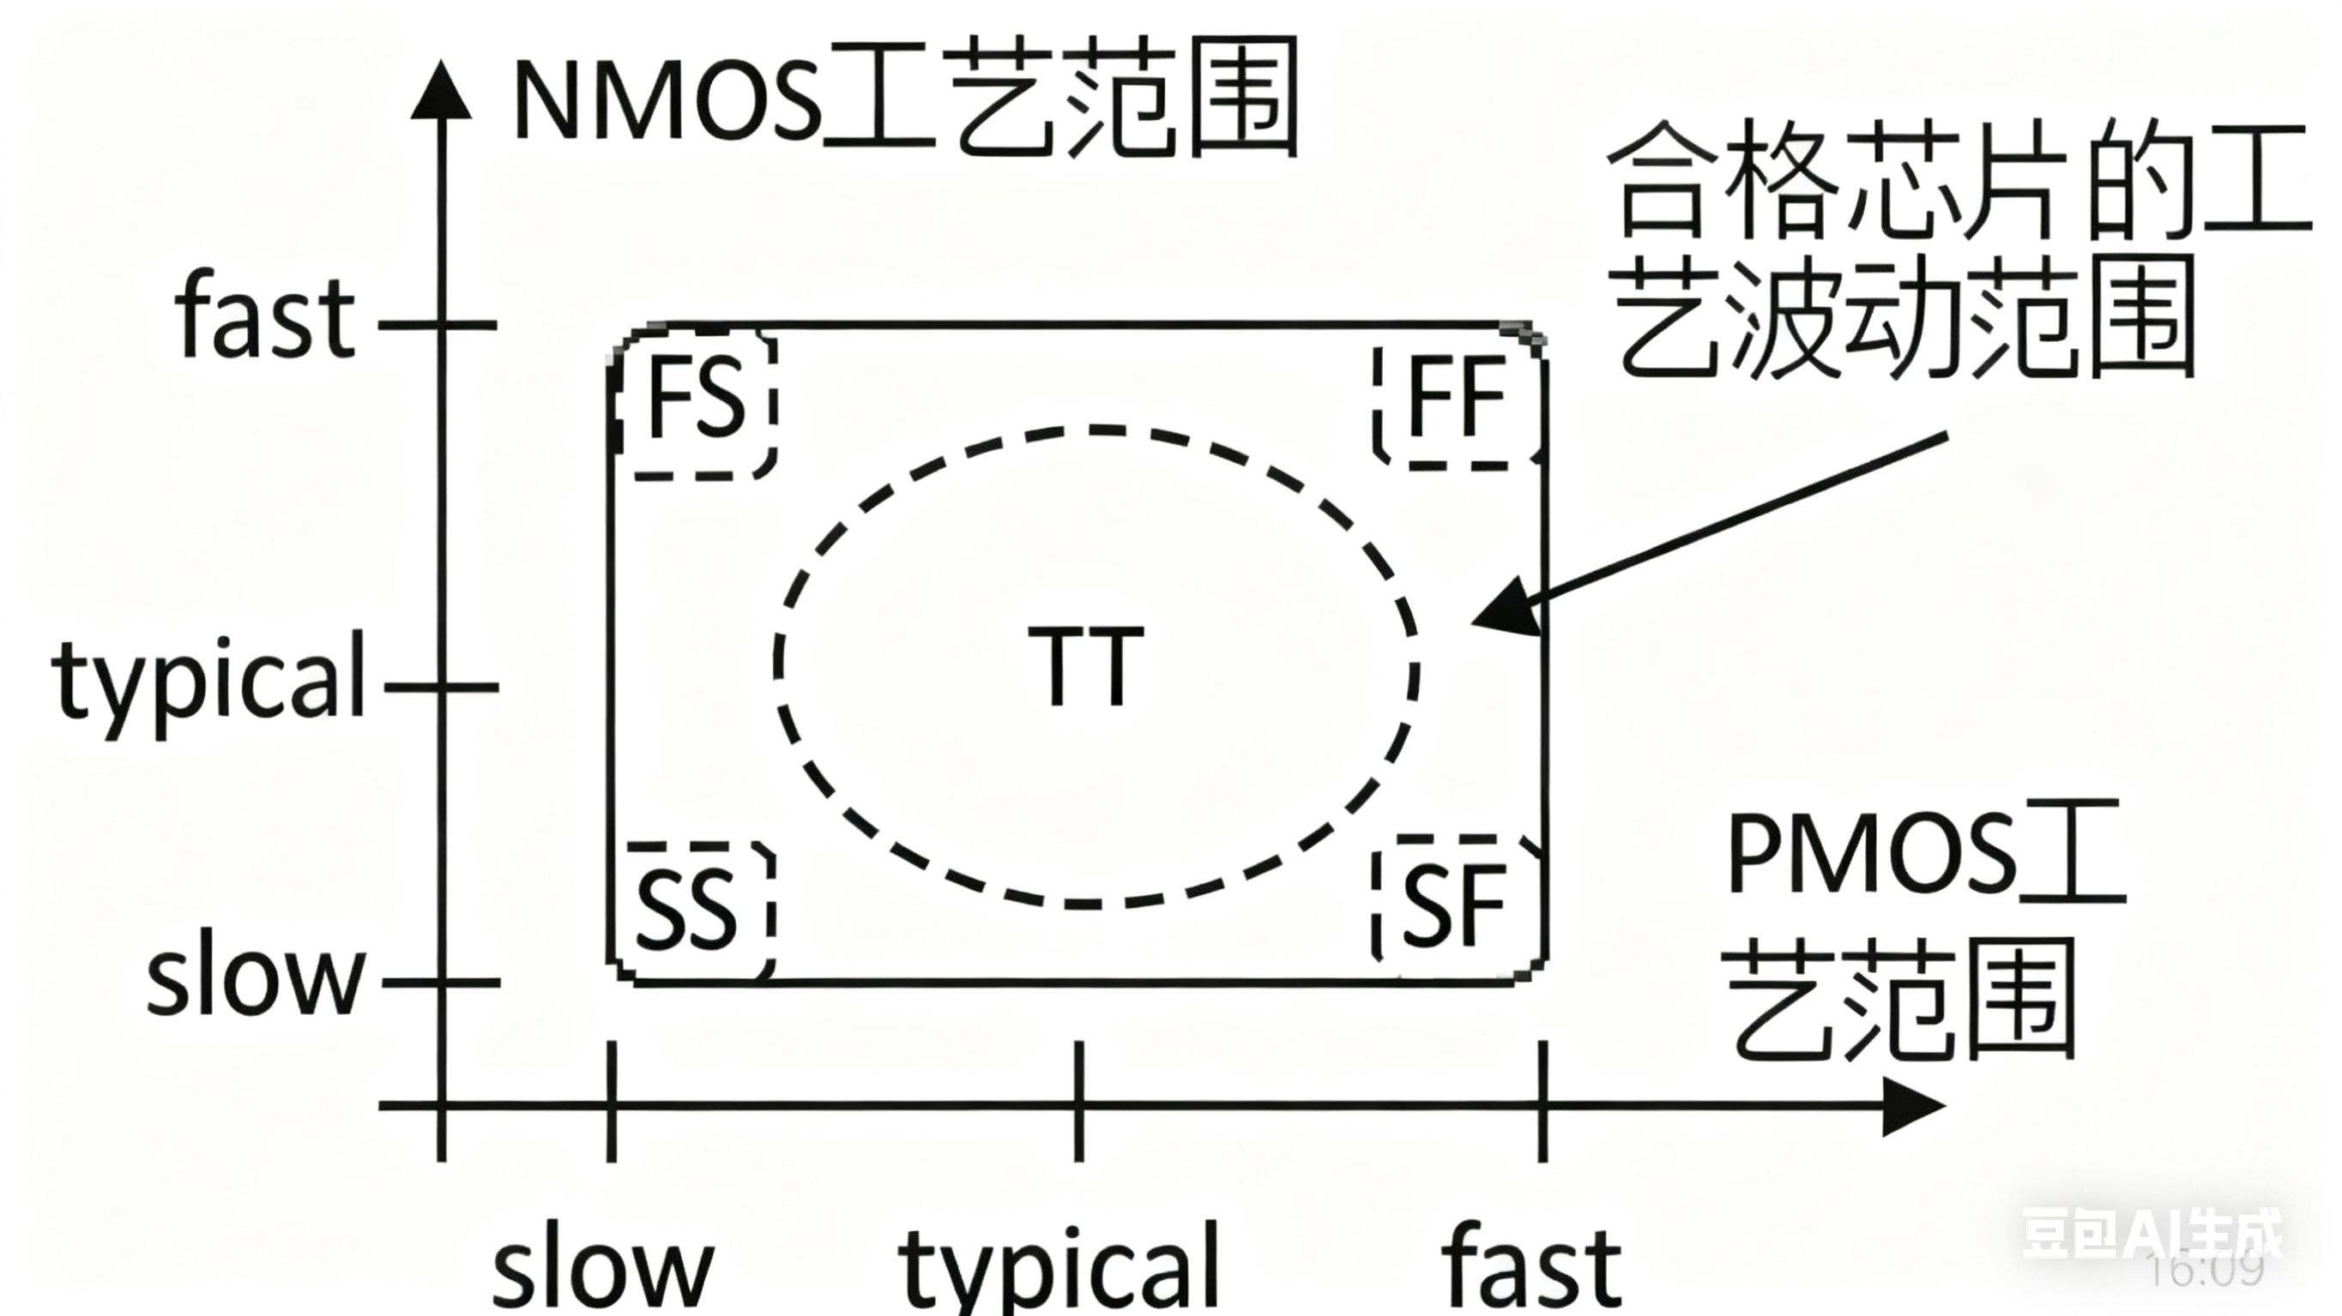
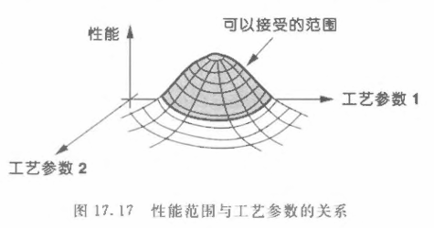
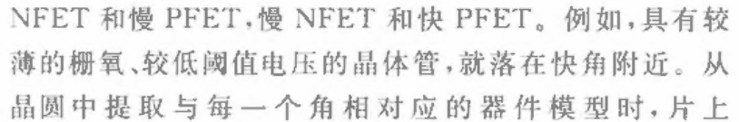
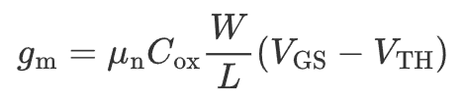
2、Short Questions 4×8 = 32 pts
(6) An NMOS transistor (working at saturation region) at FF corner has a lower (lower/higher) threshold voltage (Vth) than at TT corner. The same transistor at SS corner has a lower (lower/higher) trans-conductance (g_{m}) than at TT corner.
教材 17.4 工艺角(非教材原图)
不同批次晶圆上的同种元件性能存在差异（由于一片晶圆上同时存在NMOS/PMOS，所以需同时考虑它们的性能）
这些元件面对相同环境条件变化时性能（速度）会有不同的变化，为了电路整体稳定，变化过于剧烈/超出可接受范围的元件需要报废
5-corner model：TT，FF，SS，FS，SF (前后两个字符分别对应 NMOS 和 PMOS，T (typical), S (slow) 和 F (fast))
教材P631

Slide 11
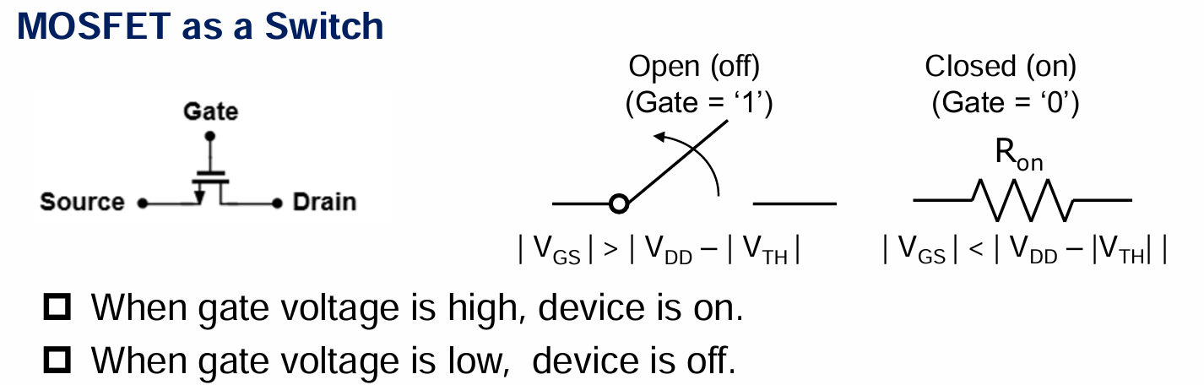
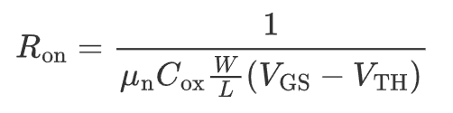
2、Short Questions 4×8 = 32 pts
(7) An NMOS transistor working as a switch has lower (higher/lower) resistance than a PMOS based switch. That is the reason why a transmission gate (consisting of a PMOS and an NMOS transistor) use a larger W/L ratio for PMOS (NMOS/PMOS).
NMOS 的导电沟道由电子形成，电子的迁移率 μₙ 很高
PMOS 的导电沟道由空穴形成，空穴的迁移率 μₚ 较低

Slide 12
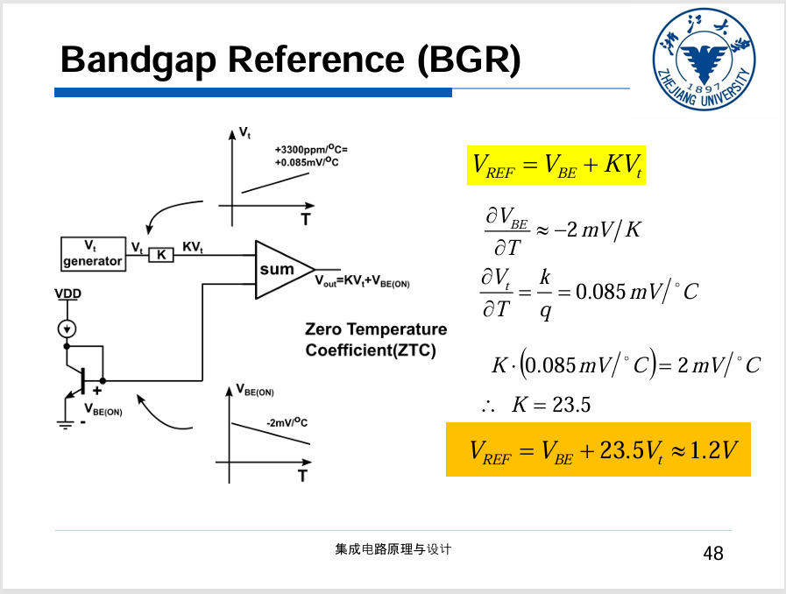
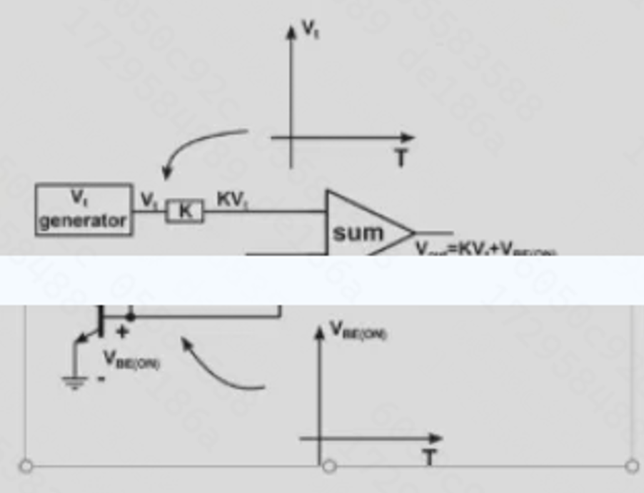
2、Short Questions 4×8 = 32 pts
(8) The Vbe is the following figure has a negative (positive/negative) temperature coefficient(TC), the KVt has a positive (positive/negative) TC. A bandgap reference provides a stable output voltage at both temperature and voltage (what) range.
历年卷中残缺的电路图

Slide 13
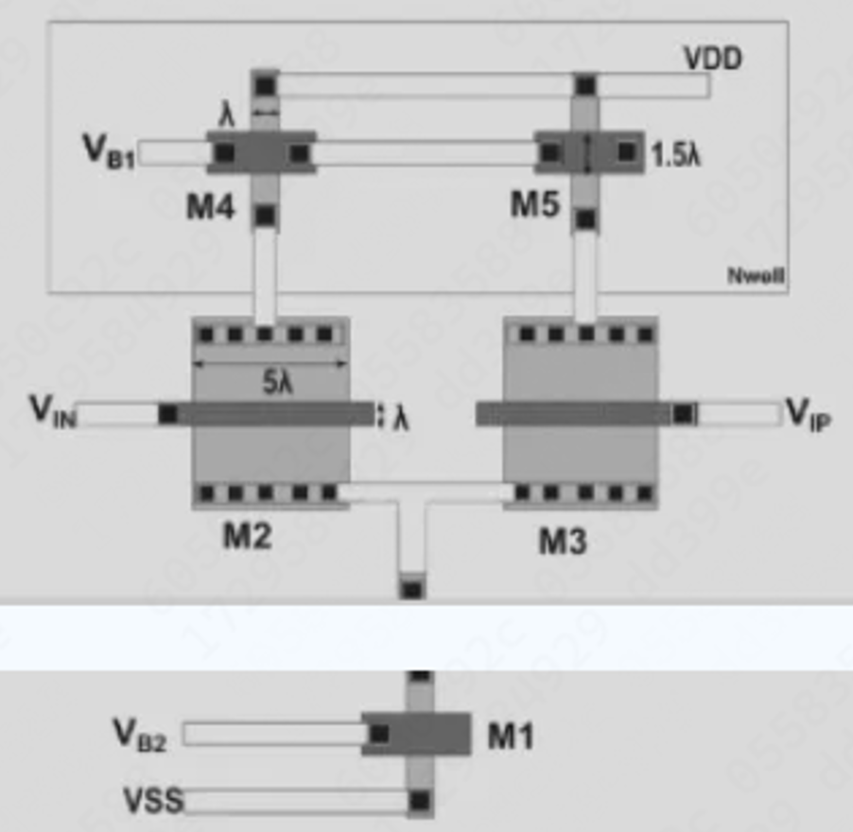
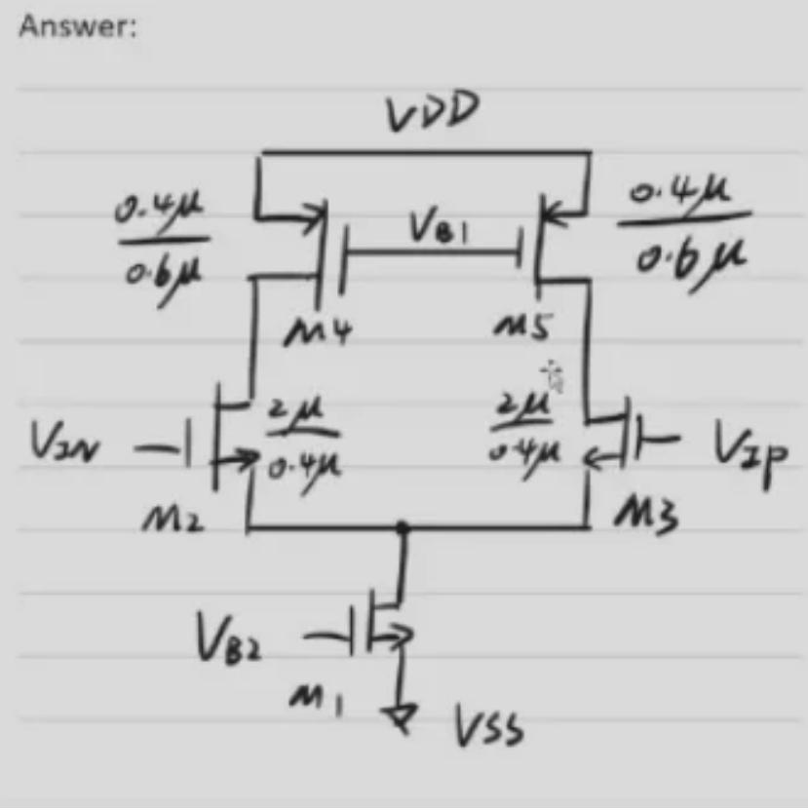
3、Calculation 5+8+10 = 23 pts
(1) The Layout of a differential pair with PMOS current source loads in p-sub N-well technology is shown as the following figure. (5 pts)
(a) Give the corresponding circuits schematics and mark the W/L sizes of each transistor. Assume λ=0.4μm.
(b) To achieve better matching of the input pair (M2 and M3), draw an alternative layout configuration. (by using multiple transistors with smaller W/L)

Slide 14
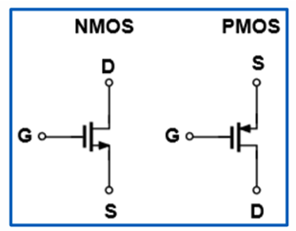
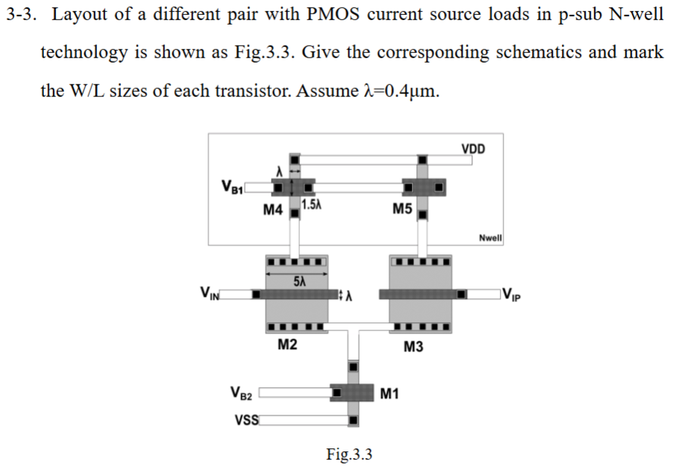
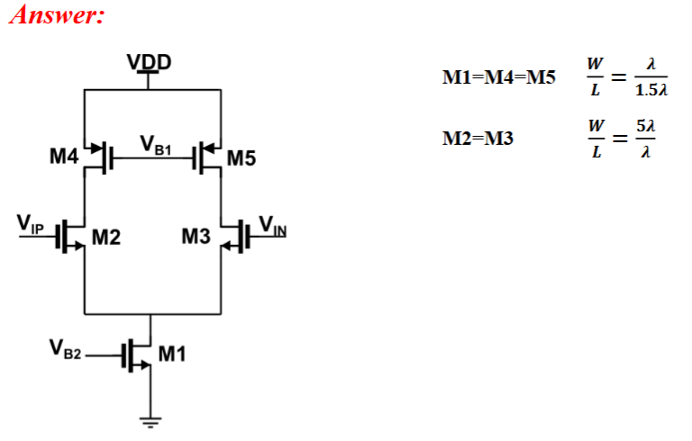
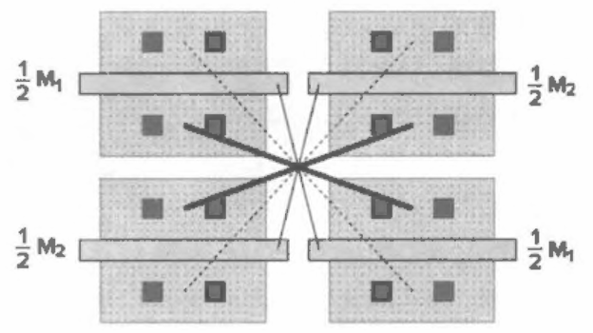
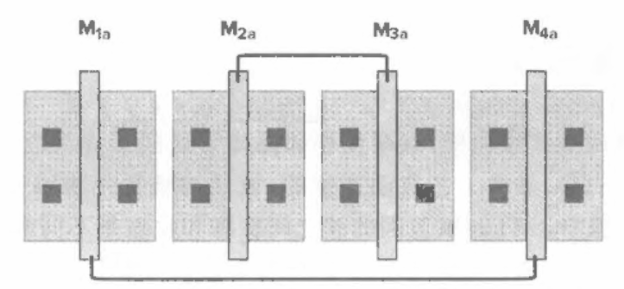
3、Calculation 5+8+10 = 23 pts
对应作业题
教材 19.2.2 差动对匹配

Slide 15
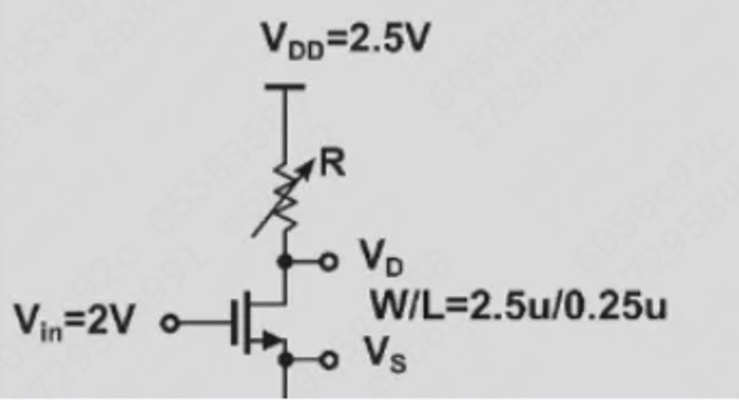
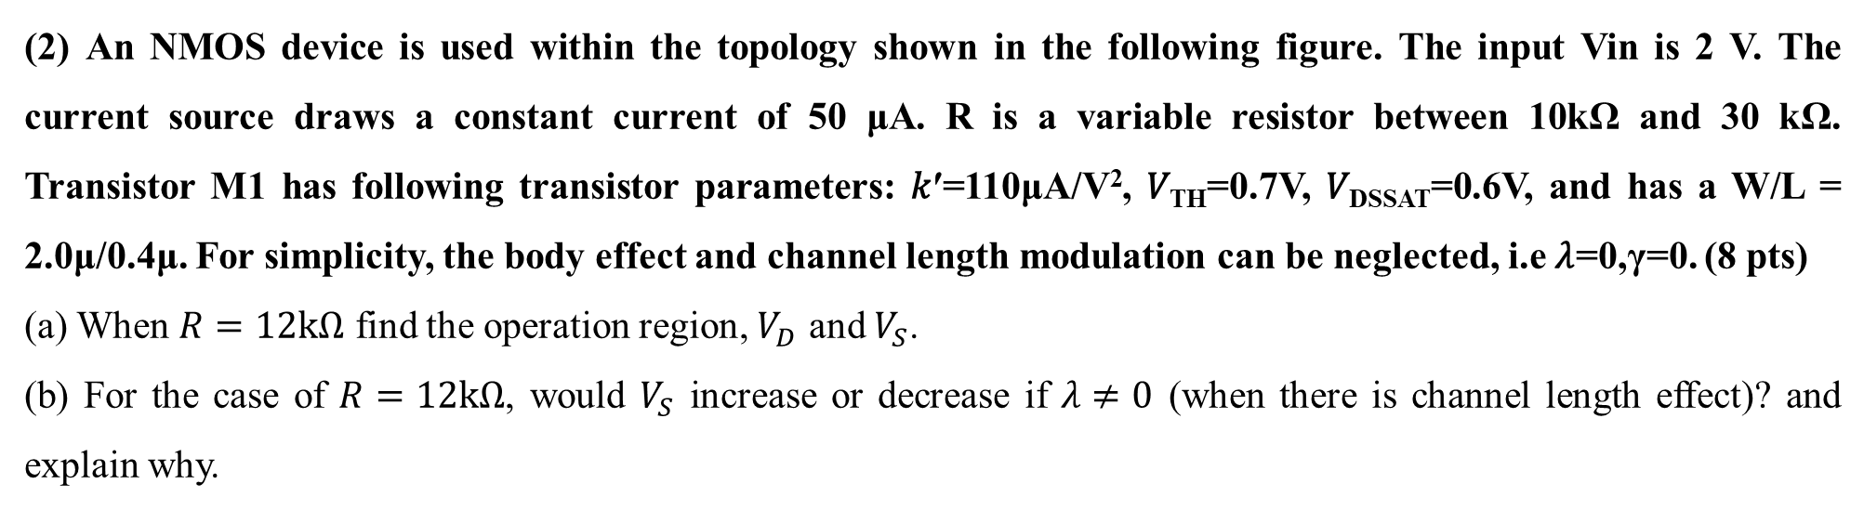
3、Calculation 5+8+10 = 23 pts
(2) An NMOS device is used within the topology shown in the following figure. The input Vin is 2 V. The current source draws a constant current of 50 μA. R is a variable resistor between 10kΩ and 30 kΩ. Transistor M1 has following transistor parameters: 𝑘′=110μA/V², 𝑉_{TH}=0.7V, 𝑉_{DSSAT}=0.6V, and has a W/L = 2.0μ/0.4μ. For simplicity, the body effect and channel length modulation can be neglected, i.e 𝜆=0,γ=0. (8 pts)
(a) When $R=12kΩ$ find the operation region, $V_{D}$ and $V_{S}$.
(b) For the case of $R=12kΩ$, would $V_{S}$ increase or decrease if $λ≠0$ (when there is channel length effect)? and explain why.

Slide 16
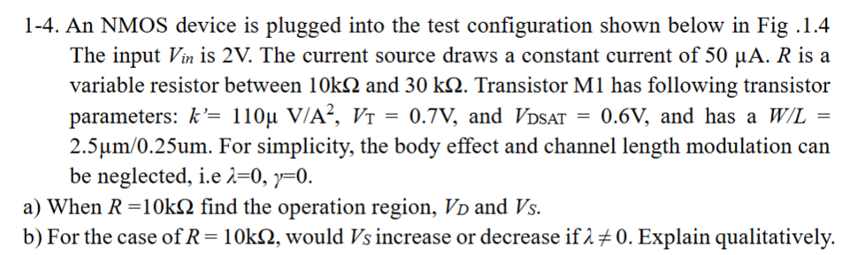

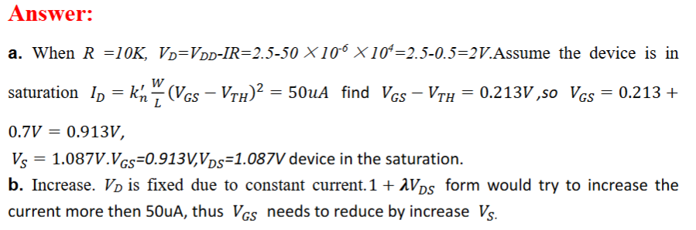
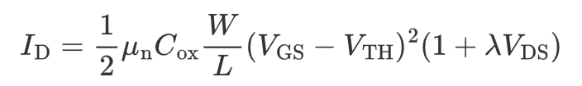
3、Calculation 5+8+10 = 23 pts
对应作业题
先假设电路处于饱和区，之后使用计算结果验证

Slide 17
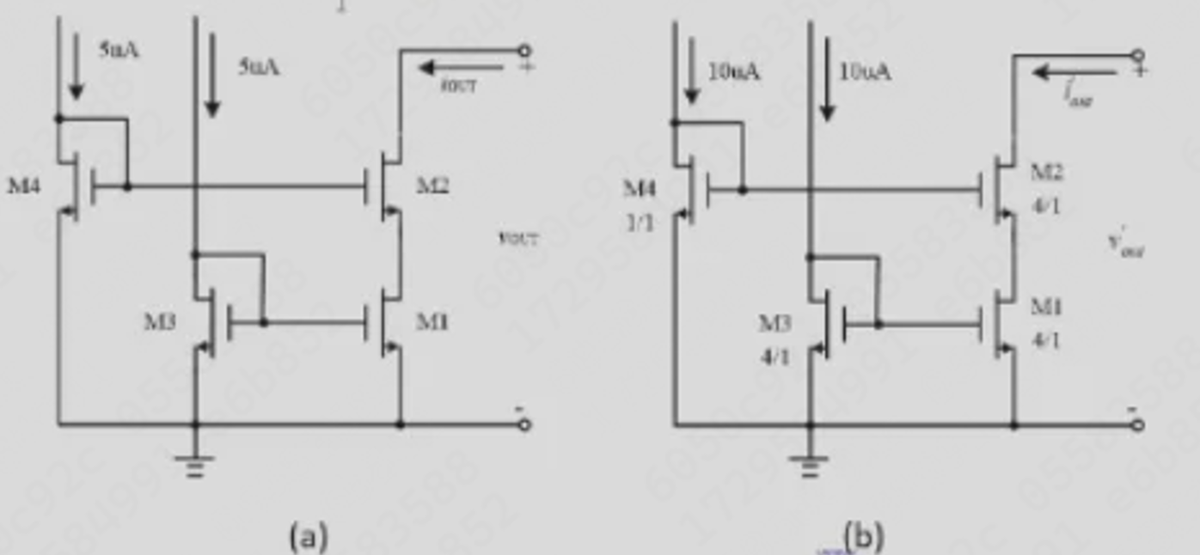
3、Calculation 5+8+10 = 23 pts
(3) There are two cascode current mirror shown in the following figures. (10 pts)
(a) Design M3 and M4 of (a) so that the output characteristics are identical to the circuit shown in Fig. (b). It is desired that IOUT is ideally 10uA.

Slide 18
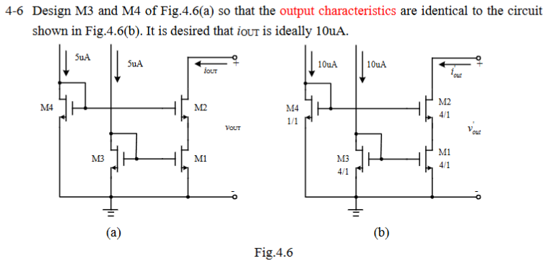

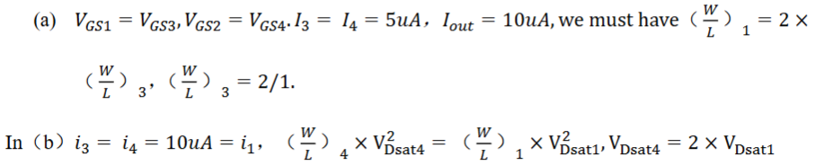
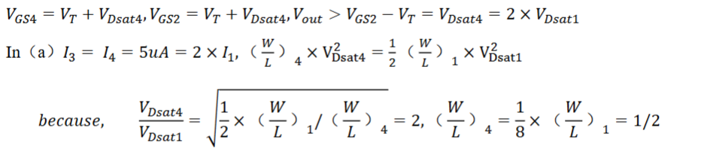
3、Calculation 5+8+10 = 23 pts
对应作业题

Slide 19
谢谢大家
集成电路期中辅学
申佳欣
2025/11/1

