Slide 1
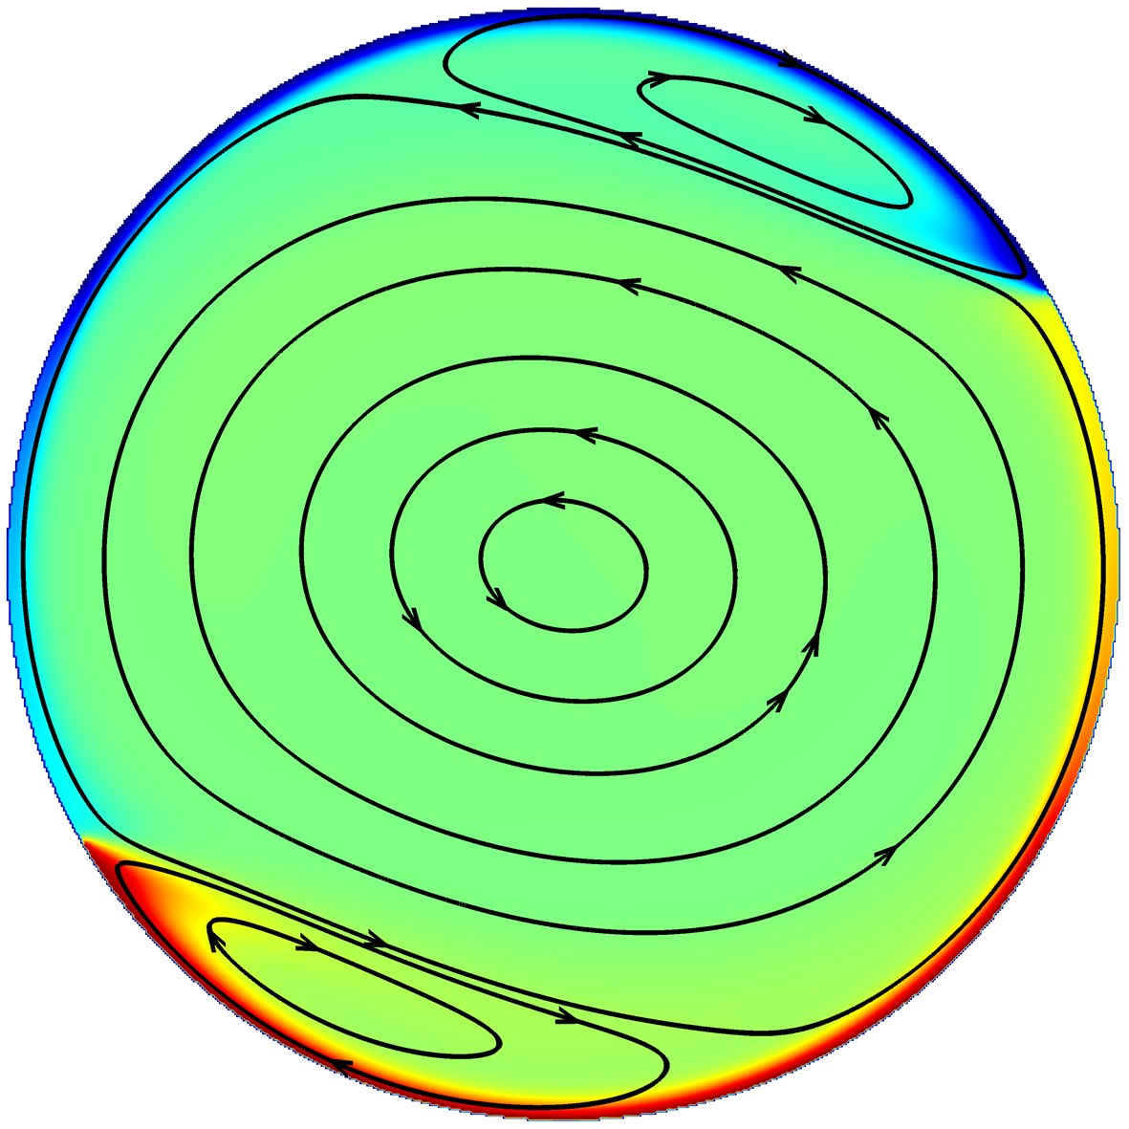
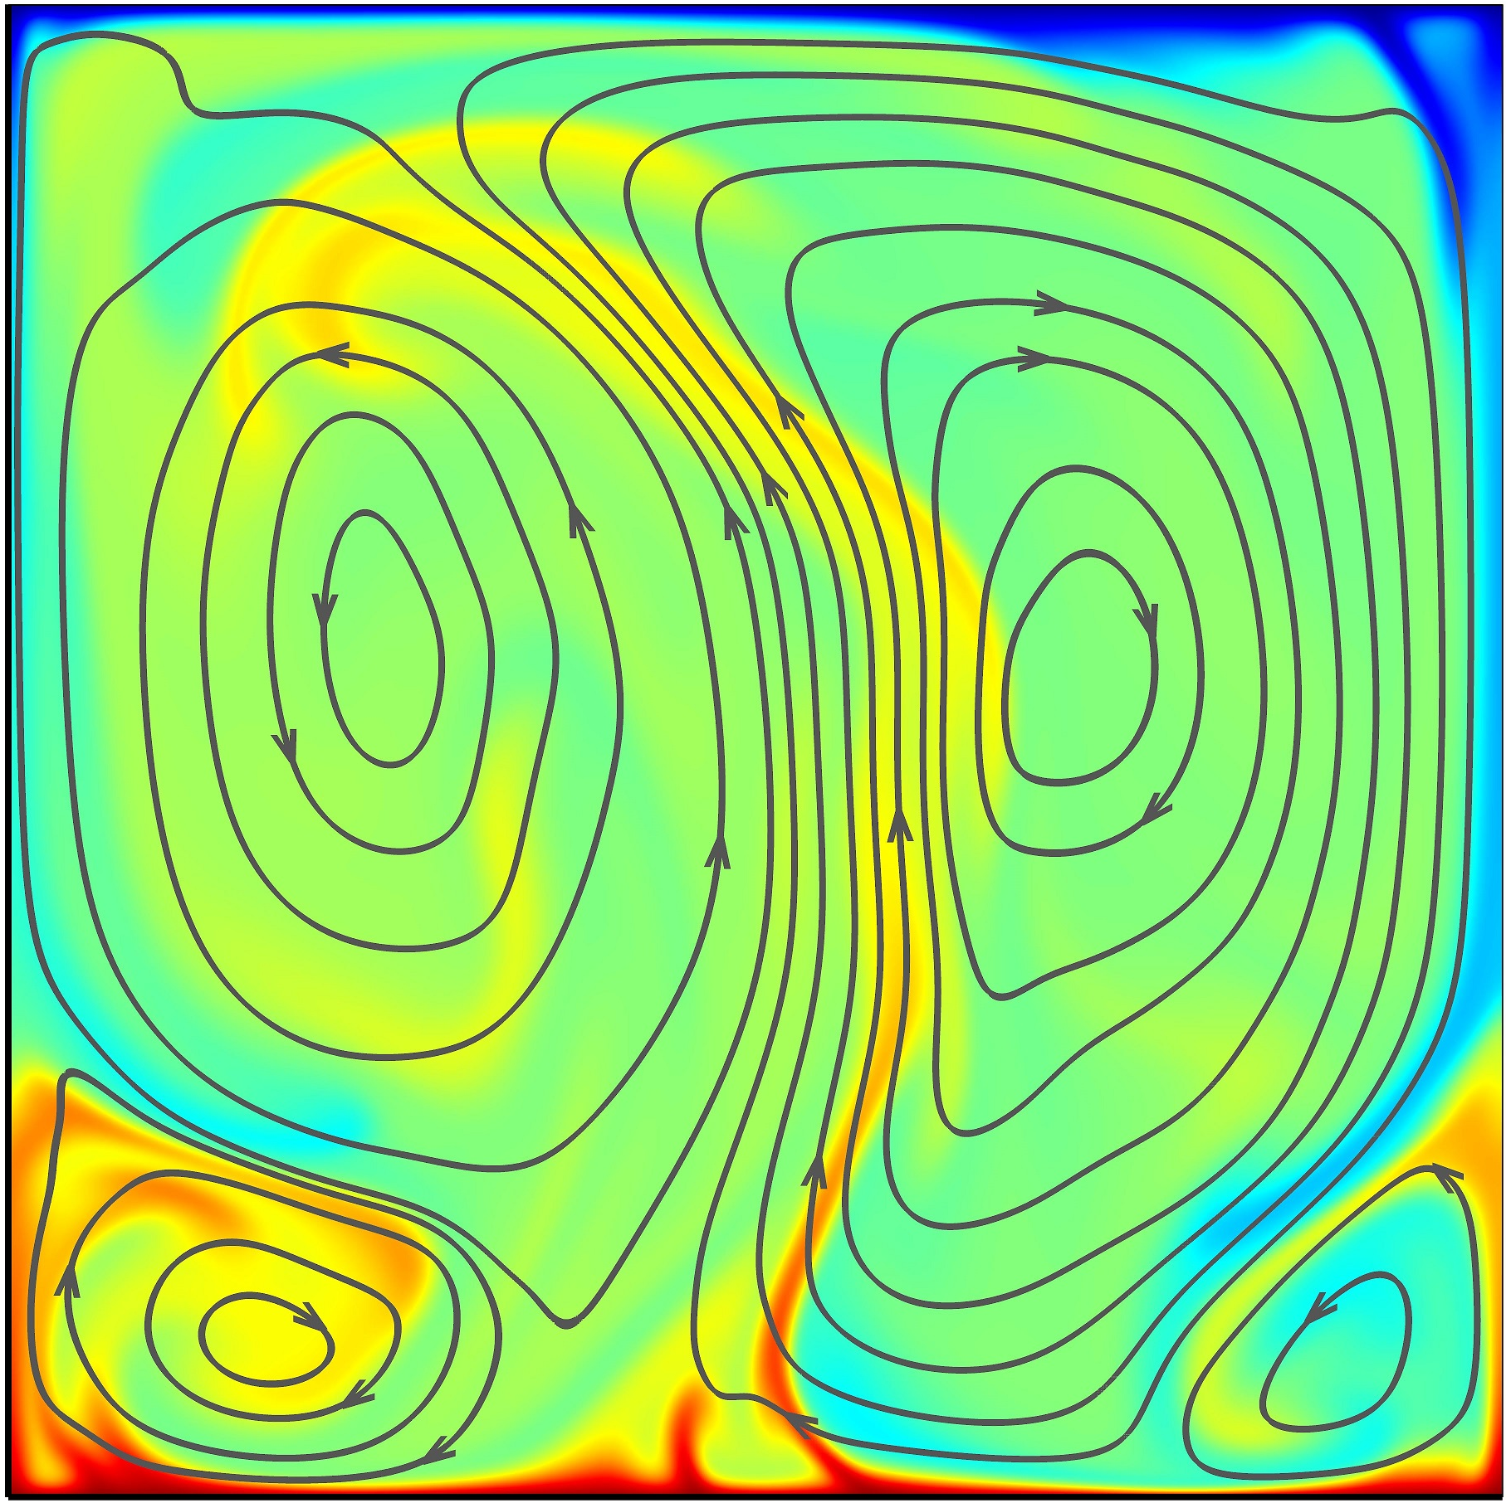
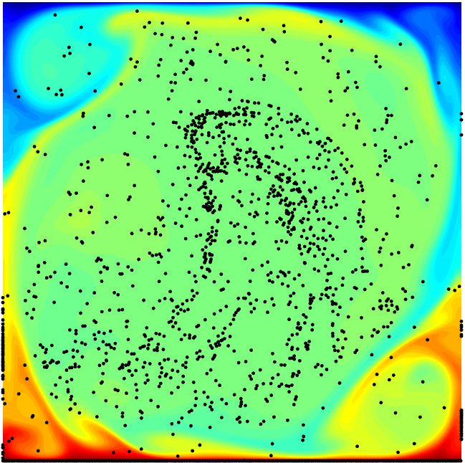
vortices evolution in
turbulent thermal convection
Turbulent Transport
heat transfer efficiency
enhancement or weakening
with active or passive control
KEY
weaken mixing for
pollutant particles
enhance mixing for
chemically reactive flows

