Slide 1
C#
Final Project
KTV Song Order System
徐锦程 1353012
范亮 1352899
王刚 1352873
陈宏俊 1352916

Slide 2
1.Introduction
In this system,you can add songs to the play list and the system will play the songs by order.In the meantime,you can change the order as you like,and you can play,pause or adjust the volume anytime.

Slide 3
2.Feature
You can search the songs by its singer,type,name,language and so on.
We will rank the top 10 songs according to its playback amount.

Slide 4
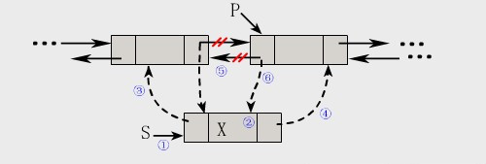
3.Data Structure
We plan to use the linked storage structure of linear list as our data structrue.The name of songs will be stored in the node and it will be easy to implement insert or delete action.

Slide 5
4.Difficulty
How to handle with the storage of songs in the database?
> String to Storage The File Path
How to play songs with c#?
> Microsoft.DirectX.AudioVideoPlayback.dll
How to rank the top 10 songs?
> DataMining

Slide 6
5.Demo Show
Here is the Latest Demo Show

Slide 7
Thank you!

