Slide 1


Slide 2
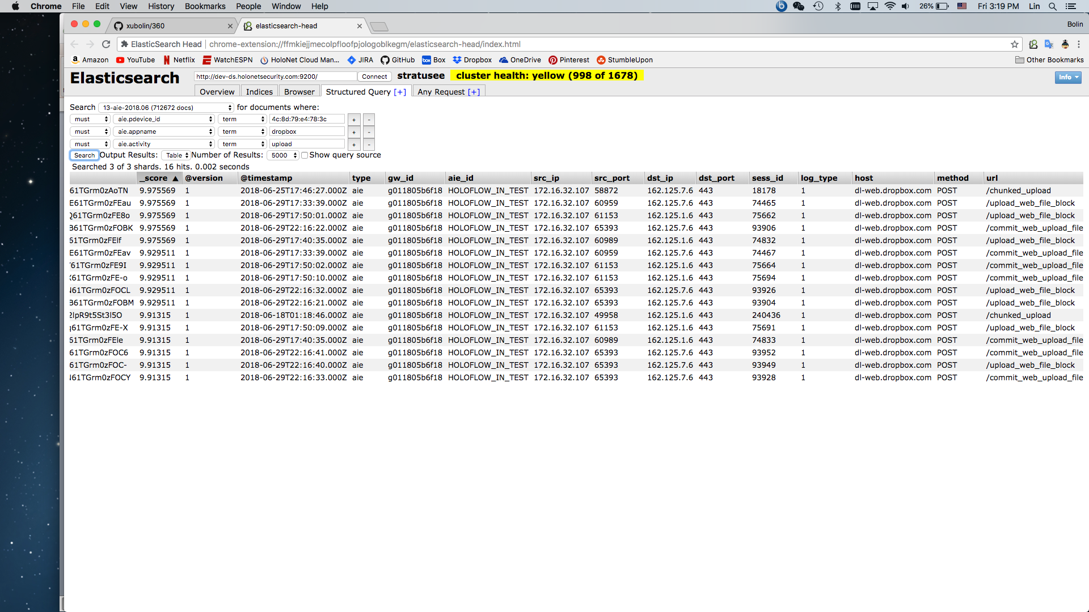
Dropbox
Test was done on 2018-06-29

Slide 3
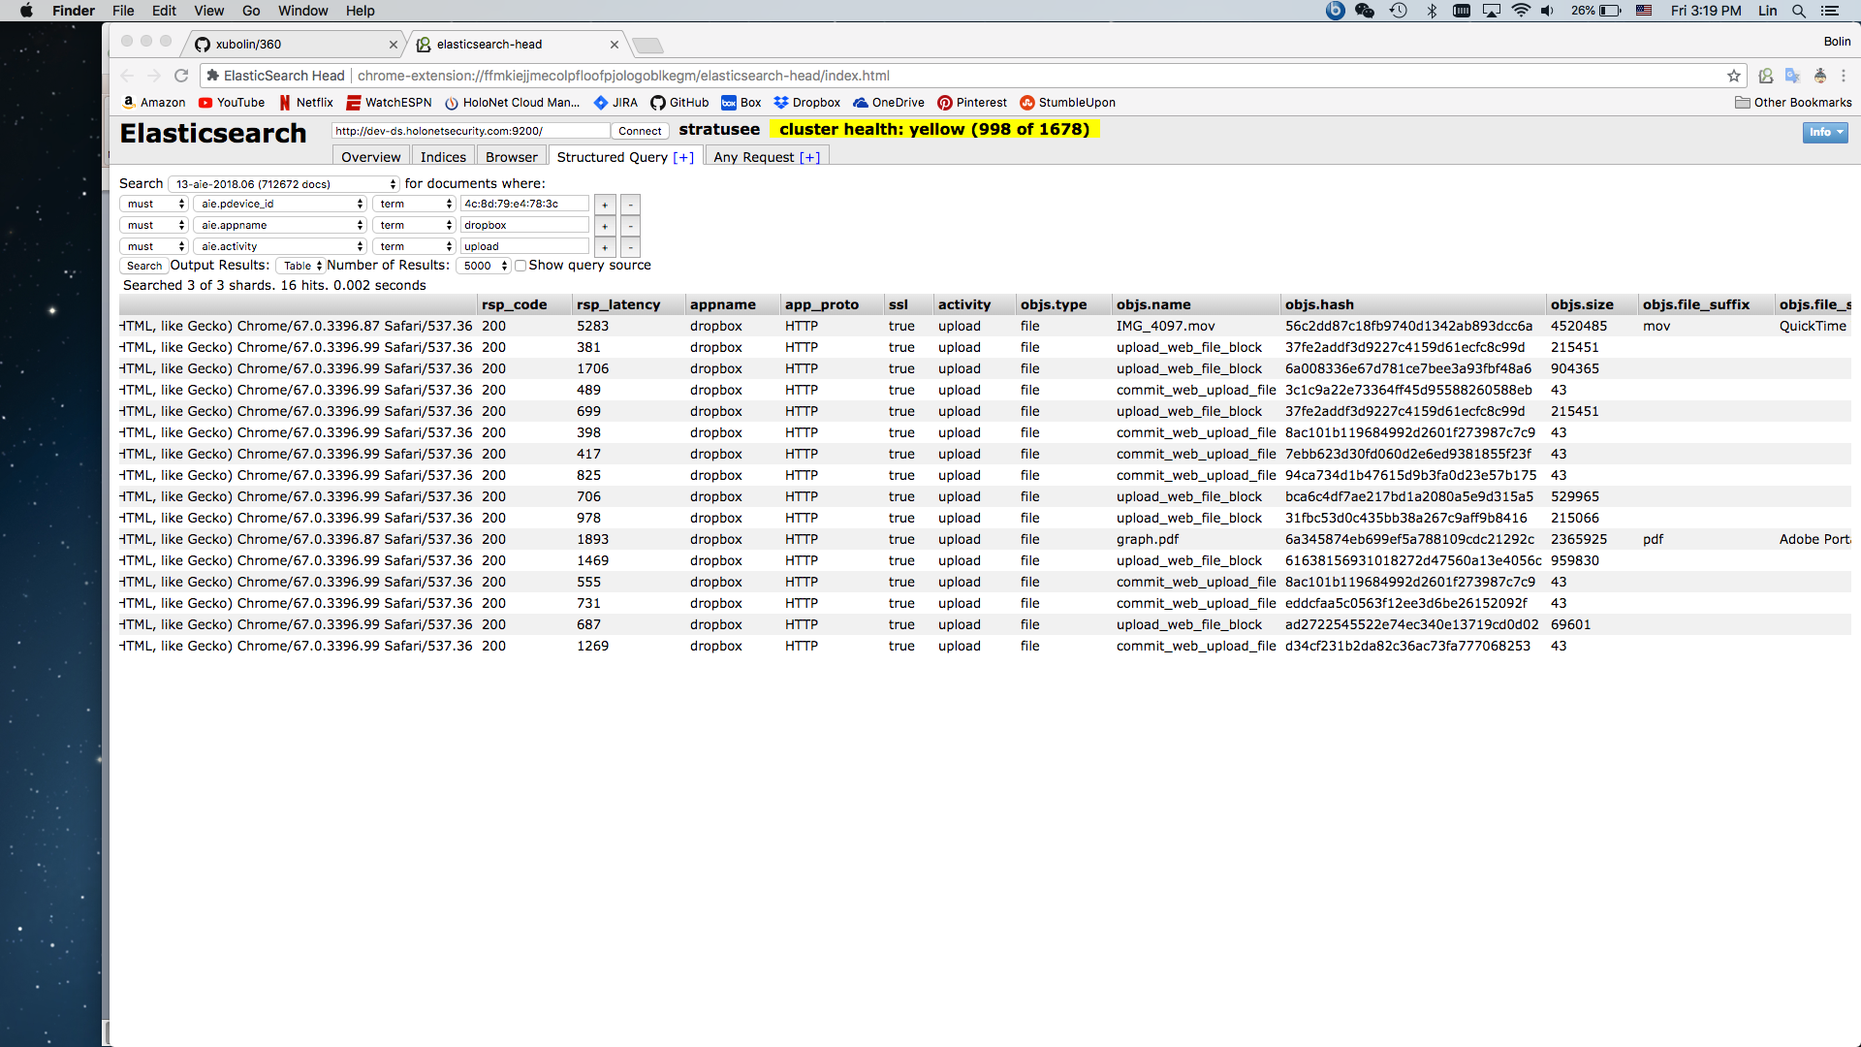
The uploaded file names became upload_web_file_block or commit_web_upload_file

Slide 4
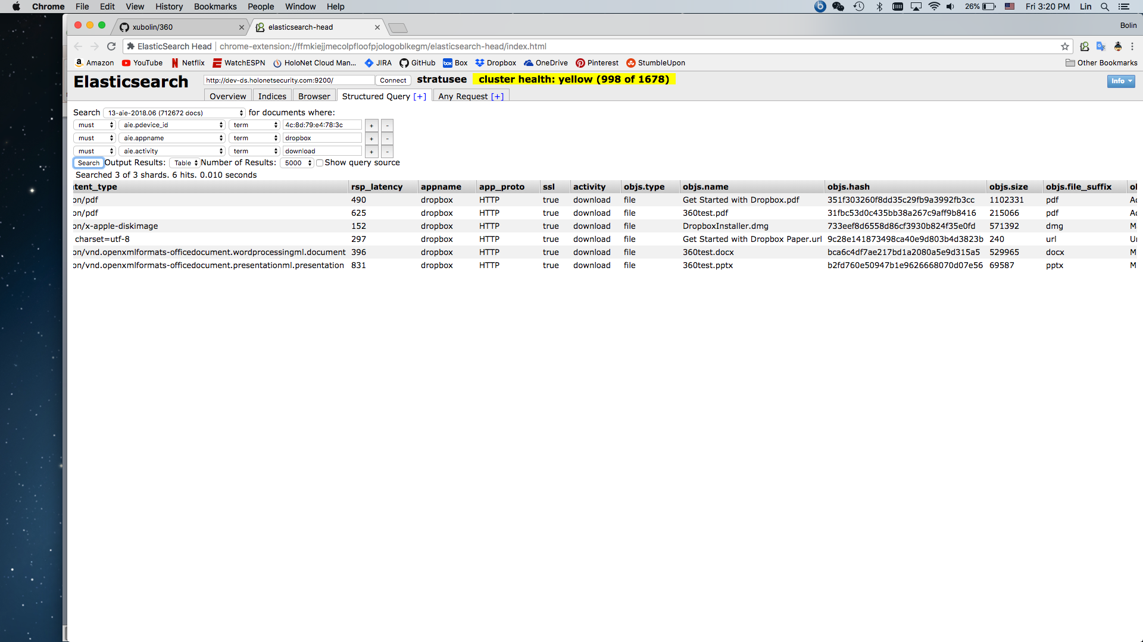
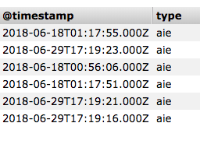
2018-06-29
The downloaded files showed the original file names

Slide 5
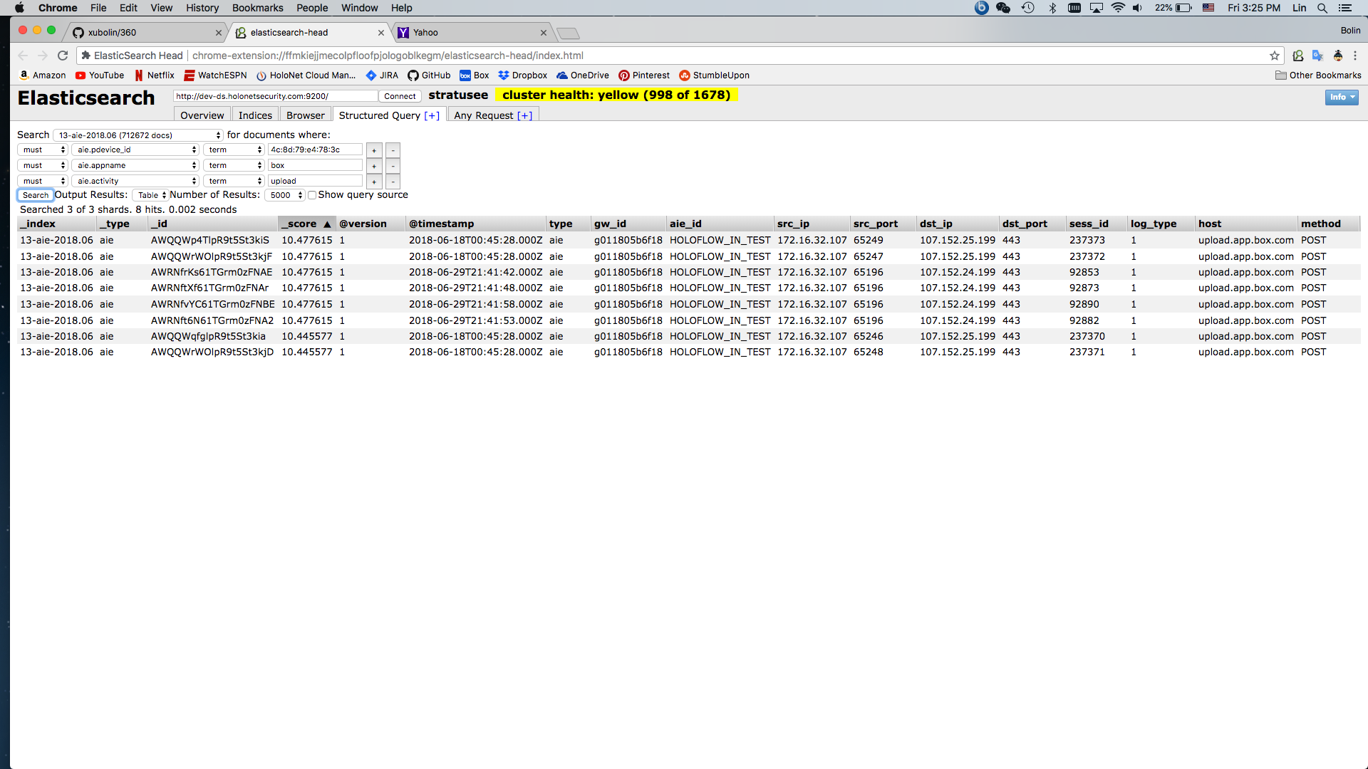
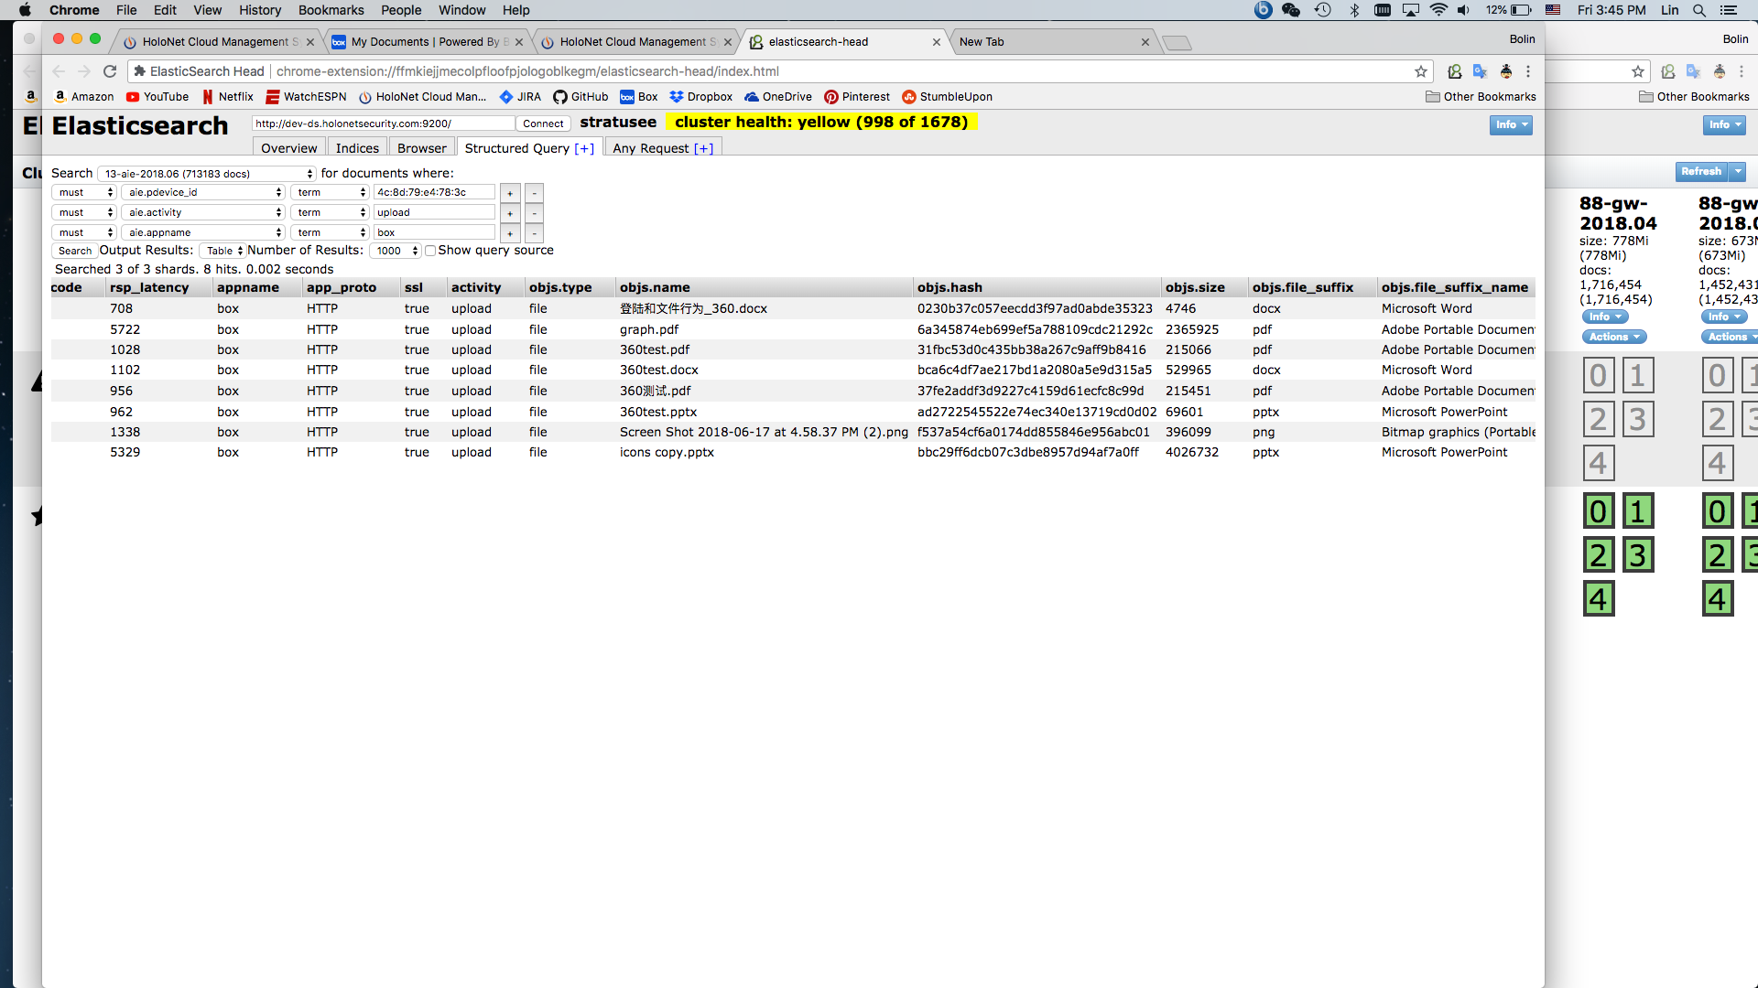
Box
Test was done on 2018-06-29

Slide 6
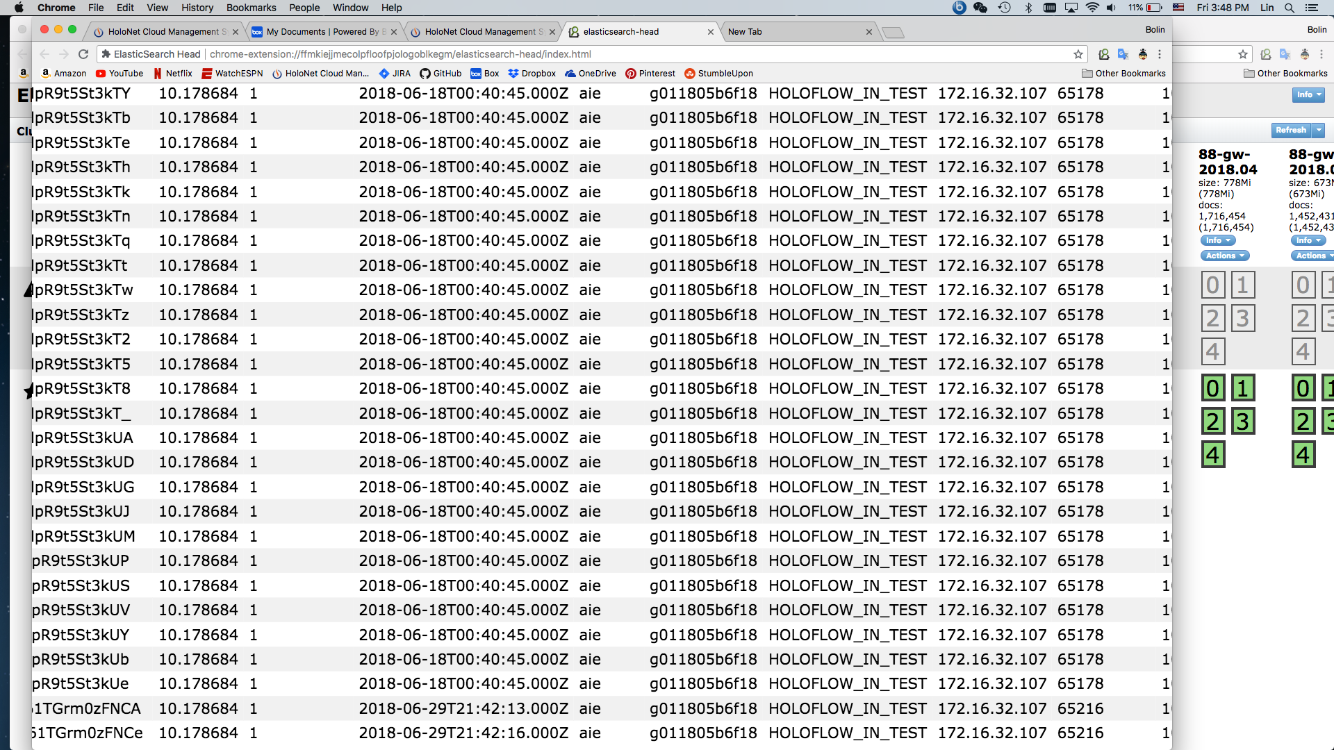
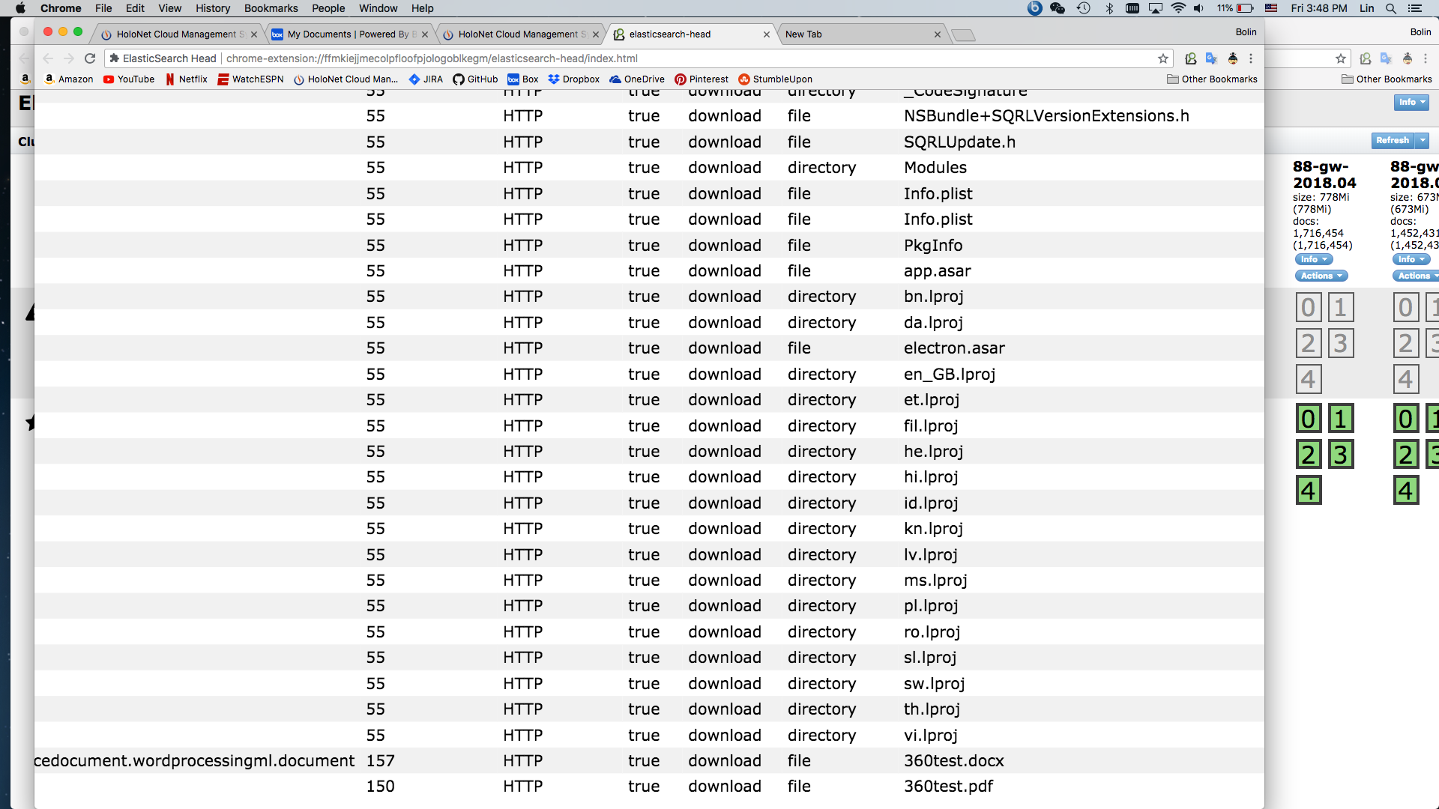

Slide 7


OneDrive
Elasticsearch only retrieved downloaded files

Slide 8

Uploaded files not available

