Slide 1
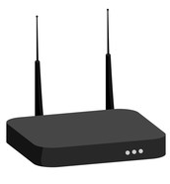


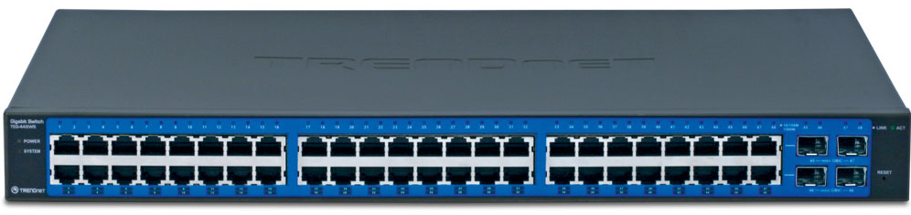
360.net
DSL/Cable Modem
Switch
ICS Host Computer
Client computers will access Internet through ICS Host Computer

