Slide 1
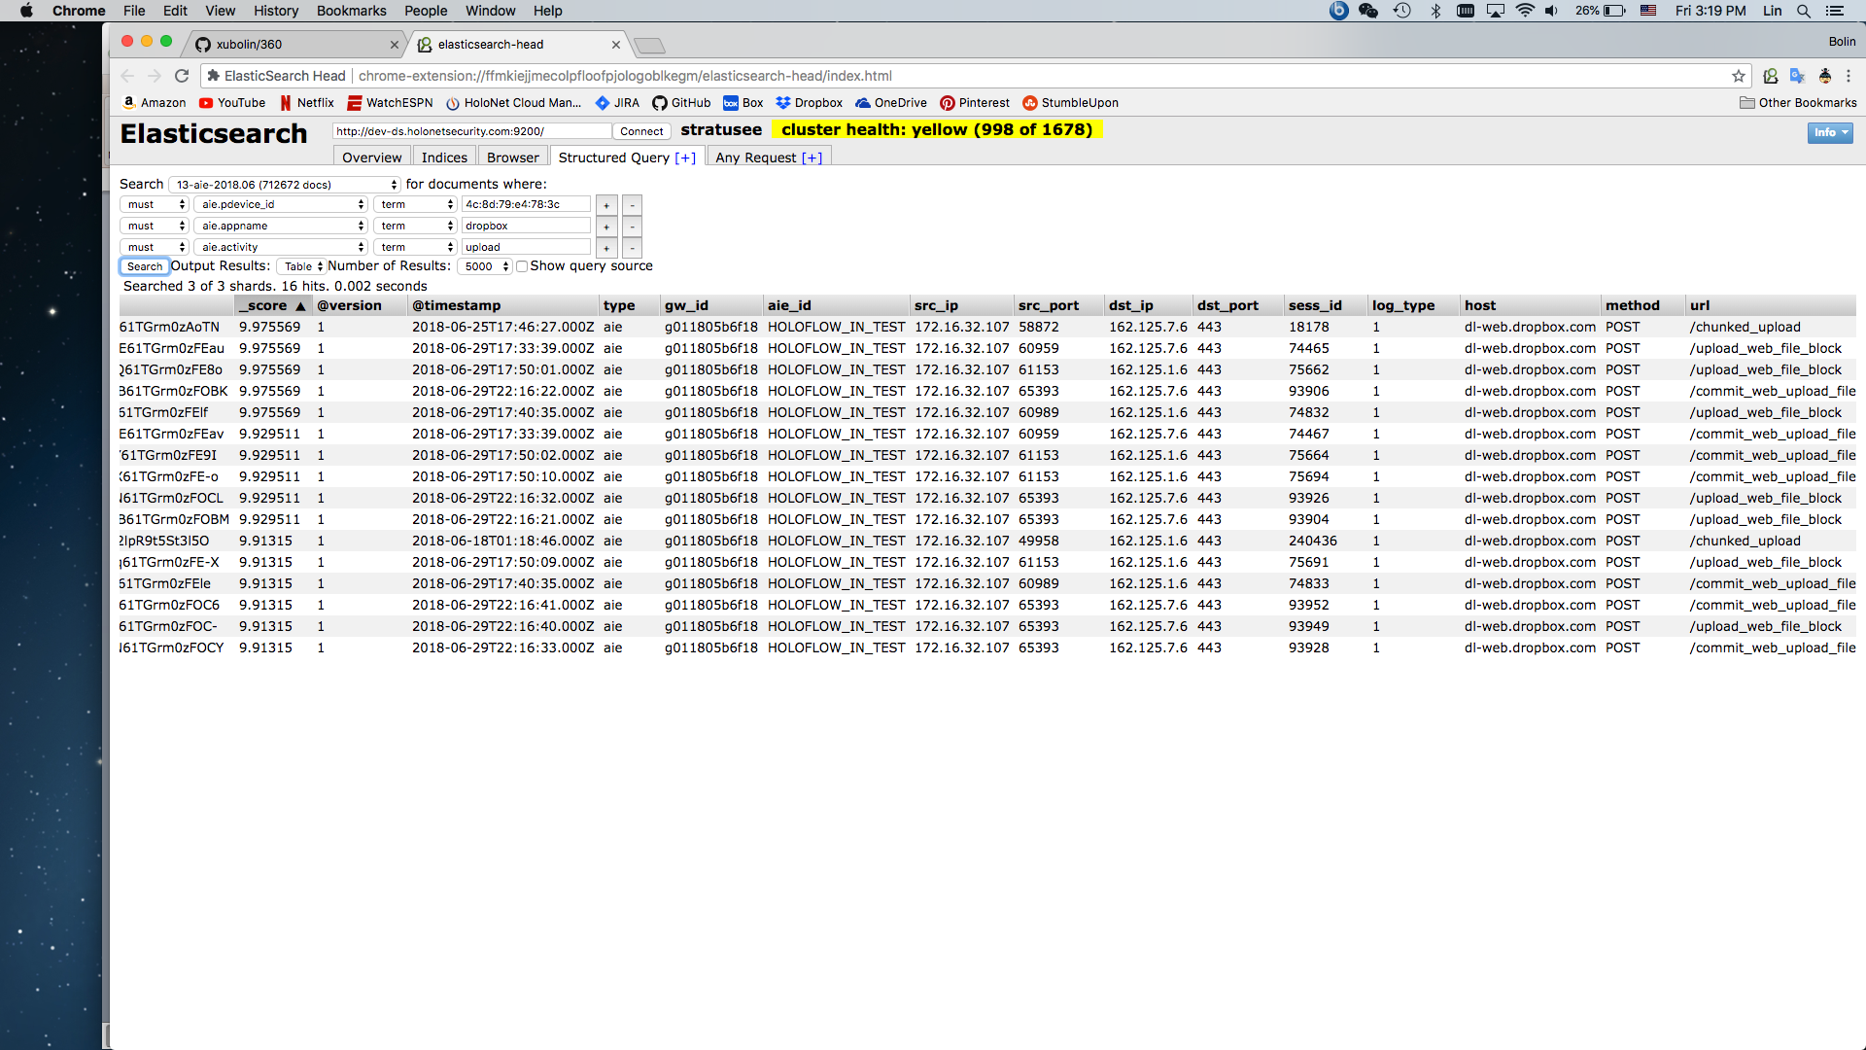
Dropbox
Test was done on 2018-06-29

Slide 2
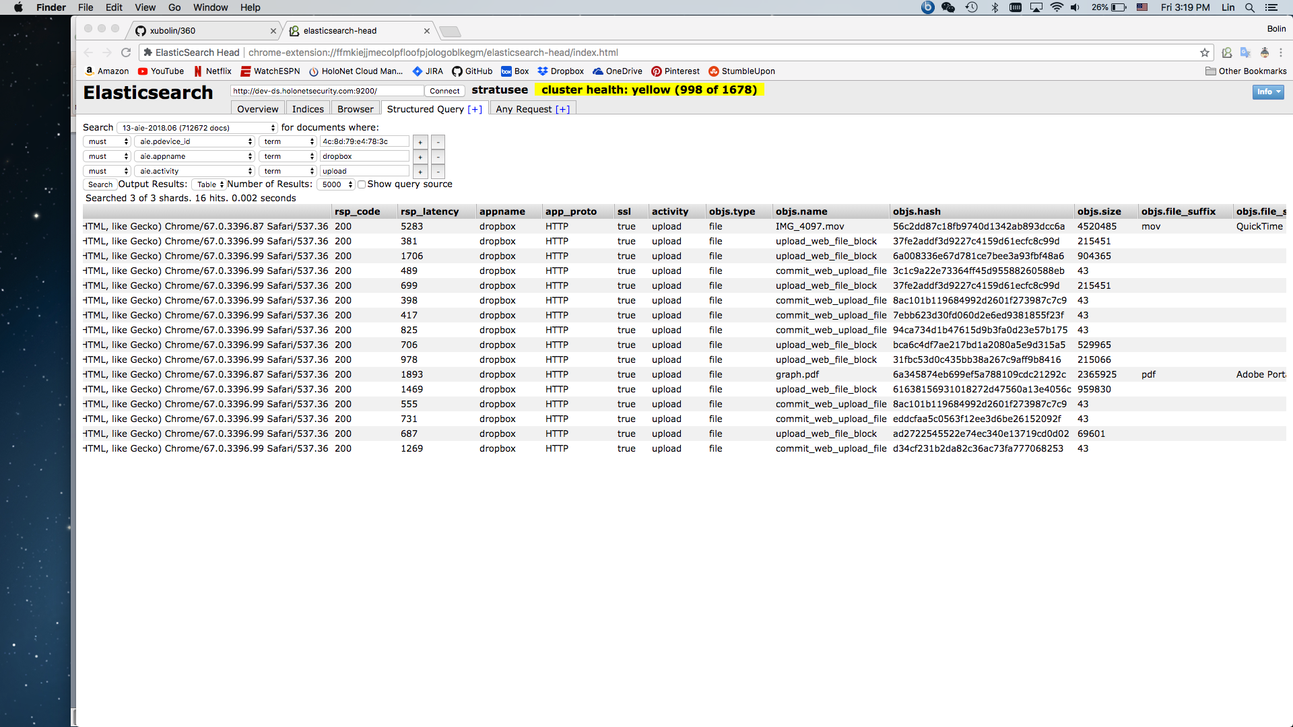
The uploaded file names became upload_web_file_block or commit_web_upload_file

Slide 3
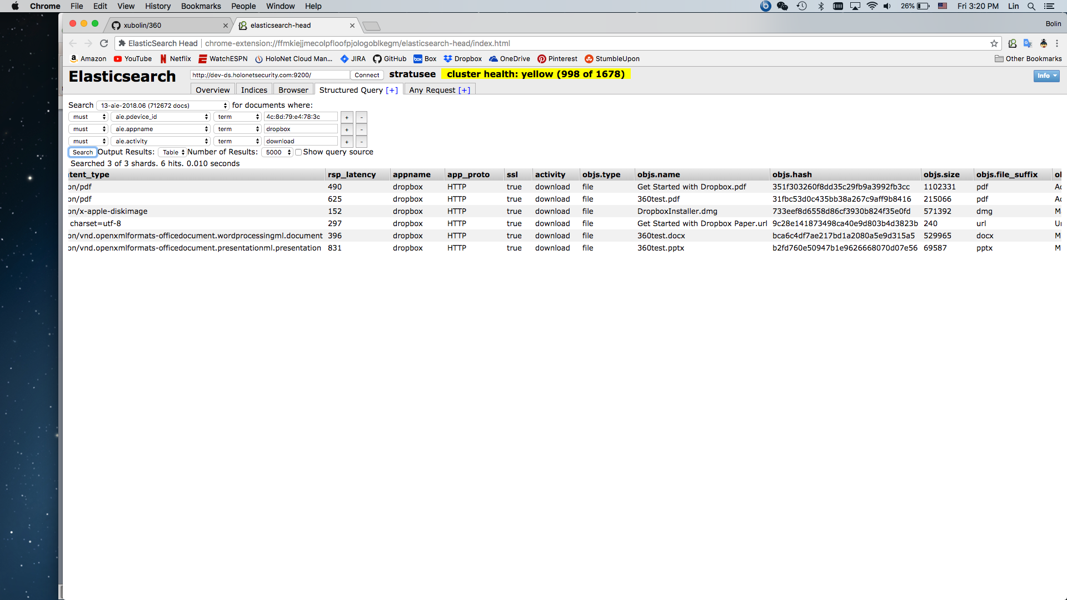
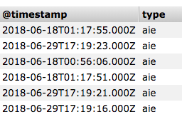
The downloaded files showed the original file names

Slide 4
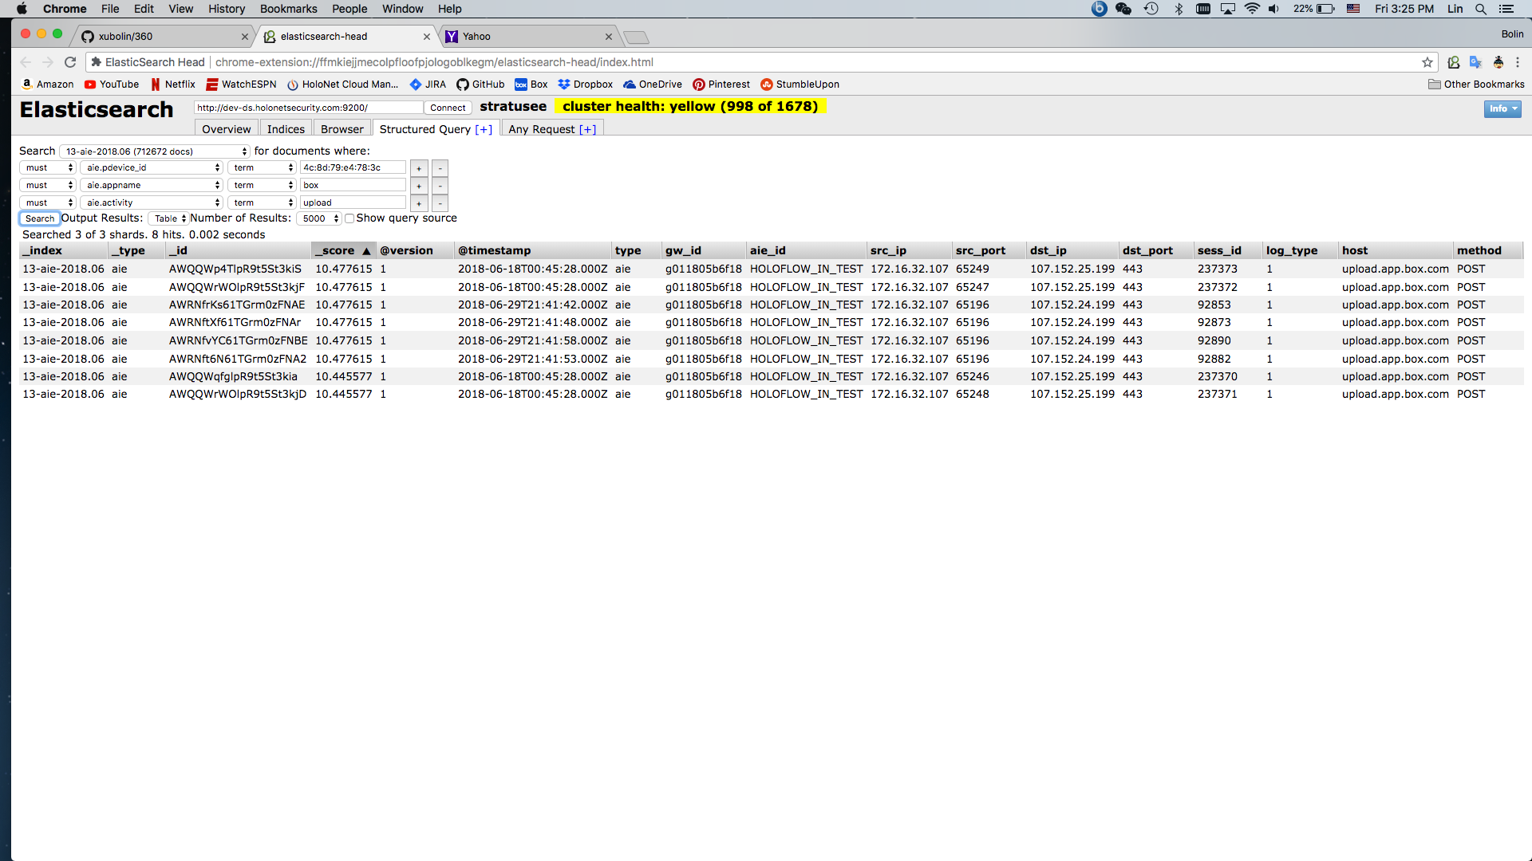
Box
Test was done on 2018-06-29

Slide 5
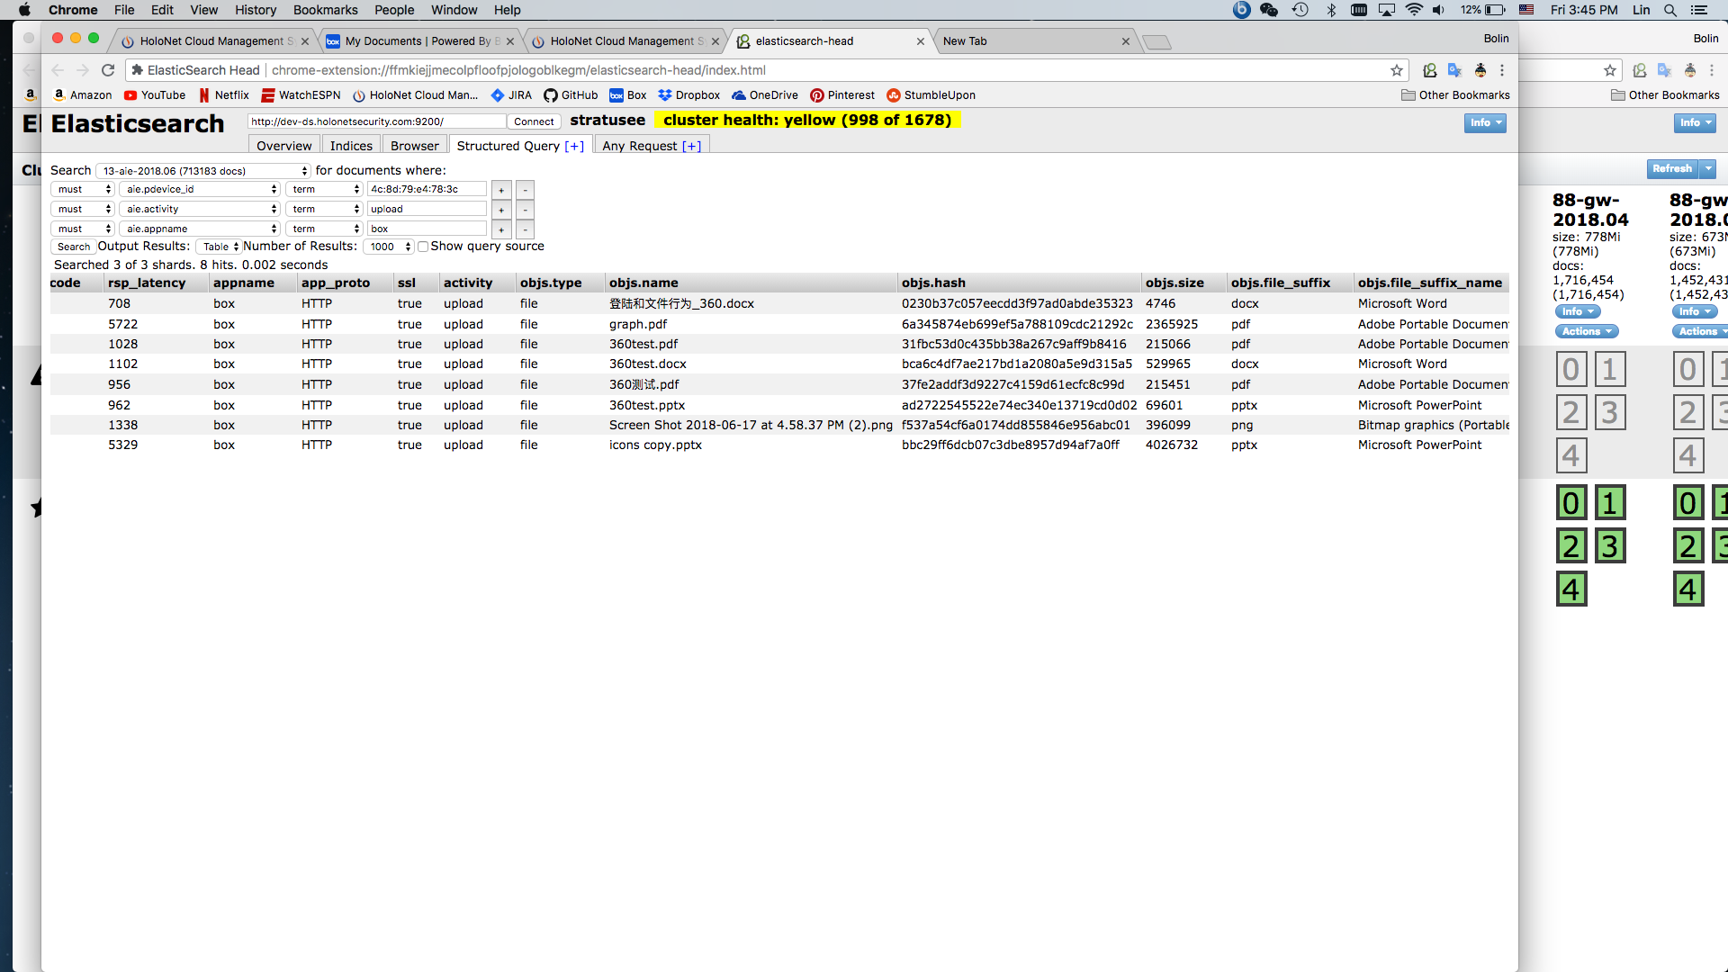

Slide 6
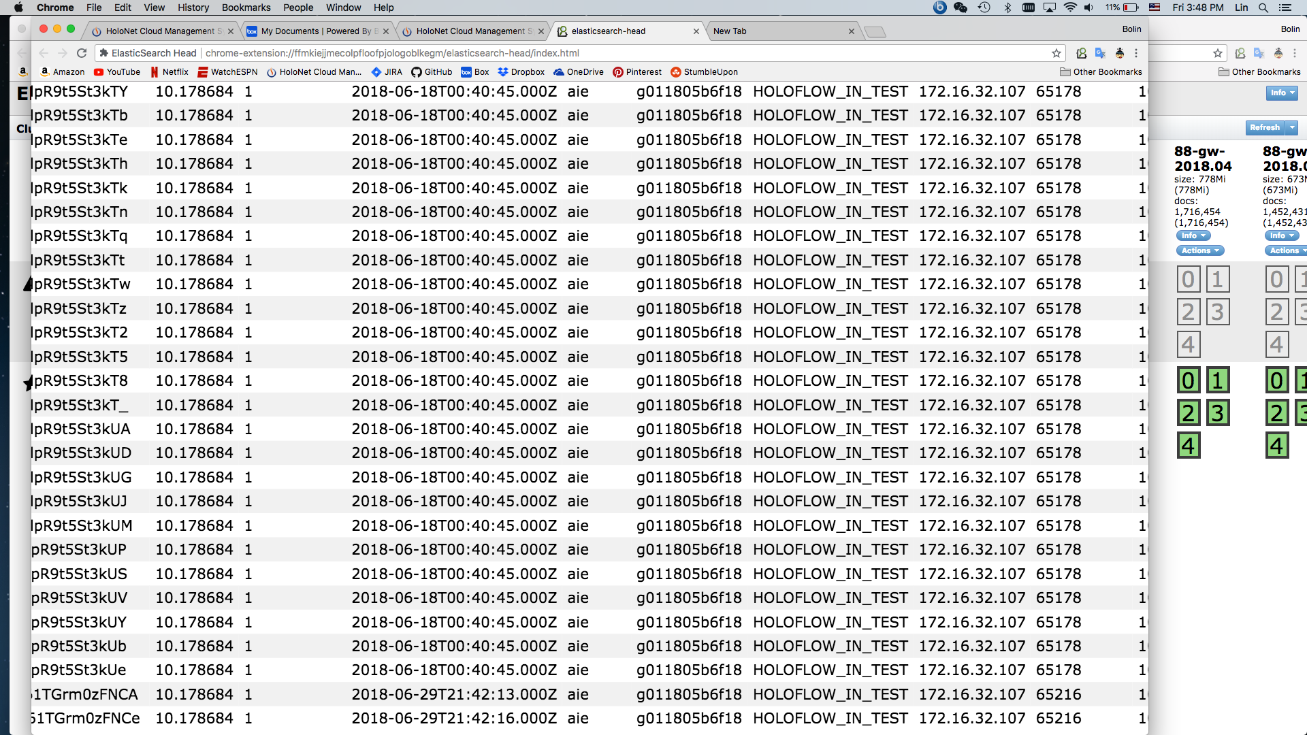

Slide 7
