Slide 1

ITCS424: Wireless and Mobile Computing Dr. Dolvara Guna-Tilaka Lect. Snit Sanghlao Xuchen guo 6188137 Wei tong Deng 6188141 Faculty of Information and Communication Technology Mahidol University 2021/1 January 4th, 2022

Slide 2
PROPOSAL
We are going to build a School Selector System; There are two login methods for teachers and students. The functions available after login are different learning pages. Teachers can write questions and modify student scores, and students can view the results and analyze the results and do the questions.
Developed for students who wish to enroll in the most suitable school, to help the school attract more students to be admitted to the school

Slide 3
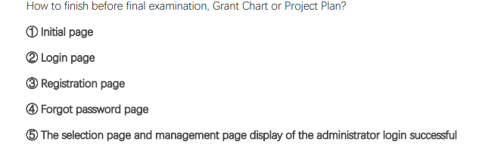
School System

Slide 4
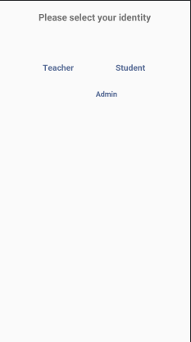
Interface and function part
The interface can be divided into initial page (welcome page), login page (administrator, teacher, student), registration page (teacher, student), administrator management page (class teacher, teacher, student, class), forgot password page, login The main page after success (divided into four: my, plan, study, forum)

Slide 5
private class JumpTeacher implements View.OnClickListener {
@Override
public void onClick(View view) {
Intent intent = new Intent();
intent.setClass(InitActivity.this, TLoginActivity.class);
startActivity(intent);
}
}
private class JumpStudent implements View.OnClickListener {
@Override
public void onClick(View view) {
Intent intent = new Intent();
intent.setClass(InitActivity.this, SLoginActivity.class);
startActivity(intent);
}
}
private class JumpAdmin implements View.OnClickListener {
@Override
public void onClick(View view) {
customClick(view); //Call custom Dialog
}
}

Slide 6

As above, the role selection is actually monitored by Relative. In this way, users can monitor the jump when they click on the picture, text or the outer border. The following is the xml code in the middle of this page, because it was found during debugging. It can’t adapt well on some phones with short screens, so we added Scroll View to make it slide up and down to enhance the adaptation effect of different models:

Slide 7
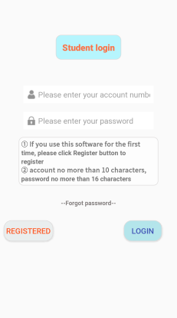
log in page Here we will introduce it with the student login page:
The input box of the login page has monitoring and restrictions on the length of the input content. The account we set is up to 10 digits and the password is up to 16 digits. The digits here are closely related to registration. The monitoring and restriction methods are as follows:

Slide 8
@Override
public void onTextChanged(CharSequence s, int start, int before, int count) {
Editable editable = usernameEditText2.getText();
int len ​​= editable.length();//The length of the input text
if (len> 10) {
int selEndIndex = Selection.getSelectionEnd(editable);
String str = editable.toString();
//Intercept the new string
String newStr = str.substring(0, 10);
usernameEditText2.setText(newStr);
editable = usernameEditText2.getText();
//New string length
int newLen = editable.length();
//The old cursor position exceeds the length of the new string
if (selEndIndex> newLen) {
selEndIndex = editable.length();
}

Slide 9
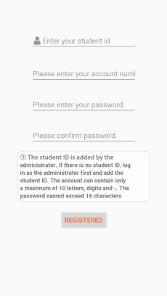
registration page The registration page on the teacher side and the student side is different. The teacher registers through the mobile phone number (send SMS verification code), and the students register through the student number:

Slide 10
The filled phone number and student number are added at the same time when the user is added by the administrator. Therefore, here, the filled content will be queried and compared in the database. If not, a pop-up window will remind the user to bind it from the administrator first. Here takes the function of student registration as an example to show the java code:
@Override
protected void onCreate(Bundle savedInstanceState) {
super.onCreate(savedInstanceState);
setContentView(R.layout.activity_sregister);
buttonRegister = findViewById(R.id.buttonRegister2);
editTextStudentNum = findViewById(R.id.editStudentNum);
editTextUserName2 = findViewById(R.id.add_username2);
editTextPassword2 = findViewById(R.id.add_password2);
editConfirmPassword2 = findViewById(R.id.confirm_password2);
//Modify the font of the registration button
Typeface customFont = Typeface.createFromAsset(this.getAssets(), "fonts/Coca-Cola.TTF");
buttonRegister.setTypeface(customFont);
nameCntentListener();
passwordCntentListener();
/**
* register
**/
buttonRegister.setOnClickListener(new View.OnClickListener() {
@Override
public void onClick(View v) {
studentNum = editTextStudentNum.getText().toString().trim();
userName2 = editTextUserName2.getText().toString().trim();
password2 = editTextPassword2.getText().toString().trim();
confirm2 = editConfirmPassword2.getText().toString().trim();

Slide 11
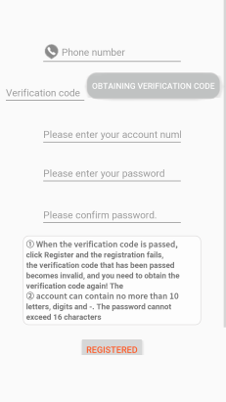
Teacher registration

Slide 12
@Override
public void run() {
userName = editTextUserName.getText().toString().trim();
password = editTextPassword.getText().toString().trim();
phoneNum = editTextPhoneNum.getText().toString().trim();
confirm = editConfirmPassword.getText().toString().trim();

Slide 13
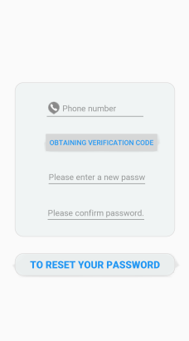
Forgot password page: Student retrieve password:

Slide 14
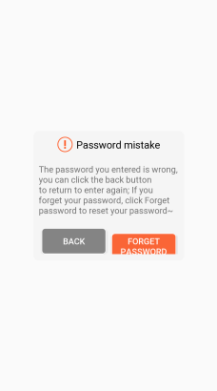
wrong password

Slide 15
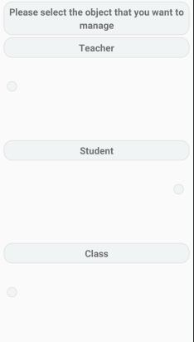
Administrator page Selection page and management page display for successful administrator login

Slide 16
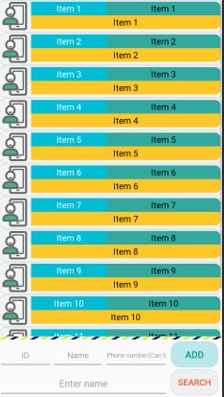
Manage student pages
For the user management page, I use List View and SimpleCursorAdapter to achieve real-time refresh and display. When using these two, it is important to have "_id integer primary key autoincrement" in the table.

Slide 17
private void initView() {
listView = (ListView) findViewById(R.id.studentListview);
btn_insert = (Button) findViewById(R.id.btn_insert);
btn_search = (Button) findViewById(R.id.btn_search);
et_ID = (EditText) findViewById(R.id.et_studentID);
et_name = (EditText) findViewById(R.id.et_studentName);
et_phone = (EditText) findViewById(R.id.et_studentPhone);
et_search = (EditText) findViewById(R.id.et_searchStudent);
}
private void initEvent() {
btn_insert.setOnClickListener(this);
btn_search.setOnClickListener(this);
openHelper = new DBOpenHelper(this);
mDbWriter = openHelper.getWritableDatabase();
mDbReader = openHelper.getReadableDatabase();

Slide 18
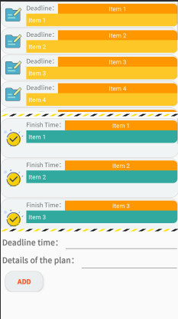
Planning interface

Slide 19
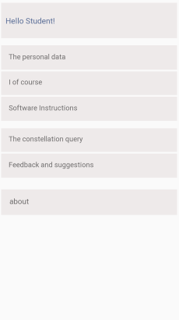
Personal interface

Slide 20
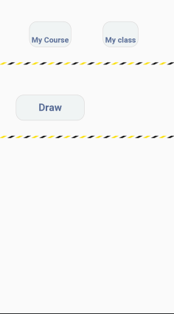
Learning interface

Slide 21
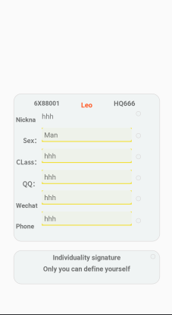
Profile page:

Slide 22
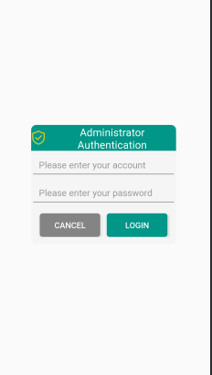
Administrator verification:

Slide 23
private void customClick(View v) {
AlertDialog.Builder builder = new AlertDialog.Builder(InitActivity.this);
final AlertDialog dialog = builder.create();
final View dialogView = View.inflate(InitActivity.this, R.layout.dialog_admin_login, null);
//Set the dialog layout
dialog.setView(dialogView);
dialog.show();
dialog.getWindow().setBackgroundDrawable(null);
final Button btnLogin = (Button) dialogView.findViewById(R.id.btn_login);
final Button btnCancel = (Button) dialogView.findViewById(R.id.btn_cancel);
btnLogin.setOnClickListener(new View.OnClickListener() {
@Override
public void onClick(View v) {
et_name = (EditText) dialogView.findViewById(R.id.et_name);
et_pwd = (EditText) dialogView.findViewById(R.id.et_pwd);
String name = et_name.getText().toString().trim();
String pwd = et_pwd.getText().toString().trim();

Slide 24
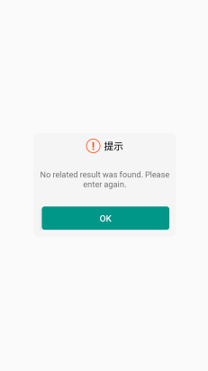
Prompt page:

Slide 25
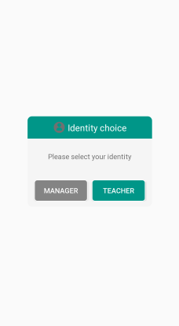
Identity selection:

Slide 26

@Override
public void onClick(View v) {
Intent intent = new Intent();
intent.setClass(AdminActivity.this, TeacherActivity.class);
startActivity(intent);
dialog.dismiss();
}
});
btnTeacher.setOnClickListener(new View.OnClickListener() {
@Override
public void onClick(View v) {
Intent intent = new Intent();
intent.setClass(AdminActivity.this, Teacher2Activity.class);
startActivity(intent);
dialog.dismiss();
}
});
}

Slide 27

To sum it up, it is actually equivalent to designing this Dialog like writing an interface layout, but its size is relatively small, and attention should be paid to the matching of its content, components and Alert Dialog. You can’t design it as you want. What kind, follow the method of Alert Dialog

Slide 28

Thank you

