Slide 1
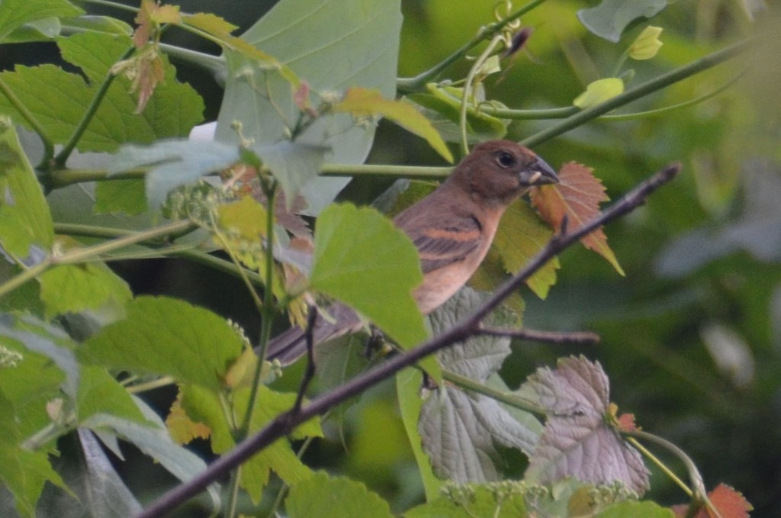
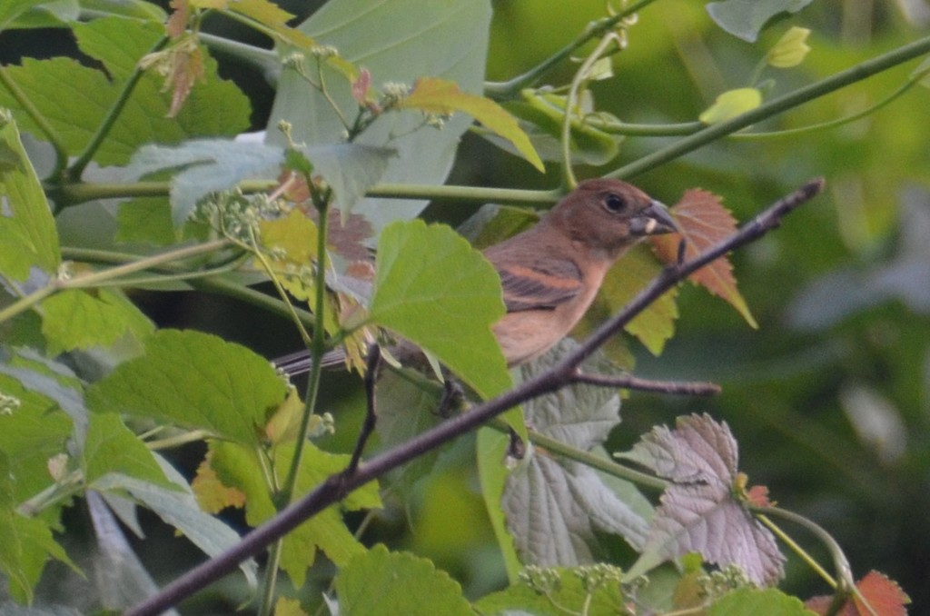
Natural observation sets and three comparisons
Natural observation
Three analyses
Measured outputs
Photo budget
1 to 5 photographs
Recognition gain
Harmful additions
Same-pool regrouping
Coarse difficulty matching
Grouping contrast
Error co-occurrence
Same-checkpoint comparison
Native set vs probability pool
Rescue and destruction
Passerina cyanea
One observation, two photographs
Illustrative source observation. Photographs: Stosh Morency, CC BY.
Notes:
Verified source: primary external manifest; case_selection.json. Original photos 8526241 and8526294 from https://www.inaturalist.org/observations/6718263, Stosh Morency CC BY. No crop, enhancement or synthetic replacement. Photo repetition in case figure is intentional and disclosed. The diagram depicts three analyses, not a new model.

Slide 2
External cohort and matching support
100 development taxa
Matching retention
2 photos: 66.4% (406/611)
44 taxa below threshold
External cohort
56 taxa / 1,121 observations
3 photos: 22.1% (62/280)
4 photos: 2.5% (3/122)
647 groups excluded
Matched subset
53 taxa / 474 observations (42.3%)
5 photos: 2.8% (3/108)
Higher-budget matched support
k = 3: 68 groups k = 4: 6 groups k = 5: 3 groups
Matching uses a subset of the external cohort.
Notes:
Sources: external_expansion_v2_2 primary_manifest.csv; explanatory_suite_v1_1 matching_attrition.csv. Before unique-frame cleaning1125 groups and3107 photos; primary1121 groups and3090 photos. Eight-observer threshold56taxa,strict10 sensitivity50taxa. Exact cardinalities611/280/122/108, retained406/62/3/3. Bars use those counts.

Slide 3
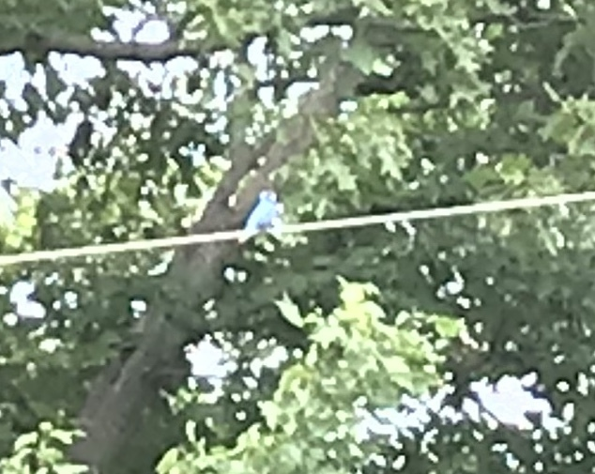
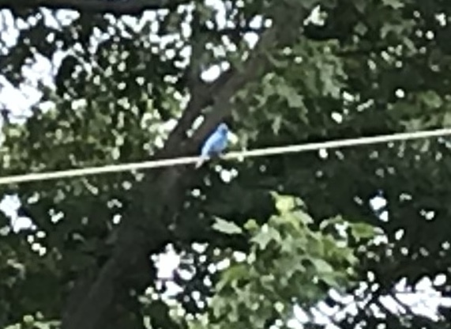
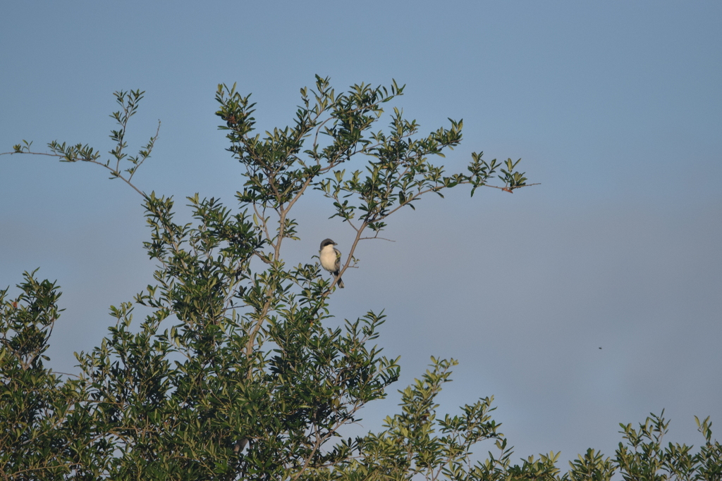
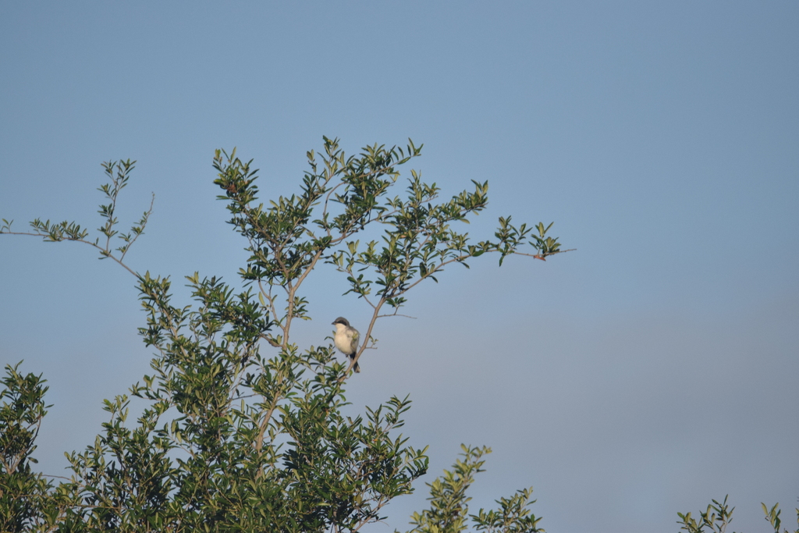
Real two-photo prediction events
a Shared error
Source label: Passerina cyanea
Photo 1
Passerina caerulea [wrong]
Photo 2
Passerina caerulea [wrong]
Native set
Passerina caerulea [wrong]
Probability pool
Passerina caerulea [wrong]
Observation 6718263
b Destruction
Source label: Passerina cyanea
Photo 1
Cyanocitta cristata [wrong]
Photo 2
Passerina cyanea [correct]
Native set
Cyanocitta cristata [wrong]
Probability pool
Cyanocitta cristata [wrong]
Observation 13807886
c Rescue
Source label: Lanius ludovicianus
Photo 1
Dolichonyx oryzivorus [wrong]
Photo 2
Tachycineta bicolor [wrong]
Native set
Lanius ludovicianus [correct]
Probability pool
Lanius ludovicianus [correct]
Observation 22037163
Illustrative cases. (a) Stosh Morency, CC BY. (b,c) CC0.
Notes:
{"selection":"Lowest numeric observation ID within each fixed event among exactly-two-photo primary groups; first registered seed; no visual screening","model":"dinov2-deepsets-all-seed20260819","case_sources":[{"observation_id":6718263,"images":[{"photo_id":8526241,"file":"figures/v5/cases/8526241.image","sha256":"2abae4deb1070cf8f6942ec6aae71b77659626a08fb7fa6cc035c8f967baf16e","attribution":"(c) Stosh Morency, some rights reserved (CC BY)","license_code":"cc-by","source_url":"https://inaturalist-open-data.s3.amazonaws.com/photos/8526241/large.jpg","observation_url":"https://www.inaturalist.org/observations/6718263"},{"photo_id":8526294,"file":"figures/v5/cases/8526294.image","sha256":"fed0a0890ef17e738959a7582ad11214b1f1cfcac7db0e44aebbd3469b54a959","attribution":"(c) Stosh Morency, some rights reserved (CC BY)","license_code":"cc-by","source_url":"https://inaturalist-open-data.s3.amazonaws.com/photos/8526294/large.jpg","observation_url":"https://www.inaturalist.org/observations/6718263"}]},{"observation_id":13807886,"images":[{"photo_id":20368359,"file":"figures/v5/cases/20368359.image","sha256":"683a08c4d78be4b90c389fb025bb06950d971a09b0d4b5bbfd61b9f8542b8de8","attribution":"no rights reserved","license_code":"cc0","source_url":"https://inaturalist-open-data.s3.amazonaws.com/photos/20368359/large.jpeg","observation_url":"https://www.inaturalist.org/observations/13807886"},{"photo_id":20379432,"file":"figures/v5/cases/20379432.image","sha256":"d221c4b790870ce965930ea3d6f5a33a1f227aed54a16c5165a4c93451727841","attribution":"no rights reserved","license_code":"cc0","source_url":"https://inaturalist-open-data.s3.amazonaws.com/photos/20379432/large.jpeg","observation_url":"https://www.inaturalist.org/observations/13807886"}]},{"observation_id":22037163,"images":[{"photo_id":34143218,"file":"figures/v5/cases/34143218.image","sha256":"76ab35b52358475d142fd8096c70329d8a4cc4ae42683ae11d25ba840a0b2184","attribution":"no rights reserved","license_code":"cc0","source_url":"https://inaturalist-open-data.s3.amazonaws.com/photos/34143218/large.jpeg","observation_url":"https://www.inaturalist.org/observations/22037163"},{"photo_id":34143544,"file":"figures/v5/cases/34143544.image","sha256":"60235a56397f58985afd6731a534a97f2edbf16814b9e97097bae9d2d500ee80","attribution":"no rights reserved","license_code":"cc0","source_url":"https://inaturalist-open-data.s3.amazonaws.com/photos/34143544/large.jpeg","observation_url":"https://www.inaturalist.org/observations/22037163"}]}],"integrity":"Stored predictions; no new inference. Complete field of view, original pixels. Model uses frozen centre-crop preprocessing. All selected cases have identical native/pool classes. Categories are illustrative not representative."}

