Slide 1
Robot field reports hold early warnings that nobody has time to read
inGen Field Intelligence · Chiyu Xu · Applied AI Analyst Intern
2,000
14
4
free-text reports from Aido Rover and Fari (synthetic, Jan–Jun 2026)
incident categories plus No Incident, with severity 1–4
hidden patterns planted and sealed, to test whether the analysis finds them
Notes:
Operators, technicians and care staff write short, messy notes. Nobody reads 2,000 of them, so recurring problems stay invisible. This project turns them into a measured classification and tested findings. All data is synthetic, with four patterns planted and sealed so we can check what the method finds and misses.

Slide 2
Four steps turn messy notes into tested, rate-based findings
1
2
3
4
Taxonomy
Gold set
LLM classifier
Analysis
14 categories by where the robot failed, not the trigger; severity 1–4
250 reports labelled by hand; 150 to tune, 100 held out and scored once
Versioned prompt, JSON schema, retry then flag; cost logged per run
Rates per operating hour, confidence intervals, multiple-testing correction
One command (python run_all.py) rebuilds every number and figure in this deck.
Notes:
The key discipline: the held-out set was used once, for the final number, so the accuracy is not tuned to the test. Every comparison uses incidents per operating hour, because busier sites naturally report more.

Slide 3
The LLM classifier is 96% accurate on unseen reports, ahead of both baselines
Category accuracy, 100 held-out reports
Human review: every confidence band met the 80% floor; only 1.6% of outputs are low-confidence.
Main error: a patrol paused by the weather rule is read as either Weather or No Incident (27 of 2,000). The fix is one sentence in the taxonomy, not a new model.
LLM classifier
96.0%
Keyword rules
94.0%
TF-IDF + logistic
78.0%
Against the generator's own labels: 96.9% on all 2,000 reports.
Notes:
Keyword rules are close because the synthetic text is template-based; on real notes the gap should be larger. The value of the LLM is that it also returns a reason and a confidence, which lets us route doubtful cases to a person.

Slide 4
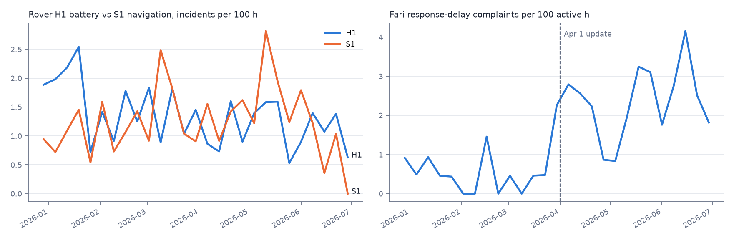
Cold nights and the April Fari update drive the biggest rises in incidents
1.8×
5.0×
battery incident rate below 0 °C (95% CI 1.32–2.45)
Fari response-delay complaints after 1 April (95% CI 2.76–9.07); latency 1.75 s → 3.04 s
Severity cannot be ranked yet: predicted severity matched hand labels only 47% of the time.
Notes:
Both are rate ratios per operating hour with confidence intervals, not raw counts. The Fari rise starts the week of the update, but a before-after comparison alone cannot prove the update caused it. Severity is weak because the reports rarely say how bad the impact was.

Slide 5
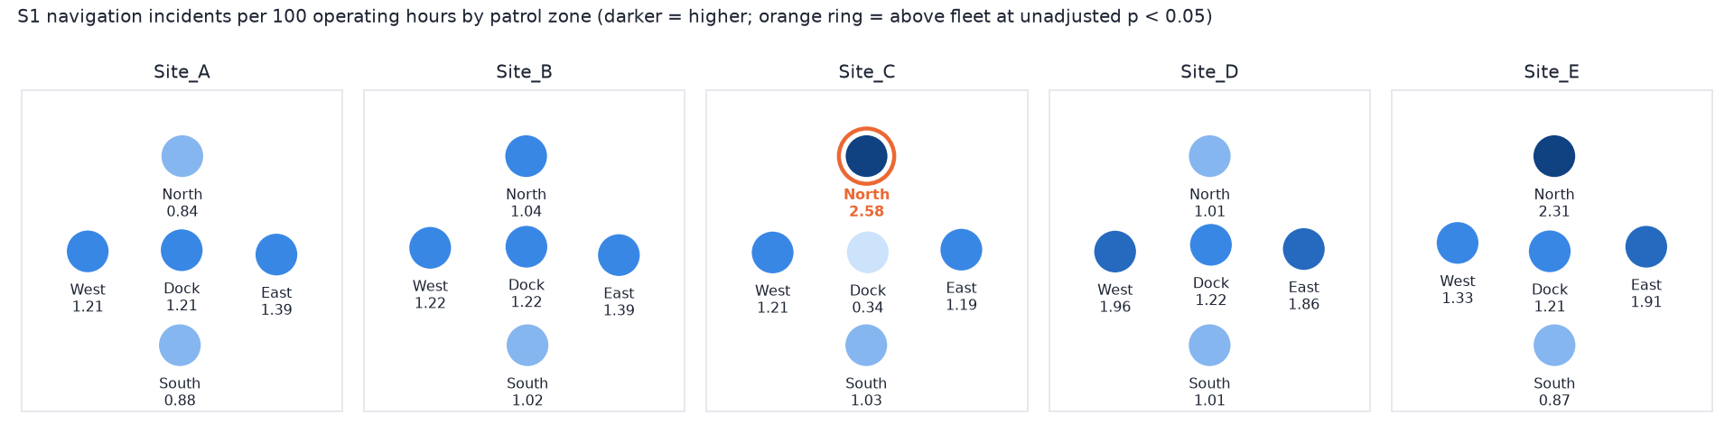
Site_C North has the most navigation incidents, but the data cannot yet confirm a hotspot
2.07×
q = 0.33
15 zone–category cells pass p < 0.05, about what 350 tests give by chance. Treat Site_C North as a lead to check, not a finding.
the fleet's navigation rate, highest of 25 zones
after correcting for 25 zones: not significant
Notes:
I tested each zone's rate against the rest of the fleet and corrected for multiple testing. Getis-Ord Gi* was also run, but with 25 zones and one to four neighbours each its p-values are unstable, so it is context only. Live demo: open maps/w03_s1_hotspot.png after python run_all.py.

Slide 6
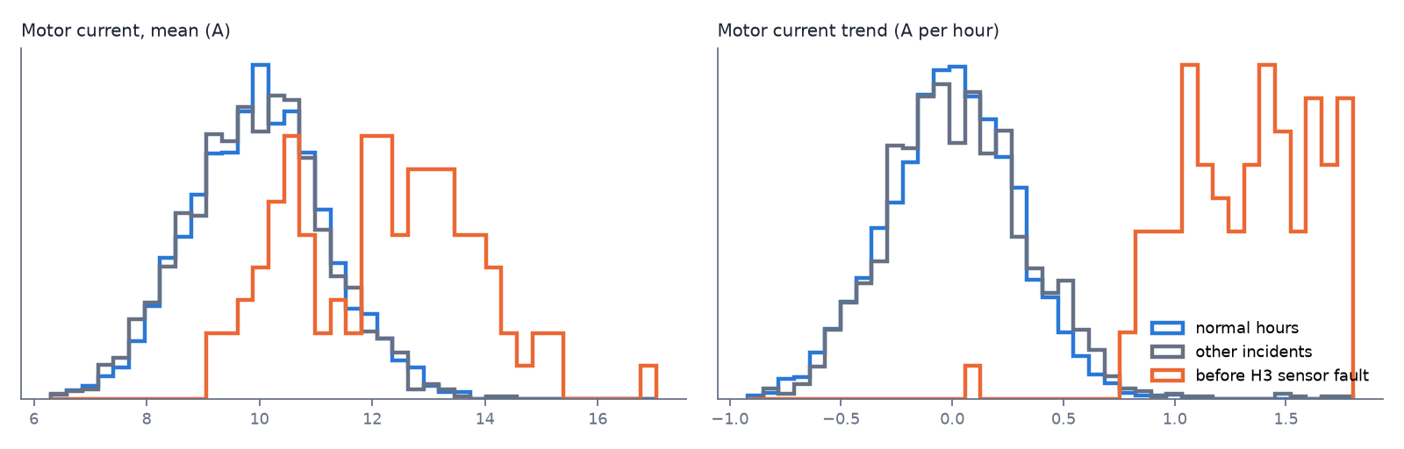
Rising motor current warns of sensor faults; most other incidents leave no trace
0.996
cross-validated AUC: sensor-fault hours vs normal hours
Signal in the hour before | AUC
Sensor fault: motor current trend | 0.996
Battery: charge and drain | 1.000
Navigation: localisation confidence | 0.986
Obstacle, connectivity, app, access | ≈ 0.5
Battery and navigation AUCs partly restate the label. The useful signal is the non-obvious one: the drive motor warns of a sensor fault.
Notes:
Compared with 2,353 normal-operation windows, using 5-fold cross-validation. The telemetry is synthetic, so these AUCs are an upper bound; the next step is to check this on real telemetry.

Slide 7
These findings come from synthetic data, and one planted pattern was only partly found
Planted pattern | Result
Cold-weather battery incidents | Found
Fari delay complaints after update | Found
Motor current before sensor faults | Found
Site_C North navigation hotspot | Partial: sample too small
All data is synthetic
Reports, operating hours and telemetry were generated, so results show what the method can detect.
One labeller
Kappa 1.0 was a same-day re-label and overstates reliability.
The miss is sample size
With the true labels the hotspot is still not significant.
Notes:
The answer key was sealed with a published hash and opened only after the analysis was final. Re-running the hotspot test with the generator's true labels shows the miss is not the classifier: about 63 reports per zone is too few.

Slide 8
Next: run the pipeline on real InGen reports and turn the sensor signal into an alert
1
2
3
Real reports
Sentinel Prime logs
Maintenance alert
Run on a month of real field notes with names removed; label 50 per month to watch accuracy.
Add alert logs as a second text source and link alerts to incidents.
Validate the motor-current signal on real telemetry, then alert on a rising trend.
Quick wins: fix the weather-pause rule; check the April Fari release for latency.
Notes:
The governance pack (W04_Governance_Pack.docx) covers how to run this on real data: data dictionary, processing rules, taxonomy change process and the monthly re-evaluation.

