Slide 1
CS222: Principles of Data Management
Notes #8
Static Hashing, Extendible Hashing， Linear Hashing
Instructor: Chen Li

Slide 2
Introduction
Hash-based indexes are best for equality selections. Cannot support range searches.
Static and dynamic hashing techniques exist; trade-offs similar to ISAM vs. B+ trees.
Notes:
2

Slide 3
Static Hashing
# primary pages fixed, allocated sequentially, never de-allocated; overflow pages if needed.
h(k) mod M = bucket (page) to which data entry with key k belongs. (M = # of buckets)
h(key) mod N
0
1
key
h
N-1
Primary bucket pages
Overflow pages
Notes:
3

Slide 4
Static Hashing (Contd.)
Buckets contain data entries.
Hash fn works on search key field of record r. Must distribute values over range 0 ... M-1.
  h(key) = (a * key + b) usually works well.
  a and b are constants; lots known about how to tune h.
Long overflow chains can develop and degrade performance.
  Extendible and Linear Hashing: Dynamic techniques to fix this problem.
Notes:
4

Slide 5
Extendible Hashing
Situation: Bucket (primary page) becomes full. Why not re-organize file by doubling # of buckets?
  Reading and writing all pages is expensive!
  Idea: Use directory of pointers to buckets, double # of buckets by doubling the directory, but splitting just the one data bucket that overflowed!
  Directory much smaller than file, so doubling it is much cheaper. Only one page of data entries is split. No overflow page now!
  Trick lies in how hash function is adjusted!
Notes:
5

Slide 6
Example
LOCAL DEPTH
2
4*
12*
32*
16*
Bucket A
GLOBAL DEPTH
2
2
00
1*
5*
21*
13*
Bucket B
Directory is array of size 4.
To find bucket for r, take last `global depth’ # bits of h(r); we denote r by h(r).
  If h(r) = 5 = binary 101, it is in bucket pointed to by the two bits 01.
01
10
2
10*
Bucket C
11
DIRECTORY
2
15*
7*
19*
Bucket D
DATA PAGES
Insert: If bucket is full, split it (allocate new page, re-distribute).
If necessary, double the directory. (As we will see, splitting a
bucket does not always require doubling; we can tell by
comparing global depth with local depth for the split bucket.)
Notes:
6

Slide 7
Insert h(r)=20 (Causes Doubling)
⁄
← (Needs to become 3 now)
LOCAL DEPTH
2
3
Bucket A
LOCAL DEPTH
GLOBAL DEPTH
32*
16*
32*
16*
Bucket A
GLOBAL DEPTH
2
2
3
2
00
1*
5*
21*
13*
Bucket B
1*
5*
21*
13*
000
Bucket B
01
001
10
2
010
2
11
10*
Bucket C
011
10*
Bucket C
2
100
DIRECTORY
Bucket D
101
2
15*
7*
19*
15*
7*
19*
Bucket D
110
⁄
111
2
← (Needs to become 3 now)
3
2
Old Bucket A
4*
12*
20*
Bucket A2
DIRECTORY
(`split image'
4*
12*
20*
Bucket A2
4*
12*
32*
16*
of Bucket A)
(`split image'
of Bucket A)
Notes:
7

Slide 8
Points to Note
20 = binary 10100. Last 2 bits (00) tell us r belongs in A or A2. Last 3 bits needed to tell which one.
  Global depth of directory: Max # of bits needed to tell which bucket an entry belongs to.
  Local depth of a bucket: # of bits used to determine if an entry belongs to this bucket.
When does bucket split cause directory doubling?
  Before insert, local depth of bucket = global depth. Insert causes local depth to become > global depth; directory is doubled by copying it over and `fixing’ pointer to split page. (Note how use of least significant bits enables efficient doubling via bulk directory copying!)
Notes:
8

Slide 9
Insert records (see textbook)
Insert h(r) = 13, 20, 9
Notes:
9

Slide 10
Comments on Extendible Hashing
If directory fits in memory, equality search answered with one disk access; else two.
  100MB file, 100 bytes/rec, 4K pages contains 1,000,000 records (as data entries) and 25,000 directory elements; chances are high that directory will fit in memory.
  Directory grows in spurts, and, if the distribution of hash values is skewed, directory can grow large.
  Multiple entries with same hash value cause problems!
Delete: If removal of data entry makes bucket empty, can be merged with `split image’. If each directory element points to same bucket as its split image, can halve directory.
Notes:
9

Slide 11
Next: Linear Hashing
This is another dynamic hashing scheme, an alternative to Extendible Hashing.
LH handles the problem of long overflow chains without using a directory, and handles duplicates.
Idea: Use a family of hash functions h₀, h₁, h₂, ...
  h_{i}(key) = h(key) mod(2^{i}N); N = initial # buckets
  h is some hash function (range is not just 0 to N-1)
  If N = 2^{d0}, for some d0, h_{i} consists of applying h and looking at the last di bits, where di = d0 + i.
  h_{i+1} doubles range of h_{i} (≈directory doubling)
Ex: d0=2
so N=4
Notes:
10

Slide 12
Linear Hashing (Contd.)
Directory avoided in LH by using overflow pages, and choosing bucket to split round-robin.
  Splitting proceeds in `rounds’. Round ends when all N_{R} initial (for round R) buckets are split. Buckets in 0 to Next-1 have been split; Next to N_{R} have yet to be split.
  Current round number is called Level.
Search: To find bucket for data entry r, find h_{Level}(r):
    If h_{Level}(r) in range `Next to N_{R}’, then r belongs here.
    Else, r could belong to bucket h_{Level}(r) or to bucket h_{Level}(r) + N_{R}; must apply h_{Level+1}(r) to find out which.
Notes:
11

Slide 13
Overview of LH File
In the middle of a round.
Buckets split in this round:
Bucket to be split
If
h
(
search key value
Level
)
Next
is in this range, must use
h
(
search key value
Level+1
)
Buckets that existed at the
to decide if entry is in
beginning of this round:
`split image' bucket.
this is the range of
h
Level
`Split image' buckets:
created (through splitting
of other buckets) in this round
Notes:
11

Slide 14
Linear Hashing (Contd.)
Insert: Find bucket by applying h_{Level} / h_{Level+1}:
  If bucket to insert into is full:
    Add overflow page and insert data entry.
    (Maybe) Split Next bucket and increment Next.
Can choose any criterion to ‘trigger’ a split.
Since buckets are split round-robin, long overflow chains don’t develop! (See why?)
Doubling of directory in Extendible Hashing is similar; switching of hash functions is implicit in how the # of bits examined in EH is increased.
Notes:
12

Slide 15
Example of Linear Hashing
On split, h_{Level+1} is used to re-distribute entries.
Level=0, N=4
Insert 43*
Level=0
h
h
PRIMARY
(43 = 101011)
h
h
PRIMARY
OVERFLOW
1
0
Next=0
PAGES
1
0
PAGES
PAGES
000
00
32*
44*
36*
000
00
32*
Next=1
9*
25*
5*
Data entry r
9*
25*
5*
001
01
with h(r)=5
001
01
010
10
14*
18*
10*
30*
Primary
010
10
14*
18*
10*
30*
bucket page
011
31*
35*
7*
11*
011
31*
35*
7*
11*
43*
11
11
(h_{i} info is shown only
for illustration....!)
(Actual contents
of linear hashed file)
100
00
44*
36*
Notes:
13

Slide 16
Example: End of a Round
Level=1
PRIMARY
OVERFLOW
h
h
PAGES
1
0
PAGES
Next=0
Level=0
000
00
32*
PRIMARY
OVERFLOW
h
h
PAGES
PAGES
1
0
001
01
9*
25*
000
00
32*
010
10
66*
18*
10*
34*
50*
001
01
9*
25*
Insert 50*
011
11
43*
35*
11*
010
10
66*
18*
10*
34*
(50 = 110010)
Next=3
100
00
44*
36*
11*
43*
011
11
31*
35*
7*
44*
36*
101
11
5*
37*
29*
100
00
101
01
5*
37*
29*
110
10
14*
30*
22*
110
10
14*
30*
22*
111
11
31*
7*
Notes:
14

Slide 17
Insert records (see textbook)
Insert h(r) = 43, 37, 29, 22, 66, 34
Notes:
9

Slide 18
Summary (Cont’d.)
Linear Hashing avoids directory by splitting buckets round-robin and (still) using overflow pages.
  Overflow chains not likely to be long.
  Duplicates handled more easily.
  Space utilization could be lower than Extendible Hashing, since splits are not concentrated on `dense’ data areas.
    Can tune LH criterion for triggering splits to trade-off slightly longer chains for better space utilization.
Note: For hash-based indexes, a skewed data distribution is one in which the hash values of data entries are not uniformly distributed!
Notes:
17

Slide 19
Summary
Hash-based indexes: best for equality searches, cannot support range searches (i.e., not efficiently).
Static Hashing can lead to long overflow chains.
Extendible Hashing avoids overflow pages by splitting a full bucket when a new data entry is added to it. (Duplicates may require overflow pages.)
  Directory to keep track of buckets; doubles periodically.
  Directory can get large with skewed data; additional I/O if it does not fit in main memory.
Notes:
16

Slide 20
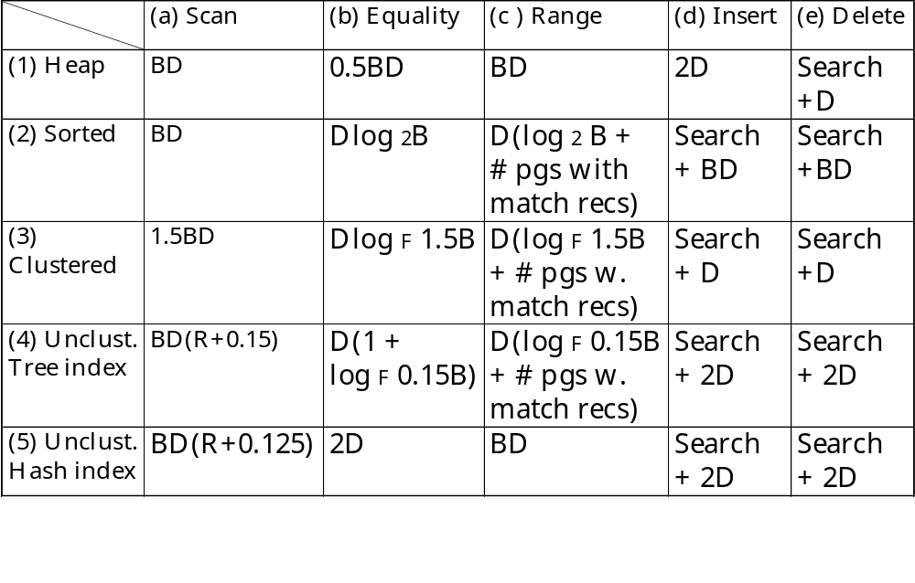
Cost of Operations
Several assumptions underlie these (rough) estimates!
Notes:
5

