Slide 1
C6H5OCl
0
1
5
2
Cl
O
4
3

Slide 2
1
6
11
2
0
7
5
3
8
10
4
9
1
9
2
0
3
8
3
2
5
7
10
4
6
11

Slide 3
C13
9
10
8
0
1
11
7
5
2
12
6
3
4

Slide 4
ThreeCircleC13
1
3
0
2
4
11
12
5
10
6
9
7
8

Slide 5
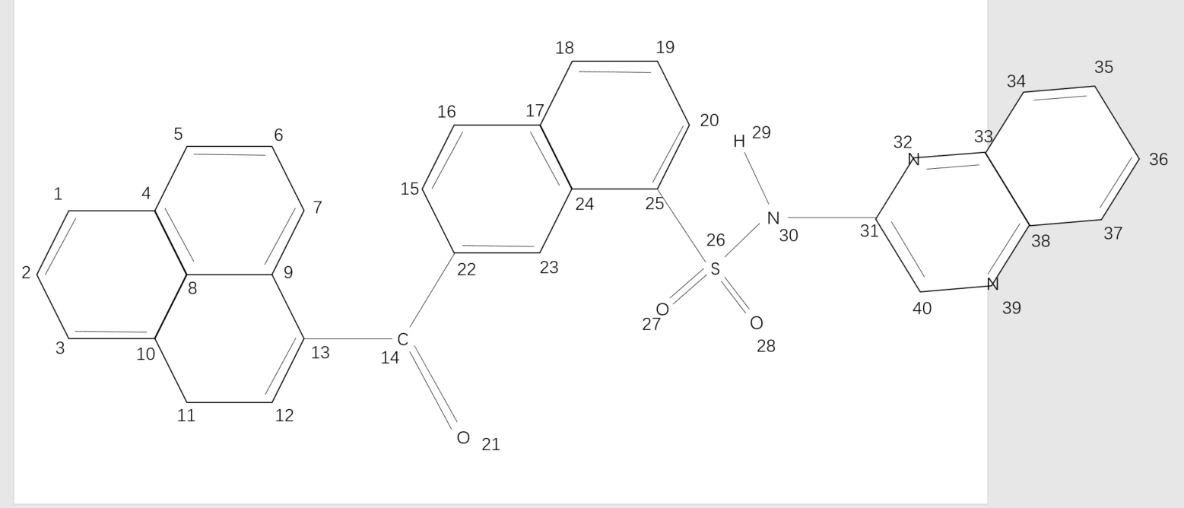
COHN

