Slide 1
Fatal Force Project
Created by: Daniel Bacal, Diwen Liu, Xudong Yang

Slide 2
Data Cleaning & Preprocessing
We created two main dataframes:
City Data (merged education, income, etc.)
Victim Data (training and test police_killing)
When merging the dataframes to build City Data, and merging the Victim Data with the City Data, we merged on both the “Geographic Area” (“state”) and “City” columns.

Slide 3
Data Cleaning & Preprocessing
For imputation:
Use median imputation for the numerical features (age, percent_completed_hs, etc.)
Take the most frequent word of non_numerical features (armed, flee, etc.)
For features deemed critical for a data point to be meaningful (race), drop any data points with missing values, rather than imputing

Slide 4
Data Cleaning & Preprocessing
When merging the City Data with the Victim Data, we encountered a problem with different naming conventions:
Because we merge the dataframes on the city column, we encountered a problem where there were no matched columns, due to the City Data adding suffixes such as “city”, “town”, “village”, “CDP”, etc. whereas the Victim Data contained only the city name itself.
In order to properly merge the 2 dataframes, we had to assimilate the naming conventions by dropping the suffixes for the City Data city column.

Slide 5
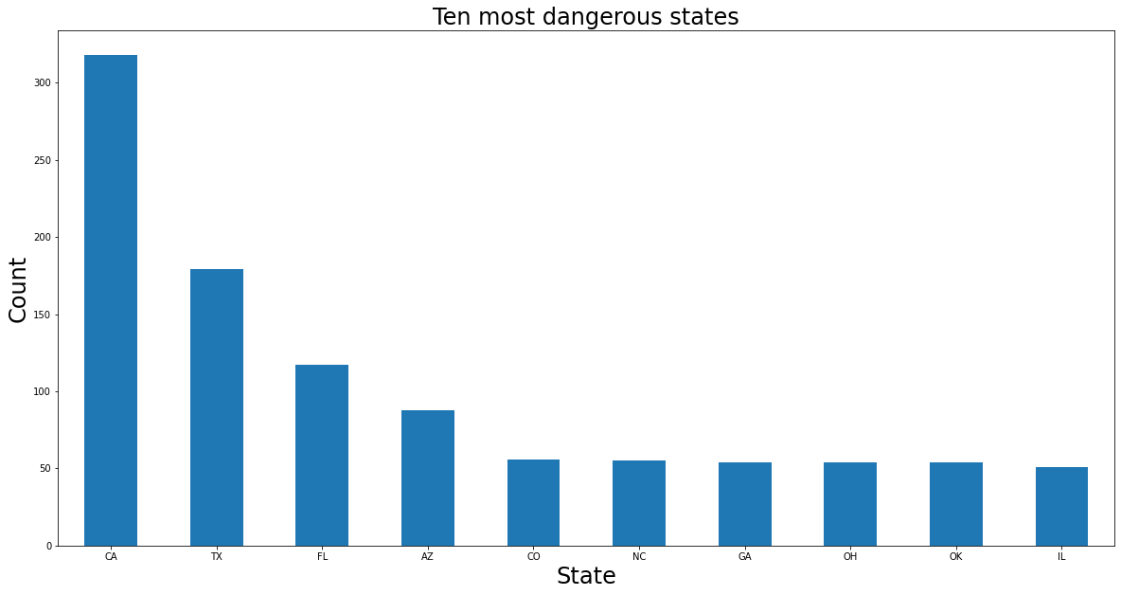
EDA

Slide 6
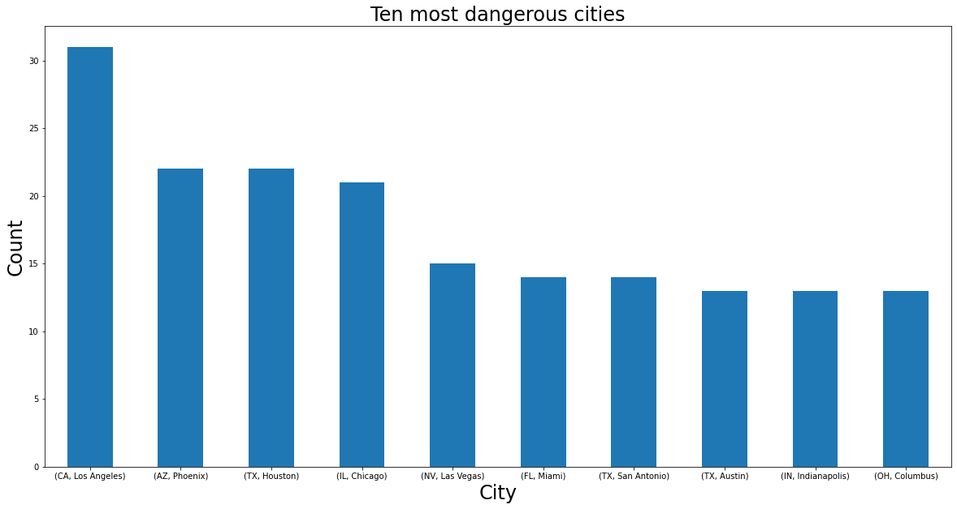
EDA

Slide 7
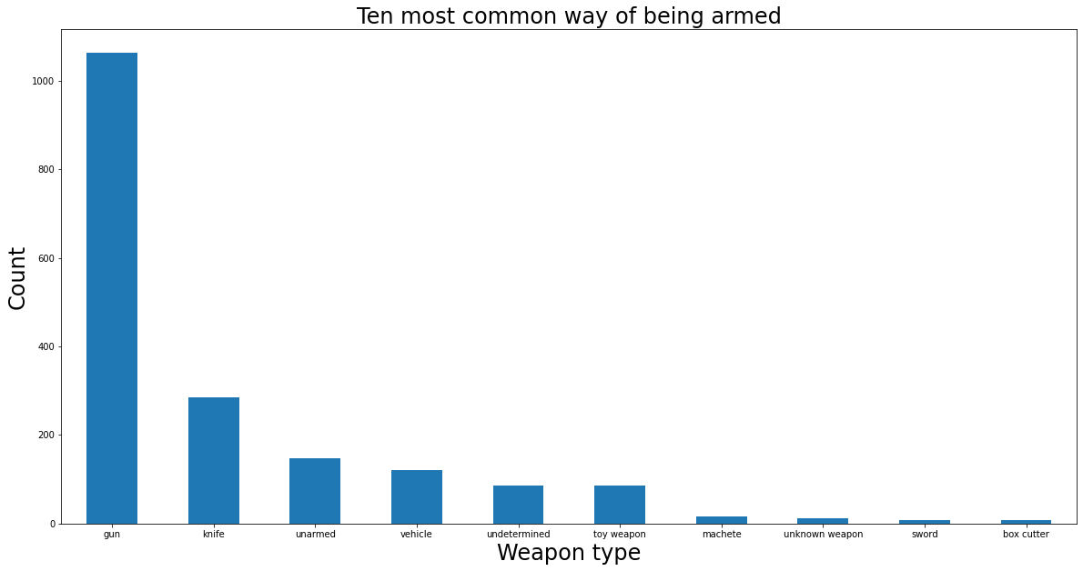
EDA

Slide 8
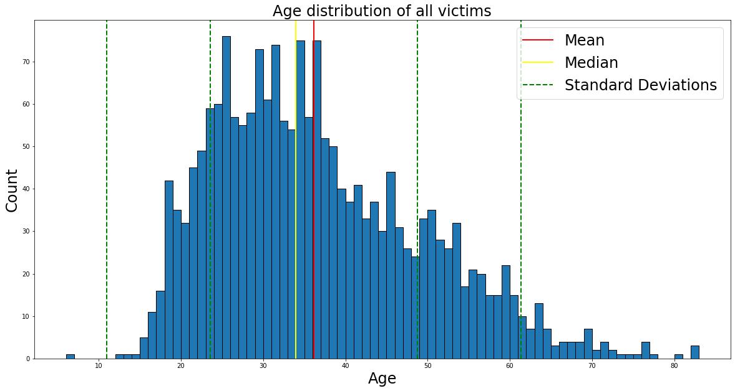
EDA

Slide 9
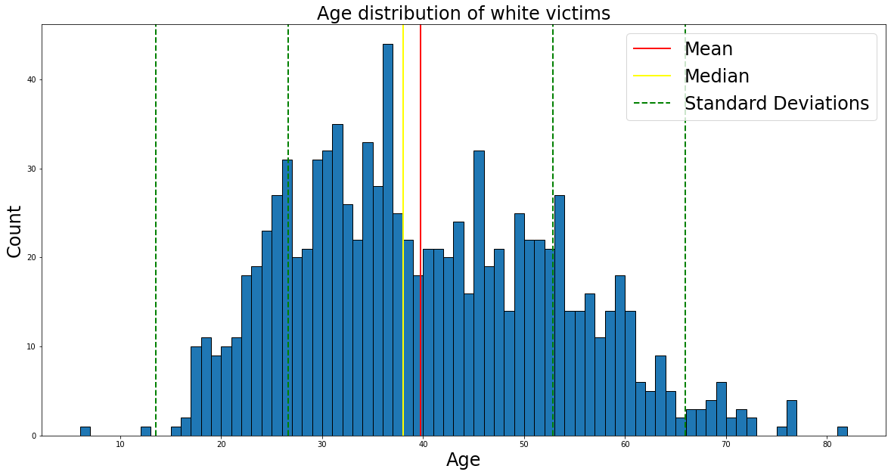
EDA

Slide 10
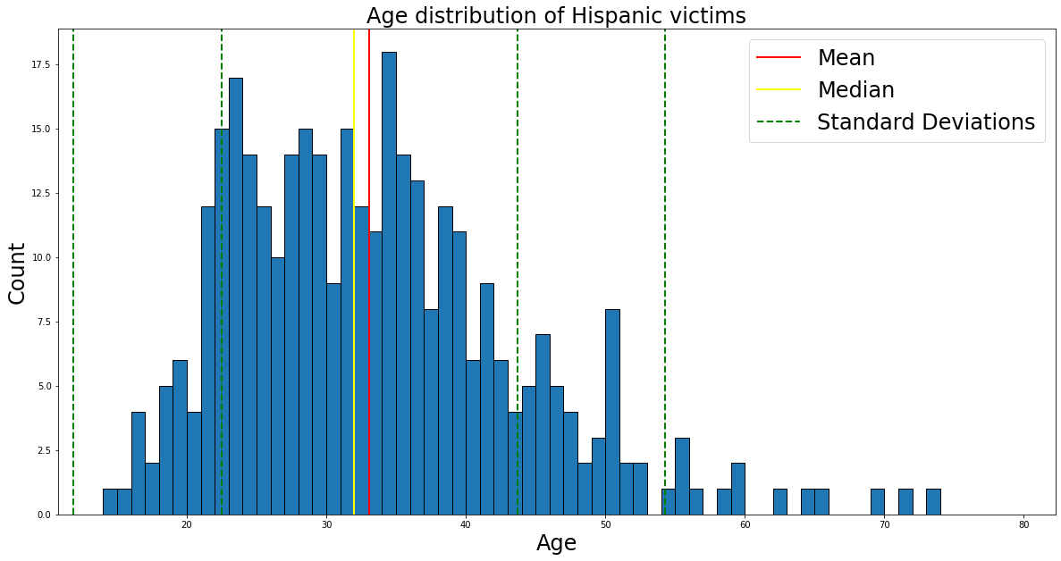
EDA

Slide 11
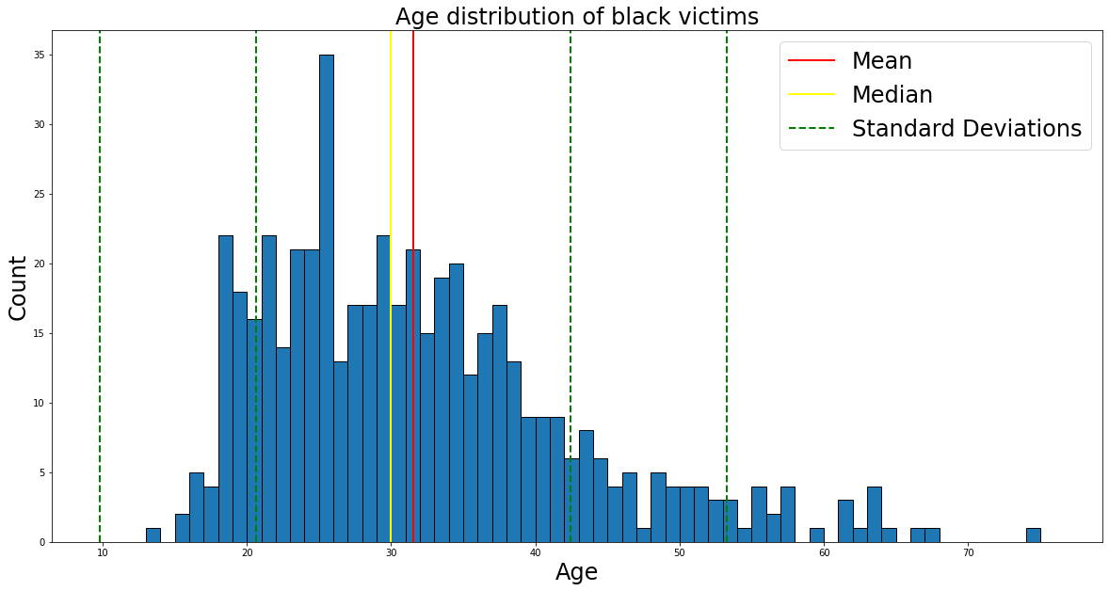
EDA

Slide 12
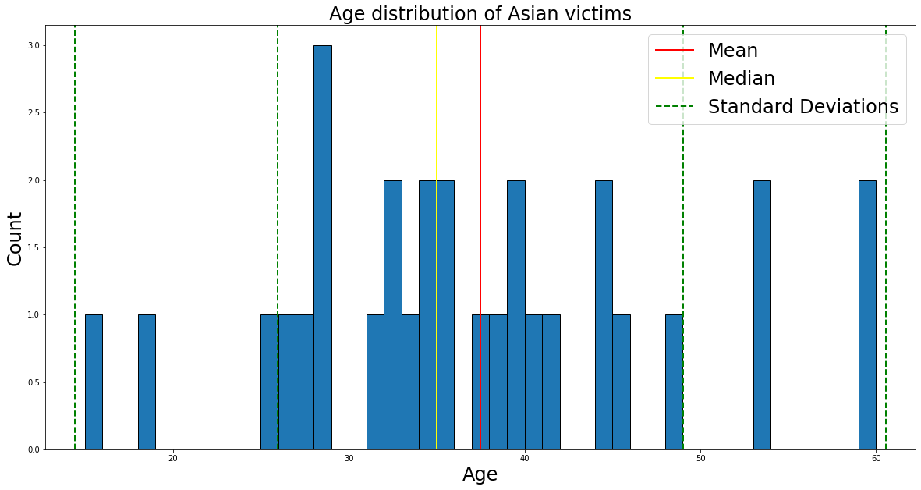
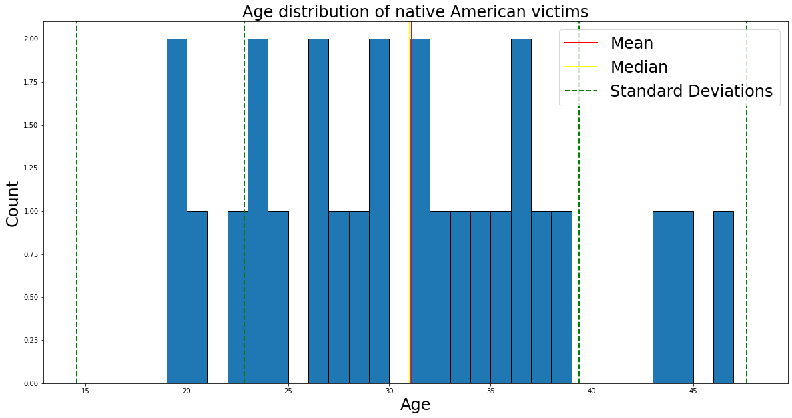
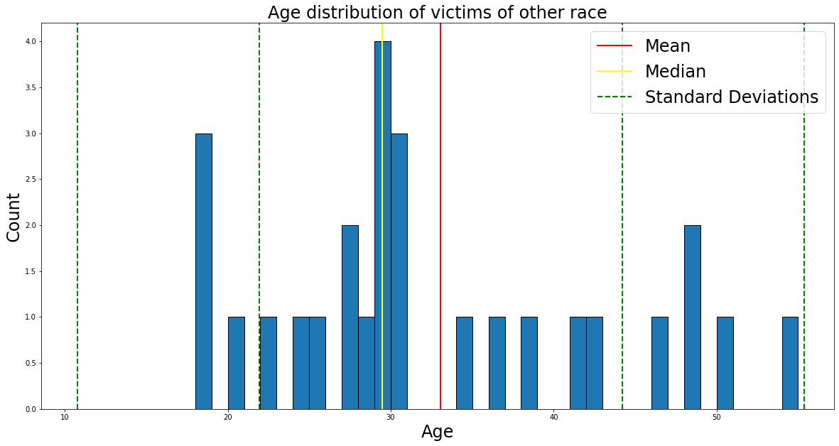
EDA

Slide 13
EDA
In the police_killing_train data sample
Race | Killed Amount | Killed Percentage
W (white) | 995 | 51.50
B (black) | 504 | 26.08
H(Hispanic) | 347 | 17.96
A(Asian) | 31 | 1.60
O(Other) | 28 | 1.44
N(Native American) | 27 | 1.39

Slide 14
Additional Data
According to the estimated race proportion in the U.S. from 2010 through 2019 by U.S. Census Bureau
- White: 60.1%
- Hispanic: 18.8%
- Black: 13.4%
- Asian: 5.9%
- Native Americans: 1.3%
- Other (two or more races): 2.8%
Also, the American population from 2014 to 2017 increases from 320 million to 330 million

Slide 15
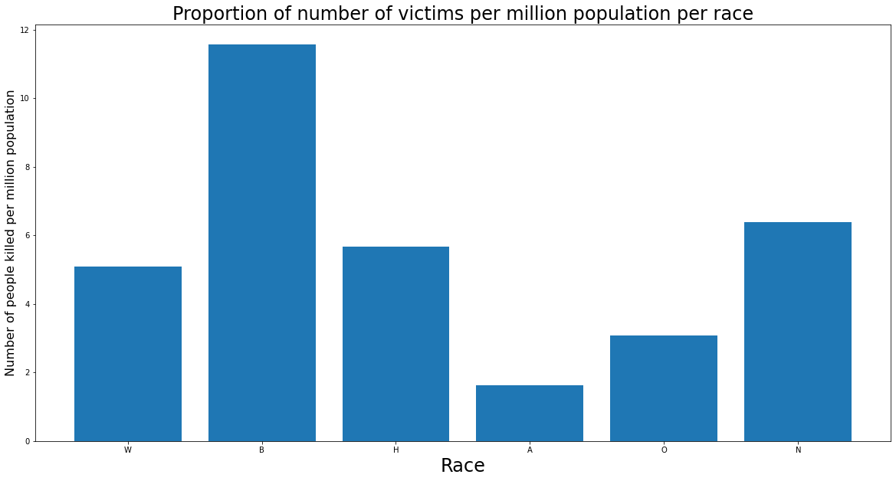
EDA

Slide 16
Machine Learning
Before being able to train our various classifiers, we had to make sure that the data we were going to use to fit and predict the models was correctly pre-processed.
Encode non-numerical features to numerical features to be used in the classifiers
Observe correlation coefficients and determine what features should be excluded from the models
Split the training and testing data into X and Y, where Y is the target labels and X is all of the other features being used.

Slide 17
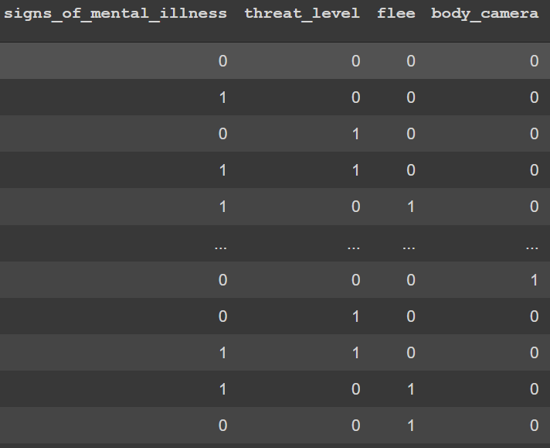
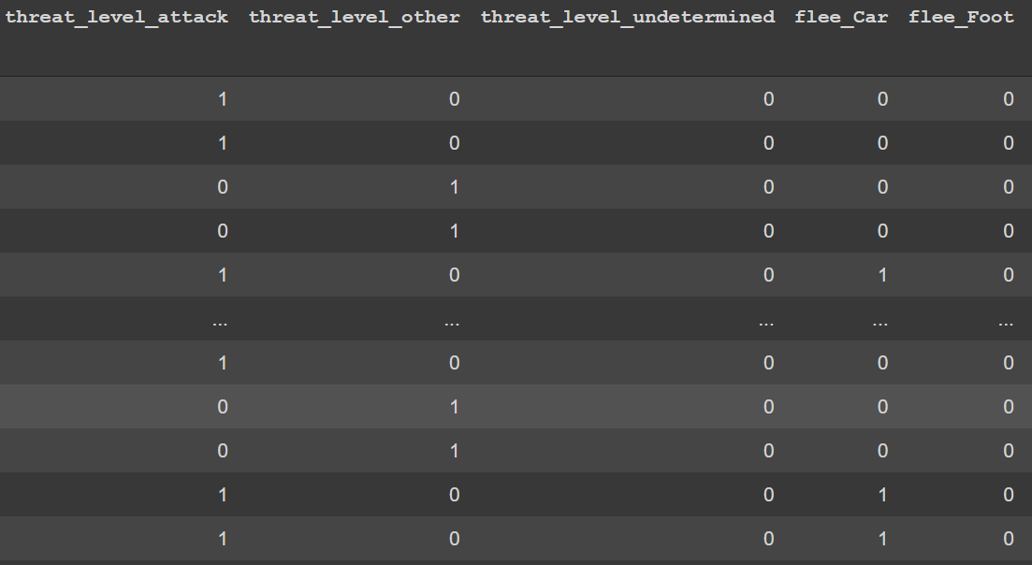
Machine Learning
Encoding Data:
Label Encoding v.s. One-Hot/Dummy encoding.

Slide 18
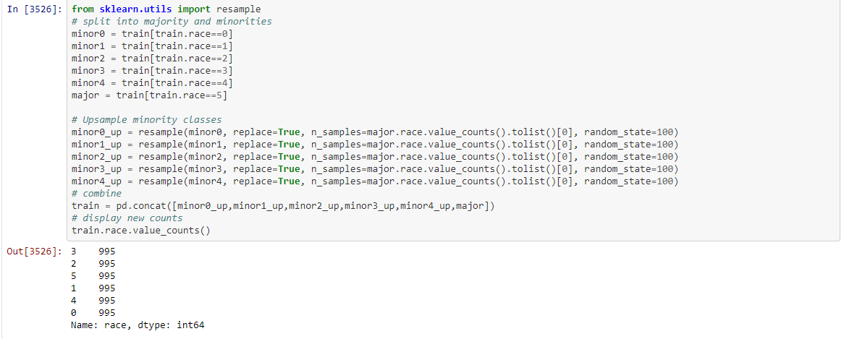
Machine Learning
Over_Sampling
Create sample case for minority class(Asian, Native American)

Slide 19
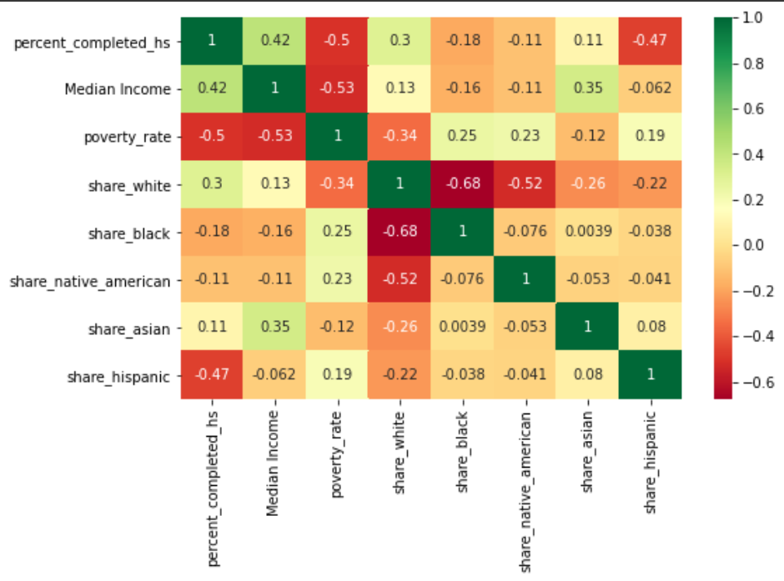
Machine Learning
Correlation Coefficients in features:

Slide 20
Machine Learning
Results of the classifiers:
Naive Bayes:
F1-Score: 0.59 , Accuracy: 0.57
K-Nearest Neighbors:
F1-Score: 0.54 , Accuracy: 0.52
Random Forest:
F1-Score: 0.55 , Accuracy: 0.55
Gradient Boosting:
F1-Score: 0.54 , Accuracy: 0.52

