Slide 3
G
F
400 MHz CDCl₃
*stands for potential overlapping with solvent peak or unremoved substrates
F
F
F
F
Label | Number | shift/ppm | Multiplets
A | 3 | 3.87 | s
B | 2 | 7.23 | s
C | 6 | 4.00 | td
D* | 6 | 1.82 | m
E | 6 | 1.45 | m
F* | 48 | 1.32 | m
G* | 9* | 0.88 | t
F
F
F
D
E
C
B
B
A

Slide 4

Side product fraction
(based on NMR integral)
G
F
F
S3E0 -> x
S2E0 -> y
S2E1 -> z
F
F
Label | Cmt | # of Hs
A | Reference H on methyl ester | 3x + 3y
B | Ortho H (may overlap with CDCl₃) | 2x + 2y + 2z
C | Alpha H on alkyl chains | 6x + 4y + 4z
D | Beta H on alkyl chains | 6x + 4y + 4z
E, F | Alkyl Hs in the middle | 54x + 36y + 36z
G | Methyl H on the alkyl chains end | 9x + 6y + 6z
F
F
F
F
D
E
C
B
C, D, E, F, G are all corrected if unremoved bromododecane is found.
B
A
$$\left(\begin{matrix}\begin{matrix}3 \\ 2\end{matrix} & \begin{matrix}3 \\ 2\end{matrix} & \begin{matrix}0 \\ 2\end{matrix} \\ 6 & 4 & 4 \\ \begin{matrix}6 \\ 54 \\ 9\end{matrix} & \begin{matrix}4 \\ 36 \\ 6\end{matrix} & \begin{matrix}4 \\ 36 \\ 6\end{matrix}\end{matrix}\right)\left(\begin{matrix}x \\ y \\ z\end{matrix}\right)=\left(\begin{matrix}A \\ B \\ \begin{matrix}C \\ D \\ \begin{matrix}E, F \\ G\end{matrix}\end{matrix}\end{matrix}\right)$$
Read from NMR integral
S3E0
(desired product)
S2E0
(s.p.)
S2E1
(s.p.)

Slide 5


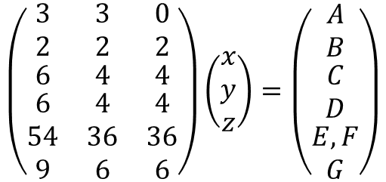
Side product fraction
(based on NMR integral)
Label | Cmt | # of Hs
A | Reference H on methyl ester | 3x + 3y
B | Ortho H (may overlap with CDCl₃) | 2x + 2y + 2z
C | Alpha H on alkyl chains | 6x + 4y + 4z
D | Beta H on alkyl chains | 6x + 4y + 4z
E, F | Alkyl Hs in the middle | 54x + 36y + 36z
G | Methyl H on the alkyl chains end | 9x + 6y + 6z
G
F
F
S3E0 -> x
S2E0 -> y
S2E1 -> z
F
F
F
F
F
F
D
E
C, D, E, F, G are all corrected if unremoved bromododecane is found.
C
$$\left(\begin{matrix}\begin{matrix}3 \\ 2\end{matrix} & \begin{matrix}3 \\ 2\end{matrix} & \begin{matrix}0 \\ 2\end{matrix} \\ 6 & 4 & 4 \\ \begin{matrix}6 \\ 54 \\ 9\end{matrix} & \begin{matrix}4 \\ 36 \\ 6\end{matrix} & \begin{matrix}4 \\ 36 \\ 6\end{matrix}\end{matrix}\right)\left(\begin{matrix}x \\ y \\ z\end{matrix}\right)=\left(\begin{matrix}A \\ B \\ \begin{matrix}C \\ D \\ \begin{matrix}E, F \\ G\end{matrix}\end{matrix}\end{matrix}\right)$$
B
Read from NMR integral
$$AX=B$$
$$X=A^{−L}B$$
B
A
B and D, E, F can overlap with CDCl₃ or D₂O,
(causing C and D not always the same.)
If only use A, C, G, pseudoinverse is not required, but results are very sensitive towards integral error (on matrix B)-> can yield negative fraction.
S3E0
(desired product)
S2E0
(s.p.)
S2E1
(s.p.)

Slide 6
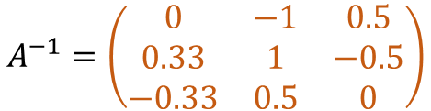


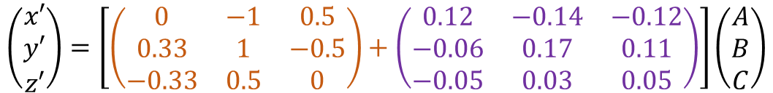
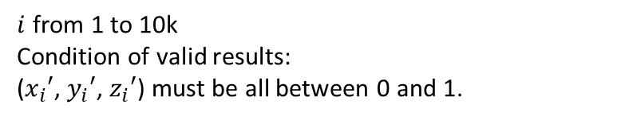







2.Calculate inverse matrix
3.Apply Gaussian random perturbation
$$\left(\begin{matrix}\begin{matrix}3 \\ 2\end{matrix} & \begin{matrix}3 \\ 2\end{matrix} & \begin{matrix}0 \\ 2\end{matrix} \\ 6 & 4 & 4 \\ \begin{matrix}6 \\ 54 \\ 9\end{matrix} & \begin{matrix}4 \\ 36 \\ 6\end{matrix} & \begin{matrix}4 \\ 36 \\ 6\end{matrix}\end{matrix}\right)\left(\begin{matrix}x \\ y \\ z\end{matrix}\right)=\left(\begin{matrix}A \\ B \\ \begin{matrix}C \\ D \\ \begin{matrix}E, F \\ G\end{matrix}\end{matrix}\end{matrix}\right)$$
$$Σ=A^{−1}\left(\begin{aligned} GRN matrix \\ shape=A^{−T} \\ mean=0 \\ std=0.1 \end{aligned}\right)$$
$$A^{−1}=\left(\begin{matrix}0 & −1 & 0.5 \\ 0.33 & 1 & −0.5 \\ −0.33 & 0.5 & 0\end{matrix}\right)$$
$$\left(\begin{matrix}x′ \\ y′ \\ z′\end{matrix}\right)=\left[\left(\begin{matrix}0 & −1 & 0.5 \\ 0.33 & 1 & −0.5 \\ −0.33 & 0.5 & 0\end{matrix}\right)+\left(\begin{matrix}0.12 & −0.14 & −0.12 \\ −0.06 & 0.17 & 0.11 \\ −0.05 & 0.03 & 0.05\end{matrix}\right)\right]\left(\begin{matrix}A \\ B \\ C\end{matrix}\right)$$
$$X=A^{−L}B$$
$$X′=(A^{−1}+Σ)B$$
If the matrix is not full rank (m != n), $A^{−1}$ -> $A^{−L}$
$$\left(\begin{matrix}\begin{matrix}3 \\ 2\end{matrix} & \begin{matrix}3 \\ 2\end{matrix} & \begin{matrix}0 \\ 2\end{matrix} \\ 6 & 4 & 4 \\ \begin{matrix}6 \\ 54 \\ 9\end{matrix} & \begin{matrix}4 \\ 36 \\ 6\end{matrix} & \begin{matrix}4 \\ 36 \\ 6\end{matrix}\end{matrix}\right)\left(\begin{matrix}x \\ y \\ z\end{matrix}\right)=\left(\begin{matrix}A \\ B \\ \begin{matrix}C \\ D \\ \begin{matrix}E, F \\ G\end{matrix}\end{matrix}\end{matrix}\right)$$
4.Repeat 10k cycles, keep valid results, work out stability
$$\left(\begin{matrix}x_{i}′ \\ y_{i}′ \\ z_{i}′\end{matrix}\right)$$
$i$ from 1 to 10k
Condition of valid results:
($x_{i}′$, $y_{i}′$, $z_{i}′$) must be all between 0 and 1.
$$X=A^{−1}B$$
1.Reduce dimension
(remove redundant rows)
$$X= \left(\begin{matrix}\overline{x}±e_{x} \\ \overline{y}±e_{y} \\ \overline{z}±e_{z}\end{matrix}\right)$$
5.Final result:

