Slide 2
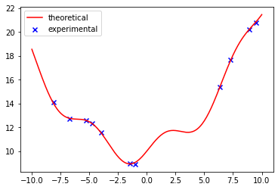
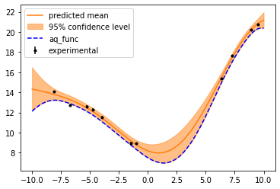
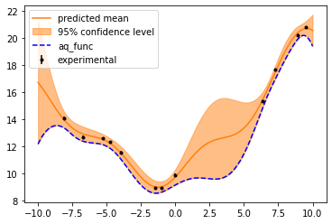
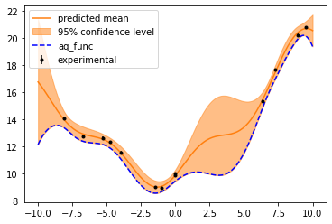
Initial experimental measurement (x):
Theoretical model (-):
Y = 0.1*X**2 + np.sin(X) + 0.2*X + 10
Initial guessed model:
GaussianProcessRegressor
(alpha=0.1, kernel=1**2 * RBF(length_scale=1) + 0**2, random_state=1)
First round refined model:
13.2**2 * RBF(length_scale=6.76) + 0.00318**2
Initial guess of x₀: 0.5 -> Recommended next x to go: [1.35567387]
Add new data point x = 0.004 to experimental set -> second round refined model:
12.2**2 * RBF(length_scale=3.67) + 0.00318**2
Initial guess of x₀: 0.5 -> Recommended next x to go: [-1.41735332]
Initial guess of x₀: -0.006 (and add results to the prior experimental set)
-> Recommended next x to go: [-1.45539305]
refined model:
12.2**2 * RBF(length_scale=3.63) + 0.00318**2

Slide 3
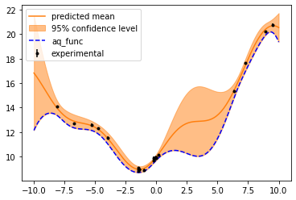
Step | Guess/test x | Refined model | Suggested next x
0 | 1.35 | 12.2**2 * RBF(length_scale=3.63) + 0.00318**2 | -1.43367269
1 | -1.43367269 | 14.8**2 * RBF(length_scale=9.55) + 0.00319**2 | 0.14327285
2 | 0.14327285 | 15.3**2 * RBF(length_scale=9.91) + 0.00319**2 | -0.0662273
3 | -0.0662273 | 15.4**2 * RBF(length_scale=10.1) + 0.00319**2 | -0.147234
4 | -0.147234 | 15.6**2 * RBF(length_scale=10.2) + 0.00319**2 | -0.20216535
5 | -0.20216535 | 15.7**2 * RBF(length_scale=10.4) + 0.00319**2 | -0.21506177
6 | -0.21506177 | 12.2**2 * RBF(length_scale=3.61) + 0.0032**2 | -1.49266673
7 | -1.49266673 | 12.2**2 * RBF(length_scale=3.62) + 0.00319**2 | -1.46983064
8 | -1.46983064 | 12.2**2 * RBF(length_scale=3.6) + 0.00319**2 | -1.46983064
Final status:

