Slide 1


Vega Map Development & GED Manager Upgrade
TD Securities · GED
Annie Zhang

Slide 2
Overview

Slide 3
Why Vega Map
Vega risk in structured notes is distributed across strikes and tenors, not a single number.
A single aggregated Vega can hide concentration risks in specific regions.
Without visualization, traders may hedge inefficiently and risk managers may miss exposures.
Vega Map makes risk transparent and actionable.

Slide 4
Build the Termsheet
Customizable parameters – e.g., underlying assets, bump size.
Real-time spot fetching for selected underlyings.
One-click Generate JSON to create standardized termsheet.
Ensures accuracy, reduces manual work, ready for pricing.

Slide 5
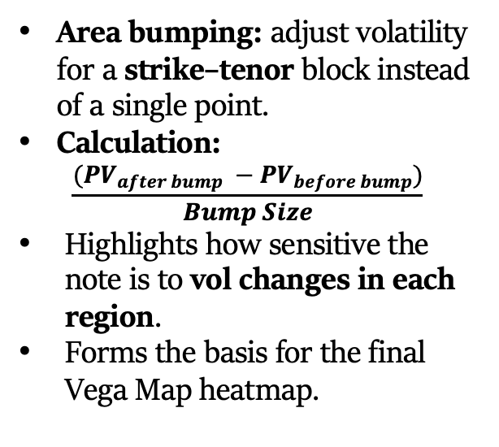
Volatility Bumps
Area bumping: adjust volatility for a strike–tenor block instead of a single point.
Calculation:
$$\frac{(PV_{after bump} −PV_{before bump})}{Bump Size}$$
Highlights how sensitive the note is to vol changes in each region.
Forms the basis for the final Vega Map heatmap.

Slide 6
Vega Map
Hypothesis 1 (Vertical): Peak Vega tenor should align closely with the Average Lifetime of the note.
Hypothesis 2 (Horizontal): Peak Vega strike should lie near the midpoint between Barrier and Initial Level.
Red dashed lines mark Average Life and Barrier for visual verification.

Slide 7
From Risk Visualization to Actionable Hedges
Locate Vega hotspots across strikes and tenors.
01
Prioritize hedging where exposure is largest.
02
Track how Vega distribution shifts with market moves.
03
Plan targeted hedges instead of broad, costly trades.
04
Support scenario analysis for new issuance or market shocks.
05

Slide 8
GED Manager Upgrade – Overview
UI Update – New layout and added dropdowns and buttons for visual clarity and user interaction
Bug Fixed & Optimization – Resolved time data and occasional unavailability during specific periods & calculation optimization
Summary Table – Added IV, DIV, and Repo benchmark comparison tables for quick and consistent performance checks

Slide 9
UI Update
Redesigned layout for better visual clarity and navigation
Added dropdown menus and buttons for more flexible filtering
Fixed issue where selected dropdown options were sometimes not visible

Slide 10
Bug Fixed & Optimization
Date Handling Correction - Clarified the distinction between trading days and calendar days
Exception Handling - Added exception handling for scenarios where no data is passed into the system
Data Refresh Reliability - Improved data refresh process to guarantee benchmarks are always calculated using the latest available data
Caching Optimization – Introduced data caching to avoid unnecessary re-runs and reduce processing time

Slide 11
Summary Table Overview
Multi-Benchmark Coverage – Includes IV, DIV, and Repo benchmarks for a complete market view
Flexible Filtering – Supports tenor, strike, and tenor range selection with multiple calculation modes (min, max, mean, median)
Deviation Ranking – Automatically calculates TD–Totem differences and sort by the largest gaps
Automated Alerts – Sends daily email ensuring timely action

Slide 12
IV Summary Table
Support tenor & strike selection
Identify nearest market neighbors
Show TD–Totem IV differences
Highlight largest gaps for quick review

Slide 13
DIV Summary Table
Support tenor range selection
Show TD–Totem dividend yield gaps
4 calculation mode (min, max, mean, median)
Highlight largest deviations

Slide 14
Repo Summary Table
Support tenor range selection
Show TD–Totem Forward Rate gaps
4 calculation mode (min, max, mean, median)
Highlight largest deviations

Slide 15
Click-to-Drilldown
Interactive tables – click any ticker to open its detailed benchmark plot.

Slide 16
Automated Email Alerts
Uses latest data from the previous trading day.
Threshold: send alert when TD–Totem difference > 5%.
Delivered daily to ensure timely awareness of deviations.

Slide 17
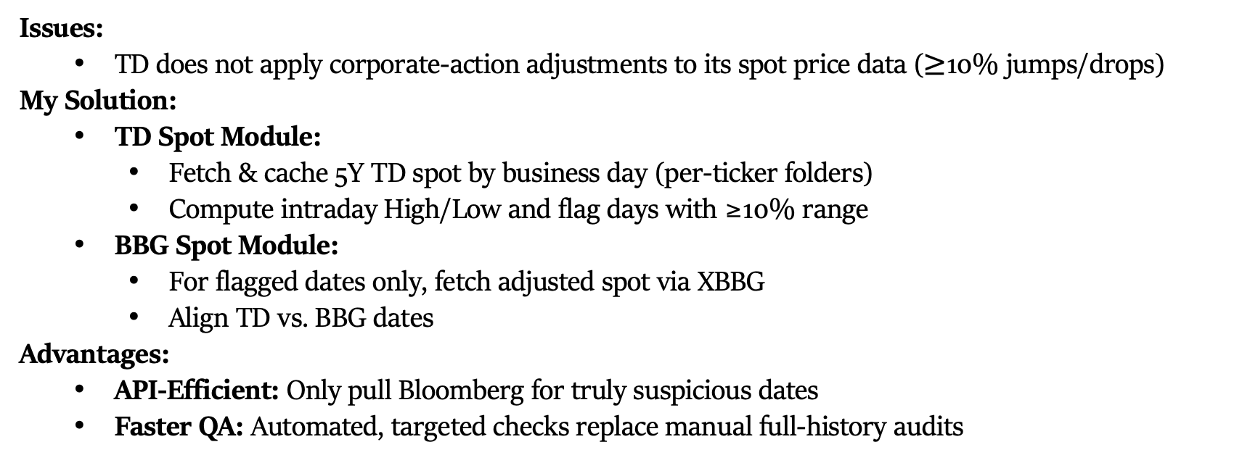
TD–BBG Spot Quality Assurance
Issues:
TD does not apply corporate-action adjustments to its spot price data ($≥$10% jumps/drops)
My Solution:
TD Spot Module:
Fetch & cache 5Y TD spot by business day (per-ticker folders)
Compute intraday High/Low and flag days with ≥10% range
BBG Spot Module:
For flagged dates only, fetch adjusted spot via XBBG
Align TD vs. BBG dates
Advantages:
API-Efficient: Only pull Bloomberg for truly suspicious dates
Faster QA: Automated, targeted checks replace manual full-history audits

Slide 18
Thank You
New GED Manager:

