Slide 1

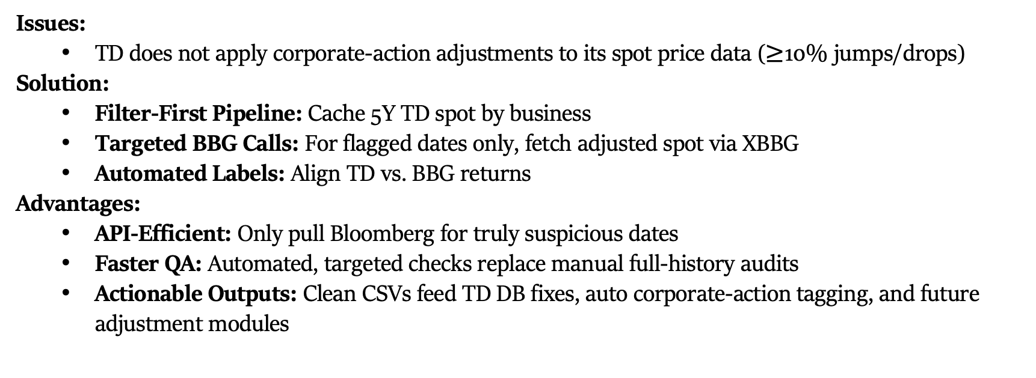
TD–BBG Spot Quality Assurance
Issues:
TD does not apply corporate-action adjustments to its spot price data ($≥$10% jumps/drops)
Solution:
Filter-First Pipeline: Cache 5Y TD spot by business
Targeted BBG Calls: For flagged dates only, fetch adjusted spot via XBBG
Automated Labels: Align TD vs. BBG returns
Advantages:
API-Efficient: Only pull Bloomberg for truly suspicious dates
Faster QA: Automated, targeted checks replace manual full-history audits
Actionable Outputs: Clean CSVs feed TD DB fixes, auto corporate-action tagging, and future adjustment modules

