Slide 1


Vega Map Development & GED Manager Upgrade
TD Securities · GED
Annie Zhang

Slide 2
Overview

Slide 3
Why Vega Map
Vega risk in structured notes is distributed across strikes and tenors, not a single number.
A single aggregated Vega can hide concentration risks in specific regions.
Without visualization, traders may hedge inefficiently and risk managers may miss exposures.
Vega Map makes risk transparent and actionable.

Slide 4
Build the Termsheet
Customizable parameters – e.g., underlying assets, bump size.
Real-time spot fetching for selected underlyings.
One-click Generate JSON to create standardized termsheet.
Ensures accuracy, reduces manual work, ready for pricing.

Slide 5
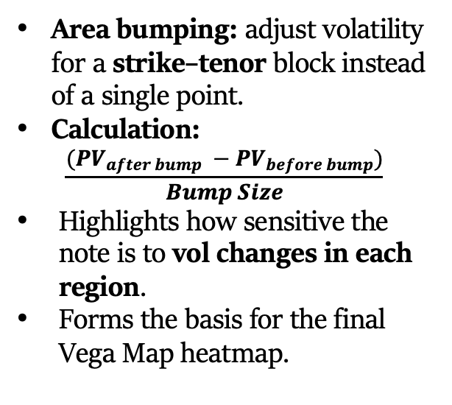
Volatility Bumps
Area bumping: adjust volatility for a strike–tenor block instead of a single point.
Calculation:
$$\frac{(PV_{after bump} −PV_{before bump})}{Bump Size}$$
Highlights how sensitive the note is to vol changes in each region.
Forms the basis for the final Vega Map heatmap.

Slide 6
Vega Map
Hypothesis 1 (Vertical): Peak Vega tenor should align closely with the Average Lifetime of the note.
Hypothesis 2 (Horizontal): Peak Vega strike should lie near the midpoint between Barrier and Initial Level.
Red dashed lines mark Average Life and Barrier for visual verification.

Slide 7
From Risk Visualization to Actionable Hedges
Locate Vega hotspots across strikes and tenors.
01
Prioritize hedging where exposure is largest.
02
Track how Vega distribution shifts with market moves.
03
Plan targeted hedges instead of broad, costly trades.
04
Support scenario analysis for new issuance or market shocks.
05

Slide 8
GED Manager Upgrade – Overview
Added summary tables for:
IV (Implied Volatility)
DIV (Dividend)
Repo
Instant overview of TD vs Totem benchmark differences.
Flexible filters: tenor, strike, tenor range, calculation mode.
Results sorted by absolute difference to highlight largest deviations.
Click-to-drilldown for detailed benchmark plots.
Automated daily email alerts for deviations above set thresholds.

Slide 9
IV Summary Table
Select tenor & strike to target a specific market point.
System finds N closest neighbors in tenor space.
Calculate TD–Totem IV difference for each neighbor.
Sort results by absolute difference to highlight largest gaps.

Slide 10
DIV Summary Table
Select tenor range to focus on specific maturities.
Calculate TD–Totem dividend yield difference for each tenor in the range.
Apply selected calculation mode (e.g., median, mean) to aggregate results.
Sort by absolute difference to highlight largest deviations.

Slide 11
Repo Summary Table
Select tenor range to focus on specific maturities.
Calculate TD–Totem repo rate difference for each tenor in the range.
Apply selected calculation mode (e.g., median, mean) to aggregate results.
Sort by absolute difference to highlight largest deviations.

Slide 12
Click-to-Drilldown
Interactive tables – click any ticker to open its detailed benchmark plot.
Works for IV, DIV, and Repo summary tables.
Instantly switch from overview to in-depth analysis.
Saves time compared to manually searching for tickers.

Slide 13
Automated Email Alerts
Uses latest data from the previous trading day.
Threshold: send alert when TD–Totem difference > 5%.
Covers all three benchmarks: IV, DIV, Repo.
Delivered daily to ensure timely awareness of deviations.

Slide 14
TD–BBG Spot Quality Assurance
Cache 5Y TD spot by business day (per-ticker folders).
Detect ≥10% intraday range days.
For flagged dates only, pull BBG adjusted PX_LAST via XBBG.
Align dates; compare TD vs BBG close-to-close returns.
Label results: True Move / Missing Adjustment / Data Gap; save to CSVs.
Save API via filter-first + caching; batch with retries under limits.
Outcome: faster Quality Assurance; inputs for TD DB fixes & corporate-action tagging.

Slide 15
Thank You
New GED Manager:

