Slide 1
Sentiment and Opinion
Members
Keli Dara-Ahato | Merve Güzeldal
Pascal Breuer | Patrick Neumann
Xuefeng Song | Marleen Matjeka

Slide 2
What we did
Created Pattern3 Baseline Classifier
Big table with all computed values (accuracy, f-score, precision, recall)
Balanced the dataset
Identify error in bert code and eventually fix it

Slide 3
What we did – Table with all computed values
 | Classifier | Accuracy | Precision | Recall | f-Score
Sentiment | Textblob and Pattern3 | 0.57 | 0.53 | 0.57 | 0.54
Opinion | Textblob and Pattern3 | 0.57 | 0.57 | 0.57 | 0.57
Sentiment | Vader | 0.62 | 0.61 | 0.62 | 0.61
Sentiment | Logistic Regression | 0.65 | 0.64 | 0.65 | 0.63
Opinion | Logistic Regression | 0.68 | 0.65 | 0.68 | 0.63

Slide 4
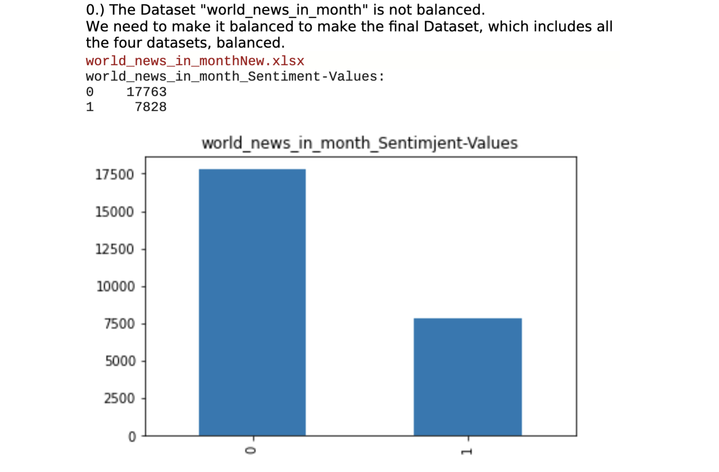
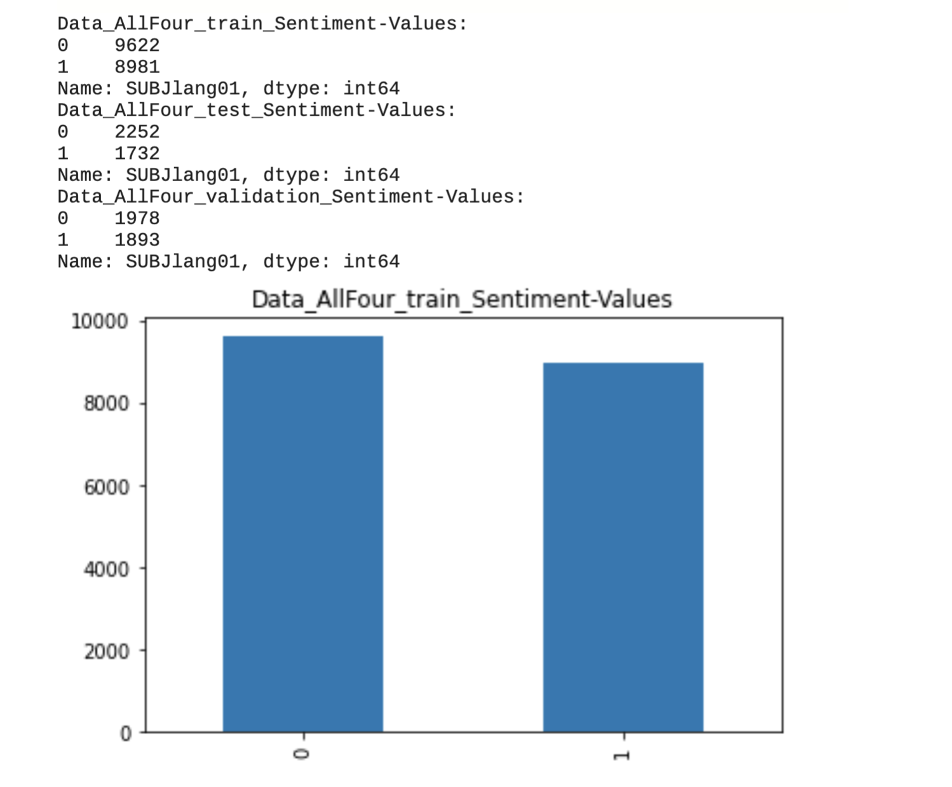
What we did – Balanced the dataset
We have 4 datasets and united it to one big dataset
First, it was not balanced, because we had too many zeros and too few 1
Then, to keep it balanced we deleted many zeros
Now, it is balanced

Slide 5
What we did – identify error in bert code
Bert has problems (Because of an enumaration without punctuation marks that is counted as a sentence and it exceeds the token capacity)
The enumaration were read as a single large sentence and exceeded our set maximum sequence length
The Quick fix would be to increase the sequence length but later, it wouldn‘t work when we take unchecked data from the network
Because we don‘t know what text they would produce
Saved the pipeline and tried to let run in the GPU -> It didn‘t work

Slide 6
Next week
Find new opinion datasets
Finish the baseline
Word embedding
Dictionary
New Manager:
Xuefeng Song

