Slide 1
Sentiment and Opinion
Members
Keli Dara-Ahato | Merve Güzeldal
Pascal Breuer | Patrick Neumann
Xuefeng Song | Marleen Matjeka

Slide 2
Task week 3
Implement further variants to get a better accuracy:
Word embeddings
Feature selection: chi-square test
Feature selection: random forest
Filter named entities
Lemmatisation instead of stemming
Sentiment/opinion dictionary
Find classifier as baseline
Find more trainingdata
Analyse balancing of dataset
…

Slide 3
What we did
Filter Named Entities
Word Embeddings
Sentiment/opinion dictionary
Test different Naive Bayes Classifier
Analyse trainingdata
New Trainingdata
Chi-Square Test
In progress

Slide 4
What we did – Named entities
spaCy
Opinion | Last week | Named Entities
Logistic Regression | 0.65 | 0.65
Naive Bayes | 0.59 | 0.58
Sentiment | Last week | Named Entities
Logistic Regression | 0.53 | 0.53
Naive Bayes | 0.50 | 0.45

Slide 5
What we did – Word embeddings
Bert
Opinion | Last week | Word Embeddings
Logistic Regression | 0.65 | 0.73
Naive Bayes | 0.59 | 0.57
Sentiment | Last week | Word Embeddings
Logistic Regression | 0.53 | 0.59
Naive Bayes | 0.50 | 0.47

Slide 6
What we did – Dictionaries
Opinion | Last week | Count value |  | Average value
 |  | Short Dictionary | Combined Dictionary | Short Dictionary | Combined Dictionary
Logistic Regression
Gaussian Naive Bayes
Complement Naive Bayes
Multinomial Naive Bayes
Bernoulie Naive Bayes

Slide 7
What we did – Dictionaries
Opinion | Last week | Count value |  | Average value
 |  | Short Dictionary | Combined Dictionary | Short Dictionary | Combined Dictionary
Logistic Regression | 0.65
Gaussian Naive Bayes | 0.59
Complement Naive Bayes
Multinomial Naive Bayes
Bernoulie Naive Bayes

Slide 8
What we did – Dictionaries
Opinion | Last week | Count value |  | Average value
 |  | Short Dictionary | Combined Dictionary | Short Dictionary | Combined Dictionary
Logistic Regression | 0.65 | 0.67 | 0.67 | 0.67 | 0.67
Gaussian Naive Bayes | 0.59 | 0.67 | 0.67 | 0.67 | 0.67
Complement Naive Bayes |  | 0.0 | 0.0 | 0.0 | 0.0
Multinomial Naive Bayes |  | 0.67 | 0.67 | 0.67 | 0.67
Bernoulie Naive Bayes |  | 0.67 | 0.67 | 0.67 | 0.67

Slide 9
What we did – Dictionaries
Sentiment | Last week | Count value |  | Average value
 |  | Short Dictionary | Combined Dictionary | Short Dictionary | Combined Dictionary
Logistic Regression | 0.53
Gaussian Naive Bayes | 0.50
Complement Naive Bayes
Multinomial Naive Bayes
Bernoulie Naive Bayes

Slide 10
What we did – Dictionaries
Sentiment | Last week | Count value |  | Average value
 |  | Short Dictionary | Combined Dictionary | Short Dictionary | Combined Dictionary
Logistic Regression | 0.53 | 0.61 | 0.61 | 0.62 | 0.61
Gaussian Naive Bayes | 0.50 | 0.58 | 0.61 | 0.63 | 0.62
Complement Naive Bayes |  | 0.27 | 0.27 | 0.27 | 0.27
Multinomial Naive Bayes |  | 0.61 | 0.61 | 0.61 | 0.61
Bernoulie Naive Bayes |  | 0.61 | 0.61 | 0.61 | 0.61

Slide 11
What we did – Dictionaries
Sentiment | Last week | Count value |  | Average value
 |  | Short Dictionary | Combined Dictionary | Short Dictionary | Combined Dictionary
Logistic Regression | 0.53 | 0.61 | 0.61 | 0.62 | 0.61
Gaussian Naive Bayes | 0.50 | 0.58 | 0.61 | 0.63 | 0.62
Complement Naive Bayes |  | 0.27 | 0.27 | 0.27 | 0.27
Multinomial Naive Bayes |  | 0.61 | 0.61 | 0.61 | 0.61
Bernoulie Naive Bayes |  | 0.61 | 0.61 | 0.61 | 0.61

Slide 12
What we did – Accuracy Results
 | Last week (Bag of Words) | Named Entities | Word Embeddings | Dictionary
Opinion
Sentiment

Slide 13
What we did – Accuracy Results
 | Last week (Bag of Words) | Named Entities | Word Embeddings | Dictionary
Opinion | 0.65 Logistic Regression
Sentiment | 0.53 Logistic Regression

Slide 14
What we did – Accuracy Results
 | Last week (Bag of Words) | Named Entities | Word Embeddings | Dictionary
Opinion | 0.65 Logistic Regression | 0.65 Logistic Regression | 0.73 Logistic Regression | 0.67 Logistic Regression / Naive Bayes
Sentiment | 0.53 Logistic Regression | 0.53 Logistic Regression | 0.59 Logistic Regression | 0.63 Naive Bayes

Slide 15
What we did – Accuracy Results
 | Last week (Bag of Words) | Named Entities | Word Embeddings | Dictionary
Opinion | 0.65 Logistic Regression | 0.65 Logistic Regression | 0.73 Logistic Regression | 0.67 Logistic Regression / Naive Bayes
Sentiment | 0.53 Logistic Regression | 0.53 Logistic Regression | 0.59 Logistic Regression | 0.63 Naive Bayes

Slide 16
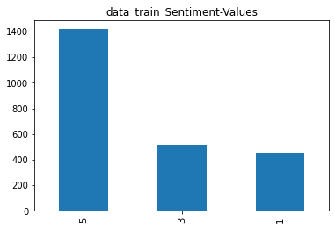
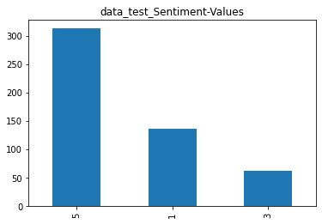
What we did – trainingdata

Slide 17
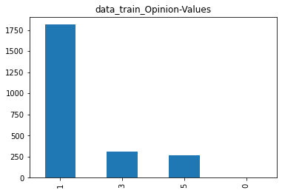
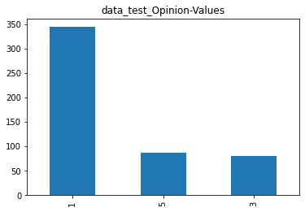
What we did – trainingdata

Slide 18
What we did – trainingdata
14.848 Tweets about US Airlines
Sentiment labels: neutral, positive, negative
21% neutral, 79% positive/negative

Slide 19
Next week
Prepare the new trainingdata
Finish chi-square test
Find baseline
Lemmatisation
New Manager:
Keli Dara-Ahato

