Slide 1
Section Header Here
/01
Supporting text here.
When you copy & paste, choose "keep text only" option.

Slide 2
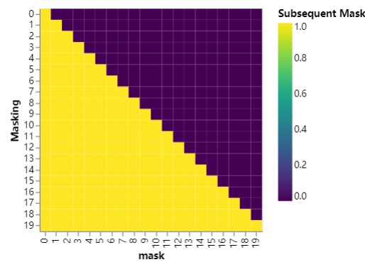
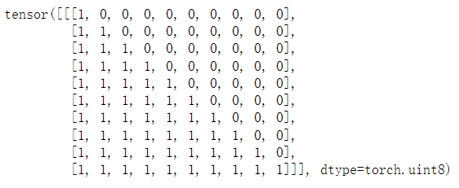

Slide 3
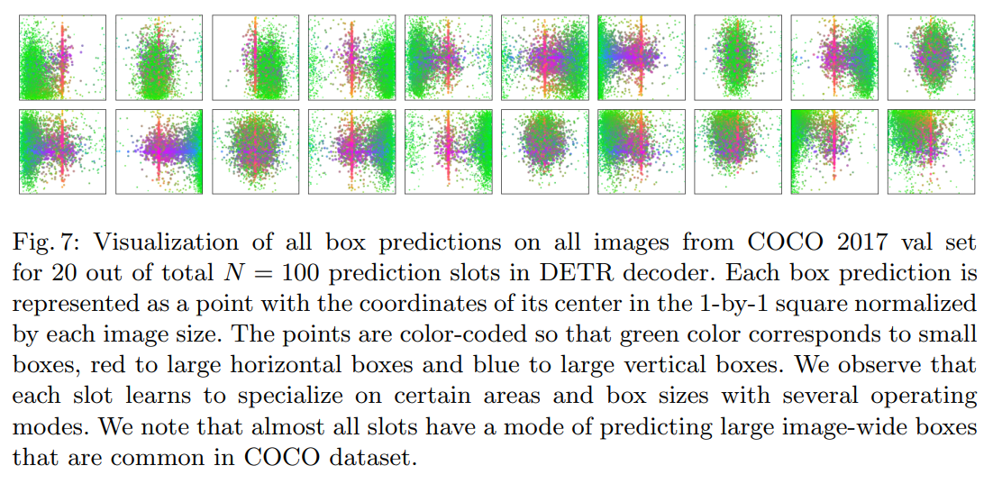

Slide 4
带有先验知识的MASK

Slide 5
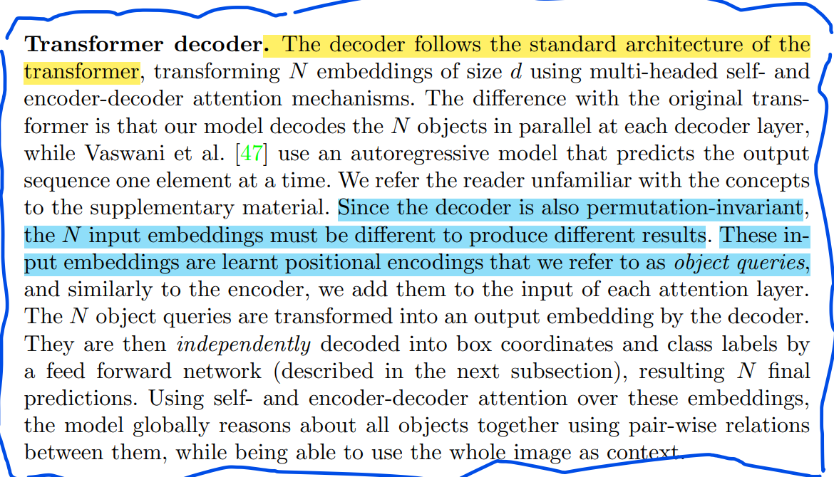
Object queries 初始化

Slide 8
/02

