Slide 1
MapReduce & Spark project Presentation
----By Haowen Xue

Slide 2
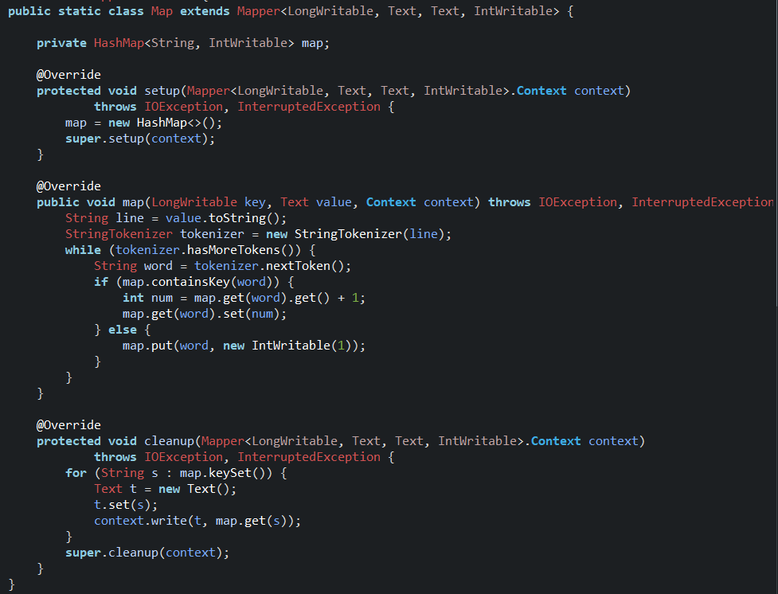
Java code for InMapperWordCount
Mapper part

Slide 3
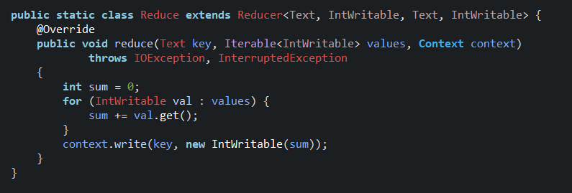
Java code for InMapperWordCount
Reducer part

Slide 4
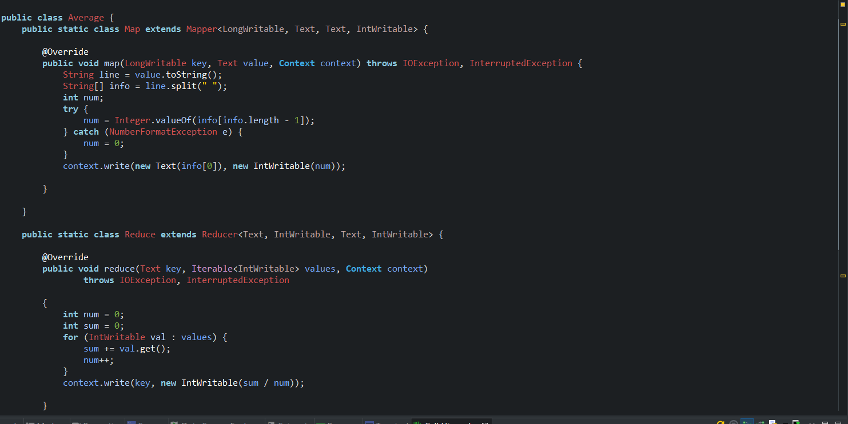
Java code for Average

Slide 5
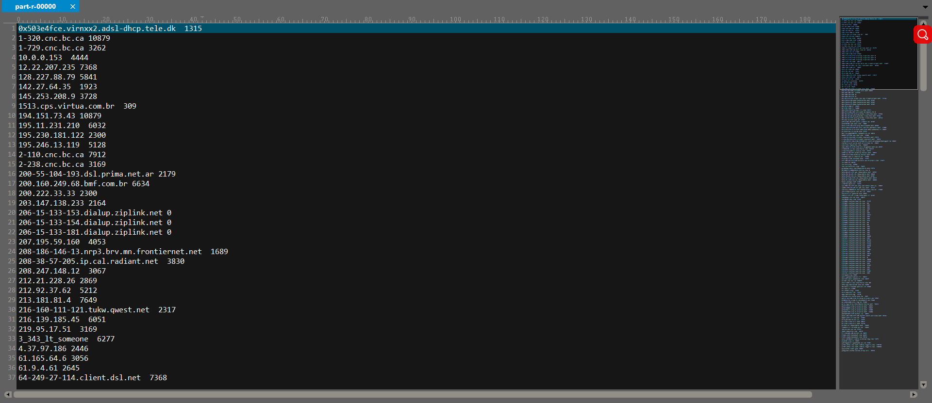
Output of Average

Slide 6
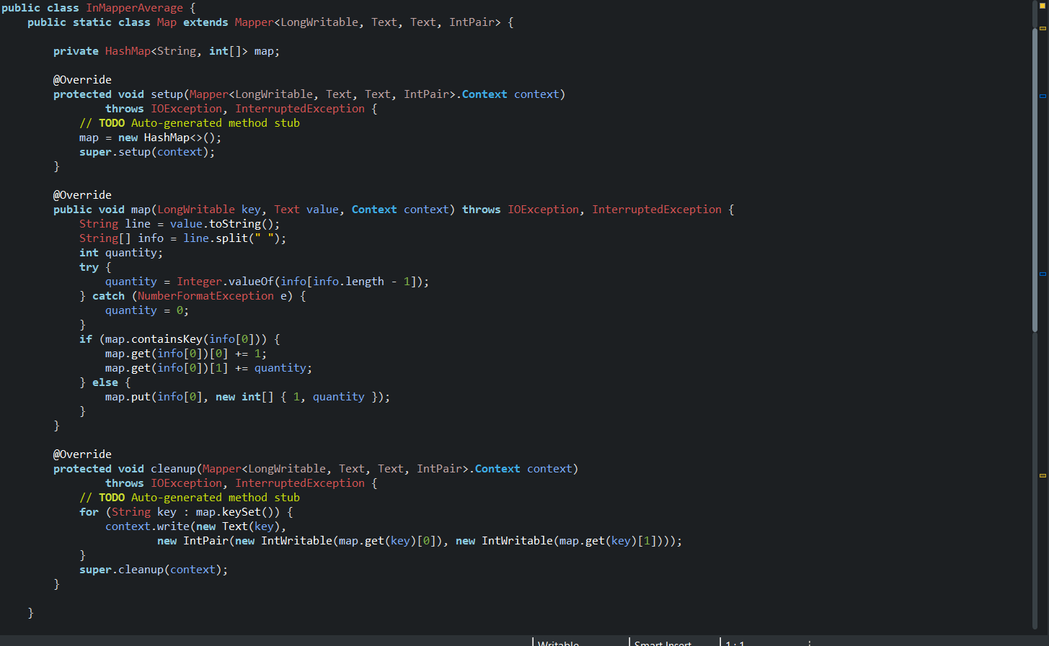
Java code for InMapperAverage
Mapper part

Slide 7
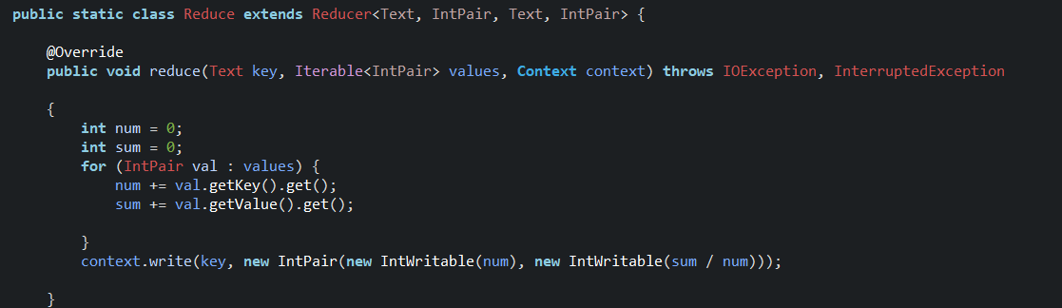
Java code for InMapperAverage
Reducer part

Slide 8
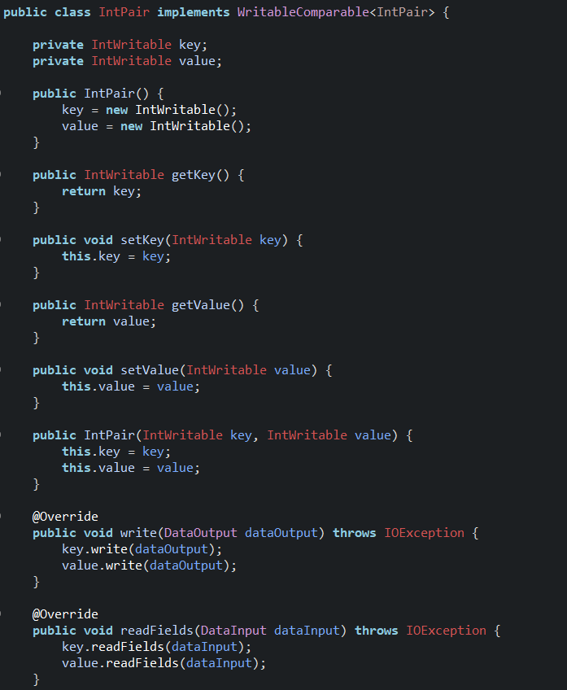
Pair class for InMapperAverage

Slide 9
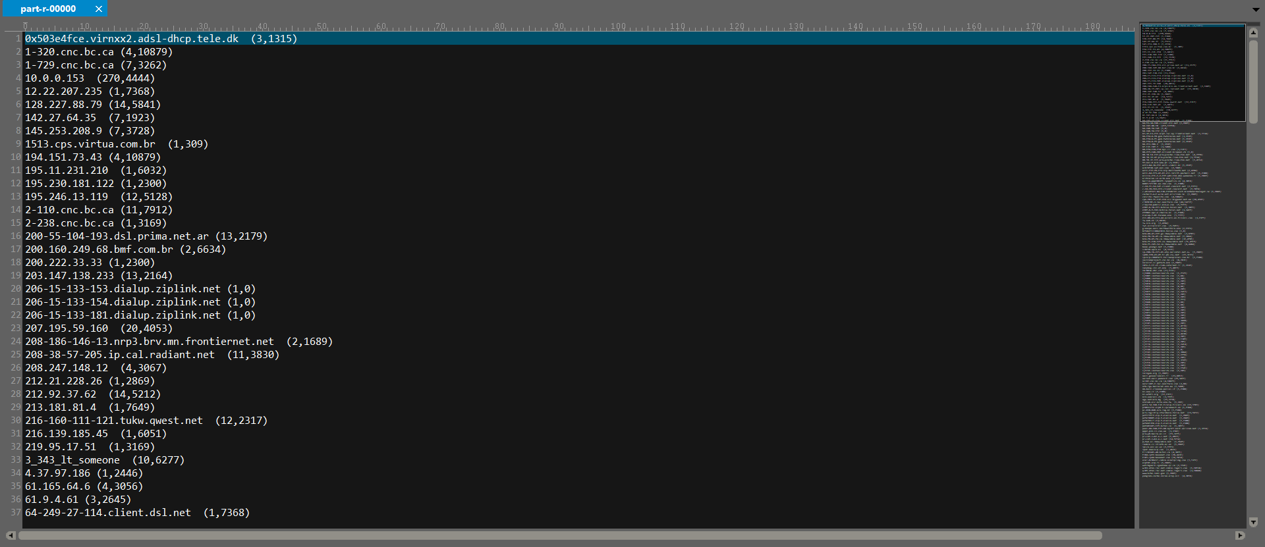
Output of InMapperAverage

Slide 10
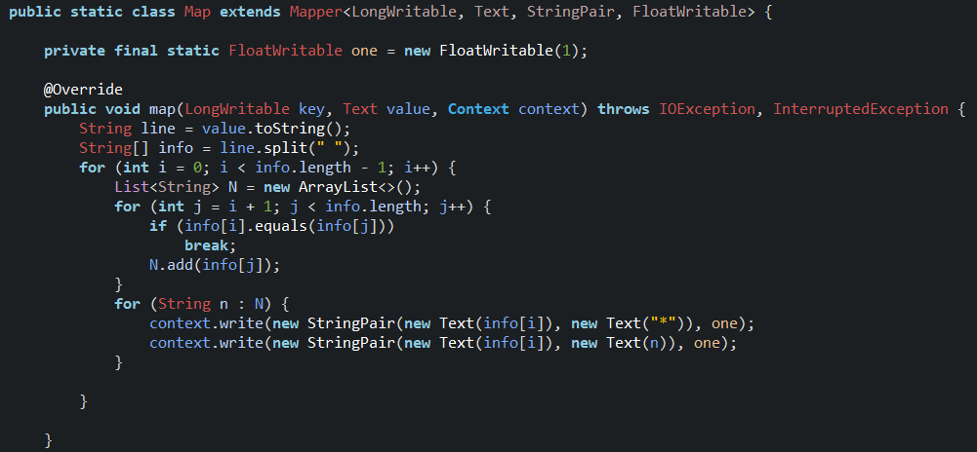
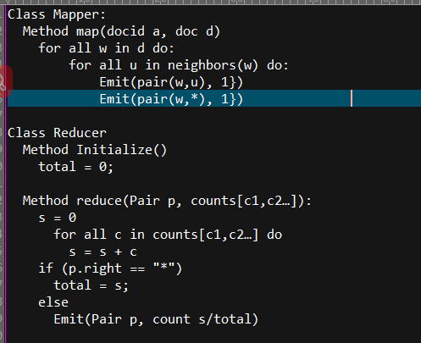
Pair approach
Pseudo code
Mapper part

Slide 11
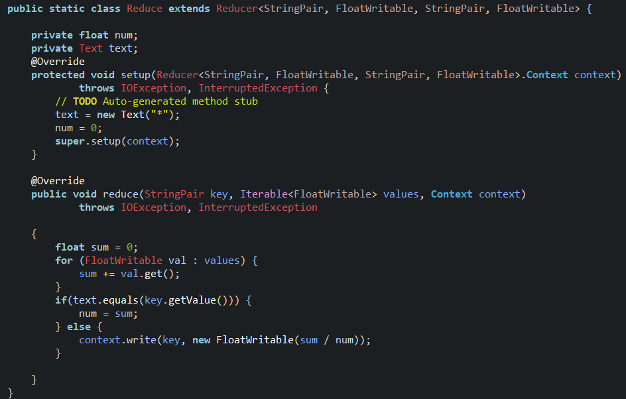
Reducer part

Slide 12
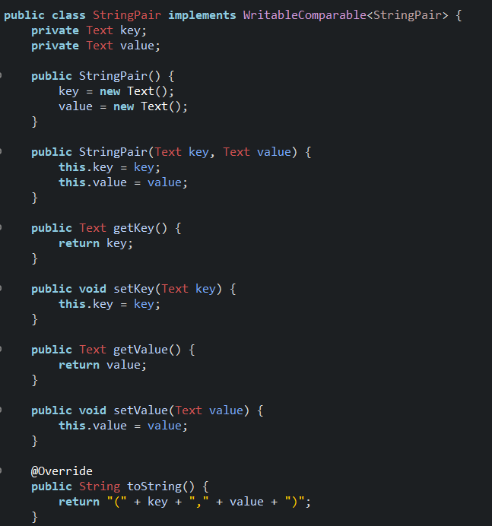
Pair class for Pair approach

Slide 13
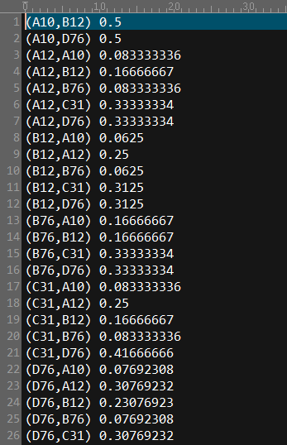
Output of Pair approach

Slide 14
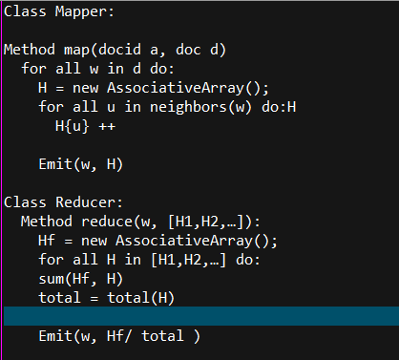
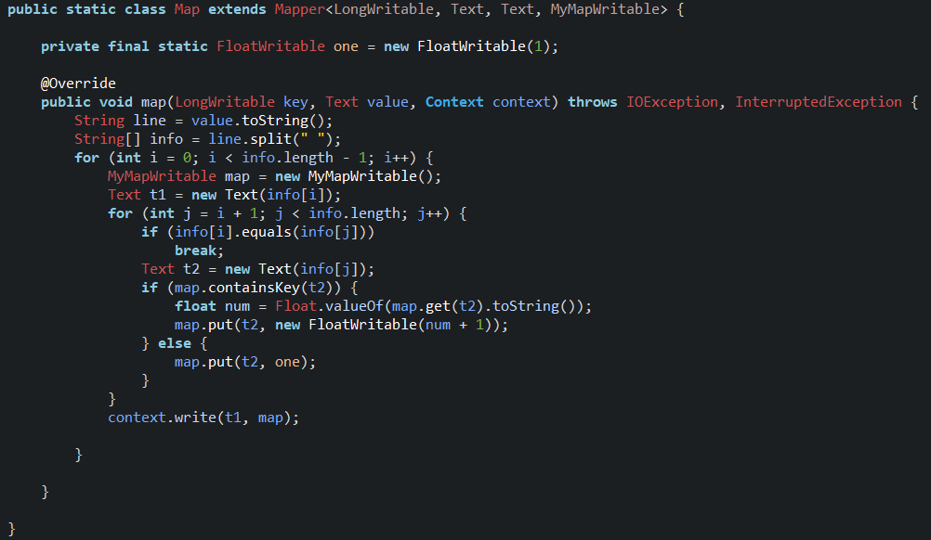
Stripe approach
Pseudo code
Mapper part

Slide 15
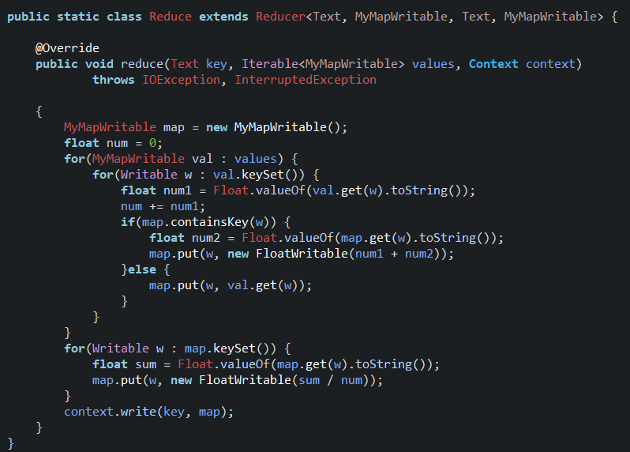
Reducer part

Slide 16
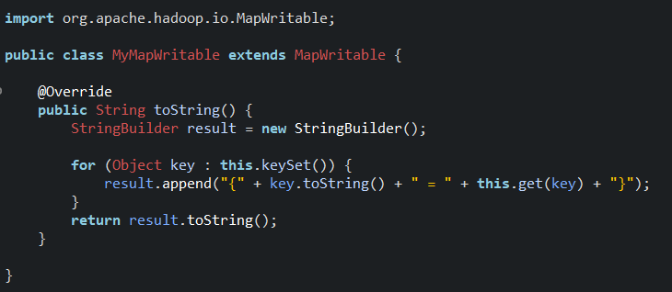
Map class for Stripe approach

Slide 17
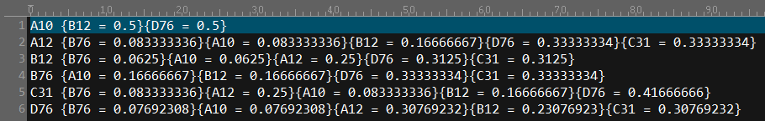
Output of Stripe approach

Slide 18
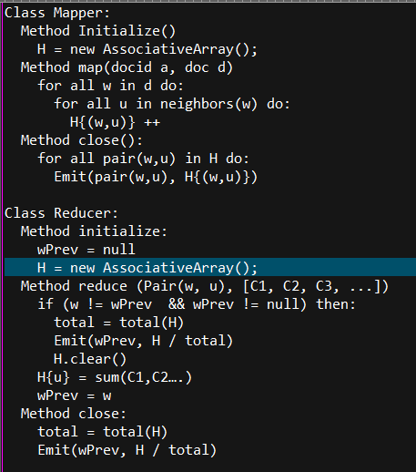
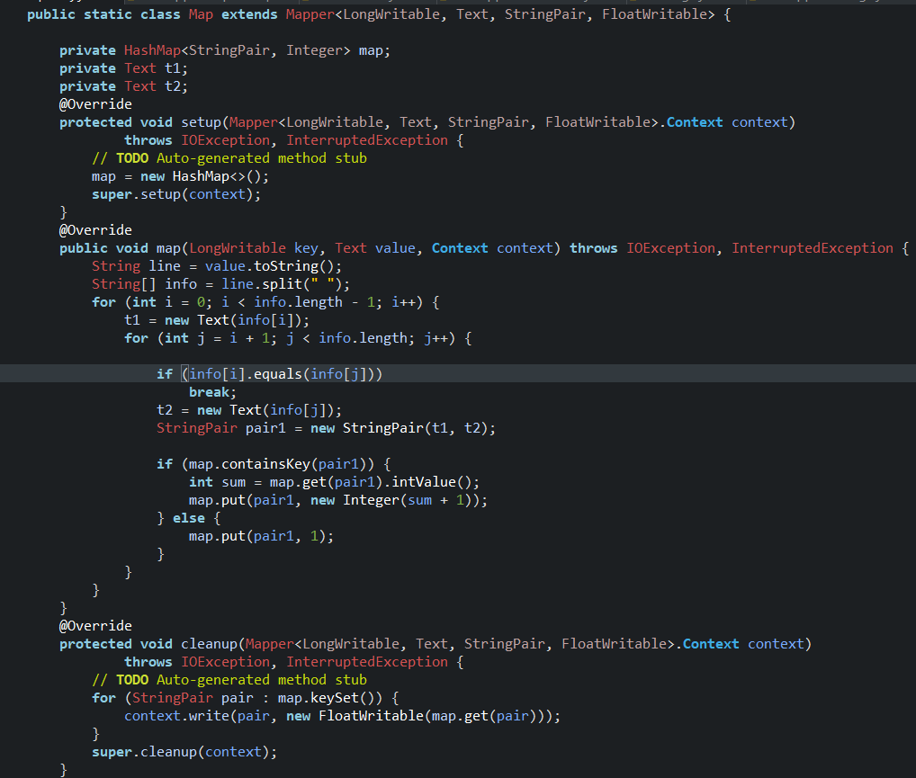
Hybrid approach
Pseudo code
Mapper part

Slide 19
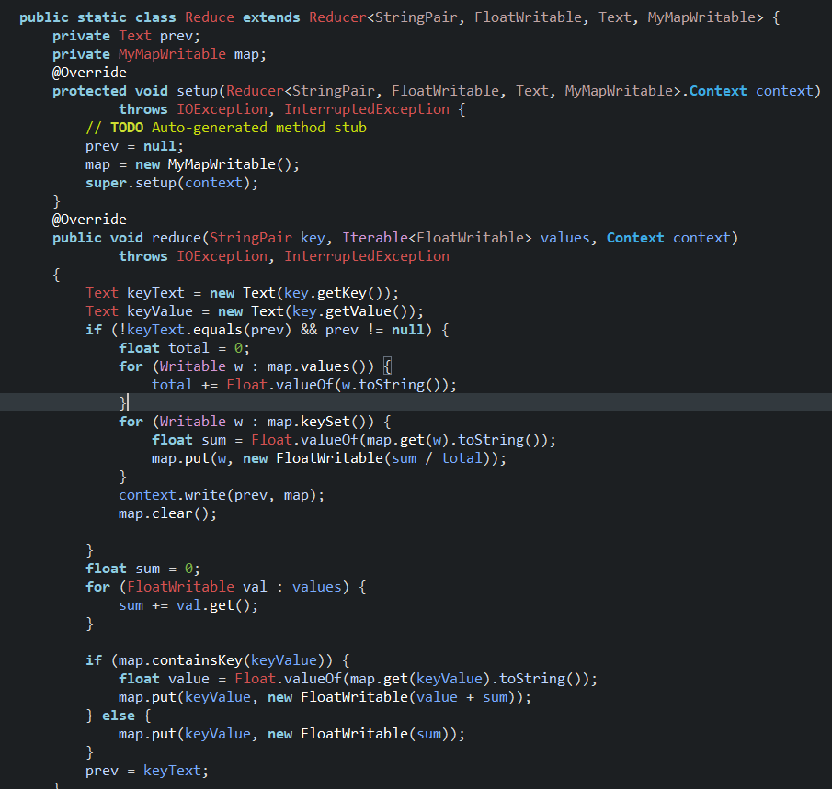
Reducer part

Slide 20
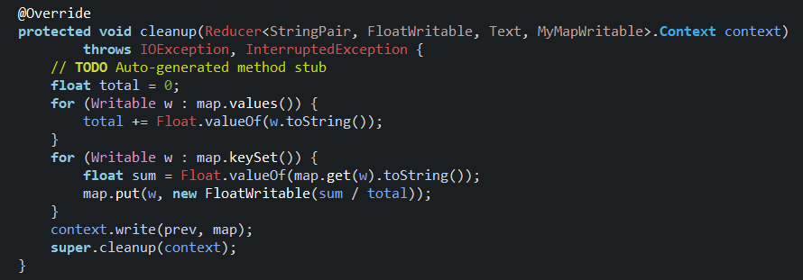
Reducer part
Cont.

Slide 21
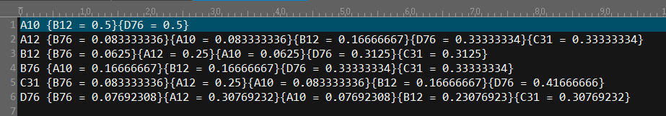
Output of Hybrid approach

Slide 22
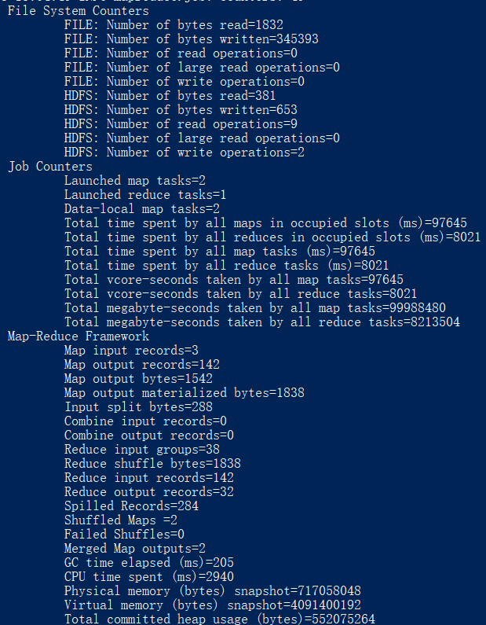
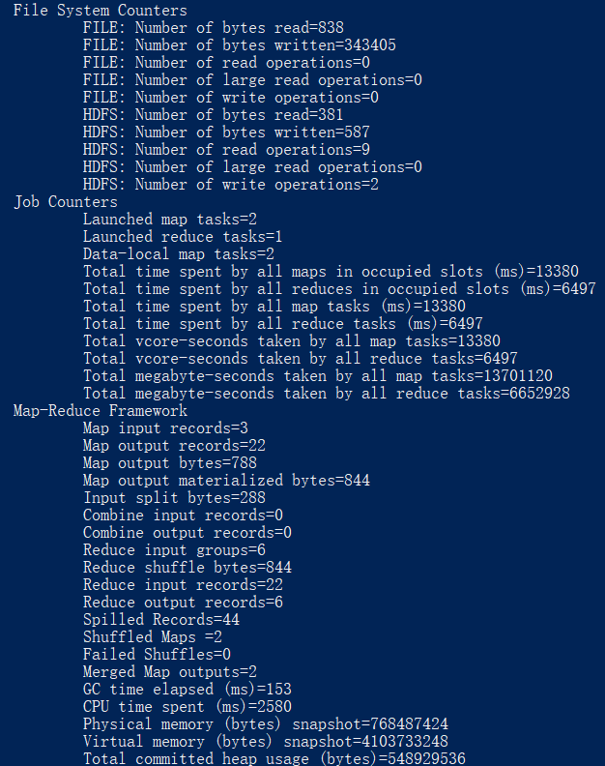
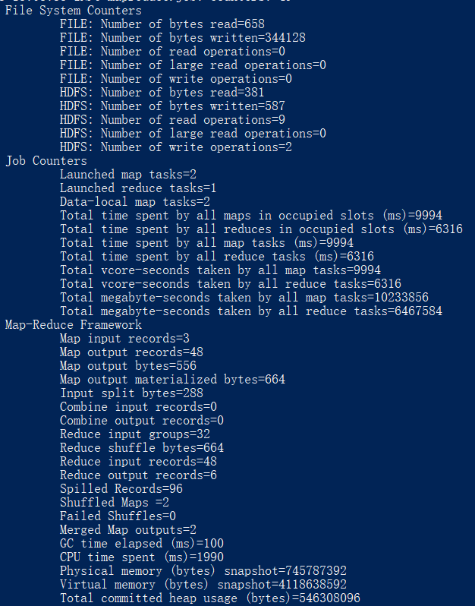
Time and resource comparison
Pair
Stripe
Hybrid

Slide 23
Map output records Map output bytes
Pair: 142 1542
Stripe: 22 788
Hybrid: 48 556
Reduce output records CPU time spent (ms)
Pair: 32 2940
Stripe: 6 2580
Hybrid: 6 1990

Slide 24
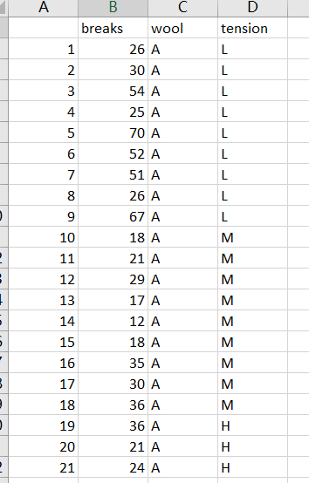
The Number of Breaks in Yarn during Weaving
Find out the relationship between tension and possibility of failure in Yarn during weaving
https://vincentarelbundock.github.io/Rdatasets/csv/datasets/warpbreaks.csv
Categorical variable: breaks
Numeric variable: tension

Slide 25
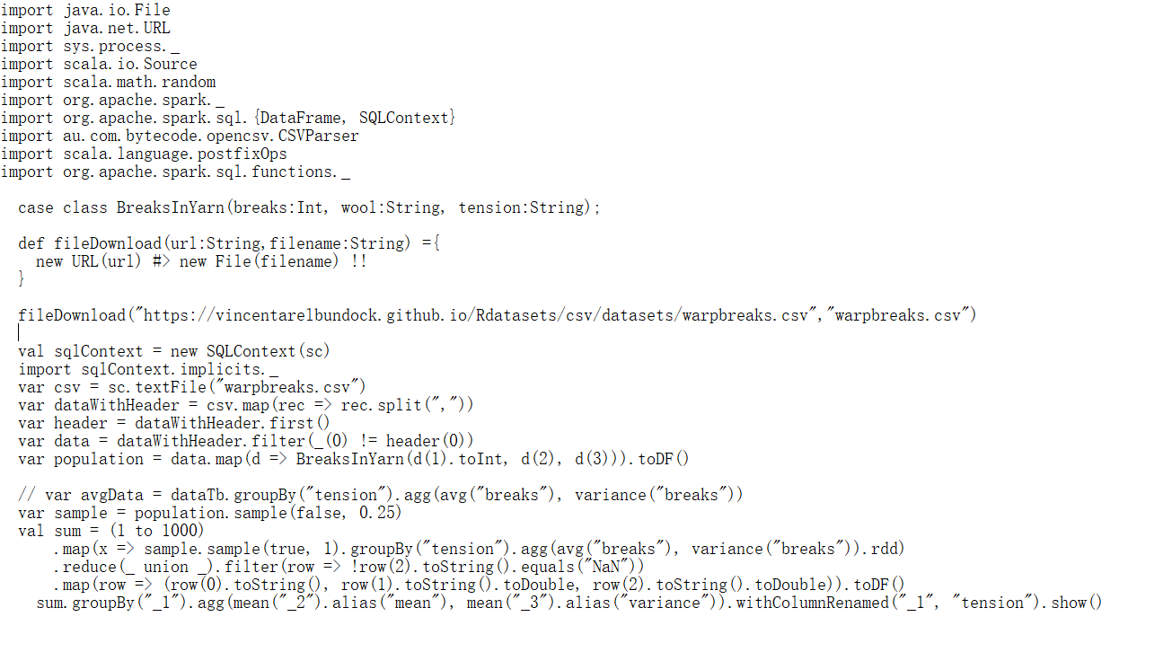
Scala code

Slide 26
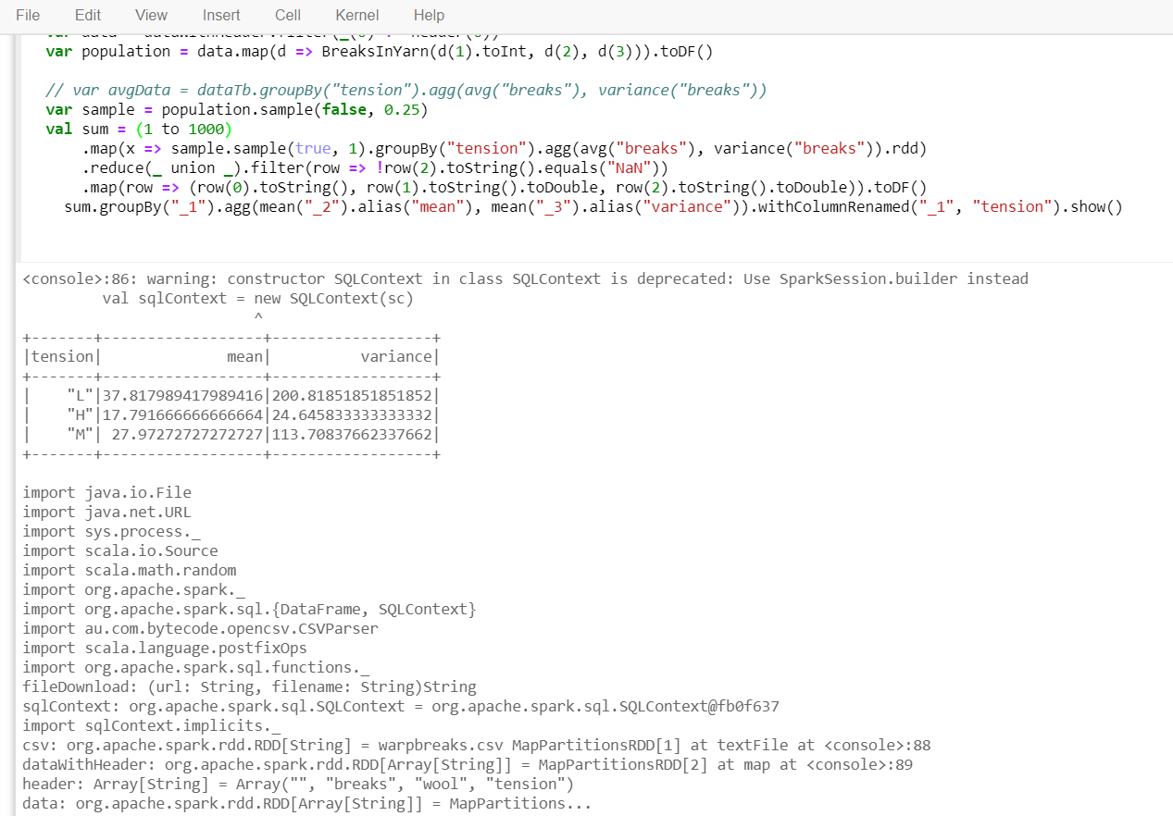
Output

