Slide 1
Protein Spectrum Quality Prediction
DS 5500 Project 1
Liang Xue, Xubo Tang
05/26/2020

Slide 2
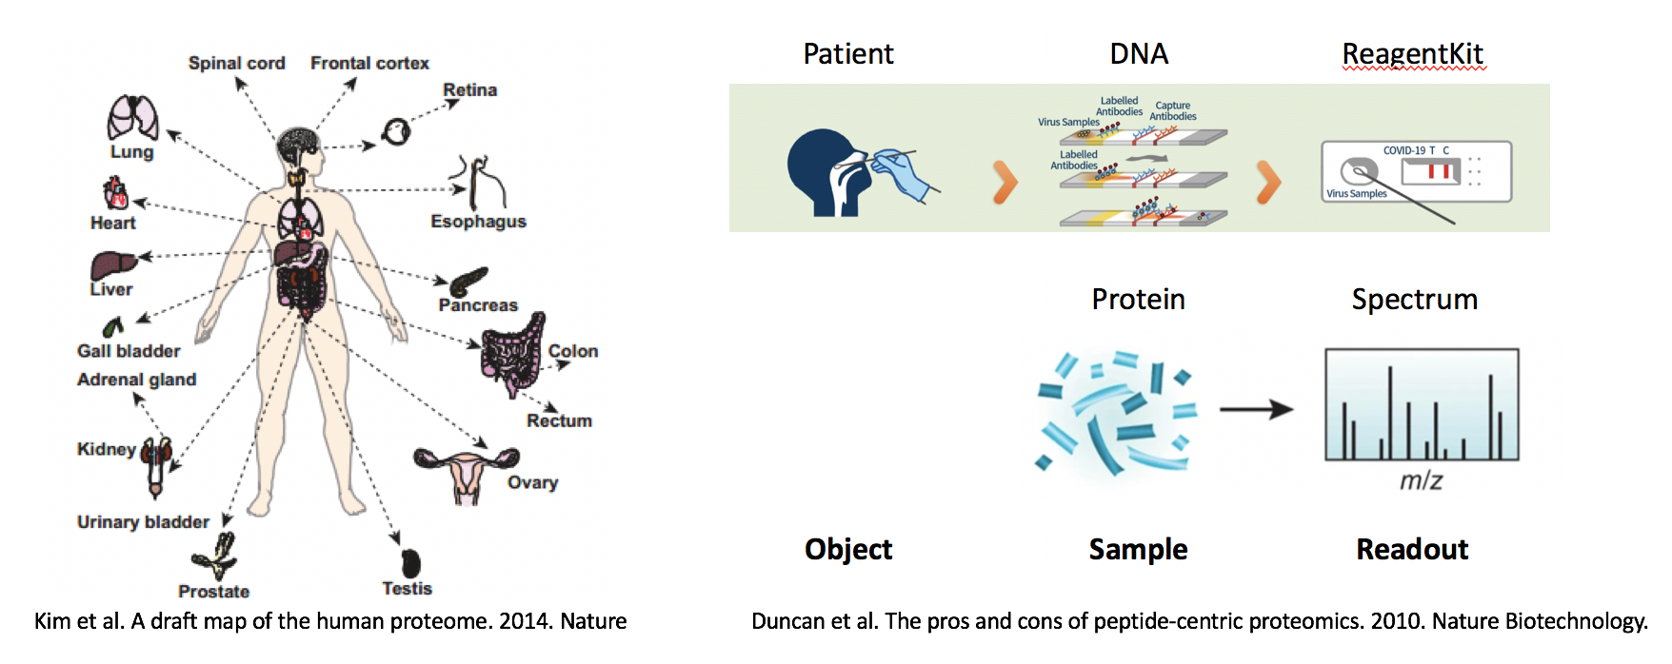
Project Overview
Context: protein identification by spectrometry based spectrum
Dataset: spectrum readouts
Goal: decide the quality of spectrum readouts
Methodology: solve classification task by supervised machine learning

Slide 3
Workflow
hyper-parameter tuning
model evaluation
ETL
result interpretation
model fitting
spectrum readout dataframe
Encapsulation
optimal model
.exe file with GUI

Slide 4
Dataset
readouts of all m/z scope of a spectrum as predictors
Usability of a spectrum as response is labeled by 3rd party software
spectrum readout data frame
observation ID
m/z scope: predictors
spectrum_ID | 0-10 | 10-20 | 20-30 | ... | 1990-2000 | usable
1 | 0 | 248 | 1128 | ... | 0 | True
2 | 0 | 0 | 0 | ... | 0 | False
... | ... | ... | ... | ... | ... | ...
response

Slide 5
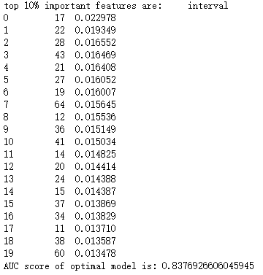
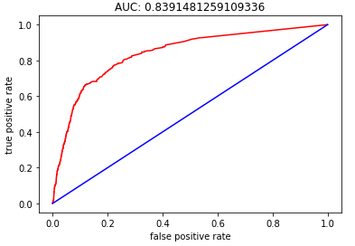
Result
Random forest classifier fitted on quantitative features
Hyper-parameter tuned by grid search
Model evaluated by AUC score and ROC curve
m/z scope: 170-180
importance score measured by impurity reduction
m/z scope: 270-280
m/z scope: 410-420
…...
spectrum features (predictors)

Slide 6
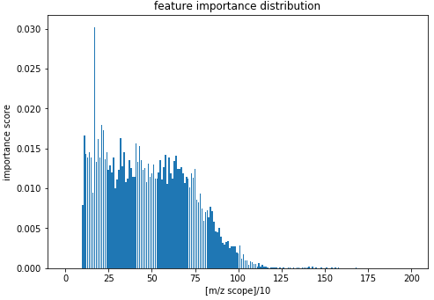
Interpretation
Feature importance distribution: importance barplot across m/z scope
Interpretation: most detected proteins fall under m/z threshold of 1250
m/z scope:0-1250

Slide 7
Next Step
Encapsulate the scripts with GUI fulfilling entire workflow
Model comparison and selection across multiple supervised machine learning algorithms

