Slide 1

Wine Retailer Case
February 17, 2020
Team 4: Yueqing(Amiee) Yang, Sanket Gomase, Xueqing Hou, Ziting Liao, Meng Guo

Slide 2
Executive Summary
Key Insights:
From average causal effect:
Consumers who received emails made more purchase than the ones who did not receive.
Sending emails to consumers leads to an $1.35 increase on purchase values.
From slicing and dicing:
Recent purchase, past purchase, and visit times are the three significant variables bring effects to consumers’ purchase values, and consumers can be segmented into 8 groups based on those variables.
Email can stimulate consumers’ purchase behavior, and it increases the total profits of 7 groups.
Targeting recommendation:
According to the results of causal forest model, 55.67% consumers, which are 43,596 consumers in total, are the targeted consumers.
Those consumers are the ones have a score greater than 0, which means they can contribute profits.
Consumers within the target group tend to spend less money on Syrah wine and more on the other three types than consumers who are not targeted. Targeted consumers purchase wine on the website more recently and purchase more in the mass. There is no significant difference of the visit time between consumers in two groups.

Slide 3
Methodology
Average causal effect
Calculate mean and standard error values for email group and control group to get the first glance of the average causal effect of sending email on the purchase value.
Put purchase value as Y variable and group classification as X variable in the regression to check if the causal effect of sending emails is statistically significant.
Using interaction variables to test whether the email will increase the profit significantly in different customer groups
Put various covariates as X variables in the regressions to find variables that can significantly affect purchase values. After trying various covariates, recent purchase, past purchase, and visit time are the significant variables need to be considered.
Recent purchase is that days since last purchase is less than 60, because the median value of that variable is 63; Values of past purchase greater than 0 are regarded as having past purchase; Visit times more than 5 are considered as frequent visitor.
Check p-values of regressions to evaluate whether the email have significant causal effect.
Using the different status of parameters to segment customers and then calculate the profits.
Causal Forest: Prediction for email campaign target group and non-target group
Advantages for using Causal Forest:
Work well for a large number of baseline variables.
Fit appropriately for non-linear relationships between baseline variables and uplift.
Does not require to define cut-offs for continuous baseline variables.
Causal Forest in practice:
Use entire data set as the training set, email as treatment, purchase as response.
Choose "last_purch", "past_purch","visits", "chard", "sav_blanc", "syrah", "cab" as baseline variables.
Apply causal forest to predict lift ti
If score : ti*margin-cost>0 (ti*0.3-0.1>0), we should send email.

Slide 4
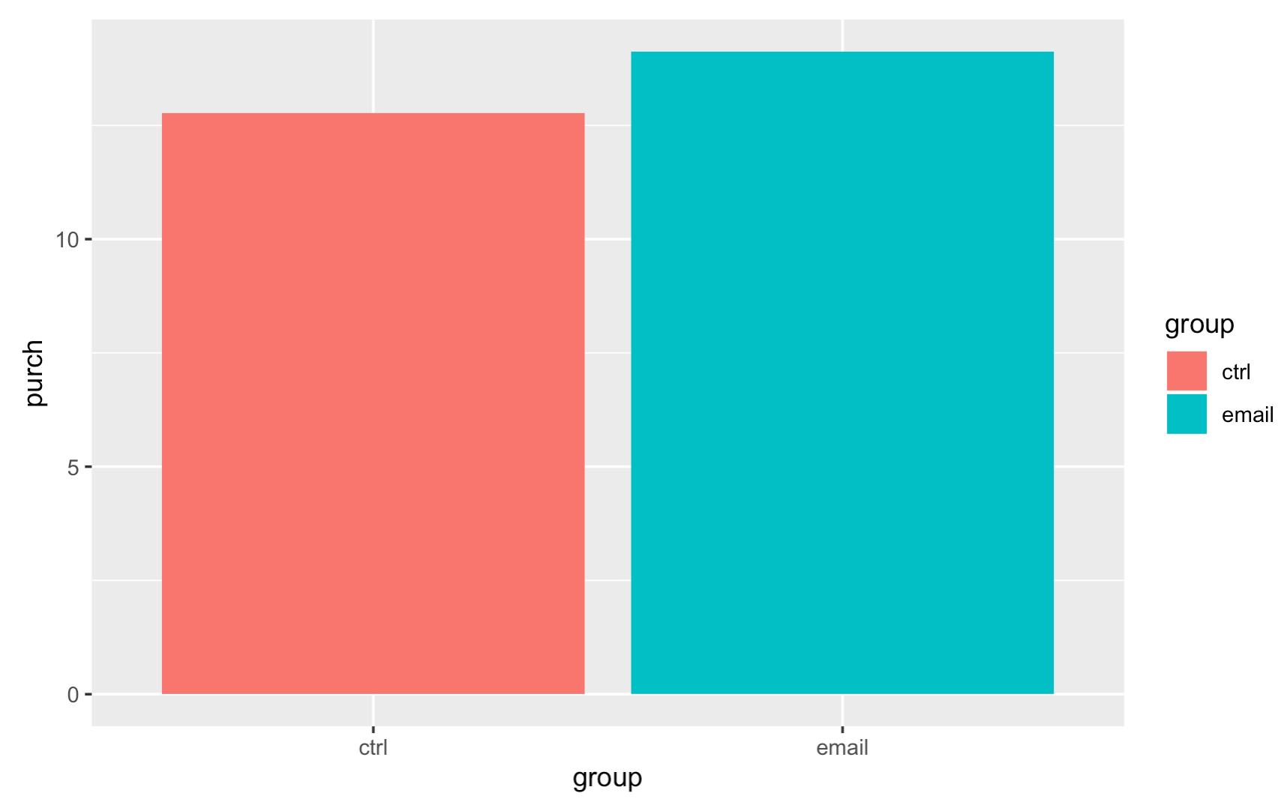
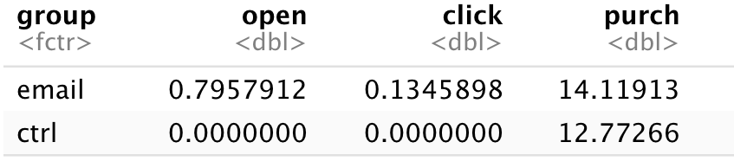
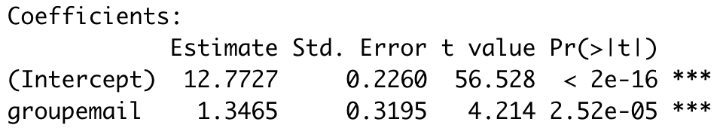
Average causal effect of sending emails to consumers is $1.35 increase on consumer purchase value
Firstly, we want to discover if consumers’ purchase value will change if they receive the email.
Consumers’ average purchase values of receiving emails and not receiving emails are followings:
The average causal effect of sending email to consumers on the purchase value is $1.35 increase.
The effect of sending email is statistically significant.

Slide 5
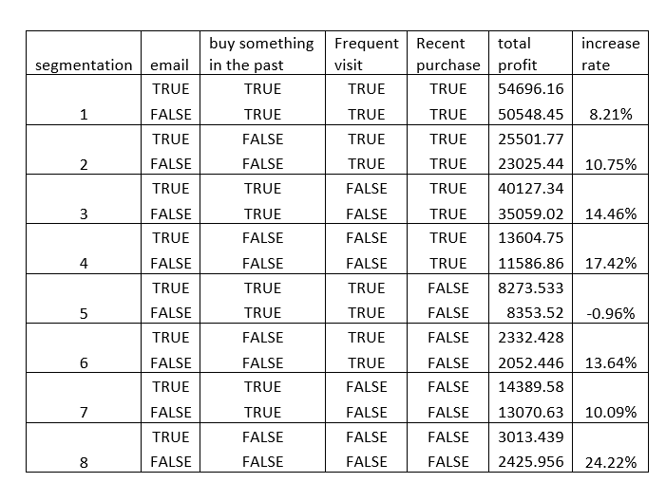
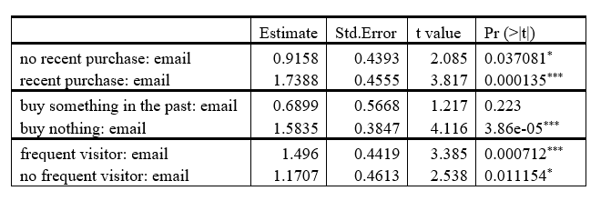
Different groups have different reactions to email campaign
Using interaction variables to check whether the email will change the customers’ behaviors.
Recent Purchase (last_purch < 60): purch~recent purchase + email : recent purchase.
Buy something in the past (past_purch >0): purch~past purchase + email: past purchase
Frequent visitor (visits > 5): purch~frequent visitor + email : frequent visitor
We use the 3 parameters to divide our customers and get 8 different customers segments.
For 7 segments, if we send email to the customers, they are more willing to buy wine on our website, leading to an increased total profit.
Different groups have different reactions. We should find the most responsive customers and send them email in order to have a higher and promising profit.
According to the interaction test results, recent purchase, buy something in the past and frequent visitor are statistically significant, and then we use these three variables to slice and dice our customers in order to find the most responsive customer segments.

Slide 6
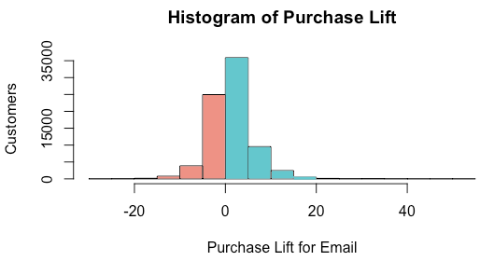
Identifying email campaign target group through Casual Forest
Baseline variables used in Causal Forest: "last_purch", "visits", "chard", "sav_blanc", "syrah", "cab", "past_purch".
Causal Forest: used for identifying heterogeneous treatment effects and scoring customer according to predicted treatment effect uplift.
Email campaign target group: score > 0.
Email campaign target group
Summary information for target group and non-target group (Appendix III)
 | Group percentage | Number of customers | Chard (mean $) | Sauvignon blanc (mean $) | Syrah (mean $) | Cabernet Sauvignon (mean $) | Last purchase (days) | Past purchase (mean $) | Visit (mean of website visits)
Target group | 55.67% | 43596 | 89.94 | 28.74 | 2.39 | 31.03 | 72.80 | 152.09 | 5.66
Non-target group | 44.33% | 34716 | 54.01 | 24.18 | 3.41 | 22.01 | 111.73 | 103.61 | 5.62

Slide 7
Appendix

Slide 8
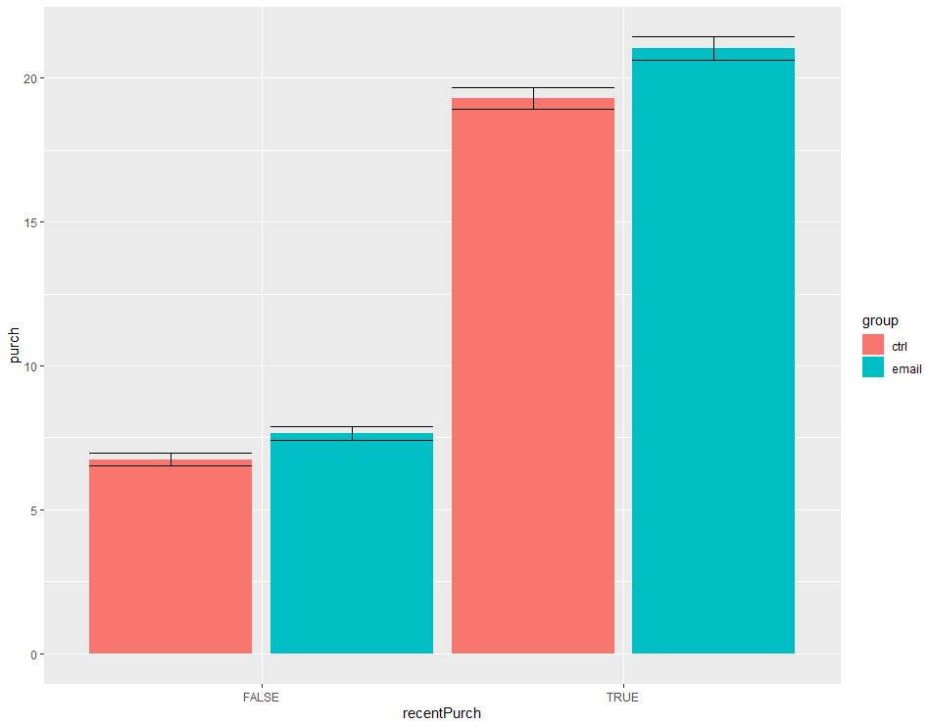
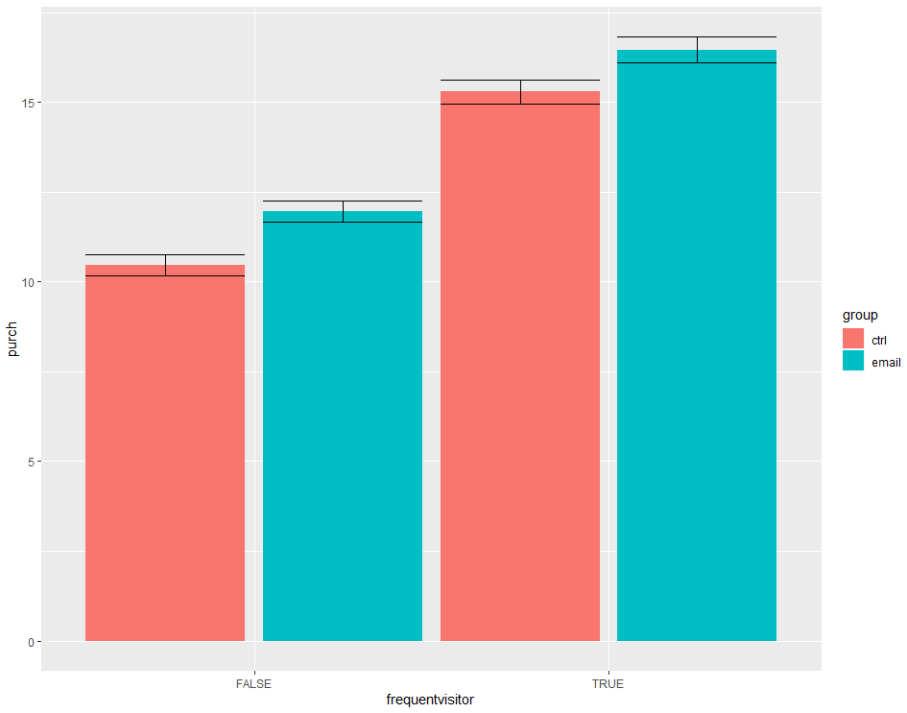
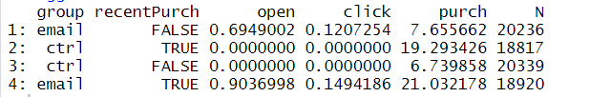

Appendix I
Recent Purchase results
Frequent visitors results

Slide 9
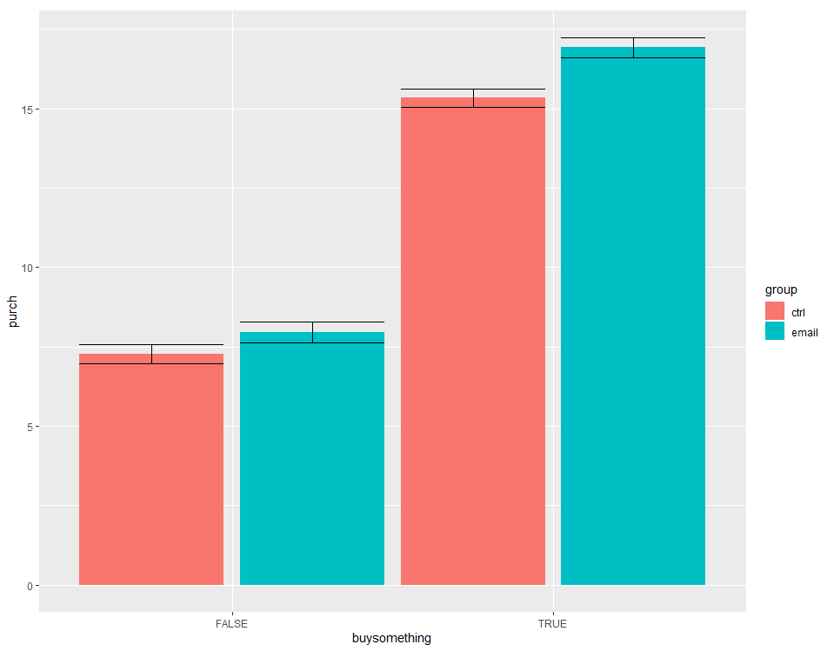

Appendix II
Buy something in the past

Slide 10
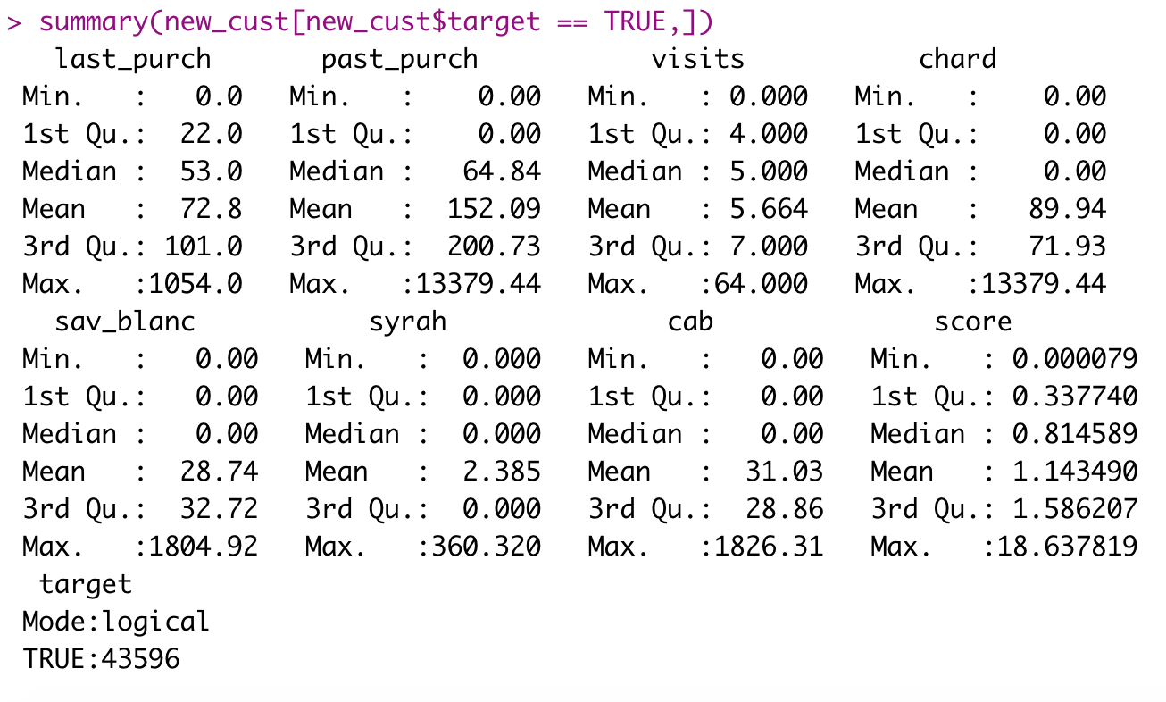
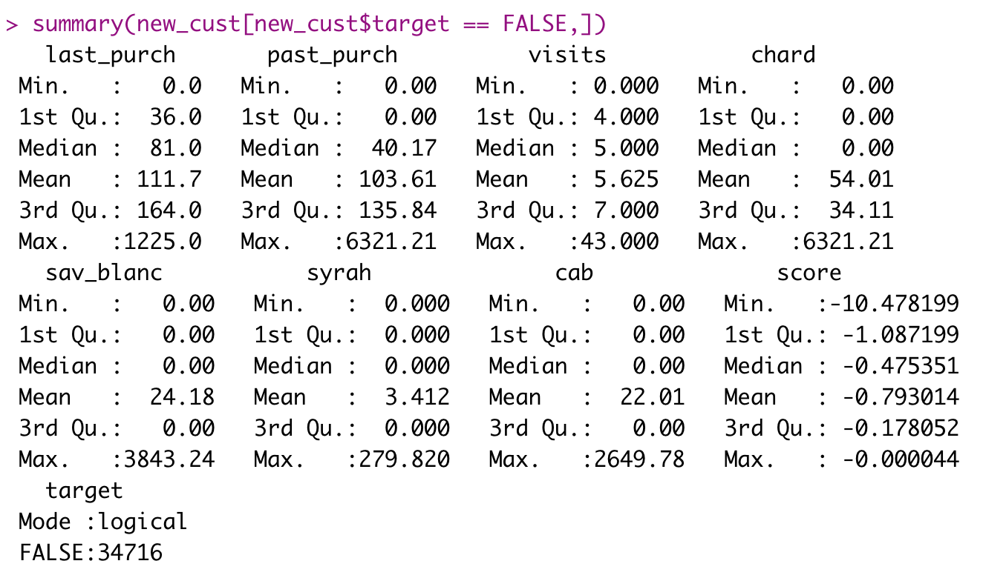
Appendix III
Summaries of the baseline variables for the targeted and non-targeted groups.

