Slide 1
Catalog.API

Slide 2
Start mongodb
docker run -d -p 27017:27017 --name shopping-mongo mongo
docker logs -f shopping-mongo
docker exec -it shopping-mongo /bin/bash

Slide 3
mongo command
show dbs
use CatalogDb
db.createCollection(‘Products’)
db.Products.insertMany()
db.Products.find({}).pretty()
db.Products.remove({})

Slide 4
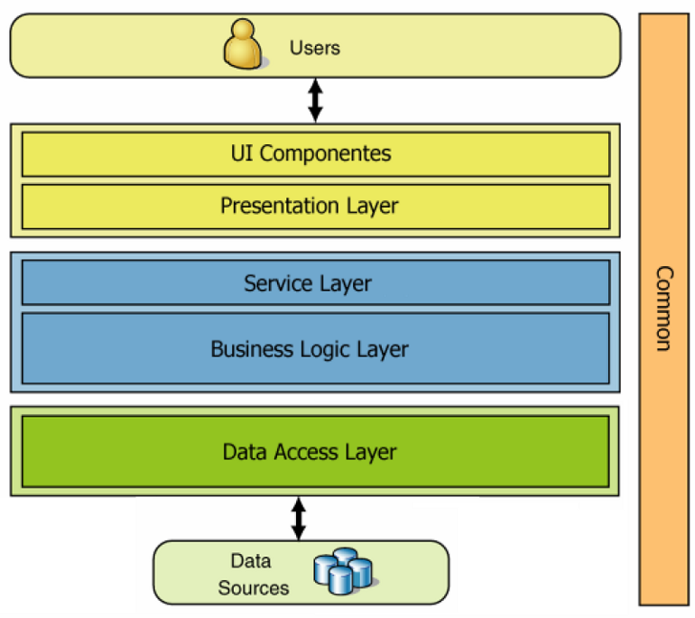
N-Tire Layer Architecture

Slide 5
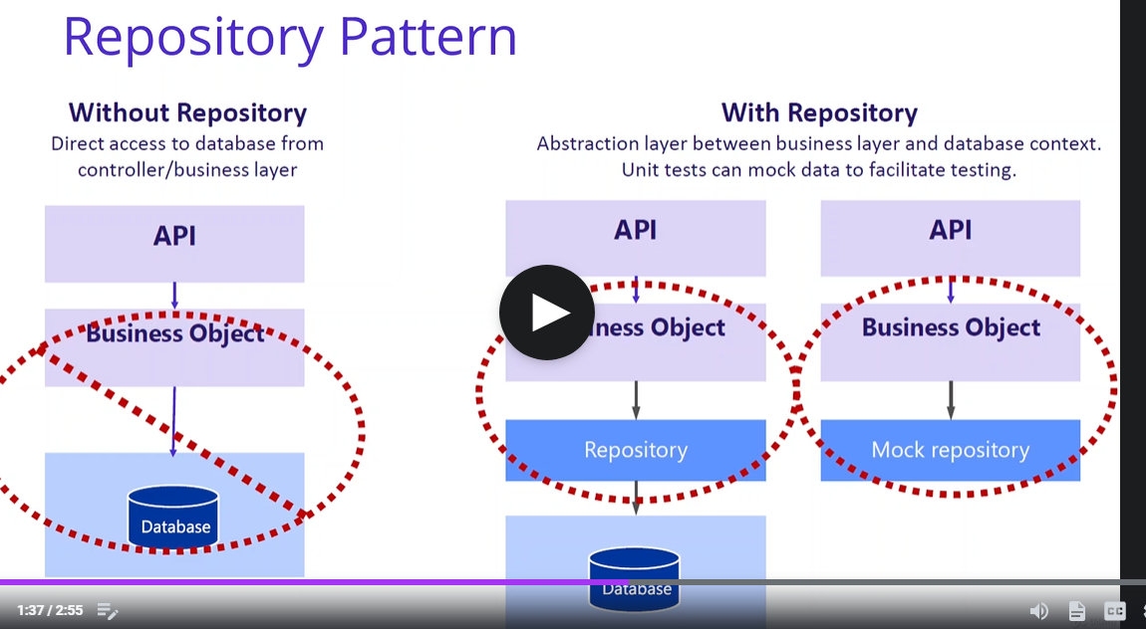
Repository Pattern
A middle layer between data layer and business layer, provide general API to access the db without knowing the real implementation

Slide 6
MongoDB.Driver Nuget package
Mongoclient for mongo GUI

Slide 7
Basket.API
Why Redis?
Distributed caching shared by all the services

Slide 8
Start redis
docker run -d -p 6379:6379 --name aspnetrun-redis redis
docker logs -f aspnetrun-redis
docker exec -it aspnetrun-redis /bin/bash

Slide 9
Nuget Packages
Microsoft.Extensions.Caching.StackExchangeRedis
Newtonsoft.Json

