Slide 1
weight1 shape=(h, 1, 1)
weight2 shape=(1, 1, c)
weight3 shape=(1, w, 1)
weight shape=(h, w, c)
*
*
=
Fig1 x

Slide 2
MaxPool2D
Input
AvgPool2D

Slide 3
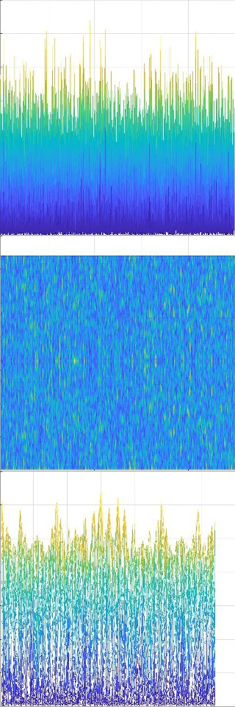
ECM-Net
(480, 160, 16)
(120, 40, 64)
(40, 40, 64)
Input
(960, 320, 3)
Output
(5, )
(240, 80, 32)
(120, 40, 64)
(10, 10, 896)
(1792,)
RB (ResidualBlock)
CB (ConvBlock)
0.3
(h, w, c)
(h, w, 2c)
0.7
RB
ECM
P2P
CB
Conv2D
Dense
BatchNorm
Flatten
Dropout
ELU
Softmax

Slide 4
k

Slide 5
Inception
CNN
Conv2D
BatchNorm
MaxPool2D

