Slide 1
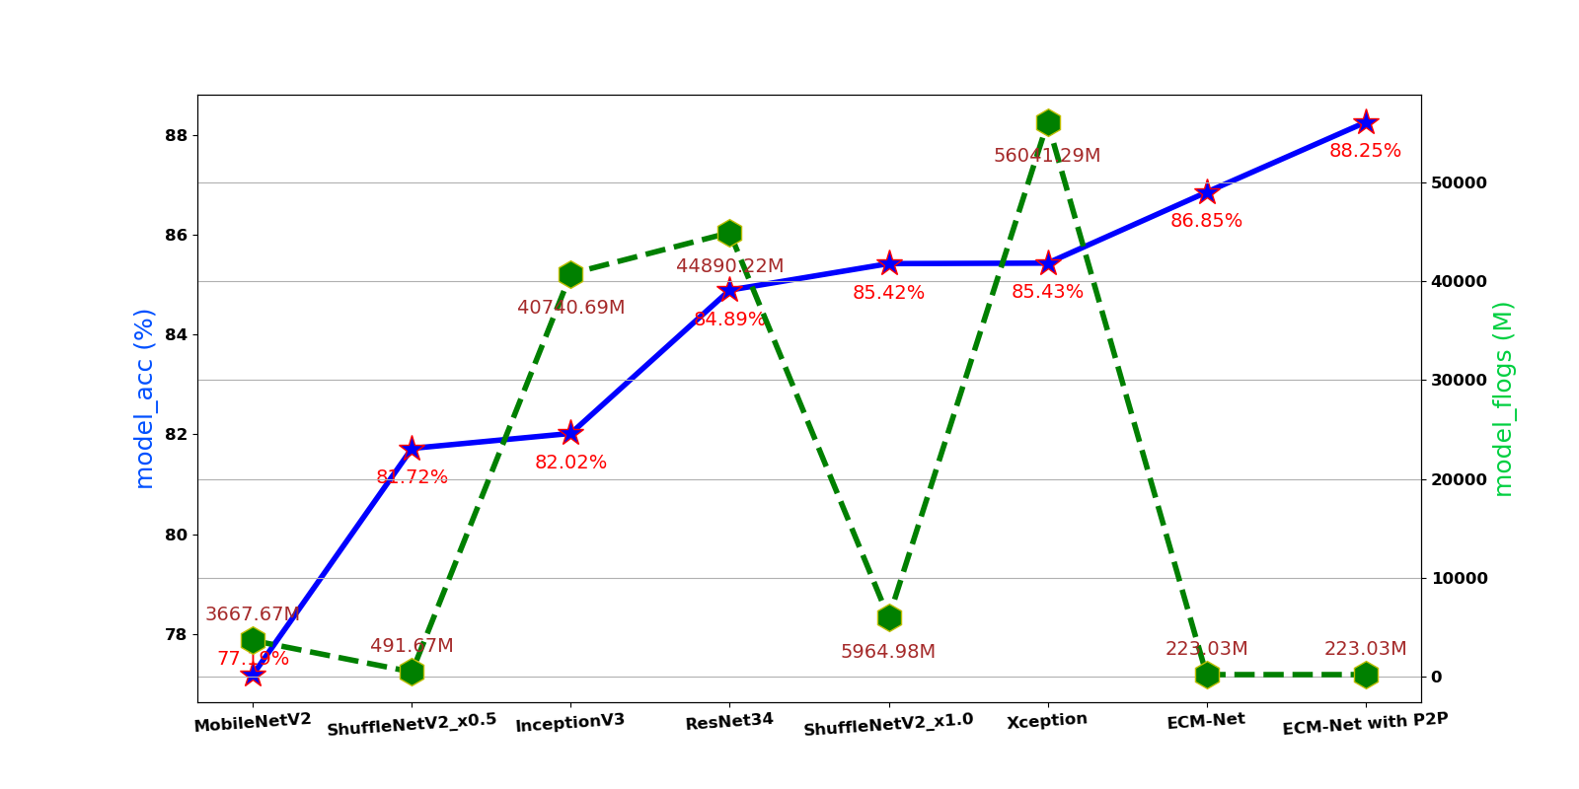


model acc (%)
model flogs (M)
model params
373,121
4,023,865
372,197
20,871,725
21,312,773
354,629
21,813,029
2,264,389

