Slide 1
Assignment 2
DYOR!
1.Update Profile Slide Information (Deadline: Friday, February 23, 2024, 12:00 PM [CET/CEST])
2.Bitcoin technical deep dive
Get a copy of “Mastering Bitcoin, 2nd Edition” by Andreas Antonopoulos for reference.
Free (non-.pdf version) at https://github.com/bitcoinbook/bitcoinbook. At least cursory read chapters 4 & 5.
Describe the steps to create a public (legacy) address, from private key to Base58 address type.
What other address types are there? Create a short description for each.
What is a HD wallet? What advantage does it have over non-deterministic wallets?
What information is contained in the Block header?
What is the current difficulty (Block 828904)? How many hashes does it take to mine a block?
3.Energy consumption and CO2 footprint
Research the current and historical power consumption of Bitcoin.
What are possible ways to reduce the CO2 footprint?
4.Practical: Connect with other Talents on Twitter, join the #twitter slack channel, follow the Bitcoin Talents Twitter list, participate in a Twitter Space. You can also introduce yourself to the whole cohort using THIS TABLE.
REMINDER: In order to participate in the program, you need to fill out this FORM. We need your confirmation on this form for GDPR reasons. Please note that you cannot participate in the program without filling out the survey.

Slide 2
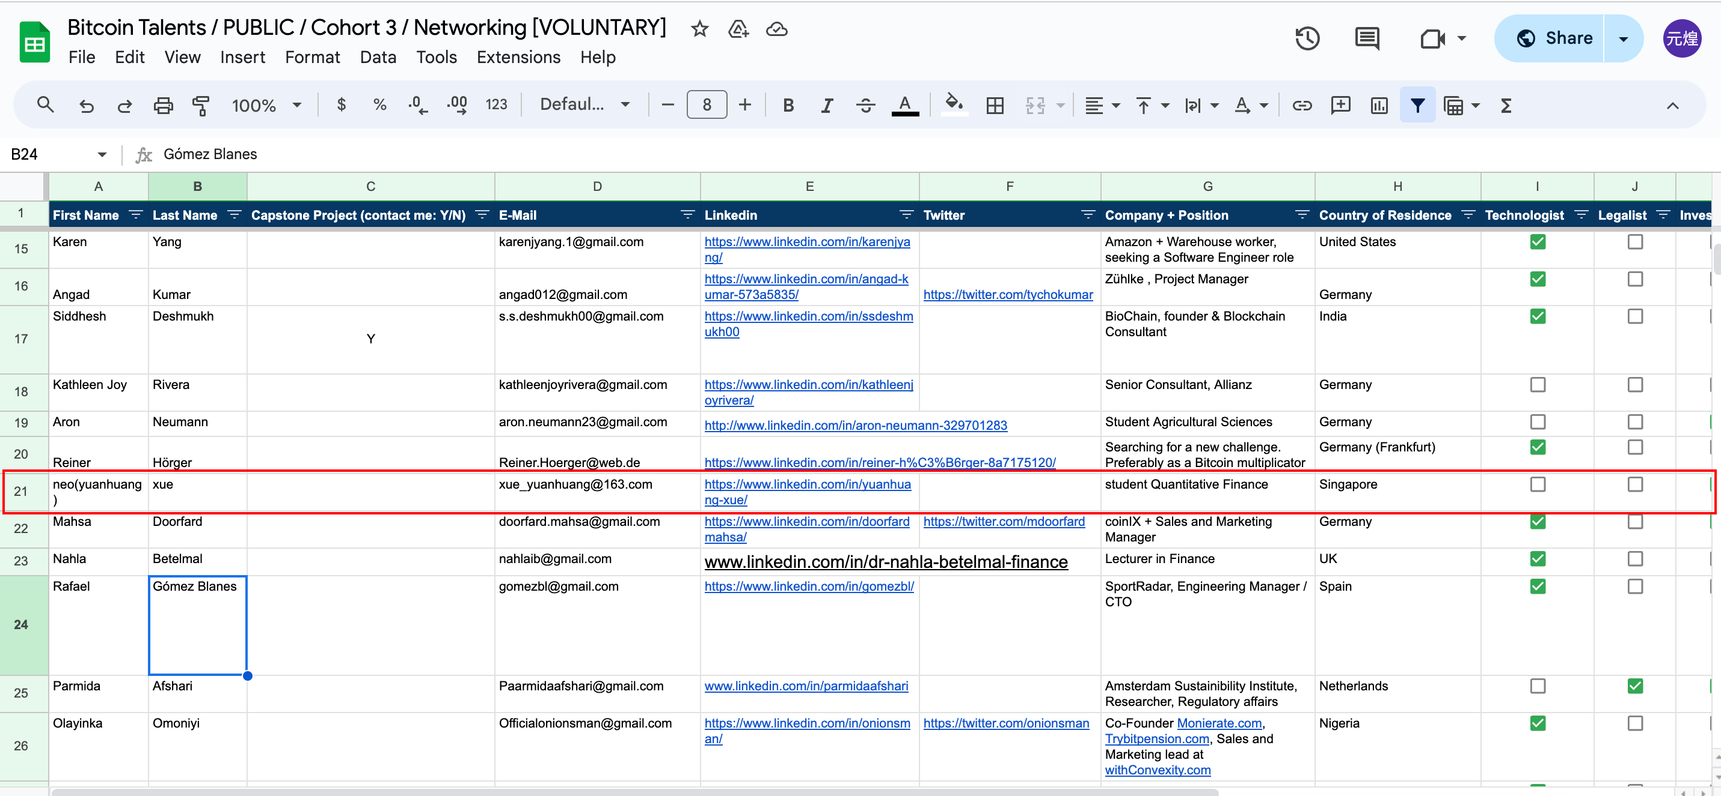
Assignment:1.Update Profile Slide Information (Deadline: Friday, February 23, 2024, 12:00 PM [CET/CEST]) .

Slide 3
Assignment:2.Bitcoin technical deep dive
2a.Describe the steps to create a public (legacy) address, from private key to Base58 address type.
How to get public key from private key:
The public key is calculated from the private key using elliptic curve multiplication, which is irreversible: K = k × G, where k is the private key, G is a constant point called the generator point, and K is the resulting public key.
Public key K is defined as a point K = (x, y)
Example:
K = 1E99423A4ED27608A15A2616A2B0E9E52CED330AC530EDCC32C8FFC6A526AEDD
x = F028892BAD7ED57D2FB57BF33081D5CFCF6F9ED3D3D7F159C2E2FFF579DC341A
y = 07CF33DA18BD734C600B96A72BBC4749D5141C90EC8AC328AE52DDFE2E505BDB

Slide 4
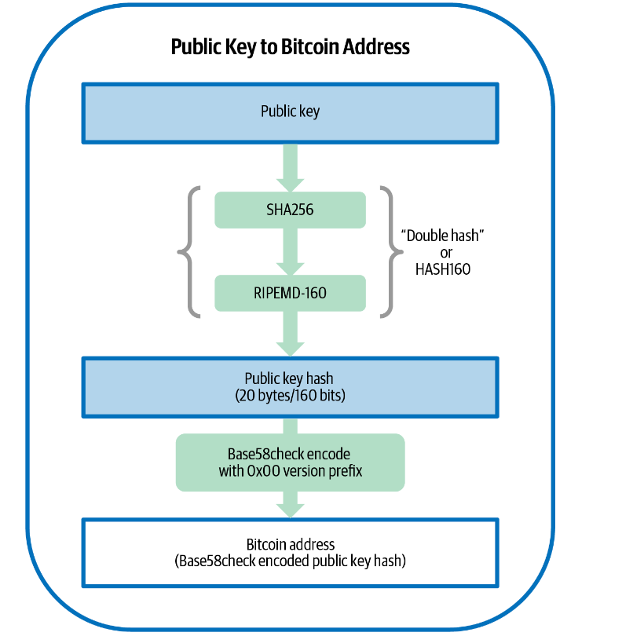
Assignment:2.Bitcoin technical deep dive
2a.Describe the steps to create a public (legacy) address, from private key to Base58 address type.

Slide 5
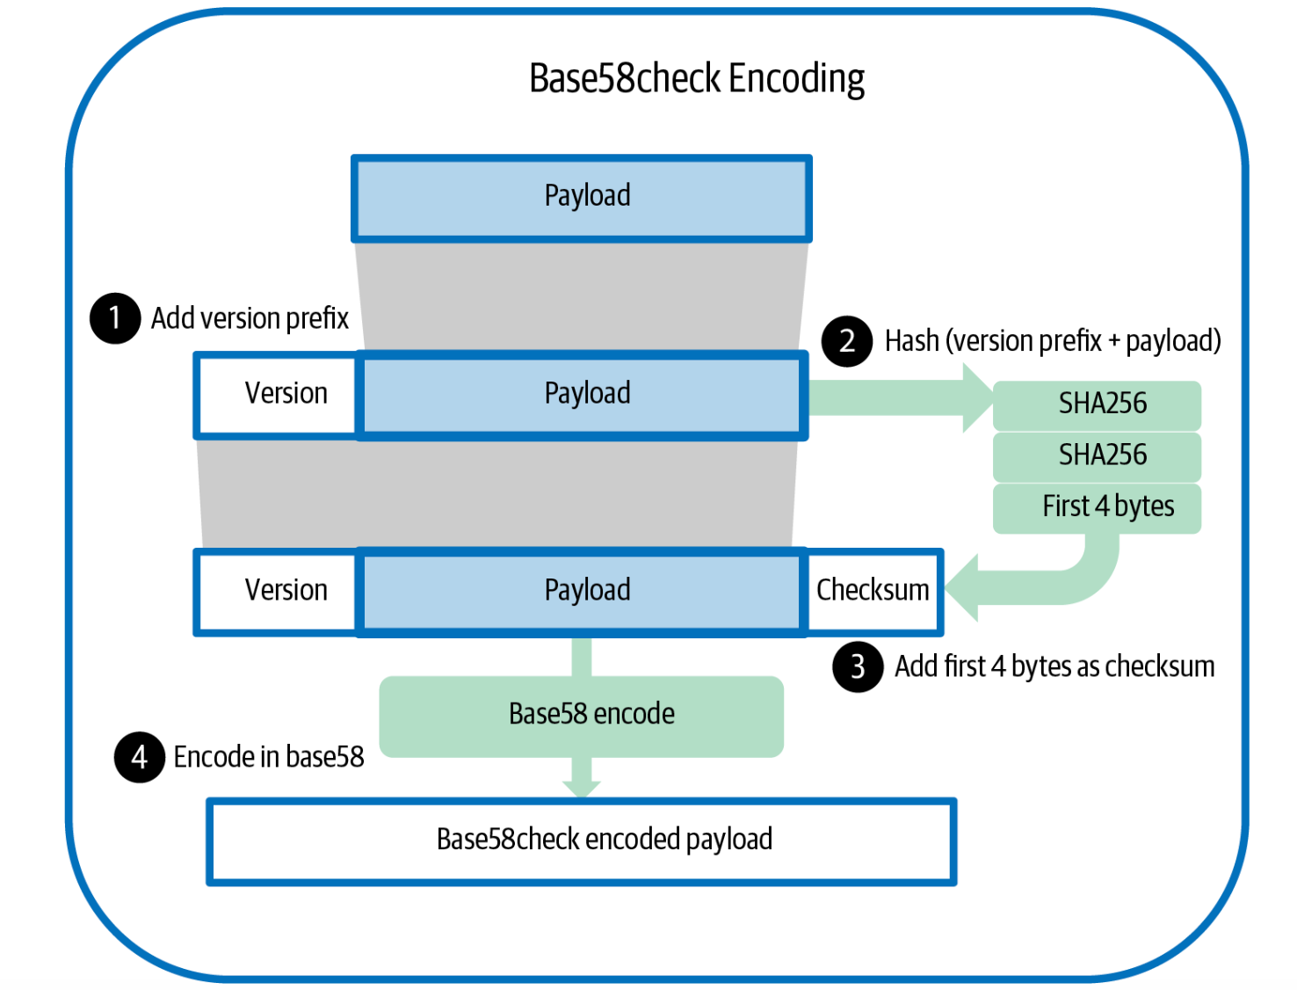
Assignment:2.Bitcoin technical deep dive
2a.Describe the steps to create a public (legacy) address, from private key to Base58 address type.

Slide 6
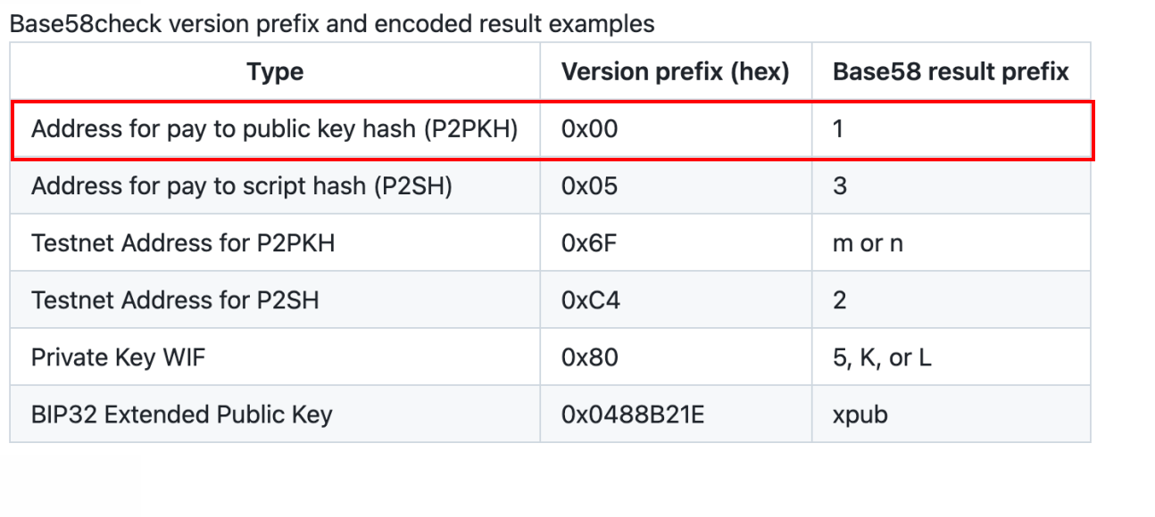
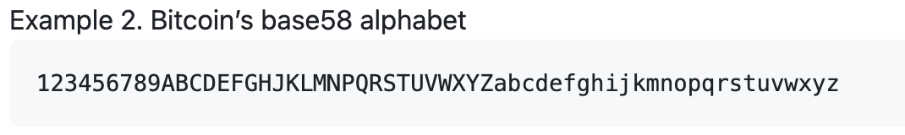
Assignment:2.Bitcoin technical deep dive
2a.Describe the steps to create a public (legacy) address, from private key to Base58 address type.

Slide 7
Assignment:2.Bitcoin technical deep dive
2b.What other address types are there? Create a short description for each.
P2PK:using ip address to pay, every time given different public key, so transcations will not being connected.
P2PKH:using hash function RIPEMD160(SHA256(K)) to shorter public key from 65 bytes to 20 bytes.
Besh32:Bech32 uses only numbers and a single case of letters (preferably rendered in lowercase)
Bech32m:The version of bech32 with a single different constant is known as bech32 modified (bech32m)

Slide 8
Assignment:2.Bitcoin technical deep dive
2c.What is a HD wallet? What advantage does it have over non-deterministic wallets?
HD wallet:A tree of keys generated from a single seed
Disadvantage:
1.it required users to back up the wallet database each time they generated and distributed new keys, which could be as often as each time they generated a new address to receive a new payment. Failure to back up the wallet database on time would lead to the user losing access to any funds received to keys that had not been backed up.
2.For each independently generated key, the user would need to back up about 32 bytes, plus overhead.

Slide 9
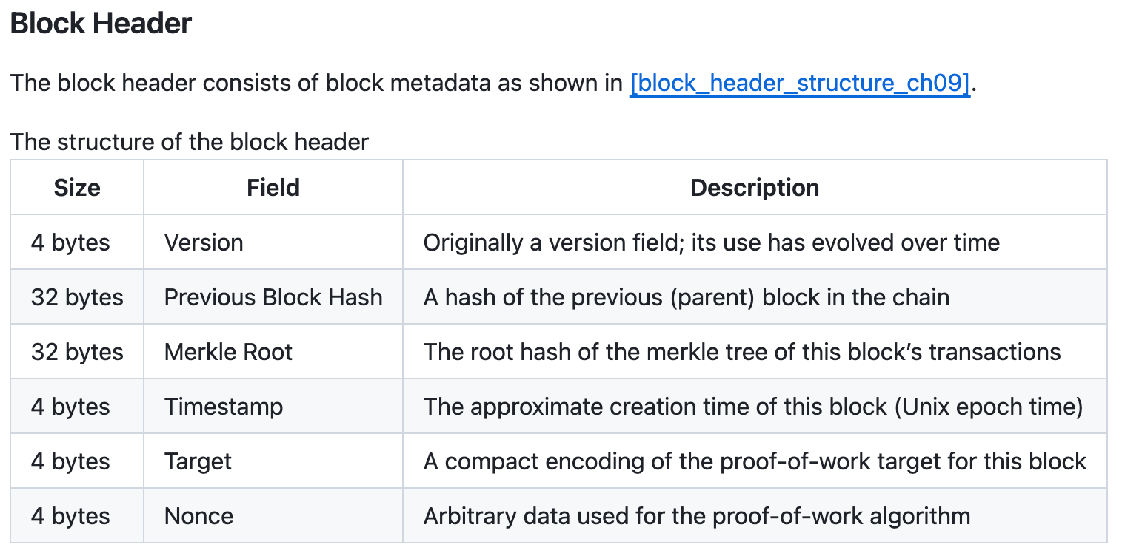
Assignment:2.Bitcoin technical deep dive
2d.What information is contained in the Block header?

Slide 10
Assignment:2.Bitcoin technical deep dive
2e.What is the current difficulty (Block 828904)? How many hashes does it take to mine a block?
200.32T
200.32 trillion

Slide 11
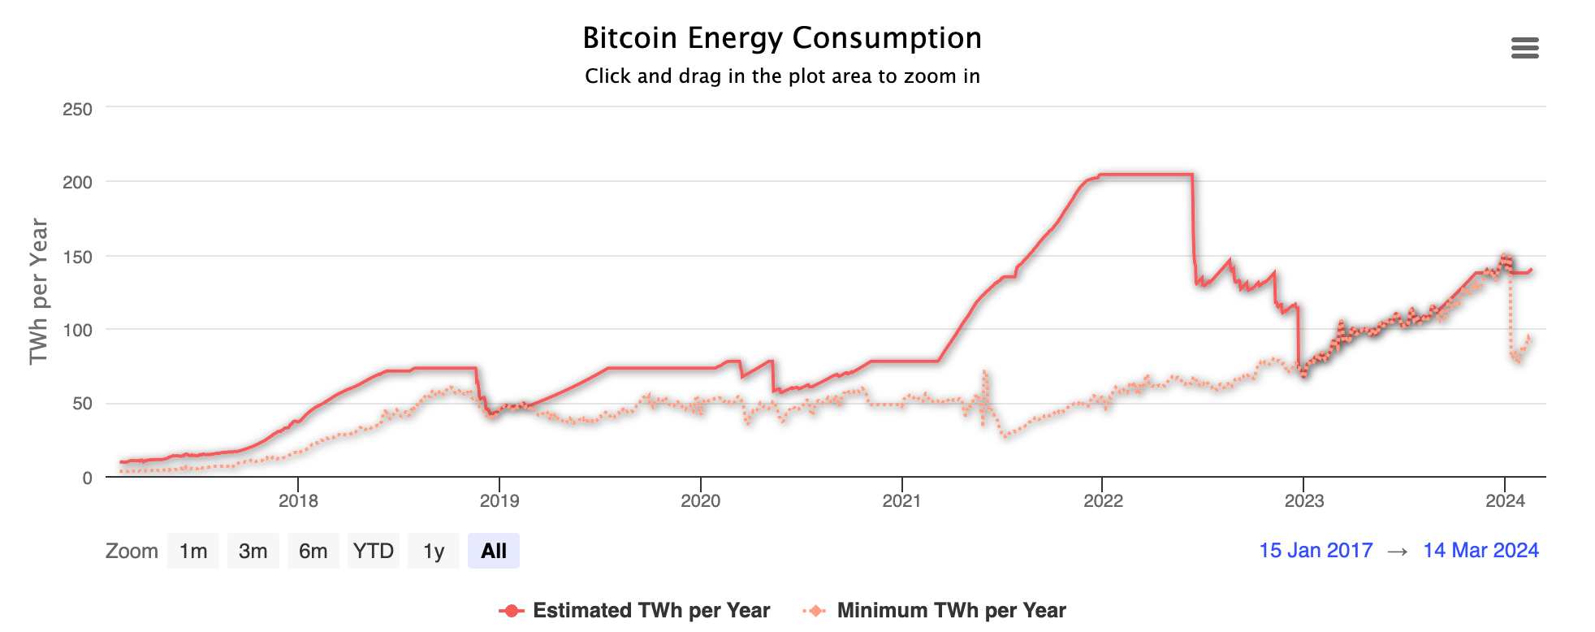
Assignment:3.Energy consumption and CO2 footprint
One TWh is enough to continuously power about 114,000 average American homes for an entire year.

Slide 12
Assignment:3.Energy consumption and CO2 footprint
3b.What are possible ways to reduce the CO2 footprint?
Mining Process Reforms: Changing the fundamental approach to Bitcoin mining, like shifting from "proof of work" to "proof of stake", could significantly reduce energy consumption. This method would eliminate the need for miners to solve complex calculations, instead of allowing the system to validate transactions based on the stake of network participants.
However, I don’t think POS is a good way.

Slide 13
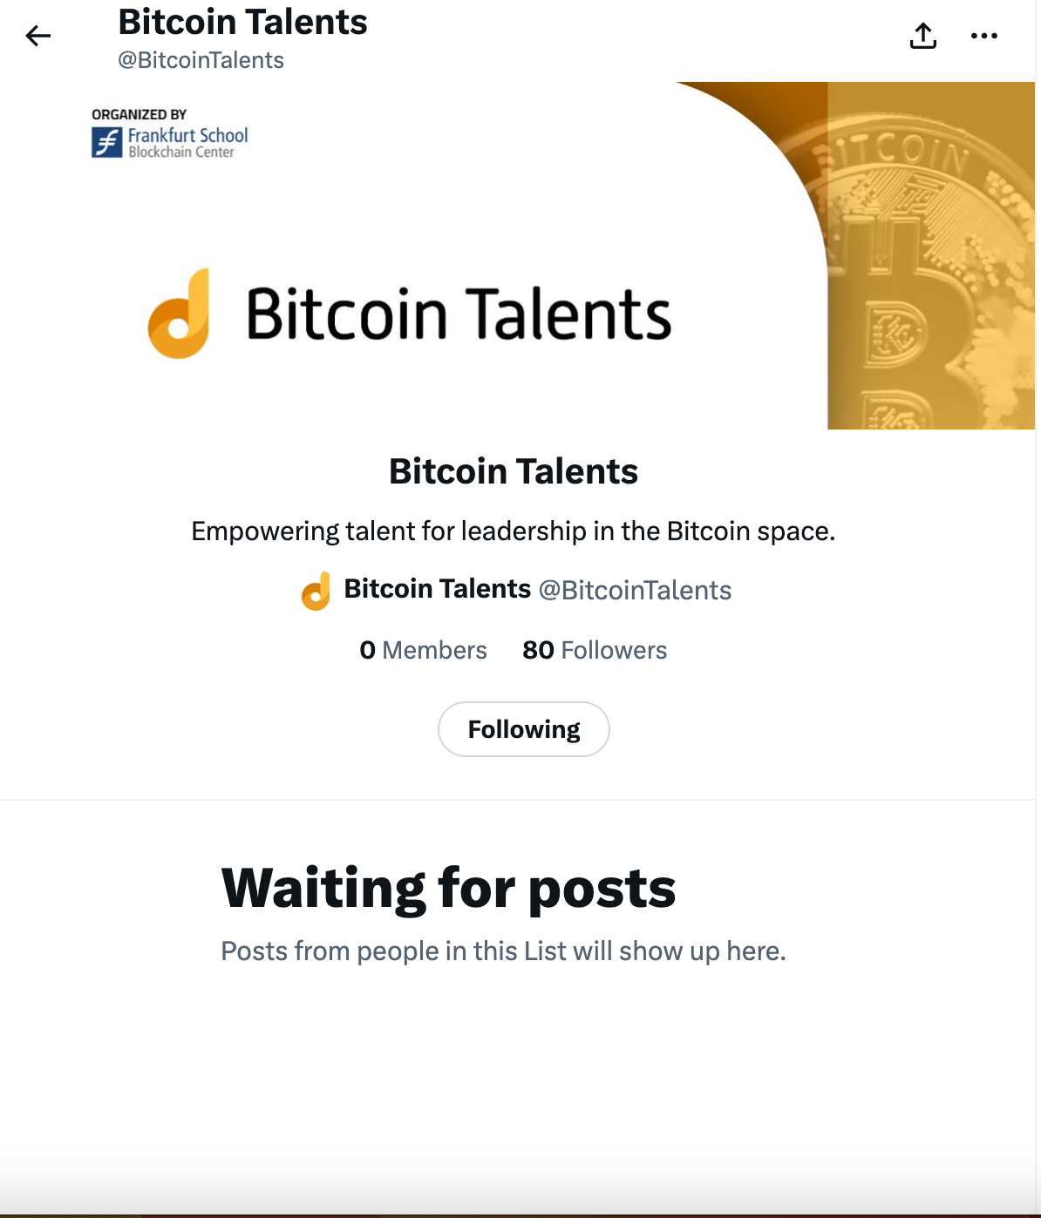
Assignment:4.Practical: Connect with other Talents on Twitter, join the #twitter slack channel, follow the Bitcoin Talents Twitter list, participate in a Twitter Space. You can also introduce yourself to the whole cohort using THIS TABLE.

Slide 14

Submit Assignment
https://forms.gle/iRNjCf8TCHi8My7v5
You can use the Content Questionnaire to submit content, e.g., articles, studies, projects relevant to Bitcoin (needs to have relevant Bitcoin insights/content)

