Slide 3
They are co-expressed in 303 cells in root tip, with AT4G38360 express in 2248 cells, 518 cells in AT4G38370. Mean expression value in cells is 1.32 for AT4G38370, 1.86 for AT4G38360

Slide 4
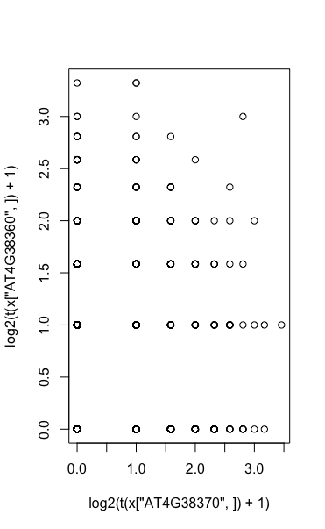
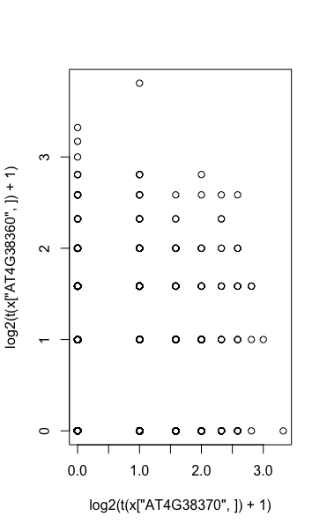
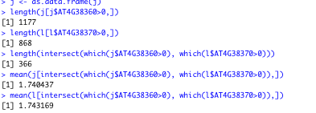


Slide 5
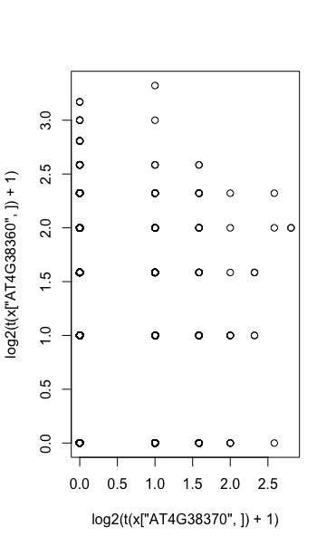
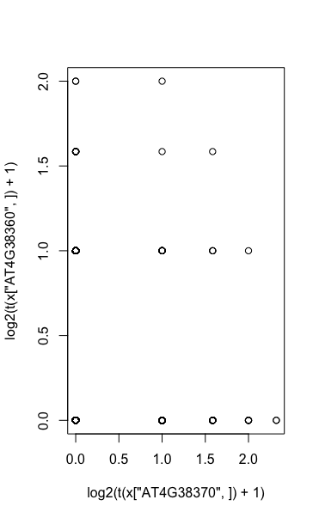
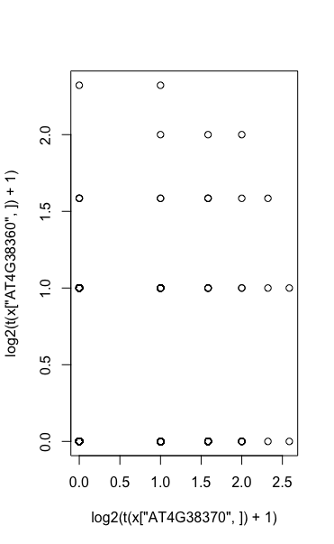


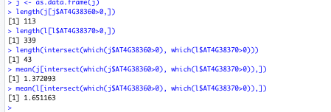
Notes:
GSE114615_not working well

