Slide 1
3D Detection For Blind People
Xufeng Shen, Zhiao Zhou, Wenxin Zu
— Group A1_01

Slide 2
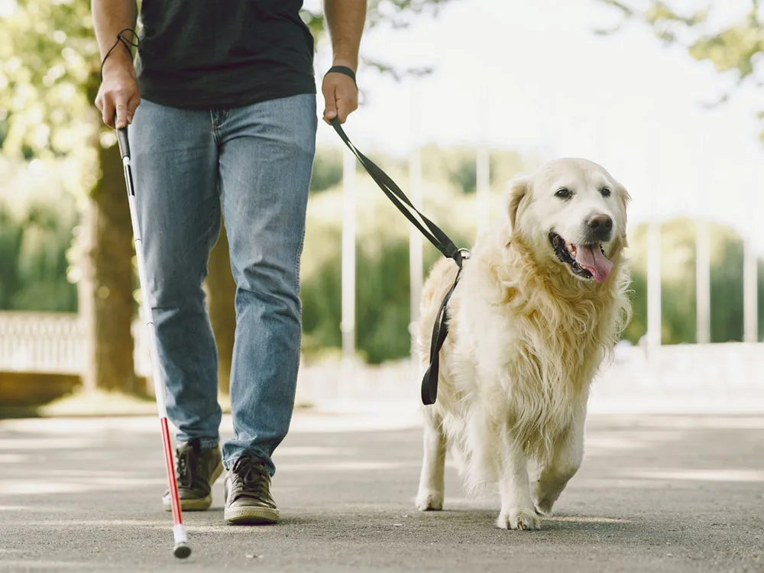
Product Mission
Help blind people or people with visual impairments and elder people to avoid collision.
Notes:
People with visual impairments face challenges in scene and object recognition, especially in unknown environments. Nowadays, only a few tools for exploring unknown spaces were available such as a guide dog. So we want to develop an APP to provide an auditory scene description to people with visual impairments.
With a search function, the system can even guide the user to a particular item. The system also provides spatial audio warnings for nearby objects and walls to avoid collisions.

Slide 3
Users
Blind people
People with visual impairments
Elder people

Slide 4
User Stories and MVP User Stories
Blind people, avoid injure;
People with visual impairments, get particular things directly;
Elder people, assistance in life.

Slide 5
User Stories and MVP User Stories
Blind people, avoid injure;
People with visual impairments, get particular things directly;
Elder people, assistance in life.

Slide 6
MVP
🌟Calculate the distance between people and obstacles, and send alarm to people when near danger.

Slide 7
Comprehensive literature review
The assistive applications on mobile platforms for users with visual impairments have been researched by years. The paper[1] summarized recent developments in this area. And concluded the main methods.
Tactile solutions
Auditory solutions
Auditory and tactile solutions
[1]Csapó, Á., Wersényi, G., Nagy, H. and Stockman, T., 2015. A survey of assistive technologies and applications for blind users on mobile platforms: a review and foundation for research. Journal on Multimodal User Interfaces, 9(4), pp.275-286.

Slide 8
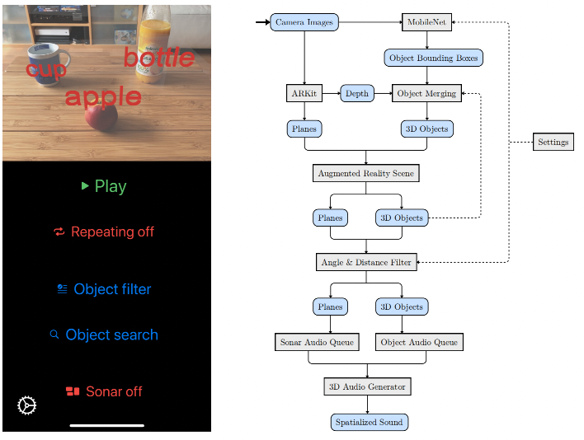
Comprehensive literature review
For AR area, the paper[1] shows us a system using ARKit and MobileNet allows users with visual impairments to avoid collisions.
(Auditory assistant)
[1]Kaul, O.B., Behrens, K. and Rohs, M., 2021, May. Mobile Recognition and Tracking of Objects in the Environment through Augmented Reality and 3D Audio Cues for People with Visual Impairments. In Extended Abstracts of the 2021 CHI Conference on Human Factors in Computing Systems (pp. 1-7).

Slide 9
Comprehensive literature review
Other related work including indoor positioning system, vision based systems are also get a huge development during these years. One of them is the ARIANNA+[1] which is a navigation system for people who has visual impairment to use indoor and outdoor.
And [2] which is a system based on pattern recognition.
[1]Lo Valvo, A., Croce, D., Garlisi, D., Giuliano, F., Giarré, L. and Tinnirello, I., 2021. A navigation and augmented reality system for visually impaired people. Sensors, 21(9), p.3061.
[2]Simões, W.C. and de Lucena, V.F., 2016, September. Hybrid Indoor Navigation as sistant for visually impaired people based on fusion of proximity method and pattern recognition algorithm. In 2016 IEEE 6th International Conference on Consumer Electronics-Berlin (ICCE-Berlin) (pp. 108-111). IEEE.

Slide 10
Technologies to evaluate and reason for choosing them
ARKit: ARKit which is a tool by Apple, it provides lots of functions including object detection and tracking, measurements. We use ARKit so we can build ios applications using it and take advantages of iphones’ camera and LiDAR.
LiDAR: The LiDAR is the sensor can get point clouds data which can be stored and analyzed. Which is important for this project.
Deep learning algorithms: In detection objects area, neural network plays a big role. Lots of work are done in object detection algorithms. We use these algorithms to do the core detection job.

Slide 11
Setup of development environment
Hardware: Macbook, iPhone13 PRO(LiDAR)
Development environment: MacOS Monterey, XCode(Version 13.4.1)
Tools: ARKit, different kinds of deep learning models

Slide 12
Next Sprint goals
Different methods advantages and disadvantages
Literature review
Test open sources

Slide 13
Citations
[1]Kaul, O.B., Behrens, K. and Rohs, M., 2021, May. Mobile Recognition and Tracking of Objects in the Environment through Augmented Reality and 3D Audio Cues for People with Visual Impairments. In Extended Abstracts of the 2021 CHI Conference on Human Factors in Computing Systems (pp. 1-7).
[2]Csapó, Á., Wersényi, G., Nagy, H. and Stockman, T., 2015. A survey of assistive technologies and applications for blind users on mobile platforms: a review and foundation for research. Journal on Multimodal User Interfaces, 9(4), pp.275-286.
[3]Simões, W.C. and de Lucena, V.F., 2016, September. Hybrid Indoor Navigation as sistant for visually impaired people based on fusion of proximity method and pattern recognition algorithm. In 2016 IEEE 6th International Conference on Consumer Electronics-Berlin (ICCE-Berlin) (pp. 108-111). IEEE.
[4]Lo Valvo, A., Croce, D., Garlisi, D., Giuliano, F., Giarré, L. and Tinnirello, I., 2021. A navigation and augmented reality system for visually impaired people. Sensors, 21(9), p.3061.
[5]https://developer.apple.com/documentation/arkit
[6]https://medium.com/@regis.loeb/playing-with-point-clouds-for-3d-object-detection-eff1d98e526a
[7]https://www.51cto.com/article/701356.html

Slide 14
THANKS!

