Slide 1

JFace Databinding
Frank Gerhardt
Michael Scharf
Boris Bokowski

Slide 2
Data Binding
Vision: Get rid of listeners in UI code.
Why?
  Hard to write, hard to maintain
  For every aspect:
    Copy initial state into widget
    Hook listener (to widget, to model)
    Write code that sync's state incrementally
    Validation, conversion typically not separated
    threading

Slide 3
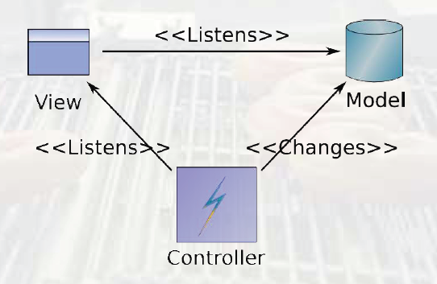
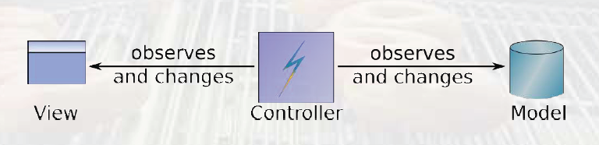
Triangle -> Straight Line
From model-view-controller (MVC) triangle to more independence
From David Orme, Introducing JFace Data Binding, EclipseCon 2006, made available under EPL 1.0

Slide 4
Concepts
Framework Code
View
Model
Observable
Binding
Observable
data flow

Slide 5
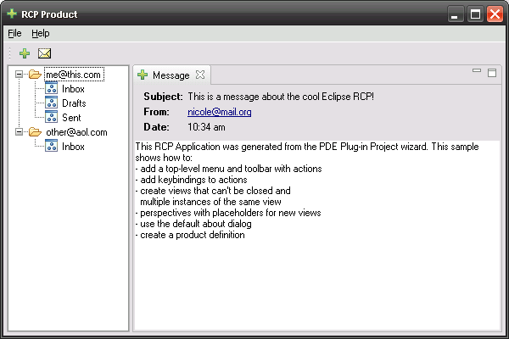
RCP Mail
RCP Mail is the base of our data binding example
We added some GUI elements to show various bindings

Slide 6
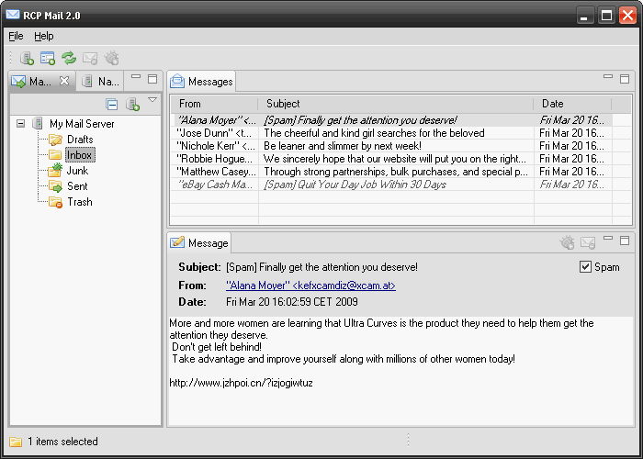
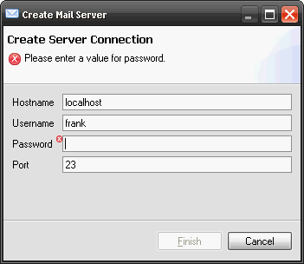
RCP Mail enhanced
4. Updating the table
based on selection
in tree
2. Validation
errors
collected
in title area
5. Binding
of table
viewer
6. Master-datail from
message list to message
1.Binding text field
to string and int property
3. Binding
of tree viewer
7. Binding subject,
from, date to labels

Slide 7
Our first binding
Bind a text field to a String property
DEMO

Slide 8
Converters & Validators
The Binding can be configured:
model to target update strategy
target to model update strategy
each with: 1 Converter and
3 Validators
Text widget
Person
Binding
text
phoneNumber
Update Strategy (automatic/manual)
Target to model
After Convert Validator
After Get Validator
Before Set Validator
String2PhoneNumberConverter

Slide 9
Architecture with DB
GUI
Controller layer
Model object, e.g. Person
Binding
Text field
firstName
Binding
Text field
lastName
Binding
phoneNumbers
List
Custom
Controller
for UI logic
e.g. delete phone number
Button
e.g. delete(aPhoneNumber)
E.g. en-/disable delete button
based on selection.
When clicked, delete
selected phone number

Slide 10

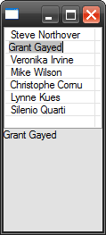
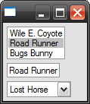
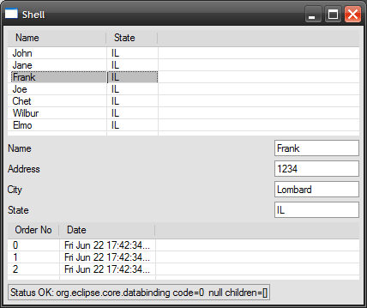
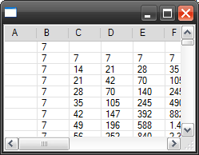
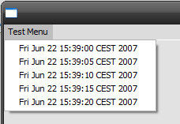
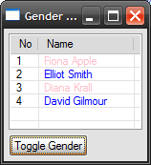
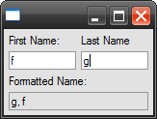


Examples
From CVS
:pserver:anonymous@dev.eclipse.org:/cvsroot/eclipse/org.eclipse.jface.examples.databinding

Slide 11
Recap: Features
IObservable and Binding
  Source and target are wrapped
No superclasses or interfaces required
  Standard Java beans, with PropertyChangeEvents
  Other models possible (e.g. EMF, ...)
  Even other UI toolkits (e.g. GWT, Swing, ...)
Bindings are set up once
  Careful design can avoid rebinding (master-detail)
Validators: context collects validation errors
Converters : model-to-UI, UI-to-model
Pluggable update strategies
(immediately, when validation is ok, manual, custom)

Slide 12
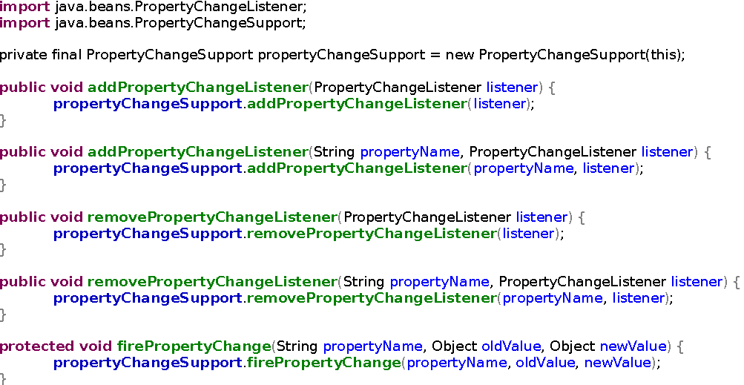
PropertyChange Support
No other requirements

Slide 13
Factories
Observables
BeansObservables
SWTObservables
ViewersObservables
MasterDetailObservables

Slide 14
Databinding Features
Binding of
  Values (String, Boolean, Integer...), 1:1
  Lists, n:n
  Master-Detail
Can bind to UI state
  Model.locked to Text.enabled
  Color, visibility, many more
Can bind to UI state, selection of list or table
  Zero additional UI logic required
Can bind to validation errors

Slide 15
Non-Features
Can only bind to one level of properties
  Not a.b.c directly
  need to bind a-b and b-c
  Workaround only for values (1:1), not for lists (n:n)
Trees are not supported well
  Internal, provisional
Little documentation, only examples

Slide 16
How-to
Decide which type to use
  Value (1:1), list (n:n), master detail
For values
  Wrap model into Observable using BeansObservables Factory
  Wrap UI into Observable using SWTObservables or ViewerObservables
For lists
  Use supplied ContentProvider and setInput

Slide 17
Benefits
Provides structure
Makes it easy to create multiple views onto the same model objects
Setting up bi-directional bindings as easy as the uni-directional case
If your model is changed from a non-UI thread
Master-detail – just try coding it by hand
Makes it easy to reuse validation code

Slide 18
Disadvantages
Learning curve
Generic implementation makes it complex (create your own helper classes!)
Overhead (space and time)
Requires model that fires change events
Hard to debug when things go wrong

Slide 19
Pro and Cons
Works in RCP and RAP
Avoids repetitive, error-prone code
Works in 80% of the cases
Set up once, zero effort afterwards
Eclipse API
  Mostly org.eclipse.core.databinding[.beans]
  Some in org.eclipse.jface.databinding
Learning required
Can be hard to debug
Need custom solution where it does not work

Slide 20
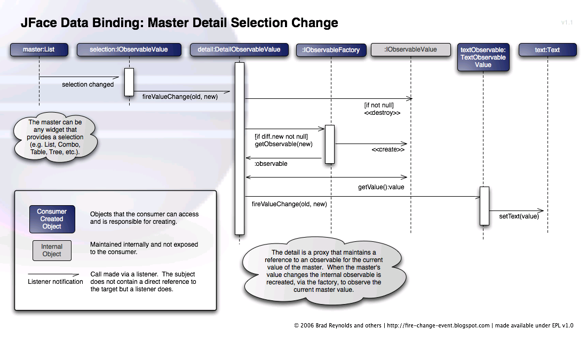
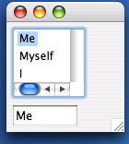
Master-Detail Binding

Slide 21
Resources
JFace Databinding Wiki page
  http://wiki.eclipse.org/index.php/JFace_Data_Binding
Newsgroup
  eclipse.platform with [DataBinding] in subject
Bugzilla
  Product=Platform, Component=UI, Summary with [DataBinding]
Examples from CVS

Slide 22
Copyright
© 2008 Gerhardt Informatics Kft.
Distributed under Creative Commons Attribution-Noncommercial-Share Alike 3.0 United States License
http://creativecommons.org/licenses/by-nc-sa/3.0/us

