Slide 1




EC10_1 E.coli
EC10_1 plasmid
EC10_2 E.coli
EC10_2 plasmid
from MEME

Slide 2
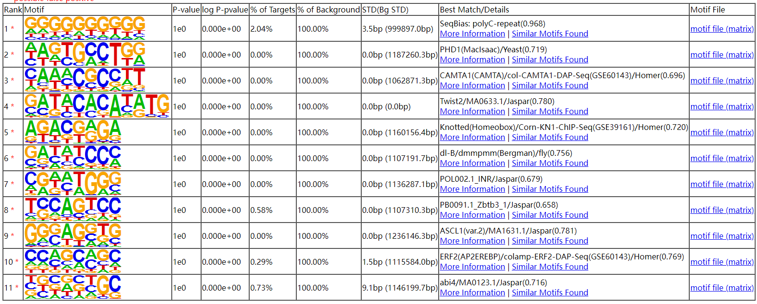

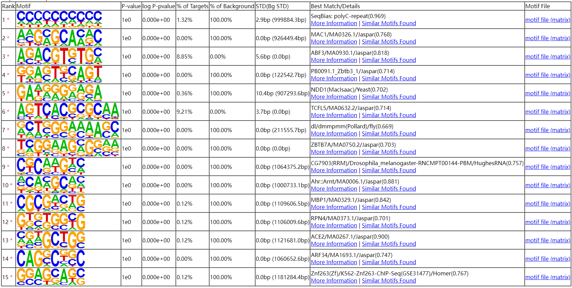
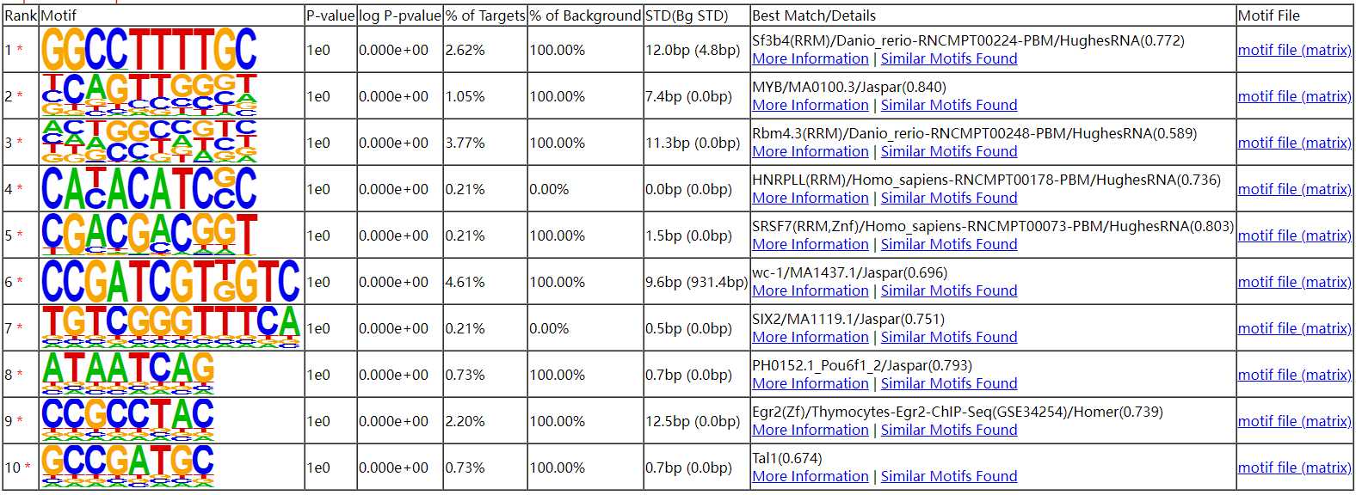
EC10_1 E.coli
EC10_1 plasmid
EC10_2 E.coli
EC10_2 plasmid
from HOMER

Slide 3
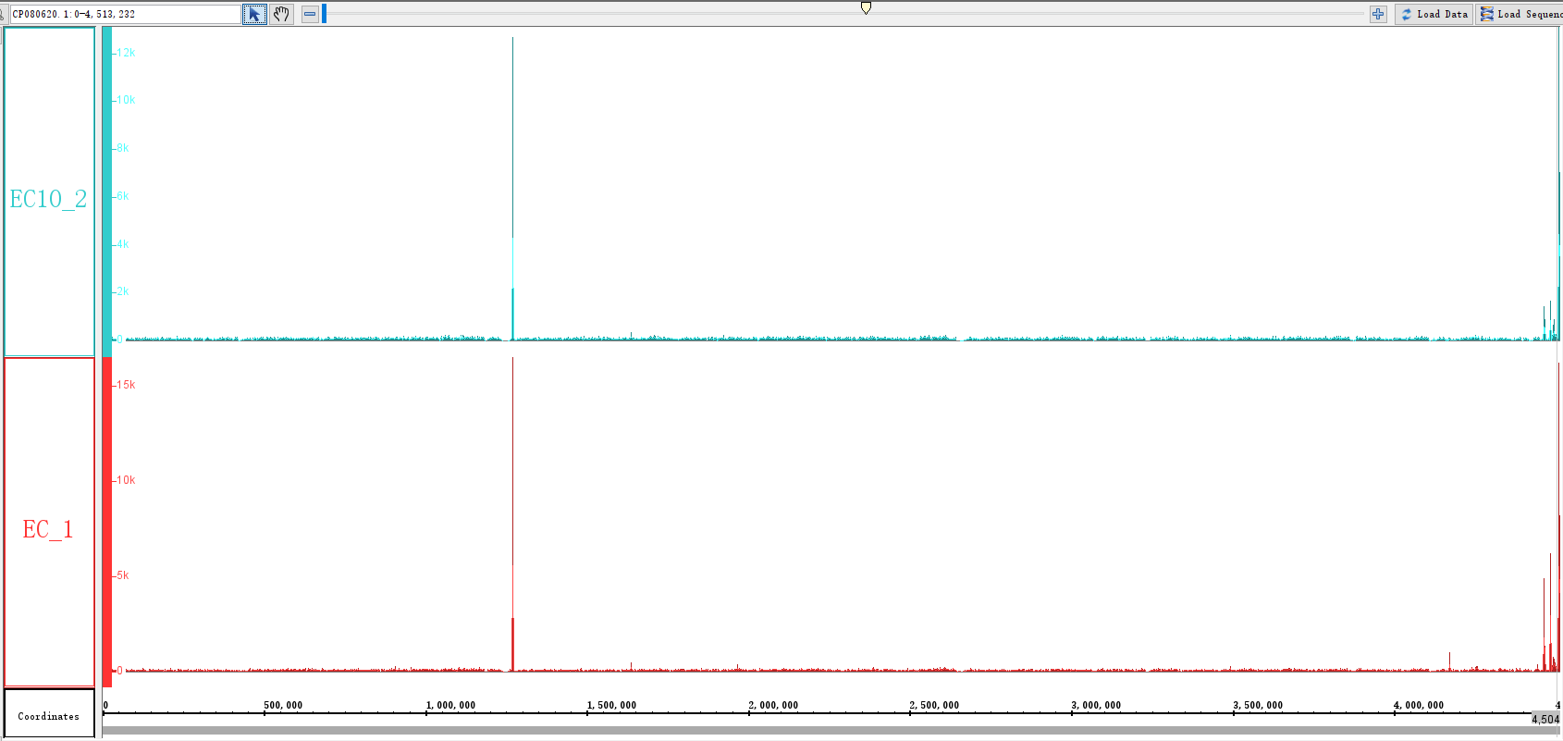
E.coli

