Slide 1
重新计算的log2 (TE)
Log2 TE case
Log2 TE case
Log2 TE control
Log2 TE control
Before
New

Slide 2
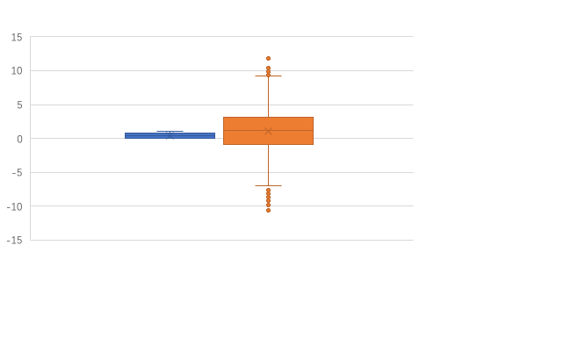
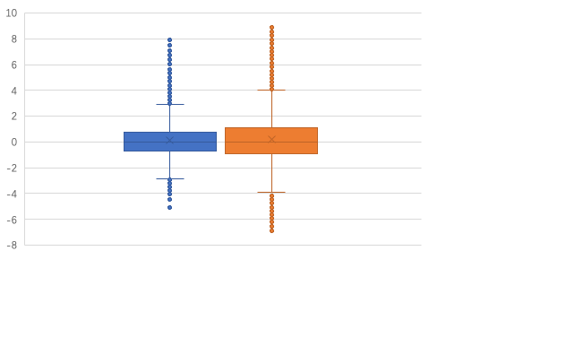
重新计算的log2 (TE)
Log2 TE control
Log2 TE case
Log2 TE control
Log2 TE case
Before
New

Slide 3
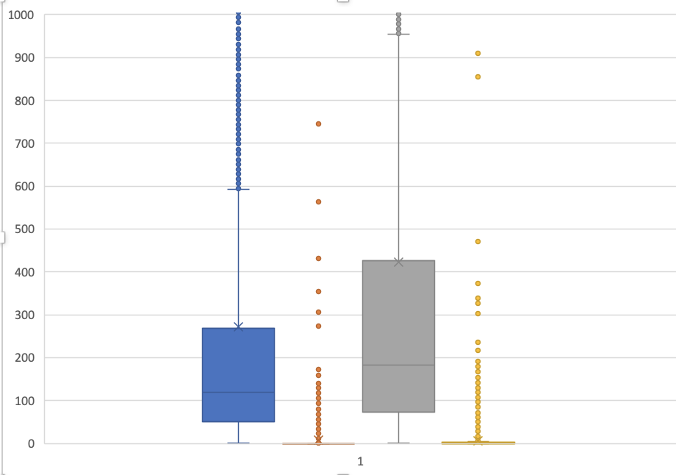
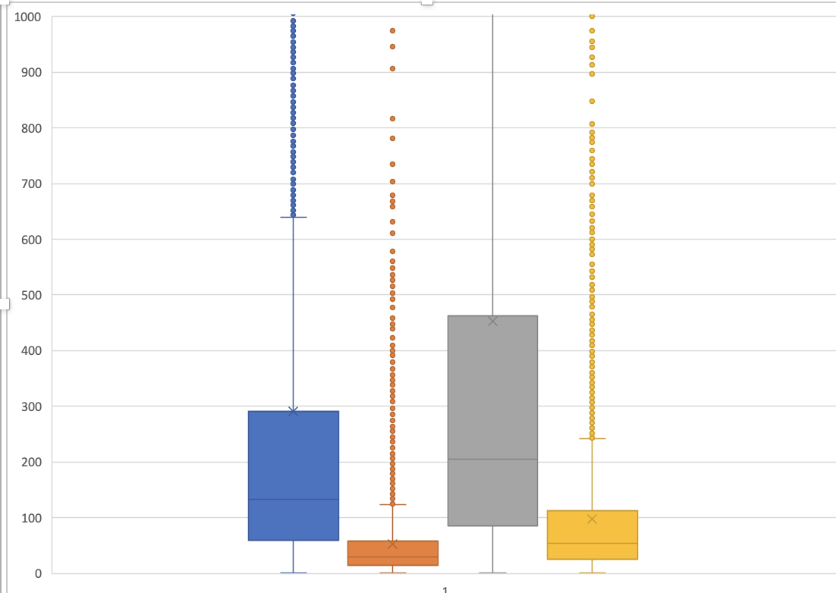
使用不同的统计方法影响统计的分布
7-7 RPF 7-7 RNA 111 RPF 111 RNA
7-7 RPF 7-7 RNA 111 RPF 111 RNA

Slide 4
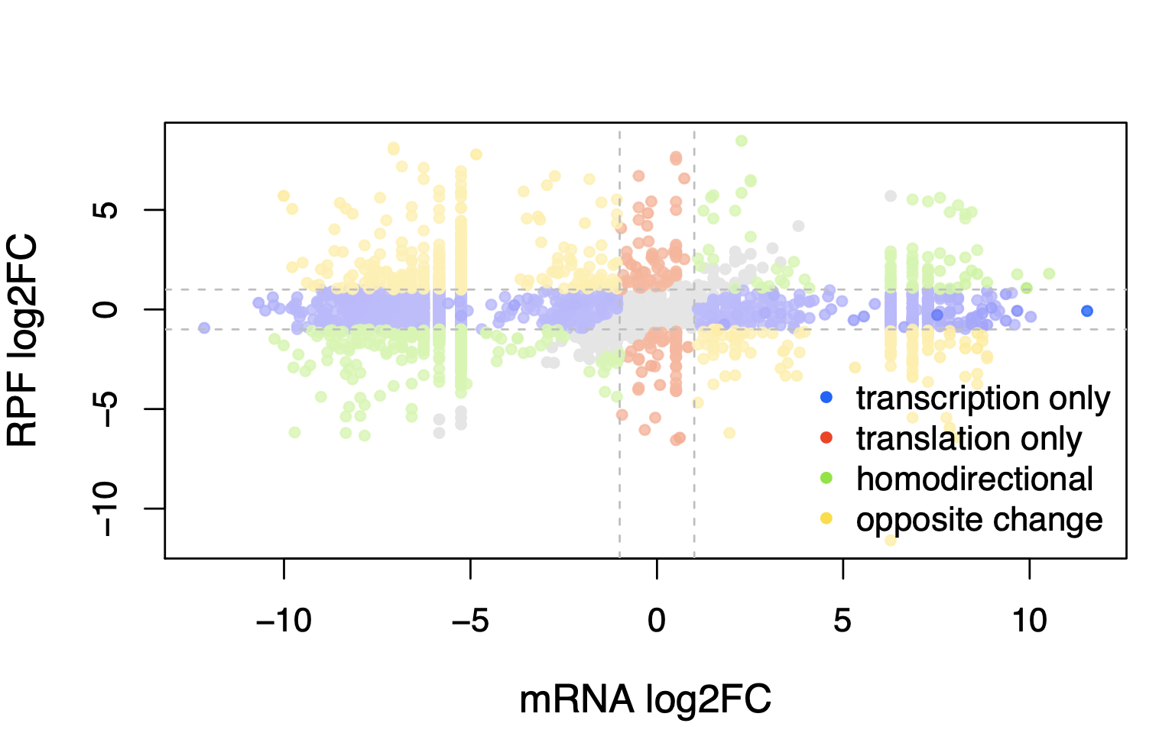
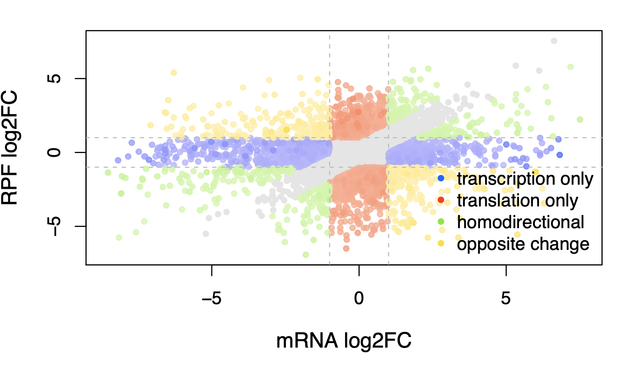
减少了RNA水平上差异特异的现象
Before
New

