Slide 1
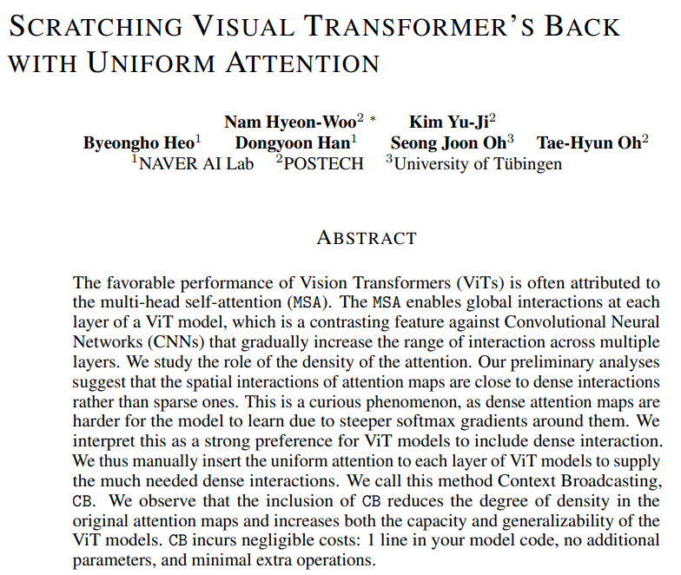
Vision Transformers的良好性能通常归因于多头自注意力（MSA）。
MSA使得ViT模型的每一层都能进行全局交互
而CNNs是通过增加卷积层数来逐渐增大交互
We study the role of the density of the attention。
Our preliminary analyses suggest that the spatial interactions of attention maps are close to dense interactions rather than sparse ones.。这是一种奇怪的现象，因为密集的attention map 更难让模型学习，因为它们周围的softmax梯度更陡峭。
我们将此解释为ViT模型对密集交互的强烈偏好。
因此，我们手动将uniform attention插入到ViT模型的每个层中，以提供非常需要的密集交互。
我们称这种方法为Context Broadcasting（CB）。我们观察到，加入CB可以降低原始attention map的密度，并提高ViT模型的容量和泛化能力。CB的成本可以忽略不计：只需1行代码，没有额外的参数，以及最小的额外操作。
ICCV2023

Slide 2
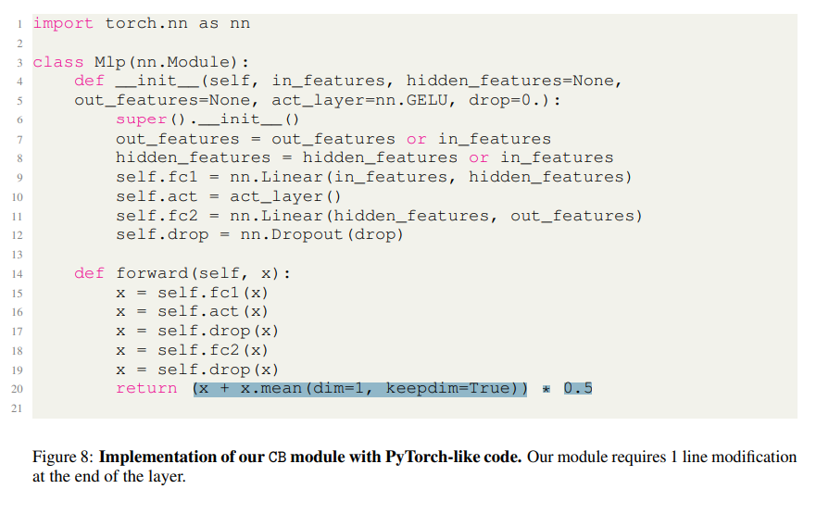

Slide 3
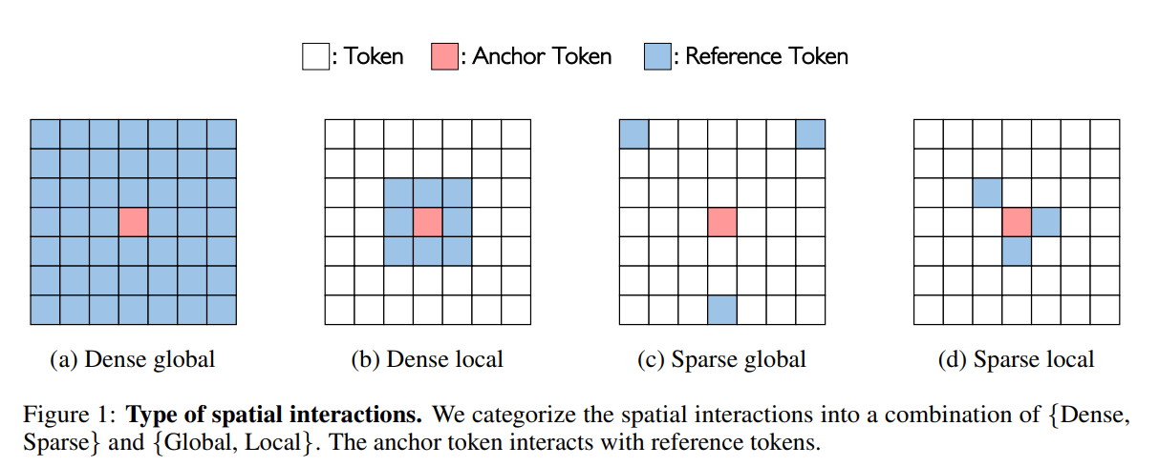
Density 是指所有token之间非零交互的比例. We illustrate the difference between the two in Fig. 1. Observe that“global”does not necessarily mean “dense” and vice versa because an attention map can be either densely local or sparsely global.

Slide 4
MOTIVATION动机
The self-attention operations let ViTs conduct spatial interactions without limiting the spatial range
in every layer.
Despite the inherent abundance of such operations compared to CNNs, we study the
density of the attention.
The first experiment examines whether ViTs need further spatial interactions.
第一个实验研究了ViT是否需要进一步的空间交互。
In the second experiment, we measure the layer-wise entropy of the attention to examine what
characteristics of spatial interactions ViTs prefer to learn.
第二个实验测量了注意力的逐层熵，以检查ViT更喜欢学习什么样的空间交互特征。

Slide 5
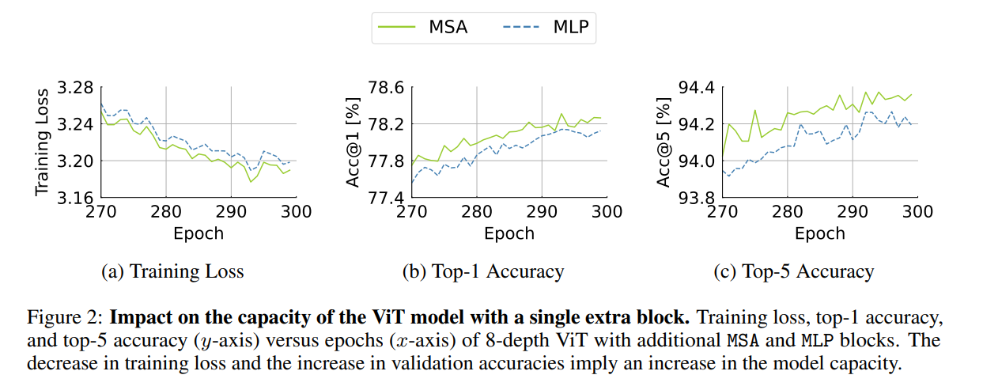
Are ViTs hungry for more spatial connections?
The multi-head self-attention (MSA) and multilayer perceptron (MLP) in ViTs are responsible for spatial and channel interactions, respectively.
We examine adding which block, either MSA or MLP, increases the performance of ViTs more. We
train the eight-layer ViT on ImageNet-1K for 300 epochs with either an additional MSA or MLP layer
inserted at the last layer. The additional number of parameters and FLOPs are nearly equal.
We observe that the additional MSA enables
lower training loss and higher validation accuracies than the additional MLP. This suggests that, given
a fixed budget in additional parameters and FLOPs, ViT architectures seem to prefer to have extra
spatial interactions rather than channel-wise interactions.

Slide 6
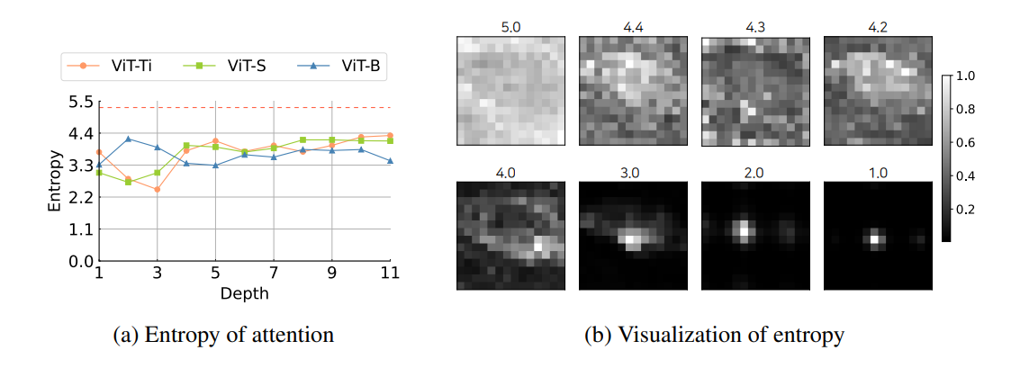
Which type of spatial interactions do MSA learn?
In this experiment, we examine the types of spatial interactions that are particularly preferred by MSA.
Knowing the type of interactions will guide us on how we could improve attention performance.
While previous studies have focused on the effectiveness of long-range dependency in MSA, we focus on the density in MSA.
We measure the dispersion of attention according to the depth through the lens of entropy. When the attention is sparse, the entropy of attention is low. On the flip side, when the attention is dense, the entropy of it is high。
We observe that attention maps tend to have greater entropy values as high as 4.4, towards the maximal entropy value,
it suggests that MSA tends to learn the dense interactions.

Slide 7
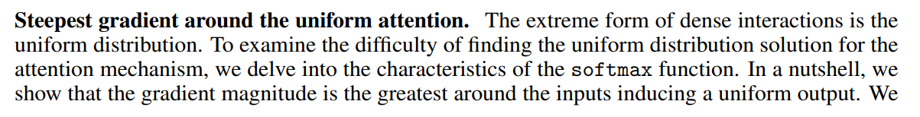
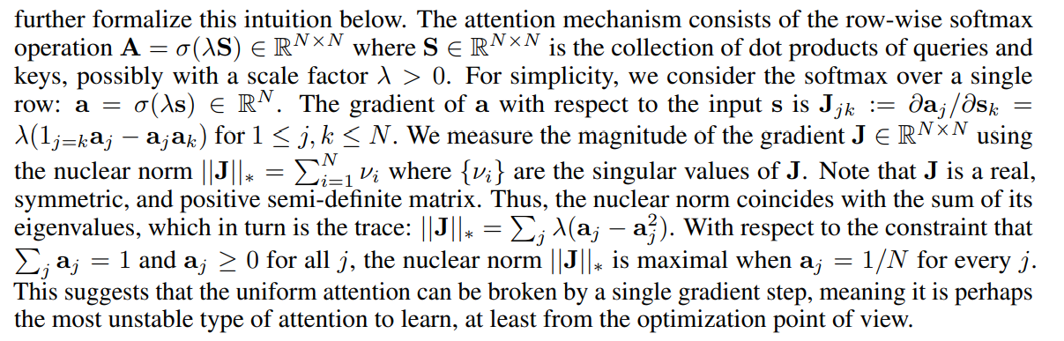
这表明均匀注意力可以通过单个梯度步骤被打破，这意味着它可能是最不稳定的学习类型，至少从优化的角度来看是这样的。

Slide 8
Conclusion. We have examined the density of the interactions in the MSA layers. We found that further spatial connections benefit ViT models more than further channel-wise interactions.
MSA layers tend to learn dense interactions with higher entropies.
The ViT’s preference for dense interactions is striking, given the difficulty of learning dense interactions: the gradient for the MSA layer is steeper with denser attention maps. Dense attention maps are hard to learn but seem vital to ViTs.
结论。我们检查了MSA层中交互的密集性。我们发现，与进一步的通道交互相比，进一步的空间交互对ViT模型更有益。
MSA层倾向于学习具有更高熵的密集交互。
考虑到密集交互学习的难度，ViT对密集交互的偏好是显着的：随着注意力图变得更加密集，MSA层的梯度也变得更加陡峭。密集的注意力图难以学习，但对ViT似乎至关重要。
We have observed certain hints for the benefit of additional spatial interaction and the fact that the
uniform attention is the most challenging attention to learn from an optimization perspective. The
observations motivate us to design a complementary operation that explicitly supplies the uniform
attention. We do this through the broadcasting context with the CB module.

Slide 9
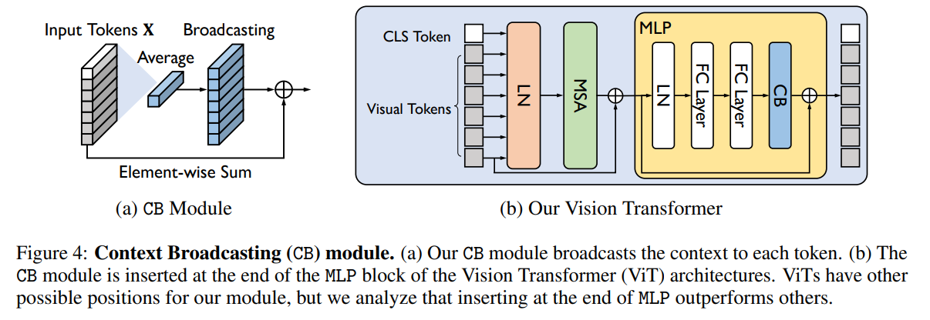
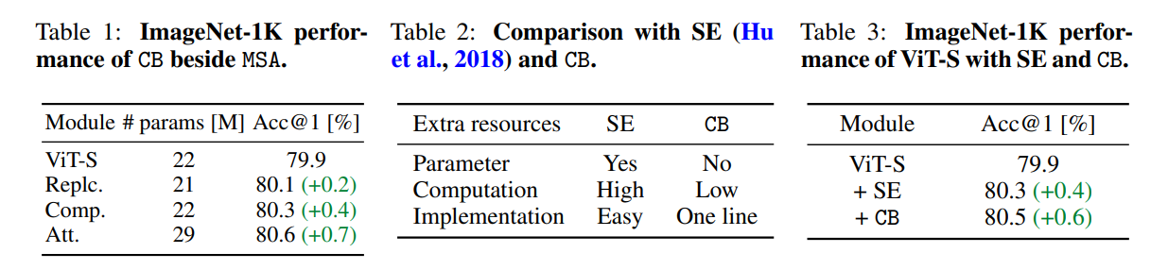
We replace one of multi-head self-attention heads to be CB (denoted as Replc.)
we adjust the number of parameters of the Replc. way to be comparable to that of the original ViT (denoted as Comp.)
we append CB to the multi-heaself-attention as an extra head in parallel (denoted as Att.).

Slide 10
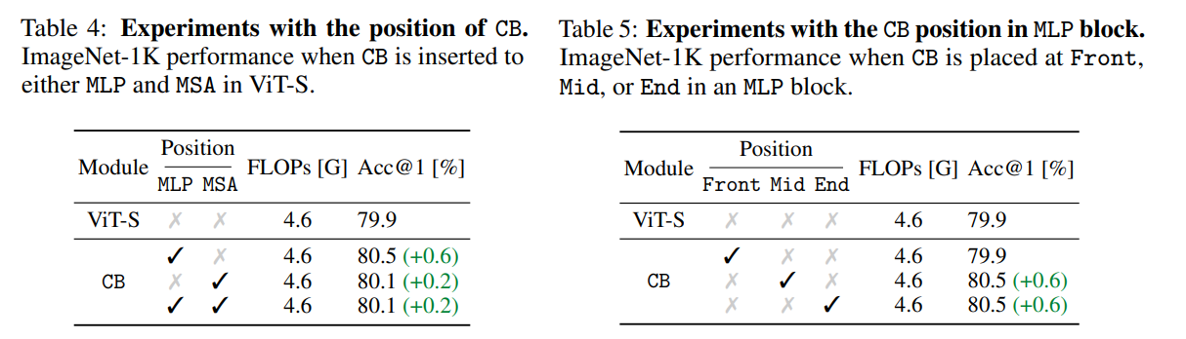
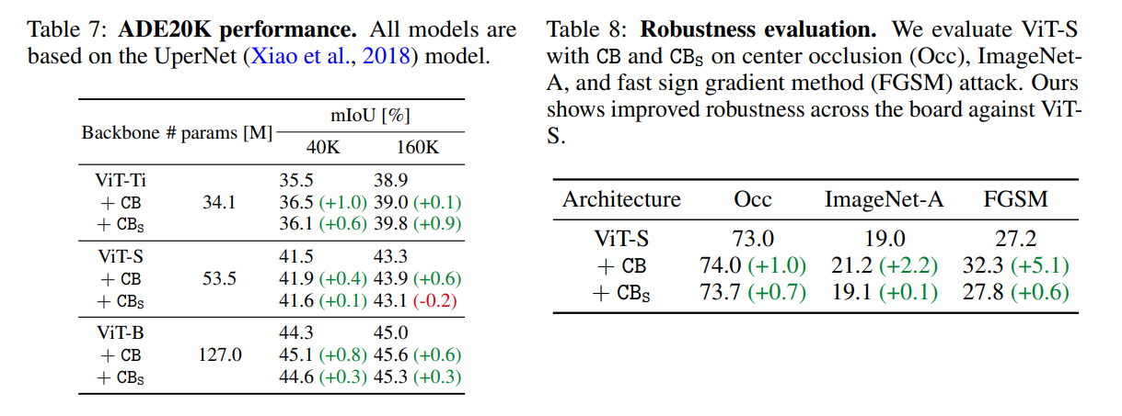
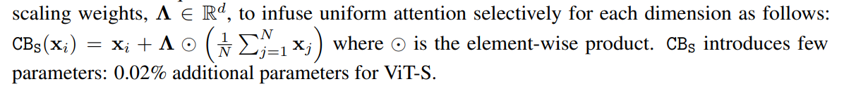

Slide 11
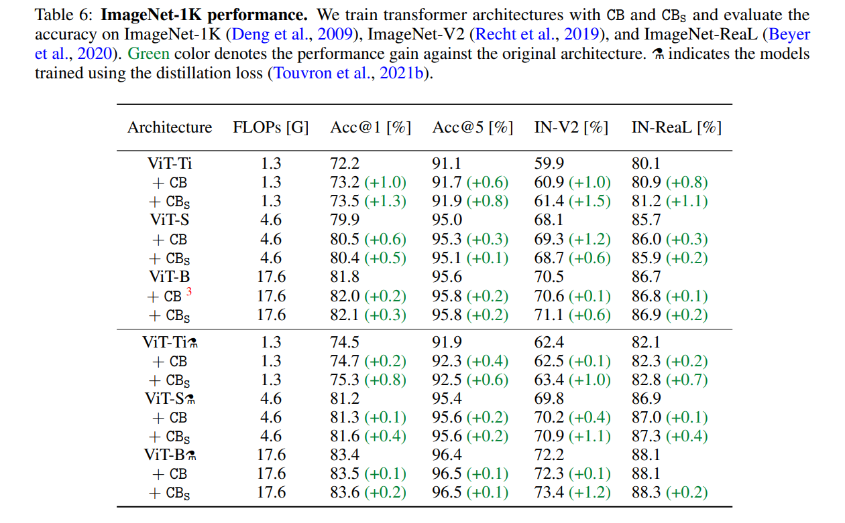

Slide 12
